Slide 1
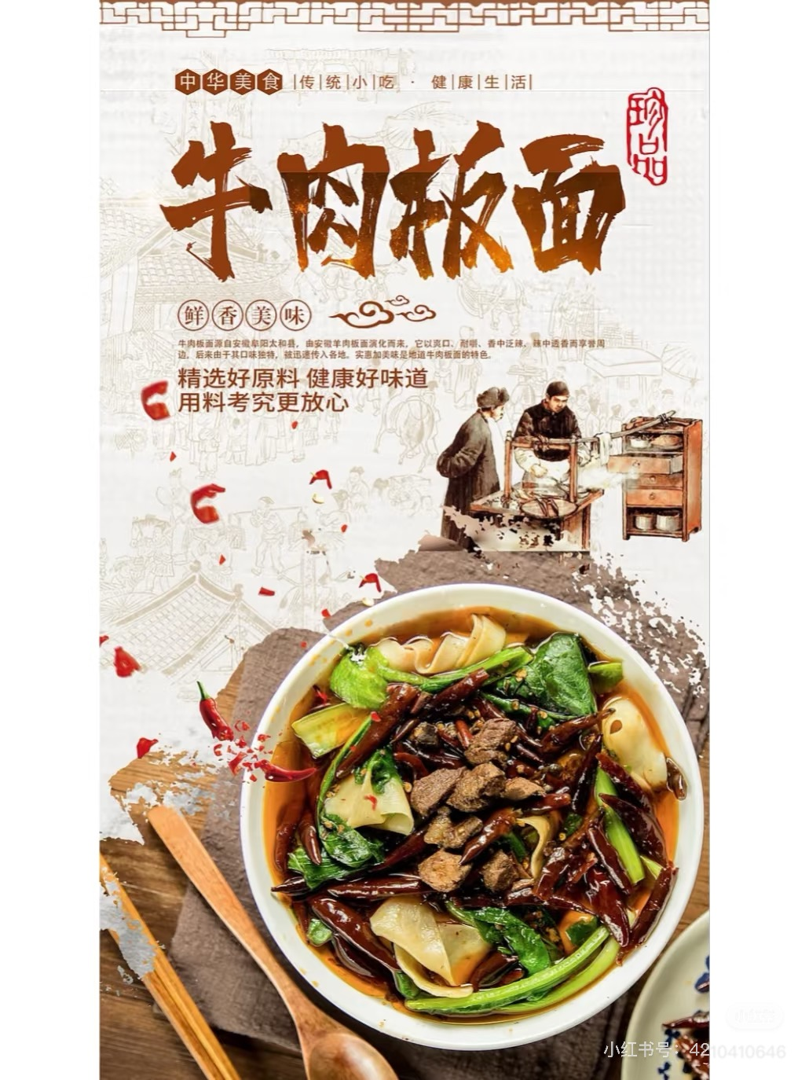
Beef Board Noodles
牛肉板面
汇报人: 闫祥

Slide 2
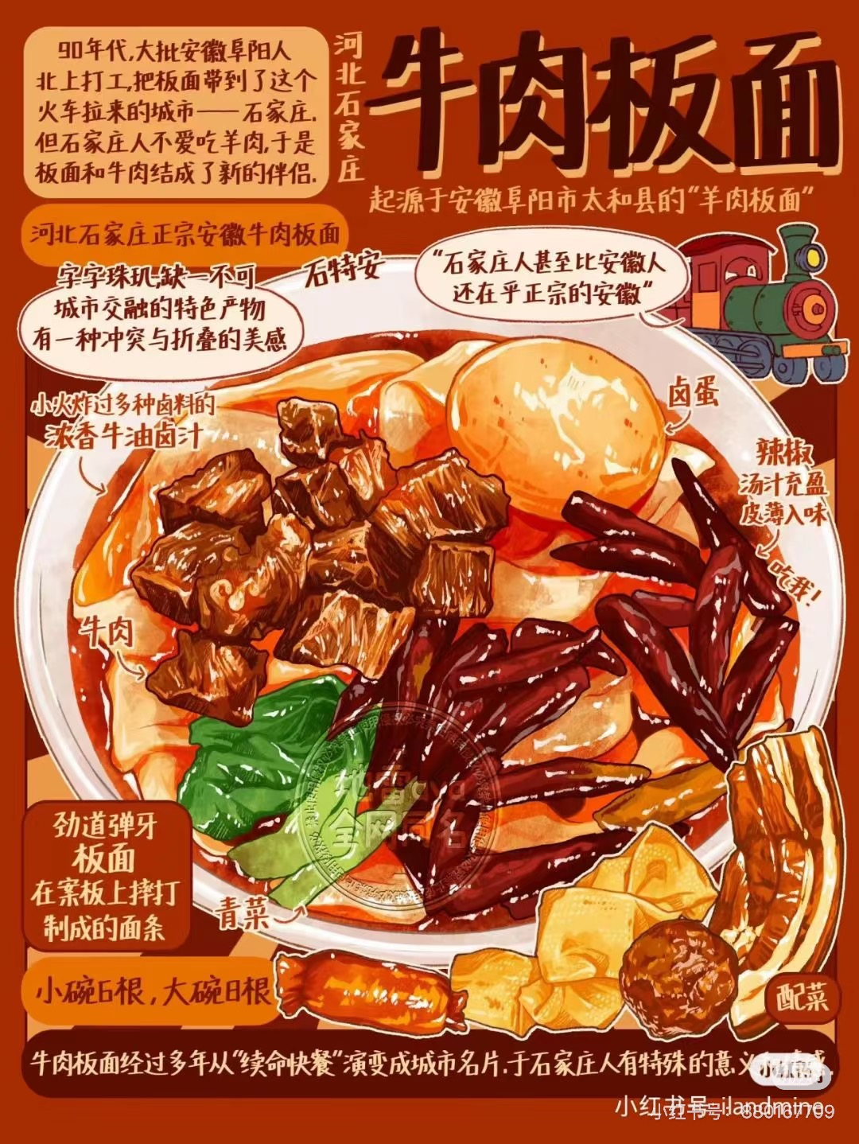
Content
1. Origin and development of Beef
Board Noodles
2. Preparation Method
3. Cultural Significance

Slide 3
Origin and development of Beef Board Noodles
01

Slide 4

Origin
Beef Board Noodles originated in Hebei Province, China, and are deeply rooted in the region’s culinary traditions.
Historically, this dish dates back to the Qing Dynasty, where it was first created by Hui Muslim chefs (回民厨师) who specialized in beef-based cuisine.

Slide 5
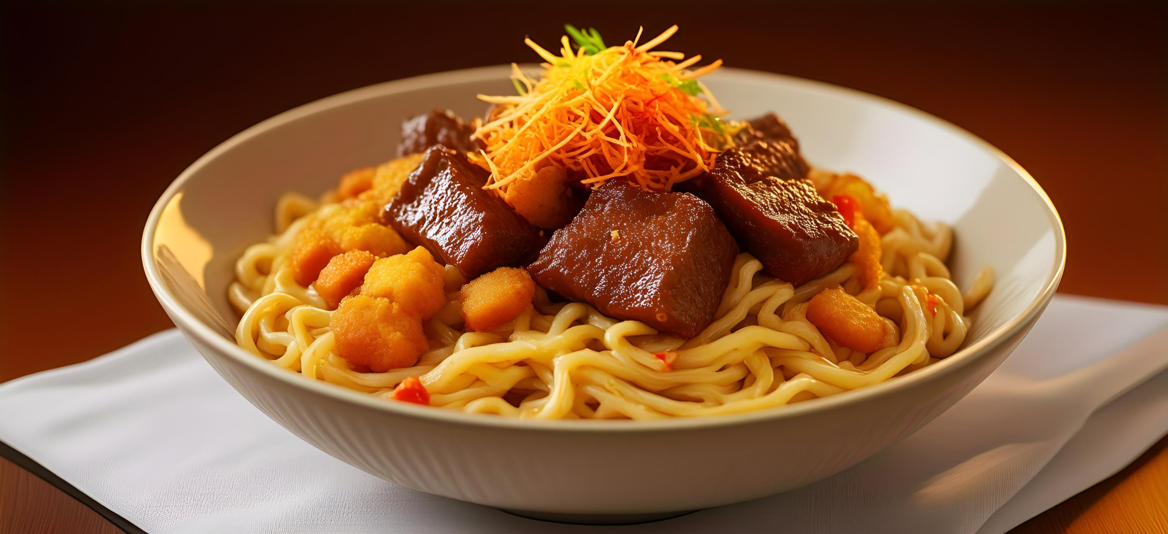
Development
01
02
03
Origins
Spread and Adaptation
Qing Dynasty
20th Century
21st Century
Modernization and Standardization

Slide 6
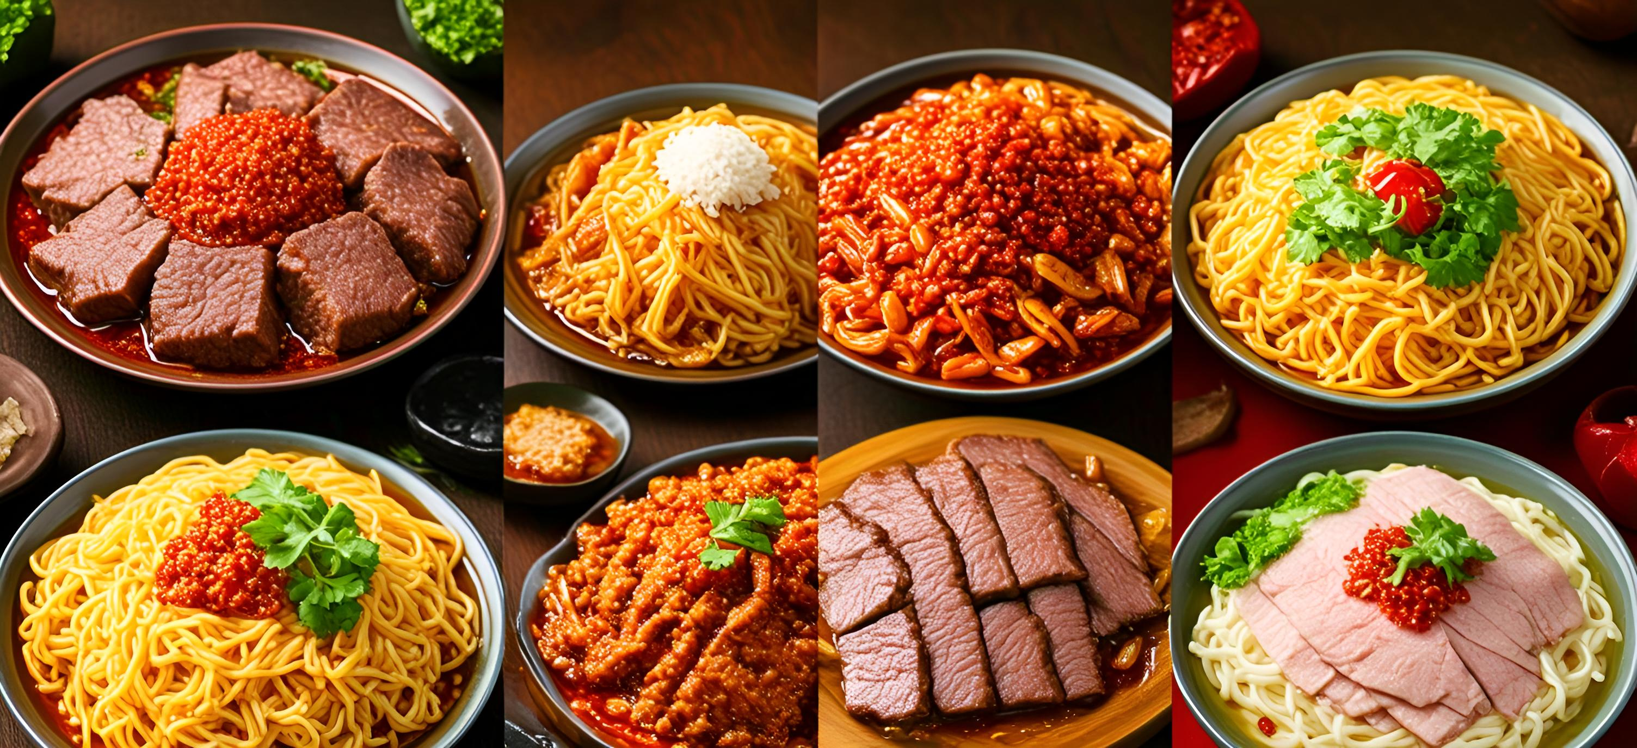
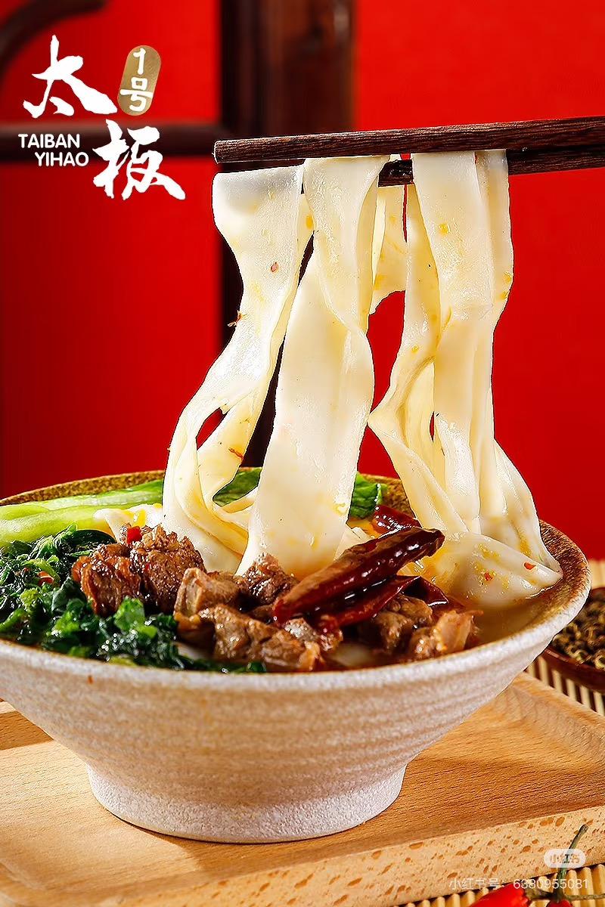
Major Regional Varieties
Region | Characteristics | Signature Pairings
Traditional Hebei Style | Rich beef bone broth, wide and chewy noodles, savory and mildly spiced. | Cilantro, chili oil
Anhui Style | Intensely spicy and braised, bright red broth with fermented bean paste and spices. | Braised eggs, tofu skin
Northwest Spicy Style | Clear broth but bold flavors, heavy on Sichuan peppercorns and chili. | Radish slices, garlic sprouts
Jiangnan Light Style | Lighter broth with chicken or seafood essence, refined toppings (e.g., bamboo shoots). | Greens, dried shrimp
Northeast Innovative Style | Incorporates pickled cabbage for tanginess, thicker noodles. | Pickled cabbage, frozen tofu

Slide 7
Preparation Method
02

Slide 8
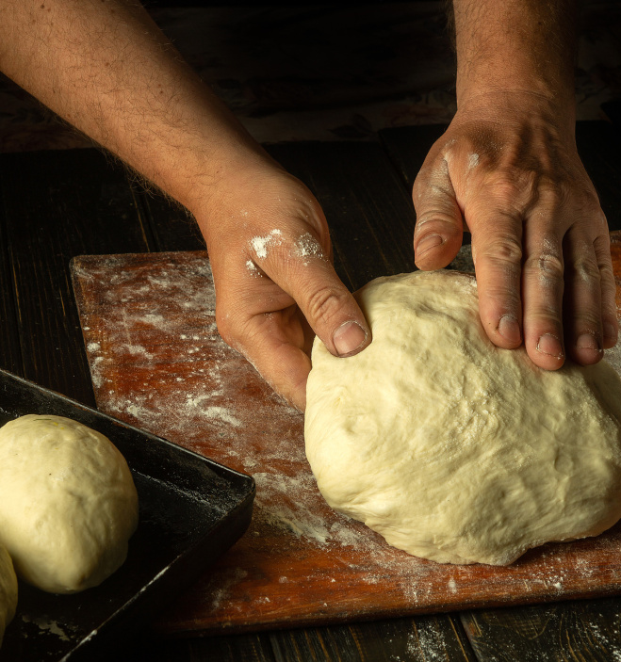
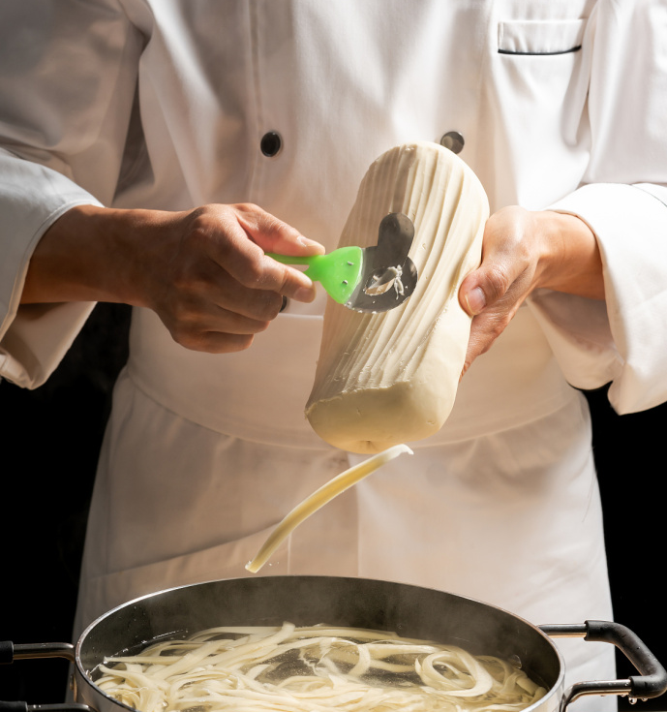
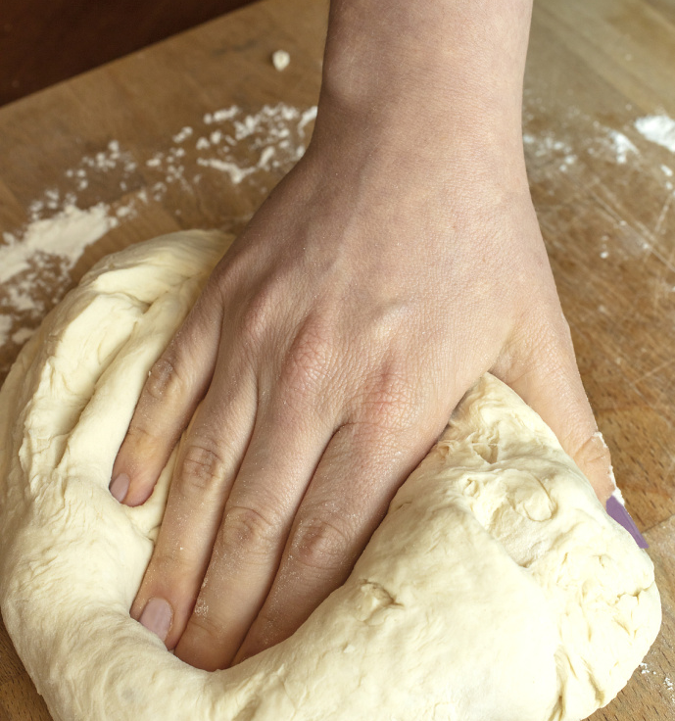
Dough Preparation
choose suitable flour
control water temperature
knead for smoothness
Use high-gluten（高筋面粉） flour for elasticity.
Knead until smooth for optimal texture.
Mix with warm water (30-40°C)

Slide 9
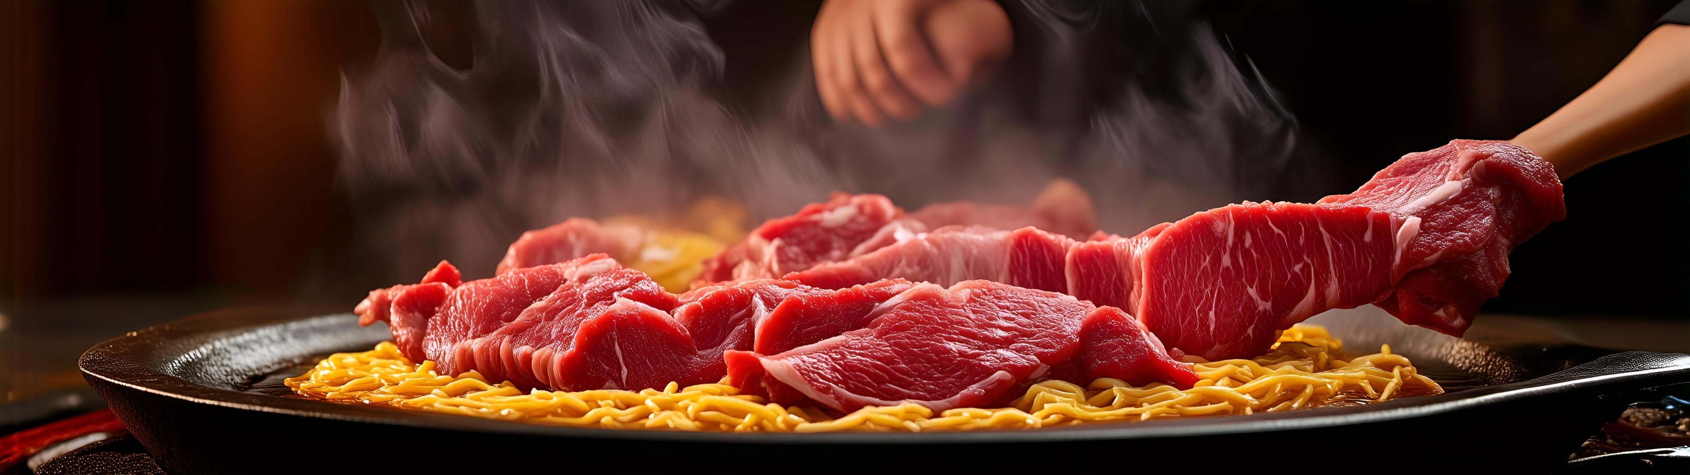
Beef Cooking
Simtenderness
Simmer beef (e.g., shank or brisket) over low heat for tenderness.
Control heat and timing to preserveve juices.

Slide 10
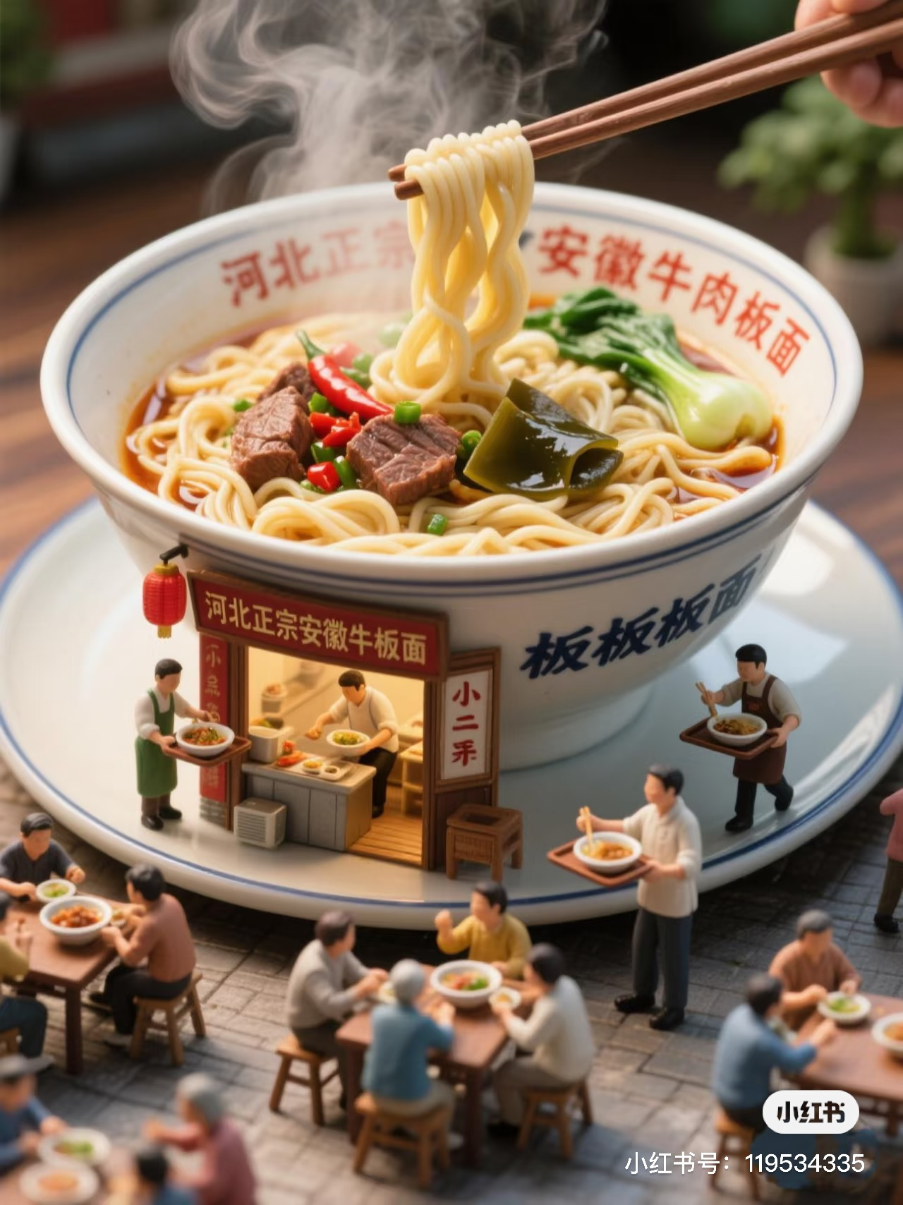
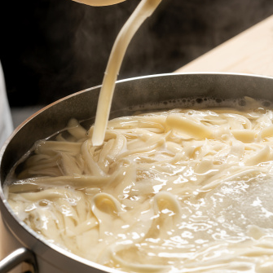
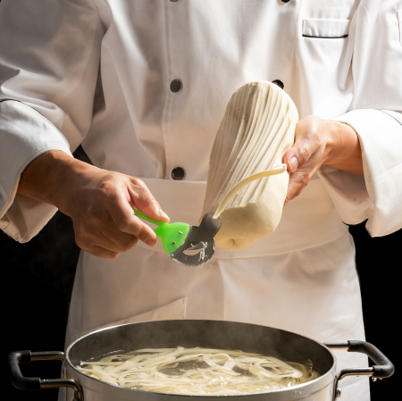
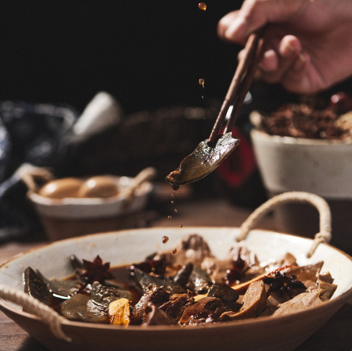
Broth Preparation
Material Selection and Preliminary Processing
01
02
Seasoning and Flavor Enhancement
Cooking process
03
star anise——八角
cinnamon bark——桂皮
ginger slices——姜片

Slide 11
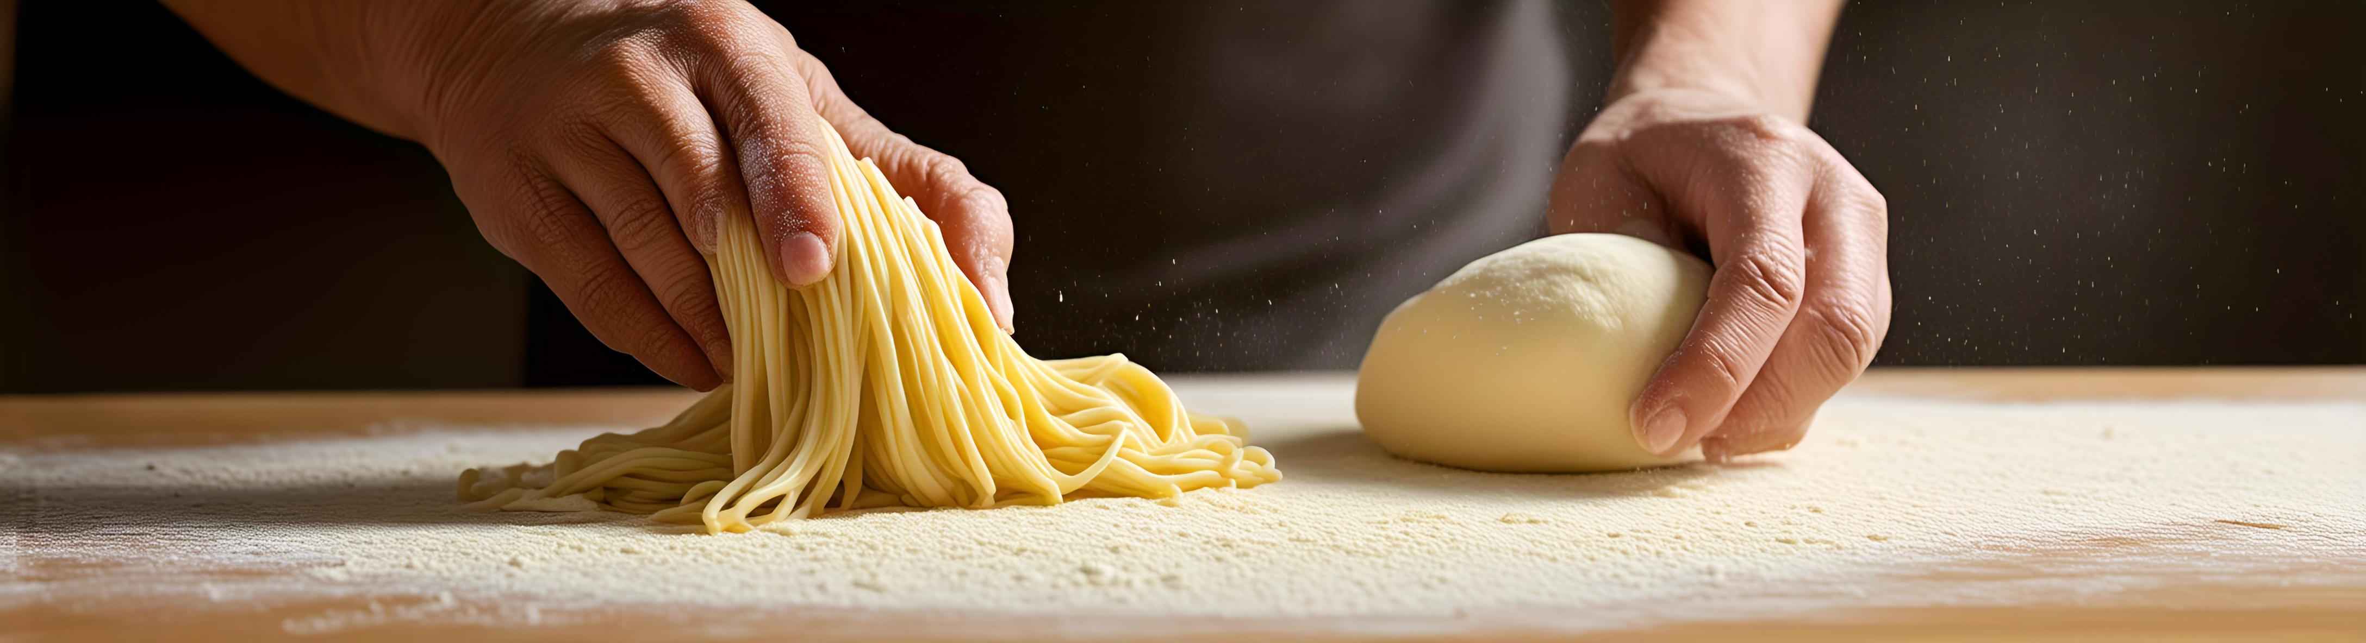
Noodle Shaping
Dough Rolling and Cutting
Roll the dough flat and cut it into uniformly sized noodles to ensure even cooking.

Slide 12
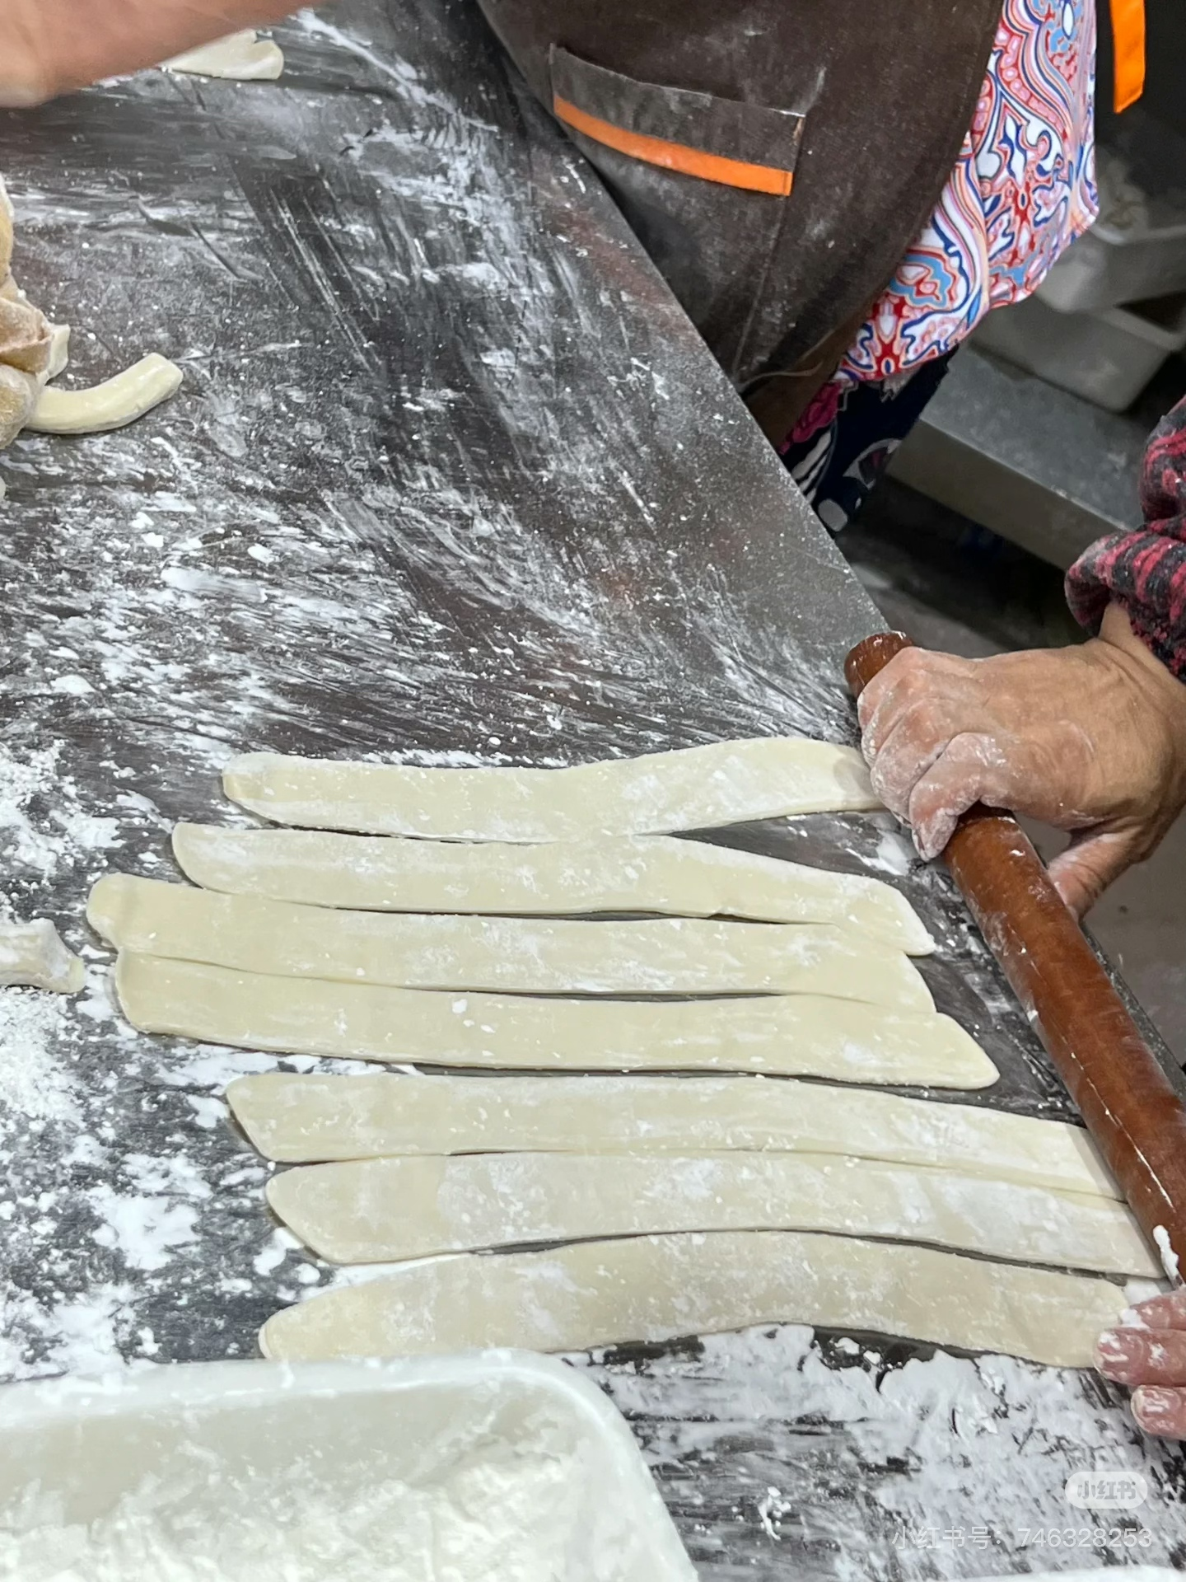
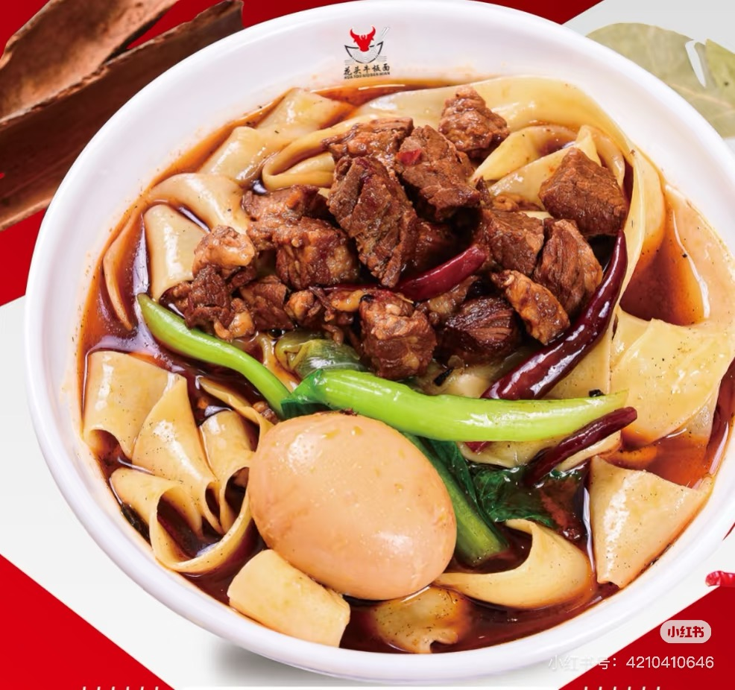

Slide 13
Cultural Significance
03

Slide 14
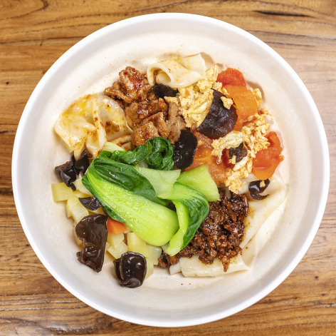
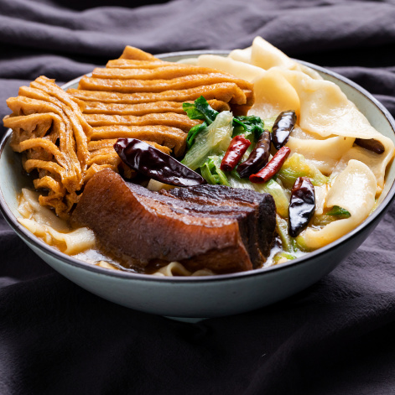
Role in Chinese Cuisine
Staple Food
Street Food Culture
Beef board noodles are a staple in many parts of China, often eaten for breakfast or as a quick meal. They are beloved for their hearty and satisfying nature.
These noodles are commonly found in street food stalls, where they are prepared fresh and served quickly, reflecting the vibrant street food culture of China.

Slide 15
Global Influence
International Popularity
Cultural Exchange
Beef board noodles have gained popularity worldwide, with many restaurants offering their own versions. They are a symbol of Chinese culinary culture.
The spread of beef board noodles has facilitated cultural exchange, introducing international diners to the flavors and traditions of Chinese cuisine.
01
02

Slide 16
Thanks for your listening

