Slide 1


China's Four Great
New Inventions
Yang Yue
TIME：2025.03

Slide 2






The Four Ancient Inventions
Compass
Gunpowder
Papermaking
Printing

Slide 3

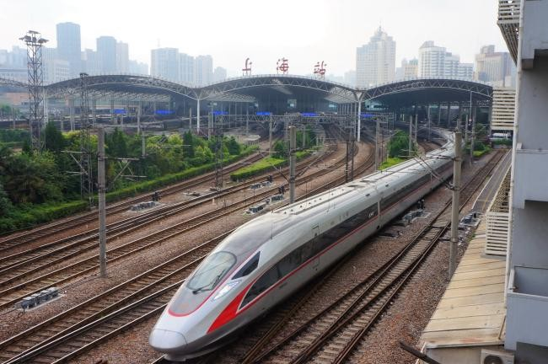





High-Speed Rail
Extensive Network
China has the world's largest high- speed rail network, with over 1,590,000 km of tracks.
This accounts for 69% of the global high- speed rail network.
Technological Excellence
The Beijing- Shanghai line covers 1,300 km at speeds of up to 350 km/h.
Cost Efficiency
A 1,300 km journey on high- speed rail costs around €70.
.

Slide 4
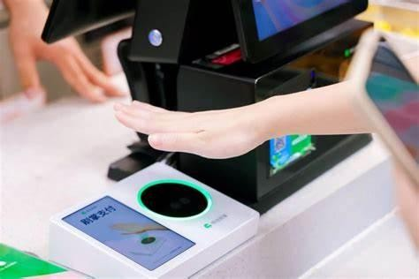








Mobile Payment
01
Diverse Use Cases
for taxi- hailing, dining, retail, and entertainment.
02
Convenience
03
Security

Slide 5
Market Dominance of Mobile Payment
Active Users
Transaction Volume
Smartphone Penetration
In 2023, there were over 900 million
active mobile payment users in China.
The annual transaction volume
reached $17 trillion.
With an 87% smartphone penetration rate, mobile payment is accessible to most people.
.

Slide 6


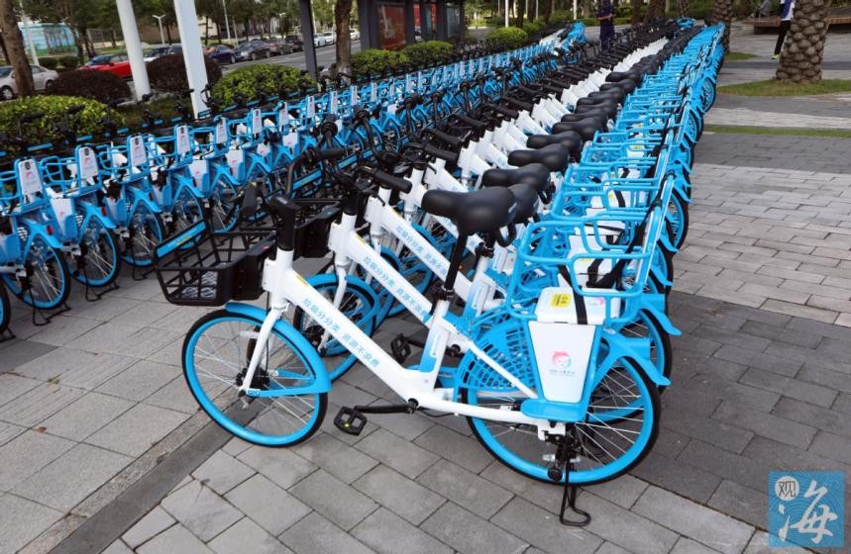
Explosive Growth of Bike Sharing
Nationwide Coverage
Annual Rides
There are over 460 million shared bike users in China, covering 500 cities.
The annual number of bike- sharing
rides exceeds 8 billion.

Slide 7
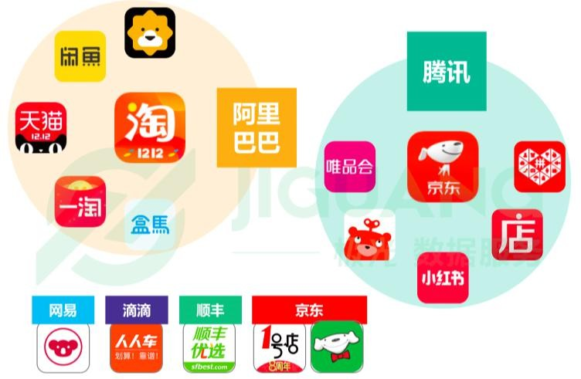
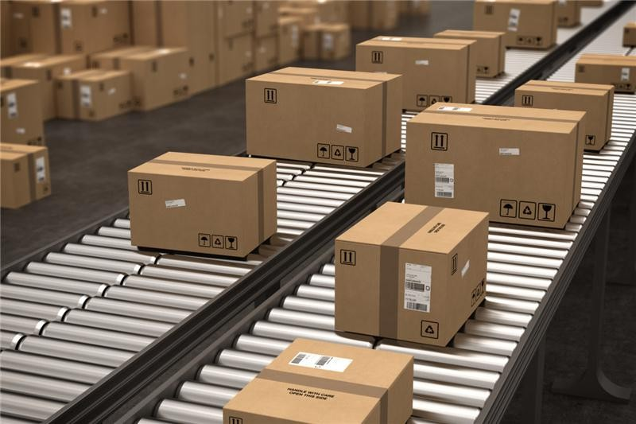

E-Commerce
Market Value
The annual GMV reaches $2 trillion
01 02
Online Shoppers
China has 915 million online shoppers, the largest e- commerce user base in the world.
03
Logistics Efficiency
The e- commerce industry handles 580 million daily logistics parcels.

Slide 8
Thanks

