Slide 1
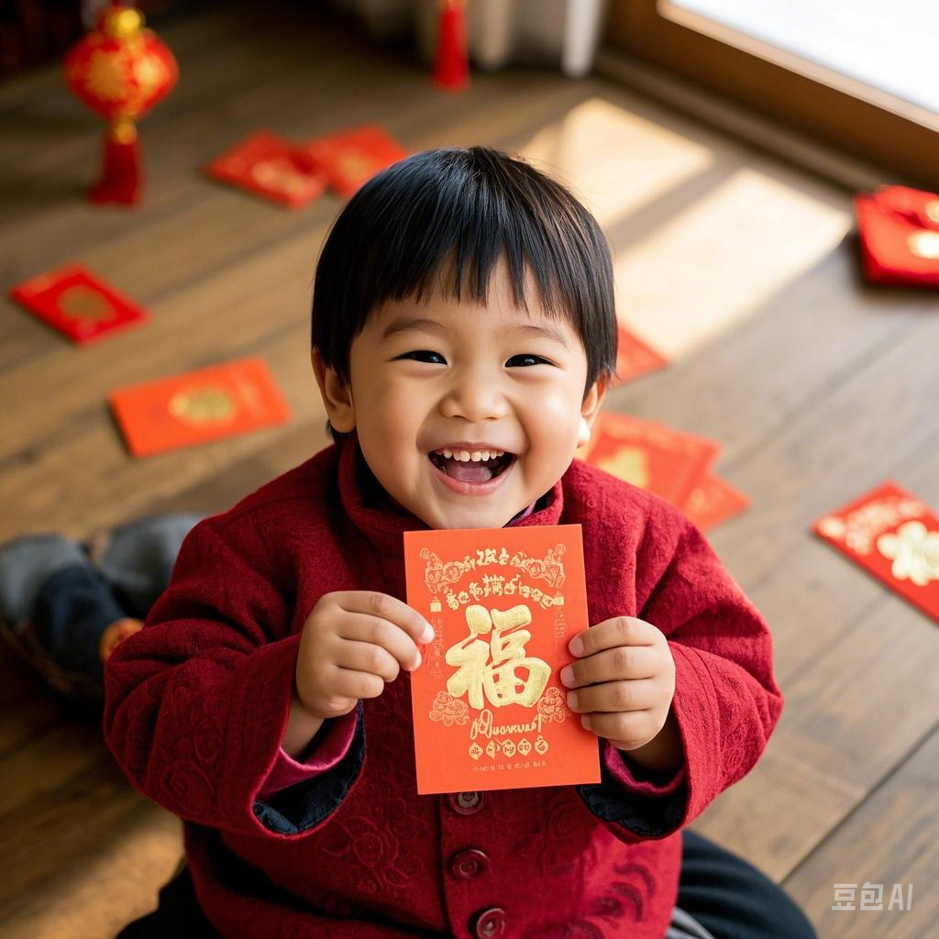
LUCKY MONEY
Legend
01
Tradition and Contrast
02
Significance
03

Slide 2
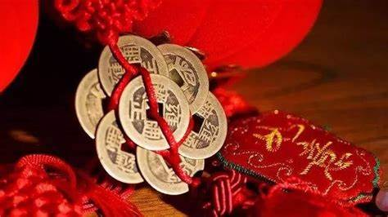
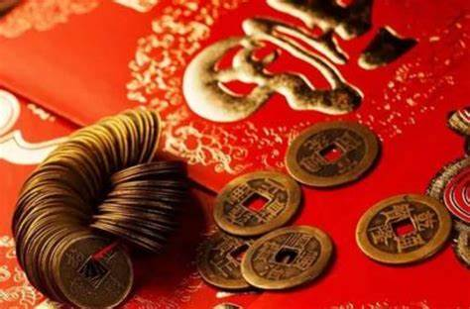
The legend of red envelope and lucky money
“Sui”
coins wrapped in red cloth
Red envelopes

Slide 3
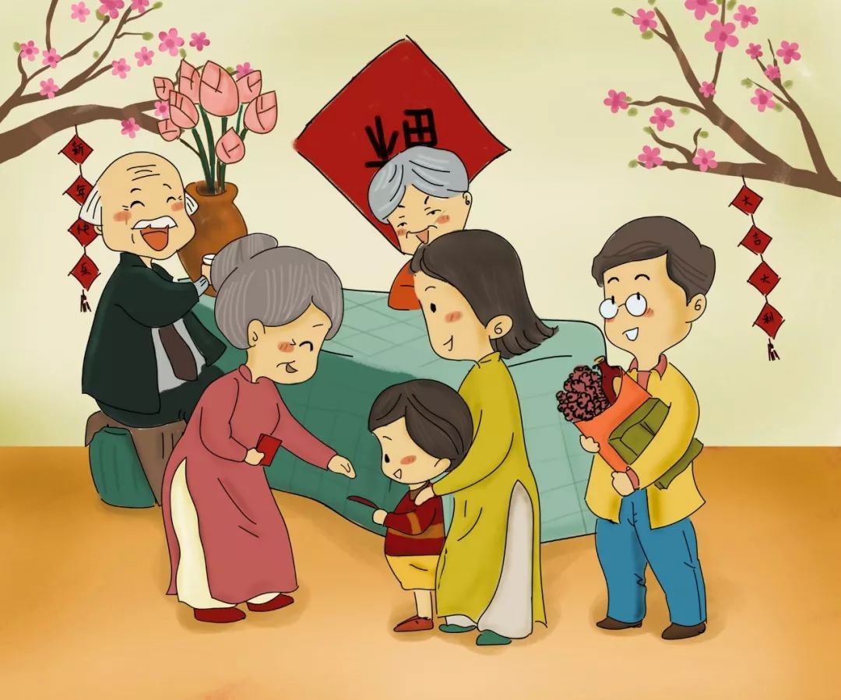
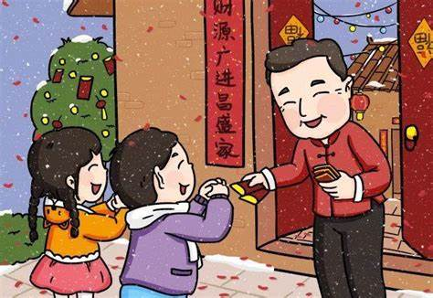
China
Red Envelopes and Auspicious Meanings
Red envelopes in China are mainly red in color, symbolizing good luck and prosperity.
Receive red envelopes with both hands on important occasions
Convey blessings and good luck

Slide 4
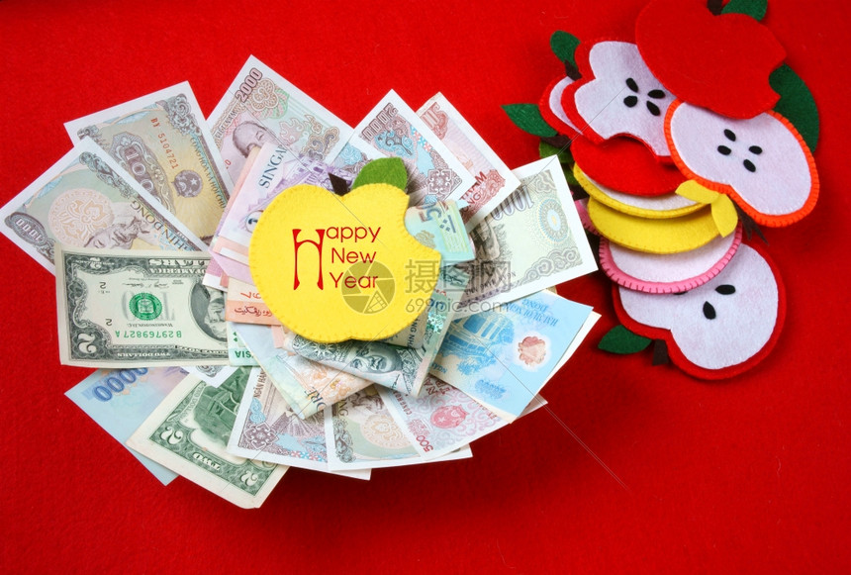
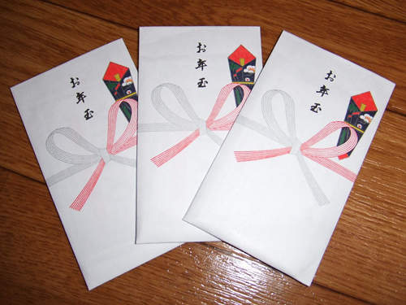
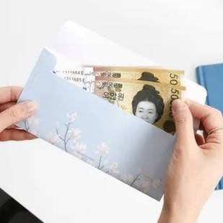
Other Countries
Vietnam (Lì xì)
Japan（Otoshidama）
South Korea (Sabae)

Slide 5
Contrast
Commonality: All convey blessings
Differences:
- Color (Chinese red envelope VS Japanese white envelope)
- Envelope ( No demand VS writing the name and sealing)
- Form (Diverse gifts in South Korea VS digital red envelopes in China)

Slide 6
Significance
Cultural Value
a festival gift
an emotional bond
The coexistence of globalization and local characteristics
Local characteristics : In Southeast Asian Islamic communities, green envelopes are used.
Digital red envelopes ,such as WeChat in China.

