Slide 1

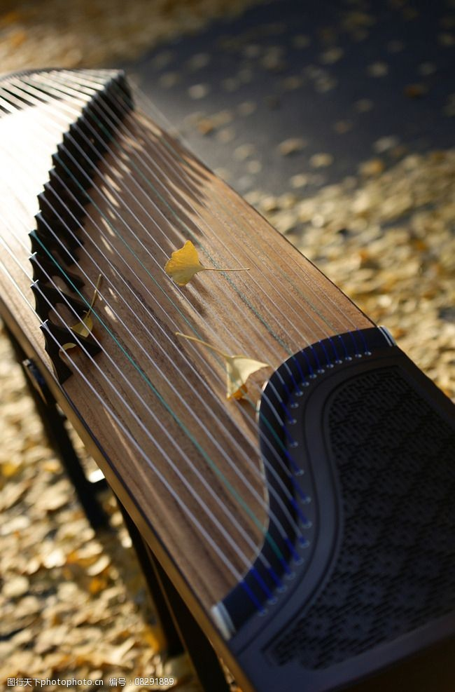
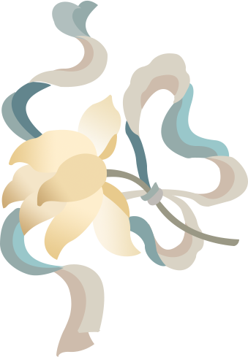
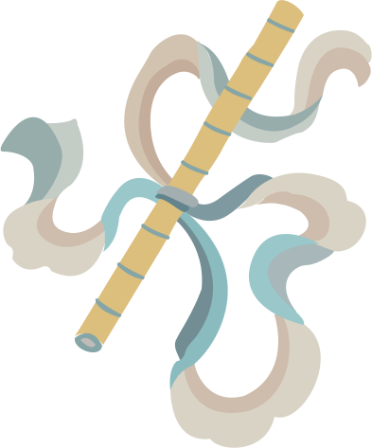
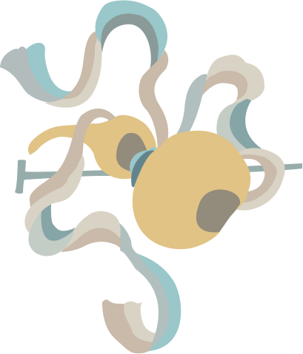
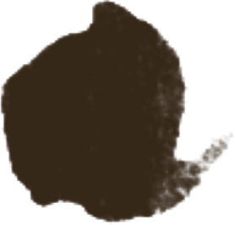
Zheng
筝
23英语口译刘泽玉（yew)
202370081606

Slide 2

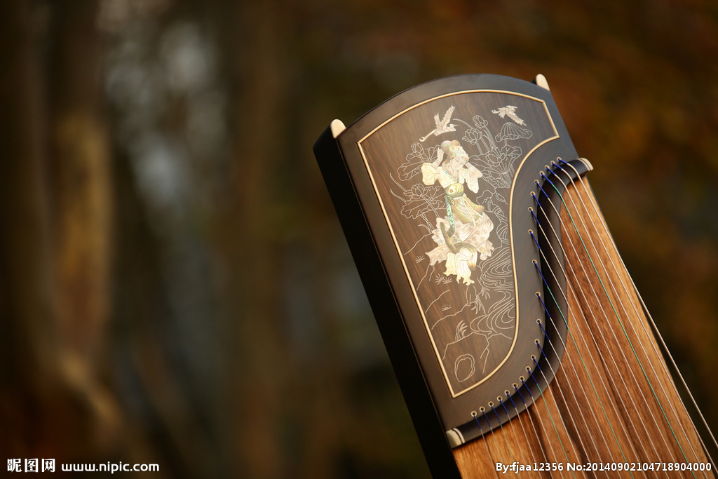
What is zheng?
  A string instrument
  Long history
  Major pentatonic scale

Slide 3
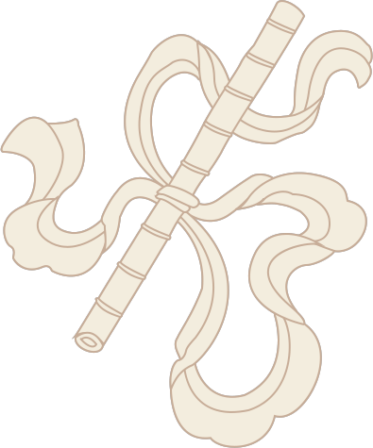

目
History
p a r t 1
CONTENTS
录
三
一
Have a try
p a r t 3
p a r t 2
Shape
二

Slide 4
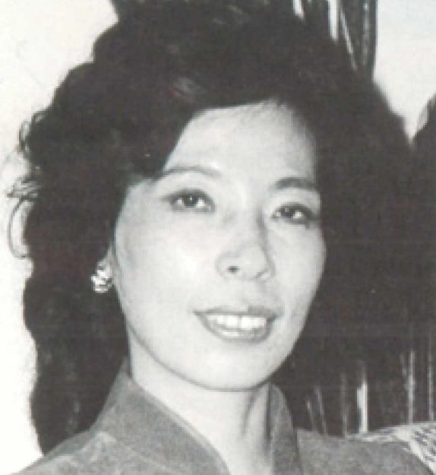
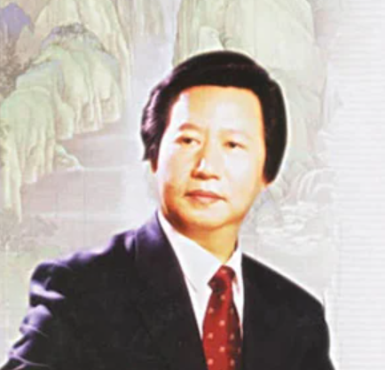
2500years old
Long history-more than 2,500 years
1:The oldest discovered 13 strings: possible during the Warring State period. DC475-221.
"筝横为乐，立地成兵”
2:They were used on palace music 雅乐 and folk music in the Tang dynasty. 618-907.
night of zheng《夜筝》
purple sleeves，red strings in the moonlight. 紫袖红弦月明中.
3:After the Qing dynasty,zheng has been added more strings,1644-1911.
4:Wang Changyuan(modern) invented new skills of Zheng. 1965.
5:Zhao Manqin invented rapid playing of fingers（快速指序）.1970S.
6:New compositions and skills are coming.1990S.
筝的历史
中国当代古筝演奏家 作曲家 王昌元
一
中国当代演奏家 作曲家 教育家 赵曼琴

Slide 5
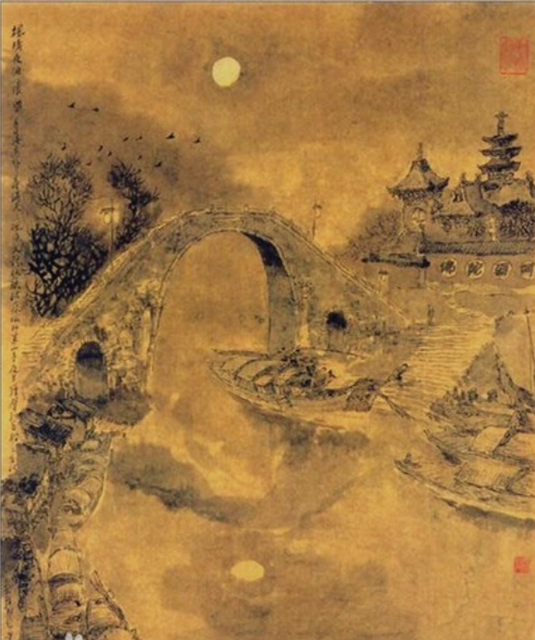
月落乌啼霜满天
江枫渔火对愁眠
姑苏城外寒山寺
夜半钟声到客船
一

Slide 6

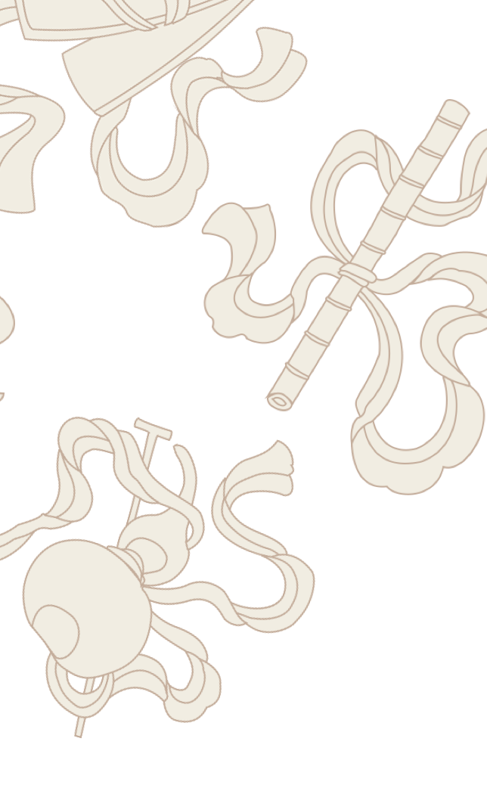


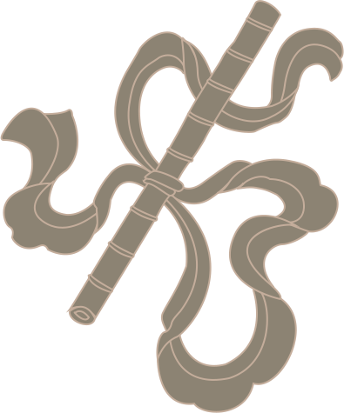

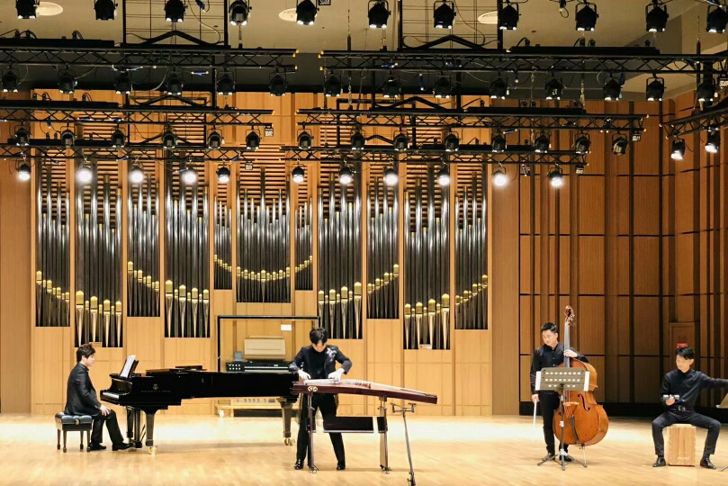
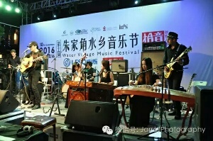
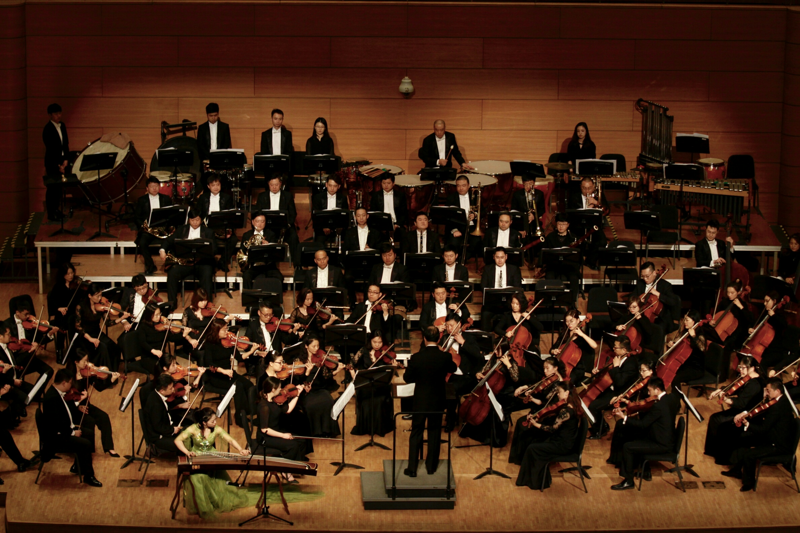
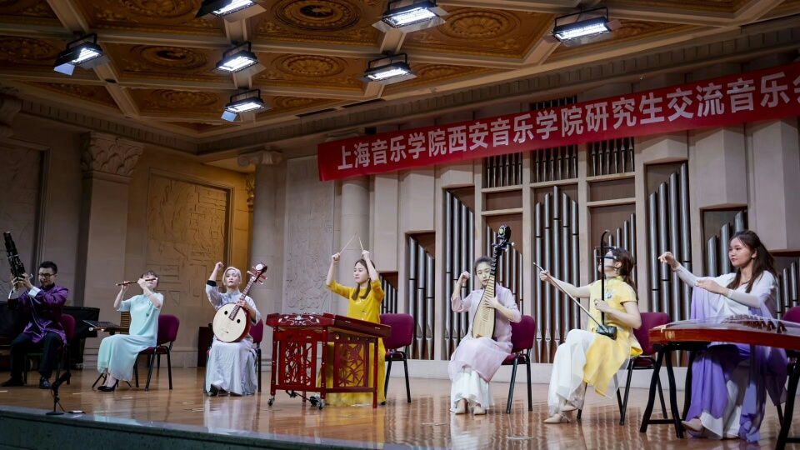
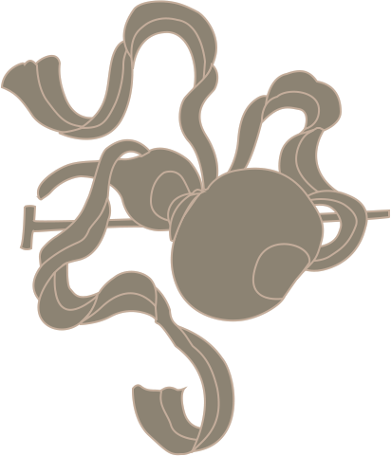
Zheng can be use in ensemble/orchestra/band/and solo.

Slide 7
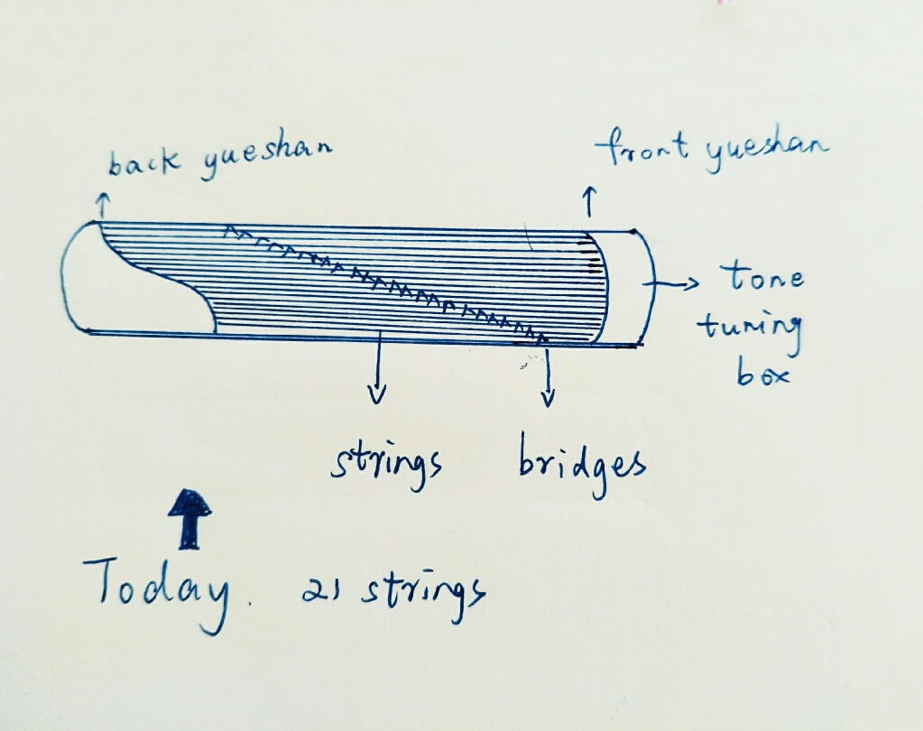
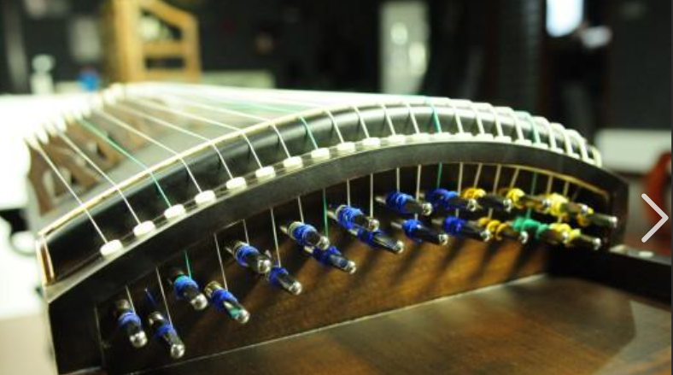
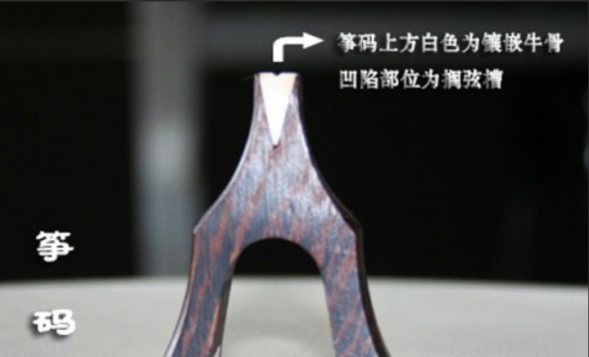
Shape
Shape
筝的形状
二

Slide 8
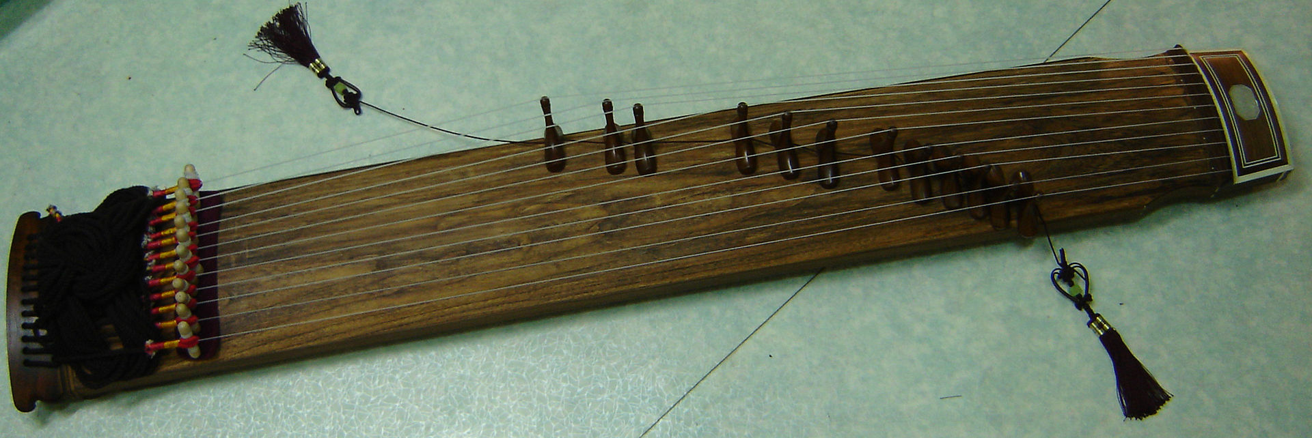
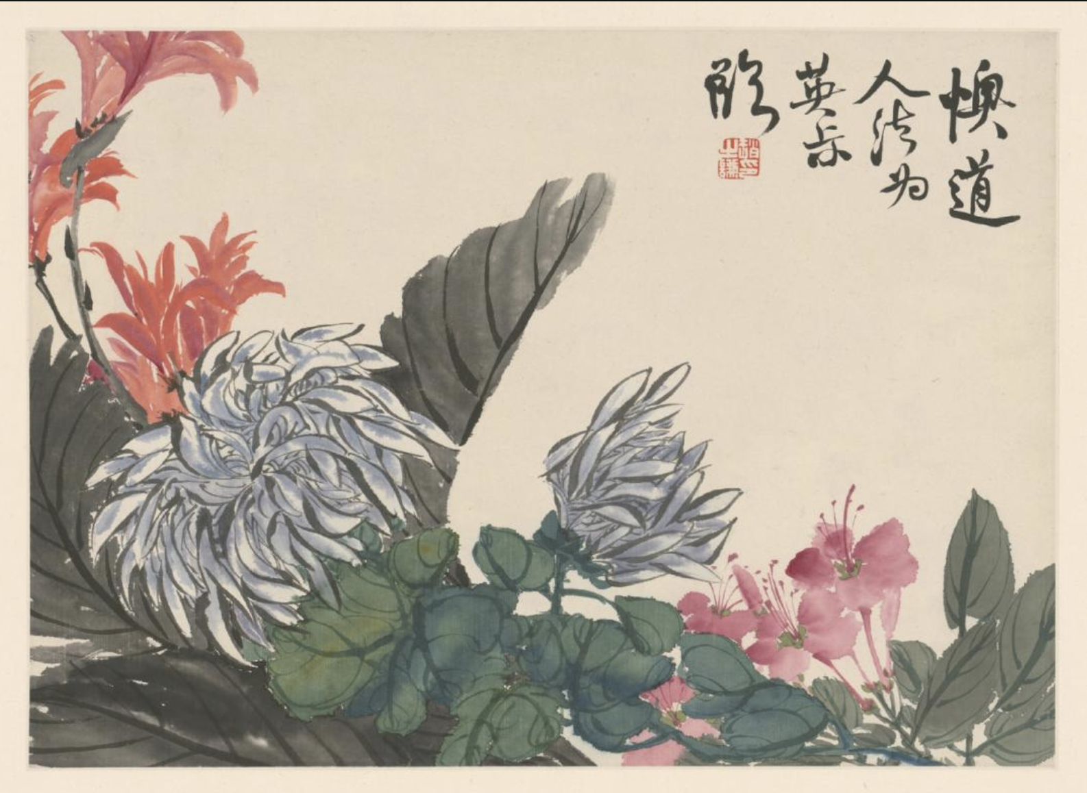
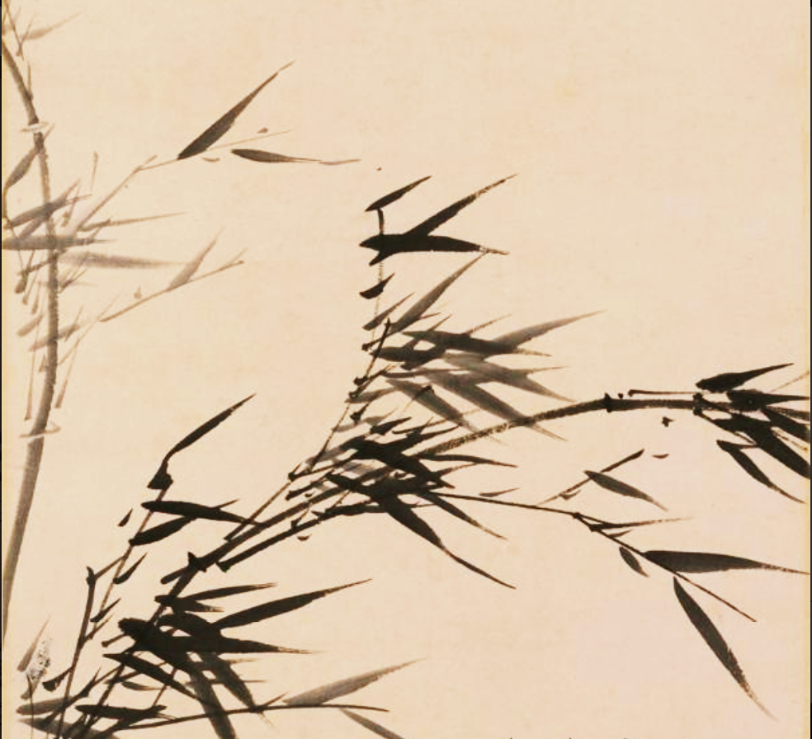
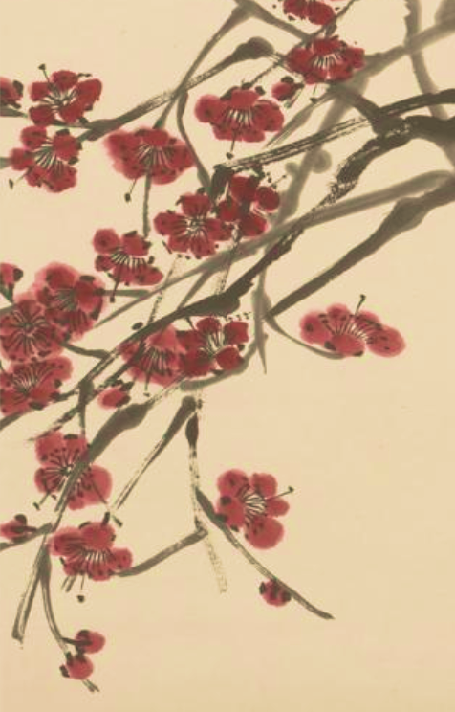
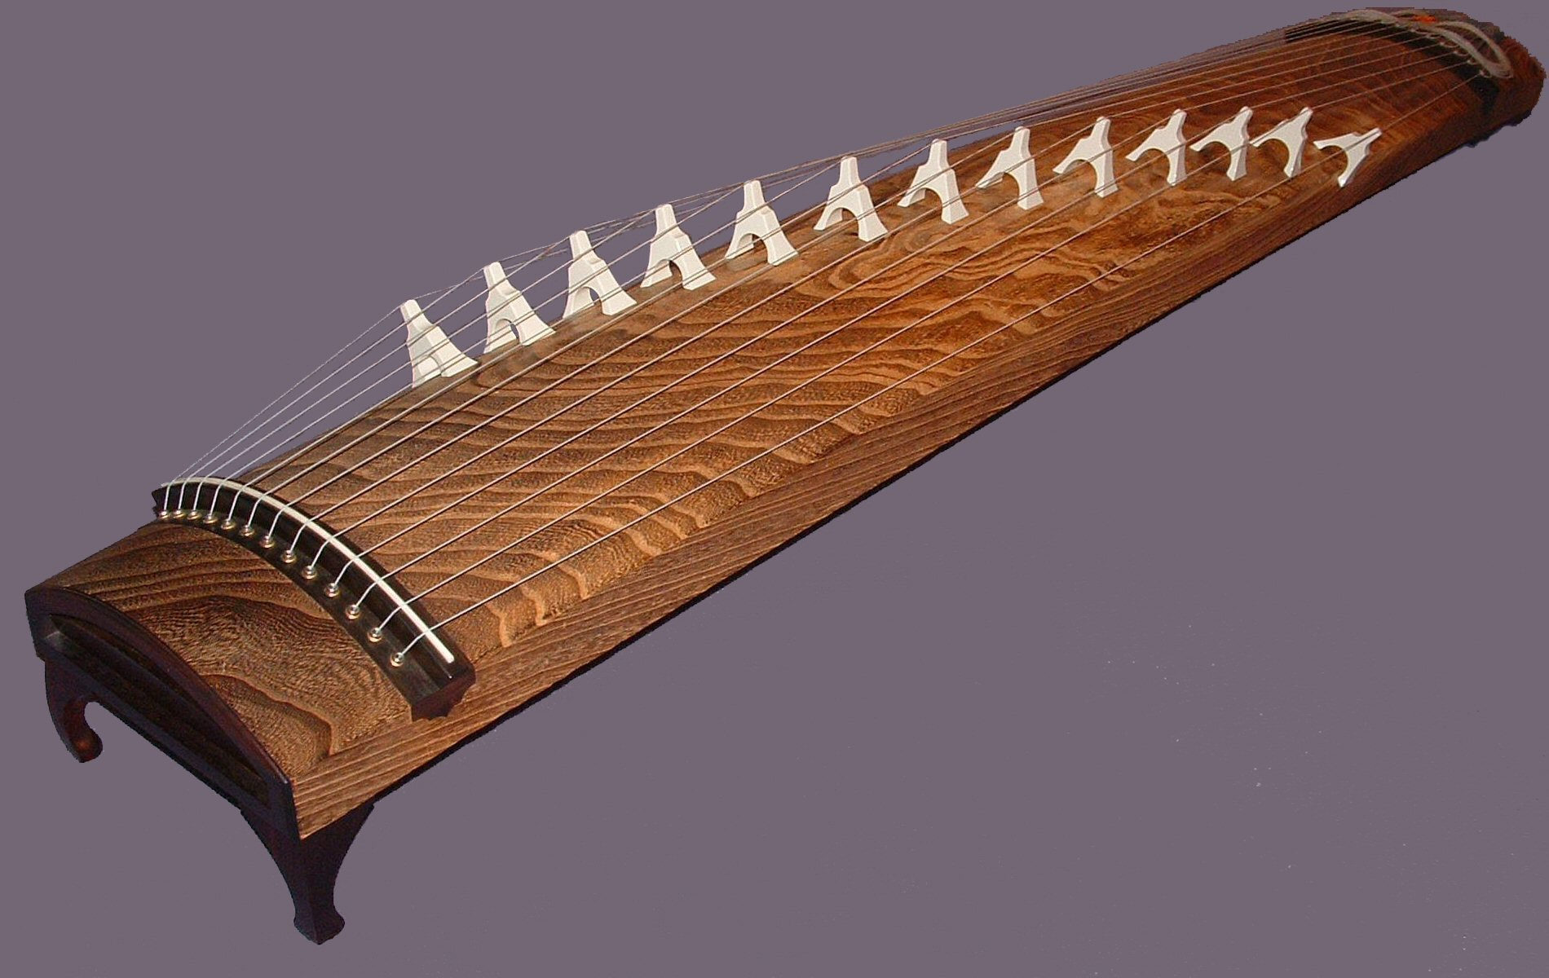
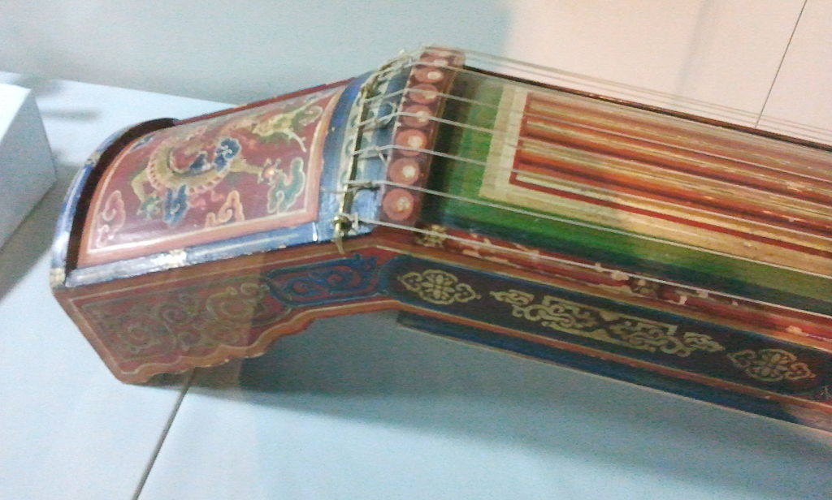
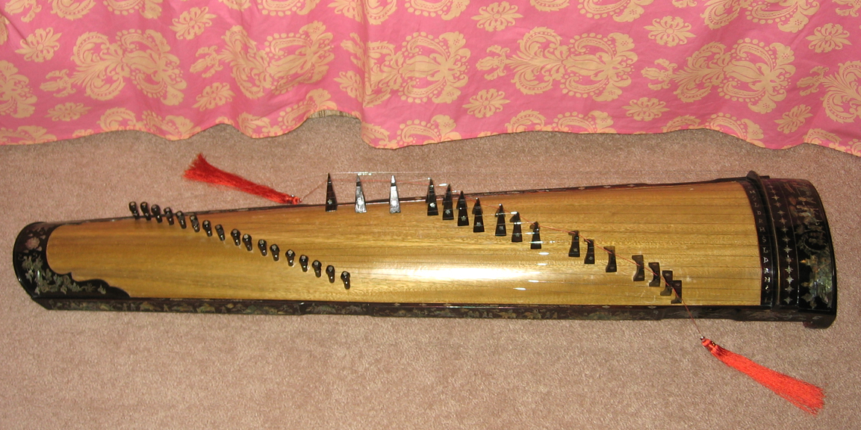
Shape
Zheng in Asia
筝的形状
·Korean gayageum·👆
·Japanese koto·👇
·Mongolian yatga·👇
·Vietnamese
dan tranh·👇
二

Slide 9
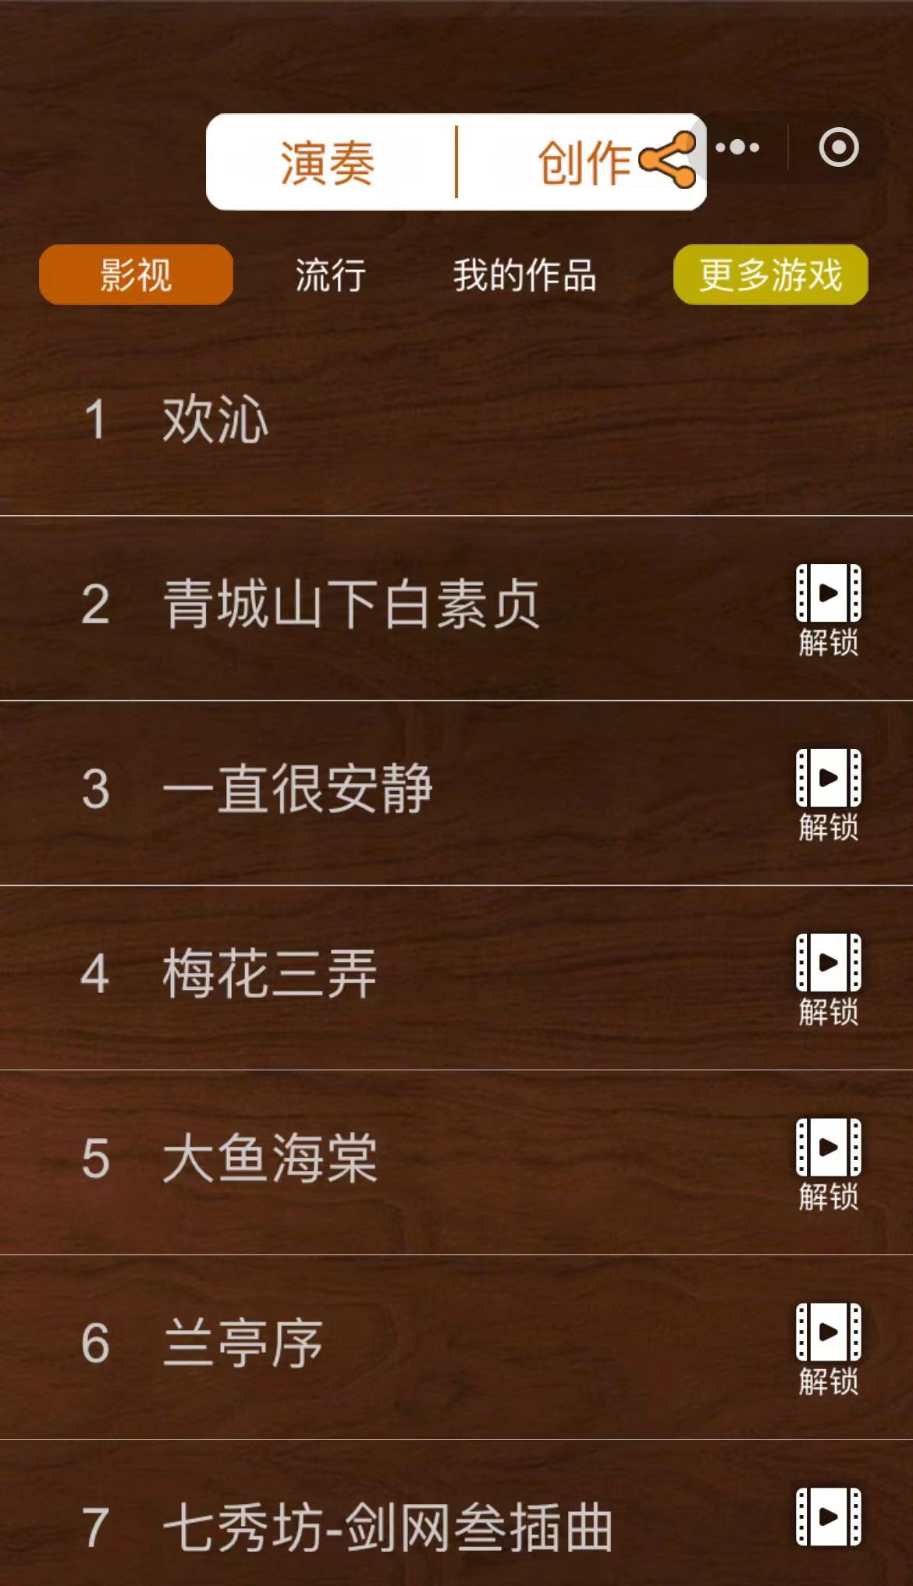
Have a try
试试看吧
三

Slide 10
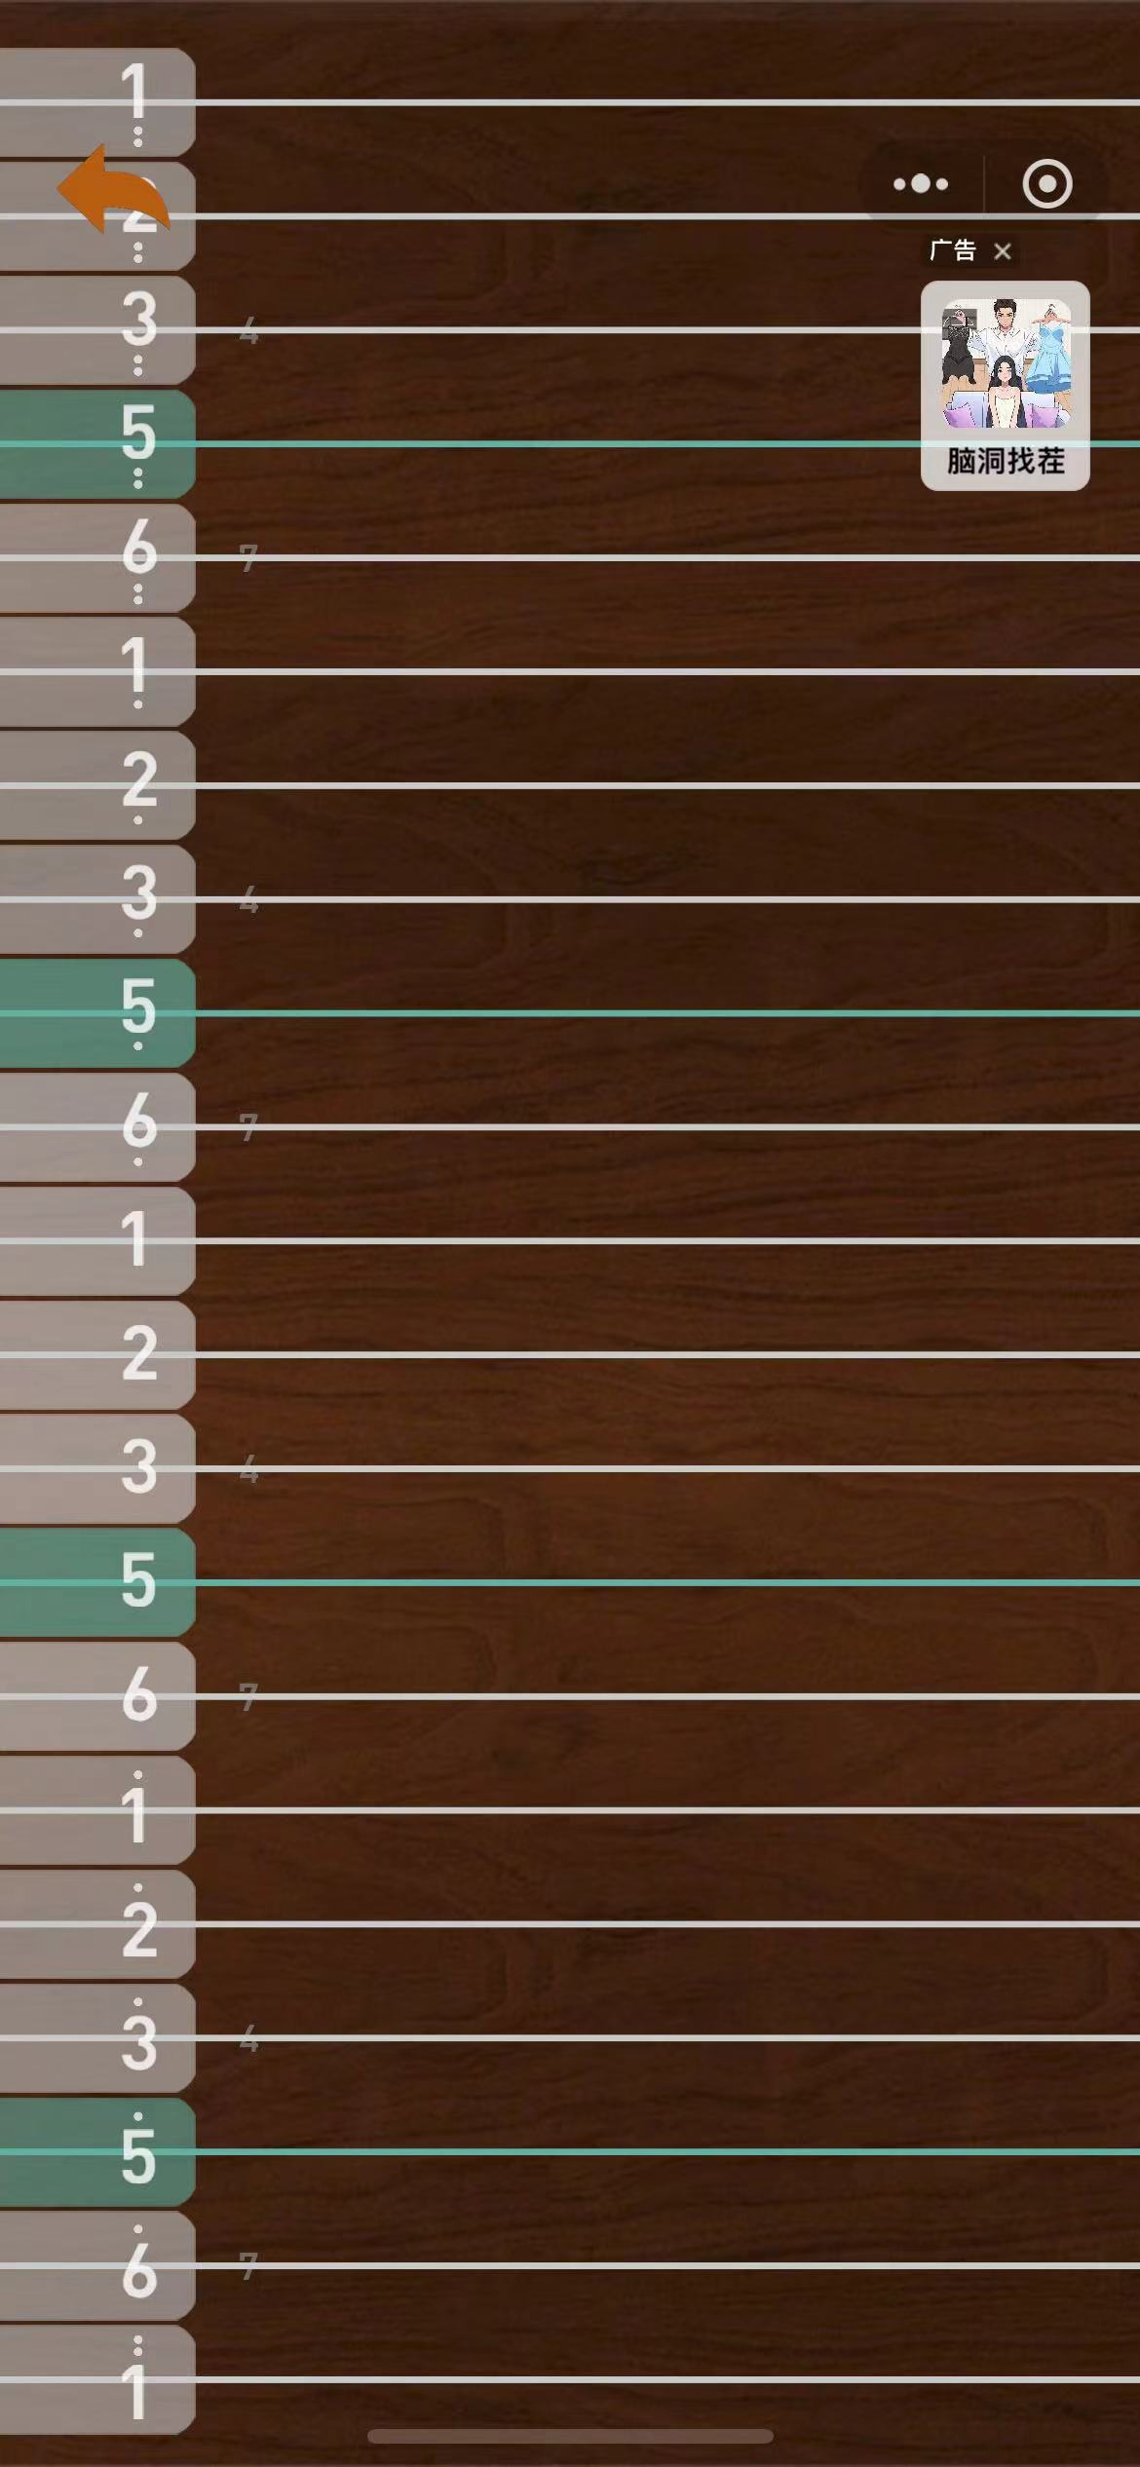
Have a try
  Major pentatonic scale
试试看吧
宫 商 角 徵 羽
1 2 3 5 6
三

Slide 11
Have a try
试试看吧
三

Slide 12
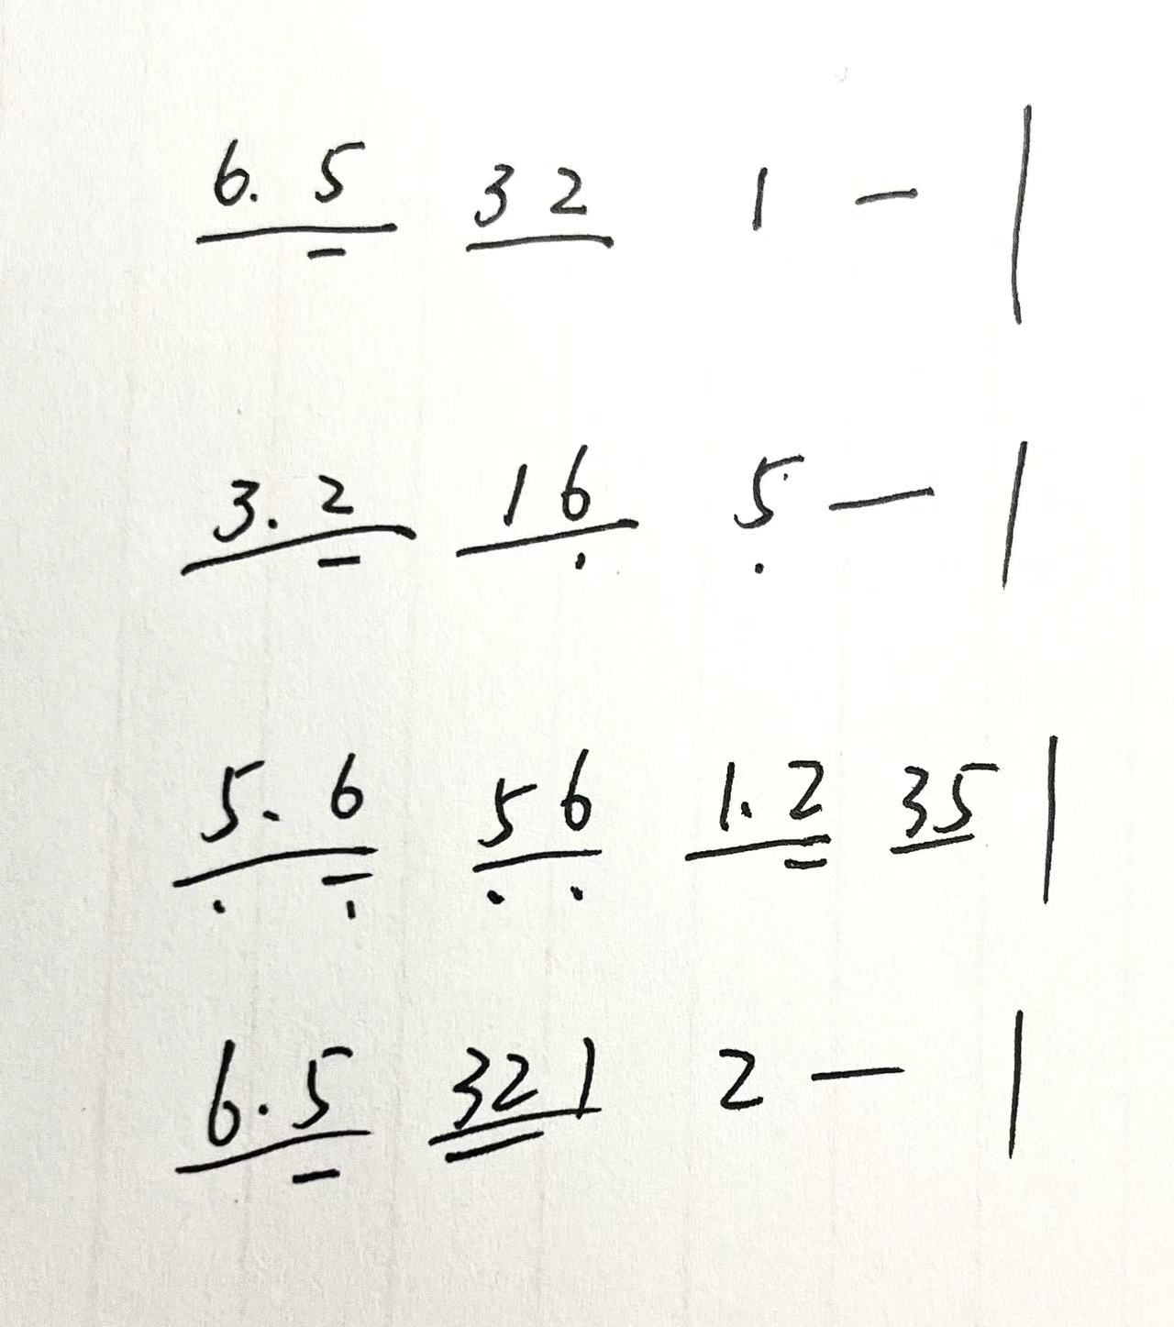
Have a try
试试看吧
三

Slide 13
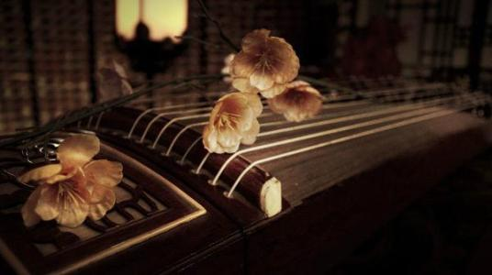
GOOD JOB!

