Slide 1


Celadon and the Celadon song
Zhou Zhengyuan

Slide 2
行业PPT模板http://www.1ppt.com/hangye/
Introduction
Content
History
点击在此输入文本内容。标题数字等都可以通过点击和重新输入进行更改，菜单开始栏设置中可以对字体、行距、大小、间距等进行修改。建议参考原模板风格字体字号。
Song
Notes:
模板来自于： 第一PPT https://www.1ppt.com/

Slide 3
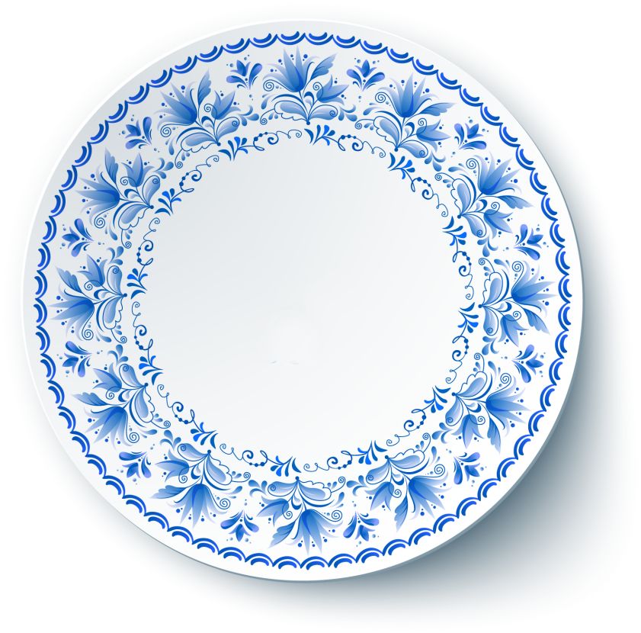
Intoduction
请添加您的标题
请在此处添加具体内容文字尽量言简意赅。

Slide 4
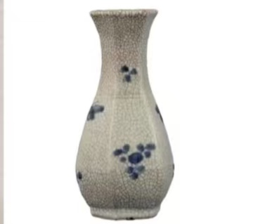
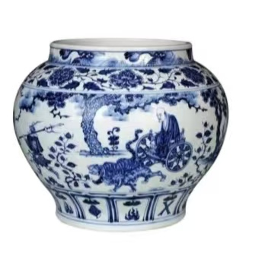

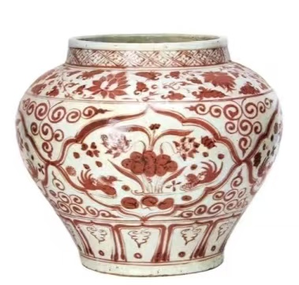
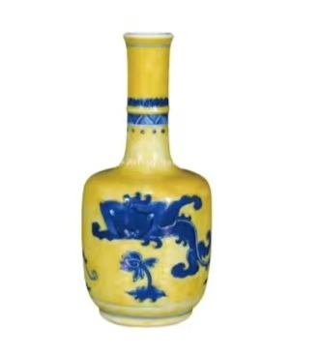
Which is not celadondon
1
2
3
4

Slide 5
History
请添加您的标题
请在此处添加具体内容文字尽量言简意赅。

Slide 6
Original
Celadon traces its roots to the Tang Dynasty, though early exzamples are rare with poorly refined technique.
However, for its success of exporting to the area of Islamic, it has witnessed the early development of the Silk Road.

Slide 7
Maturation
Celadon flourished during the Yuan Dynasty.
Innovations in skin technology and access to high-quality cobalt(钴) enabled artisans to creat bold and intricate designs on white celadon bodies.

Slide 8
Golden Age
The Yongle and Xuande reigns saw the use of imported cobalt, producing vivid hues, and Jingdezhen became the epicenter of the celadon.
In 16th CE, cobalt shortages led to the use of domestic “pitched” cobalt, resulting in softer grayish-blue tones and more refined designs.

Slide 9
Refinement
In Qing Dynasty, advances in glaze control and cobalt processing created luminous “peacock blue” shades.
Imperial wares showcased technical perfection, with layered landscape and poetic inscriptions.

Slide 10
Song
请添加您的标题
请在此处添加具体内容文字尽量言简意赅。

Slide 11
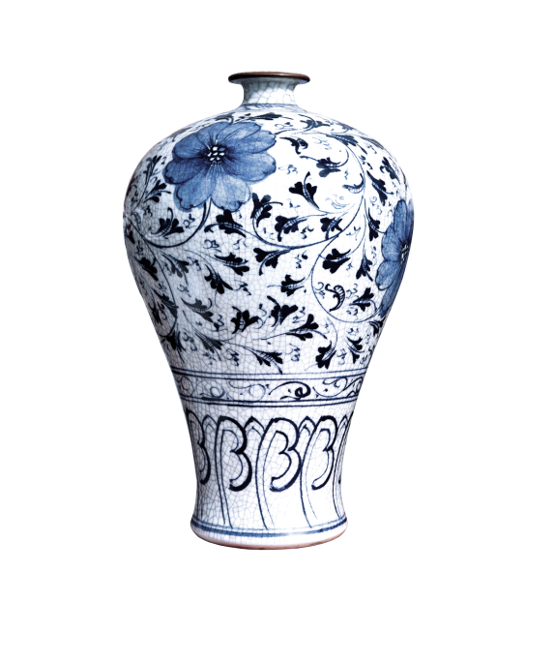

素胚勾勒出青花，笔锋浓转淡。
瓶身描绘的初妆，一如你初妆。
冉冉檀香透过窗心事我了然，
宣纸上执笔至此搁一半
This is a metaphor to begin this love story

Slide 12
釉色仕女图韵味被私藏，
而你嫣然的一笑如含苞待放。
你的美一缕飘散，
去到我去不了的地方
Direct discription about the celadon and the beauty.

Slide 13
天青色等烟雨，而我在等你。
炊烟袅袅升起，隔江千万里。
在瓶底书汉隶（Han Li）仿前朝的飘逸，
就当我为遇见你伏笔。
Here is a willful mistake

Slide 14
天青色等烟雨，而我在等你。
月色被打捞起，晕开了结局。
如传世的青花瓷自顾自美丽，
你眼带笑意。
This is the end of the love story

Slide 15

If you are ordered to translate one of these sentences, your answer may be...

Slide 16
Thank you

