Slide 1


Chinese Panda Diplomacy
汇报人：蔡思 日语笔译
关娜 英语笔译

Slide 2


https://www.ypppt.com/
Part 1： Origin and History
Part 2： Means
Part 3： Significance
Part 4： Problems and Solutions

Slide 3

Origin and History

Slide 4

Origin-Animals play an important role in China's diplomatic activities.
qilin diplomacy--As early as the Yongle period of the Ming Dynasty, Zheng He brought back many "qilin" (giraffes) from the African continent on his way to the West.
In the early years of New China, in 1957, China gave the giant pandas Ping Ping and An An to the Soviet Union.
Vietnam, which is in the same socialist camp as China, also gave two Asian elephants to China in 1953.

Slide 5

History
It begins with Wu Zetian. Wu Zetian gave two "white bears" and 70 furs to Japanese Emperor.
Technically speaking, the first time giant panda served as the highest-level national gift was in 1941 when the Song sisters, Song Ailing and Song Meiling presented a pair of pandas to the United States as a token of appreciation for their relief of Chinese refugees.
China's most famous "panda diplomacy" dates back to 1972, when President Nixon's visit to China. Premier Zhou Enlai announced at a banquet to welcome President Nixon that giant pandas Lingling and Xingxing would be given to the United States.

Slide 6
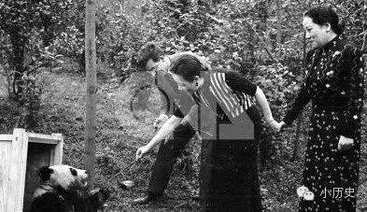
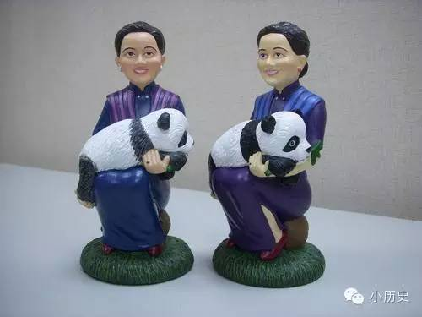

Slide 7
Means

Slide 8

Panda Touring and Leasing
In 1982, in response to a global call to protect endangered animals, the government of the People's Republic of China announced that it would stop giving pandas abroad starting in 1982.
In 1984 Olympic Games in Los Angeles, China temporarily loaned two pandas, Yongyong and Ying Xin, from the Beijing Zoo to the Los Angeles Zoo for a three-month tour to show China's support for the Los Angeles Games.

Slide 9
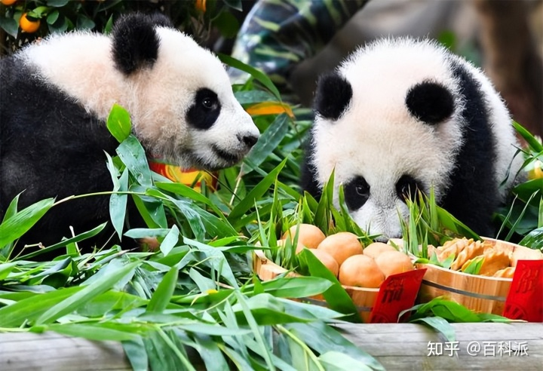
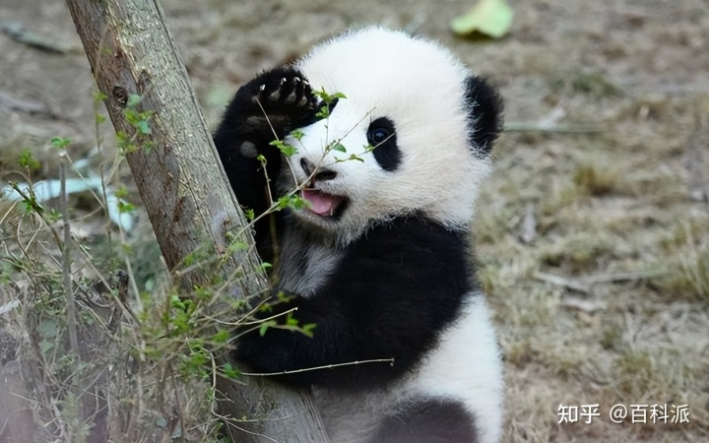
Joint Research on Giant Panda
It begins in 1994. Two pandas from the Chengdu Research Base of Giant Panda Breeding went abroad for the first time as "research and exchange ambassadors" to the Shirahama Safari Park in Japan.
Notes:
https://www.ypppt.com/

Slide 10
Significance

Slide 11

Building a good national image
enhance national cohesion;
improve the country's recognition and credibility; carry out international affairs in the international community
Creating communication topics
create a middle ground for China's diplomatic activities with other countries and create communication topics.
When common topics occur, communication between countries becomes possible.
Creating economic value
give rise to related cultural industries and many cultural products.

Slide 12
Problems and Solutions

Slide 13
Problems
Political misinterpretation
a cultural invasion
not having strong explanatory power or tendencies
Single content will cause aesthetic fatigue
lacking artistic processing and cultural connotation
difficult to raise interest and weak communication effect
Over-commercialization and dissipation of public interest
When commercial companies take advantage of the "panda fever" to over-market, people are inevitably suspicious of the panda image and even question whether the cute panda image is originally a scam by the business. When interest is dissipated, not only will the panda industry suffer, but the international influence of the "panda symbol" will also decline, which will directly affect China's international communication power.

Slide 14
Solutions
Enrich the content of communication and add more cultural connotations.
1
3
Refine the connotation of the symbol to reduce political misinterpretation.
Moderate exploitation of commercial value.
2

Slide 15
References
[1]赵丽君.“熊猫外交”的效果研究[J].公共外交季刊,2018,(01):103-110+148.
[2]张旭琰. 新中国熊猫外交的变化与挑战[D].辽宁大学,2022.DOI:10.27209/d.cnki.glniu.2022.001101.
[3]赵丽君,郑保卫.国家形象视角的“熊猫外交”研究[J].新闻爱好者,2017(12):15-19.DOI:10.16017/j.cnki.xwahz.2017.12.005.
[4]刘晓晨.从东方到西方:冷战背景下中国的熊猫外交[J].近现代国际关系史研究,2014(02):192-212.

