Slide 1
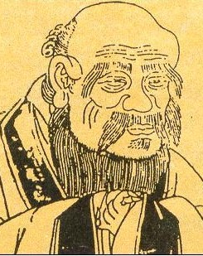
LaoZi
The DaoDeJing

Slide 2
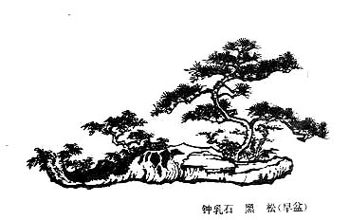
Biography
Born between 200-300BCE
He was born at today’s Guoyang, Anhui province and Died
He was buried in Xilouguan Province
However…

Slide 3
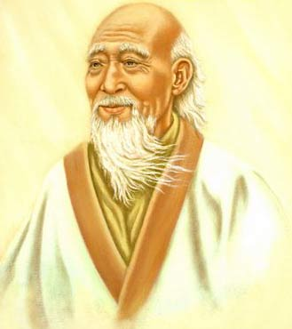
The Legends of Lao Zi
    Lao Zi’s mother was deeply “influenced” by the big falling stars and gave birth to Lao Zi.
    Lao Zi’s mother was pregnant for 81 years
    Lao Zi was the teacher of Confucius
    Lao Zi once acted as the librarian of National Library of East Zhou Period.

Slide 4

The Importance to Chinese Culture
  The father of chinese culture
  The founder of Chinese Taoism
  The originator of Chinese philosophy
  The greatest saint of Chinese spirituality
  A God-Like Diety: Huang Da Di or The Supreme Being of Jade Emperor.
  Lao Zi in the mind of Chinese people was greater thanConfucius, Mozi, Mencius, Xun Zi, Zhu Zi and other great saints and masters in spirituality history of China.

Slide 5
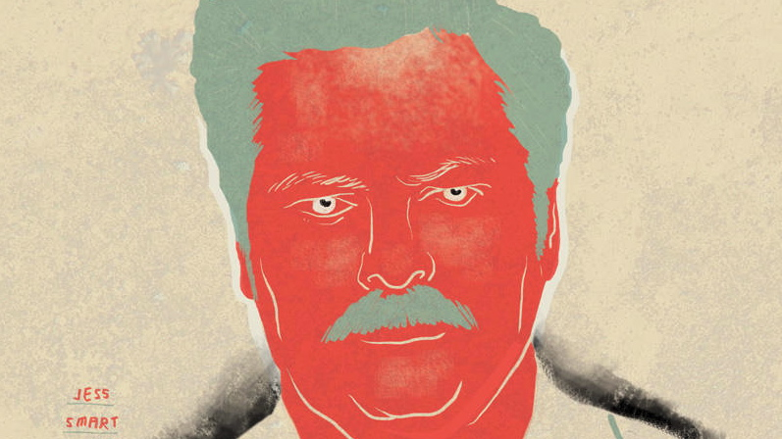
DaoDeJing
Catalogues the Dao or the “Way” of Virtue
  Naturalist: draws many metaphors from nature
  Various Motifs: water, female energy, non-action
  Enigmatically Contradictory
  “The clearest Way seems obscure; The Way ahead seems to lead backward; The most level Way seems uneven”`

Slide 6

Taoism as a Religion
Strong emphasis on inaction
Reflects Lao Zi typical “contradictions”
Daoism: Ying Yang

Slide 7
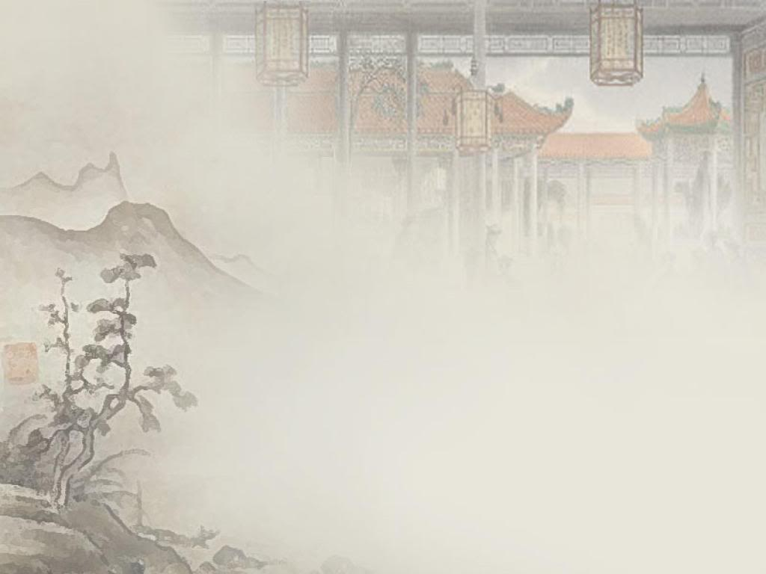
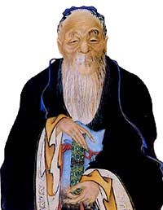
Lao Zi
f

Slide 8
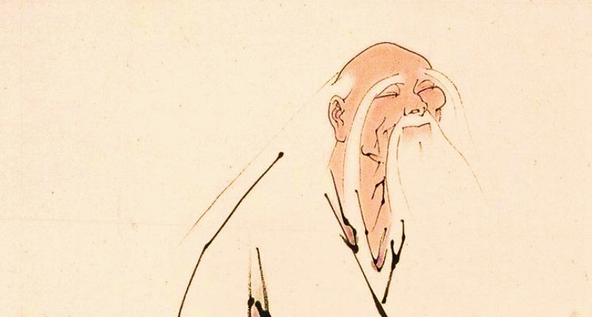
Historical Emergence
When it was put together, China was near the end of a prolonged era of fierce interstate rivalry known as the Warring States.
Denounces:
  wars of expansion
  government corruption
traces both complaints to the unbounded greed and ambition of those inpower.

Slide 9
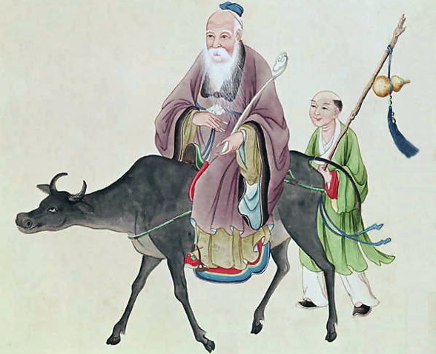
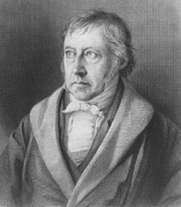
Critisism From Hegal
Philosopher Friedrich Hegel contends that “Tao” is too abstract:
“Die Bestimmungen des Tao bleiben vollkommene Abstraktionen, und die Lebendigkeit, das Bewusstsein, das Geistige falt nicht in das tao selbst.”
The provisions of the Tao remain perfect abstractions, and the liveliness, consciousness, the spiritual diversity is not in itself the tao

Slide 10
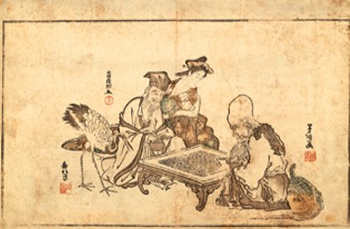
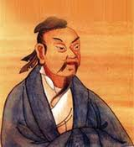
Lao Zi & Mo Zi
“Not paying honor to the worthy leads the people to avoid contention.” – Lao Zij
Mozi: Govern the People
Laozi: Action through Non-Action

Slide 11

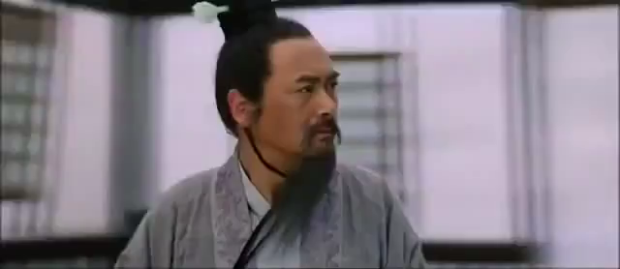
Lao Zi and Confucius
“The rites are the wearing thin of loyalty and trust, and the beginning of chaos.” –Lao Zi
“The Old Way” Vs. “My Way”

Slide 12

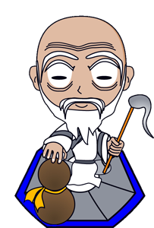
Modern Influences
various anti-authoritarian movements have embraced the Laozi teachings on the power of the weak.
The economist Murray Rothbard suggests that Laozi was the first libertarian, likening his philosophy the theory of spontaneous order.
LaoZi is still considered to be a deity in the Taoist Religion; considered one of the “three Pure Ones”

Slide 13

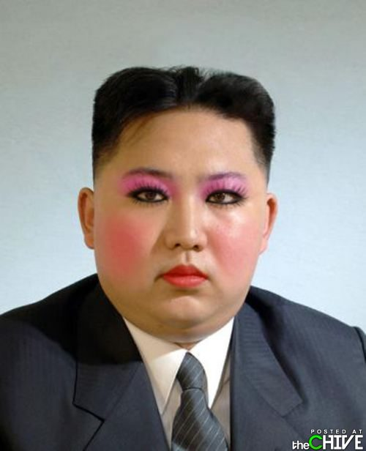
END

