Slide 1
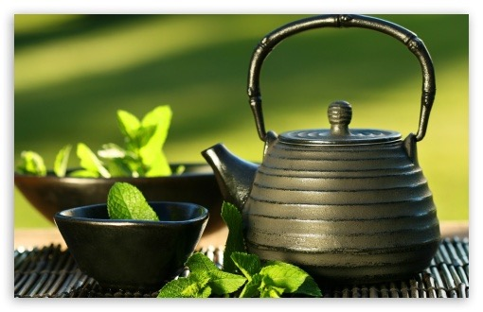
Tea
Teacher: Martin Woesler – CHINESE LANGUAGE AND CULTURE.
Students：Zhu Meimei, Zhou Yuanqu

Slide 2
History of Tea
Generally people believe tea was produced in China about 4,000 years ago. However, some people find evidences that it was first appeared in other places such as India or Africa.
During the Tang Dynasty (618-907), Japanese monks introduced tea seeds to Japan, and by combining tea with Zen Buddhism（禅宗）, created the world-famous Japanese tea ceremony.
In the 17th century, the Dutch took to Europe the Chinese habit of tea drinking,which then became a tradition of the Europeans.
the English word “tea” was a transliteration of the pronunciation of “tea” in the Fujian dialect of China.

Slide 3
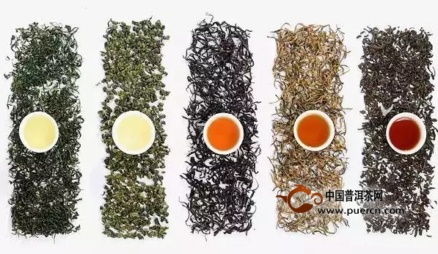
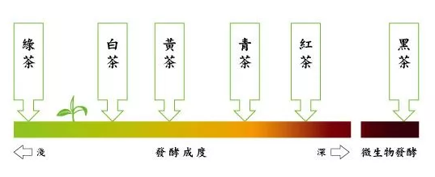
Six Types of Tea
green tea: Long-jing Tea, in Xihu
white tea: Fuding White Tea 福鼎白茶
yellow tea：Yellow-bud Tea 黄芽茶
black tea 红茶：Dian Black 滇红
oolong tea：Da Hung Pao 大红袍
dark green tea黑茶：Fuzhuan Tea 茯砖茶
A same leaf can be made into six kinds of tea by different level of fermentation。
Attention：红茶 in English is Black Tea.

Slide 4
Functions of Tea
Liu Zhenliang(刘贞亮), a tea master of the late Tang Dynasty, put forward the theory of “ten virtues” of tea:
茶可尝滋味，可以养身体，可以驱腥气，可以防疾病，可以聚生气，可以散闷气，可以促礼节，可以表敬意，可以顺心意，还可以助行道。
tea is tasty; maintain health;
drive away stinking odors; prevent the attack of diseases
cultivate energy in the human body; relieve depression;
improve manners; convey respect;
smooth the mind; uphold justice.

Slide 5
Translation Tips
This translation version uses several similar phrases to convey the meaning in Chinese, which are both brief and to the point. For example, “tea can relieve depression”, we won't translate as “茶可缓解抑郁” because not all people are depressed if they are just a little upset or sad，instead we use “闷气“, which means the feeling of stuffiness.

Slide 6
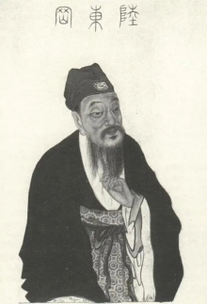
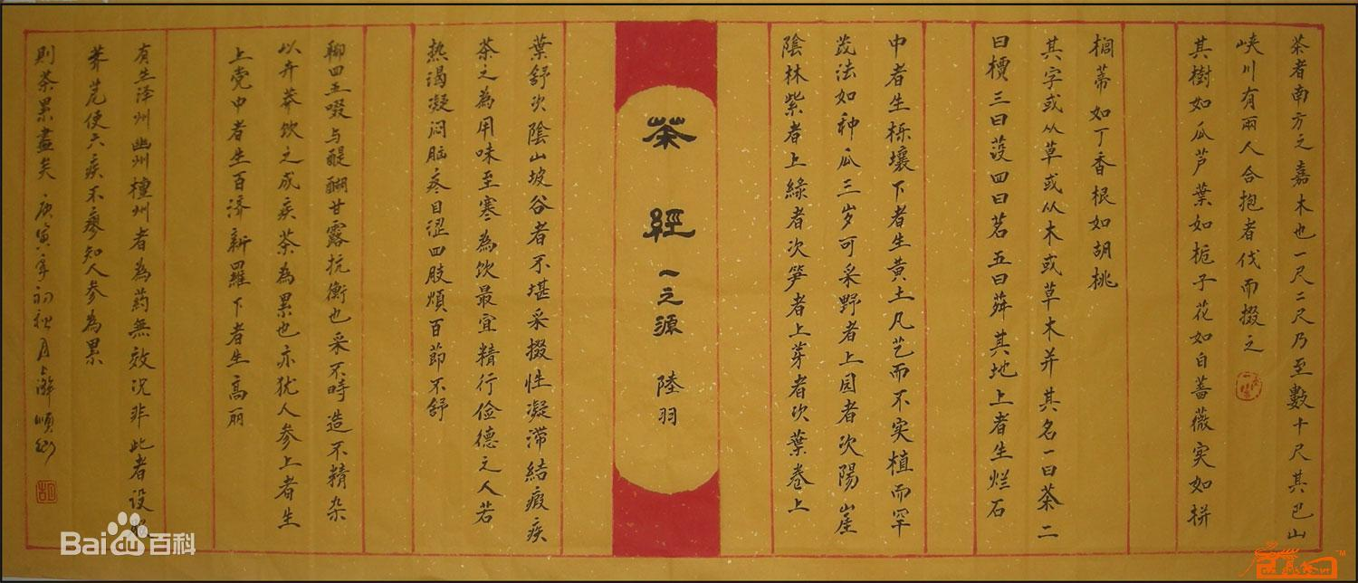
Lu Yu, the Tea Saint of China
To Tea drinking, the first and formost pleasure derived from drinking tea is “cleansing.”
Tea prefers to grow on in clean places. The cleaner a place, the better the quality of the tea it nurtures.

Slide 7
Ways of Savoring Tea
The Chinese attach great importance to the water, tea leaves, tea set, and fire, when making and drinking tea.
Prepare Tea Set
Rinse Teapot and Teacups
Heat Water
Put Tea Leaves into Teapot
Wash Tea Leaves
Brew Tea
Pour Tea Soup into Tea Cups
Offer Tea Cups
Smell and then Sip Tea

Slide 8
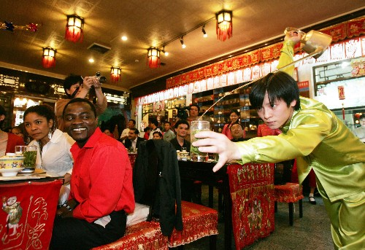
Four Elements should be observed
Different tea have different colors, such as black tea, green tea, oolong tea, white tea ( leaves with fine and soft white hair), and dark tea.
Fine tea is a combination of color, aroma, taste, and form, and requires patience to be well appreciated. Therefore, Chinese speak of “savoring tea,” instead of “drinking tea”.
International friends at a tea party

Slide 9
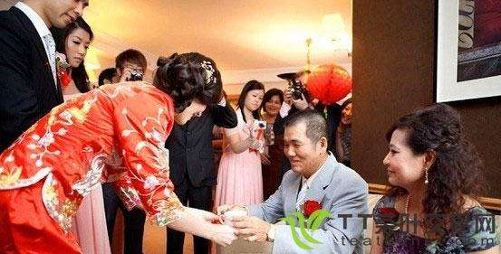
Tea Drinking and Folk Customs
Many Chinese folk customs are related to tea, such as the wedding ceremony. Tea trees grow out of seeds, and cannot be moved, so newlyweds customarily plant tea seeds to symbolize their devotion to love. The engagement ceremony is called a “tea ceremony” in China, which is still popular in some place.
女子受聘称“吃茶”。订婚、结婚被称为“受茶”，订婚的定金被称为“茶金”。

Slide 10
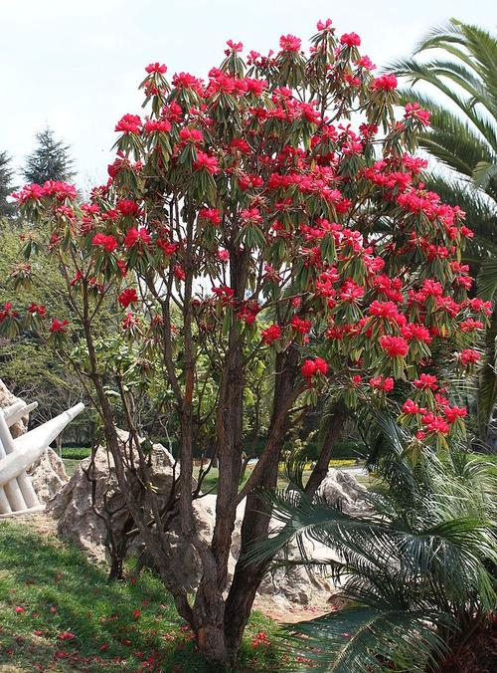
Lead a Poetic Life with Tea
Tea drinking, with the touch of love, can be very romantic,along with its long aesthetic elements. The following folksong describes the love of Wang Gui'an and Yunniang.
My home is situated by the Pantuo River,
Come have tea some time, my sweetheat.
With earthen walls and a thatched roof,
In front, a silk tree in full bloom.
盘陀江上是侬家，
郎若闲时来吃茶。
黄土筑墙茅盖屋，
门前 一树马缨花。

Slide 11

Thank you for your Listening!

