Slide 1

Chinese movie

Slide 2


C O N T E N T S
Brief introduction
Catogories
Movies awards
1
2
3

Slide 3

1
Brief introduction

Slide 4
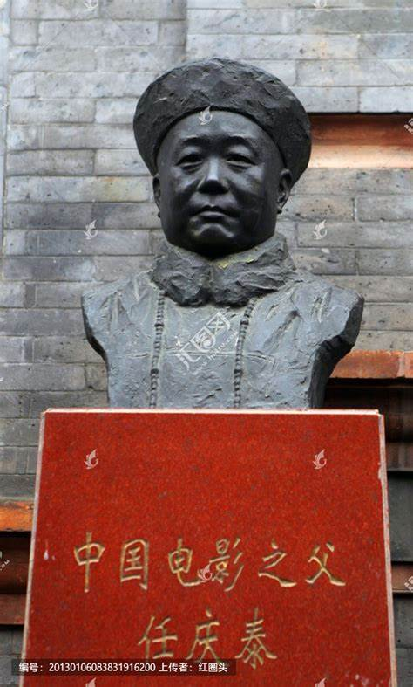
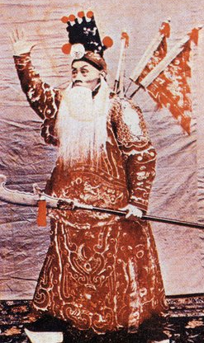
Brief introduction
Origination：
Chinese movies were born in 1905, and Ren Qingtai's "Ding Jun Shan"《定军山》 was the first film made by Chinese, for which he is also known as "the father of Chinese movies".
Categories:
Chinese movies are a collective term for movies screened and broadcasted in mainland China, Hong Kong and Taiwan.
1

Slide 5
2
Catogories

Slide 6
Mainland China Movies
Brief development history:
From 1949 to 1967, the initial stage of Chinese cinema, mainland Chinese films took revolution and war as their main themes.
From 1980 to 1990, there was a tendency to diversify in terms of subject matter and style.
《白毛女》、《红色娘子军》
《红高粱》、《霸王别姬》
Since 2010, Chinese films have grown rapidly out of the fickle blockbuster trend
Since the 2020 epidemic, the main film is the Patriotic Movies
2001 to 2009, huge blockbusters become more, high cost, strong star lineup
《建国大业》《让子弹飞》
《哪吒之魔童降世》《流浪地球》《我和我的祖国》
《中国女排》《八佰》《长津湖》《中国医生》《中国机长》
《英雄》、《十面埋伏》
2

Slide 7
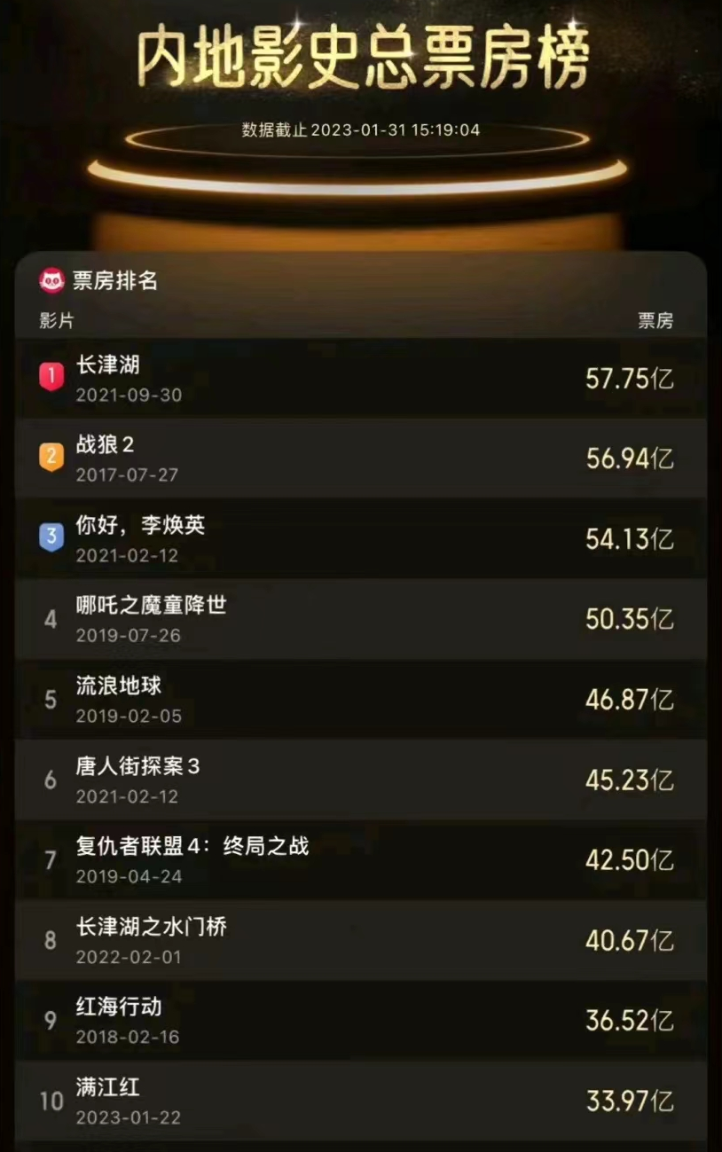

Brief introduction
By the end of January 2023, in the total box office ranking of the mainland, five of the top ten are Patriotic Movies
2

Slide 8
Hong Kong Movies
Hong Kong film genres are mainly Comedy, Action, Police（警匪片）, Gangster（黑帮片）, Spy（卧底片）, Martial arts and Literary films.
Features：
1. The production cycle is short. Some films are even made in as little as three or four months.
2. As opposed to meticulous and logical plots, Hong Kong films focus more on characterization. So many Hongkong actors are more famous than there works.
3. Exhilarating. Suitable for people who seek excitement to watch.
American film researcher David Bovell describes Hong Kong cinema as "all over the top, all crazy".(尽皆过火，尽是癫狂）
2

Slide 9
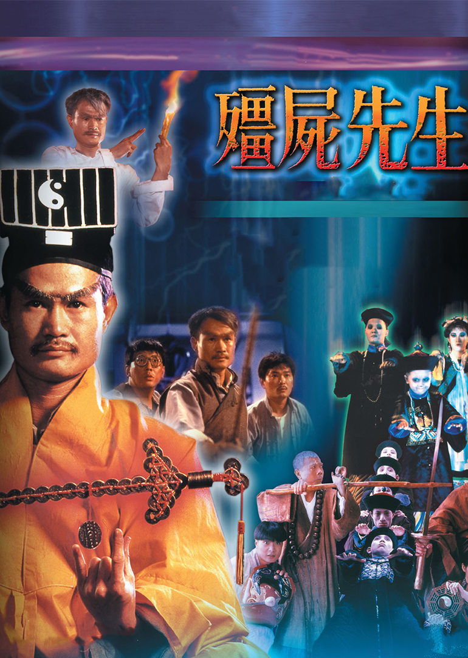
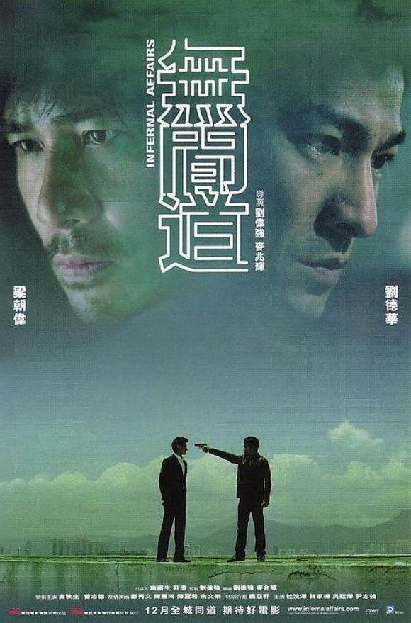
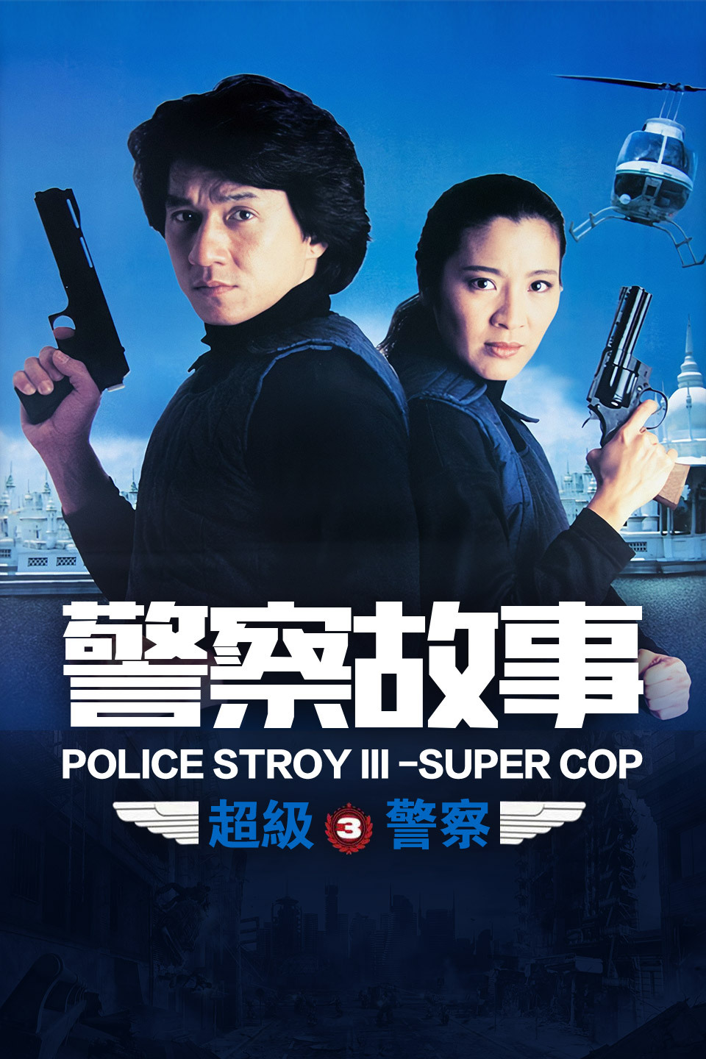
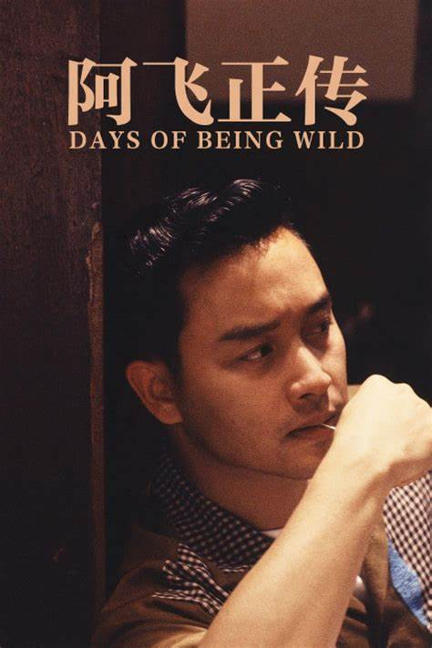
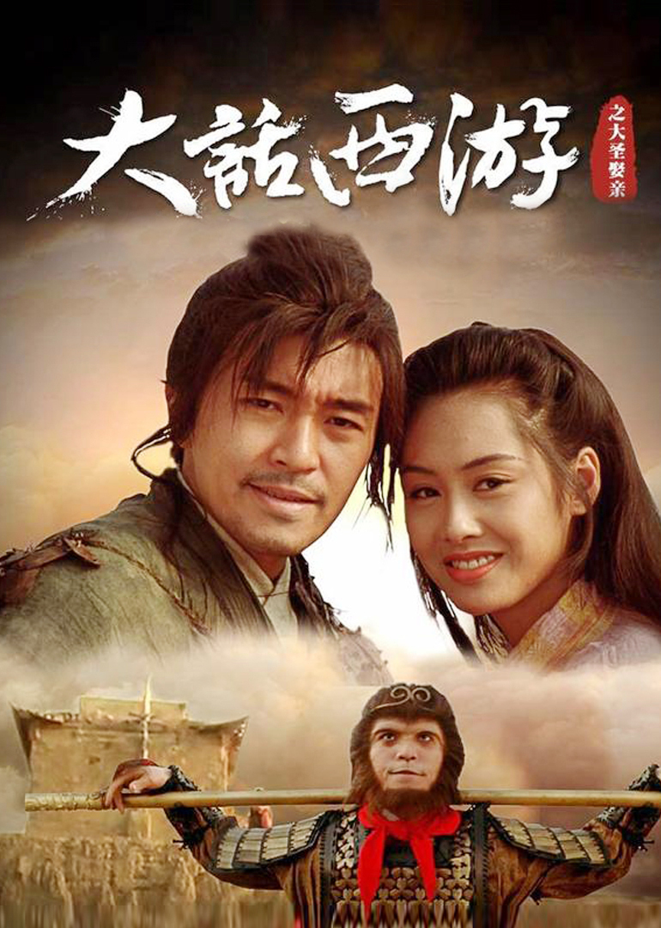
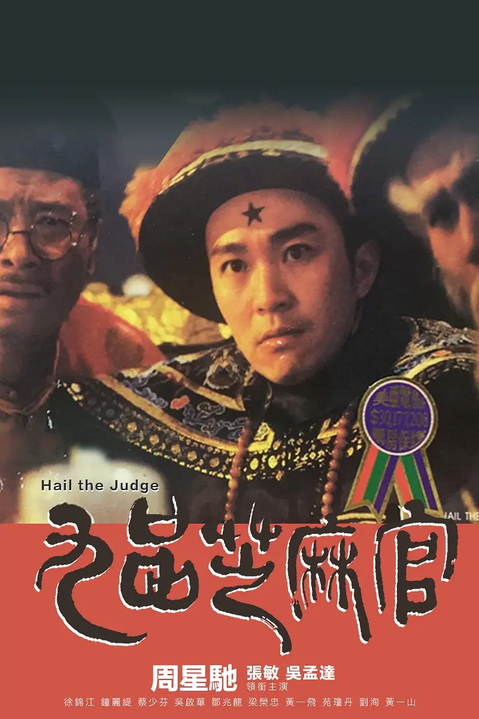
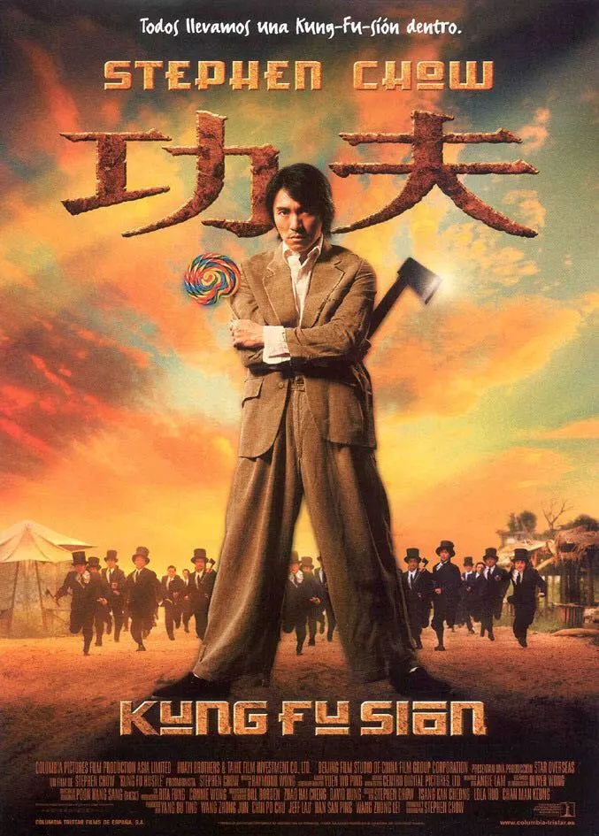
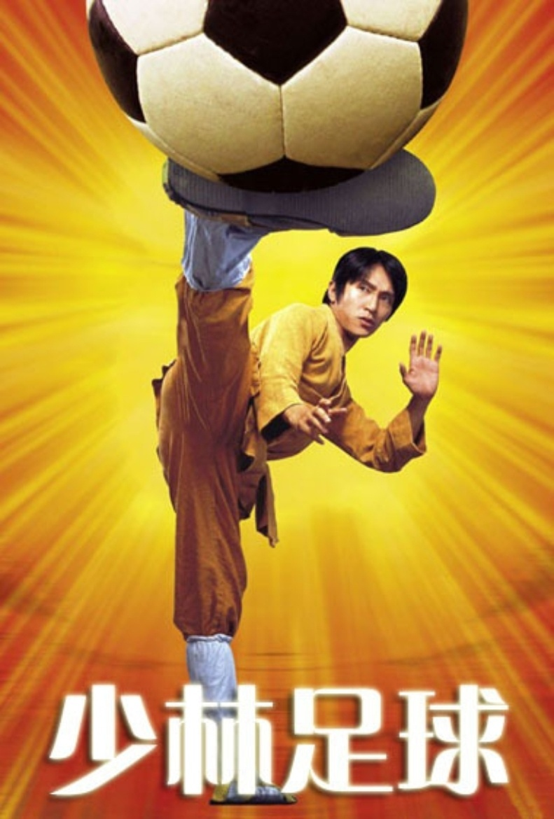
Hong Kong Movies
《僵尸先生》
林正英
《无间道》
刘德华、梁朝伟
《警察故事》
成龙
《阿飞正传》
梁朝伟、张曼玉
周星驰
2

Slide 10
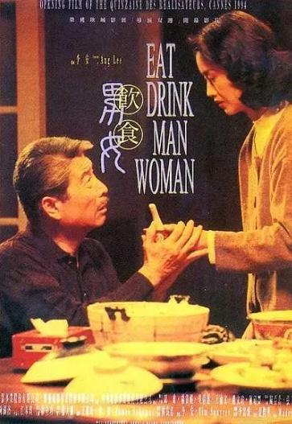
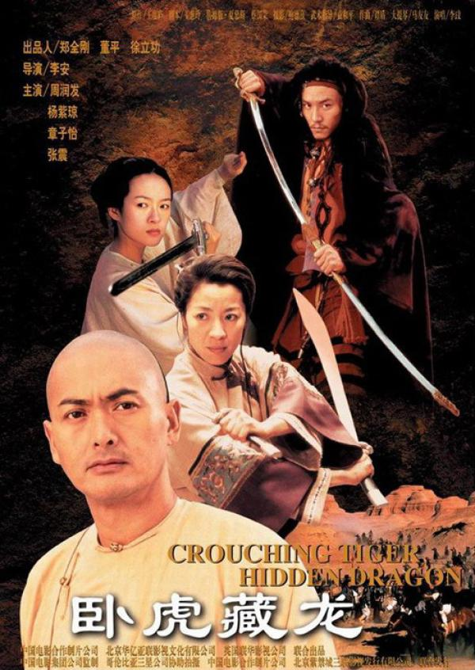
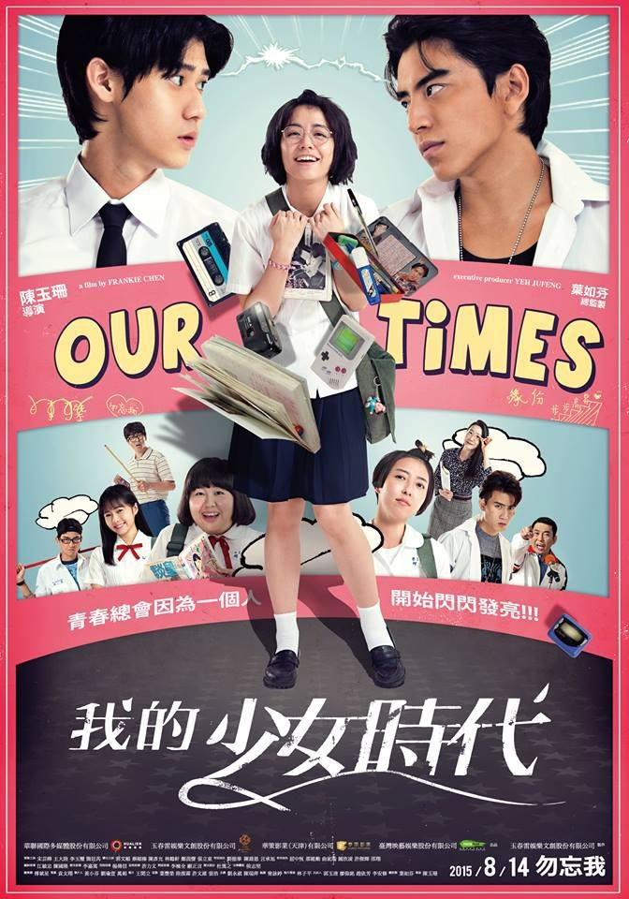
Taiwan Movies
Features:
Taiwan films are characterized by an emphasis on directorial style, a preference for non-star actors, a love of live action, a close adherence to the realities of society, and a filming style that is aesthetically pleasing and very artistic.
《我们的少女时代》
《饮食男女》
《卧虎藏龙》
1

Slide 11
3
Movies Award

Slide 12
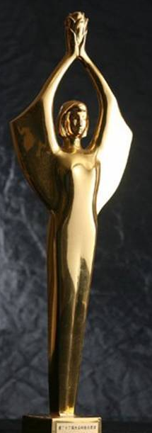
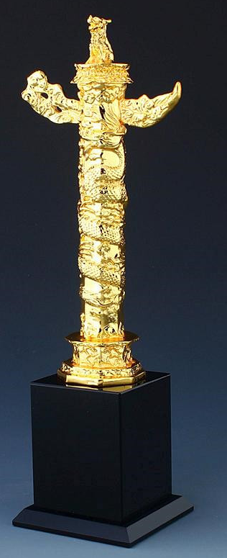
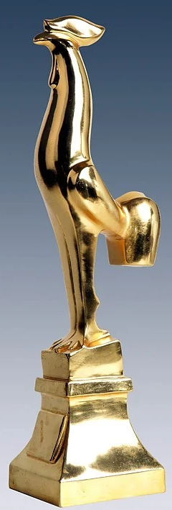
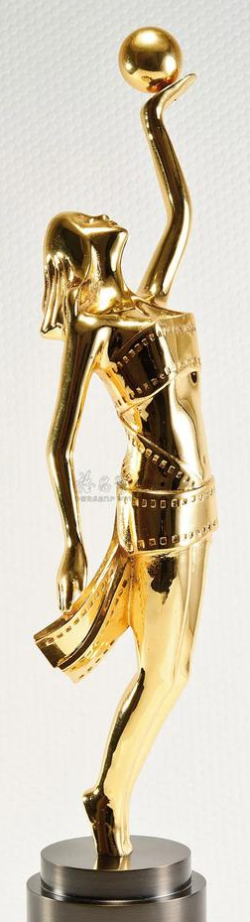


Movie Awards
Golden Rooster Award
Hundred Flowers Award
Huabiao Film Awards
中国电影金鸡奖
大众电影百花奖
中国电影华表奖
Hong Kong Film Awards
Chinese Film Media Awards
Golden Horse Awards
香港电影金像奖
华语电影传媒大奖
台湾电影金马奖
3

Slide 13
Thank you

