Slide 1
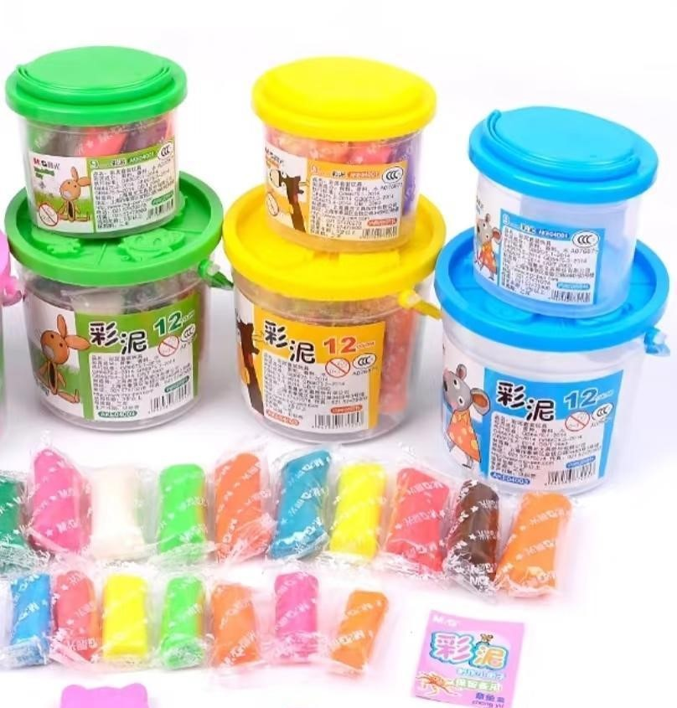
plasticine
橡皮泥

Slide 2
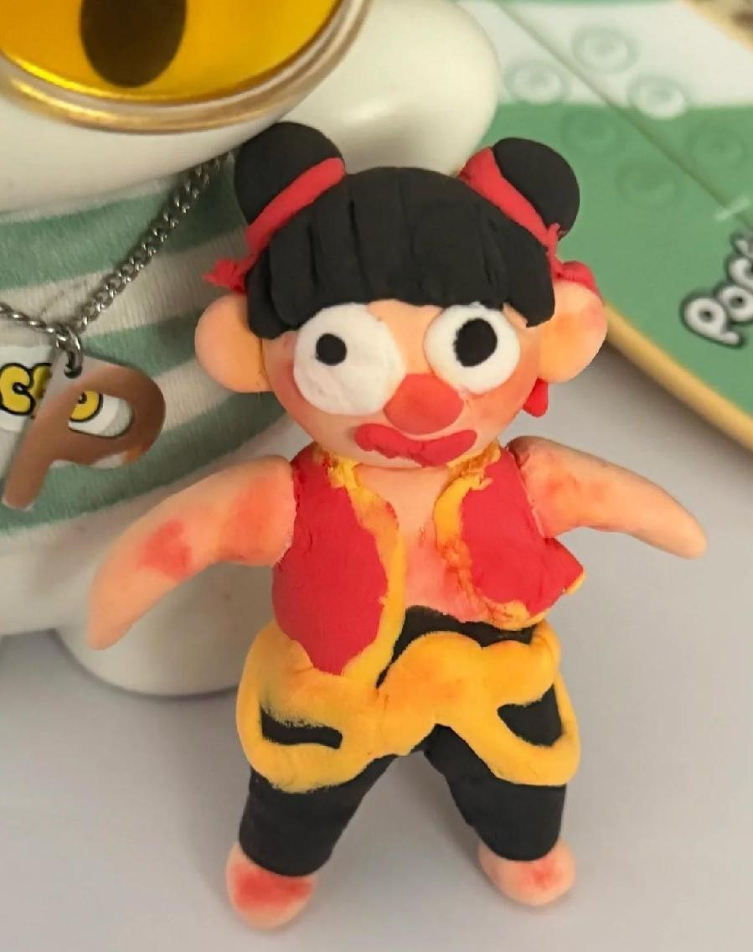
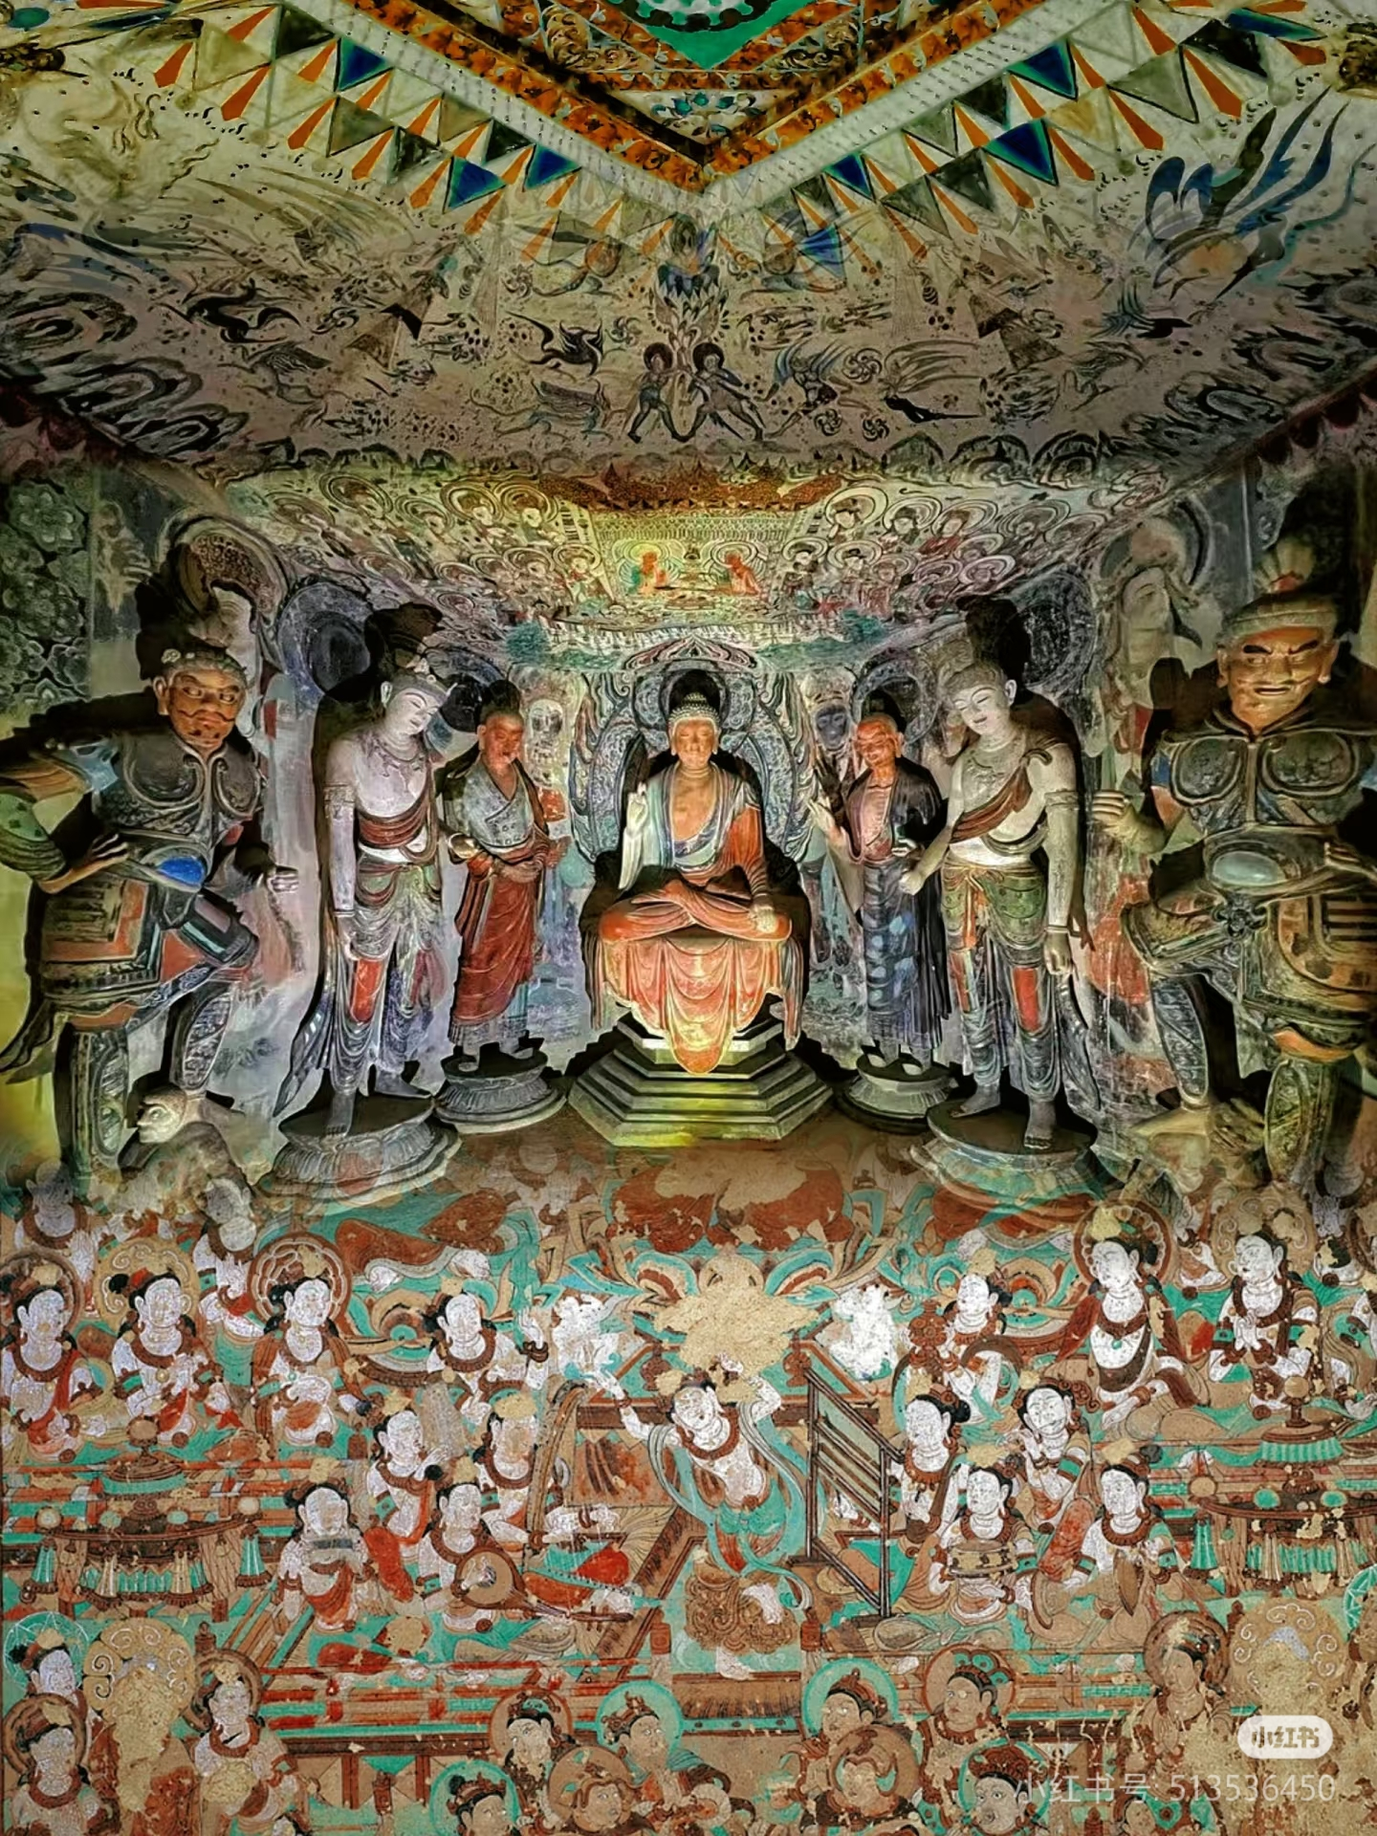
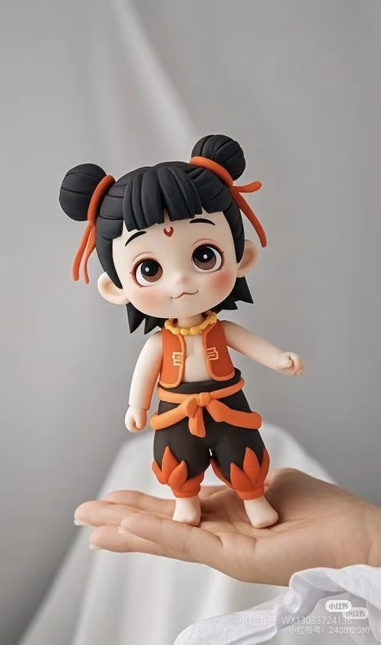
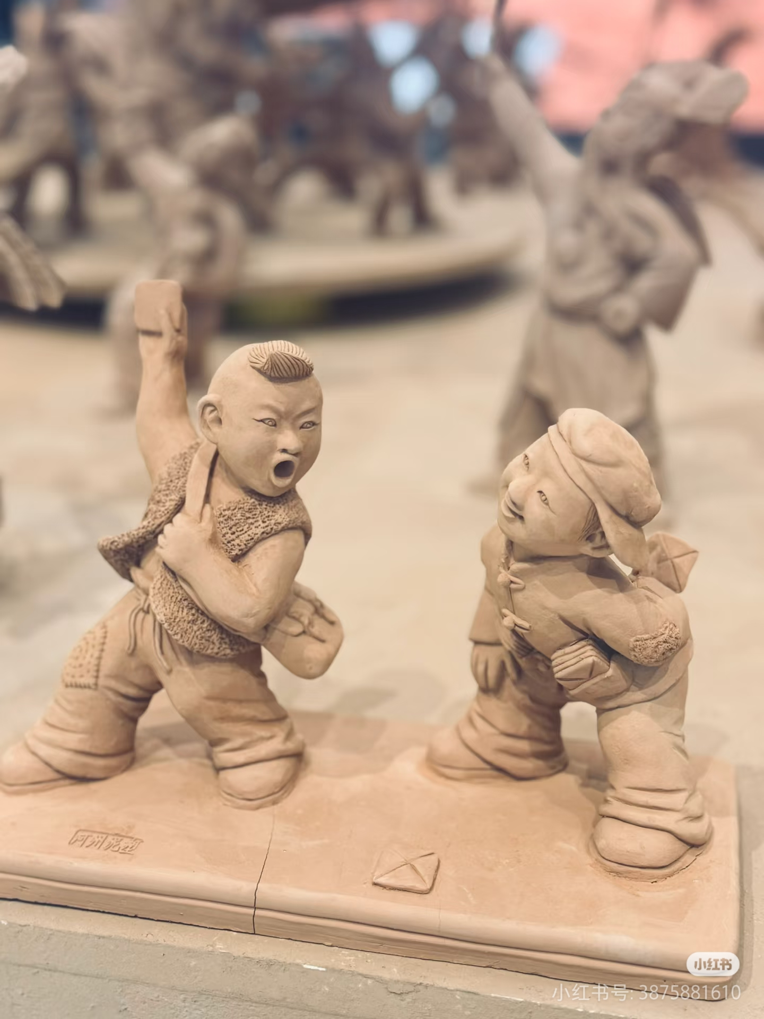

Slide 3

The Magic and Legacy of Clay Sculpture
“
”
Speaker：
陈琳 ChenLin
时间：
2025.5.6
Notes:
Clay sculpture is a traditional form of sculptural art that uses earth as the primary material to handcraft or mold various figures and scenes. This art form has a long history, spanning multiple cultures and eras, and is renowned for its unique texture and expressiveness. Clay sculptures can be abstract or figurative, often reflecting the artist's emotions and thoughts, or observations of nature and society. Clay sculpture is not only a visual art but also contains rich cultural and historical value, serving as a bridge between the past and the present.

Slide 4
目录
Development
01
02
Making
Conclusion
03

Slide 5
01
“
Development

Slide 6
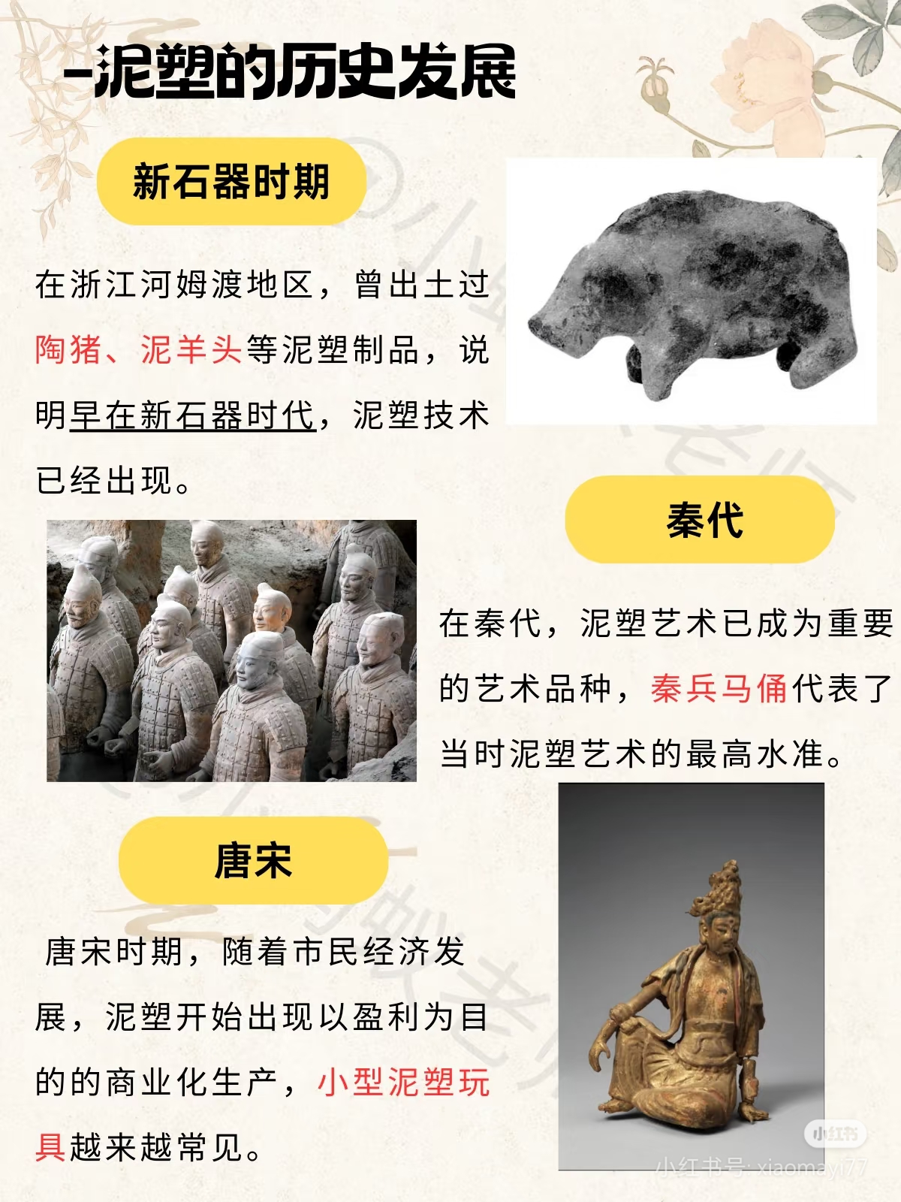
Development
Late Neolithic period
In the Hemudu area of Zhejiang Province, pottery pigs, clay heads of sheep and other clay sculptures have been unearthed.
Tang and Song Dynasty
Along with the economy growth, clay sculptures began to be produced for profit, and small clay toys became increasingly common.
Qin and Han Dynasty
Clay sculpture art had become an important artistic category, with the Terracotta Army of the Qin Dynasty representing the highest level of clay sculpting art.

Slide 7
02
“
Making

Slide 8
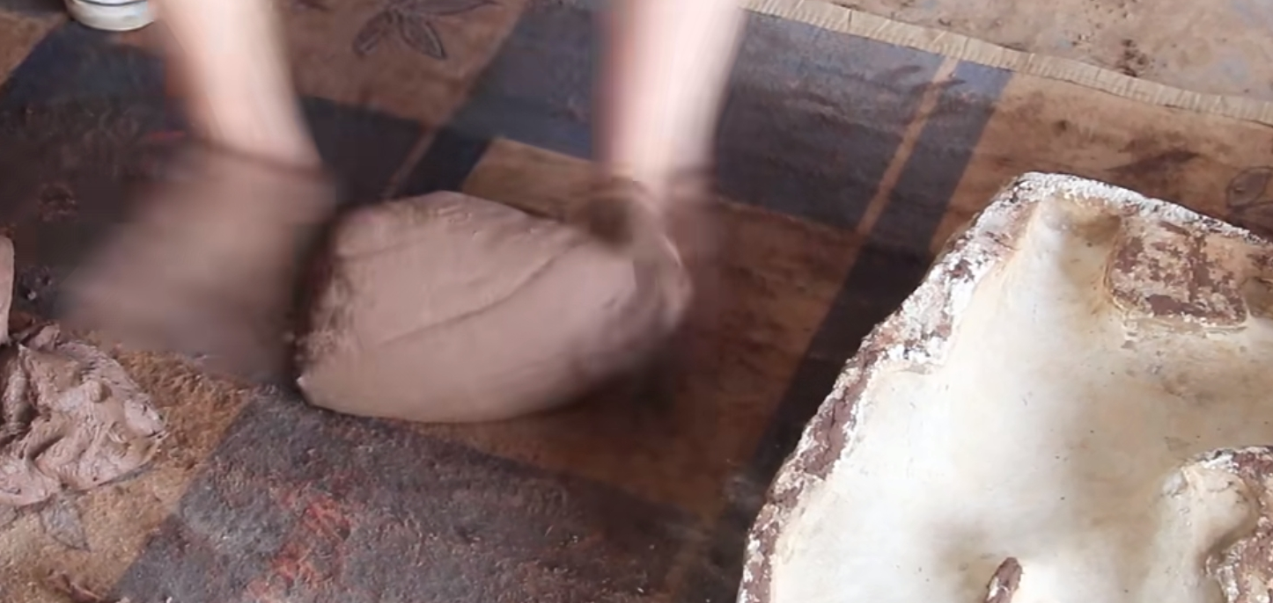
Techniques and Processes
1. Making the original model
制子儿

Slide 9
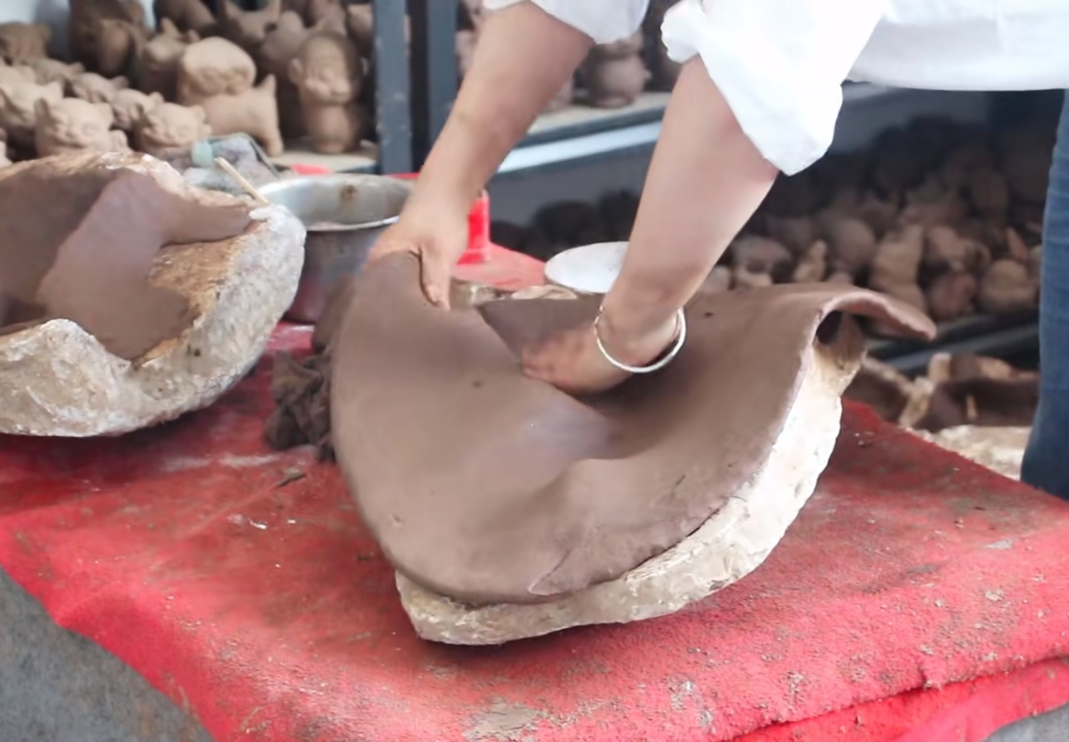
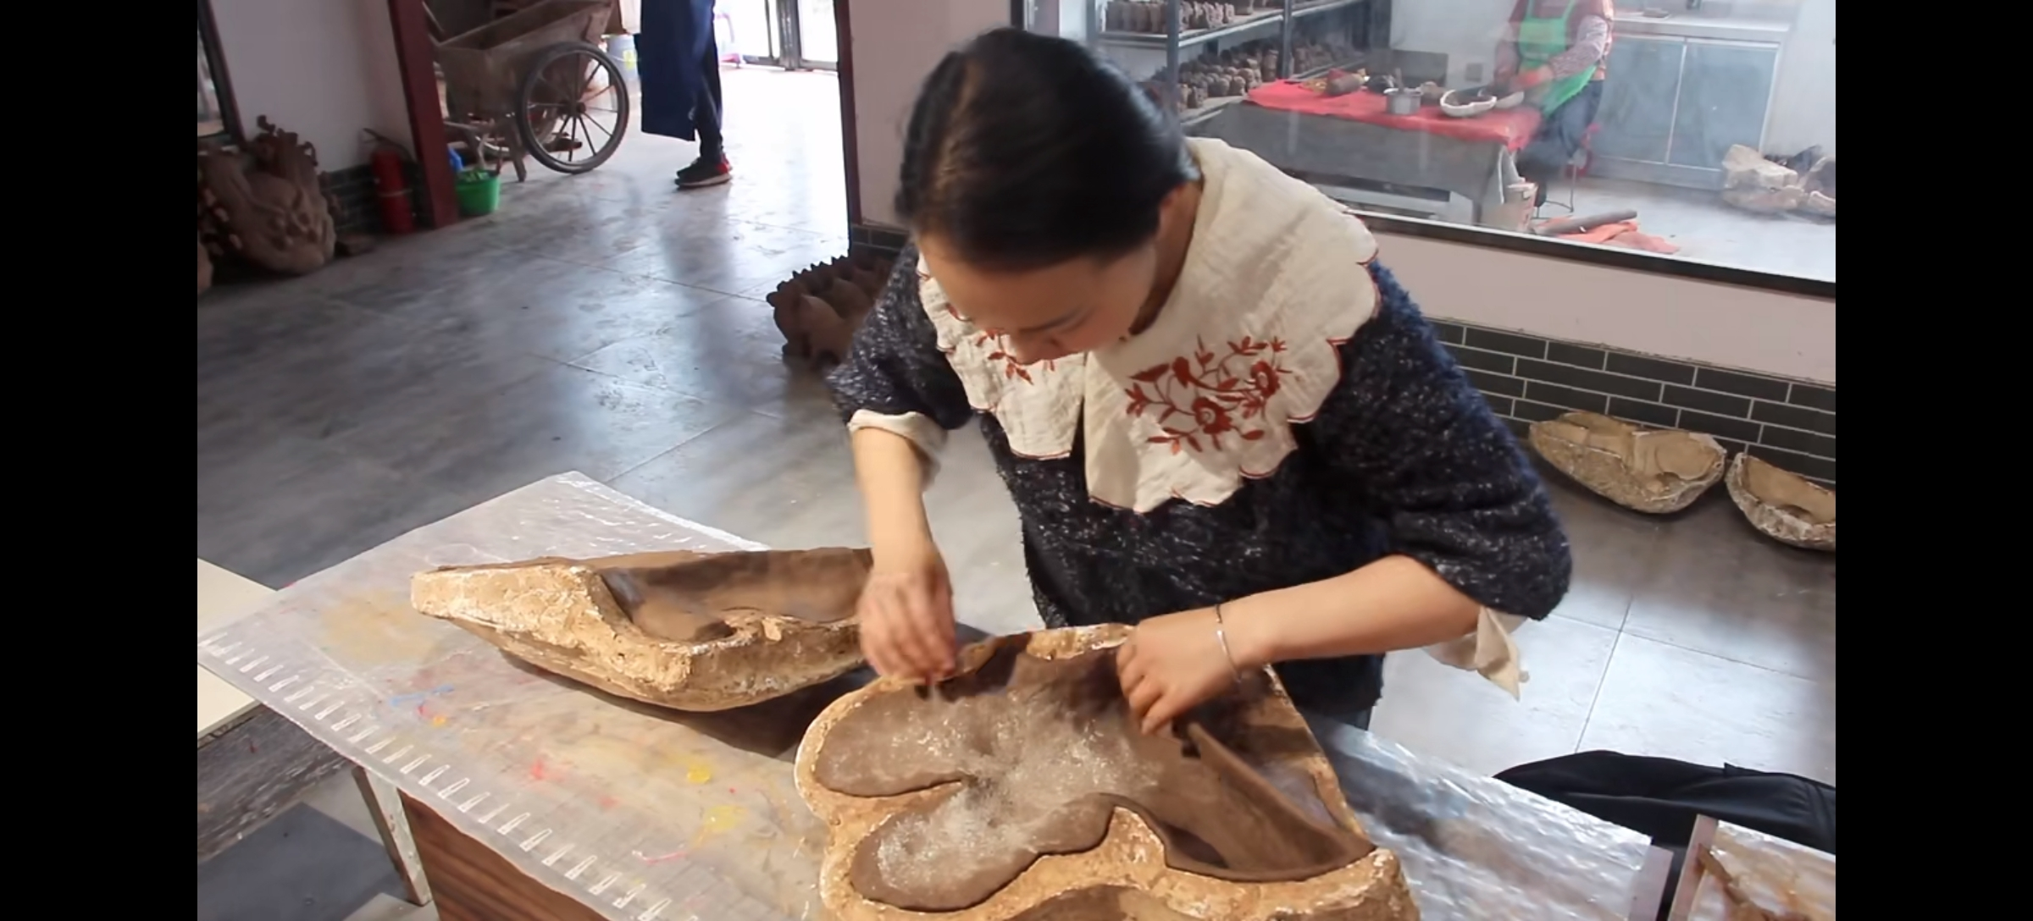
2. Mold-making翻模

Slide 10
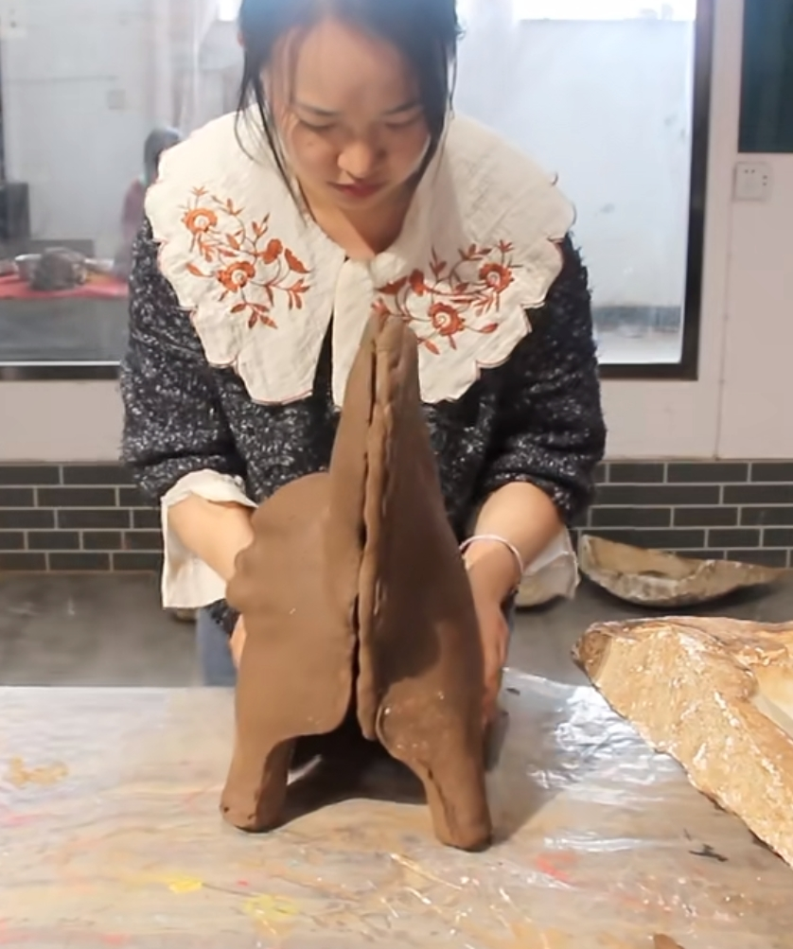
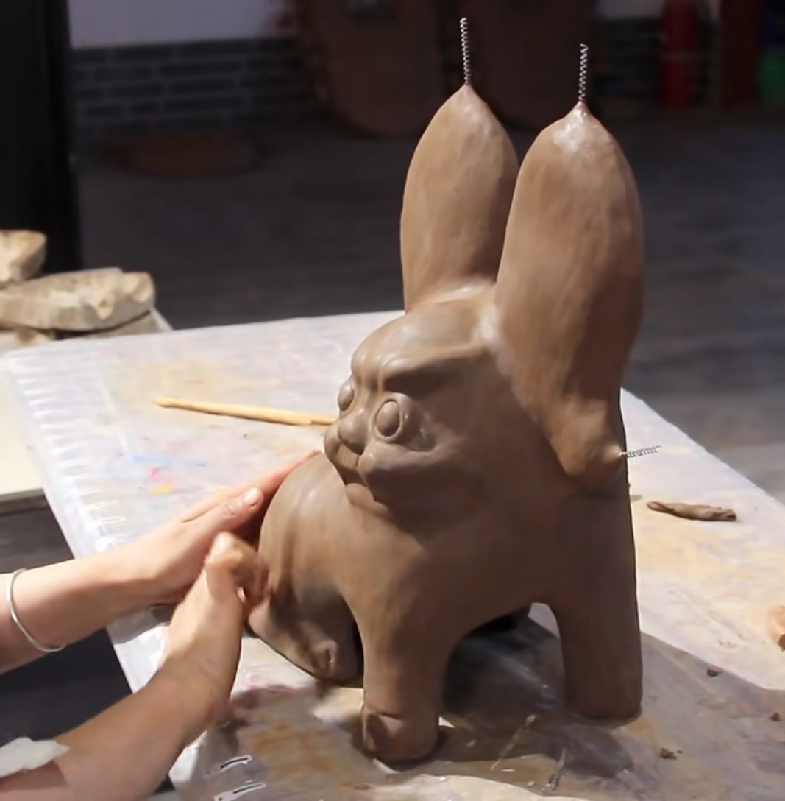
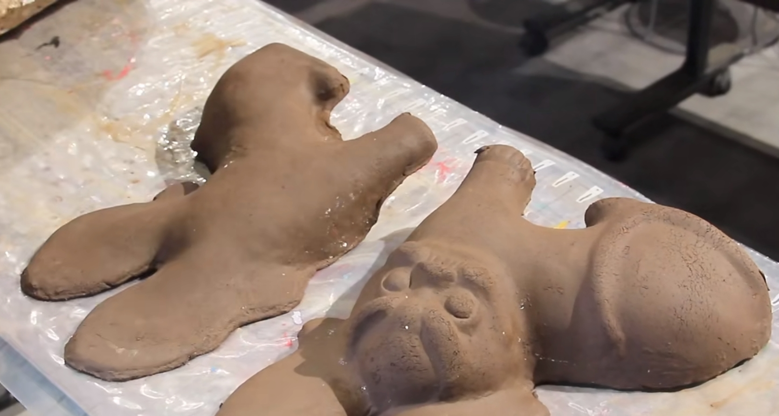
3.Creating the clay prototype脱胎

Slide 11
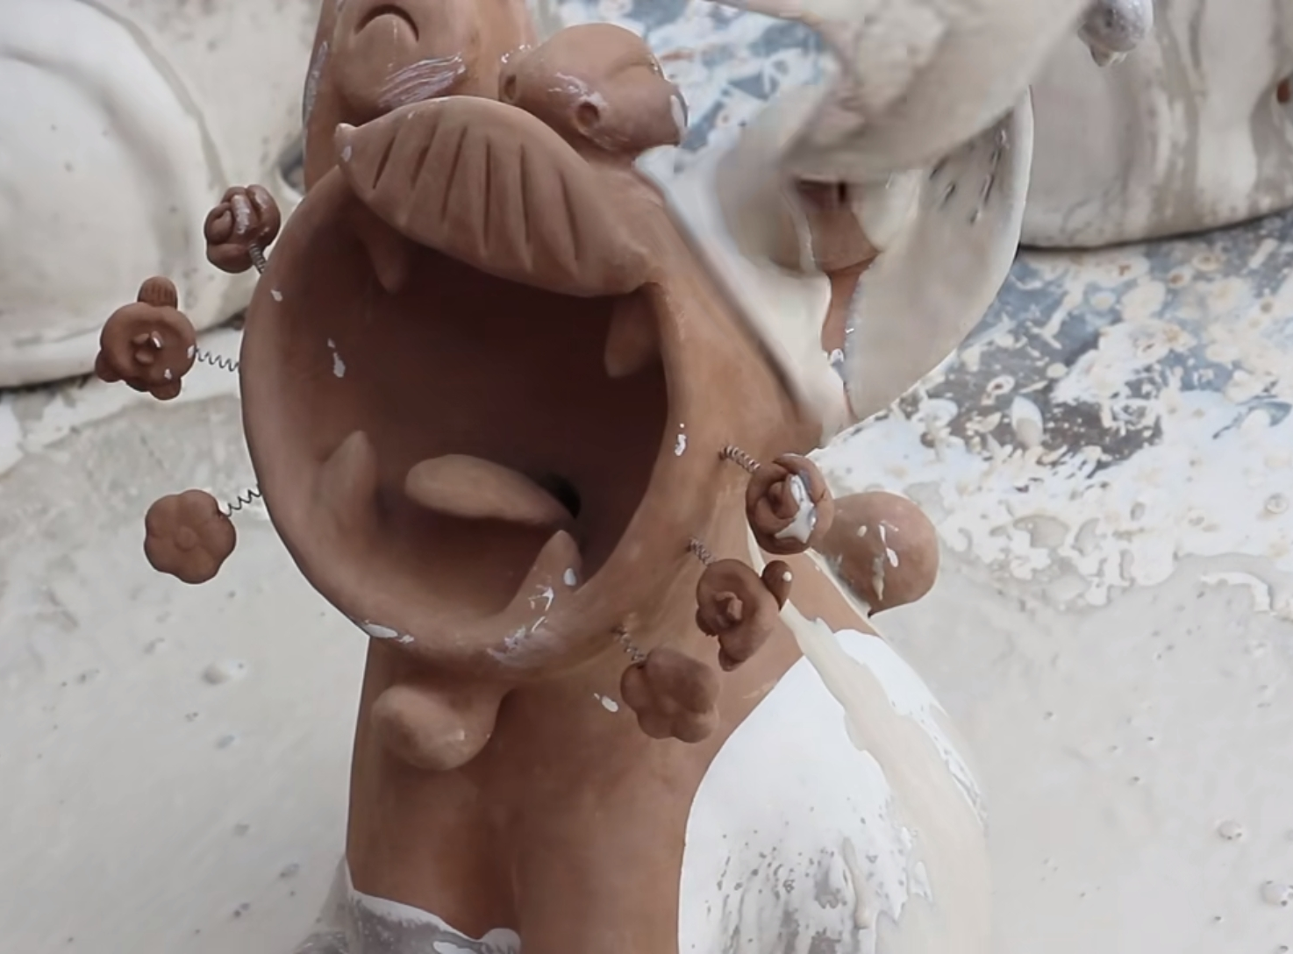
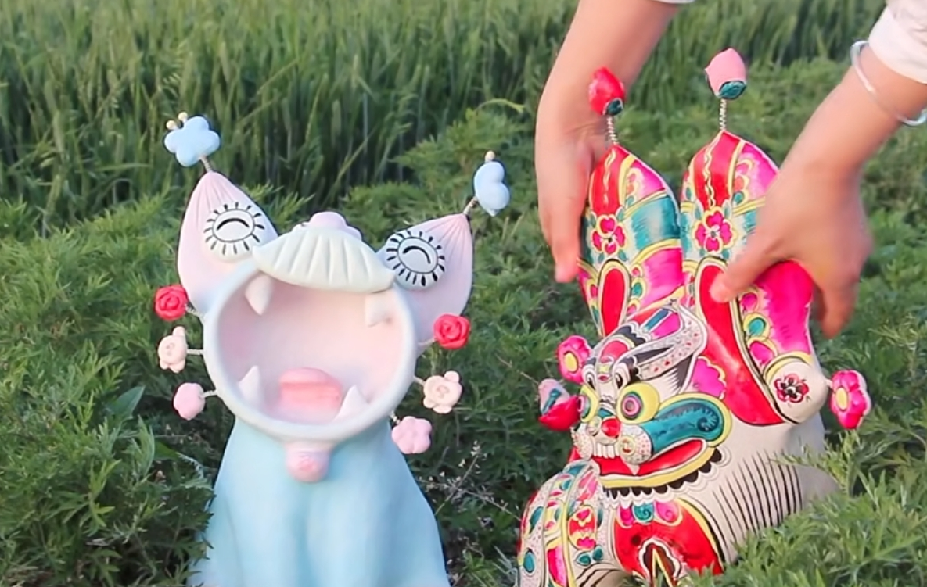
4. Coloring着色

Slide 12
03
“
Conclusion
Notes:
Clay sculpture is a traditional Chinese folk art that primarily uses clay as its material, creating a variety of figures through manual shaping and carving techniques. This art form has a long history, dating back to the Neolithic period. The process of making clay sculptures includes four steps: making the original model ,mold-making, creating the clay prototype, and finally, coloring, which involves painting the clay sculpture. The works are rich in color and vivid in form, serving not only for artistic creation and cultural heritage but also widely used in religious ceremonies and architectural decoration. Additionally, clay sculptures often serve as decorative pieces, temple statues, children's toys, or as gifts. This art form is widespread across China, with a history of thousands of years, and is a very important form of folk art for the Chinese nation.

Slide 13
“
”
Thanks
主讲人：
陈琳
时间：
2025.5.6

