Slide 1
Money in China

Slide 2
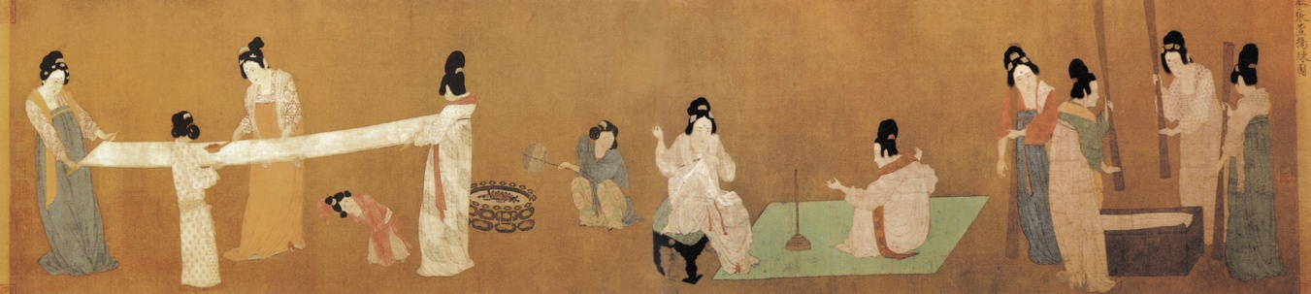
Used silk and grain at first as a way to exchange goods.

Slide 3
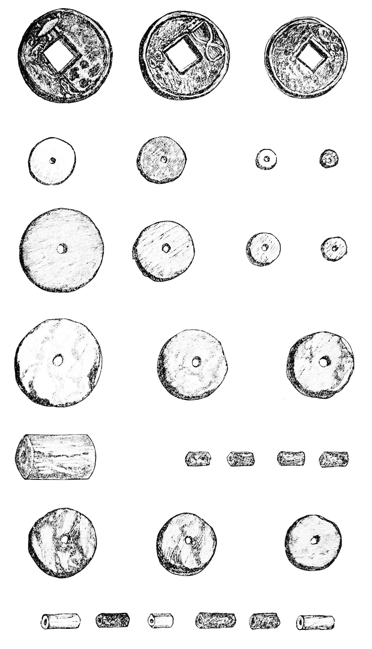
Most dynasties created their own coins. Coins were made from different metals and of different thicknesses.

Slide 4
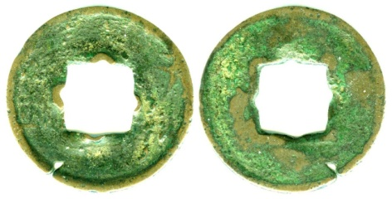
Song Coin
Commonly, these coins were put on a string to wear on the body. Some, like the one below, were put on a square rod.

Slide 5
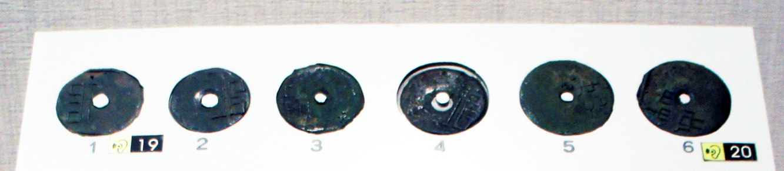
Wei Coins

Slide 6
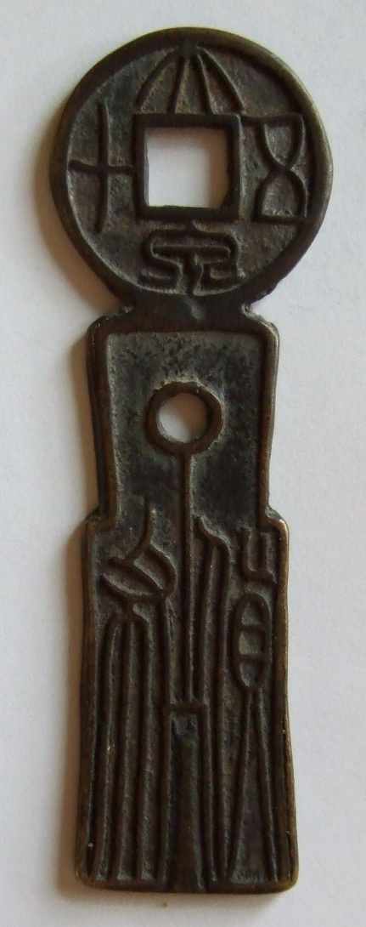
Xin Dynasty Coin
Early coins were made in the shape of knives and spears
P 42

Slide 7
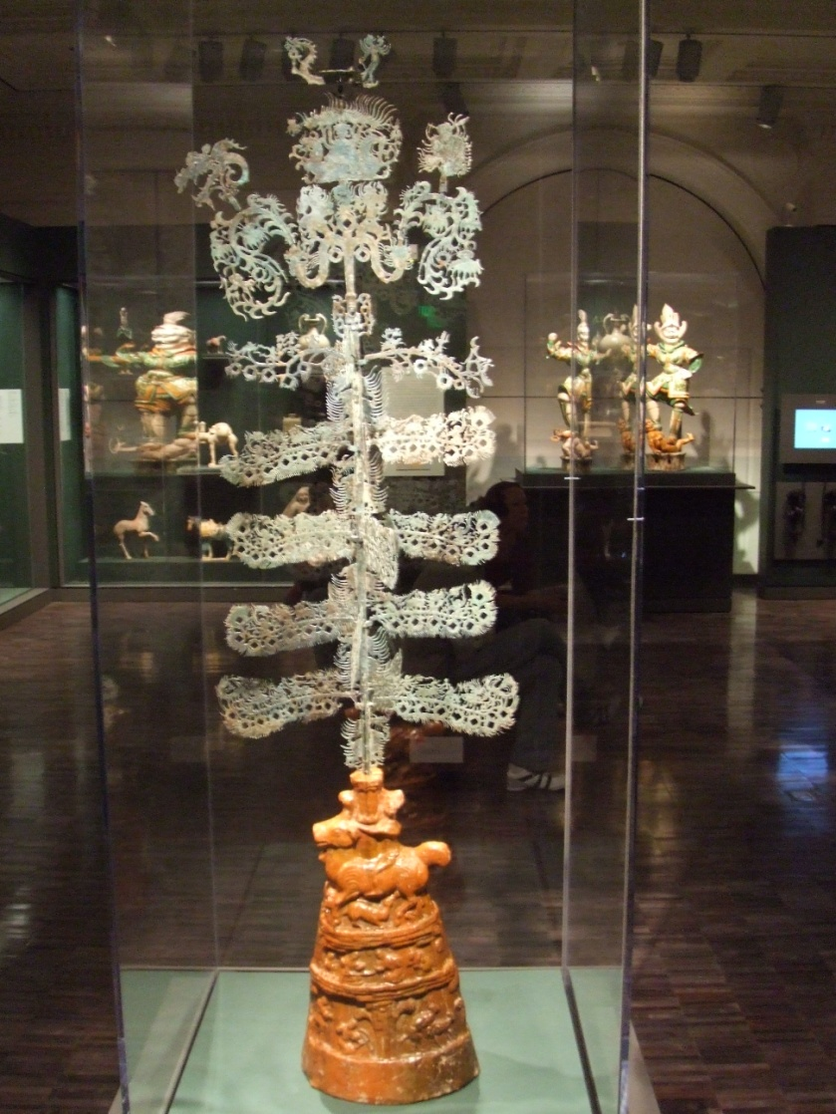
1120- Song empire started using paper money instead of coins.
Worlds first government paper money system.
Credit became more available through money-lenders, brokers, wholesalers, and warehousemen.
Money tree
From Han Dynasty

