Slide 1

拼多多
Buy Together

Slide 2


Amazon VS Pinduoduo
a giant, serious,
air-conditioned supermarket
a chaotic, fun, incredibly loud night market

Slide 3
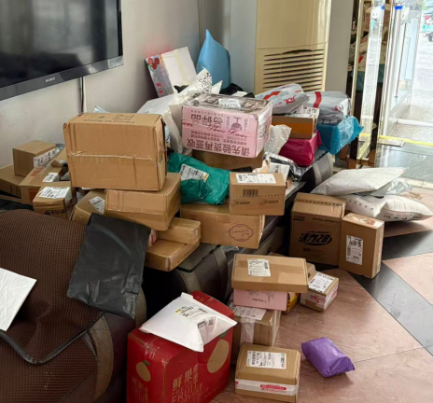
The app understands a fundamental human truth:
We all love a good bargain

Slide 4

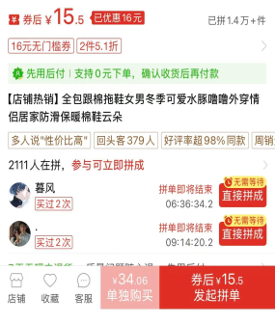
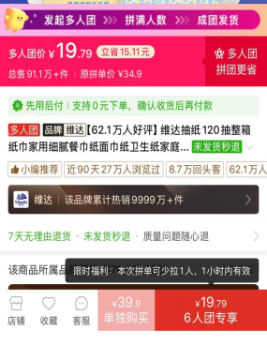
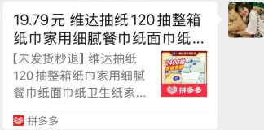
Team up
Save more
拼着买，更便宜
parents
friends
ex-boyfriend or ex-girlfriend

Slide 5
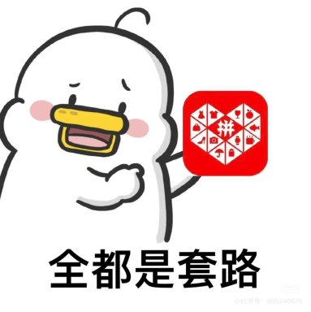
The real killer feature
But the real killer feature, the one that makes Pinduoduo's downloads explode in a viral frenzy, is the function that the entire nation has a love-hate relationship with—the "Cash Reward" game.

Slide 6

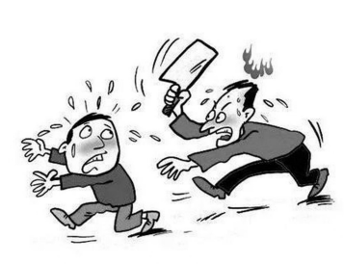
What is “Help me ‘砍一刀’Pinduoduo?”

Slide 7
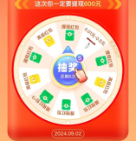
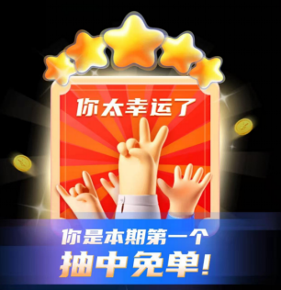
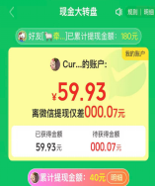
The logic of this feature is a masterpiece of social engineering. It tells you, "Get a new user to help you 'cut' the price, and you can get this air fryer for free!" or "Share with friends to 'cut' the price and withdraw 100 yuan directly!"
And so begins a massive online "begging" session. You send the link not just to close friends and family, but also to that elementary school classmate group chat that's been silent for years, your gym check-in group, even your neighborhood property management chat. To get that last few cents, you'd practically stop a stranger on the street and ask them to download the app on the spot.

Slide 8

First, it leverages our strong-tie networks. To help you "cut the price," your family, coworkers, and best friends—your closest circles—get roped in. They became Pinduoduo's first wave of "seed users."
So, how does this "cut the price" game allow Pinduoduo's user base to snowball so massively?
The answer lies in how it precisely leverages two huge user groups:
Second, and more crucially, it leverages a network of weak ties and even no ties—what we often call the "lower-tier market."

Slide 9
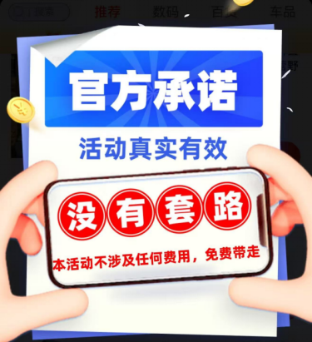
Pinduoduo isn't just an app; it's a social experiment wrapped in a shopping addiction. It's chaotic, it's clever, and it proves that when it comes to "getting a steal," human social potential is limitless.

Slide 10
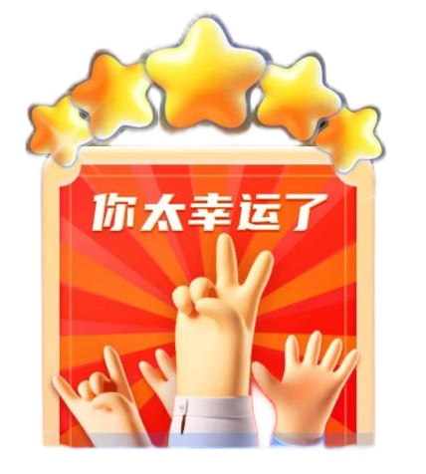
Thank you!
Hope everyone can face life positively and be optimistic, because Pinduoduo said we are the luckiest people.

