Slide 1


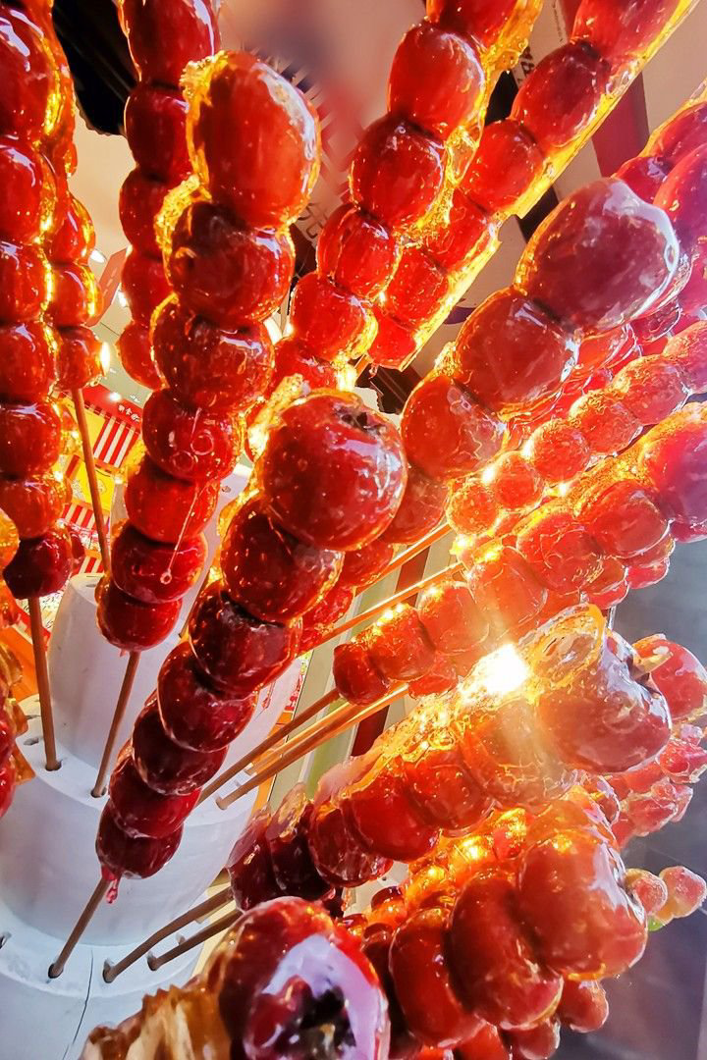


Tang hulu
Jiang Luyun

Slide 2
contents
Origin And Development of Tang hulu
Making Ways And Types of Tang hulu
Advantages And Disadvantages of Tanghulu
Chinese Culture in Tang hulu

Slide 3

章节一
Origin And Development of Tang hulu

Slide 4
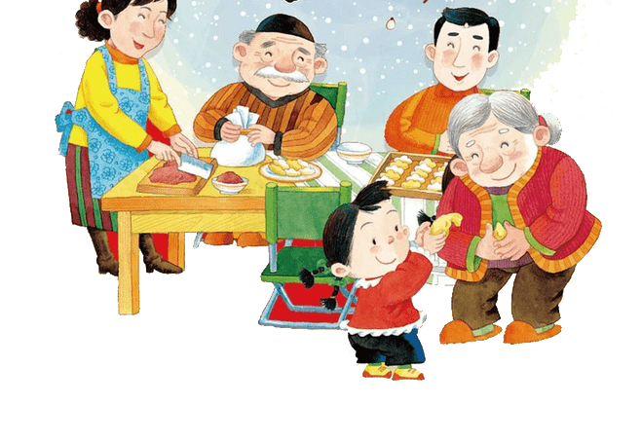
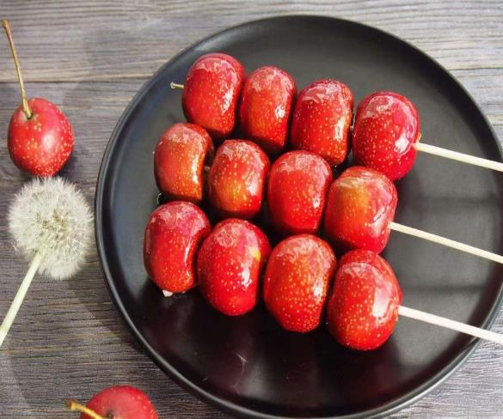
What is Tang hulu?
It is a traditional Chinese food or called snack,which is also called sugar calabash, sugar pier, it is popular in Tianjin, Beijing.It is usually a string of wild fruits with bamboo sticks and the most common is sugar-coated haws on a stick.

Slide 5
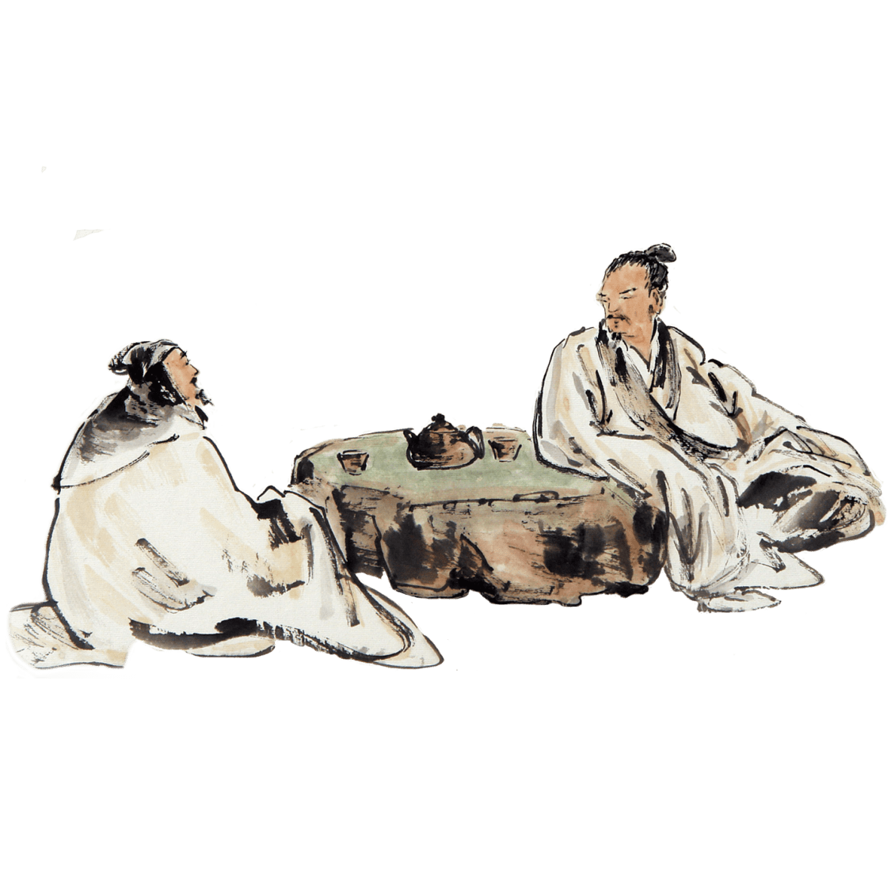
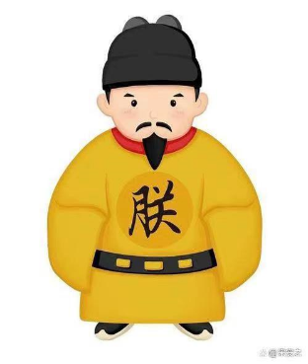
Where is it from?
one story of its origin
It is originated in the Southern Song Dynasty.
Later, this practice spread to normal people, and
they put the ingredients together to sell, which became Tanghulu
eventually.
Zhao Dun search for Tang hulu to pet concubine
Emperor of the Southern Song Dynasty was named Zhao Dun. During his reign, his favorite concubine, Huang Guifei, fell ill. She had a sallow complexion and refused to eat or drink.
Finally he had no choice but to seek medical advice. A quack came to the palace and felt her pulse. He said, "As long as you use rock sugar and red fruits (that is, hawthorn) to torment, eat five to ten before every meal, you will get well in half a month. " At the beginning they were suspicious, but this kind of eating also fits the taste of the concubine. She followed this method and, as expected, recovered from the illness.

Slide 6

章节二
Making Ways And Types of Tang hulu

Slide 7
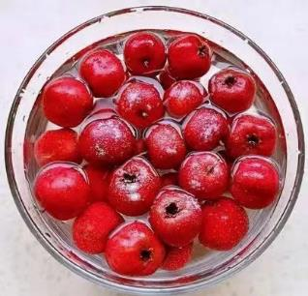
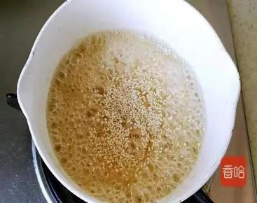
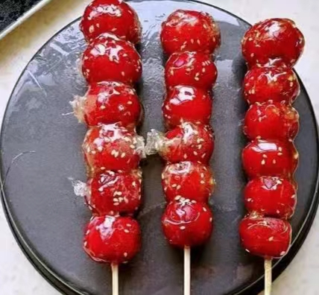
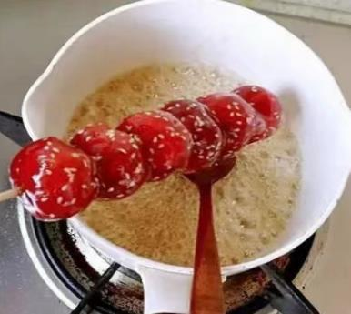
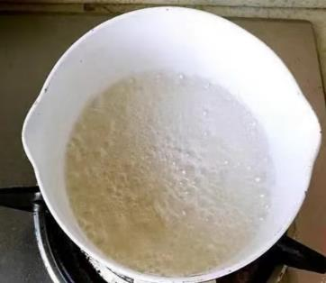
making ways of Tang hulu
Steps
String fruit
Boil sugar
Dip in sugar
cool it for two or three minutes on the water board which refers to the smooth wood
tips
The heat of boiling sugar is the most critical.
The color of alright boiled sugar should be pale yellow and slightly brushed.
We should put the syrup onto the sugar gourd instead of throwing the gourd into the pot directly.

Slide 8
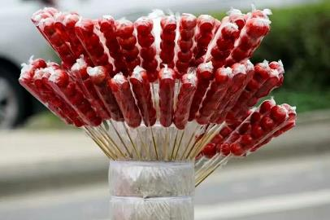
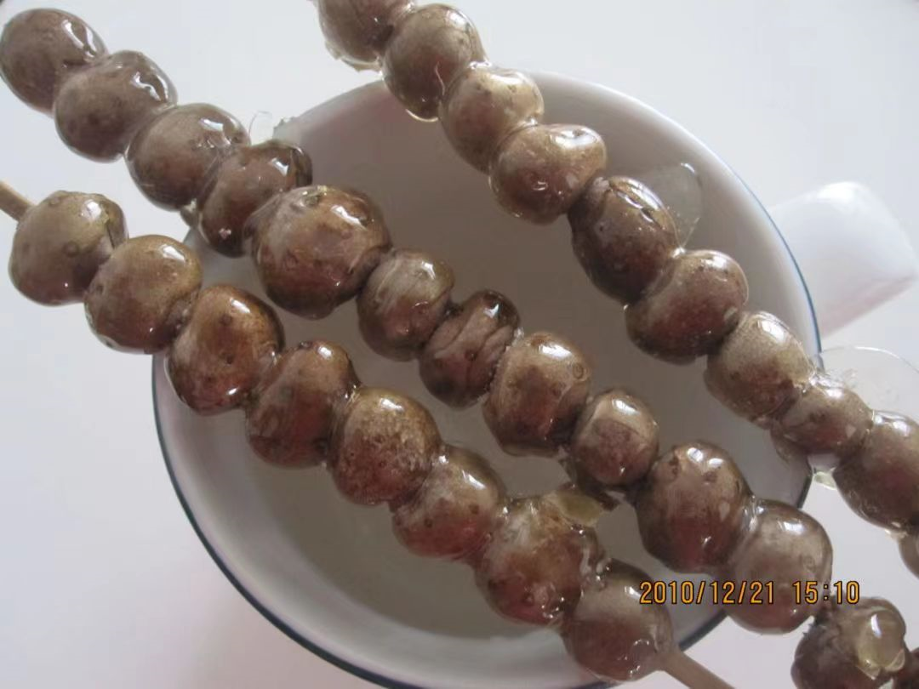
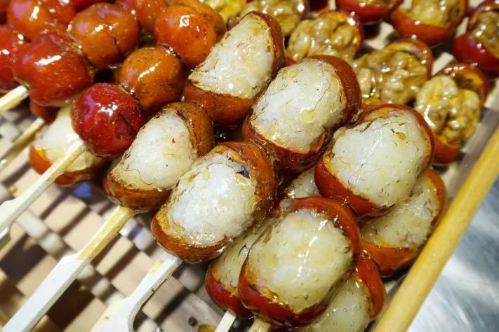
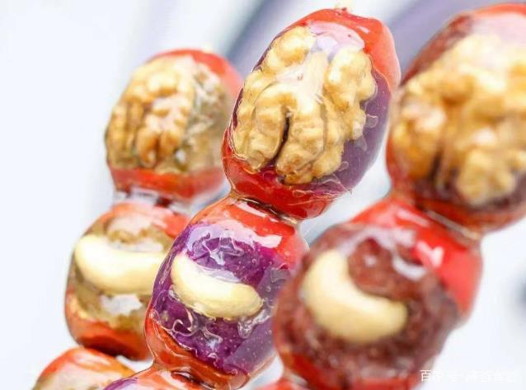
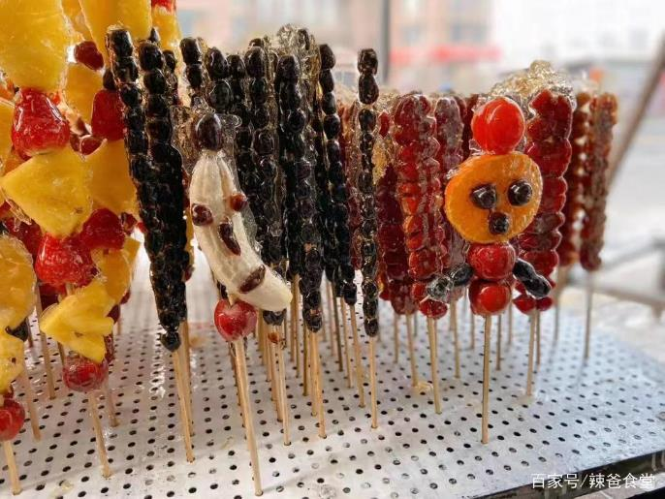
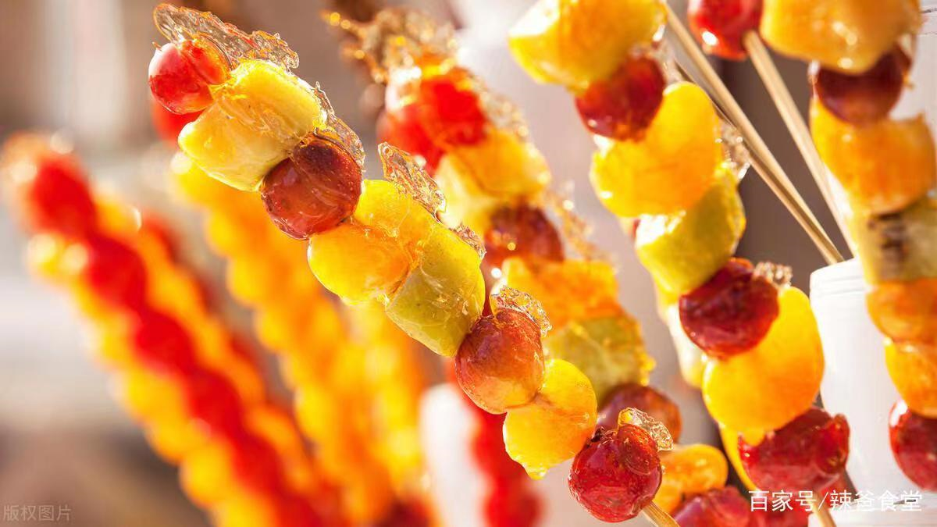
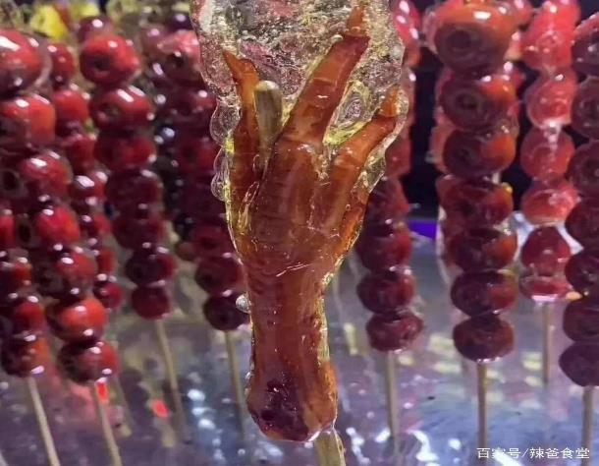
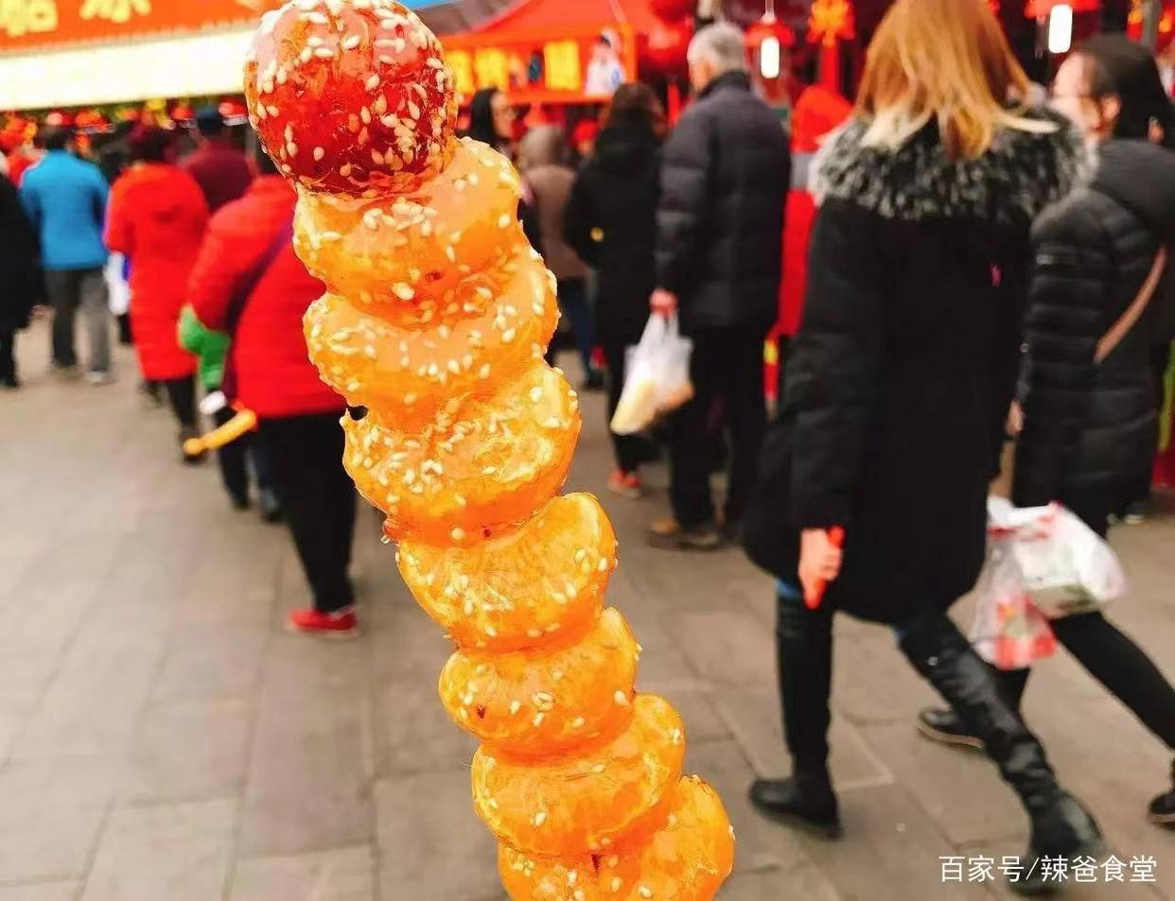
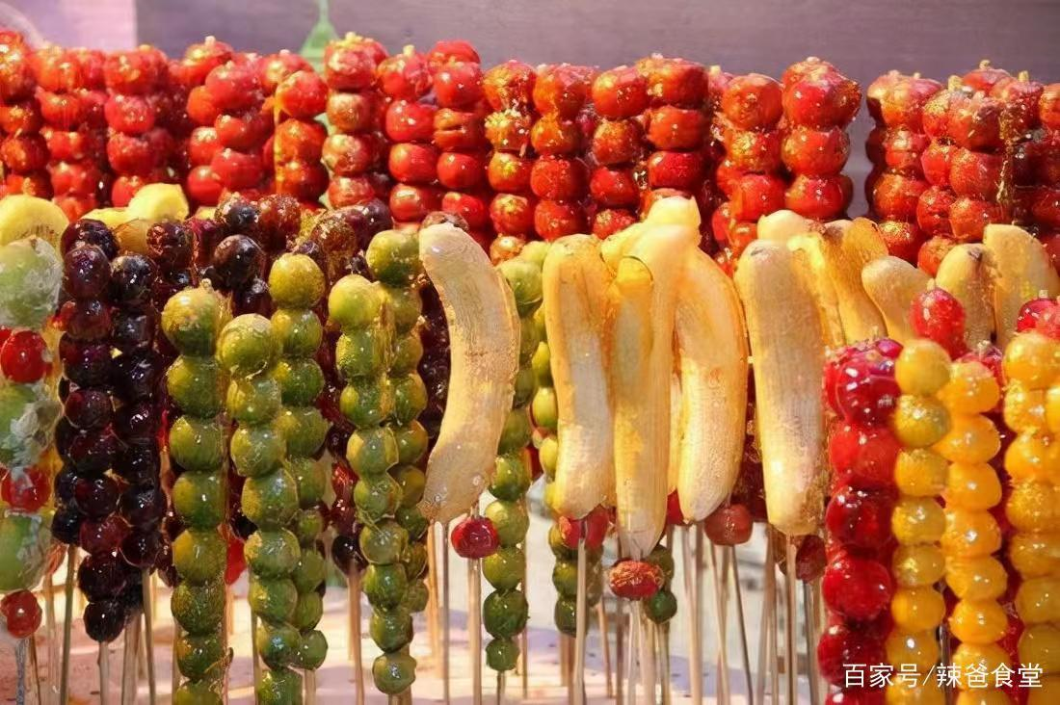
types of Tang hulu
Tang hulu have different selling forms,different inner materials, different tastes popular in different places.
Famous Shops selling Tanghulu: "Fountain of Youth", "Nine Dragons Garden", "Xin Yuan Garden" and "Quan Fu De"(“不老泉”、“九龙斋”、“信远斋”、“全福德”).
selling forms
street cries for selling Tang hulu,usually holding a stick with Tang hulu stuck in it
e.g.
sweet gourd with yam
sweet gourd with sticky rice
sweet gourd with black dates
sweet gourd with fruit,such as orrange,banana,strawberry
sweet gourd with nuts
sweet gourd with chicken feet
inner ingredients

Slide 9
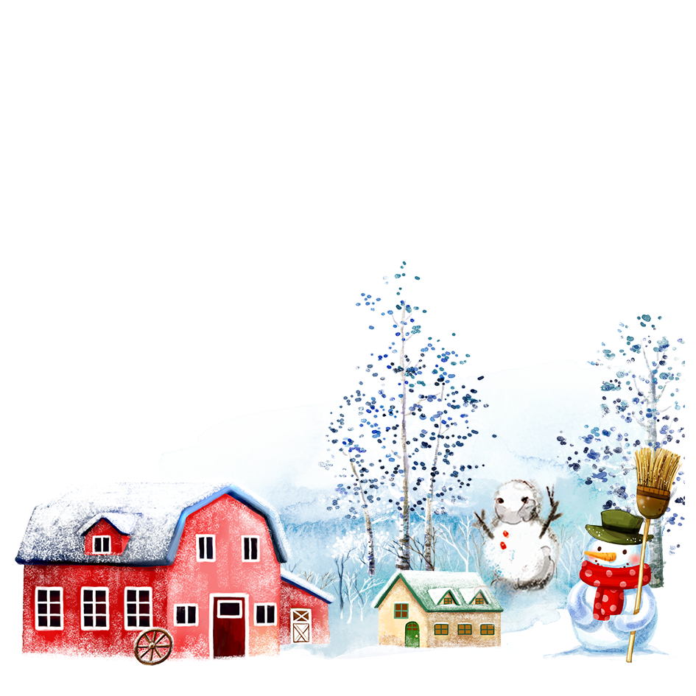
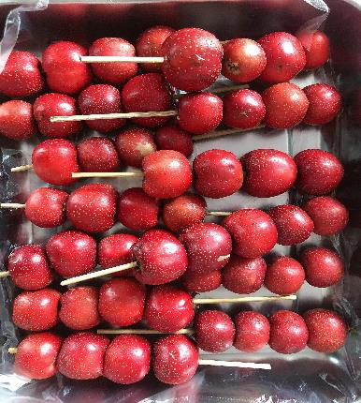
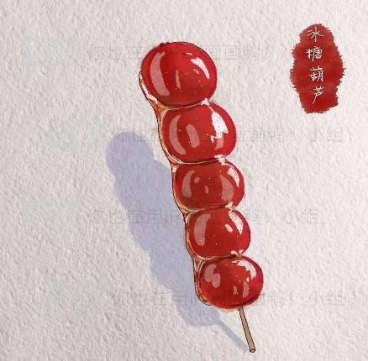
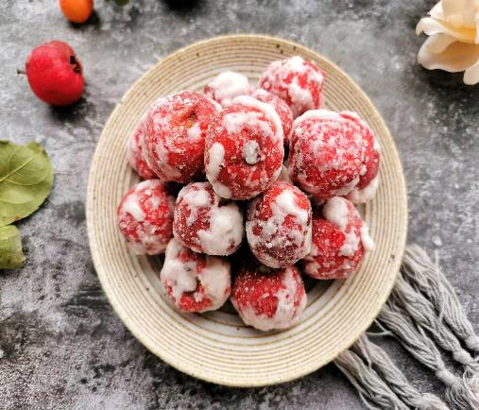
节日PPT模板 http://www.1ppt.com/jieri/
types of Tang hulu in Beijing
One is made of maltose, which is called Tangxi in Peking dialect.(糖稀，山里红大糖葫芦）
One is pasted with white sugar and then cooled with a layer of white frosting.（白糖霜糖葫芦）
The most authentic one is only a thin layer of sugar with a variety of materials including begonias, yam, yam beans, dried apricots, grapes, oranges, water chestnuts, walnuts and of course hawthorn.（冰糖葫芦，薄薄一层糖）

Slide 10
章节三
Advantages And Disadvantages of Tanghulu

Slide 11
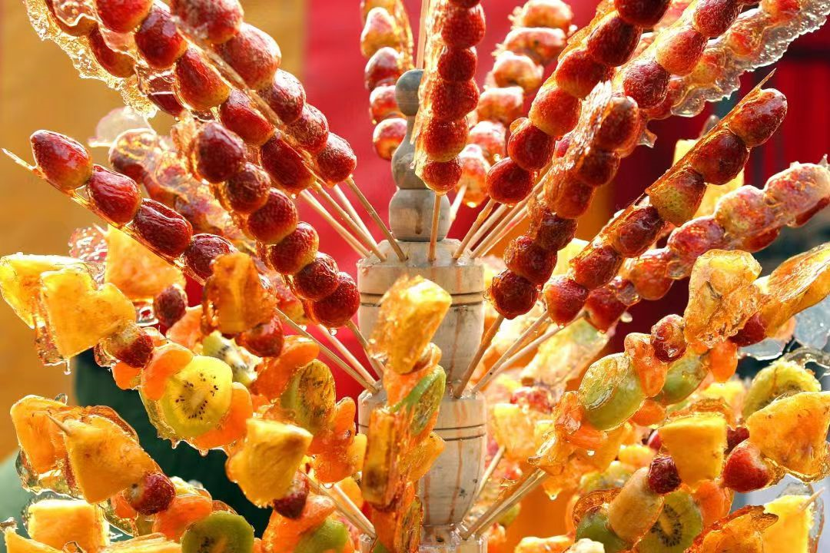
pros and cons of Tang hulu
pros
taste:sweet mainly
nutritional value
Tanghulu is rich in vitamin C, pectin, chlorogenic acid, caffeic acid, hawthorn acid,other organic acids and nutrients.
medicinal value
eliminating food accumulation, dispersing congestion, driving tapeworms, stopping dysentery, especially helping digestion,reducing blood lipid and serum cholesterol
cons
Not all people are suitable for long-term consumption.Because of its sugar content, diabetes patients should be cautious.
People with a weak spleen and stomach or suffering acid heartburn should not eat too much hawthorn too.
happy,joyous,relieving our mood,increasing our appetite

Slide 12
章节四
Chinese Culture in Tang hulu

Slide 13
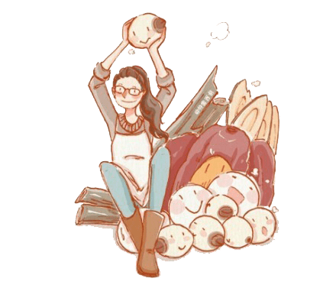
culture in Tang hulu
implied meaning
The shape of round symbolizes reunion and happiness.
Hulu homophones "fulu", which means auspiciousness and wealth.
The sweet taste means a sweet life.
Red means prosperous and happy days.
The sweet outer and the bitter inner means a Chinese spirit of pleasure in pain and the essence of life--pain mixed with pleasure.

Slide 14
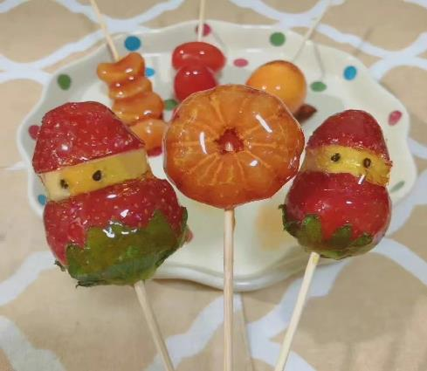
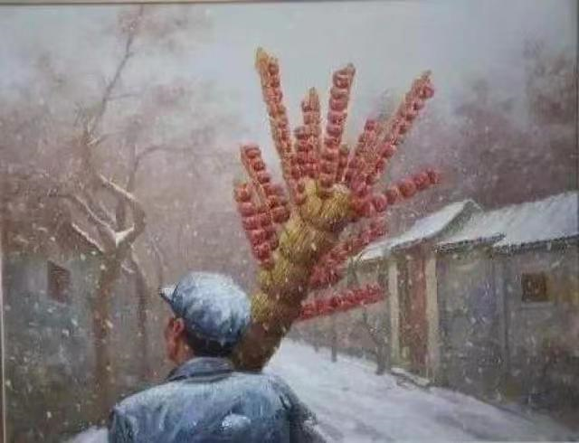
culture in Tang hulu
in conclusion
As a food
The appearance of a kind of food actually brings together the cultural elements of a place, such as ethnic groups, beliefs and customs.
As a complex and symbolic meaning
A kind of respect for ancestors and history
emboding the creativity and imagination of Chinese food
expressing people's yearning and appeal for a better life

Slide 15
thanks！

