Slide 1


A Study on the Translation Strategies of Chinese Idioms
English interpretation
Liu Yaqin 刘雅琴
English Translation
Zhang Ting 张婷

Slide 2


CONTENTS
01
Definition of idioms
02
Origin of idioms
03
Translation strategies

Slide 3


Lead in
What are Chinese idioms?
谚语
习语
熟语
成语

Slide 4


Definition of idioms
PART.01

Slide 5

Definition of idioms
Chinese idioms are a kind of long-used fixed phrases unique to the ancient Chinese vocabulary.(Chinese Language and Culture)
It includes four character phrases 、proverbs、allusions、allegorical sayings etc..

Slide 6
Origin of idioms
PART.02

Slide 7
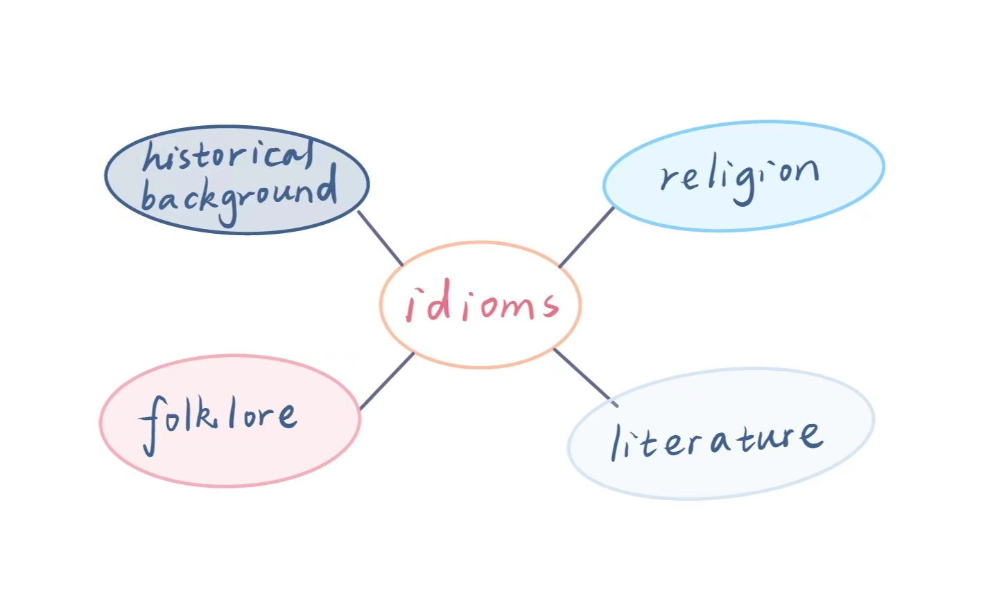
Origin of idioms
Fixed structure
Number-fixed words
Integrity of meaning

Slide 8

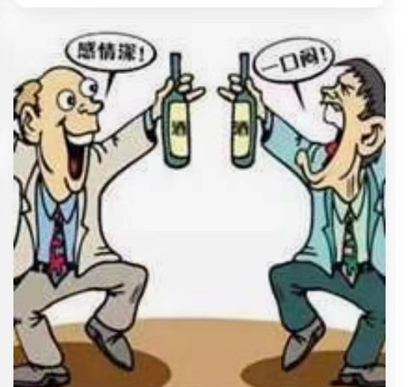
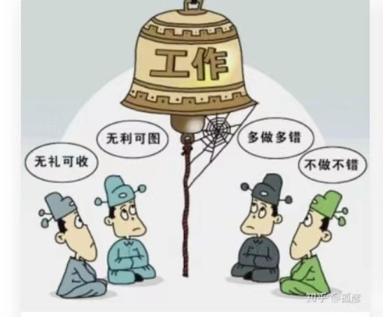
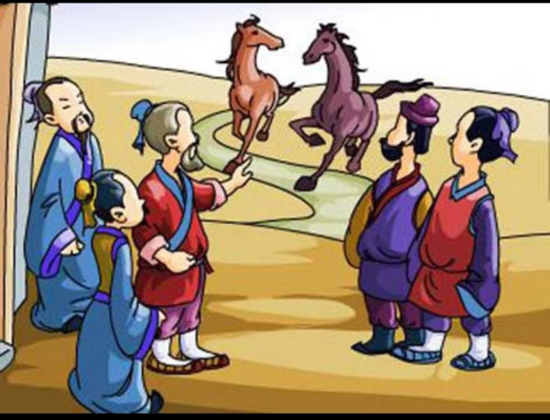
Examples
狼烟四起
狐朋狗友
做一天和尚撞一天钟
塞翁失马焉知非福
Smoke from wolf
Bad friends
To do the least that is expected of one
A blessing in disguise

Slide 9

Interactive activity
When the music starts, pass the note to the person behind you. When the music stops, stop passing the note. The person holding the note needs to translate the Chinese idiom into English and the person next to him or her guesses which Chinese idiom he or her is translating.
CYBER PUNK

Slide 10
Interactive activity
活到老，学到老
It is never too old to learn.
爱屋及乌
Love me, love my dog.
冰冻三尺，非一日之寒
Rome is not built in one day.

Slide 11
Translation strategies
PART.03

Slide 12
01
Literal Translation
02
Free Translation
Translation strategies
03
Domestication
04
Foreignization

Slide 13
As for words
Section A

Slide 14

Literal translation and free translation
Literal translation
Free translation
word-for-word
sense for sense
direct translation
Translation according to meaning

Slide 15
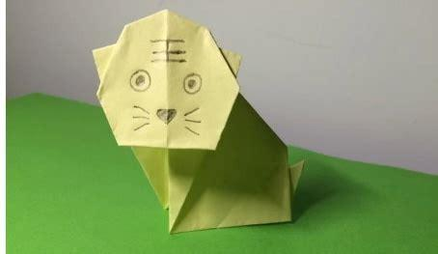
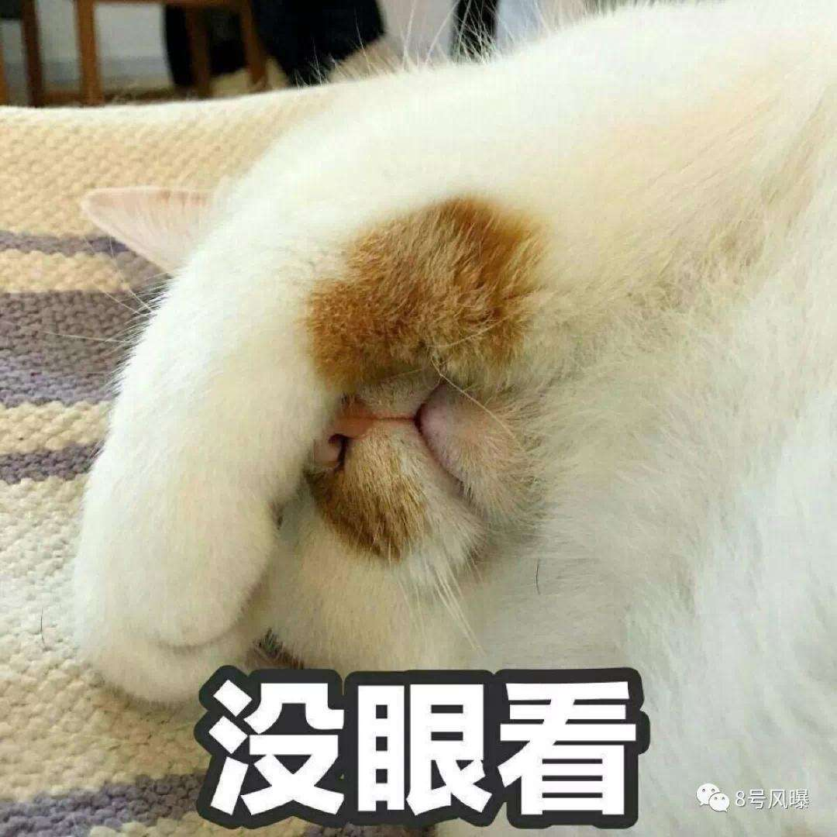
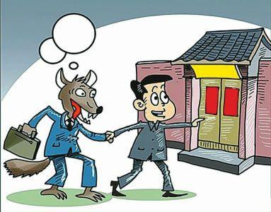
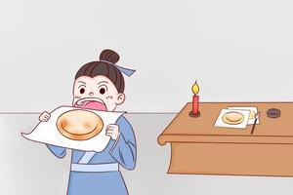
Literal translation
纸老虎
丢脸
引狼入室
画饼充饥
paper tiger
lose face
to lead a wolf into the house
to draw cakes to allay hunger

Slide 16
can we translate them literally?
眉飞色舞
粗枝大叶
无孔不入
扬眉吐气

Slide 17
•眉飞色舞
•His eyebrows are flying and his countenance is dancing
•To beam with joy
•粗枝大叶
•With big branches and broad leaves
•To be crude（rough，coarse）and careless
•无孔不入
•To get into every hole
•To take advantage of every weakness
•扬眉吐气
•To raise the eyebrow and let out a breath
•To feel proud and elated

Slide 18

Tips
Literal translation
Wether the meaning,image, rhetoric and national characteristics of the original idiom are preserved ?
Free translation

Slide 19
As for culture
Section B

Slide 20

In 1995, Lawrence Venuti has put forward the translation strategies: domesticating translation &
foreignizing translation in The Translator’s Invisibility: A History of Translation

Slide 21

Domestication
(归化)
Foreignization
(异化)
moves the author towards reader
target language-reader centered
moves the reader towards author
source language-reader centered
Advantage:
Smoothness
Esasily accepted by TR
Advantage:
Retaining the original flavor
of ST

Slide 22
Choose
竭泽而渔
• To drain a pond to catch all the fish
• Kill the goose that lays the golden eggs
打草惊蛇
• Wake a sleeing dog
• To stir up the grass and alert the snake
易如反掌
•As easy as turning over one’shand
•As easy as falling off a log

Slide 23
Reference
[1] Martin Woesler. Chinese Language and Culture. European University Press, 2022.
[2]于薇薇,徐钟.IDIOM是译成“成语”,还是“习语”?[J].上海翻译,2005(03):56-58.
[3]王小妹.论“idiom”一词的翻译[J].郑州航空工业管理学院学报(社会科学版),2007(03):111-112.
[4]杜彬. 归化与异化翻译策略下的汉语习语英译研究[D].吉林大学,2010.
[5]吕冰. 文化视角下的习语翻译研究[D].山东大学,2010.
[6]唐慧.英汉习语的文化差异及翻译策略探讨[J].文化创新比较研究,2021,5(22):151-154.
[7]王珈唯.英汉成语对比及其翻译策略[J].才智,2014(25):304-305.
[8]张默. 归化异化法视角下习语翻译探析[D].山西大学,2019.
[9]刘静. 从文化角度看习语翻译策略[D].山东大学,2006.

Slide 24
Thank you
bye bye

