Slide 1

The Evolution of Chinese Calligraphy
Wang Fangling
202270081696
October18,2022
Hunan Normal University

Slide 2
1
A Brief Overview on History of Chinese Calligraphy
2
Characteristics of Chinese Calligraphy
3
Influences of Calligraphy
4
Calligraphy Today

Slide 3
1. A Brief Overview on History of Chinese Calligraphy
1. It begins with hieroglyphs.
2. It is generally divided into five categories:
Seal script (篆书; Zhuanshu)
Clerical (or Official) script (隶书; Lishu)
Regular script (楷书; Kaishu)
Running script (行书; Xingshu)
Cursive script (草书; Caoshu)
Qian, Z., & Fang, D. (2007). Towards Chinese Calligraphy. Macalester International, 18(1), 12.
Notes:
Chinese calligraphy, like script itself, began with hieroglyphs and, over time, has developed various styles and schools, constituting an important part of the national cultural heritage.
Chinese scripts are generally divided into five categories: Seal script, Clerical (or Official) script, Regular script, Running script, and Cursive script.

Slide 4
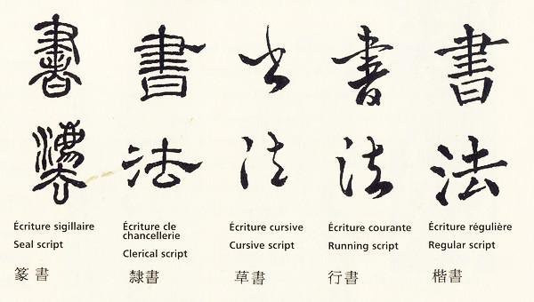
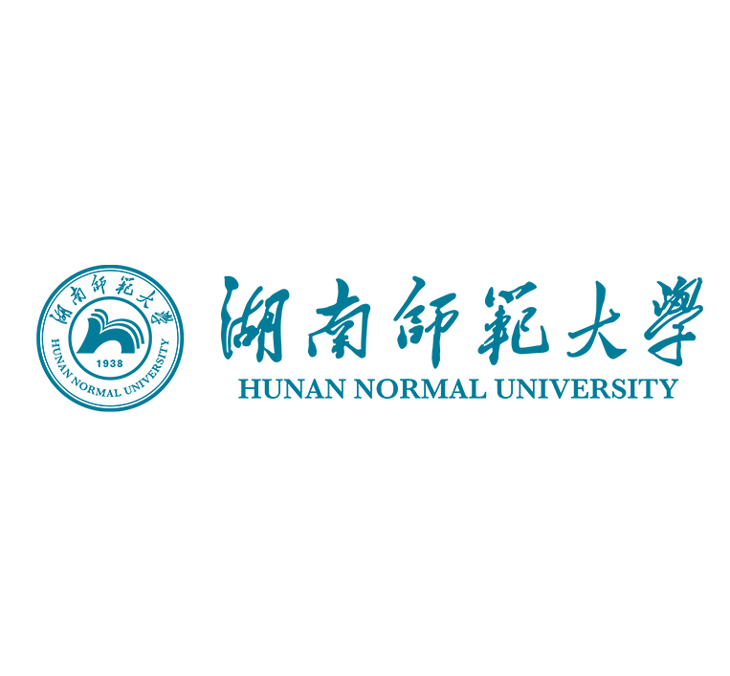
Examples of 5 categories:
https://www.quora.com/How-did-the-seal-script-evolve-into-the-clerical-script-We-can-easily-see-the-continuity-of-the-evolution-of-Chinese-calligraphy-but-seal-and-clerical-seem-so-different

Slide 5
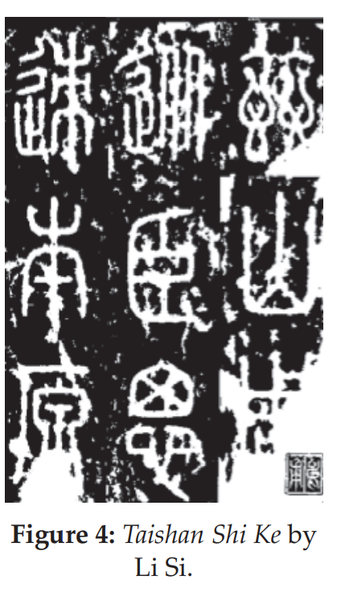
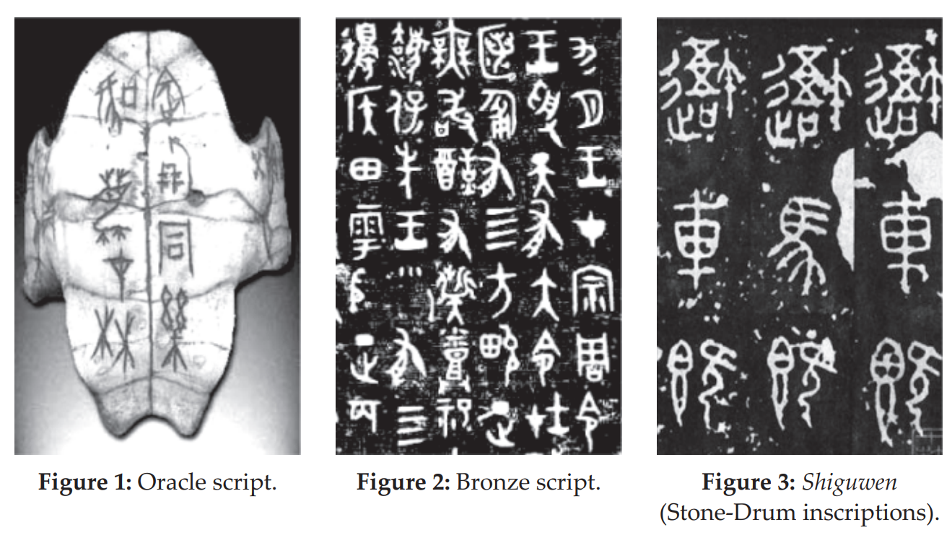
From prehistory to Xia Dynasty
Shang Dynasty-the Warring States Period
Qin Dynasty
01
02
03
picture-like symbols
appeared on ceramic vessels
showed ambiguous concepts without clear meanings
Oracle script (甲骨文; Jiagu Wen)
Bronze Script (金文; Jin Wen)
stone calligraphy works (石鼓文; Shigu Wen)
Small-Seal Script (小篆; Xiaozhuan )
Qian, Z., & Fang, D. (2007). Towards Chinese Calligraphy. Macalester International, 18(1), 12.
Notes:
From prehistory to Xia Dynasty: , instead of characters, the first calligraphy works were picture-like symbols. These symbols first appeared on ceramic vessels and only showed ambiguous concepts without clear meanings.
2. The Oracle script refers to the scripts carved by the ancients of the Shang Dynasty on tortoise shells and ox scapulas (shoulder blades), which are considered to be the earliest written language of China. The Shangs were a very superstitious people. Their rulers performed divination. After each divination, the dates, events, and results would be written down by carving on tortoise shells or bones.
3. During this period, inscription on bronze was another calligraphy form. This kind of calligraphy style is generally called Bronze script (Fig. 2). It was prevalent in the Zhou dynasty. Different from the Oracle script, these characters were created through casting a mold, instead of being engraved with a sharp instrument. Therefore, the strokes of the characters are much thicker
In the Zhou Dynasty, calligraphy works engraved on stones appeared, which later were popular in the Qin Dynasty. These stone calligraphy works were highly praised for their forceful strokes and structure. One of the most famous works is the inscription carved on the 10 Stone Drums, called Shiguwen (Stone-Drum inscriptions, see Fig. 3), the content of which praises the emperor of Qin. Shiguwen can now be seen in the Palace Museum in Beijing.

Slide 6
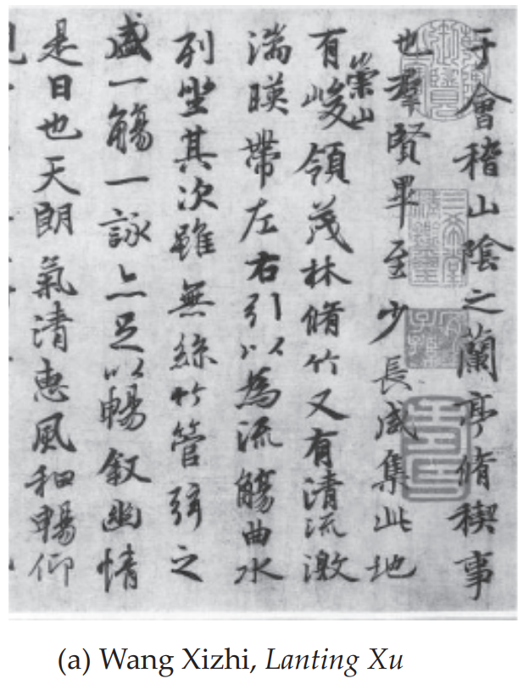
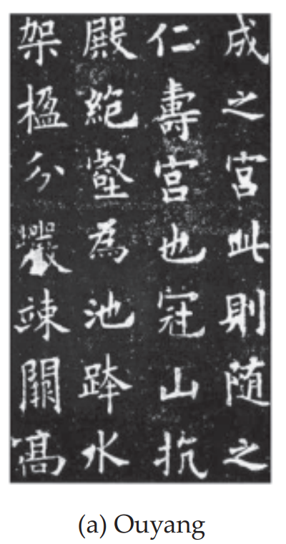
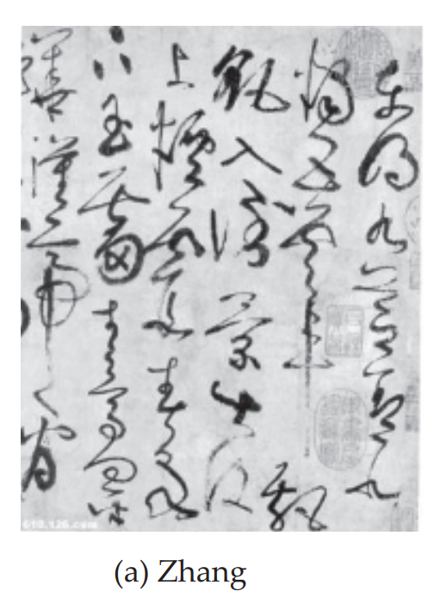
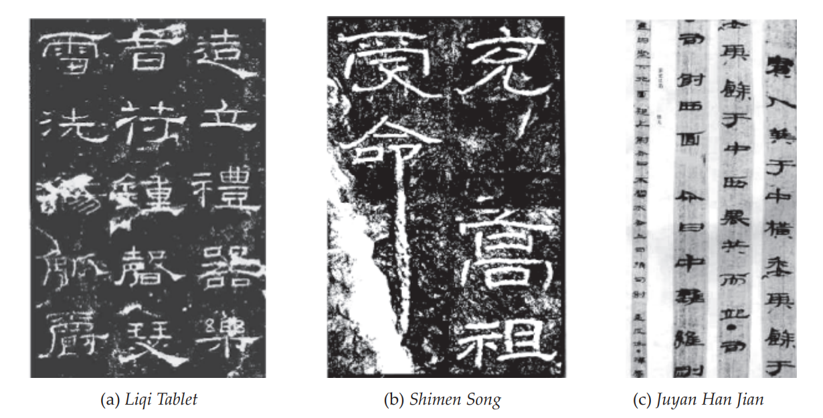
Han Dynasty
Wei, Jin, Southern and Northern Dynasties
Sui and Tang Dynasties
04
05
06
Three Kingdoms Period: Regular Script
Jin Dynasty: Running script
Regular Script (楷书; Kaishu)
Running Script (行书; Xingshu)
Cursive Script (草书; Caoshu)
Clerical Script
(隶书; Lishu)
Qian, Z., & Fang, D. (2007). Towards Chinese Calligraphy. Macalester International, 18(1), 12.
Notes:
4.After the country was unified by Emperor Qin, Chinese characters were unified too. This is a great achievement in the history of China. The unified style is called the Small-Seal Script. All the different calligraphy styles before the Qin Dynasty, including the Oracle script, the Bronze script, and characters on stone, are called the BigSeal Script. Both the Big-Seal and the SmallSeal are called the Seal script, which is the first calligraphy style in history. Compared with Big-Seal, we can see that the Small-Seal characters are more abstract and standardized.
5.In the Three Kingdoms period, Clerical script declined gradually. At the same time, Kai Shu, or Regular script, came into being and became the major style of calligraphy;
There were many great calligraphers who had a profound effect on those coming afterwards. The most famous is Wang Xizhi. He is respectfully addressed as “Calligraphy Saint” and his calligraphy work, Lanting Xu (the Preface of Lanting, Fig. 6a), is considered the best Running script on earth.
6. calligraphy flourished. During the Tang Dynasty, Regular, Running, and Cursive script all began a new phase and the effect on future eras is much greater than during any other dynasty in history. In this period, Chinese characters reached full maturity when they became standardized. . The mainstream is the Regular script, but cursive script also appeared.

Slide 7
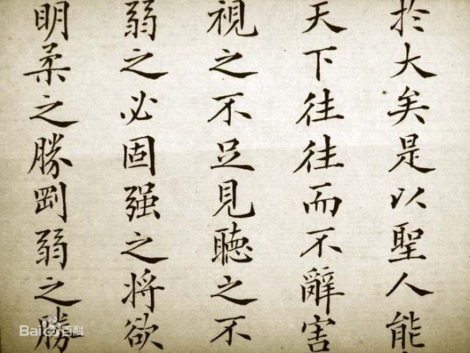
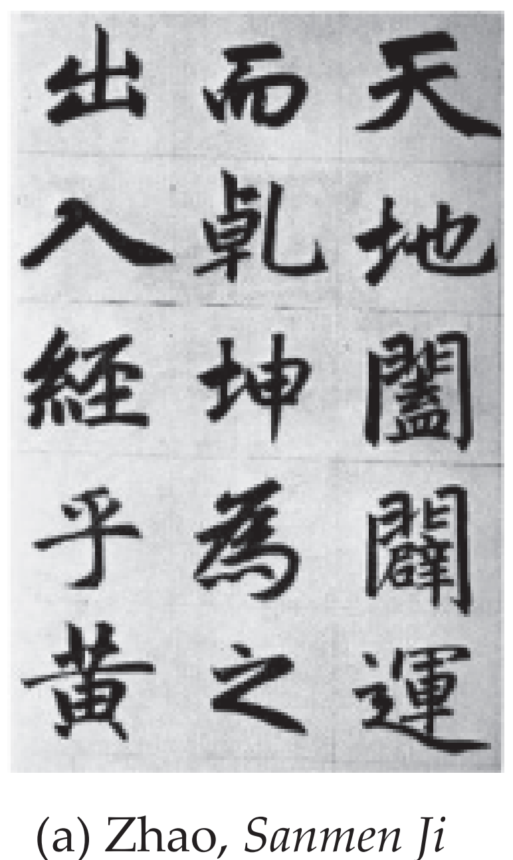
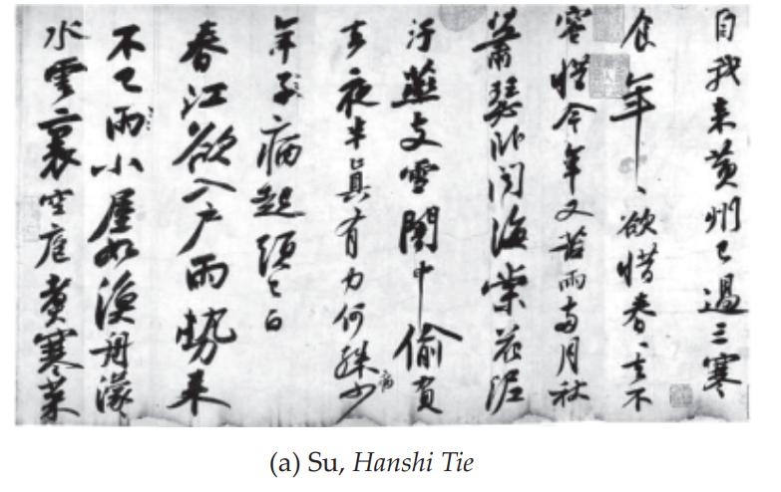
Song Dynasty
Yuan and Ming Dynasty
Qing Dynasty
7
8
9
Focus on personality and creation
e.g. Zhao Mengfu
Guange Style of calligraphy
Notes:
7. Figure 11a is Su’s most famous work, Hanshi Tie (Hanshi Script),
8.Economic and cultural development slowed during the Yuan Dynasty. Calligraphy returned to the ancients, following Jin and Tang with little innovation. The calligraphy of Yuan emphasizes form, and calligraphers strictly follow the rules of writing. The best calligrapher in Yuan was Zhao Mengfu.
9.In the Qing Dynasty, the government required intellectuals nationwide to write in the so-called Guange Style of calligraphy, which was uniform, smooth, dark, and clear. Of course, there were a lot of calligraphic dissidents in the middle and late Qing Dynasty, for example, Zheng Banqiao during the earlier Qing Dynasty and Kang Youwei during the late Qing Dynasty

Slide 8
2. Four Treasures of the Study
Brush (笔; Bi)
Ink (墨; Mo)
Paper (纸; Zhi)
Ink stone (砚; Yan)
Qian, Z., & Fang, D. (2007). Towards Chinese Calligraphy. Macalester International, 18(1), 12.
Notes:
Not only the art form of Chinese calligraphy is unique, but its tools to create art works are also distinctive. The four necessary tools of calligraphy, the “four treasures of the study,” included brush, ink, paper, and ink stone, and are different from what we use to write characters today

Slide 9
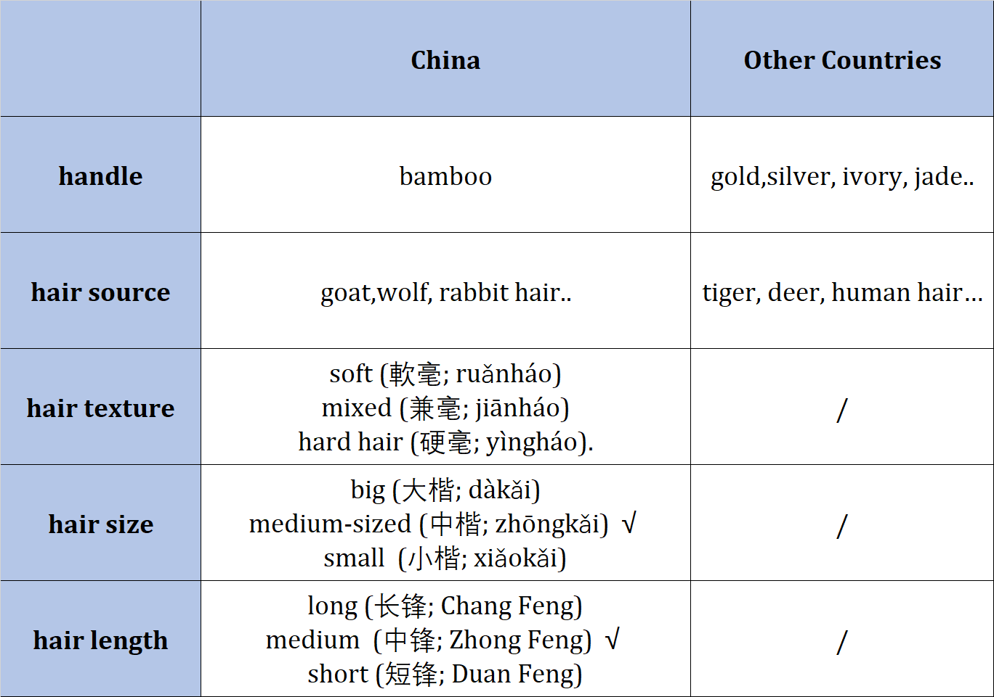
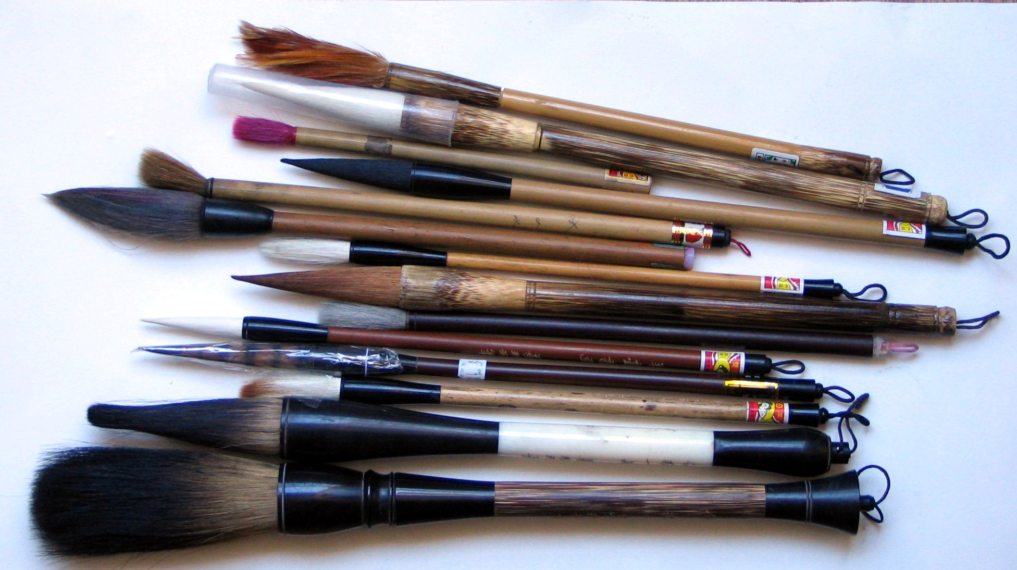
Four Treasures of the Study: Brush (笔; Bi)
https://en.wikipedia.org/wiki/Ink_brush#Types
Notes:
1、Because of the special tool, the brush pen, calligraphy can show the “abstract” beauty of the line. One must take good care of the brushes to keep the point stiff and straight. Writing brushes vary in many aspects including handle, hair source, hair texture, hair size and hair length. More information could be found in the left picture.
2、the right picture is Brushes of various sizes and types of hair, including one of chicken feathers at the top.

Slide 10
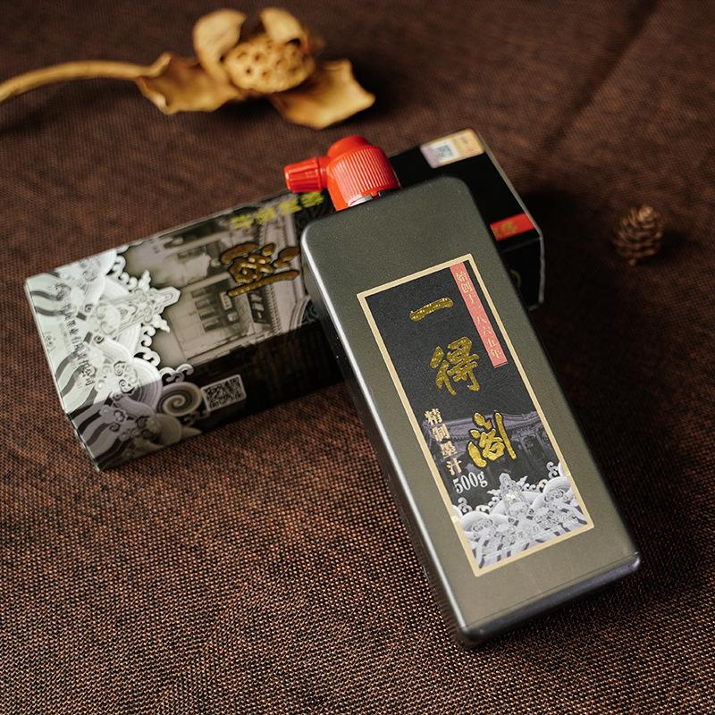
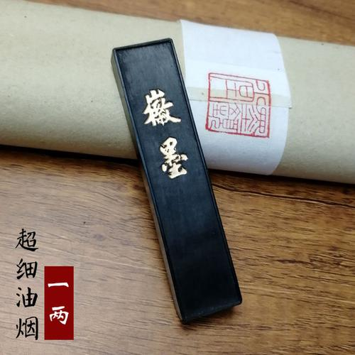
Four Treasures of the Study: Ink (墨; Mo)
“一得阁”墨汁; Yide Ge ink
徽墨；Hui-mo
Notes:
Before the Five Dynasties, the ink-producing center was in the North, and then it reached the South. The most celebrated Southern ink-stick was Hui-mo, which was produced in Huizhou of Anhui. Nowadays, we use calligraphy ink instead of grinding ink-sticks. There are many good quality inks, such as Yide Ge ink.

Slide 11
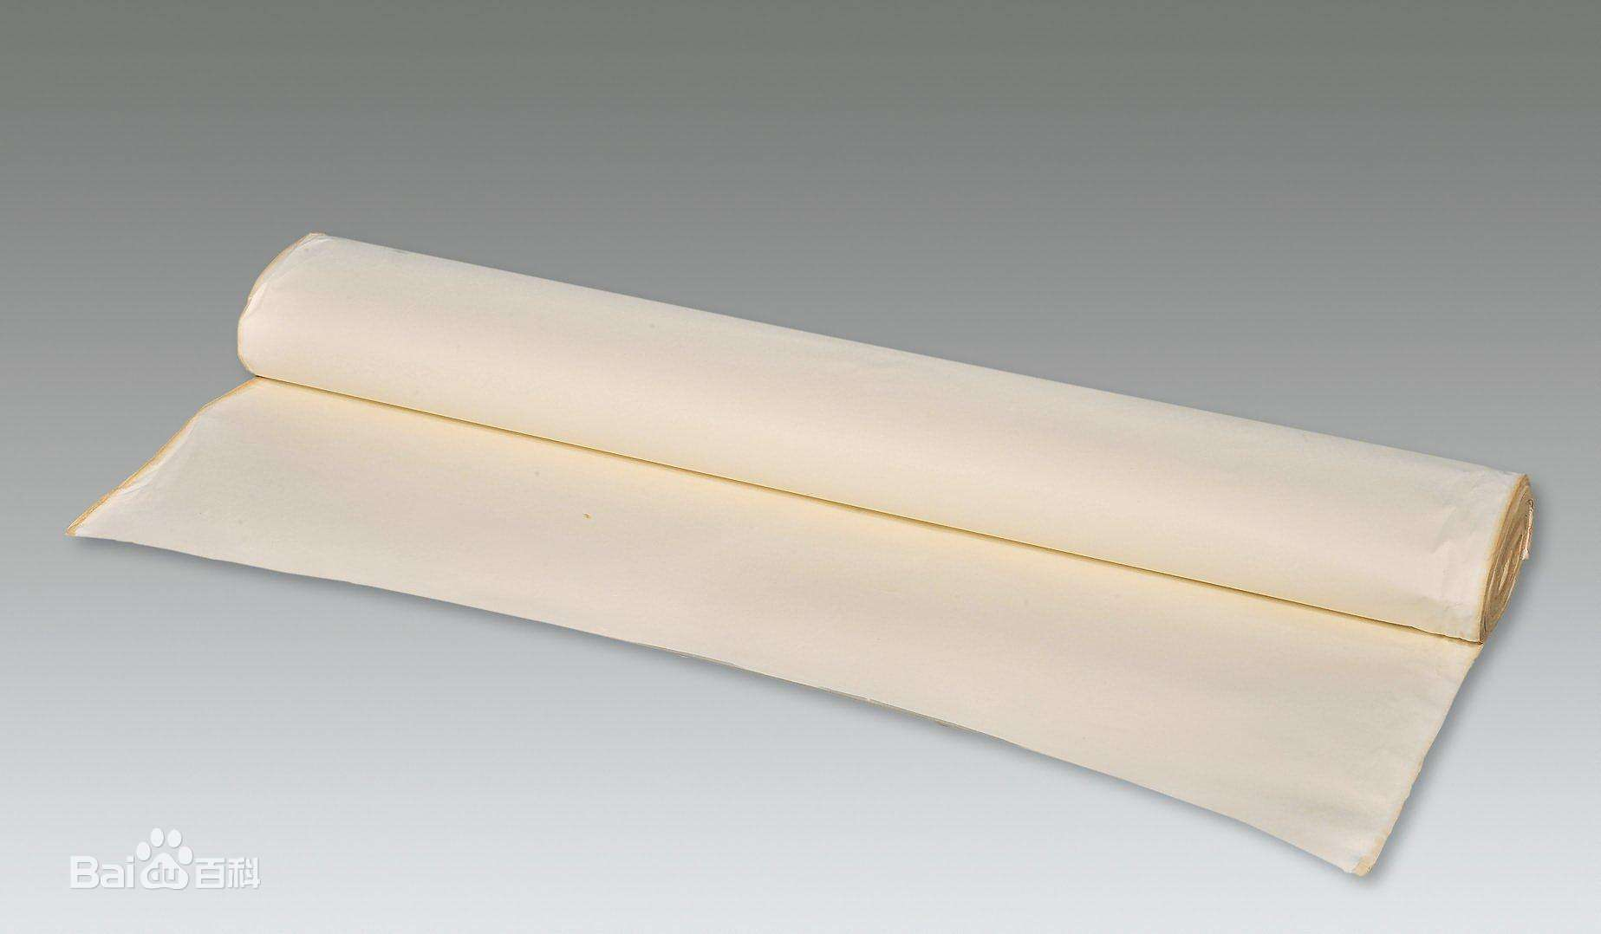
Four Treasures of the Study: Paper(纸; Zhi)
宣纸; Xuan Paper
Notes:
The vehicle of Chinese calligraphy changed from oracle bones to wood slips, bamboo slips, and silk. Finally, paper became the best material for its cheap price and good quality. In the Qing, Xuan paper, produced in Jing Prefecture of Anhui (Xuanzhou), became the special paper for painting and calligraphy, and was regarded as “the king of the paper.” Nowadays, we call special calligraphy paper Xuan paper. Xuan paper is different from modern papers, which are soft and absorbent. Writing on the special paper, we can find the different depths of ink according to the ink concentration and the writing speed. The better the quality of a paper, the more delicate variation can be expressed;

Slide 12
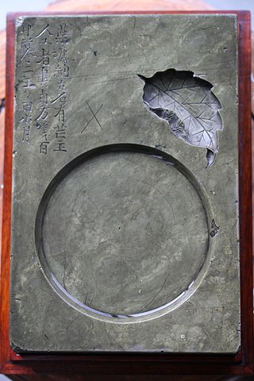
Four Treasures of the Study: Ink Stone (砚; Yan)
砚; ink stone
Taohe inkstone from Song Dynasty, China, with Ming Dynasty inscription
https://en.wikipedia.org/wiki/Inkstone#/media/File:Leaf-inkwell.JPG
Notes:
The ink stone is the most valuable among the four treasures of the study. Because of their solid texture, ink stones have been handed down from ancient times.

Slide 13
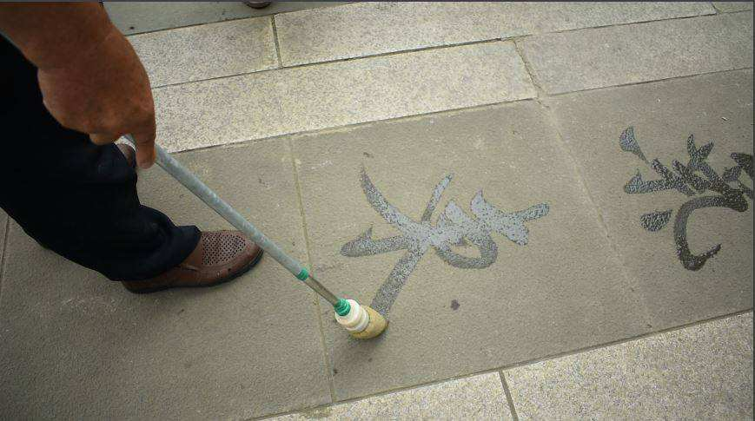
3. Influences of Calligraphy
Calligraphy in Japan, Korea and Vietnam.
Other arts: water calligraphy, Ink wash painting.
Notes:
1. The Japanese and Koreans have developed their own specific sensibilities and styles of calligraphy while incorporating Chinese influences, as well as applying to specific scripts. Japanese calligraphy extends beyond Han characters to also include local scripts such as hiragana and katakana.
In the case of Korean calligraphy, the Hangeul and the existence of the circle required the creation of a new technique.^{[31]}
Vietnamese calligraphy is heavily influenced by Chinese calligraphy. Currently, in Vietnam, calligraphy is used for two types of characters: Hán Nôm and chữ Quốc ngữ.
2. Water calligraphy[edit]
Water calligraphy or ground calligraphy is a popular pastime in China.^{[32]}
The existence of temporary calligraphy, or water calligraphy, is also to be noted. This is the practice of water-only calligraphy on the floor which dries out within minutes. This practice is especially appreciated by the new generation of retired Chinese in public parks of China.
Ink wash painting[edit]
Calligraphy has influenced ink wash painting, which is accomplished using similar tools and techniques. Calligraphy has influenced most major art styles in East Asia, including Ink wash painting, a style of Chinese, Japanese, Korean painting and Vietnamese based entirely on calligraphy.

Slide 14
4. Calligraphy Today
Chinese calligraphy used to be popular in China, Taiwan, Japan, Korea, Vietnam and Hong Kong. In Taiwan, students were requested to write Chinese calligraphy starting from primary school all the way to junior high school on a weekly basis at least to the year 1980.
As young generations are "typing" more often than "writing", when PC, tablets and mobile phones became the major communication channels, Chinese calligraphy became purely art.
https://en.wikipedia.org/wiki/Chinese_calligraphy

Slide 15
