Slide 1


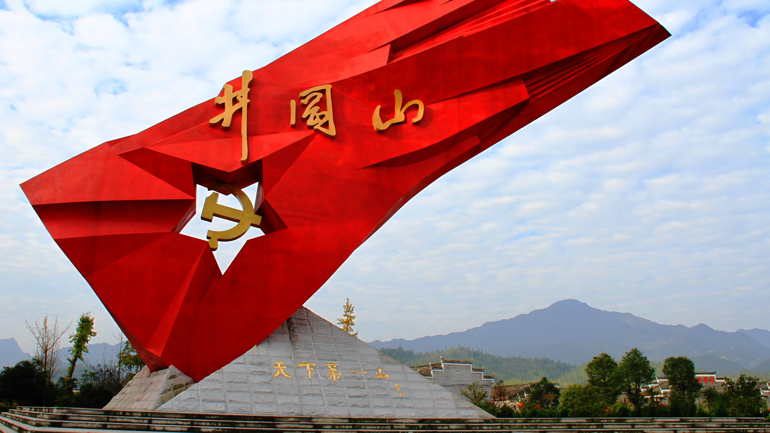


Jinggangshan：The Diverse Coexistence of Revolutionary Heritage, Ecological Protection, and Cultural Inheritance

Slide 2
CONTENTS
The Interweaving of Hakka Culture and Red Memory
3.
1.
Historical Positioning and Revolutionary Narrative
Contemporary Enlightenment of the Jinggangshan Spirit
4.
Ecological Protection and the Modern Value of Natural Heritage
2.

Slide 3

01
Historical Positioning and Revolutionary Narrative

Slide 4
Perspective of Revolutionary Geography
Jinggangshan is located at the border of Hunan and Jiangxi provinces, with steep mountains that are easy to defend and hard to attack. It provided a natural barrier for the revolutionary base, and the revolutionary path of encircling cities from the countryside was explored here by revolutionary pioneers like Mao Zedong.
Geographical Advantages and Strategic Significance
1
2
From the perspective of spatial politics, the establishment of the Jinggangshan base broke the ruling pattern of surrounding the countryside with cities by the Kuomintang reactionaries. It laid a solid foundation for the development and growth of subsequent revolutionary forces and had profound strategic significance.

Slide 5
Symbolization of Red Heritage
The oil lamp in the Octagonal Building symbolizes the enlightenment of knowledge and the light of thought, illuminating the path for revolutionary predecessors to explore the truth. It has become a spiritual beacon inspiring people to keep pursuing progress. The cannon fire at Huangyangjie represents the bravery and tenacity of military struggle, highlighting the fighting spirit of the Red Army soldiers.
Core Symbols and Cultural Connotations
There are more than 100 existing revolutionary sites in Jinggangshan, with 21 national cultural relics protection units. These sites are not only witnesses to history but also important carriers for the inheritance of red culture, carrying rich historical memories and revolutionary spirit.

Slide 6
Inheritance and Development of Revolutionary Narrative
Mao Zedong's works such as "The Struggle in Jinggangshan" provide detailed records of the revolutionary struggle in Jinggangshan. They are valuable first- hand materials for later generations to study and understand this historical period. The profound theoretical exposition and vivid practical description in these works have widely spread the Jinggangshan revolutionary spirit.
Historical Records and Contemporary Dissemination
In contemporary times, the revolutionary stories of Jinggangshan are continuously excavated and disseminated through various forms such as film and television works, literary creation, and red tourism. This further strengthens the influence of red culture, giving it new vitality in the new era.

Slide 7
02
Ecological Protection and the Modern Value of Natural Heritage

Slide 8

Practice of Biodiversity Conservation
Protected Area Status and Conservation Achievements
Jinggangshan was included in the World Network of Biosphere Reserves in 2007. This status fully reflects its important value in biodiversity conservation. The area has a rich variety of species and a complete ecosystem, providing a good living environment for many rare species.
The flagship species, the rhododendron of Jinggangshan, is known for its unique beauty and rarity. It has become a representative species of the protected area. The protection work of its type locality has achieved significant results. At the same time, rare animals such as the Chinese monal have also been effectively protected, with their population gradually recovering.

Slide 9
Dialectical Analysis of Ecotourism
Balancing Tourist Growth and Ecological Carrying Capacity
In recent years, the number of tourists in Jinggangshan has been growing rapidly, with an average of 3 million visitors per year. This poses a huge challenge to the local ecological carrying capacity. How to meet the needs of tourists while protecting the ecological environment has become an urgent problem to be solved.
The Longtan Waterfall Scenic Area has implemented a flow control policy to reasonably control the number of tourists, effectively alleviating ecological pressure. At the same time, it actively guides local community residents to participate in ecotourism services. This not only increases residents' income but also enhances their awareness of ecological protection, achieving a virtuous interaction between ecological protection and community development.

Slide 10
Sustainable Development Strategies for Ecological Protection
Policy Support and Technological Innovation
The government has introduced a series of ecological protection policies, increased financial investment in the protected area, and strengthened supervision to provide strong support for ecological protection work. The protected area has also actively introduced advanced ecological monitoring technologies and equipment to monitor ecological environment changes in real- time and provide data support for scientific decision- making.
In terms of ecological restoration, various measures such as afforestation and soil and water conservation have been taken to effectively improve the quality of the ecological environment, enhance the stability and service functions of the ecosystem, and lay a solid foundation for sustainable development.

Slide 11
03
The Interweaving of Hakka Culture and Red Memory

Slide 12
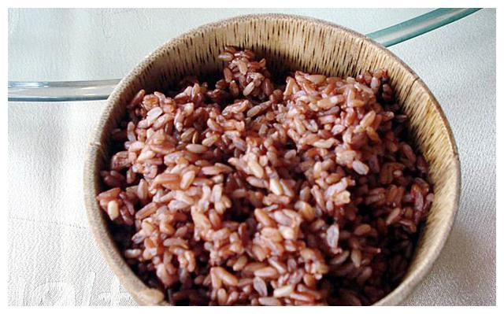

Cultural Stratification Structure
Inheritance of Intangible Cultural Heritage
Hakka mountain songs, with their unique melodies and rich lyrics, carry the historical memories and emotional life of the Hakka people and are important carriers of Hakka culture. Bamboo weaving craftsmanship shows the wisdom and creativity of the Hakka people and has been listed as intangible cultural heritage for effective protection and inheritance.
Red rice and pumpkin soup, as representative foods during the revolutionary period in Jinggangshan, have evolved from a means of survival to a cultural symbol with profound educational significance. Through cultural and creative products, the historical stories and red spirit behind them are conveyed to more people, achieving a sublimation from material to spirit.

Slide 13
Production of Collective Memory in Space
Scene Recreation of Former Dwellings
The former dwellings in Ciping have been carefully recreated and arranged to vividly restore the living scenes of the revolutionary period. Visitors feel as if they were in that turbulent era, enhancing their intuitive feelings and emotional identification with revolutionary history.
Oral history research provides fresh materials for the inheritance of red memory. Local Hakka elders vividly narrate their personal experiences and what they saw and heard during the revolutionary period. These oral materials not only enrich the content of historical research but also provide valuable first- hand materials for later generations to understand and inherit red culture.

Slide 14
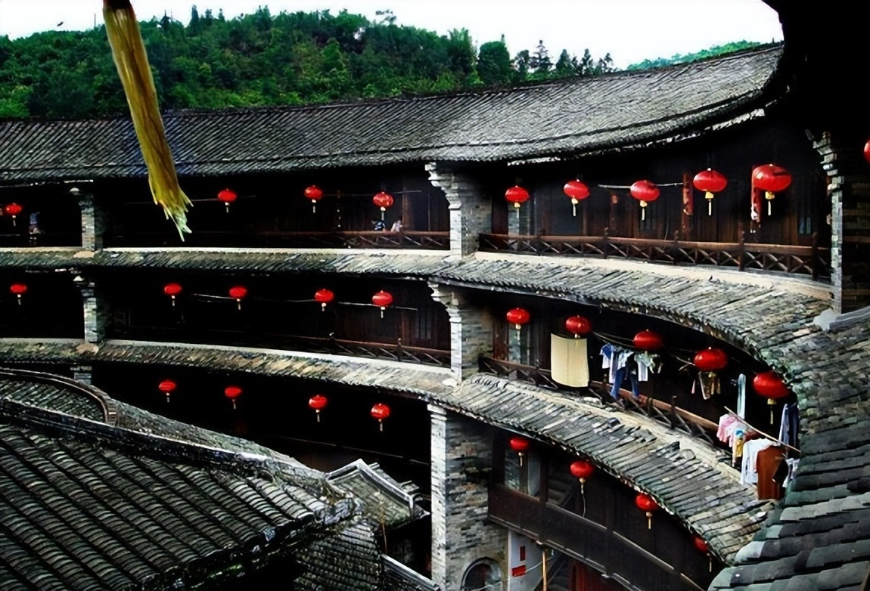
Combination of Tradition and Modernity
Cultural Integration and Innovative Development
The deep integration of red culture and Hakka culture has formed the unique cultural characteristics of Jinggangshan. For example, Hakka mountain songs with red themes and bamboo weaving handicrafts based on revolutionary stories are innovative forms that not only enrich the cultural connotation but also inject new vitality into cultural inheritance and development.
On the basis of inheriting Hakka culture, modern elements are actively integrated. Through activities such as holding Hakka cultural festivals and folk performances, traditional culture is closely combined with modern life, making it more vibrant and attractive in the modern era.

Slide 15
04
Contemporary Enlightenment of the Jinggangshan Spirit

Slide 16
Academic Controversies and Reinterpretation
Multi-dimensional Interpretation of the Spirit
There are different views in academia about the compatibility of the "hard struggle" spirit and consumerist society. On the one hand, some people believe that in modern society, the spirit of hard struggle still has great significance. It can guide people to establish correct values and consumption views. On the other hand, some people believe that in the context of rampant consumerism, the spirit of hard struggle may be impacted to a certain extent and needs to be re- examined and interpreted.
From the perspective of ecological civilization construction, the "Jinggangshan experience" provides beneficial references for other regions. For example, the successful practice of forest rights reform pilot not only promotes the development of local forestry economy but also effectively protects the ecological environment. It achieves a win- win situation between economic development and ecological protection and provides new ideas and methods for ecological civilization construction in the new era.

Slide 17
International Comparative Perspective
01
Jinggangshan and Cuba's Sierra Maestra are both revolutionary bases. There are similarities and differences in their ecological protection models. Jinggangshan focuses on the combination of ecological protection and the inheritance of red culture. It achieves a virtuous interaction between ecological protection and economic development through the development of ecotourism. In contrast, Cuba's Sierra Maestra is more inclined to strict protection of nature reserves and self- repair of ecosystems.
02
Through comparative analysis, it can be found that different countries and regions need to formulate ecological protection strategies suitable for themselves according to their own geographical environment, cultural background, and social and economic development conditions. At the same time, they can also learn from each other and jointly promote the development of global ecological protection.
Comparison with Cuba's Sierra Maestra

Slide 18
Contemporary Value and Inheritance Development
Practical Significance of Spirit Inheritance
01
02
To better inherit and promote the Jinggangshan Spirit, it is necessary to strengthen publicity and education. Through school education, social propaganda, and other means, more people should be made to understand and recognize the connotation and value of the Jinggangshan Spirit. At the same time, it is necessary to combine the characteristics of the times and continuously give new contemporary connotations to the Jinggangshan Spirit, so that it can shine more brightly in the new era.
The Jinggangshan Spirit, as a precious spiritual treasure of Chinese Communists, has eternal contemporary value. In today's era, it is still a powerful spiritual force to inspire us to keep moving forward. Whether in scientific and technological innovation, economic development, or social construction, it is necessary to inherit and promote the Jinggangshan Spirit with a spirit of hard struggle and innovation.

Slide 19
Thank you for listening
2025.5

