Slide 1


Reading The Analects
—watching the high-energy day of Confucius
Presenter : Zhu Zhu

Slide 2
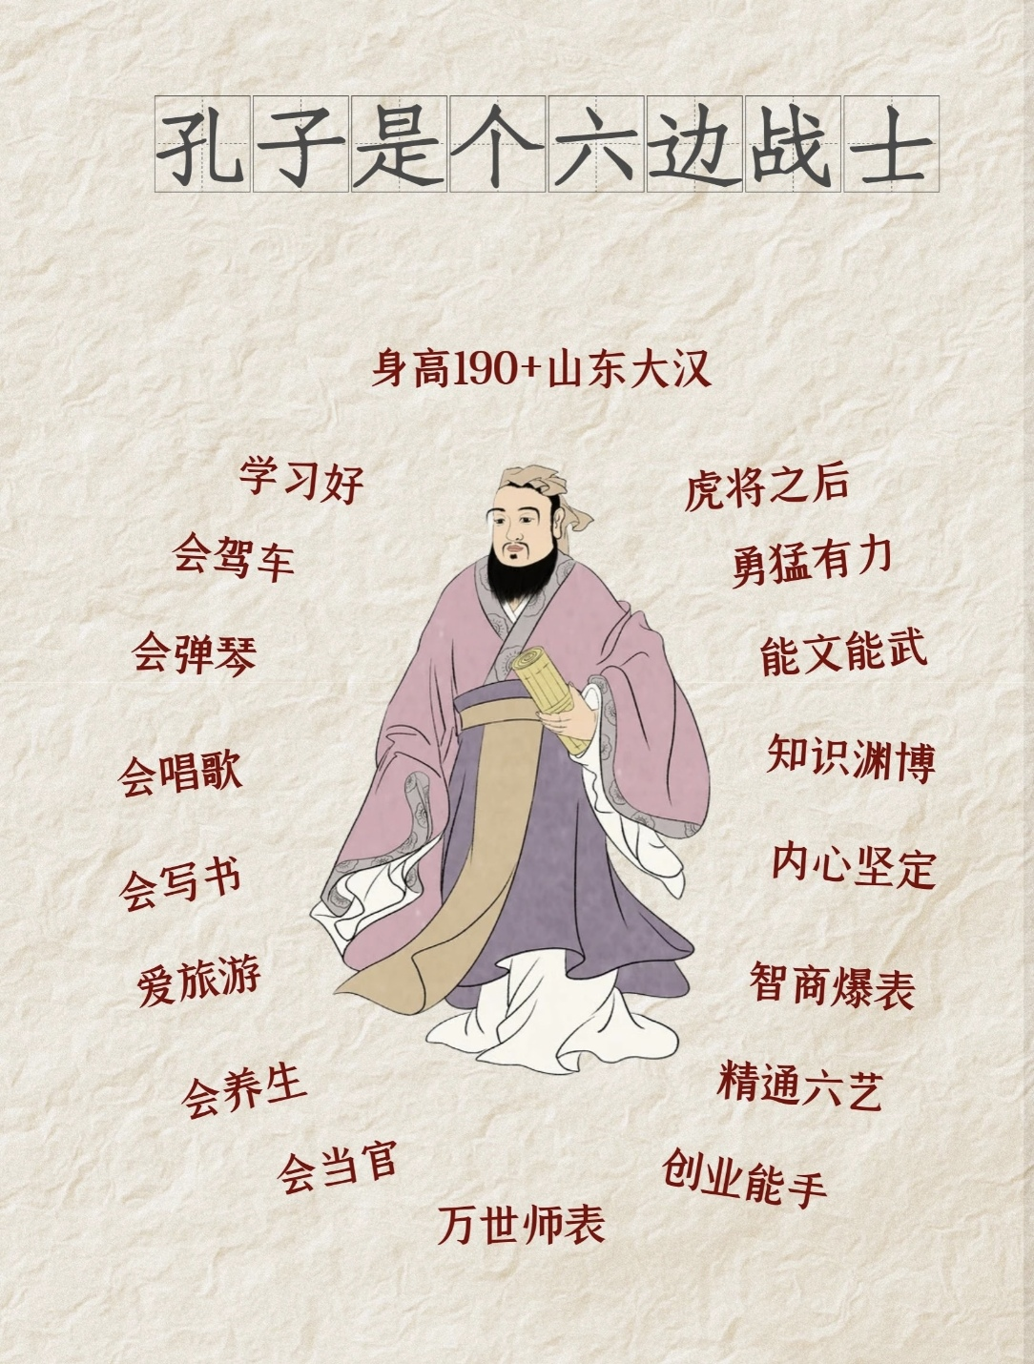
Confucius
What was Confucius really like?
What is the most memorable opinion from the Analects ?

Slide 3
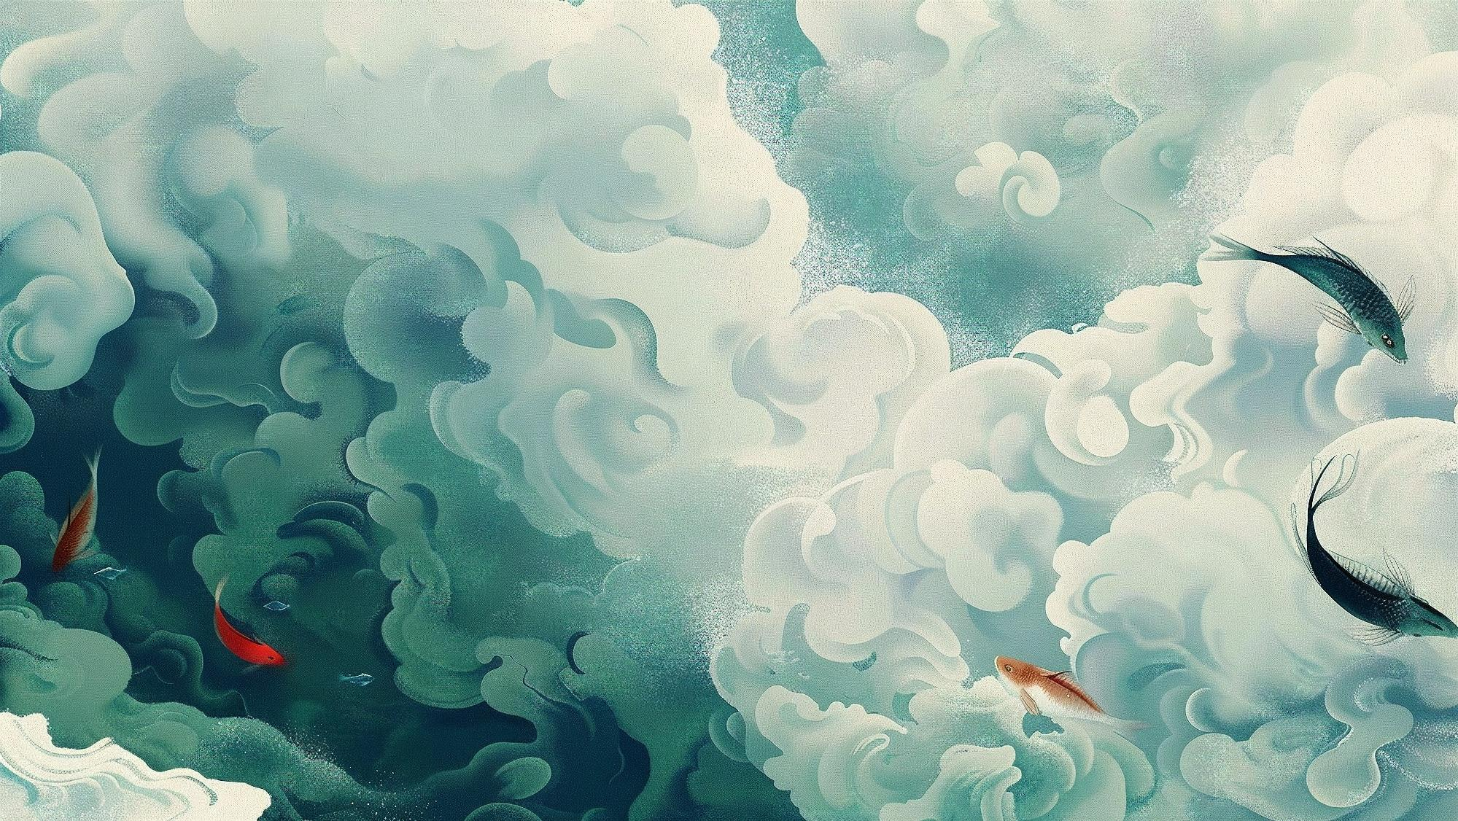
壹
贰
Daily Routine Schedule
Inner Stablity
叁
肆
Anti-involution Pioneer
Conclusion

Slide 4
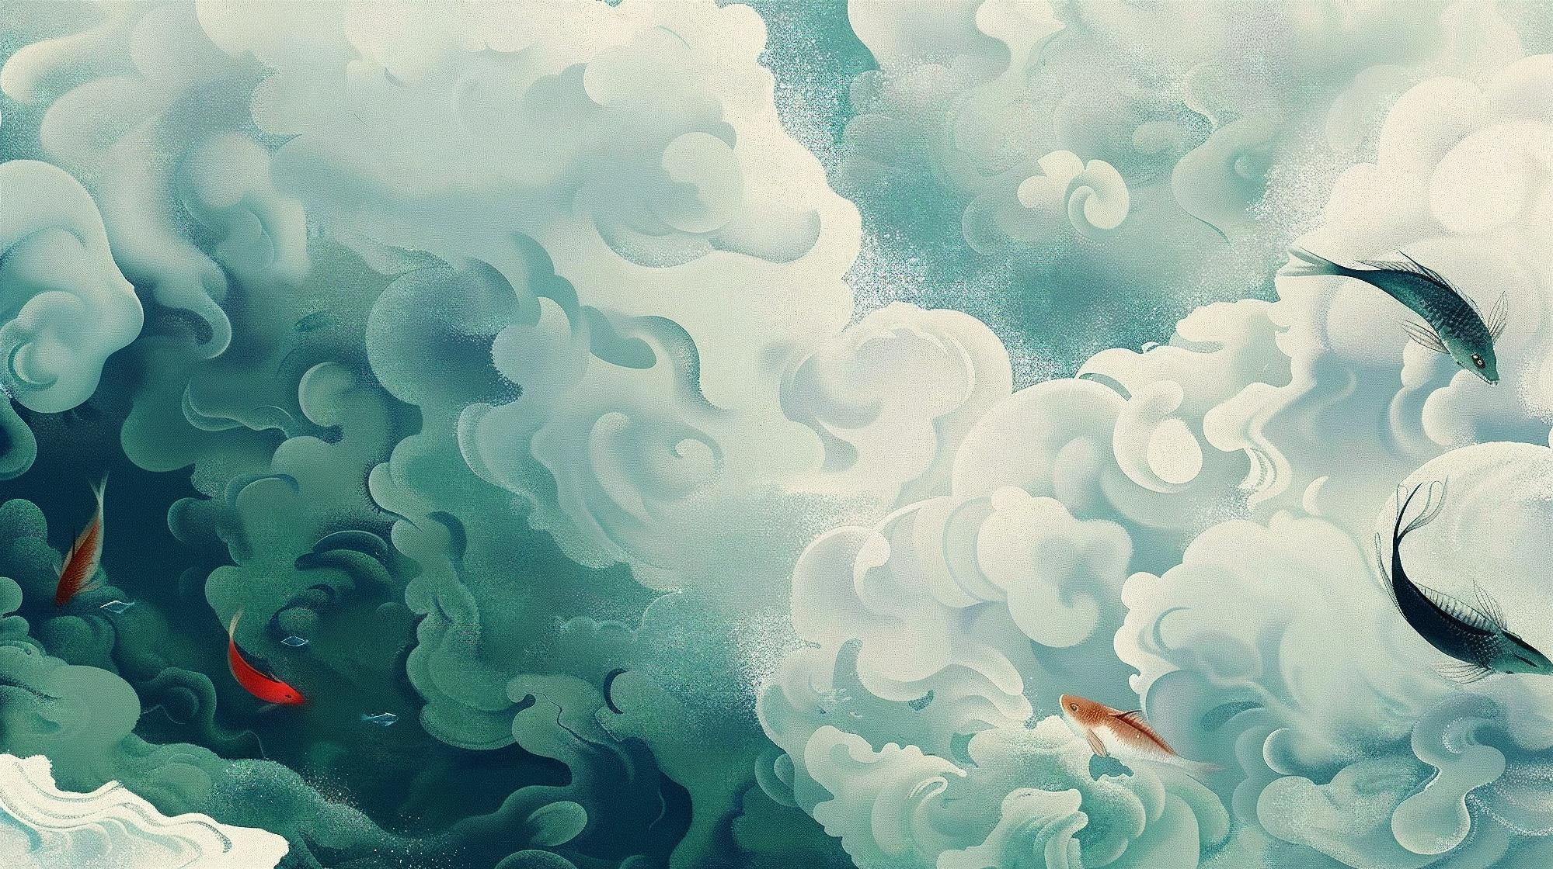


壹
Daily Routine Schedule

Slide 5
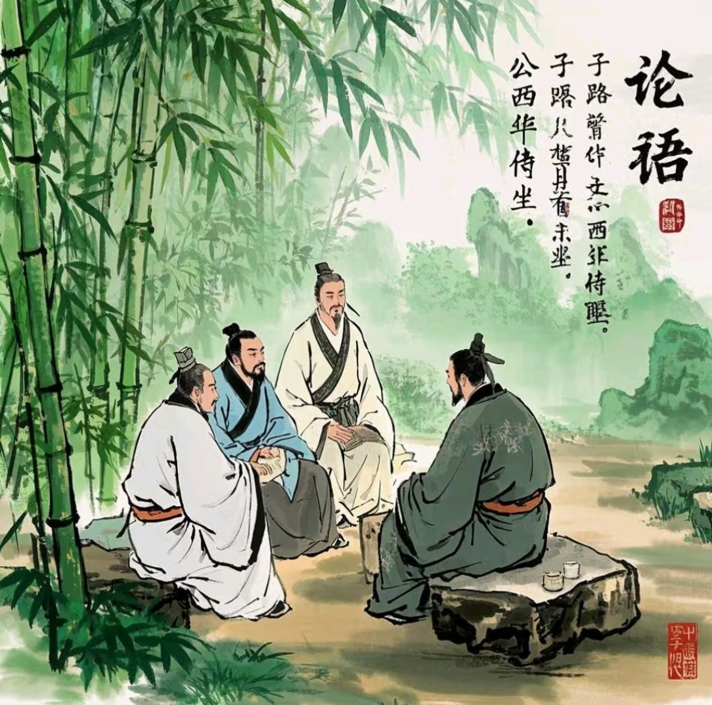
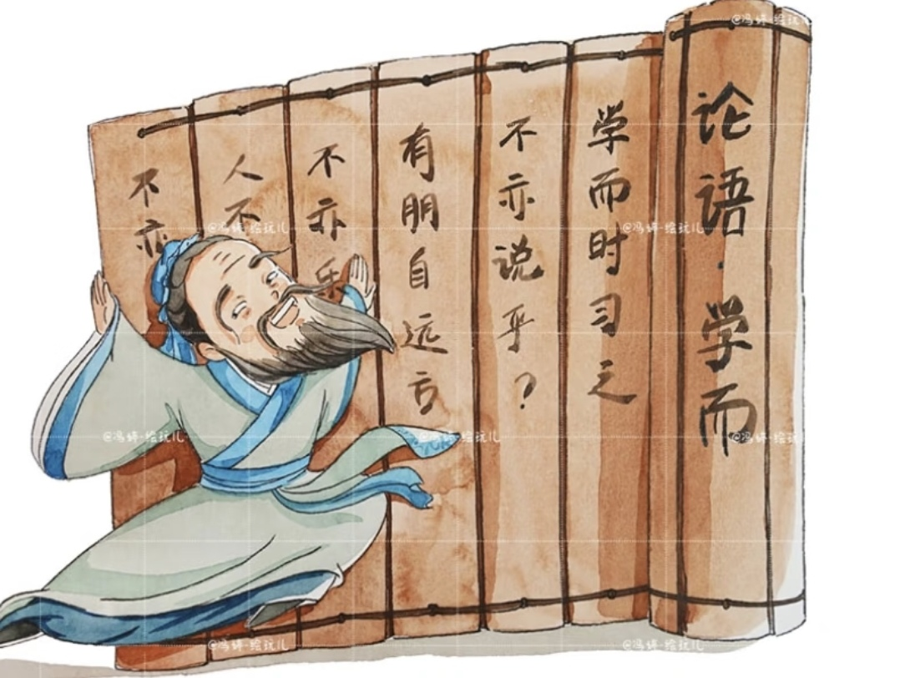
Morning
6:00 am
7:00 am
8:30am
10:30am
The dawn of meditation
吾日三省吾身
Ajusting his garb with dignity
君子不以绀緅饰，红紫不以为亵服
Interactive teaching
不愤不启，不悱不发
Engaged in creation
述而不作，信而好古

Slide 6
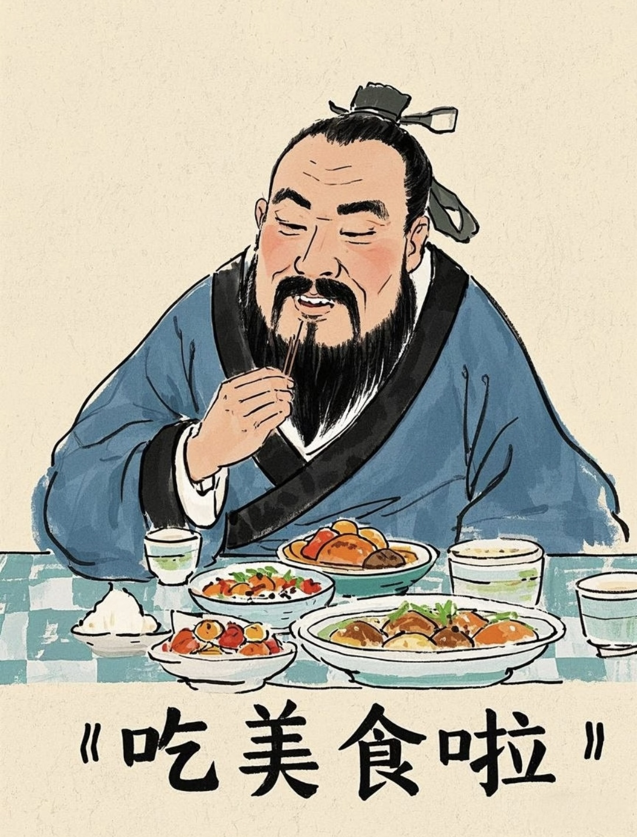
Noontime
12:30
Nutritional lunch and having a break
食不厌精，脍不厌细。食饐而餲，鱼馁而肉败，不食；色恶，不食；臭恶，不食；失饪，不食；不时，不食；割不正，不食；不得其酱，不食；沽酒市脯，不食。
He did not dislike his rice finely cleaned, nor his minced meat cut small.

Slide 7
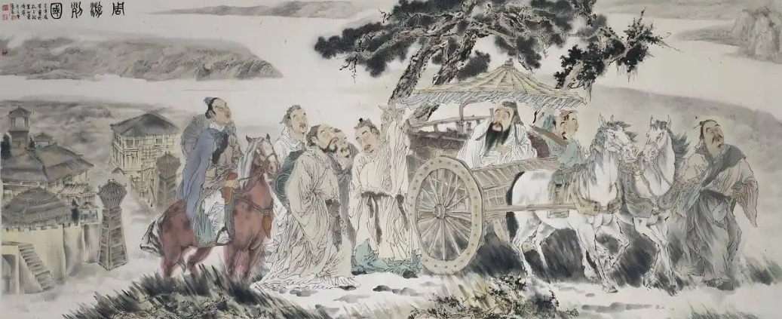

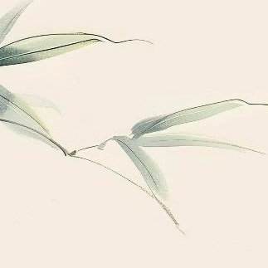
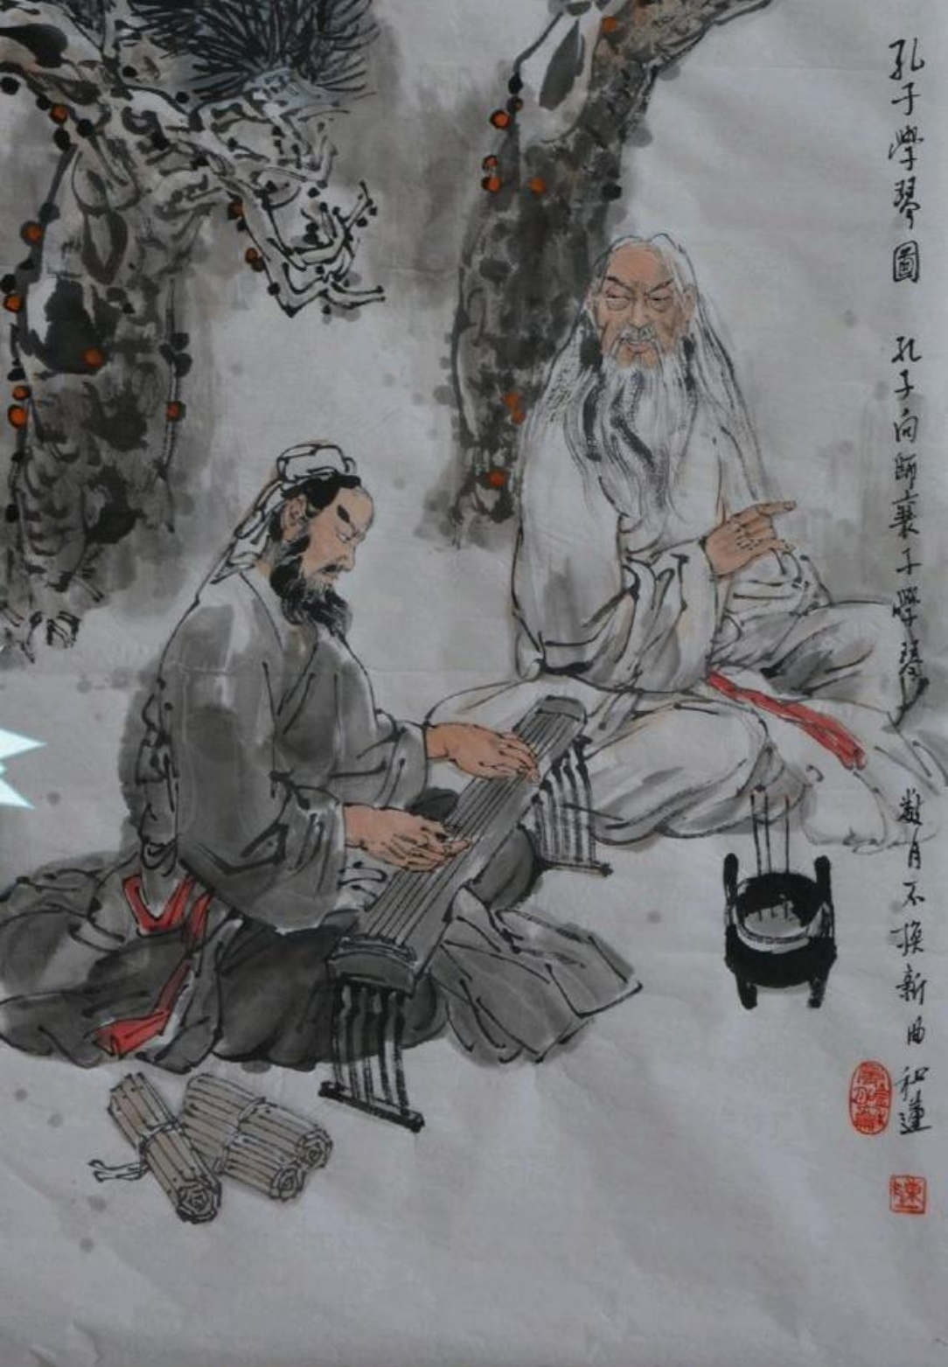

Afternoon
2:00pm
5:00pm
On governance
为政以德，譬如北辰，居其所而众星拱之。
Exercising and art appreciation
子在齐闻《韶》，三月不知肉味，曰：“不图为乐之至于斯也。”

Slide 8
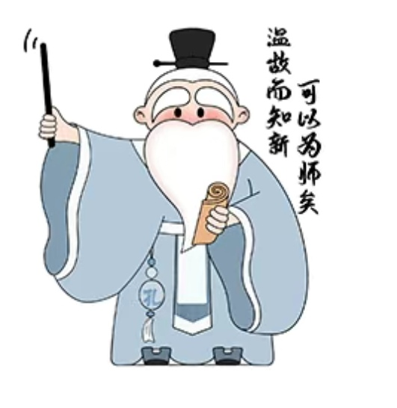
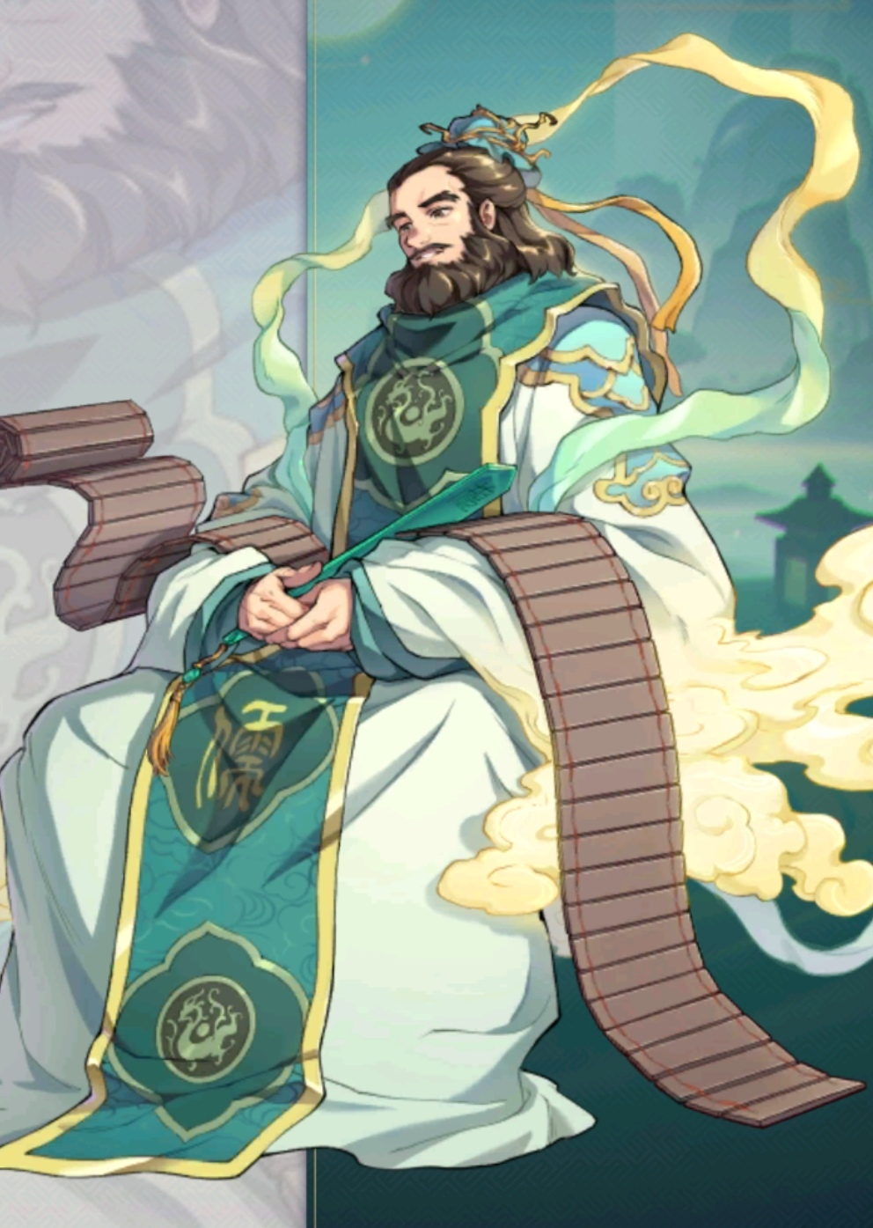
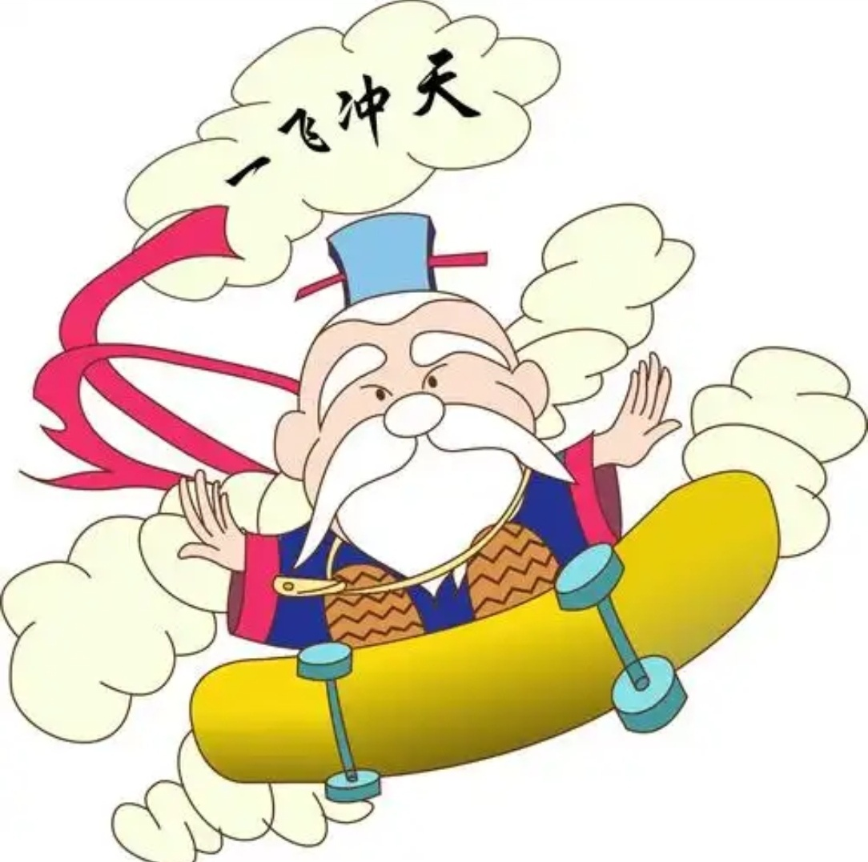
Evening and Night
7：00pm
9:00pm
10：00pm
High-quality socializing
有朋自远方来，不亦乐乎？
Review and summary
温故而知新
Go to bed on time
寝不尸
寝不言

Slide 9
贰
Inner Stability

Slide 10
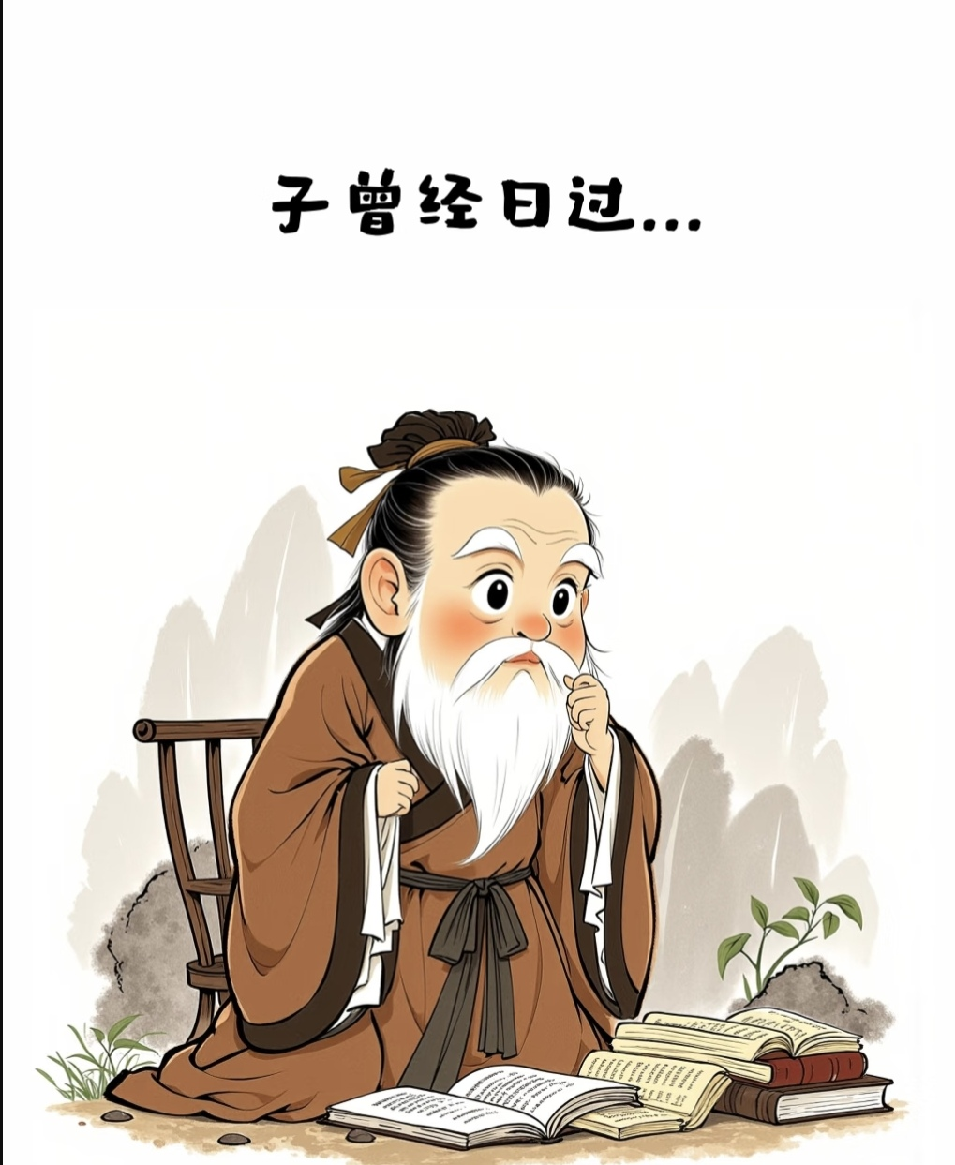
Inner Stablity
1.
Perisistence
夫子之道，忠恕而已。
参乎，吾道一以贯之。
2.
Ren is the central virtue.
君子无终食之间违仁

Slide 11
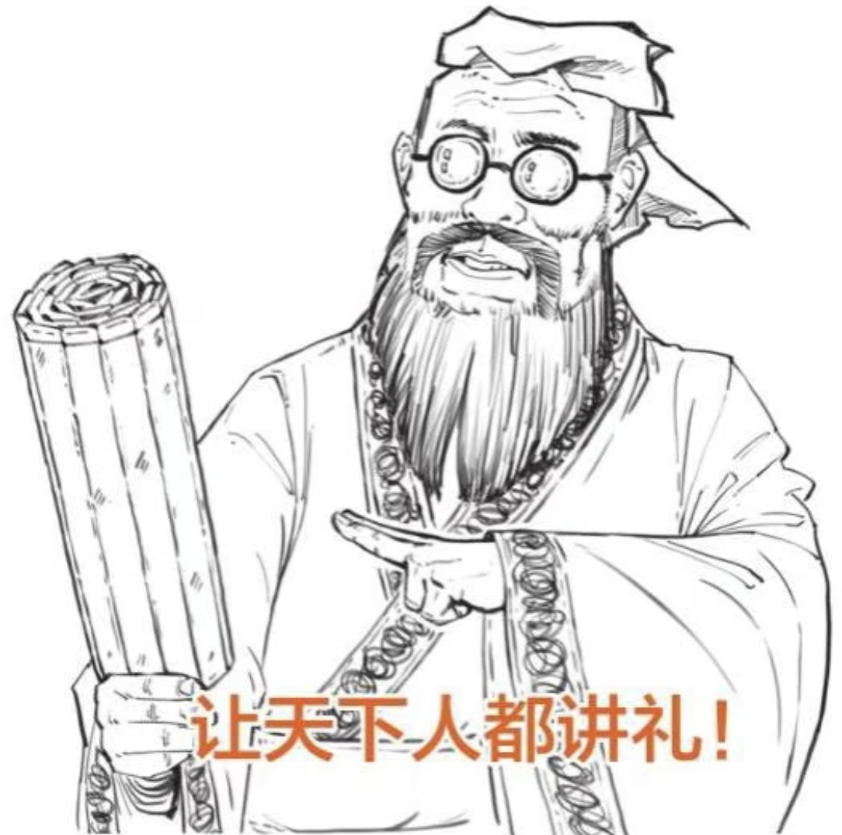
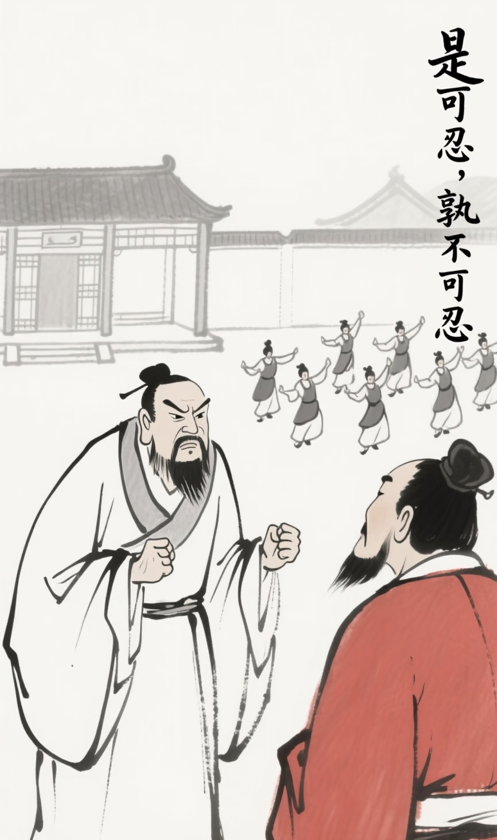
Inner Stability
3.
Action-oriented
君子欲讷于言而敏于行
4.
Enthusiasm for learning
发愤忘食，乐以忘忧，不知老之将至云尔。

Slide 12
叁
Anti-involution Pioneer

Slide 13
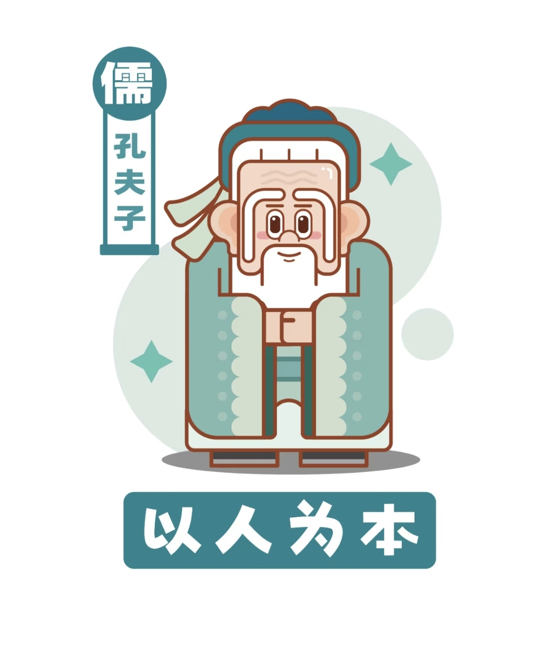
Anti-involution
The Golden Mean
Disapproval of burning oneself out
子温而厉，威而不猛，恭而安
暴虎冯河，死而无悔者 吾不与也。
Attacking a tiger with his bare hands, or crossing a river without a boat
Against vicious competition
Opposition to utilitarian learning
君子和而不同
The superior man is harmonious but not conformist.
古之学者为己，今之学者为人
Learning for one's own sake

Slide 14
肆
Conclusion

Slide 15
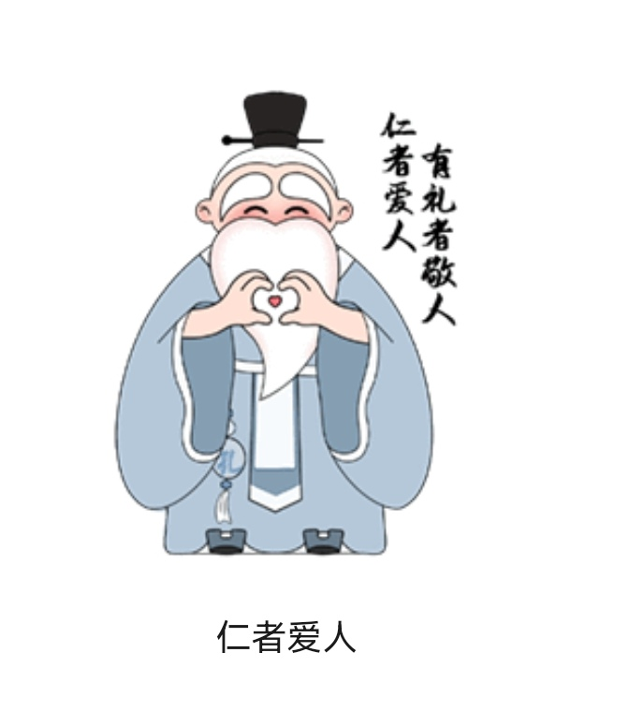

Conclusion
Humanism
1.serving ghost→serving human( In his era, the prevailing worldview was influnced by God worship. But the opinion was shifted by Confucius.)
2..emphasizing self-cultivation ( The path of self -cultivation is the empowerment of individuals, beginning with yourself but extending outwards.)

Slide 16
Thanks for listening

Slide 17
图片与文字来源
文字来源
百度，每日英语听力
图片来源
百度，小红书

