Slide 1
中國語言文化
Session 11, Thursday Nov 21, 2024, Zhishan Bldg. 至善楼105, room 105
Martin Woesler

Slide 2
TOPICS
Field research: Daily entries => You can see your oral contribution grade on the wiki website and also your
加分

Slide 3
TOPICS
197. Chinese Rural Dogs p. 1773 (Zhao Jing/winnie)
198. Hanfu 汉服 p. 1781（Guo Zibin/Anne）
200. Suzhou Gardens 苏州园林 p. 1795 (Liang Dan/Anne)
201. Moon-shaped Fans 团扇 p.1806 (Le Yuxuan/Lydia)
202. Miao Silver Ornaments Culture p. 1827 (Yang Hanxu/Hansu)
203. Facial Physiognomy 相面术 p. 1836 (Zhou Xiaoqiao）
204. Games: Chinese Chess 游戏：象棋 p. 1847 (Zhou Xukai/Kyrie)

Slide 4
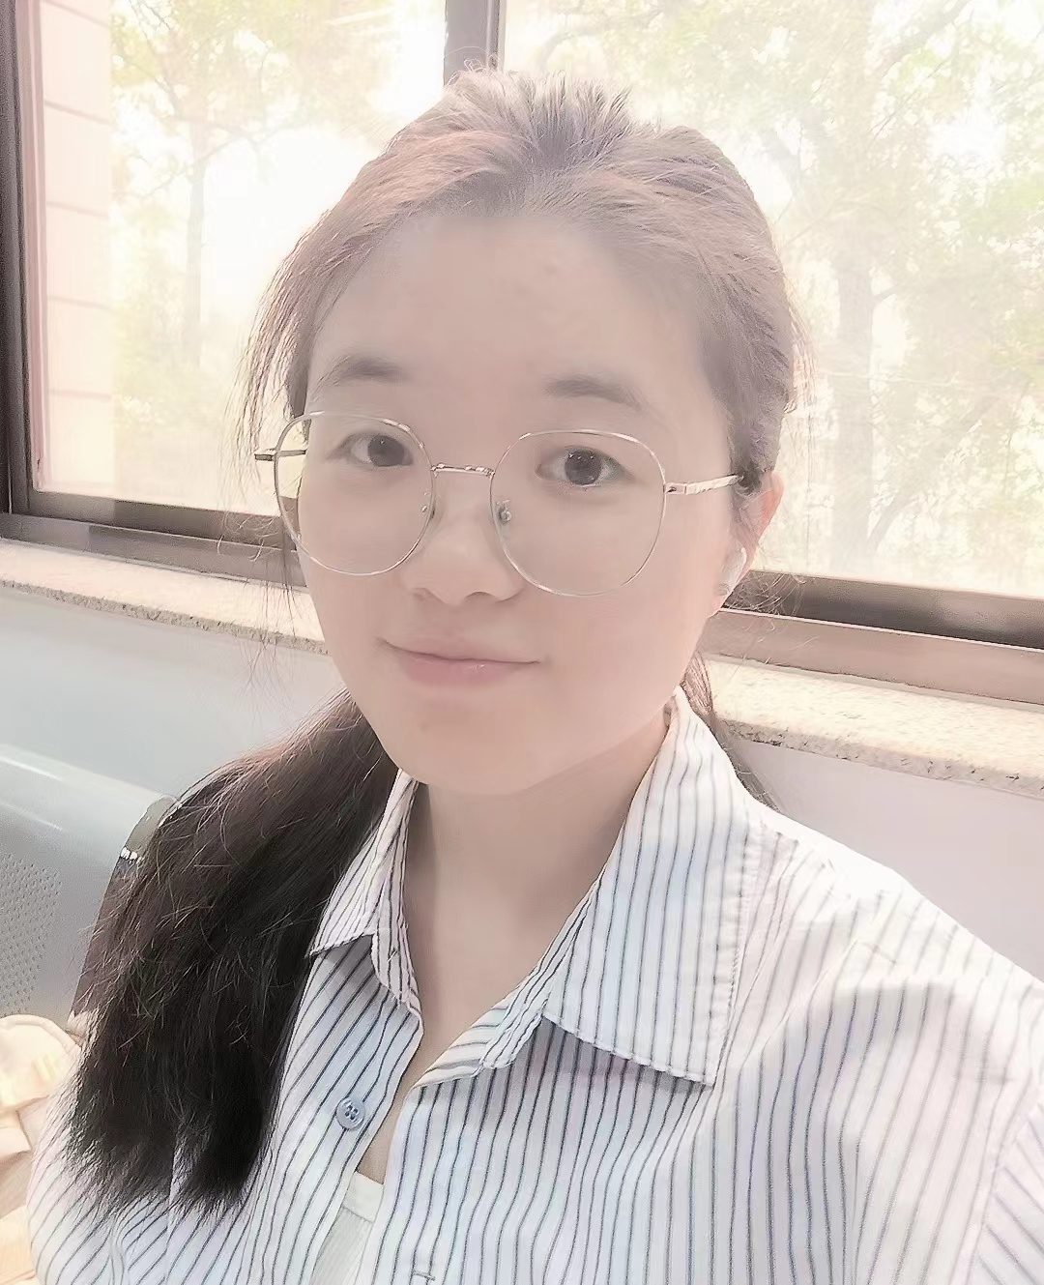
197. Chinese Rural Dogs p. 1773 (Zhao Jing/Winnie)

Slide 5
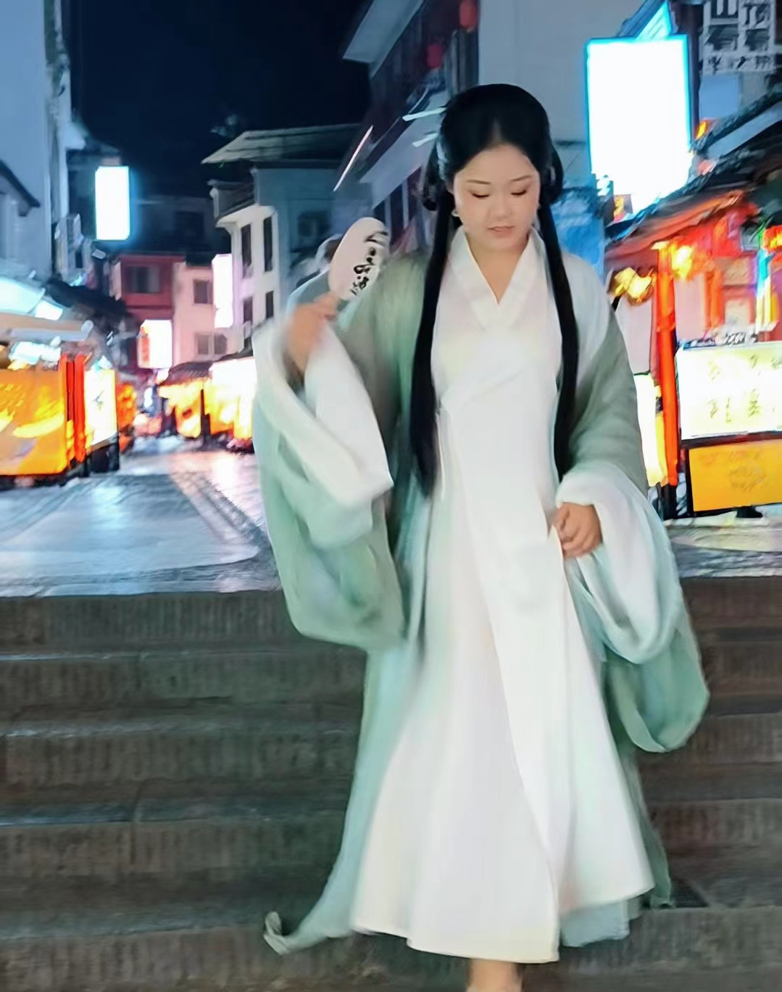
198. Hanfu 汉服 p. 1781（Guo Zibin/Anne)

Slide 6
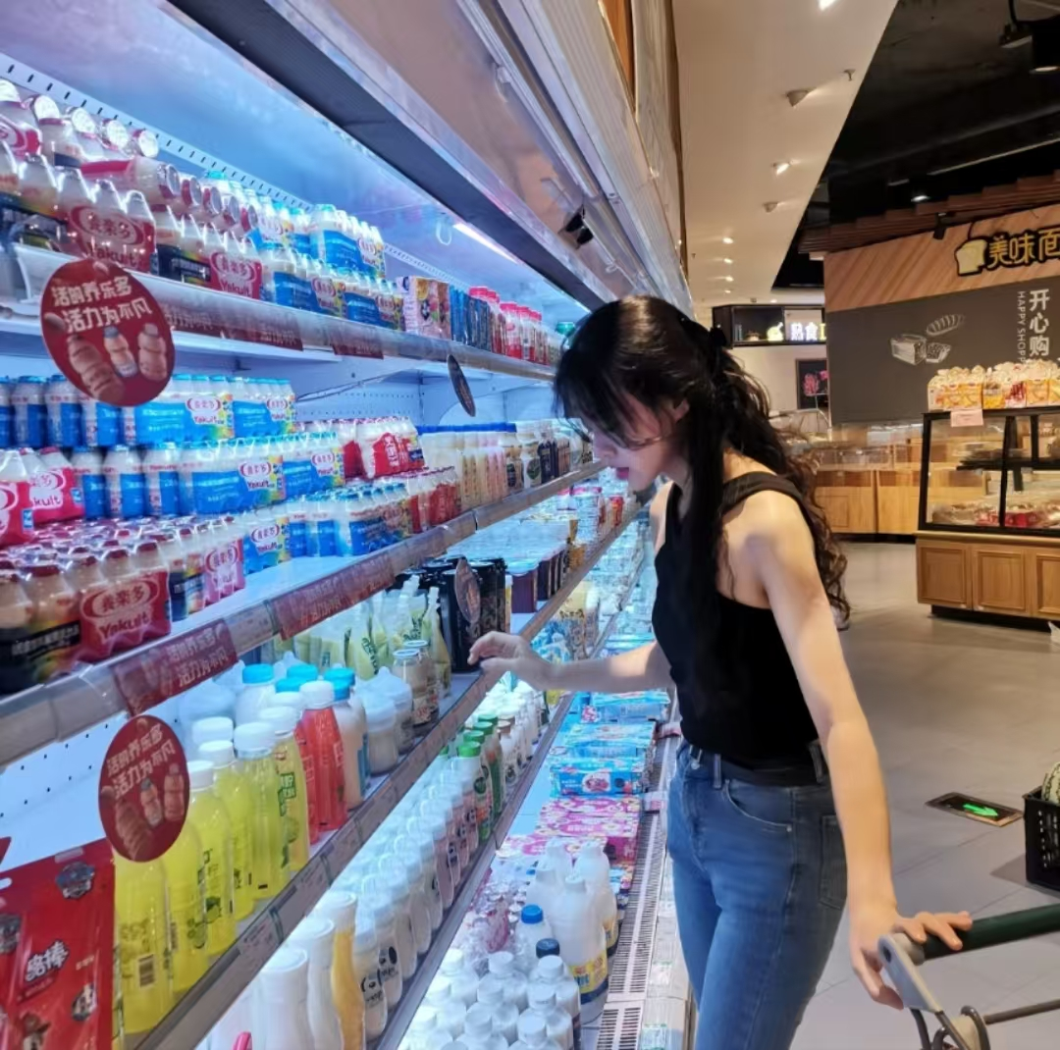
200. Suzhou Gardens 苏州园林 p. 1795 (Liang Dan/Anne)

Slide 7

201. Moon-shaped Fans 团扇 p.1806 (Le Yuxuan/Lydia)

Slide 8
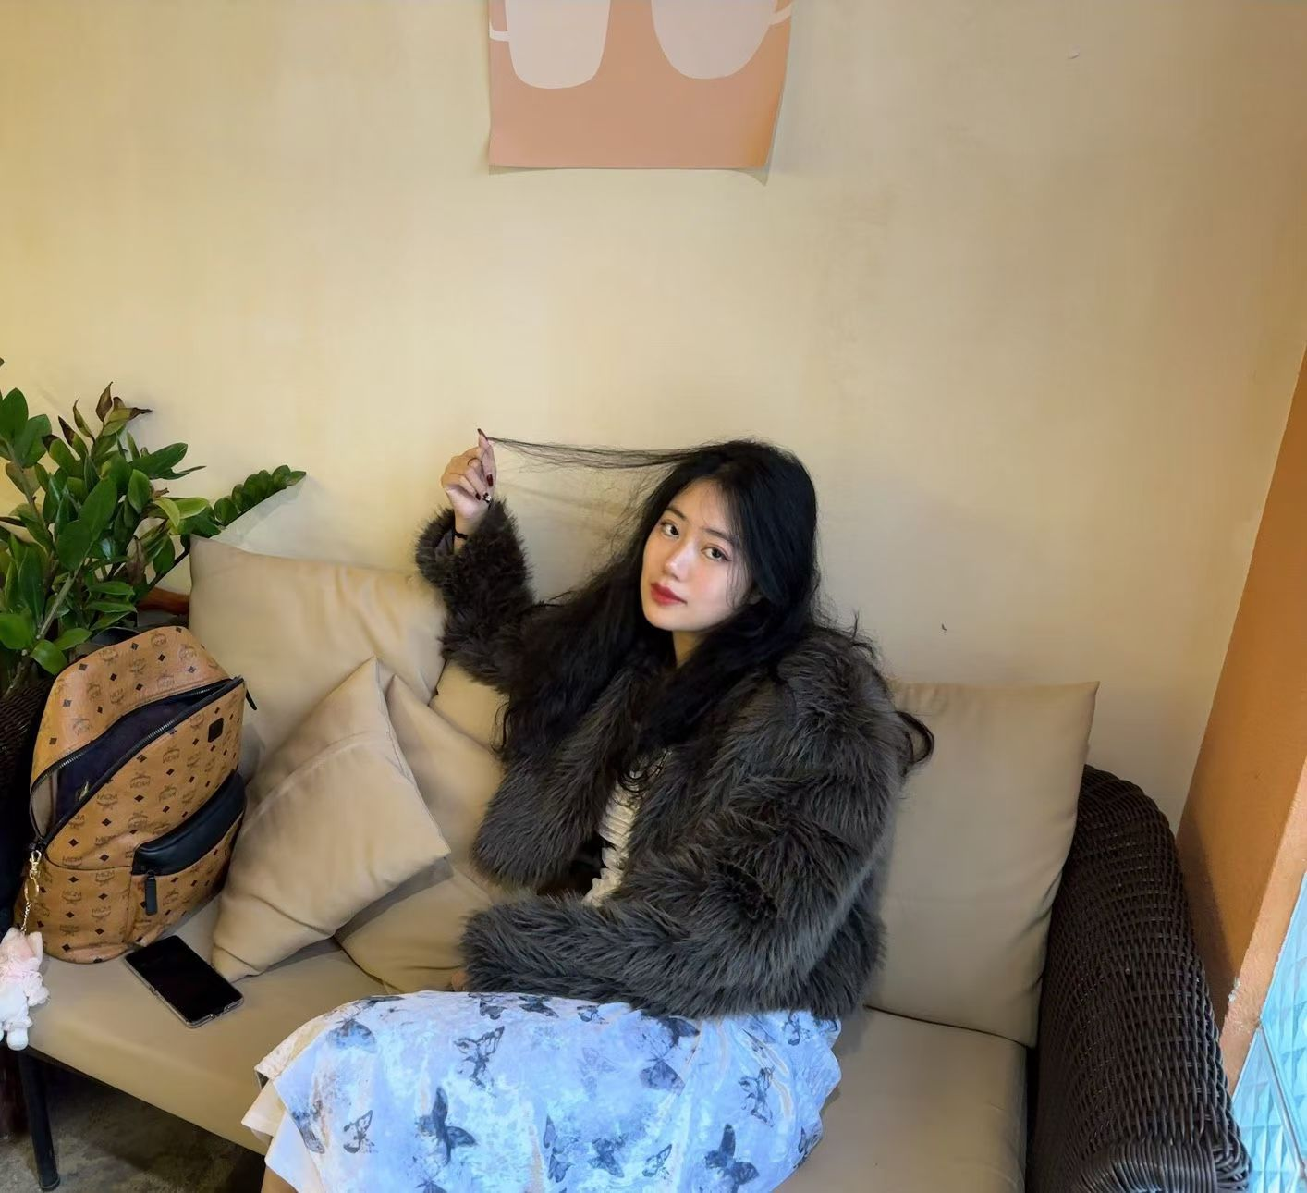
202. Miao Silver Ornaments Culture p. 1827 (Yang Hanxu/Hansu)

Slide 9
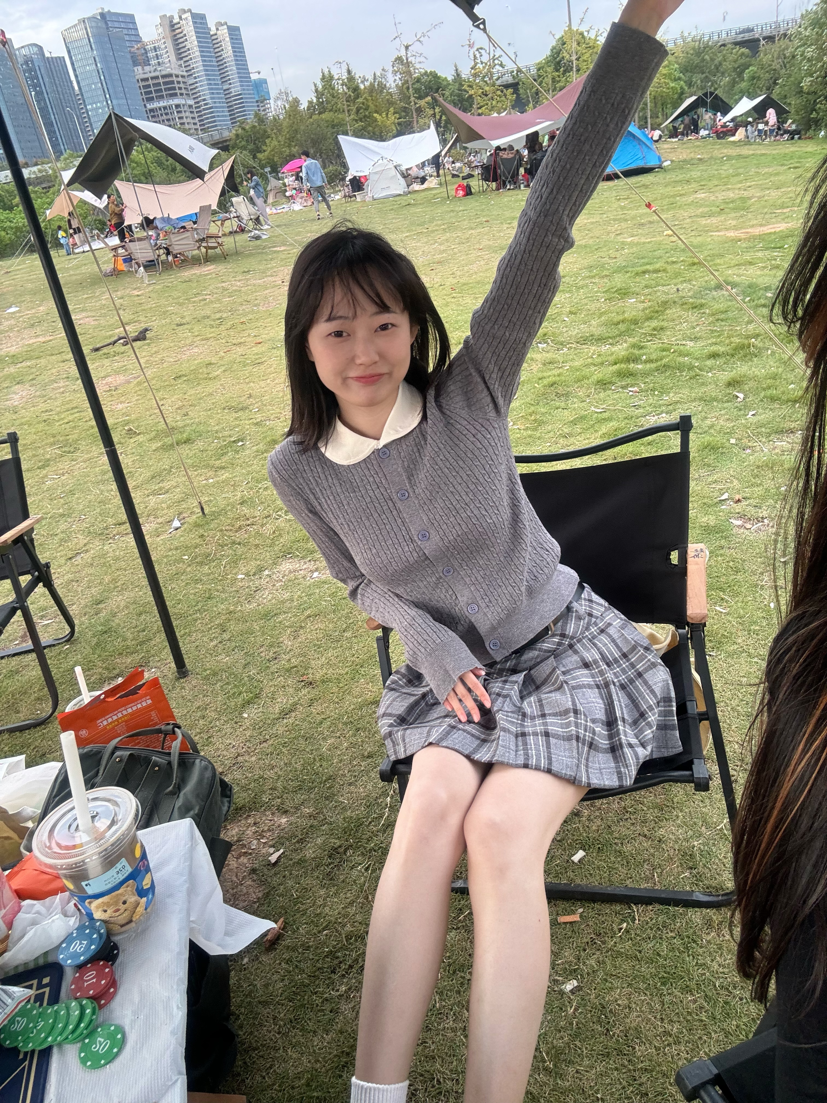
203. Facial Physiognomy 相面术 p. 1836 (Zhou Xiaoqiao）

Slide 10
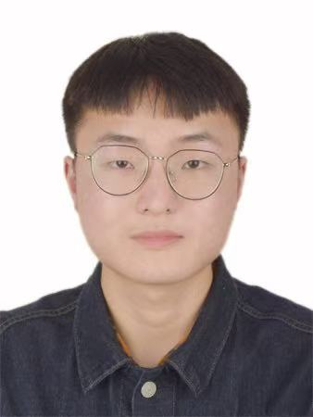
204. Games: Chinese Chess 游戏：象棋 p. 1847 (Zhou Xukai/Kyrie)

Slide 11
Prepare for next time
Homework:
1. Please read the six texts for next time in the textbook.
2. Please add your final exam paper topic and your name in the respective section above.
3. Take the surveys (EU: https://wn8ae3qwafbc11zv.mikecrm.com/9gdWrQT
, 2024: https://wn8ae3qwafbc11zv.mikecrm.com/CTrdOjm).

Slide 12
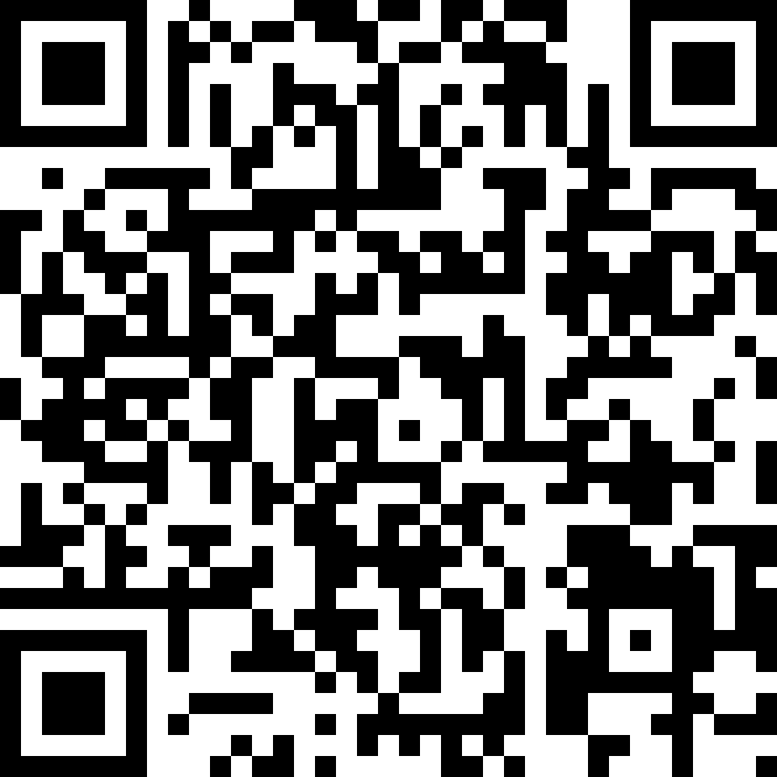
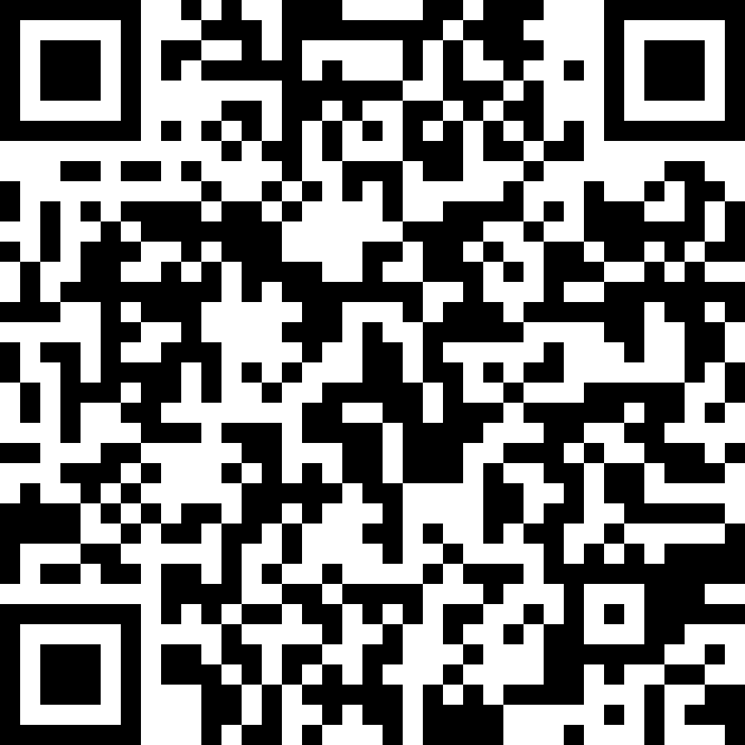
Questionnaires
EU
https://wn8ae3qwafbc11zv.mikecrm.com/9gdWrQT
2024 https://wn8ae3qwafbc11zv.mikecrm.com/CTrdOjm

