Slide 1
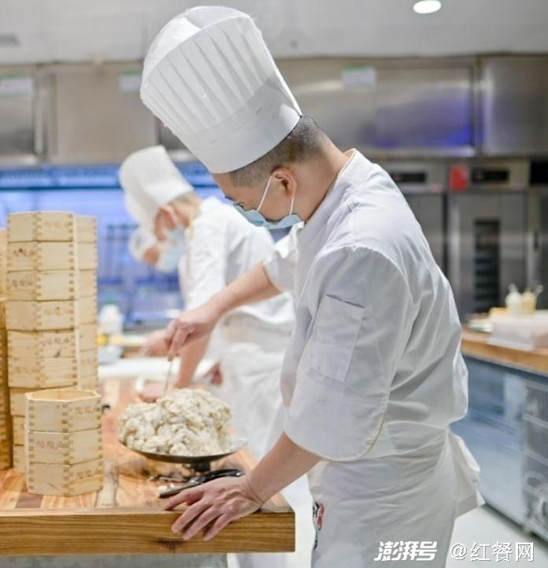
Modern Evolution of Guangdong Breakfast

Slide 2
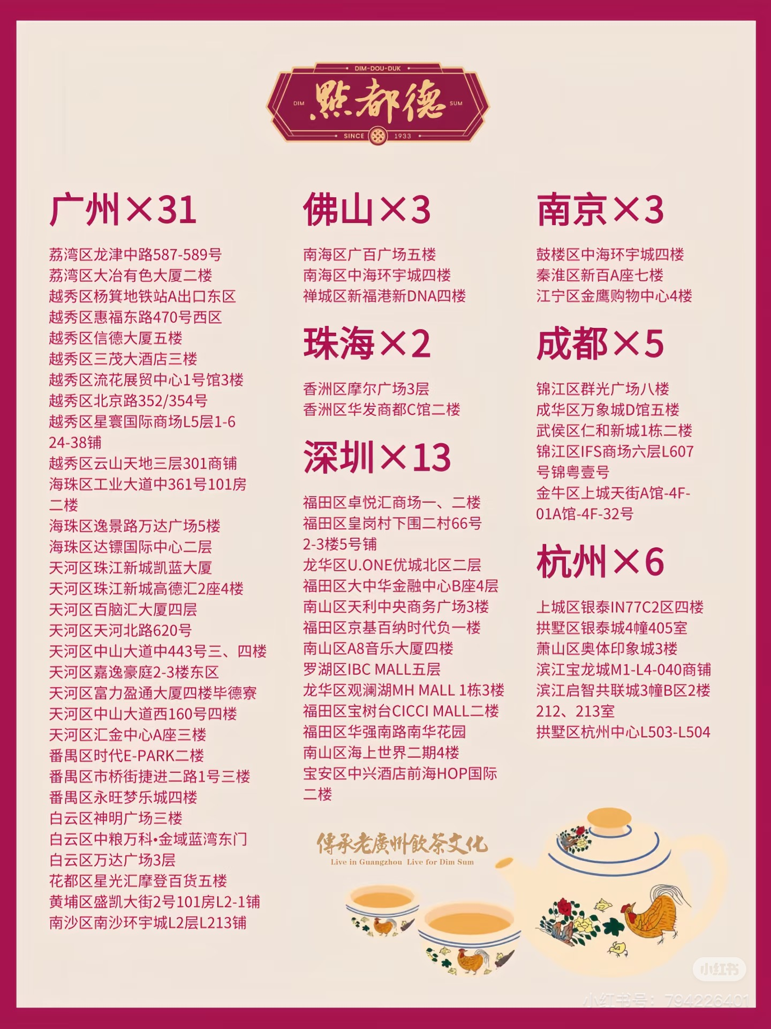
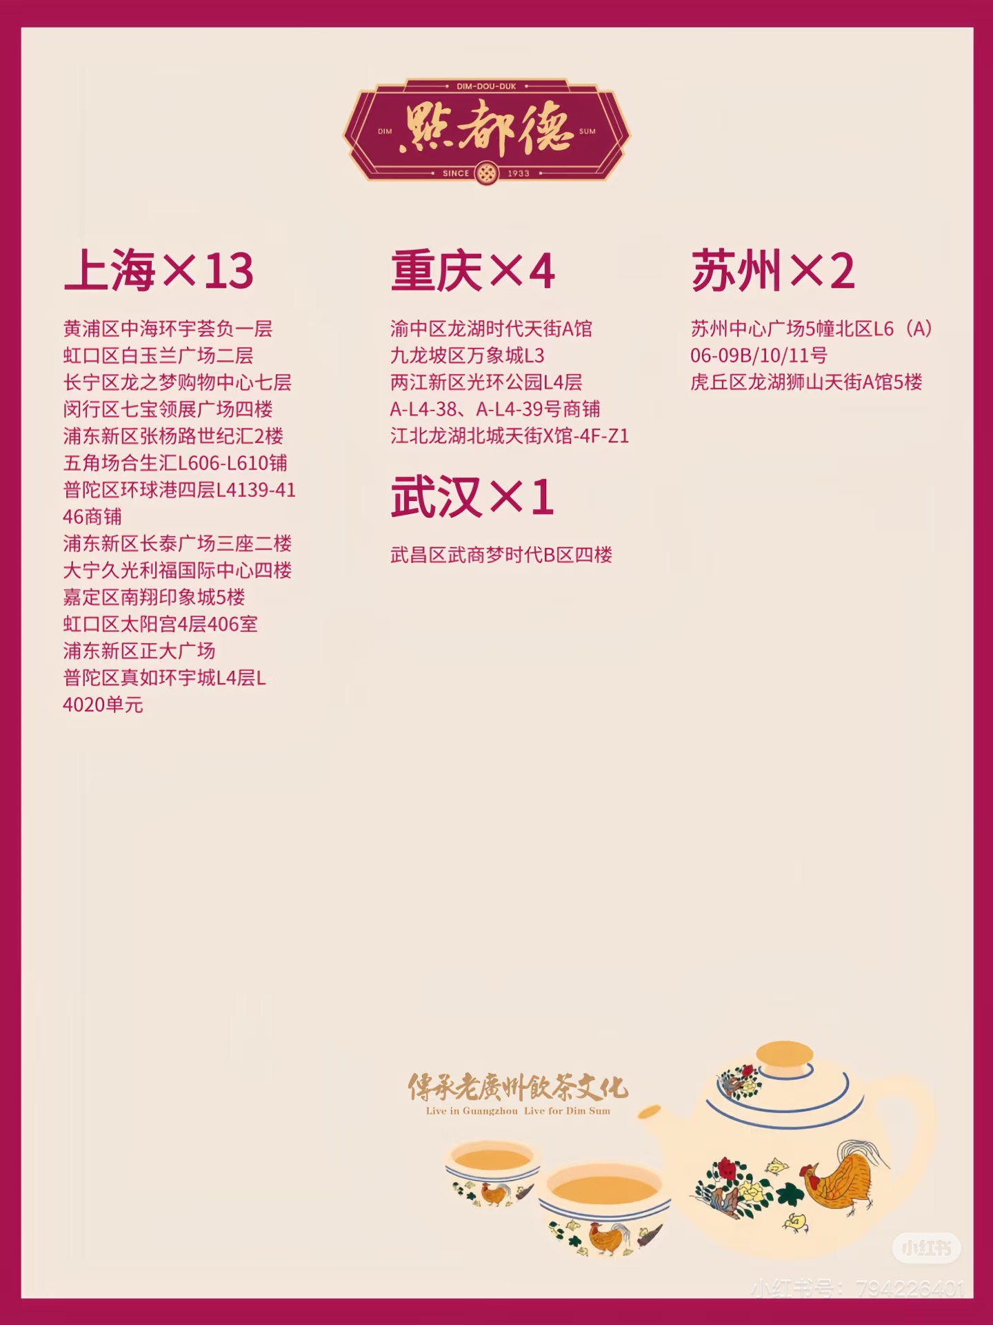
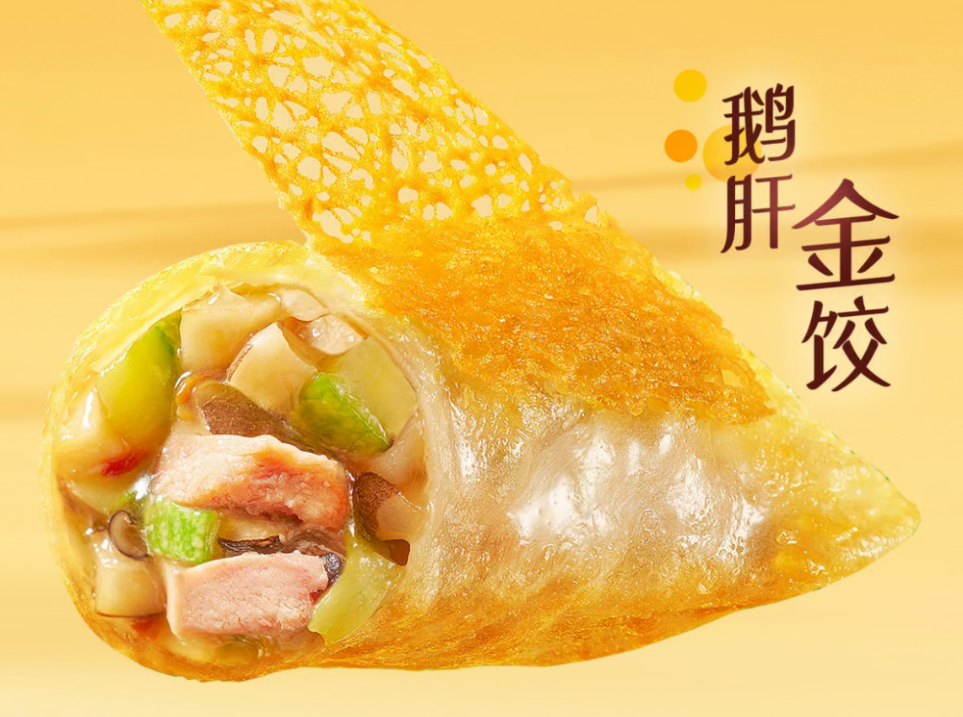
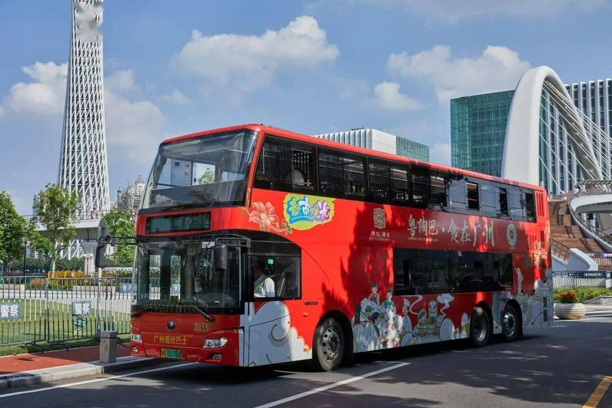
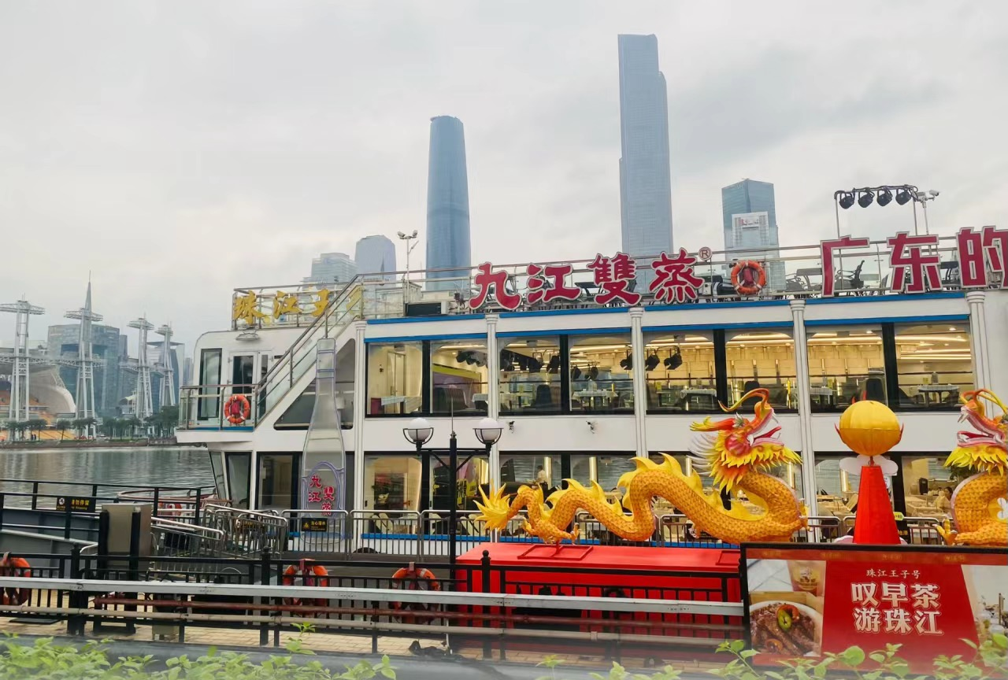
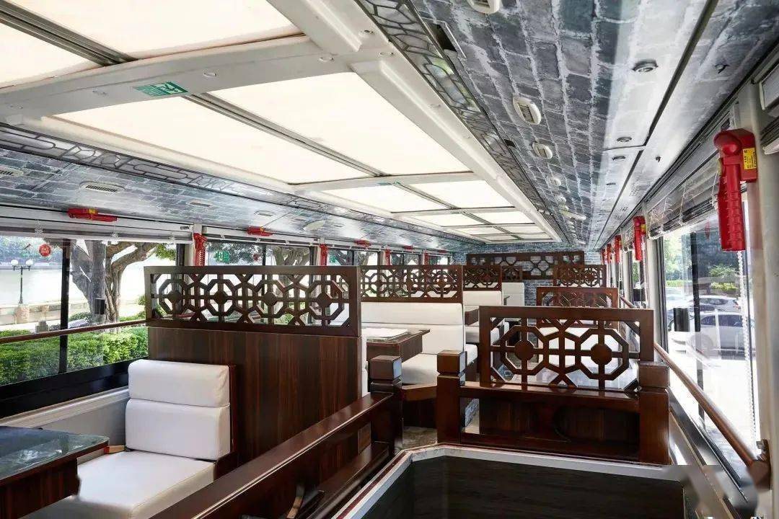
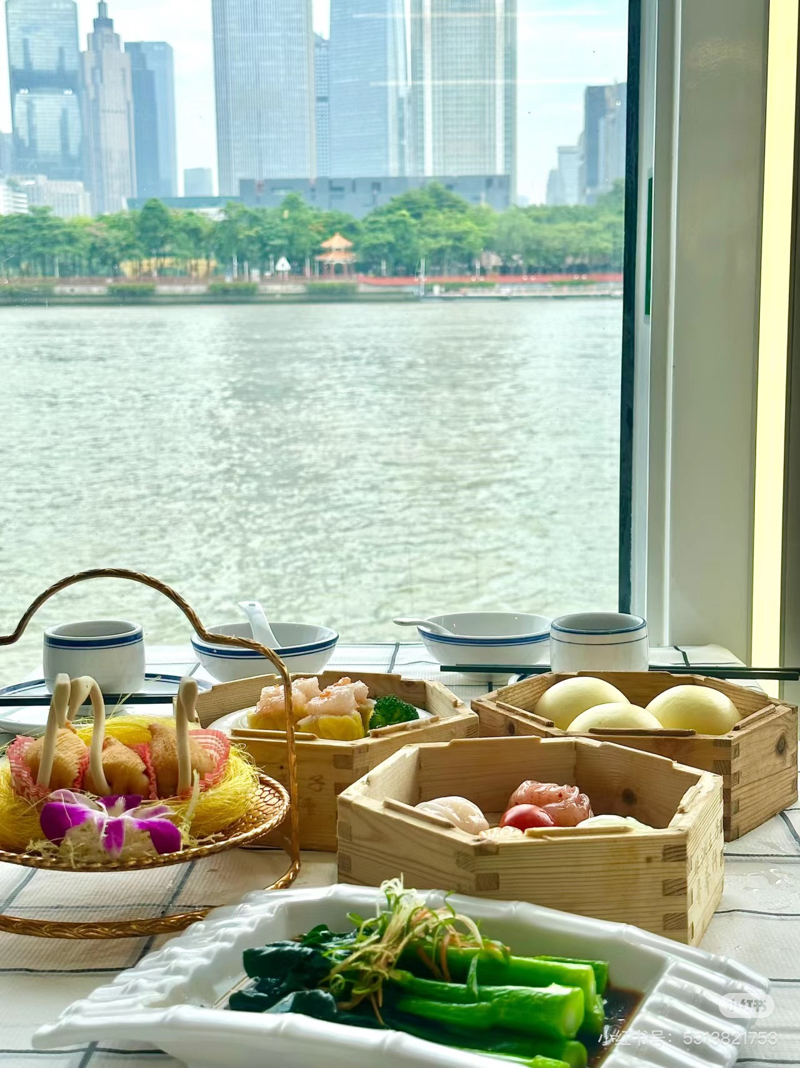
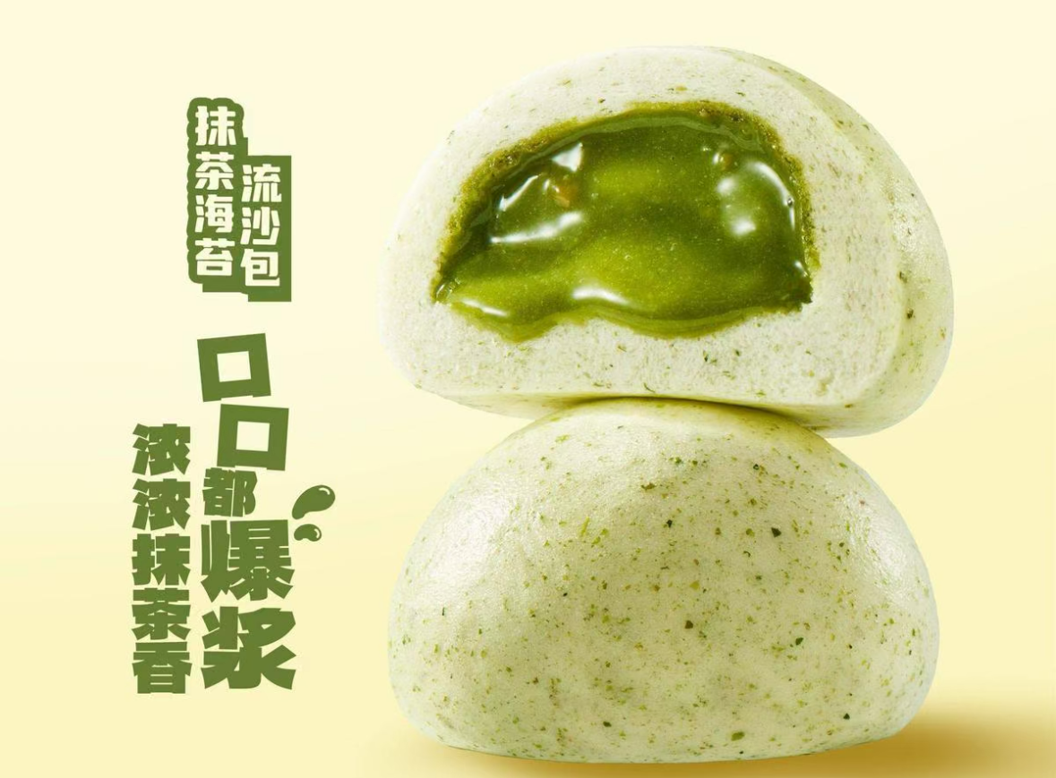
Modern Evolution of Guangdong Breakfast
Chain Brands
Take-out Services
Eating on Board
Fusion Foods
Eg. 点都德（dim2 dou1 dak1）
Eg. Meituan & Eleme
Eg. travelling bus or ship breakfast
Eg. Foie gras fried jiaozi & steamed bun with custard and matcha fillings

Slide 3
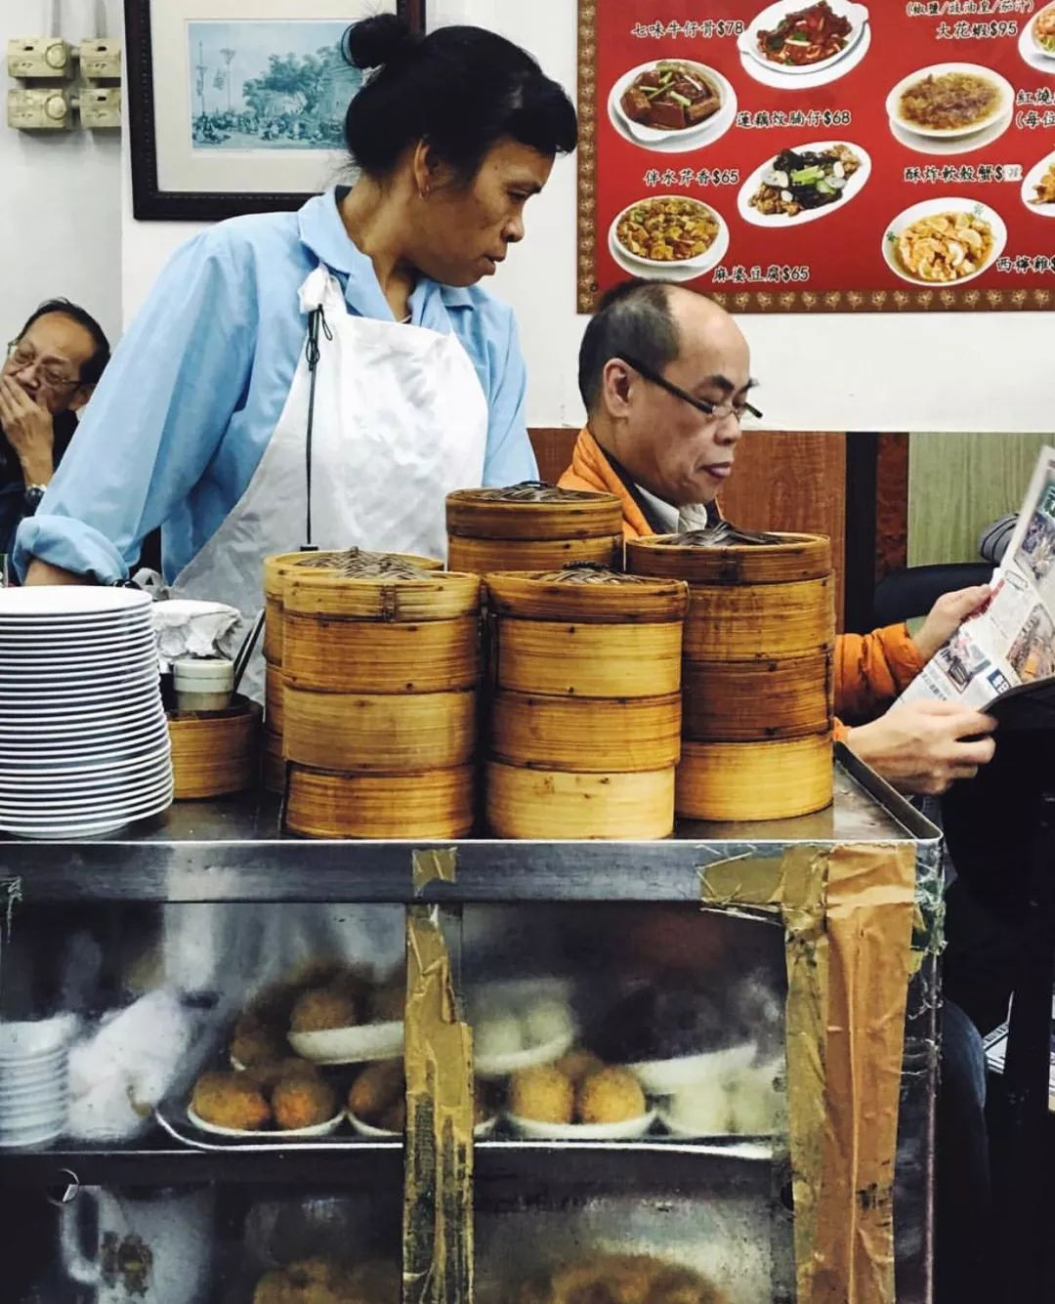
Questions and Bonuses

Slide 4
Questions and Bonuses
01
What are the common types of tea in Guangdong teahouses? Name 2 or 3 in Cantonese.
02
What is the King of daily Guangdong breakfast? In Cantonese.
03
What do the Cantonese usually do when they are in breakfast stores or teahouses?
04
Where you can have Guangdong dim sums besides teahouses on land?

Slide 5
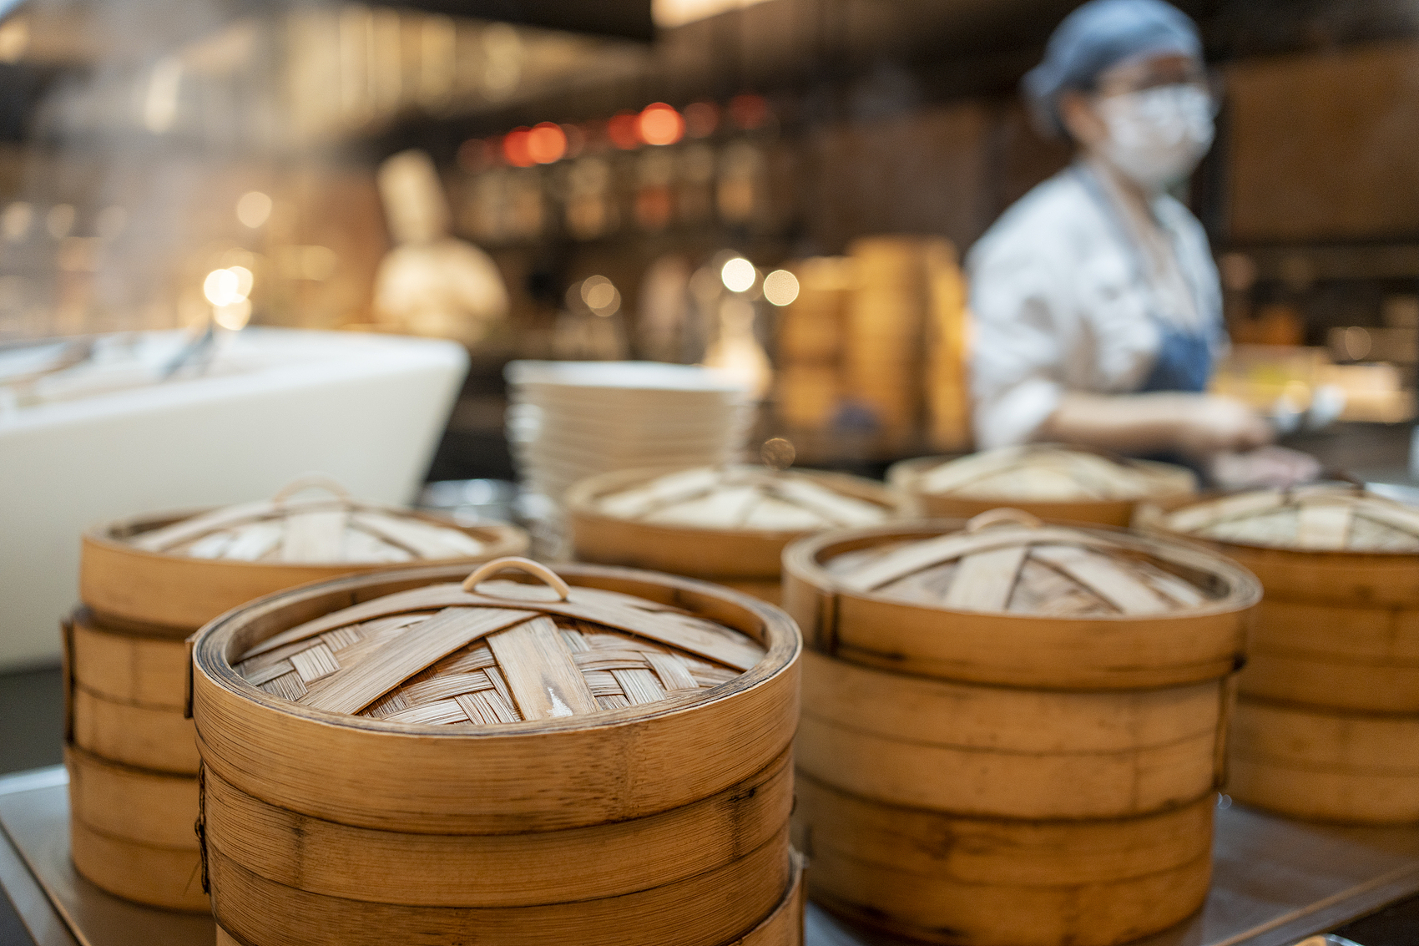
Thanks for watching! 得闲饮茶!

