Slide 1
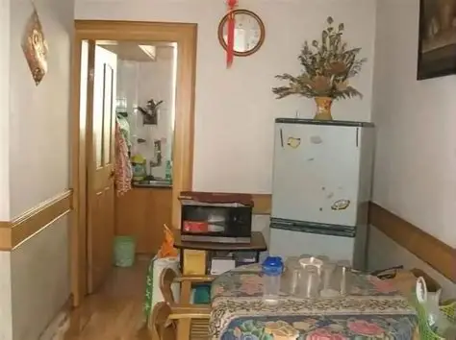

Blurred Dreams Hidden in Memories
CHINESE DREAM-CORE
2025.10.16

Slide 2
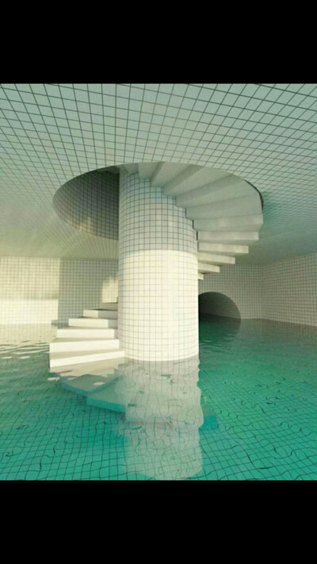
DO YOU DREAM ?

Slide 3
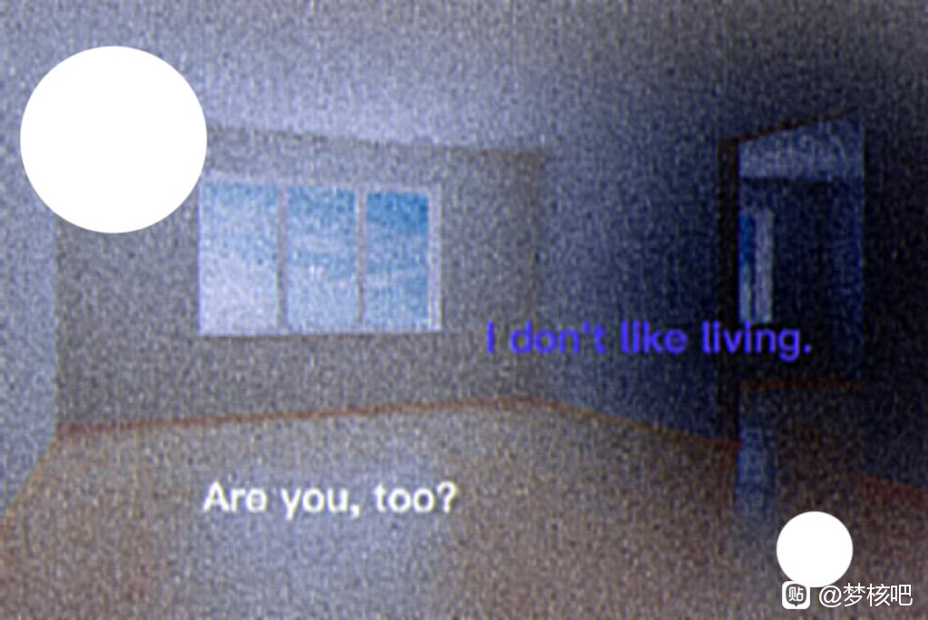
DID YOU HAVE A NIGHTMARE ?

Slide 4
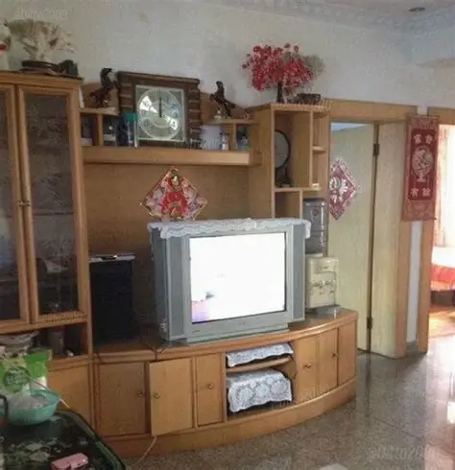
WHAT IS DEARM-CORE ?

Slide 5
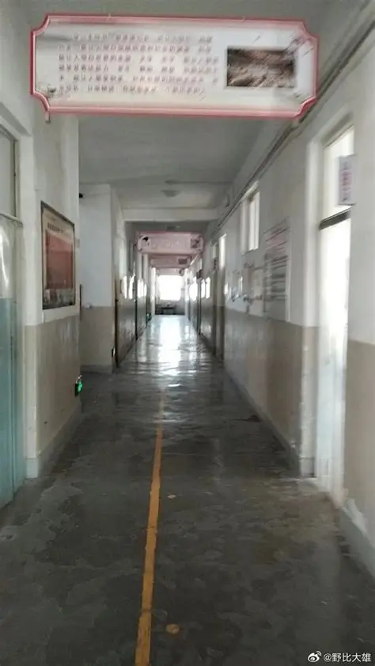
CŒUR
“Heart”、“stubborn or unyielding minority group”、“core art”
DREAM-CORE
Escape and nostalgia
BEING POPULAR IN CHINA
Because of the COVID-19

Slide 6
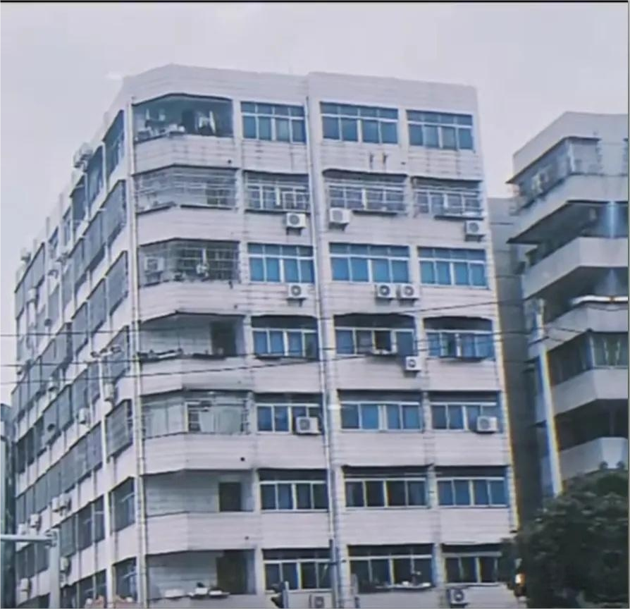
Chinese Dream-core
It uses images which are similar to chinese lives and adds some strange details to simulate a sense of dream.
It makes you feel familiar but unsettling.

Slide 7
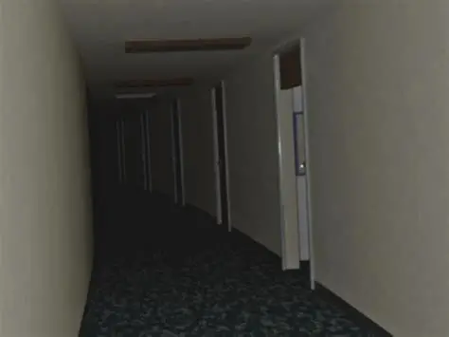
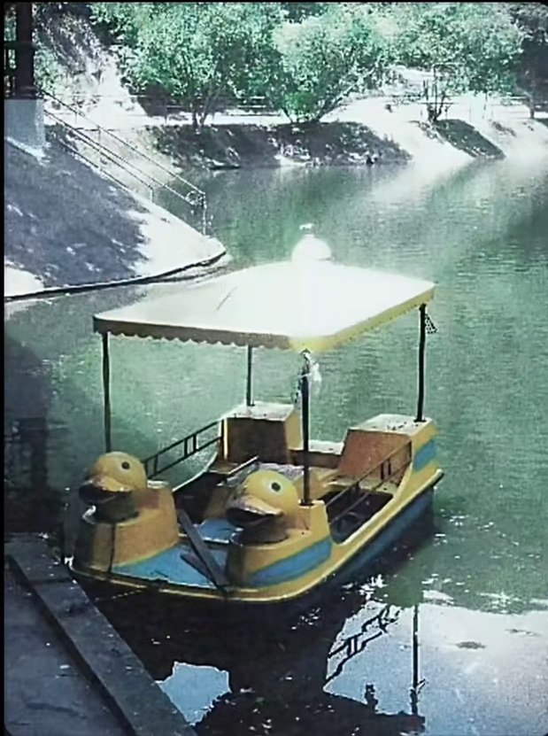
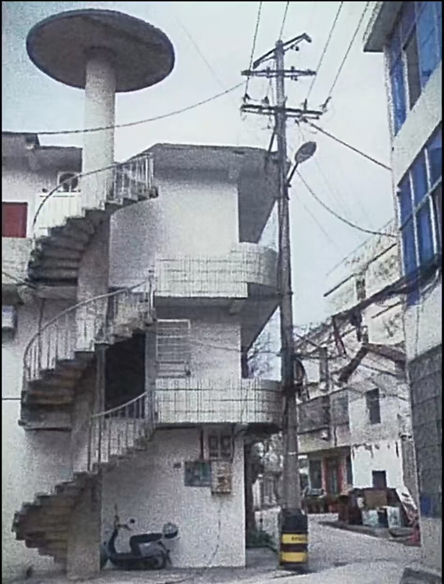
Try to imagine......
an endless corridor
an old boat
an empty building

Slide 8
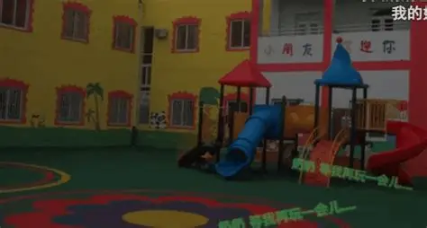
Its charms:
Connection with childhood
Energy and solace brought by blurred effect
Weirdly eerie vibe

Slide 9
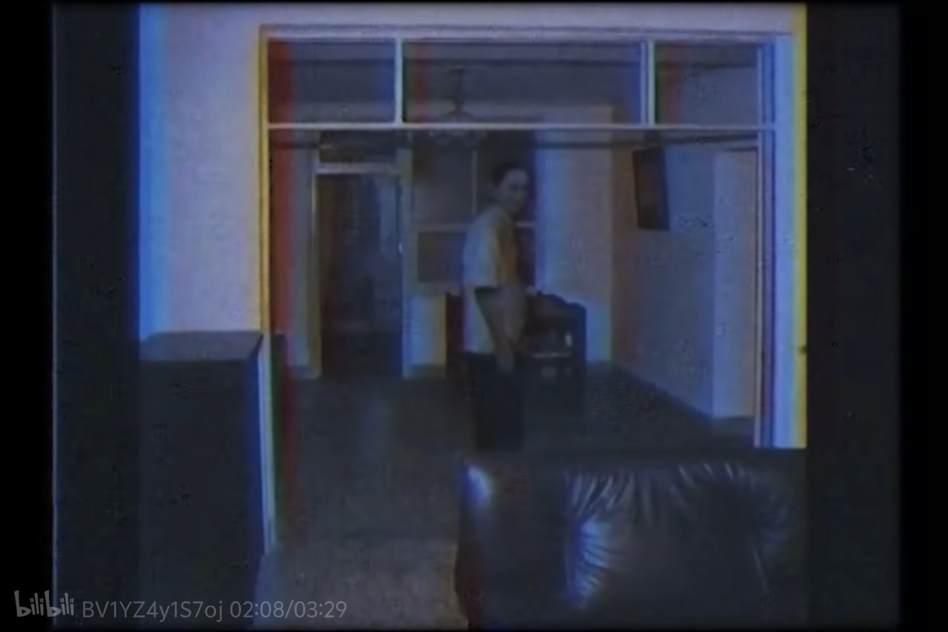

Slide 10
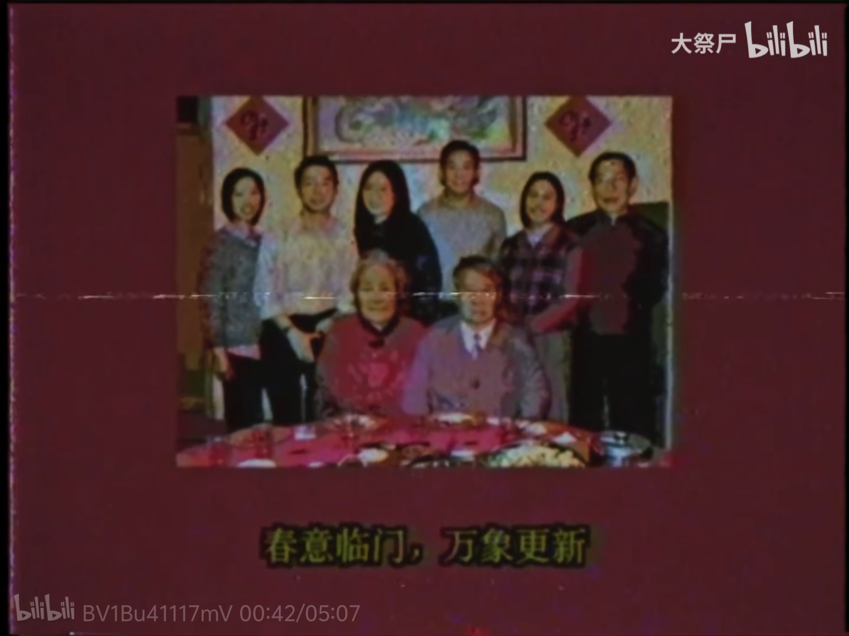

Slide 11
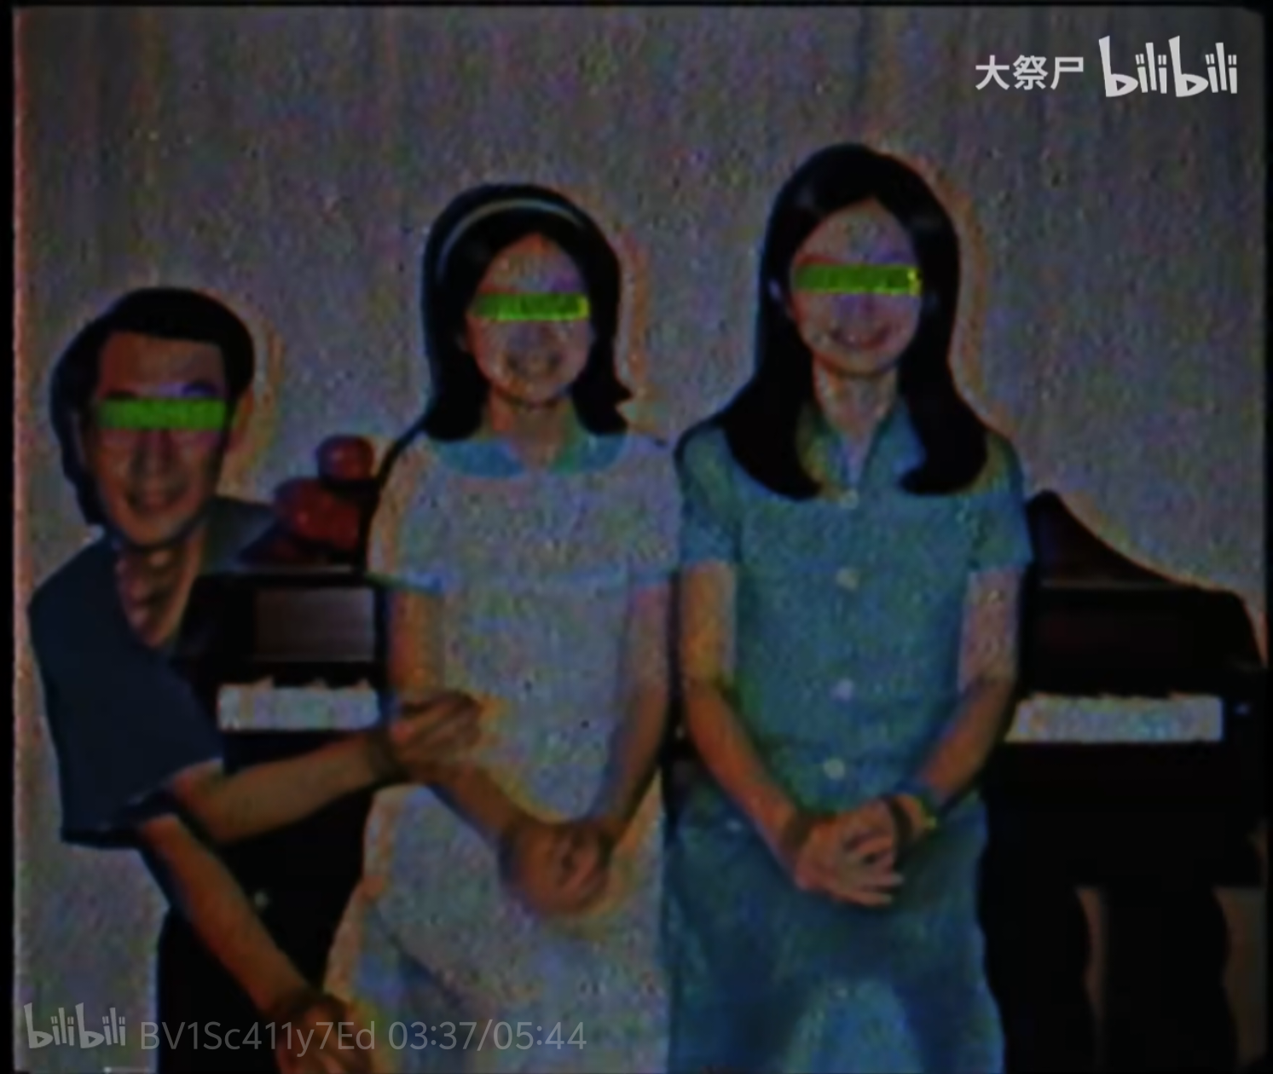

Slide 12
Its methods of creating unease
01.
Vision
02.
Paradox
Ancient pictures、blurred faces、abnormal movements、some characters......
A scene that is close to life yet full of errors,evoking the unfamiliar within familiar memories, generating powerlessness.

Slide 13

Characteristics of Chinese Dream-core:
Collective memory
More warmth than uneasiness
Cultural Identity

Slide 14
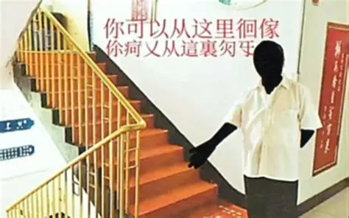

Slide 15
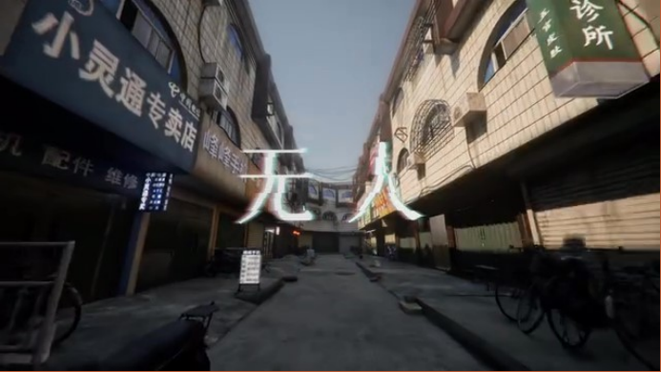

Slide 16
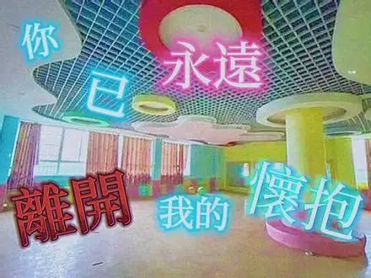

Slide 17


谢谢您的观看
Thank you for watching
汇报人：曾凌楷

