Slide 1
Lin Yutang' s Translation Aesthetics
Handout：石丽青 Shi Liqing
PPT：罗安怡 Luo Anyi

Slide 2
Introduction
The Origins of Lin Yutang' s Aesthetic Views on Translation
Analysis of Lin Yutang' s Aesthetic Views on Translation
Conclusion

Slide 3
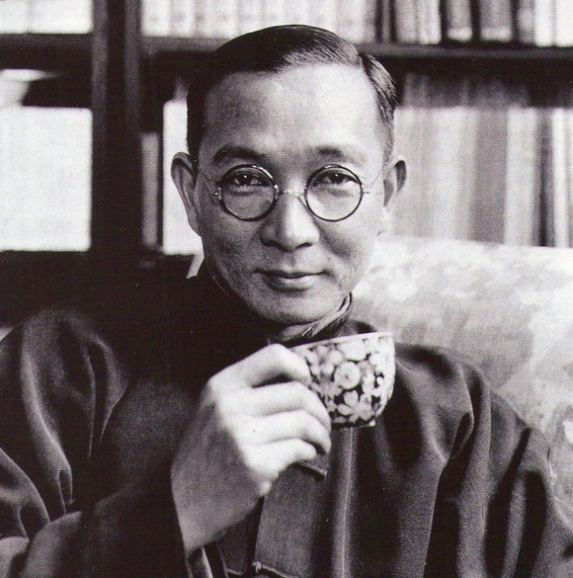
Introduction
Famous Chinese bilingual translator, novelist, philosopher
He once wrote on his fortieth birthday a couplet to himself:
" One mind seeks the learnings of ancients and moderns;
two legs straddle the cultures of East and West."
林语堂 Lin Yutang
(1895-1976)

Slide 4
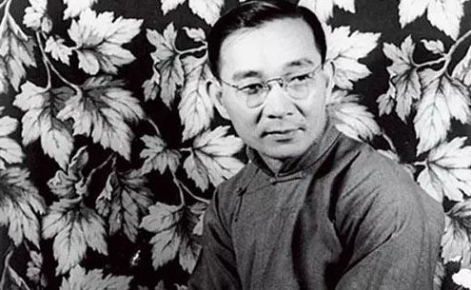
—— The cultural ambassador who built up the bridge between the East and the West
Works：
My Country and My People；
The Importance of Living；
Six Chapters of a Floating Life and Moment in Peking （Trans);
.......

Slide 5
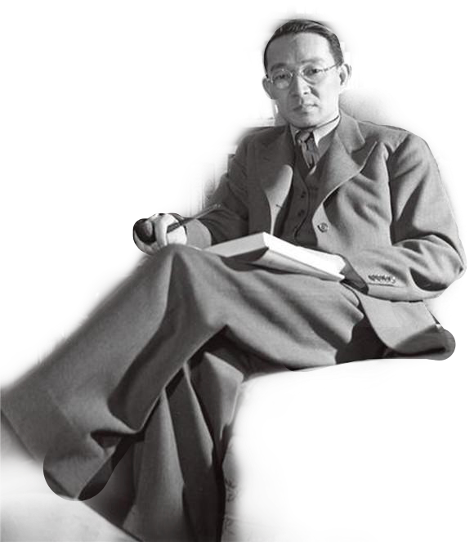
“On Translation”
“Faithfulness”, “Smoothness” and “Beauty”;
“Translation is an art”;
Lin supposed that a perfect translation should not only be faithful to the original text, be smooth in target language, but also be beautiful in writing;

Slide 6
The Origins of Lin Yutang' s Aesthetic Views on Translation

Slide 7
I. Take-in from Western Aesthetic Views
“Aesthetic” by German philosopher Alexander Baumgarten: the sensuous feeling from physical things in life.
“Aesthetic” by Immanuel Kant: the beauty both in art and in nature.

Slide 8
Western translation aesthetics theory
Transformation of ideas, contents and expression modes
Transformation of language
The purpose of translation aesthetics:
Analyzing and conveying aesthetic ideas in
Source Text (ST) under the guidance of basic principles of modern aesthetics.
When interpreted to Target Text (TT),
it is supposed to reserve the beauty of the original text.

Slide 9
Lin Yutang:
“ Translation is a kind of art in which the translator need to take its aesthetic values into consideration.”

Slide 10
II. Take-in from Chinese Traditional Culture
Confucianism
Taoism: leisure, nature and truth
“Leisure came from a temperament , was erected into a literary cult, and found its justification in a philosophy. It grew out of an intense love of life, was actively sustained by an underlying current of literary romanticism throughout the dynasties, and was eventually pronounced right and sensible by a philosophy of life, which we may , in the main, describe as Taoism”
(Lin Yutang 1984：231)

Slide 11
Lao Zi：Forerunner of Chinese aesthetics
“Tao”(道), “State”(气), “Immanent”(象)
Yan Fu: “Faithfulness, Expressiveness and Elegance”
(“Xin”<信>, “Da”<达>, “Ya”<雅>)

Slide 12
Analysis of Lin Yutang' s Aesthetic Views on Translation

Slide 13
I. Lin Yutang' s Views on Translation
“Translation issues were the issues of words and psychology.”
(Lin Yutang 1984: 261)
“...The first one is the criterion of faithfulness, the second one is the criterion of smoothness, and the third one is the criterion of aesthetic quality.” (Lin Yutang 1984: 260)
“The translator's responsibility for the original author, for the target readers and for the arts.” (Lin Yutang 1984: 260)

Slide 14
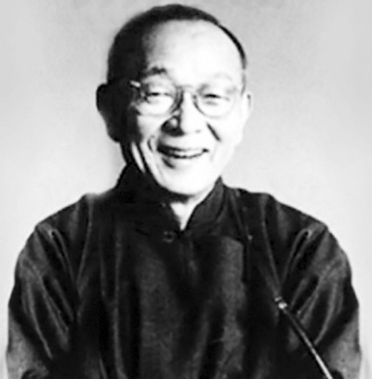
II. Interpretation of “Aesthetic Quality”
“Aesthetic translation” is the way of expressing his translation. He pointed out that the beauty of a work not only lay in its content, but also in its style.
“An excellent translator should regard his work as an art and treat it like an artistic art, be conscientious in dealing with it as with art, and then make translation a fine art.”

Slide 15
CONCLUSION

Slide 16
Reference
Lin Yutang, The Importance of Living. New York: the Modern Library, 1998.
Lin Yutang, Six Chapters of a Floating Life. New York: the Modern Library, 1998.
Lin Yutang, Moment in Peking. Beijing: Foreign Language Teaching and Research Press, 1999.
Lin Yutang, My Country and My People. Beijing: Foreign Language Teaching and Research Press, 2000.
Luo Xinzhang [罗新璋]，翻译论集. 北京：商务印书馆，1984.
Liu Miqing[刘宓庆]，翻译美学导论. 北京：中国对外翻译出版公司，2005.

Slide 17
THANKS

