Slide 1





MilkTea
By:Agnes

Slide 2


CONTENTS
The Origin of Milk Tea
The Development of Milk Tea
A Comparison of Oriental and Foreign Milk Tea
Milk Tea and Health

Slide 3
PART.01
The Origin of
Milk Tea

Slide 4
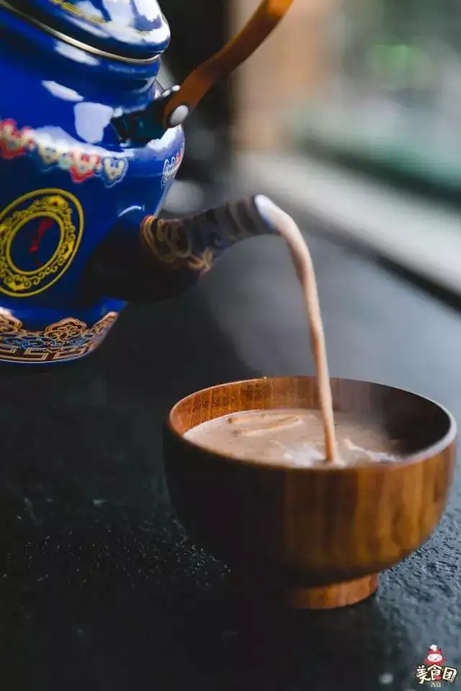
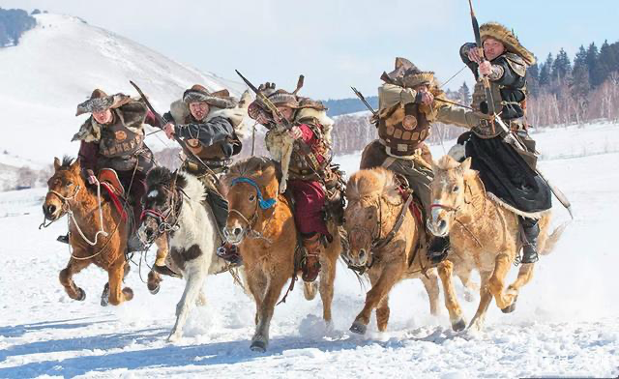
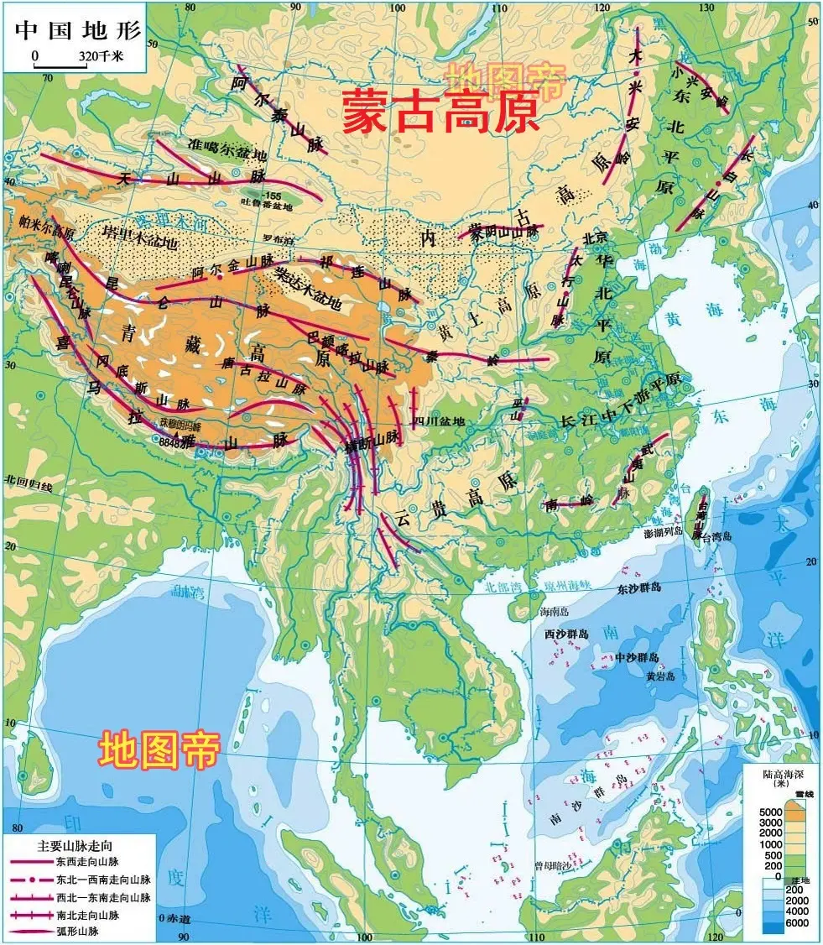
Origin
Mongolia Milk Tea
Nomadic tribes
Mongolia Plateau
Each school holds its own opinion about the origin, but in fact, if we carefully analyse the fact, we can easily find its true origin, that is - ”Mongolia Milk Tea” drunk by nomadic tribes in Mongolia Plateau. Till now, the nomadic tribes living in Inner Mongolia Autonomous Region of PRC still treat visitors with milk tea, which is an unshakable traditional custom.

Slide 5
PART.02
The Development of
Milk Tea

Slide 6
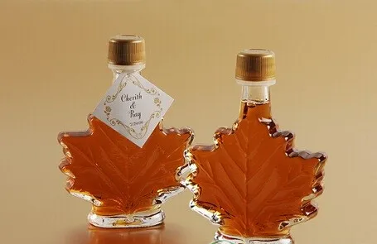
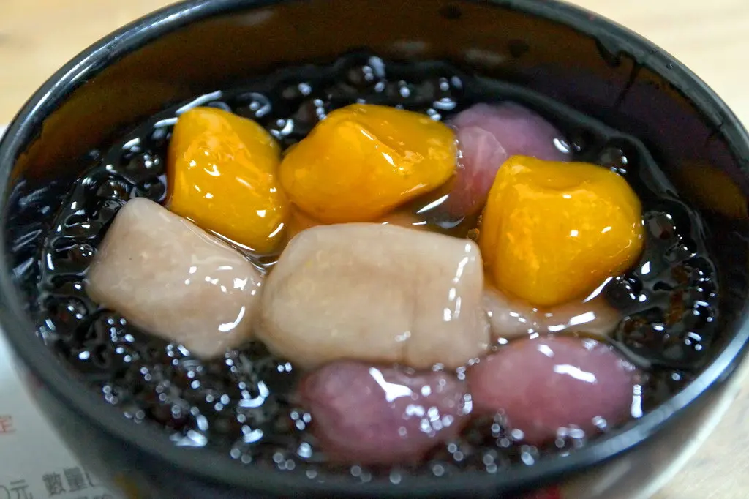
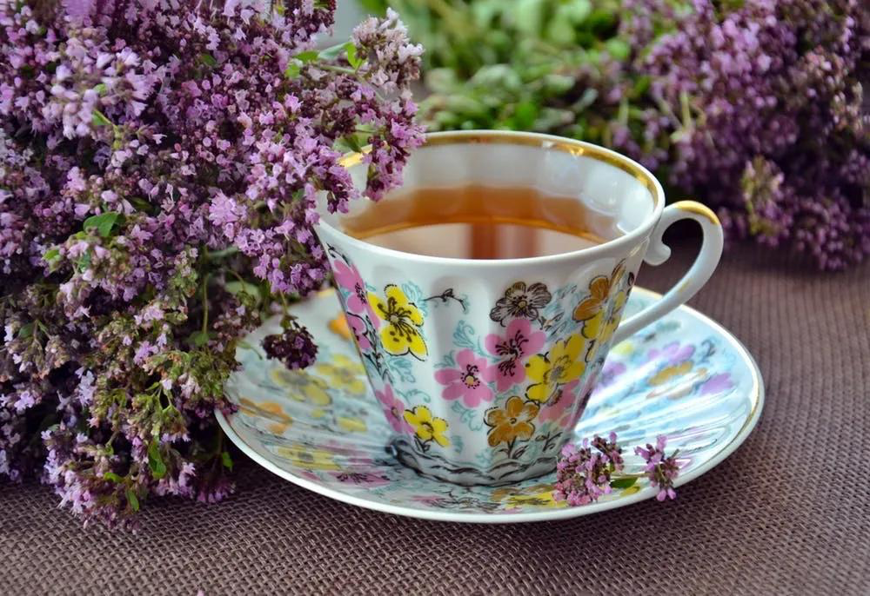
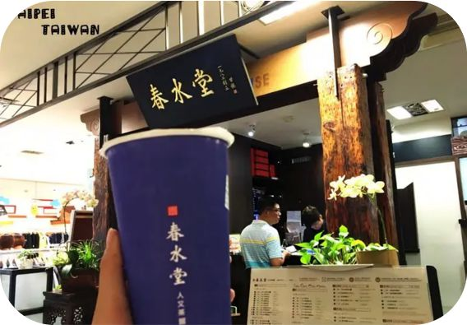
Development
Britain
Taiwan
maple sugar
snack flour
Gave birth to the rudiment of modern
milk tea and its basic ingredients.
Modern milk tea has preliminarily
come into shape.

Slide 7
PART.03
A Comparison of Oriental and Foreign Milk Tea

Slide 8
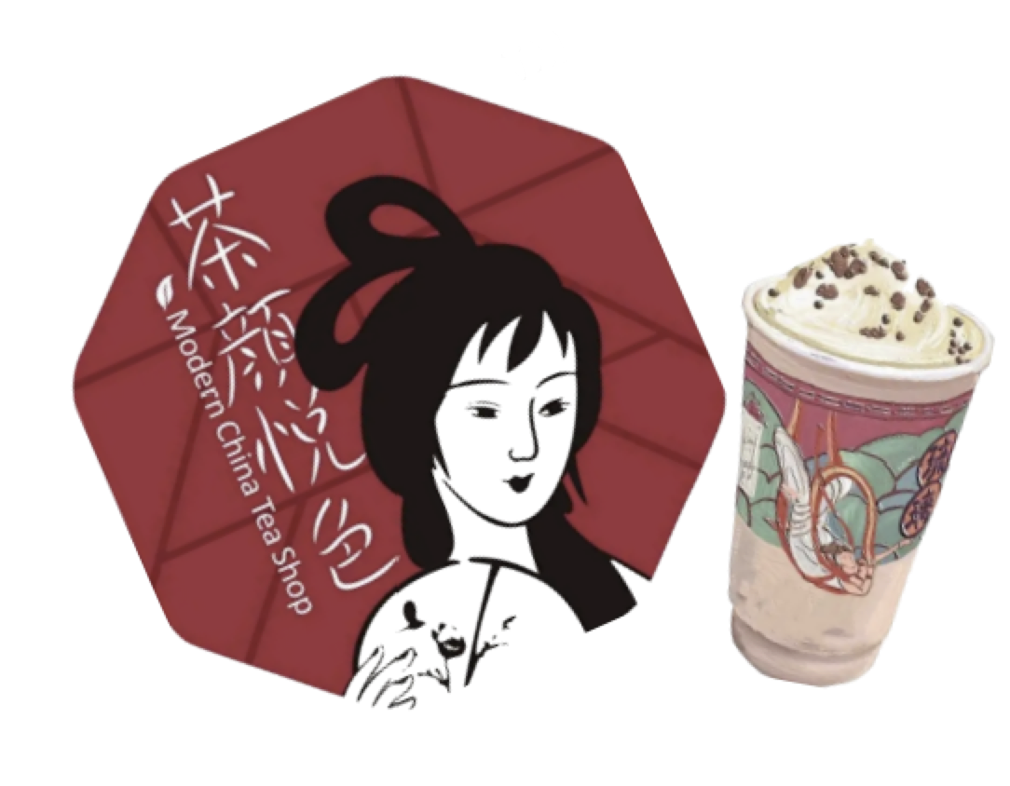

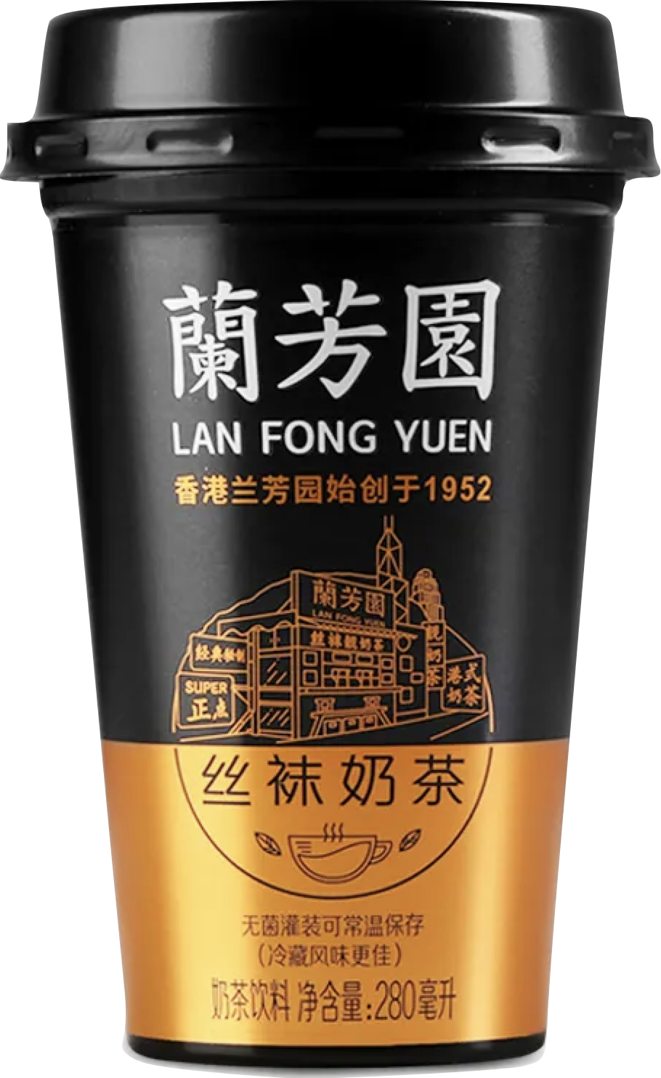
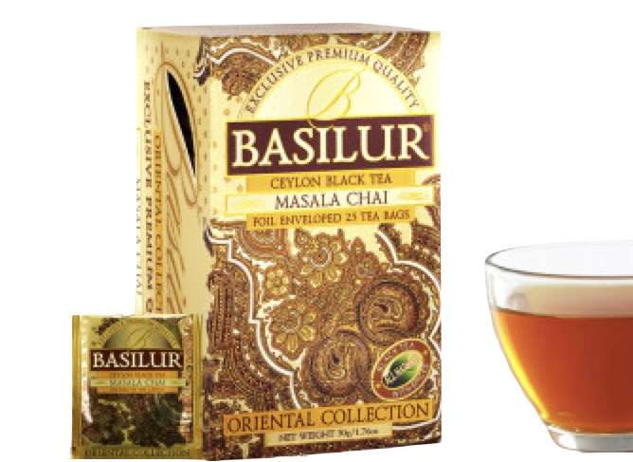
Comparison
Local Changsha Milk Tea
Hong Kong-style milk tea
Indian Masala Chai
Sexytea
Lanfangyuan
Only be drunk
in India
Founded in 2013
Founder Lin Muhe
“Black Tea Latte”
Silk Stockings Milk Tea
Various spices

Slide 9
PART.04
Milk Tea and Health

Slide 10
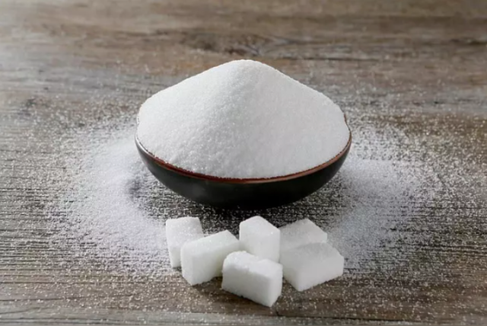




Advantages
Supplement sugar
Mitigate
fatigue
Increase
body
energy
Improve
working
efficiency

Slide 11









Disadvantages
Getting fat
Increasing cholesterol
Hyperlipidemia and Hyperglycemia
Increasing risks of
angiocardiopathy
Causing cancer
Damaging normal gastrointestinal function
Doing harm to liver and kidney

Slide 12
Thank You
By:Agnes

