Slide 1
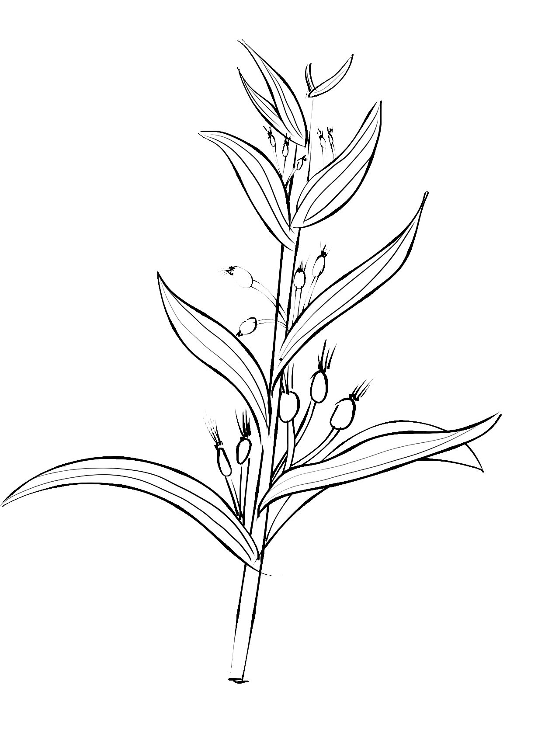
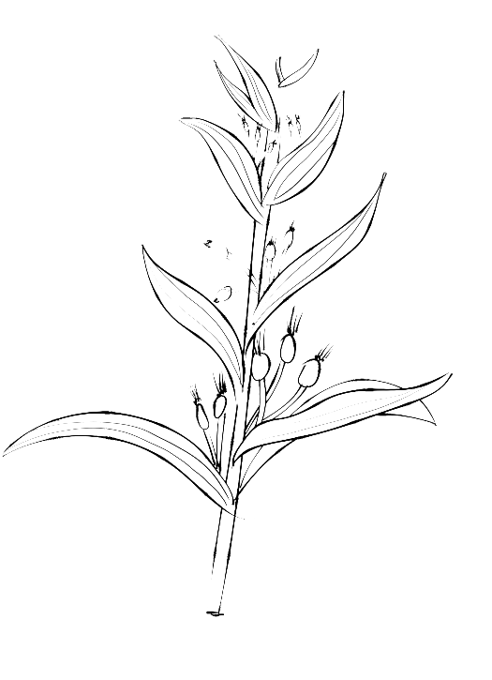
Ambiguity of Chinese Language
Group members: 廖诗韵、李媛、刘唱、邝雨琪
Reporter：邝雨琪、刘唱

Slide 2
CONTENT
01 Definition & Reasons
02 Classification
03 Function of Ambiguity
04 Ambiguity of Chinese Poetry in Tang Dynasty

Slide 3

Part 01
Definition & Reasons

Slide 4
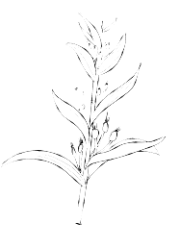
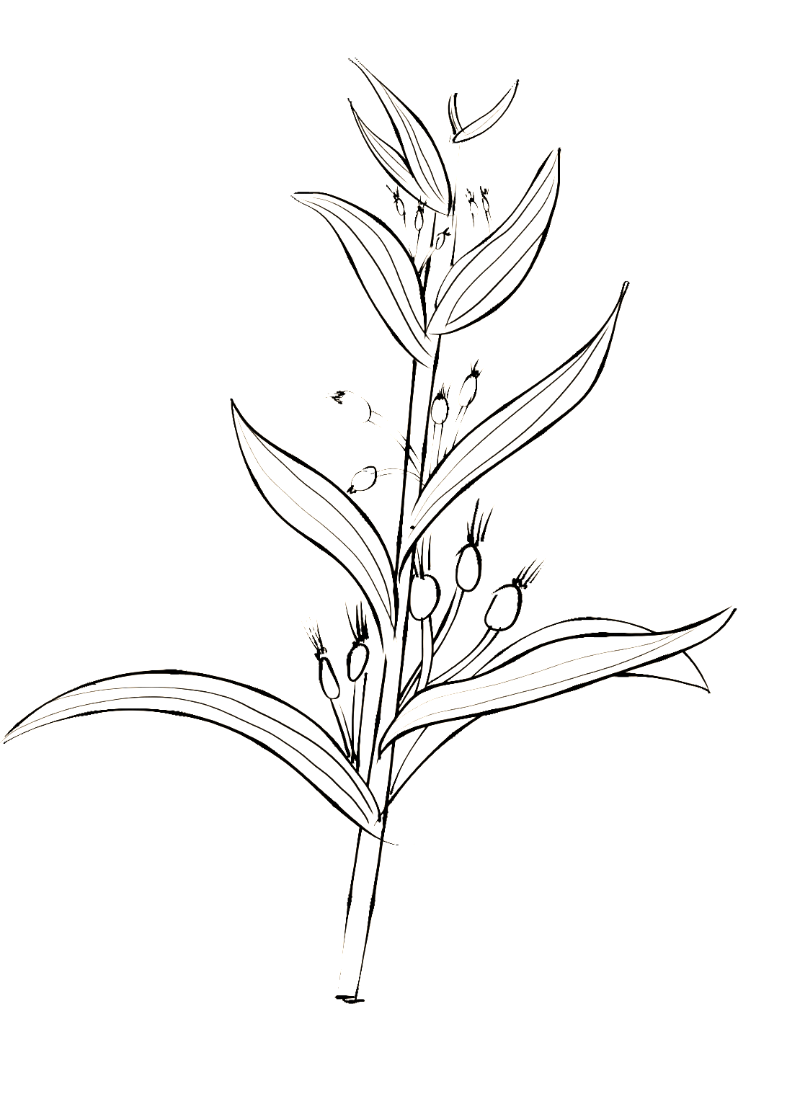
I. Definition of Ambiguity
Ambiguity is a common and interesting phenomenon in all natural languages. Since there is no compulsory correspondence between the form and the meaning of a language, a form can have many meanings.
According to Oxford English Dictionary, ambiguity can refer to the state of having more than one possible meaning. In this regard, the phenomenon of ambiguity in a language means that writing or utterance can be understood in multiple ways, resulting in the uncertainty of meaning.

Slide 5

II. The Reasons for Ambiguity of Chinese Language
Lexical Factors
The Chinese character is a combination of pronunciation, meaning and form. When considering the ambiguity caused by lexical factors, we need to consider the above three elements. In this regard, there are four reasons for ambiguity in Chinese: polysemy, polyphone, homonym and homophone.
Grammatical Factors
Grammar is the grammatical relationship and grammatical structure among words, phrases, sentences and other linguistic units, and the ambiguity in the grammatical level is mainly caused by the complexity of lexis and syntax.

Slide 6
Part 02
Classification of Ambiguity of Chinese
PPT模板 http://www.1ppt.com/moban/

Slide 7
III. Classification of Ambiguity of Chinese
phonetic ambiguity
grammatical ambiguity
pragmatic ambiguity
lexical ambiguity
semantic ambiguity

Slide 8
III. Classification of Ambiguity of Chinese
phonetic ambiguity
Pragmatic ambiguity
lexical ambiguity
homophone
"石"“食”“十”
"法制" and "法治"
polyphone
“薄”
"báo" "bò" and "bó"
the different understandings of the meaning of a word
“他原来是医生”
"He turns out to be a doctor"
"He used to be a doctor"
mainly generated in the process of people's interaction and communication, referring to the possibility of different understandings of a certain discourse in different contexts.
“你可真行” praise or irony

Slide 9

III. Classification of Ambiguity of Chinese
grammatical ambiguity
different structural relations
eg: "他们老师工作很努力"
different syntactic divisions
eg: "咬死了猎人的狗" （咬死了/猎人的狗）or（咬死了猎人/的狗）
different grammatical functions of multi-category words
eg: "给我看看这幅画" " have a look for me" or " let me have a look"
semantic ambiguity
YOUR TITLE
"她的妈妈明天要做手术" perform or accept ?
"老王有一个儿子，很骄傲" who is proud? 老王 or 儿子 ?

Slide 10
Part 03
Function of Ambiguity
aesthetic function

Slide 11

Function of Ambiguity
When it comes to the function of ambiguity, we usually refer to its special aesthetic function in poetry. The ambiguity space of poetry refers to how many ways a poem (or a word and phrase) can be understood. Without linguistic ambiguity, poetry would lose its unique artistic charm. According to many ancient poetry critics, an important criterion to test whether a poem is an excellent work is to see how many interpretations it can raise.
As the saying goes: "Words have an end but meanings are endless" (Yan Yu, Poem Theory of Candling). Great works tend to have numerous profound connotations and meanings, which have been the subject of endless debate and exploration by generations of readers and critics. This leads to a function of ambiguity, namely, to achieve the beauty of ambiguity in ancient poetry.

Slide 12
Part 04
Ambiguity of Chinese Poetry in Tang Dynasty

Slide 13
Ambiguity of Chinese Poetry in Tang Dynasty
Phonetic Ambiguity
Lexical Ambiguity
Grammatical Ambiguity
Semantic Ambiguity
Pragmatic Ambiguity

Slide 14
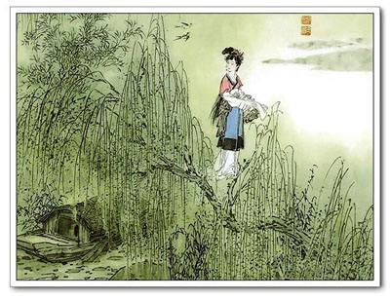
Phonetic ambiguity
《竹枝词》
刘禹锡
杨柳青青江水平，闻郎江上踏歌声。
东边日出西边雨，道是无晴却有晴。
Poets often employ homophone to achieve the aesthetic effect of ambiguity. For example:
This poem indicates a young girl's confusion, affection and wishes after hearing her Mr. Right singing. The key ambiguous character in the poem is‘晴(qing)’, which has the same pronunciation with another character ‘情(qing)’. The former one means the changeable weather, while the later one can refer to the affection of the young girl.

Slide 15
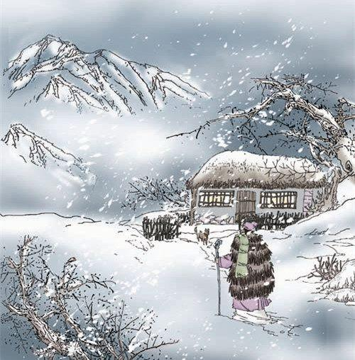
Lexical ambiguity
《逢雪宿芙蓉山主人》
刘长卿
日暮苍山远，
天寒白屋贫。
柴门闻犬吠，
风雪夜归人。
This poem tells that the poet stayed at a man's house in the mountain on a wintry night without too many complex expressions. However, there are a lot of lexical ambiguities in it. Firstly, "苍山" can be understood as a mountain named Cangshan Mountains, or just the far-away vast mountains. Secondly, "白屋" can be interpreted as the white house of the owner cover by the white snow, or the miserable housing condition of the poor owner. Thirdly, who is the "归人"? It can be the poet himself or the owner of the house.

Slide 16
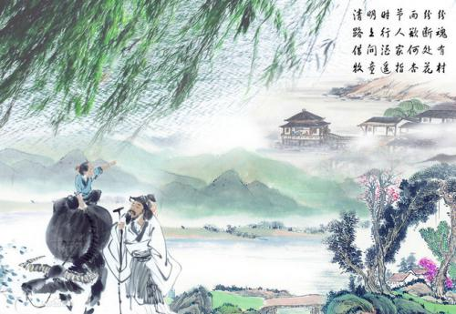
Grammatical ambiguity
《清明》
杜牧
清明时节雨纷纷，路上行人欲断魂。
借问酒家何处有，牧童遥指杏花村。
In poetry, the different division within the lines can make it possible to achieve special effect of ambiguity. It can be divided like this:
清明时节，雨纷纷路上，行人欲断魂。
借问酒家，何处有牧童，遥指杏花村。
In this way, the connotation of the poem has changed dramatically. The original poem says that the shepherd boy helps the pedestrian to find the wineshop, but the changed one says that the owner of the wineshop helps the pedestrian to find the shepherd boy.

Slide 17
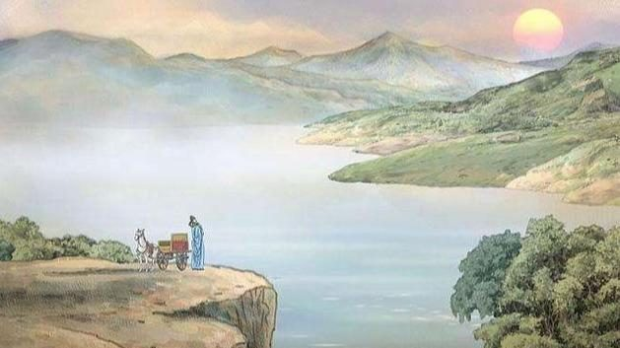
Semantic ambiguity
《乐游原》
李商隐
向晚意不适，驱车登古原。
夕阳无限好，只是近黄昏。
A single word will have different semantic orientations, and can convey a deeper meaning through the surface words. The last two lines of this poem “夕阳无限好，只是近黄昏” depicts a picture of "the afterglow of the sun, the sunset filling the sky, and the coming of the quiet night". But the semantic orientation of "黄昏(dusk)" is uncertain. The poet's sense of the decline of the times, the pain of the sinking of the family and country, and the sadness of his life are all integrated together in the picture of the scene at dusk, giving the poem a profound philosophical meaning that has been widely quoted in later times.

Slide 18
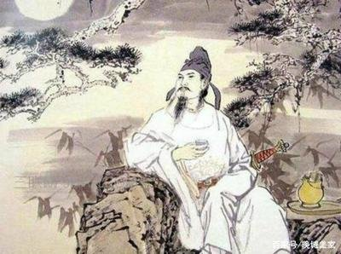
Pragmatic ambiguity
《锦瑟》
李商隐
锦瑟无端五十弦，一弦一柱思华年。
庄生晓梦迷蝴蝶，望帝春心托杜鹃。
沧海月明珠有泪，蓝田日暖玉生烟。
此情可待成追忆，只是当时已惘然。
The poem is one of the most ambiguous of all, and its subject is so diverse that it has been interpreted in a wide range of ways. Some say it is a summary of the poet's life in his later years, some think it is a poem of mourning, some think it is a poem of remembrance for a female Taoist priest who had an affair with the poet, and others say it is a poem about a musical instrument. In fact, the different understanding of the implicit subject of a poem is its charm and beauty, which allows it to display new vigor and vitality in different times.

Slide 19
References
[1]谢思炜. 汉语诗歌歧义句探析[J].武汉科技大学学报(社会科学版), 2018, 20(03):342-348.
[2]向晓云. 浅析汉语中的歧义现象[J]. 北方文学, 2016(13):169.
[3]王婕妤. 浅谈汉语中的歧义现象[J]. 散文百家(理论), 2021(07):102-103+129.
[4]https://baijiahao.baidu.com/s?id=1722888657165142661&wfr=spider&for=pc[Z]. 2022.

Slide 20
Thanks！

