Slide 1
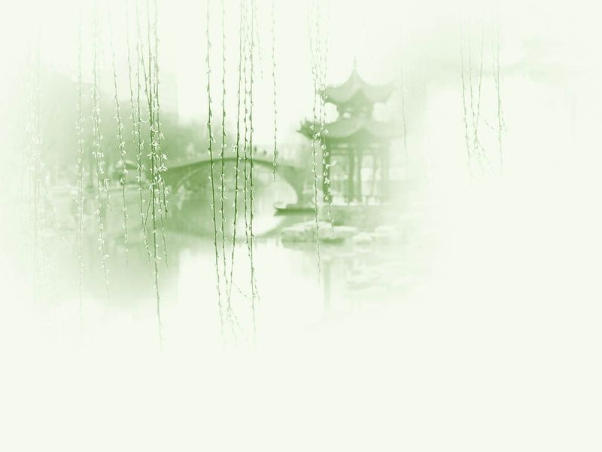
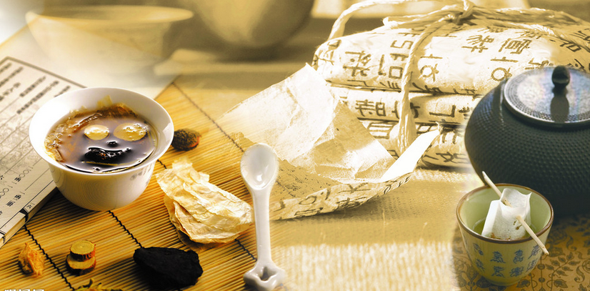
Unit 11 Traditional Medicine

Slide 2
Questions Concerning Section A Chinese Medicine
1. What are the 2 theoretic bases of traditional Chinese medicine? What do they mean?
2. How are diagnoses made in Chinese medicine? What are “the 4 methods”?
3. What does treatment proceed to do?
4. What other therapies are there in Chinese medicine?
5. Does traditional Chinese medicine treat only the symptoms? How does it form a unified idea of an illness?
6. What measures are taken in Chinese preventive medicine?

Slide 3
Questions Concerning Section A Chinese Medicine
7. What are the 3 greatest Chinese medical works written before the 3rd century B.C.?
8. What’s the earliest existing Chinese medical masterpiece? What do you know about its history, contents and importance?
9. What do you know about the history and contents of the other 2 masterpieces?
10. How are the properties of medicinal herbs differentiated?
11. What are the 3 branches of medicine in China?

Slide 4
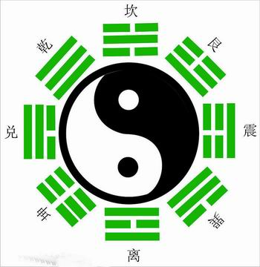
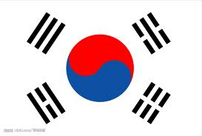
The Yin-Yang Theory diagram & South Korea’s national flag

Slide 5
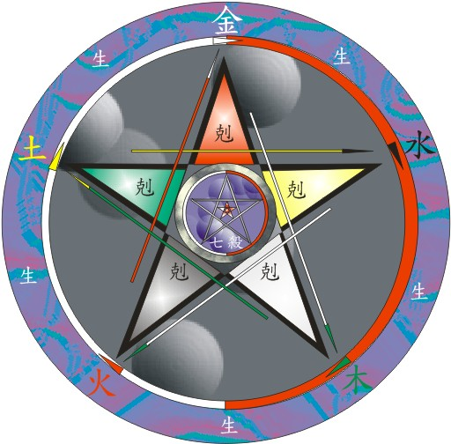
The Five-Element Theory diagram

Slide 6
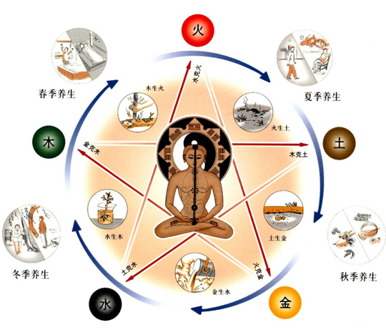
The Theory of Five Elements & Health-Preserving

Slide 7
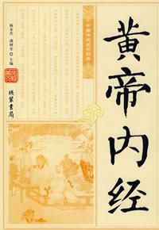
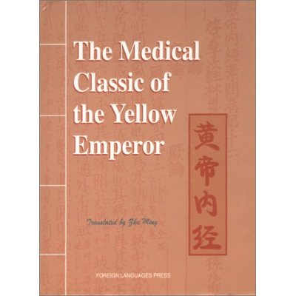
The earliest medical classic and its translation

Slide 8
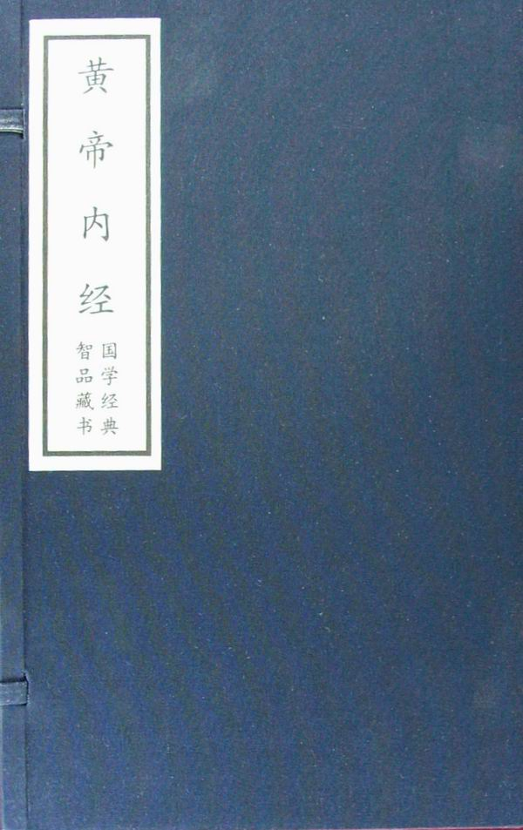
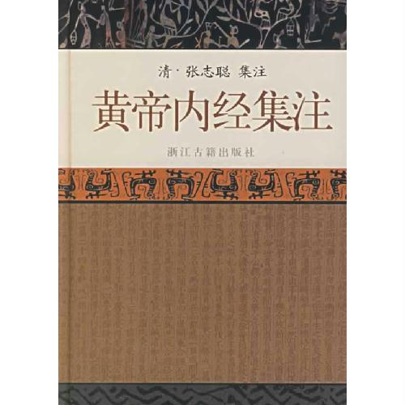
2 other editions

Slide 9
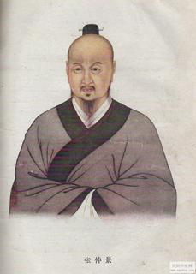
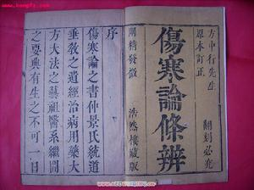
On Typhoid and Other Diseases & its author Zhang Zhongjing

Slide 10
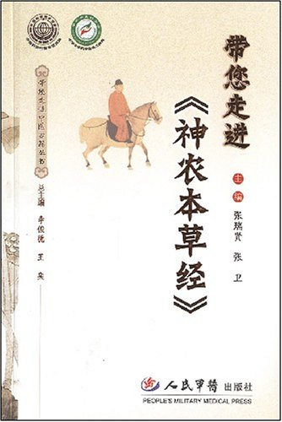
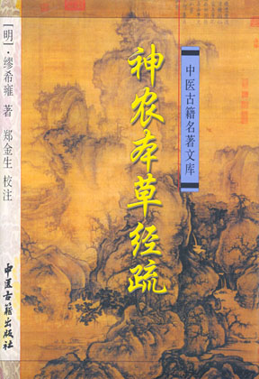
The Herbal Canon of Shen Nong

Slide 11
Questions Concerning Section B Diagnosis and Pharmacology
1. How does a doctor of Chinese medicine diagnose a disease?
2. What did Bian Que contribute to Chinese medicine?
3. What do you know about Shen Nong and his medical book?
4. How did Li Shizhen investigate the effects of medicinal herbs?
5. What do you know about Compendium of Materia Medica?

Slide 12
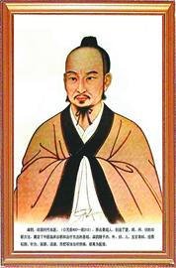
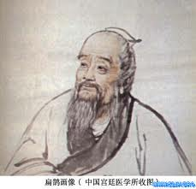
Bian Que (407-310 B.C.), a theorist of diagnosis

Slide 13
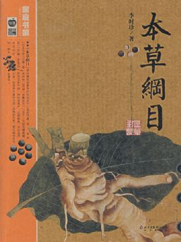
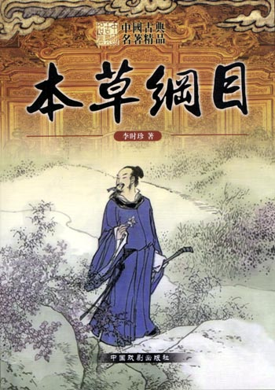
Compendium of Materia Medica

Slide 14
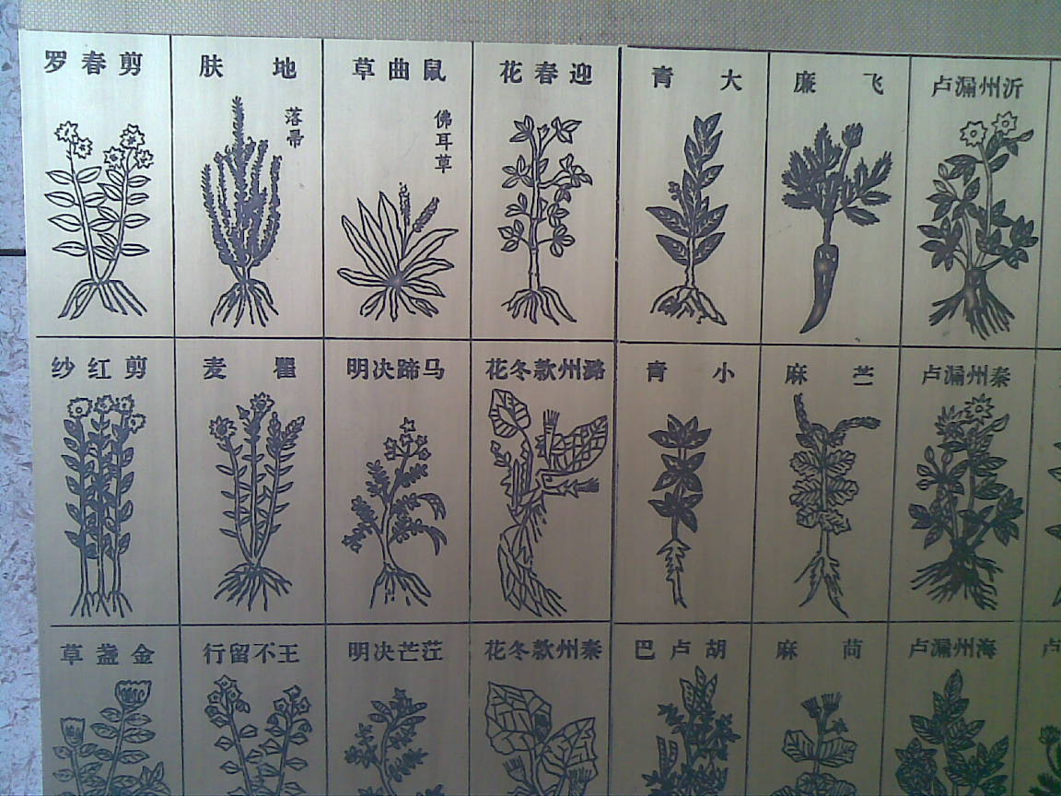
An illustration in Compendium of Materia Medica

Slide 15
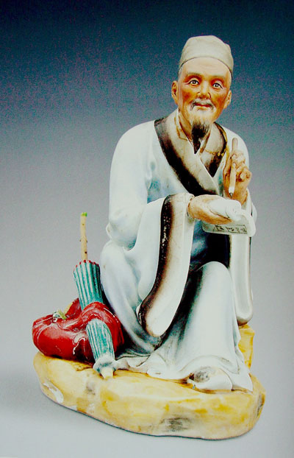
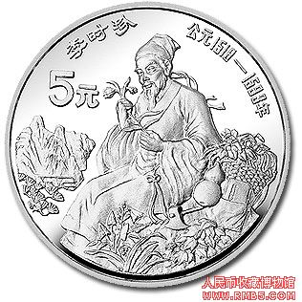
Li Shizhen

Slide 16
Questions Concerning Section C Acupuncture and Moxibustion
1. What do you know about the earliest success with acupuncture and moxibustion?
2. What do acupuncture and moxibustion mean respectively?
3. How do they achieve similar results?
4. What are some of their merits?
5. What are acupuncture points? How were they named?
6. How did the discovery of acupuncture points contribute to the theory of channels and collaterals?
7. What do you know about the network of channels and collaterals?

Slide 17
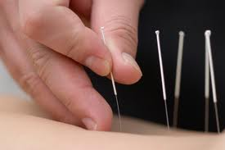
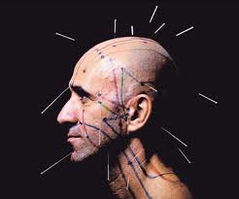
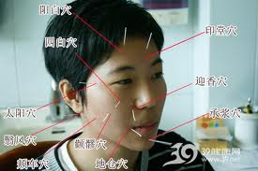
Acupuncture on the back, face and head

Slide 18
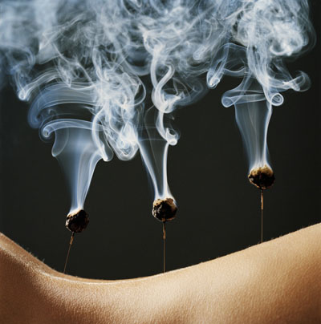
Acupuncture and moxibustion

Slide 19
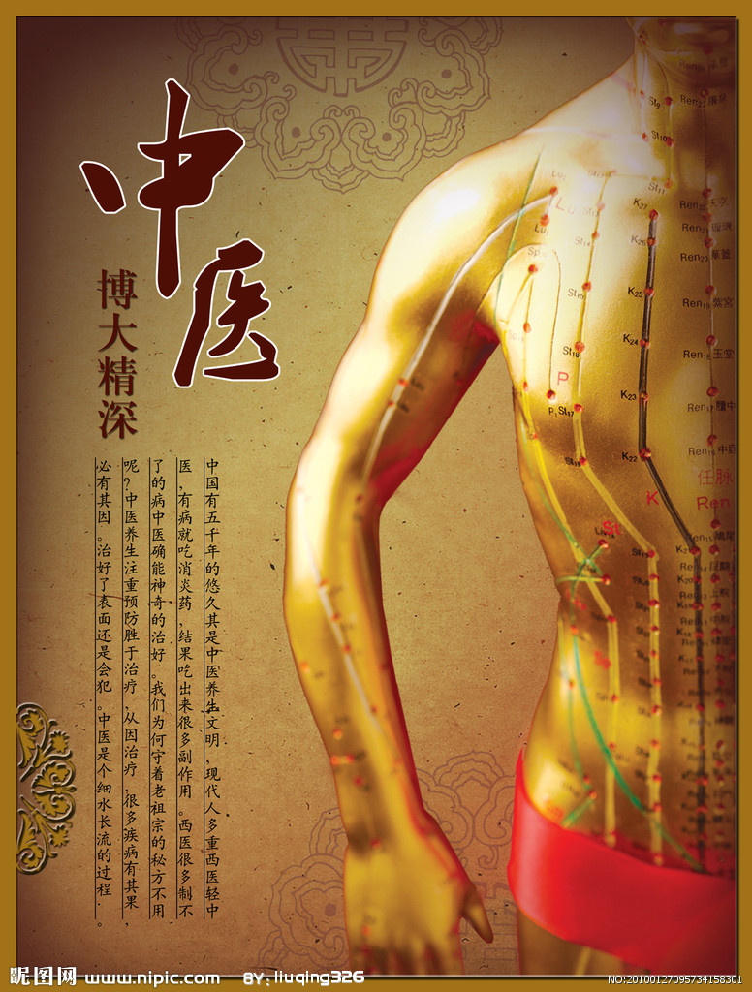
Channels and collaterals in the skin of the human body

Slide 20
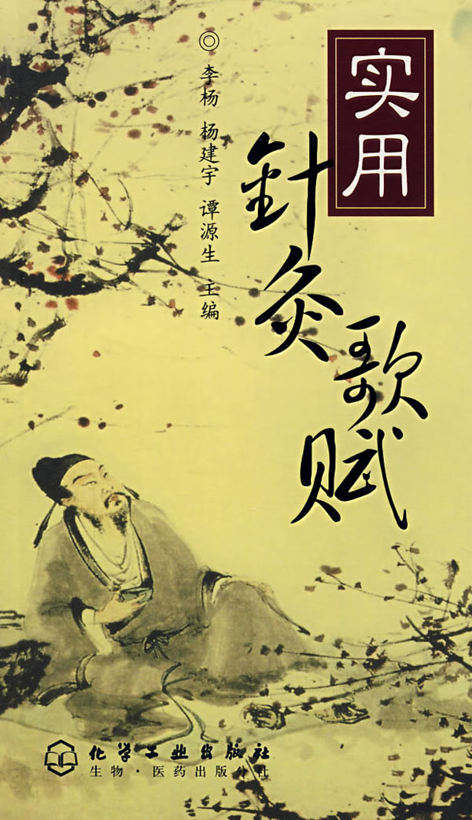
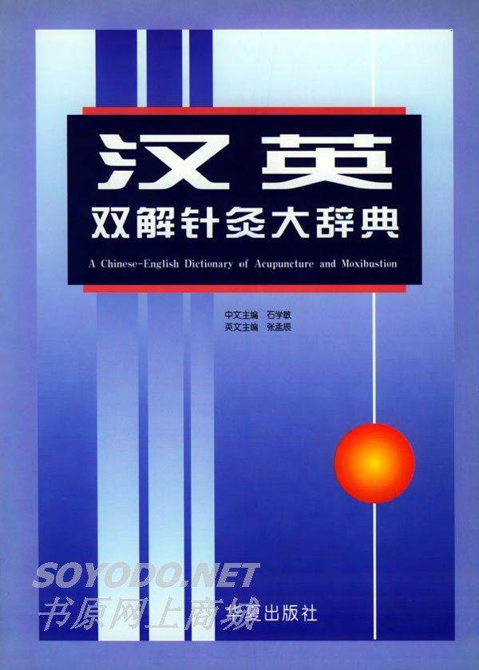
A guidebook & a dictionary

Slide 21
Translation Exercises
《三国演义》“刮骨疗伤”：关平慌与众将商议曰：“父亲若损此臂，安能出敌？不如暂回荆州调理。”于是与众将入帐见关公。公问曰：“汝等来有何事？”众对曰：“某等因见君侯右臂损伤，恐临敌致怒，冲突不便。众议可暂班师回荆州调理。”公怒曰：“吾取樊城，只在目前；取了樊城，即当长驱大进，径到许都，剿灭操贼，以安汉室。岂可因小疮而误大事？汝等敢慢吾军心耶！”平等默然而退。众将见公不肯退兵，疮又不痊，只得四方访问名医。
忽一日，有人从江东驾小舟而来，直至寨前。小校引见关平。平视其人：方巾阔服，臂挽青囊；自言姓名，乃沛国谯郡人，姓华，名佗，字元化。因闻关将军乃天下英雄，今中毒箭，特来医治。平曰：“莫非昔日医东吴周泰者乎？”佗曰：“然。”平大喜，即与众将同引华佗入帐见关公。时关公本是臂疼，恐慢军心，无可消遣，正与马良弈棋；闻有医者至，即召入。礼毕，赐坐。茶罢，佗请臂视之。公袒下衣袍，伸臂令佗看视。佗曰：“此乃弩箭所伤，其中有乌头之药，直透入骨；若不早治，此臂无用矣。”公曰：“用何物治之？”佗曰：“某自有治法，但恐君侯惧耳。”公笑曰：“吾视死如归，有何惧哉？”

Slide 22
Translation Exercises
佗曰：“当于静处立一标柱，上钉大环，请君侯将臂穿于环中，以绳系之，然后以被蒙其首。吾用尖刀割开皮肉，直至于骨，刮去骨上箭毒，用药敷之，以线缝其口，方可无事。但恐君侯惧耳。”公笑曰：“如此，容易！何用柱环？”令设酒席相待。斋，公饮数杯酒毕，一面仍与马良弈棋，伸臂令佗割之。佗取尖刀在手，令一小校捧一大盆于臂下接血。佗曰：“某便下手，君侯勿惊。”公曰：“任汝医治，吾岂比世间俗子，惧痛者耶！”佗乃下刀，割开皮肉，直至于骨，骨上已青；佗用刀刮骨，悉悉有声。帐上帐下见者，皆掩面失色。公饮酒食肉，谈笑弈棋，全无痛苦之色。须臾，血流盈盆。佗刮尽其毒，敷上药，以线缝之。公大笑而起，谓众将曰：“此臂伸舒如故，并无痛矣。先生真神医也！”佗曰：“某为医一生，未尝见此。君侯真天神也！”后人有诗曰：“治病须分内外科，世间妙艺苦无多。神威罕及惟关将，圣手能医说华佗。”
关公箭疮既愈，设席款谢华佗。佗曰：“君侯箭疮虽治，然须爱护。切勿怒气伤触。过百日后，平复如旧矣。”关公以金百两酬之。佗曰：“某闻君侯高义，特来医治，岂望报乎！”坚辞不受，留药一帖，以敷疮口，辞别而去。

Slide 23
Translation Exercises
华佗死因：公元208年，曹操要华佗尽弃旁务，长留府中，专做侍医。专门侍奉一个权贵，这对以医济世的华佗来说，自然是不愿意。他托故暂回家乡，却一去不归。据《三国志》记载，华佗回家后，曹操曾多次写信催他回来，还曾令郡县官员将华佗遣送回来，但是华佗均以妻病为由而不从。曹操恼羞成怒，遂以验看为名，派出专使，将华佗押解许昌，严刑拷问。面对曹操，华佗矢志不移。曹操益怒，欲杀华佗。有谋士一再进谏，说华佗医术高超，世间少有，天下人命所系重，望能予以宽容，但曹操一意孤行，下令在狱中将他处决。
华佗临死，仍不忘济世救民，将已写好的《青囊经》取出，交狱吏说：“此书传世，可活苍生。”狱吏畏罪，不敢受书。华佗悲愤之余，只得将医书投入火中，一焚了之。后来，曹操的头风病几次发作，诸医束手，他仍无一丝悔意，还说，“佗能愈吾疾，然不为吾根治，想以此要挟，吾不杀他，病亦难愈。”

Slide 24
Translation Exercises
17 November 2008：The World Health Organization says traditional medicines are an effective treatment for modern illnesses and should be integrated into primary health care. The head of the WHO says China, where herbal remedies are prescribed alongside western medicine, is a good model to follow. But as Daniel Schearf reports from Beijing, there are still concerns about the effectiveness and safety of traditional medicines.
Chinese traditional medicine has been practiced for over two thousand years. It is used to treat everything from the common cold to cancer. Its holistic approach of herbal remedies, diet, and exercise is gaining popularity in the West. Now the head of the World Health Organization, Margaret Chan, says the ancient remedies should be used together with western medicine to treat modern disease.

Slide 25
Translation Exercises
"The two systems of traditional and western medicine need not clash," Chan said. "Within the context of primary health care they can blend together in beneficial harmony, using the best features of each system and compensating for certain weakness in each."Chan spoke in Beijing at the WHO's first-ever conference promoting traditional medicine.
The WHO says traditional medicines have fewer side effects than western drugs and can be a cheap, effective treatment for common illnesses such as diarrhea and malaria. Chan says traditional medicine can also help prevent so-called modern lifestyle diseases such as diabetes, heart disease and mental disorders. She says China, where doctors prescribe both medicines, sets a good example. But she warns that not all traditional medicines meet scientific and safety standards.

Slide 26
Translation Exercises
"Many traditional medicines have an inadequate evidence base when measured by these standards," Chan stated. "Tests for quality and standards for production tend to be less vigorous and controlled. Products may escape the strict regulations set up to ensure safety. Practitioners may not be certified or licensed.”
Herbal medicines have long been a focus of research to incorporate their active ingredients into western drugs.But the herbal medicine market is now worth billions and too many are being sold without a clear understanding of their ingredients or how they work.
Pediatrician Robbie Parkman, who was in Beijing for the summer Olympics, says that doctors like him are concerned.

Slide 27
Translation Exercises
"I think the holistic part is fine. I think the active ingredient part could be made better," Parkman said. "Because I'm just worried that even if something is working, that you're not going to consistently treat people. “The WHO says integrating traditional medicines into modern health care would encourage scientific research and oversight and ensure they are used safely and effectively.
Wang Qi is a professor at Beijing University of Chinese Medicine. He says the biggest challenge to promoting traditional Chinese medicine abroad is scientifically proving it works. "Science can gradually resolve this issue," Wang said. "For us ordinary people, the most important thing is effectiveness. As long as there is a benefit, it is good.”

Slide 28
Topics for discussion
1. In Mid-Nov., 2010, acupuncture and moxibustion of traditional Chinese medicine were accepted by UNESCO as World Non-Material Cultural Heritage. What do you think of it?
2. Could you introduce any classic or well-known doctor of traditional Chinese medicine?
3. What do you think of the combination of Chinese medicine and Western medicine?

Slide 29
See you next time!

Slide 30
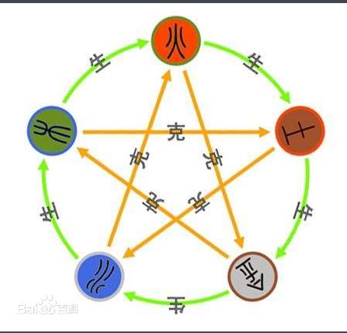
What are the 2 theoretic bases of traditional Chinese medicine? What do they mean?

Slide 31
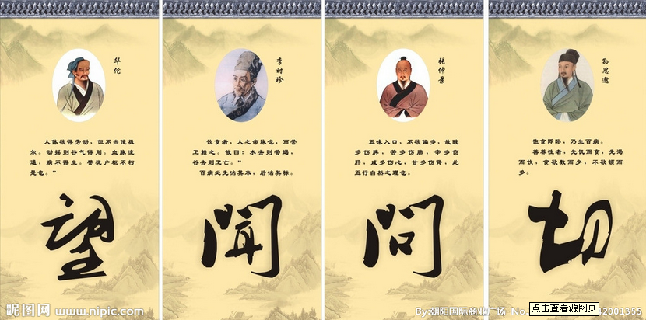
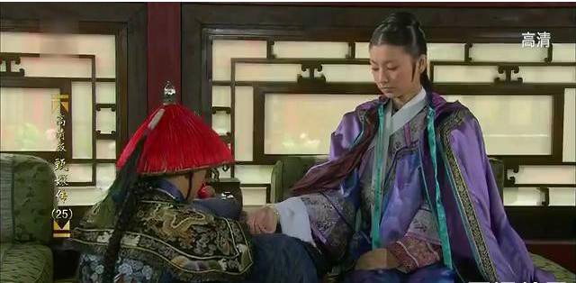
How are diagnoses made in Chinese medicine? What are “the 4 methods”?

Slide 32
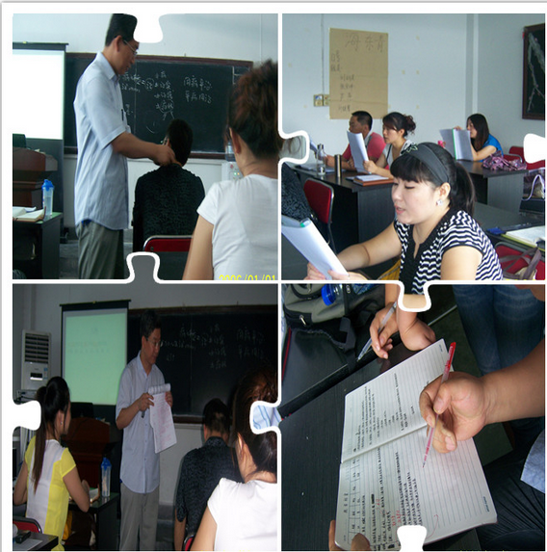
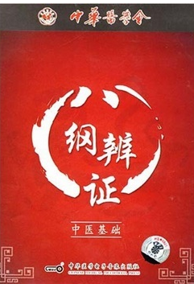
What does treatment proceed to do?
Notes:
八纲，即阴、阳、表、里、寒、热、虚、实，是辨证论治的理论基础之一。八纲辨证，是将四诊得来的资料，根据人体正气的盛衰，病邪的性质，疾病所在的部位深浅等情况，进行综合、分析归纳为阴、阳、表、里、寒、热、虚、实八类证候。

Slide 33
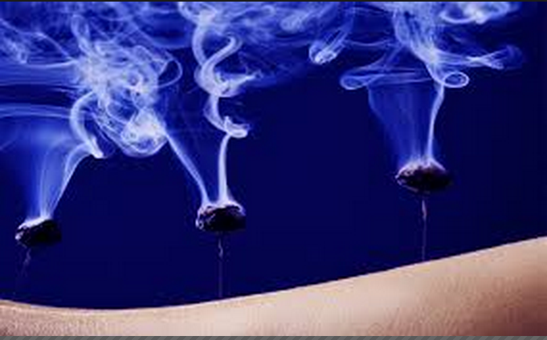
What other therapies are there in Chinese medicine?

Slide 34
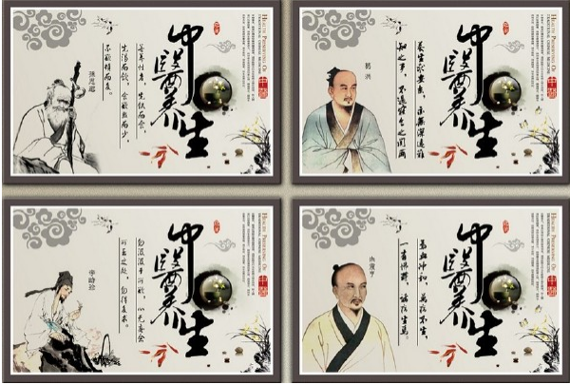
Does traditional Chinese medicine treat only the symptoms? How does it form a unified idea of an illness?

Slide 35
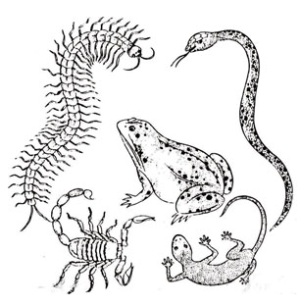
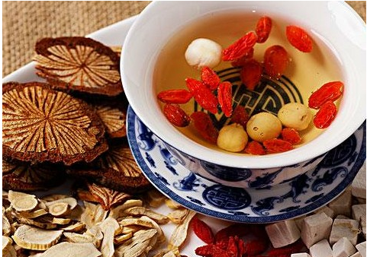
What measures are taken in Chinese preventive medicine?
Notes:
以毒攻毒：五毒是指蝎子、蛇、壁虎（无毒。但通常认为他的尾巴能致聋）、蜈蚣、蟾蜍，这五种毒物是汉族民间盛传的一些害虫

Slide 36
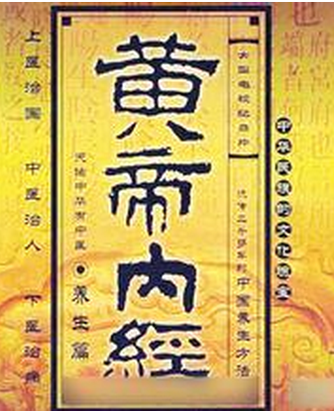
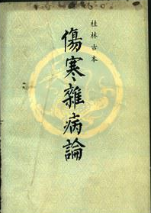
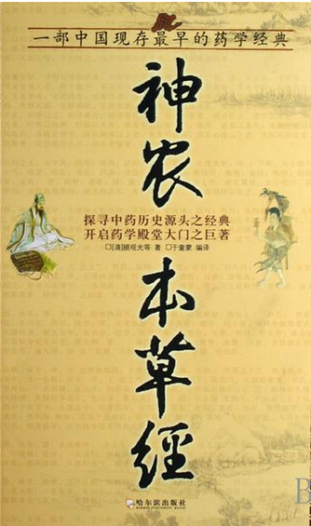
What are the 3 greatest Chinese medical works written before the 3rd century B.C.?

Slide 37
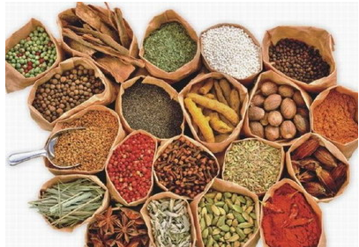
How are the properties of medicinal herbs differentiated?

Slide 38
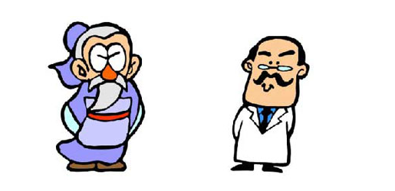
What are the 3 branches of medicine in China?

Slide 39
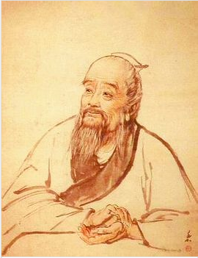
What did Bian Que contribute to Chinese medicine?

Slide 40
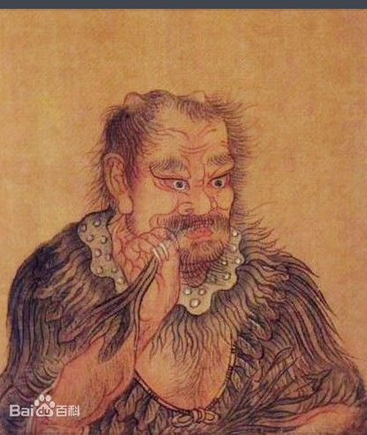
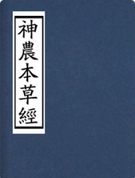
What do you know about Shen Nong and his medical book?

Slide 41
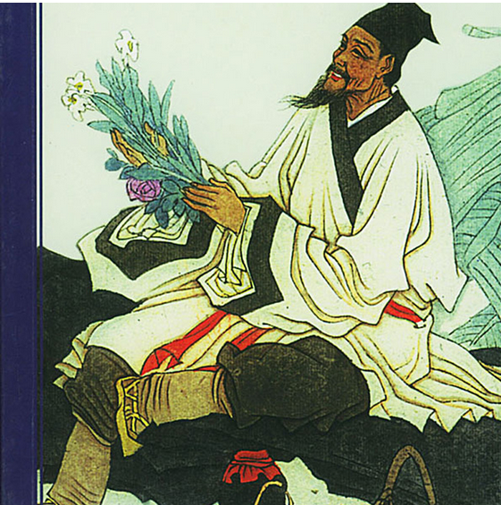
How did Li Shizhen investigate the effects of medicinal herbs?

Slide 42
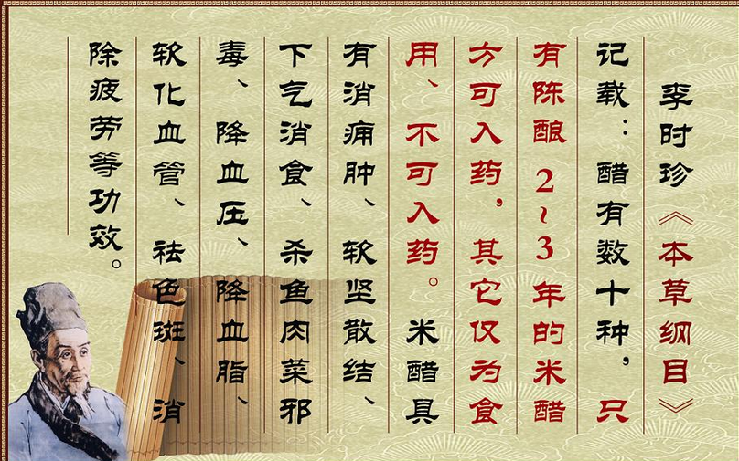
What do you know about Compendium of Materia Medica?

Slide 43
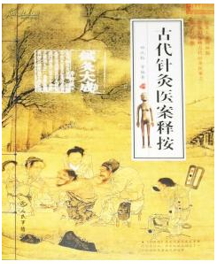
What do you know about the earliest success with acupuncture and moxibustion?

Slide 44
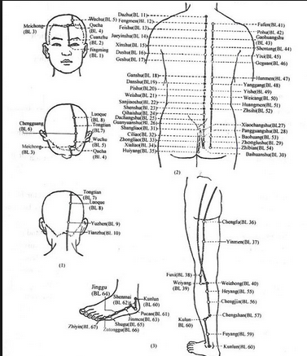
What are acupuncture points? How were they named?

Slide 45
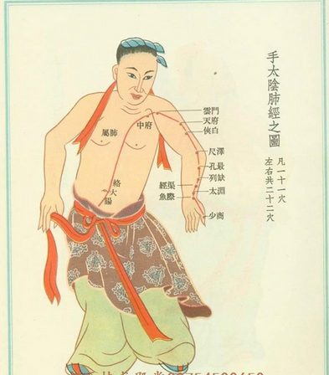
How did the discovery of acupuncture points contribute to the theory of channels and collaterals?

