Slide 1

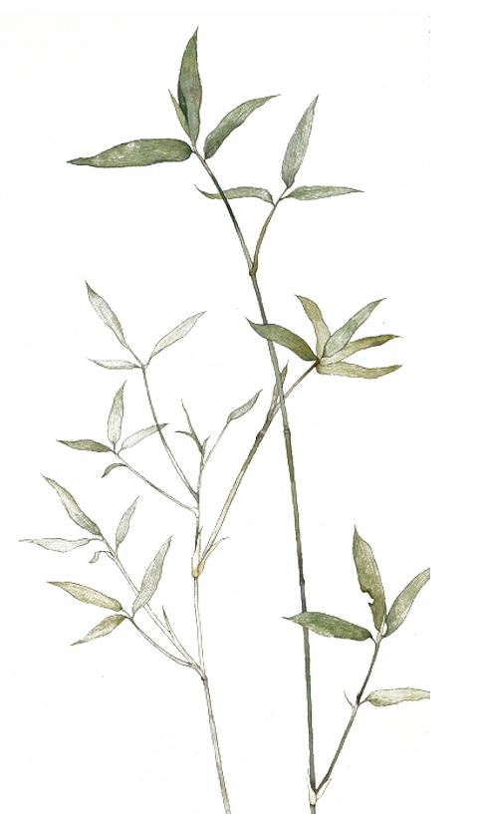
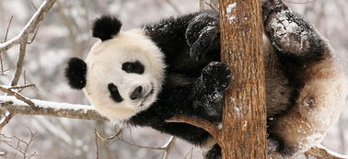

Giant Pandas
known as "living fossils"
Chinese "national treasures."
黄芳芳

Slide 2
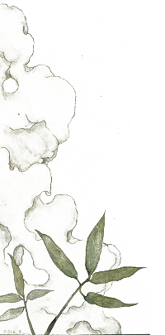
CONTENTS
The origin of giant pandas
Appearance features of giant pandas
The diet features of giant pandas

Slide 3
The origin of giant pandas

Slide 4

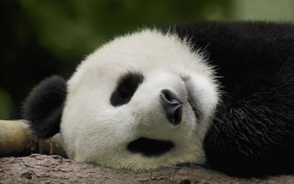
The ancestor : Ailuaractos（始熊猫）
The main branch of it continued to evolve in central and southern China. One species of Ailuaractos appeared in the early Pleistocene(更新世) about 3 million years ago, and it was smaller than the current panda.

Slide 5
Appearance features of giant pandas

Slide 6
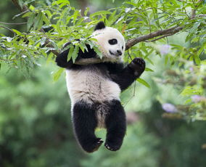
1. Shape
Giant pandas are fat like bears, plump and rich, round heads and short tails. The weight is 80-120kg, and its maximum weight can reach 180kg.

Slide 7
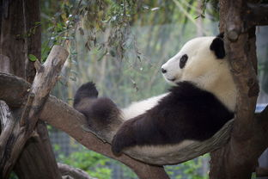
2. Colour
The hair color of its head and body is distinct from black and white. However, it is not pure black, or pure white. It is black with brown through and white with yellow.
3. Skin
The giant panda's skin is thick, which can be up to 10 mm at its thickest point. The skin thickness of different parts of the body is different. The back of the body is thicker than the ventral side, and the outside of the body is thicker than the inside of the body. The average thickness of the skin is about 5 mm, and it is white, elastic and tough.

Slide 8
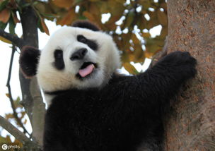
4. vision
The vision of giant pandas is extremely underdeveloped. This is because giant pandas live in dense bamboo forests for a long time. The light is very dark and there are many obstacles, making their eyes very short and shallow.
Giant pandas live in the high mountains and deep valleys of the upper reaches of the Yangtze River in China, which are the windward side of the southeast monsoon. The climate is warm and humid, and their humidity is often above 80%. The giant pandas prefer humid environment.

Slide 9
The diet features of giant pandas

Slide 10
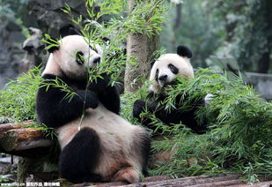
Eating all kinds of bamboo that can be found in high mountain areas.
Occasionally eating meat (usually the carcasses（尸体） of animals or sometimes of rhizomys（竹鼠）)

Slide 11
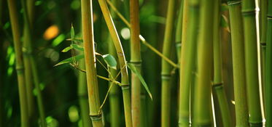
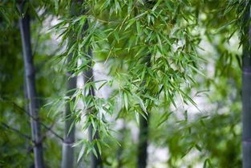
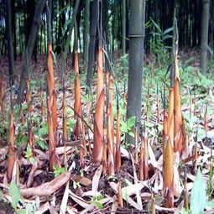
The most nutritious and least cellulose（纤维素）-containing parts of bamboo
【tender stems】
【burgeons】
【bamboo shoots】

Slide 12
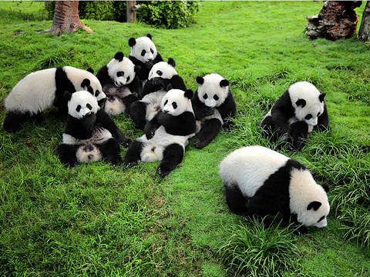
"bamboo bear"
The unique dieting characteristics of the giant panda make it known as the "bamboo bear" by the locals.
Panda
"cat bear"
The scientific name of the giant panda is actually "cat bear", which means "a bear like a cat“.
“white-black bear”
It was a French missionary, Armand David, who let the whole world know of this unique creature. He called it white-black bear.

Slide 13
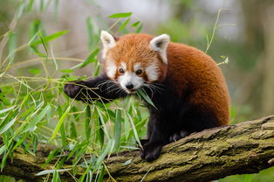
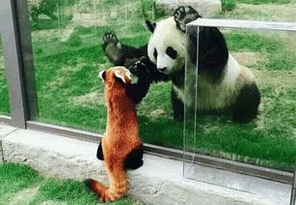
In the early 20th century, wildlife researchers and taxonomists（分类学者） discovering the giant pandas in China thought they were related to the red pandas（小熊猫） since they also eat bamboo and share some similar unusual anatomical（结构上的） features such as a part of their wrist that acts like an opposable thumb. So they started to be called "giant pandas"

Slide 14
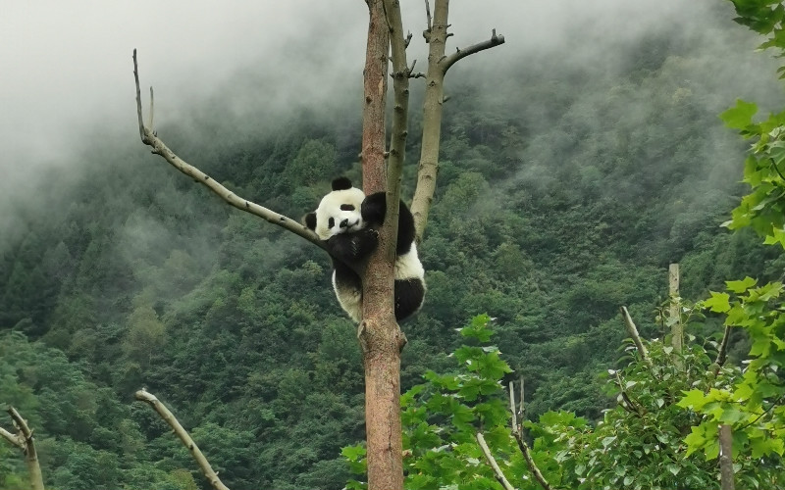
THANKS

