Slide 1


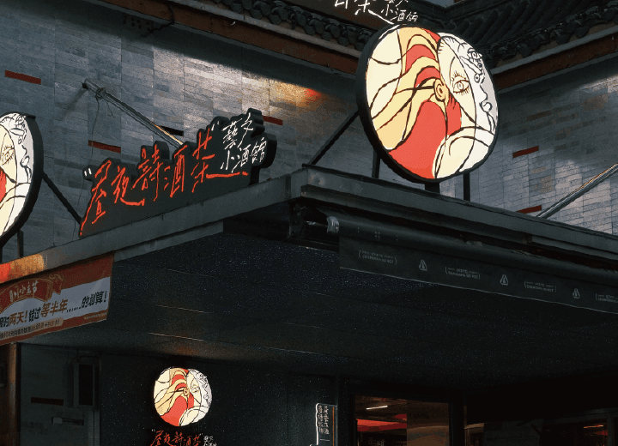

"Day and Night Poetry, Wine, and Tea, Artistic and Cultural Small Tavern." Established on April 15, 2024.
The current drinks are divided into three categories: tea cocktails, cocktails, and exclusive specials.
The overall product design concept of Day and Night Tavern is to create distinctive tea-based drinks by combining tea with traditional Chinese spirits, Western-style base spirits, and milk bases. Moreover, they offer options for different alcohol concentrations, ranging from light, moderate, to full.
Notes:
www.v5ppt.com

Slide 2
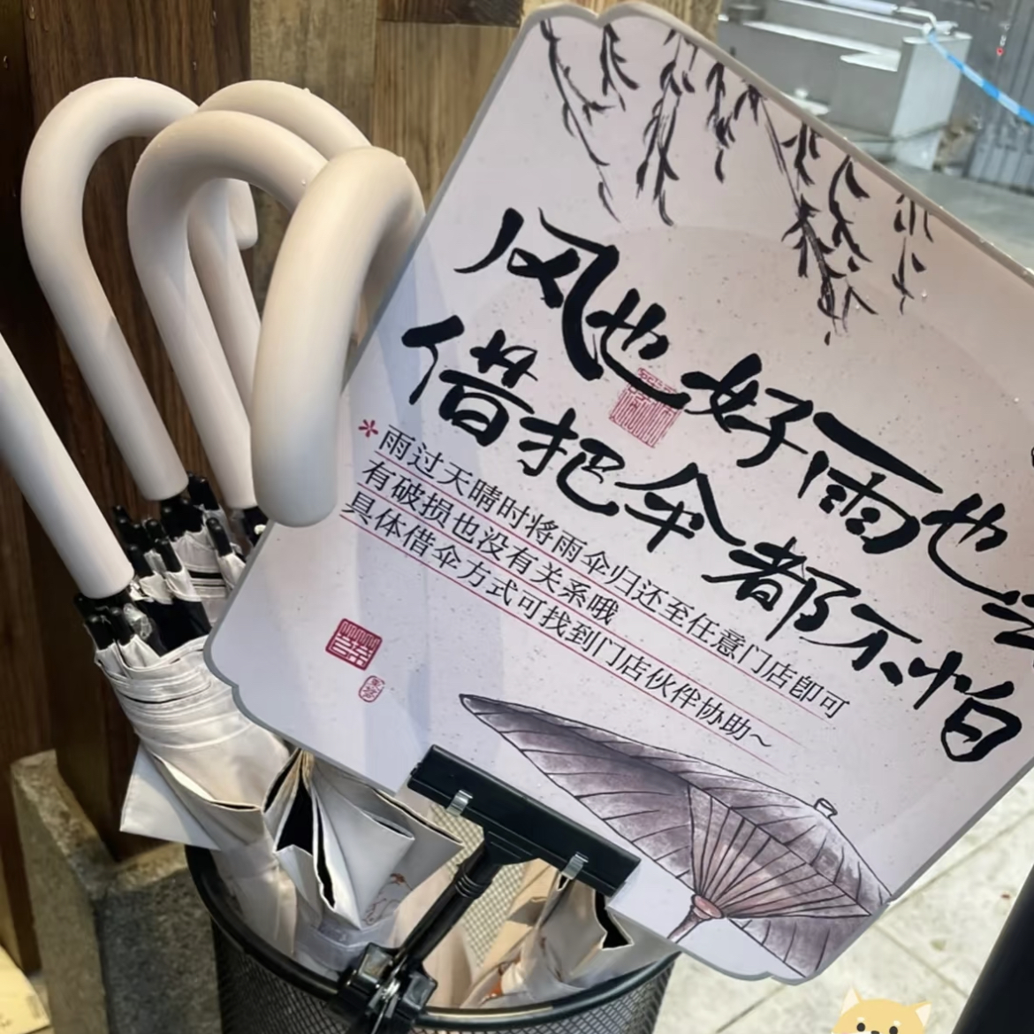
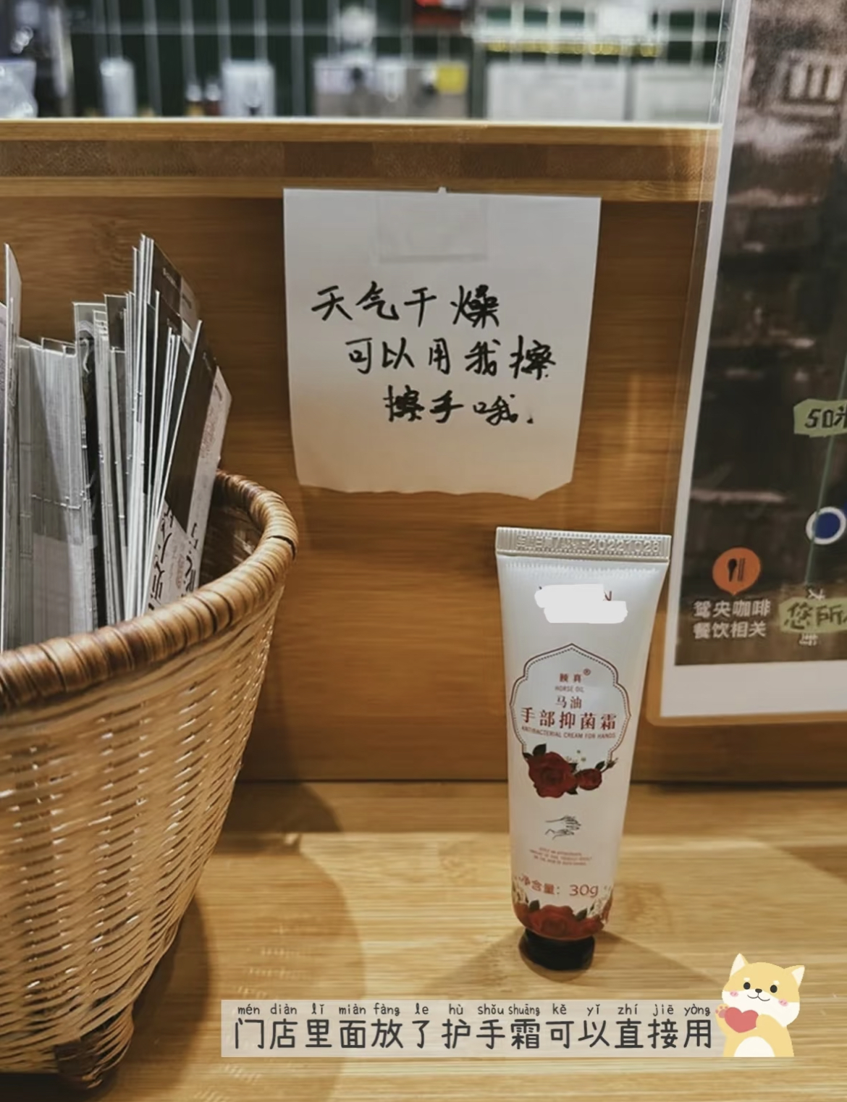

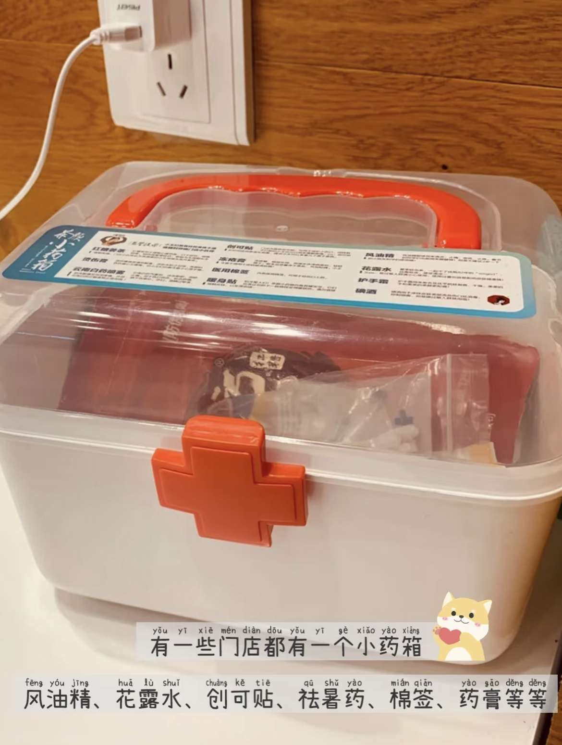

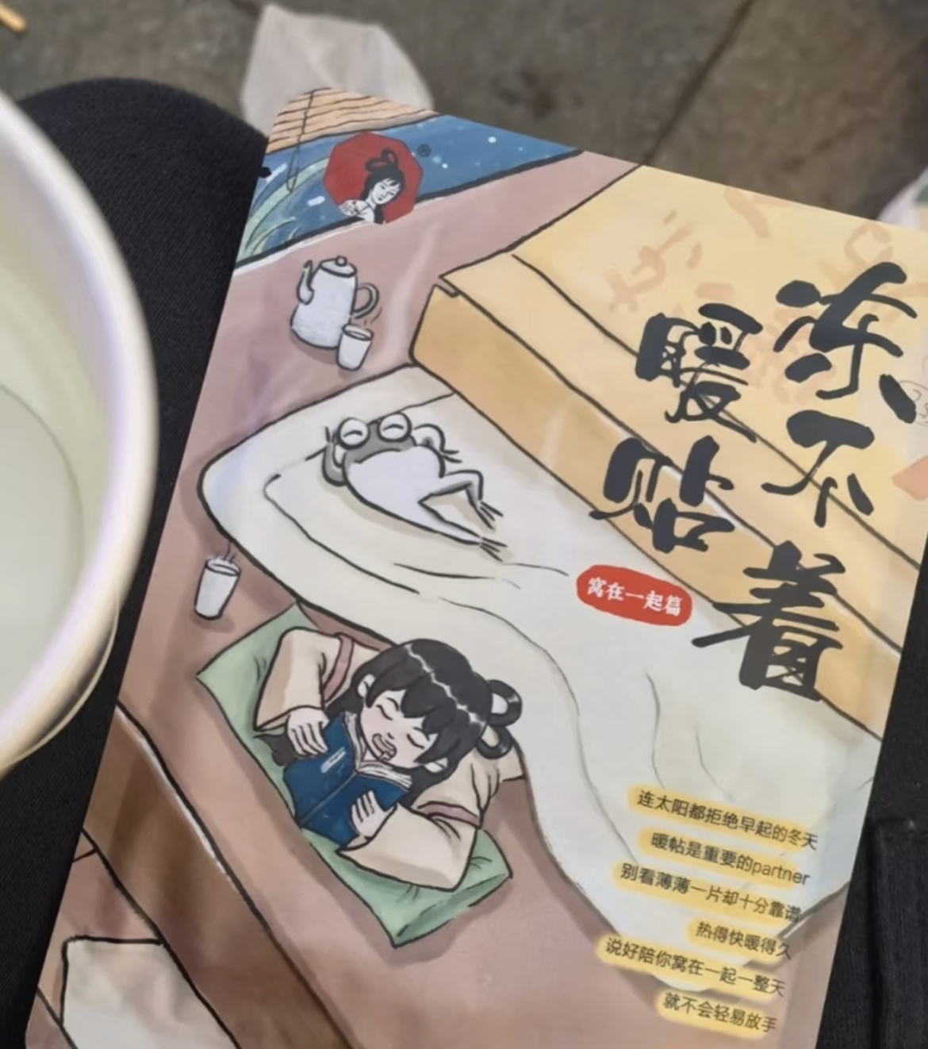
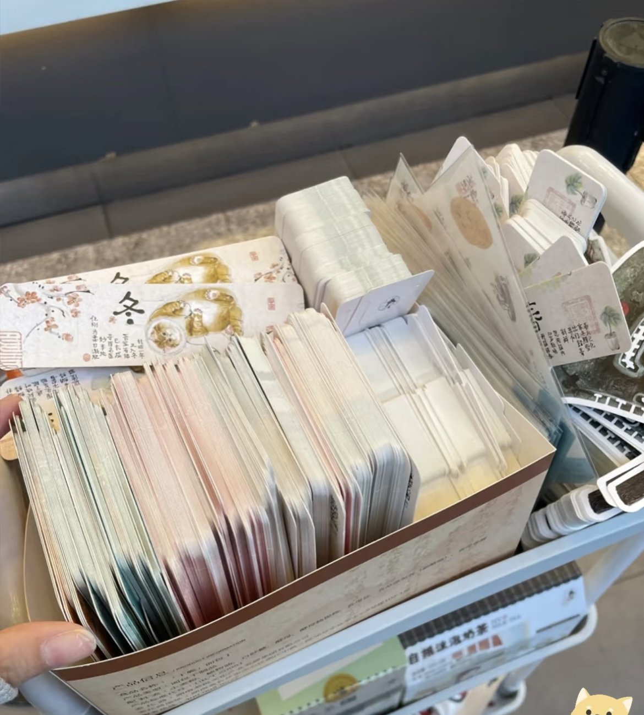

“Customer first”
顾客至上
Service Philosophy
Everyone has the "permanent right to claim a cup of fresh tea."
Caring services (medicine box, offering umbrellas on rainy days)
Introduce seasonal limited edition drinks and corresponding tea menus
Notes:
www.v5ppt.com

Slide 3

Question 1 When did the first Cha Yan store open?
2013/12/28
Question 2 (Open Question)
Please recommend a Cha Yan drink that you like to have, and explain why.
Question 3 Please name three sub-brands of Cha Yan.
Yuan Yang Coffee,
Good Morening
Day and Night Tavern
Notes:
www.v5ppt.com

Slide 4




Thank you
Notes:
www.v5ppt.com

