Slide 1
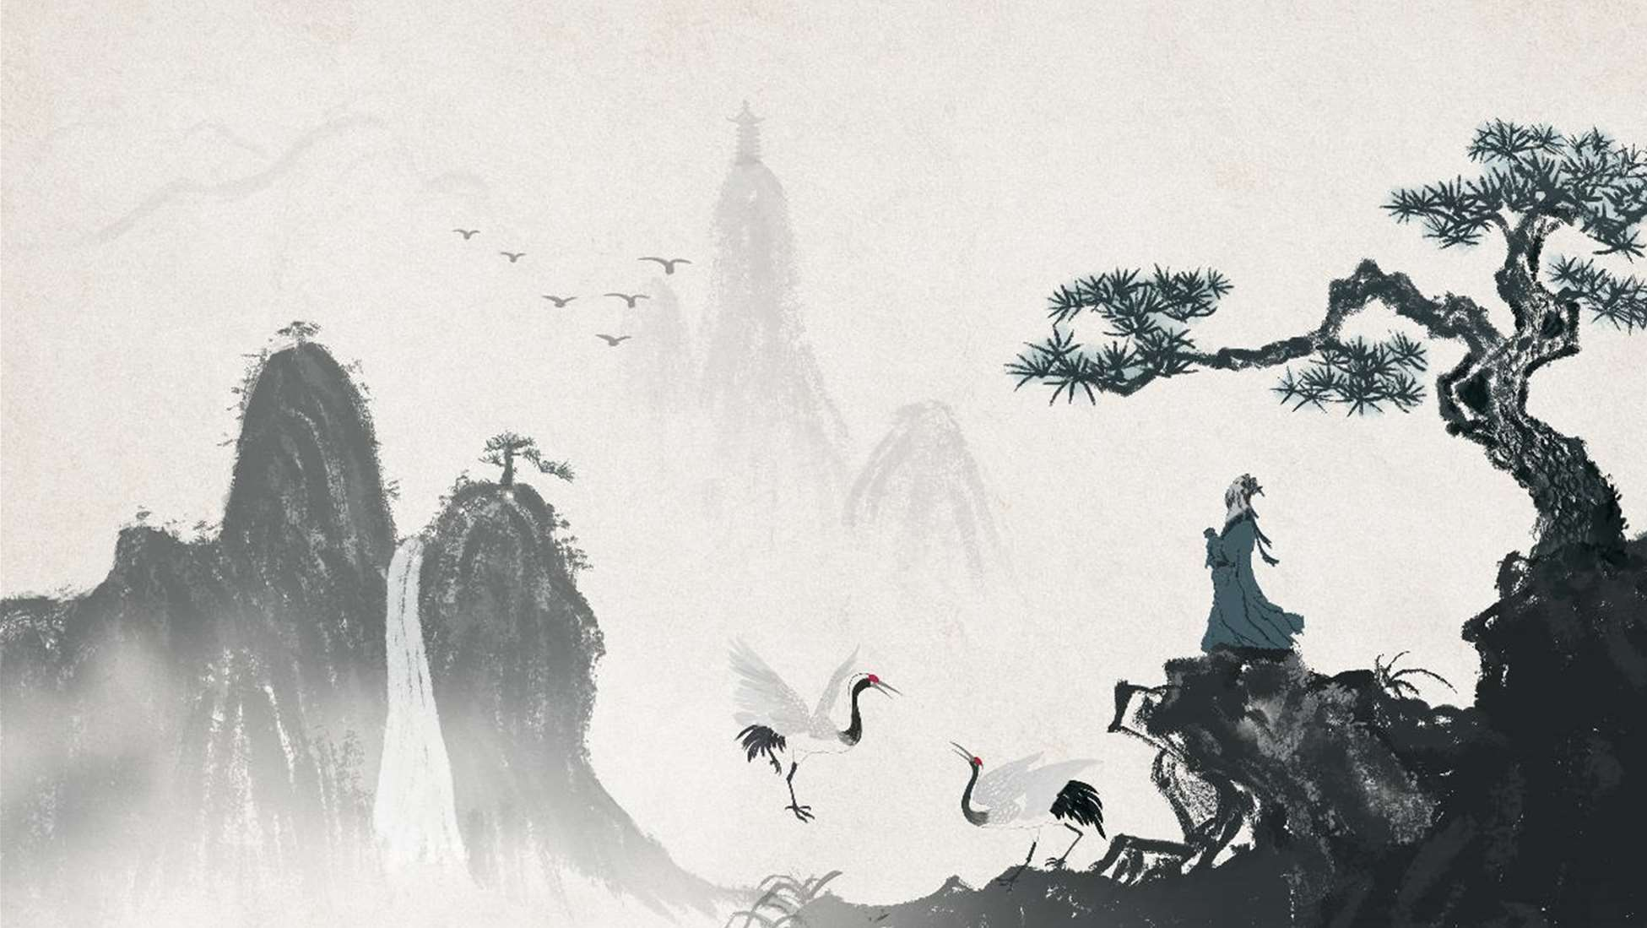


The Yangqin (扬琴)A Journey Through Sound and History
戴业迅
时间：
2025.5

Slide 2

Introduction to the Yangqin

Slide 3
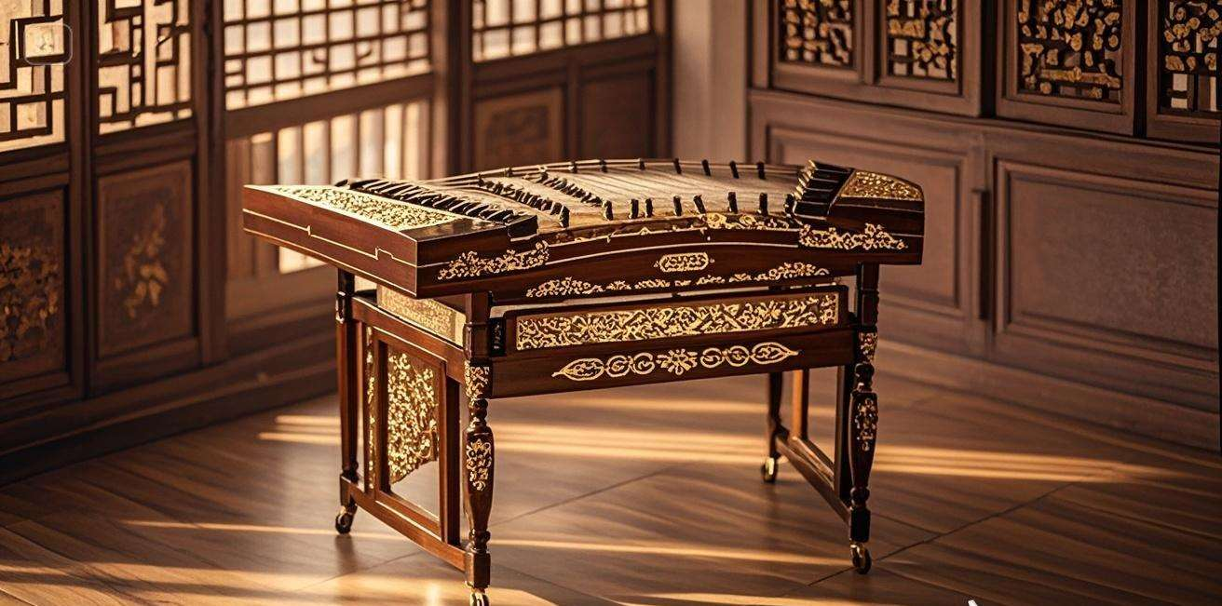

Slide 4
Historical Background

Slide 5
Structure and Components

Slide 6
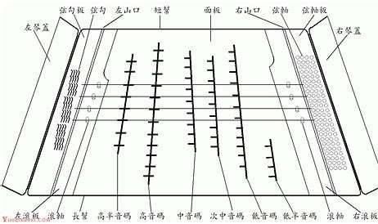

Slide 7
Playing Techniques

Slide 8
Cultural significance

Slide 9
Modern Evolution

Slide 10
谢谢大家
主讲人：
戴业迅
时间：
2025.5

