Slide 1

中华典籍外译
Chinese Classics Translation for Master Students of Translation Studies
湖南师范大学 2022年2月25日-2021年6月10日
中国文化基础 周五第九和第十节课14:30-16:10，
上课地点：线上VooV
助教：Li Xin 李欣 – Session no. 5
吴漠汀特聘教授 Distinguished Professor Dr. Martin Woesler
培高德 教授 Professor Dr. Cord Eberspächer
湖南师范大学外国学院 Foreign Studies College, Hunan Normal University

Slide 2
Schedule 学期题目
1 2.25 Organizational things, intro to the concept of a „classic“
2 3.4 Canonization
3 3.11 Early Translation of Chinese Literature
4 3.18 Reception of the Red Chamber Dreams in the West
5 3.25 How to make people read classics again?
6 4.1 Western Classics in Chinese clothes: The example of Utopian Literature
7 4.8 Attractiveness of Chinese Classics as part of softpower
8 4.15 Chinese Classics in the West: The Example of Germany
9 4.22 Sinicization – Politics for Cultural Export: The Example of the Chinese classics
10 4.29 Chinese Classics in World Lit. Anthologies and World Literary History Books
11 5.6 Translation of Modern Classics: Mo Yan, Yu Hua, Liu Cixin etc.
12 5.13 Chinese Classics on Overseas Bookfairs
13 5.20 Cinema Movie Adaptions of Chinese Classics
14 5.27 Lessons to learn from the Classics: Integration or Sharpening the Cultural Profile?
15 6.3 Final Discussion
16 6.10 Final Exam

Slide 3
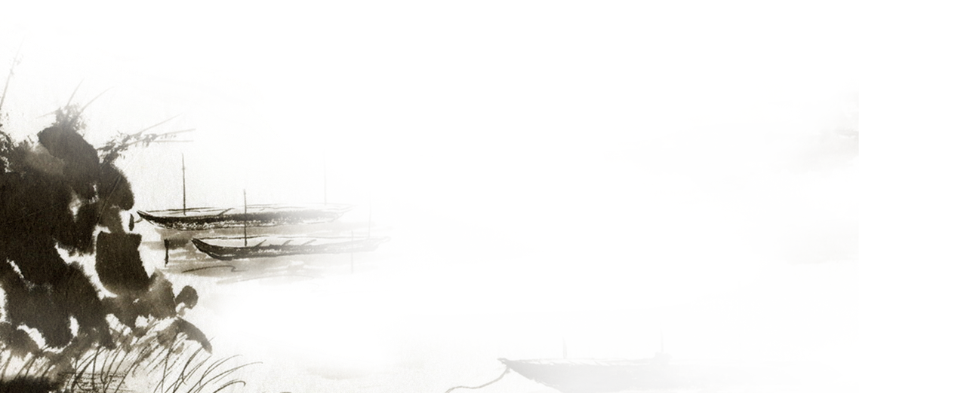



How to make people
read classics again?
for Master Students of Translation Studies
吴漠汀教授
Prof. Dr. Martin Woesler
Hunan Normal University
Spring 2022

Slide 4
Student Input
https://wiki.rub.de/uvu/index.php/How_to_Make_People_Read_Classics_Again%3F
Presentation by Xie Xiaoying 谢晓莹 How to Read Classics Again
literature review with handout by Zheng Dongqin 郑冬琴 How to Read Classics Again by Zheng Dongqin
argumentative debate live in class on Classical or Popular Culture, with list of arguments posted here Wang Siqi 王思琪、Tong Lüeya 童略雅 handout:Classic Culture or Popular Culture?
吴漠汀教授
Prof. Dr. Martin Woesler
Hunan Normal University
Spring 2022

Slide 5
Teacher Input
The example of the D-Book (3 video clips)
Discussion
吴漠汀教授
Prof. Dr. Martin Woesler
Hunan Normal University
Spring 2022

Slide 6
Preparation for next session
1 2.25 Organizational things, intro to the concept of a „classic“
2 3.4 Canonization
3 3.11 Early Translation of Chinese Literature
4 3.18 Reception of the Red Chamber Dreams in the West
5 3.25 How to make people read classics again?
6 4.1 Western Classics in Chinese clothes: The example of Utopian Literature
7 4.8 Attractiveness of Chinese Classics as part of softpower
8 4.15 Chinese Classics in the West: The Example of Germany
9 4.22 Sinicization – Politics for Cultural Export: The Example of the Chinese classics
10 4.29 Chinese Classics in World Lit. Anthologies and World Literary History Books
11 5.6 Translation of Modern Classics: Mo Yan, Yu Hua, Liu Cixin etc.
12 5.13 Chinese Classics on Overseas Bookfairs
13 5.20 Cinema Movie Adaptions of Chinese Classics
14 5.27 Lessons to learn from the Classics: Integration or Sharpening the Cultural Profile?
15 6.3 Final Discussion
16 6.10 Final Exam

Slide 7
Preparation for next session
Read paper provided for Western classics in Chinese clothes: The example of Utopian literature
Take the quiz
Translation
Correction of translation
Please choose your final exam paper and start writing (grade)

Slide 8
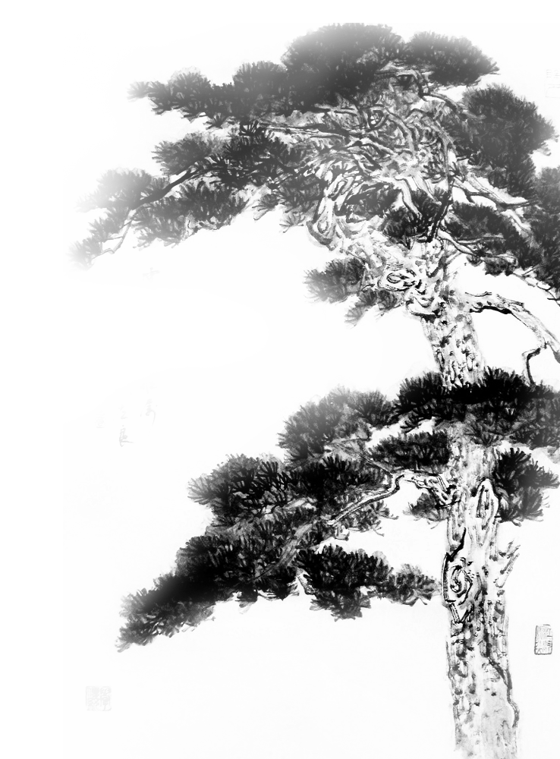
謝謝觀賞

