Slide 1
Chinese Bossy Fictions & Micro-dramas
He Yunfeng

Slide 2


Chinese Bossy Fiction
2010~
Jinjiang Literature City
Qidian

Slide 3



Themes
Forced marriage
Romance(CEO-employee)
Revenge

Slide 4

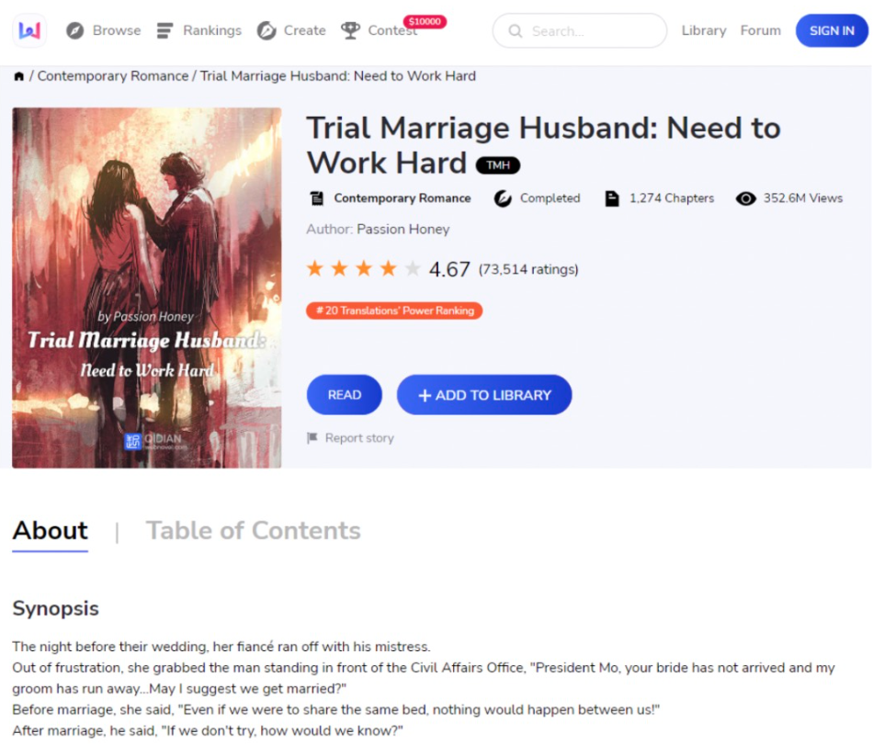

Slide 5
Excerpt from the 1st chapter
唐宁忍得眼泪直掉，她怎么也没想到，她明天就要登记的未婚夫，竟然带着小三在她床前偷情。
Tangning tried to hold back her tears but could feel them slowly trickling down her face. Who would have thought, the man she was to marry the next day would be cheating right in front of her.

Slide 6


Chinese Bossy Micro-drama
Video-form of the bossy fictions
Tailored for mobile platforms

Slide 7
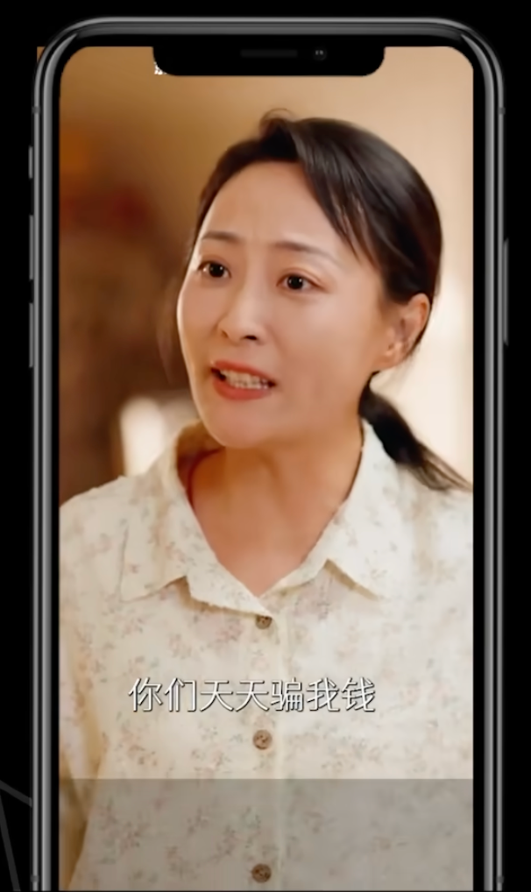
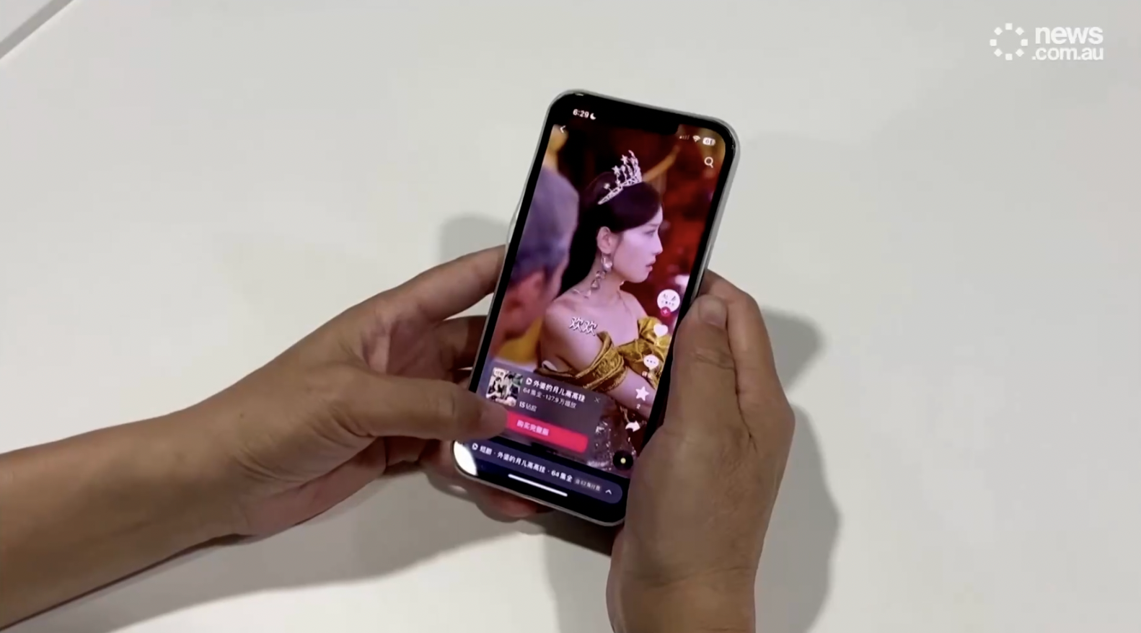
Minute-long, vertical

Slide 8



Themes: revenge, betrayal and romance

Slide 9
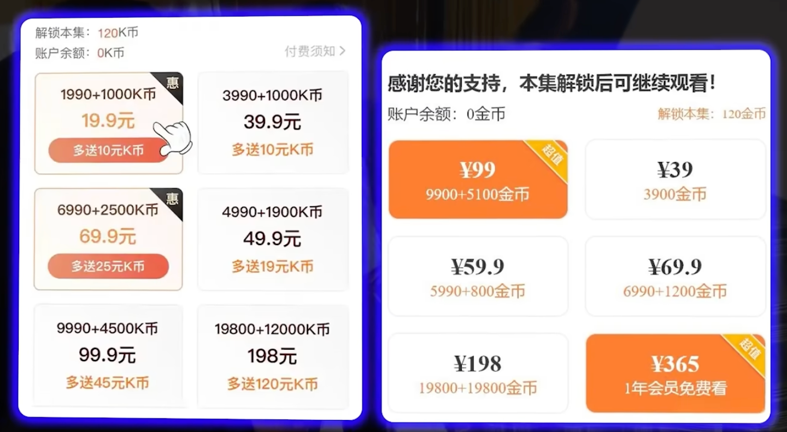
Commercialization

Slide 10
Interactive Part

Slide 11
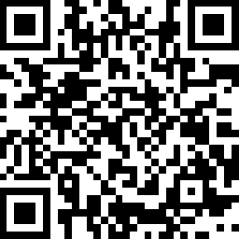
What would you like to see most in the next scene？
A. Polite negotiation
(男主角出现，礼貌地与经理协商)
B. Abuse of wealth and power
(男主角出现，使用钞能力摆平)
C. Silent dismissal
(男主角出现，装作无事发生并转身离开)

Slide 12
A. Politely negotiate with the manager.
C. Ignore them and just walks away.
More reasonable choices in real life
B. Use wealth and power to solve the problem
Most selected
WHY?

Slide 13
When watching bossy micro-dramas,
Unconsciously,
we tend to expect ...
A desire to escape the reality
and experience the wealth and power in the micro-dramas.
Surreal and dreamlike feeling
instant gratification / feel-good content
ADDICTION

Slide 14
Is it WRONG to enjoy the bossy genres?
Living in a dream bubble can be dangerous
THANK YOU!

