Slide 1
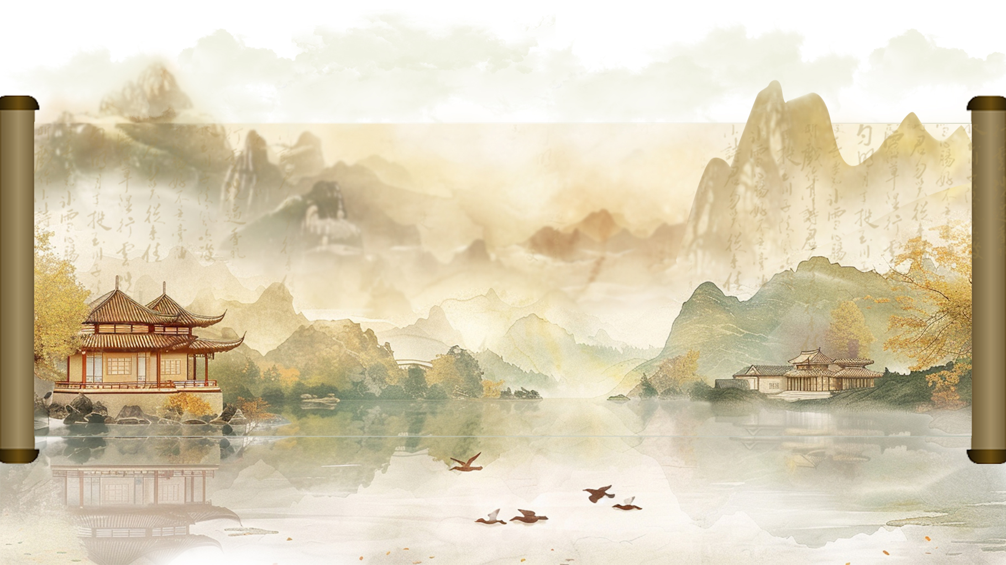
Chinese Garden
汇报人：蒋晨美
汇报时间：2024.9

Slide 2
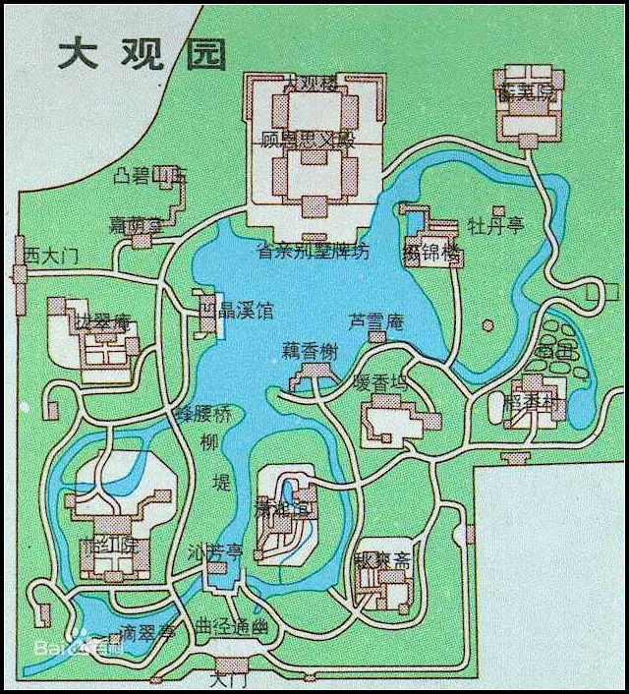


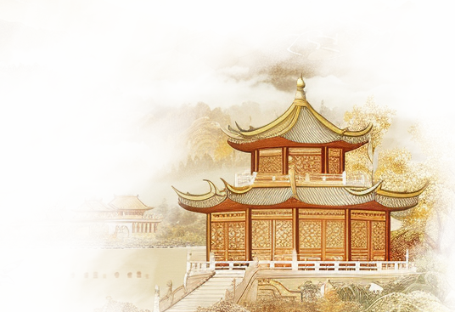

Grand View Garden
The Grand View Garden is a garden in the book "Dream of the Red Chamber".It shows the prosperity of the Jia family and the luxury of the noble life. It's not only where the main characters like Jia Baoyu and Lin Daiyu lived, but also the main place for their emotional problems and cultural activities.
The design of the Grand View Garden mixes the art of gardens in the south and north. The buildings in it are nice, there are mountains, water, flowers and trees. It's full of poetic and artistic charm. The Grand View Garden is not only an important symbol in "Dream of the Red Chamber", but also an outstanding example of classical Chinese garden art.

Slide 3
content
01
Garden layout
02
Garden structures
03
Garden design

Slide 4


01
Garden layout

Slide 5
Garden-within-garden design
Garden within garden is a unique technique in Chinese garden design. By setting small gardens in large gardens.The design of the garden within the garden not only increases the sense of hierarchy of the garden, but also provides visitors with a richer and more exquisite viewing experience.
Axis design
Axis is a virtual line used to organize and guide the layout of space in garden design. It connects different landscape elements and guides the route and sight of visitors. The axis can be straight or tortuous, and they can be symmetrical or asymmetric, helping to highlight the spatial structure of the garden.
Water system design
The design of water in Chinese garden is an important part of garden art, which not only carries the ornamental and practical functions, but also contains profound cultural connotation. The water design of Chinese classical gardens pays attention to the harmony and unity with nature, and pursues the aesthetic effect of "though it is made by man, it is like nature".

Slide 6
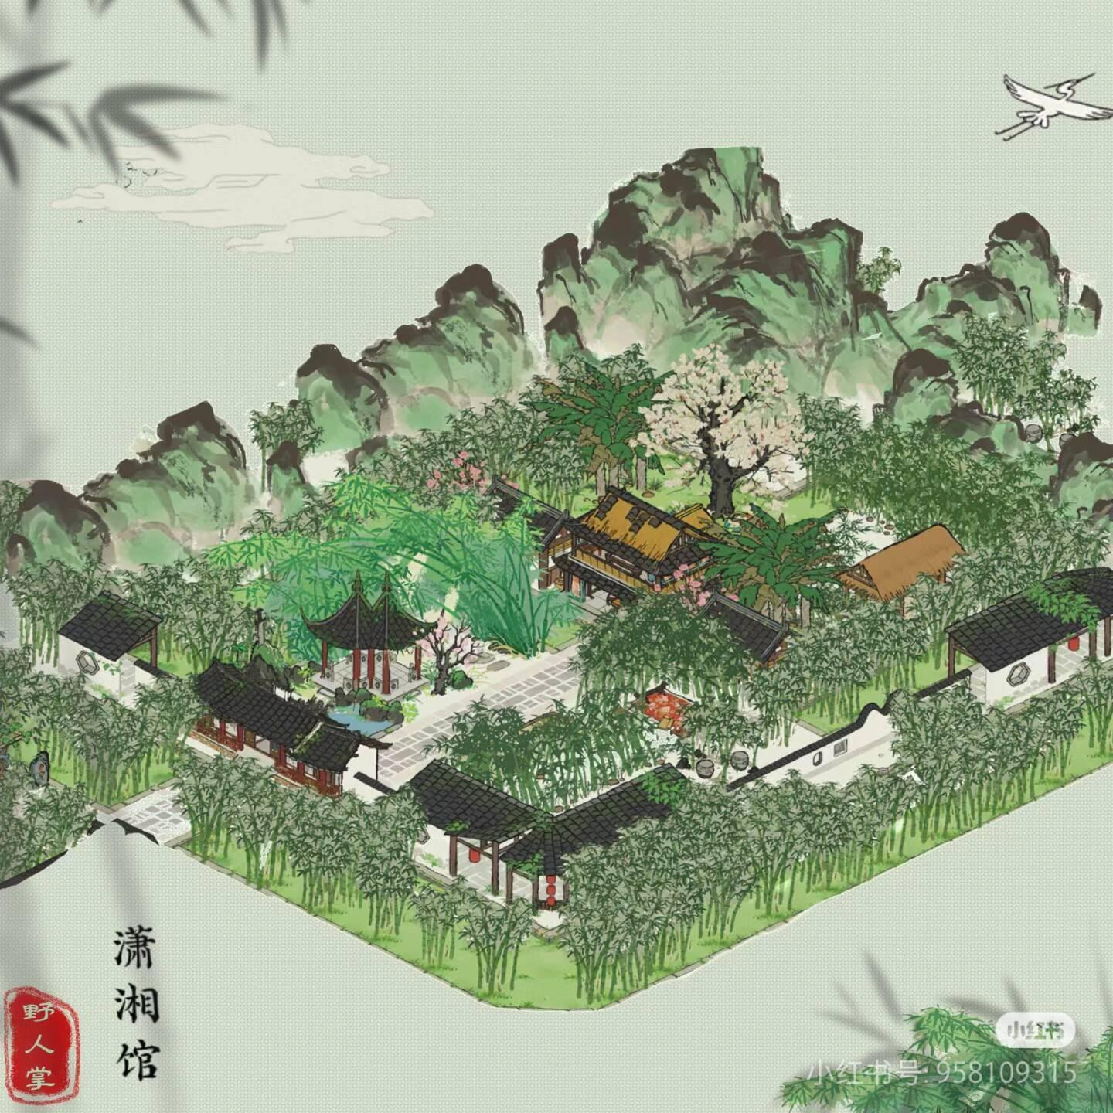
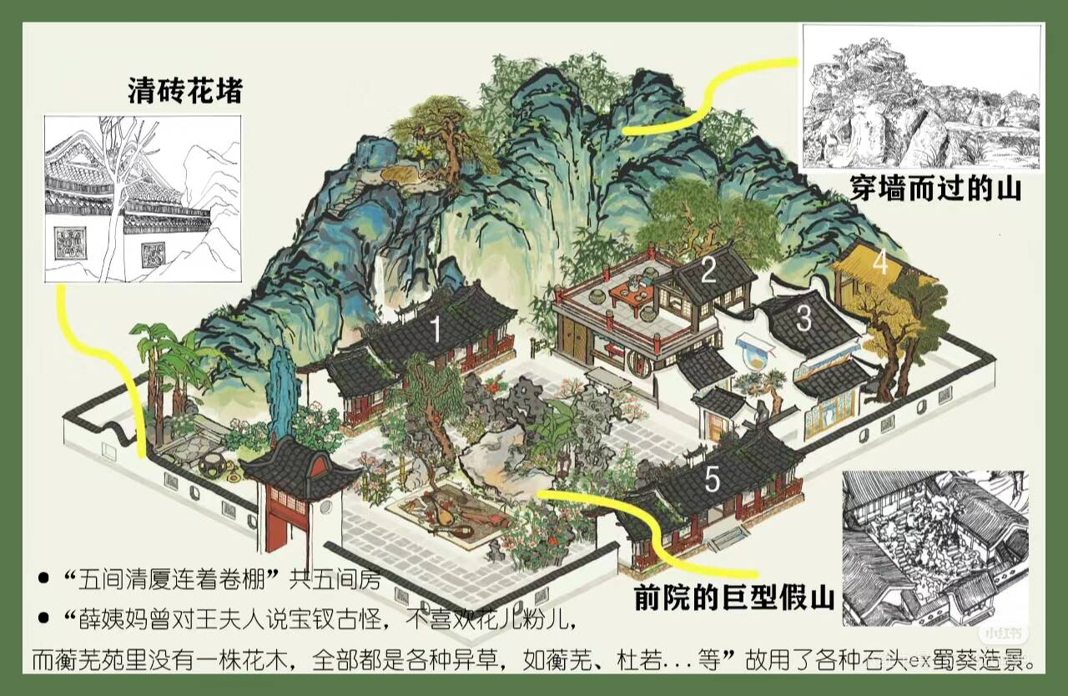
一所清凉瓦舍，一色水磨砖墙，清瓦花堵。那大主山所分之脉，皆穿墙而过。忽迎面突出插天的大玲珑山石来，四面群绕各式石块，竟把里面所有房屋悉皆遮住，而且一株花木也无。只见许多异草：或有牵藤的，或有引蔓的，或垂山巅，或穿石隙，甚至垂檐绕柱，萦砌盘阶，或如翠带飘摇，或如金绳盘屈，或实若丹砂，或花如金桂，味香气馥，非花香之可比。
忽抬头看见前面一带粉垣，里面数楹修舍，有千百竿翠竹遮映。众人都道：‘好个所在！’于是大家进入，只见入门便是曲折游廊，阶下石子漫成甬路。上面小小两三房舍，一明两暗，里面都是合着地步打就的床几椅案。从里间房内又得一小门，出去则是后院，有大株梨花兼着芭蕉。又有两间小小退步。后院墙下忽开一隙，清泉一派，开沟仅尺许，灌入墙内，绕阶缘屋至前院，盘旋竹下而出。

Slide 7
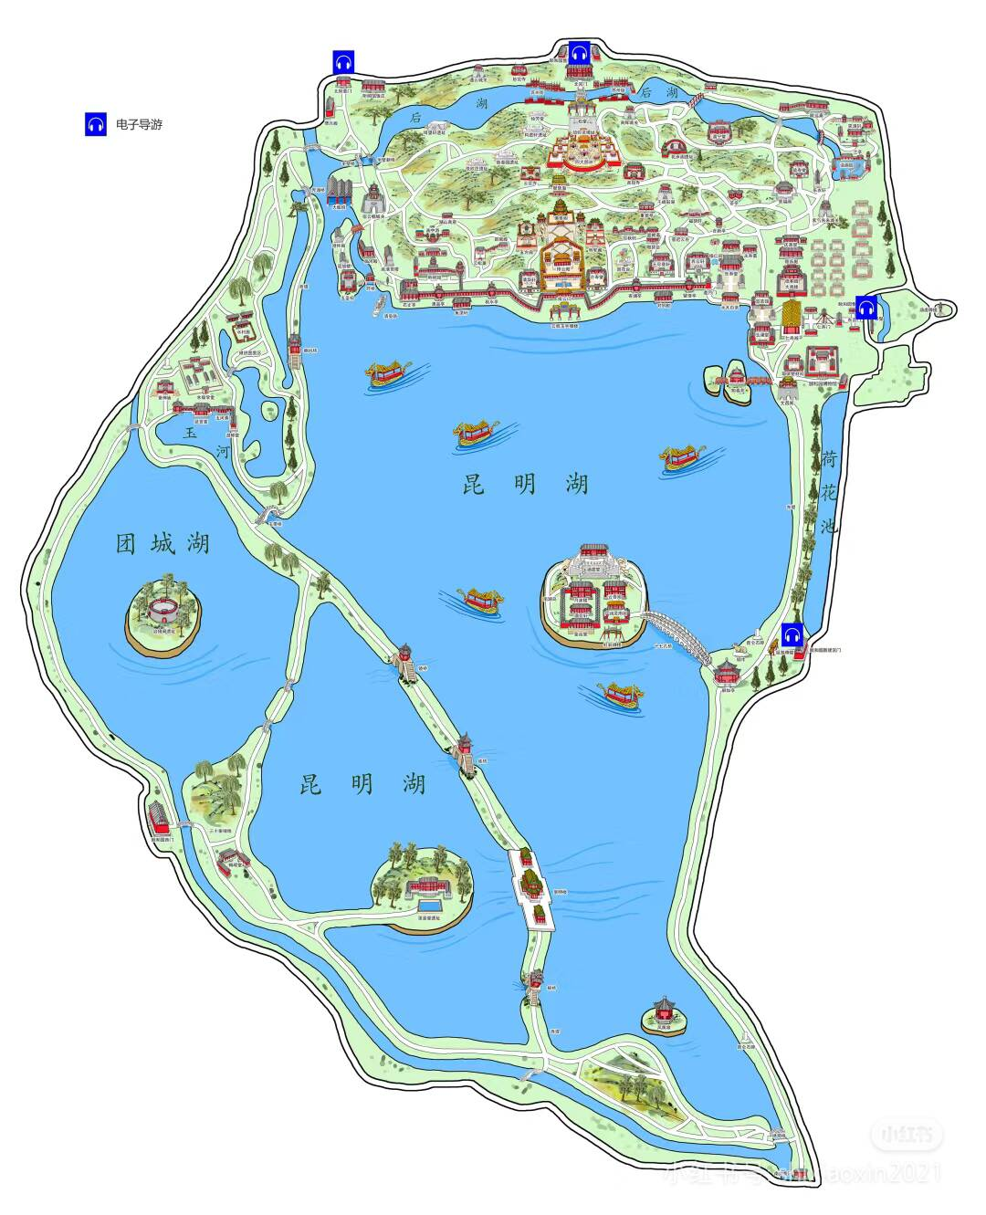
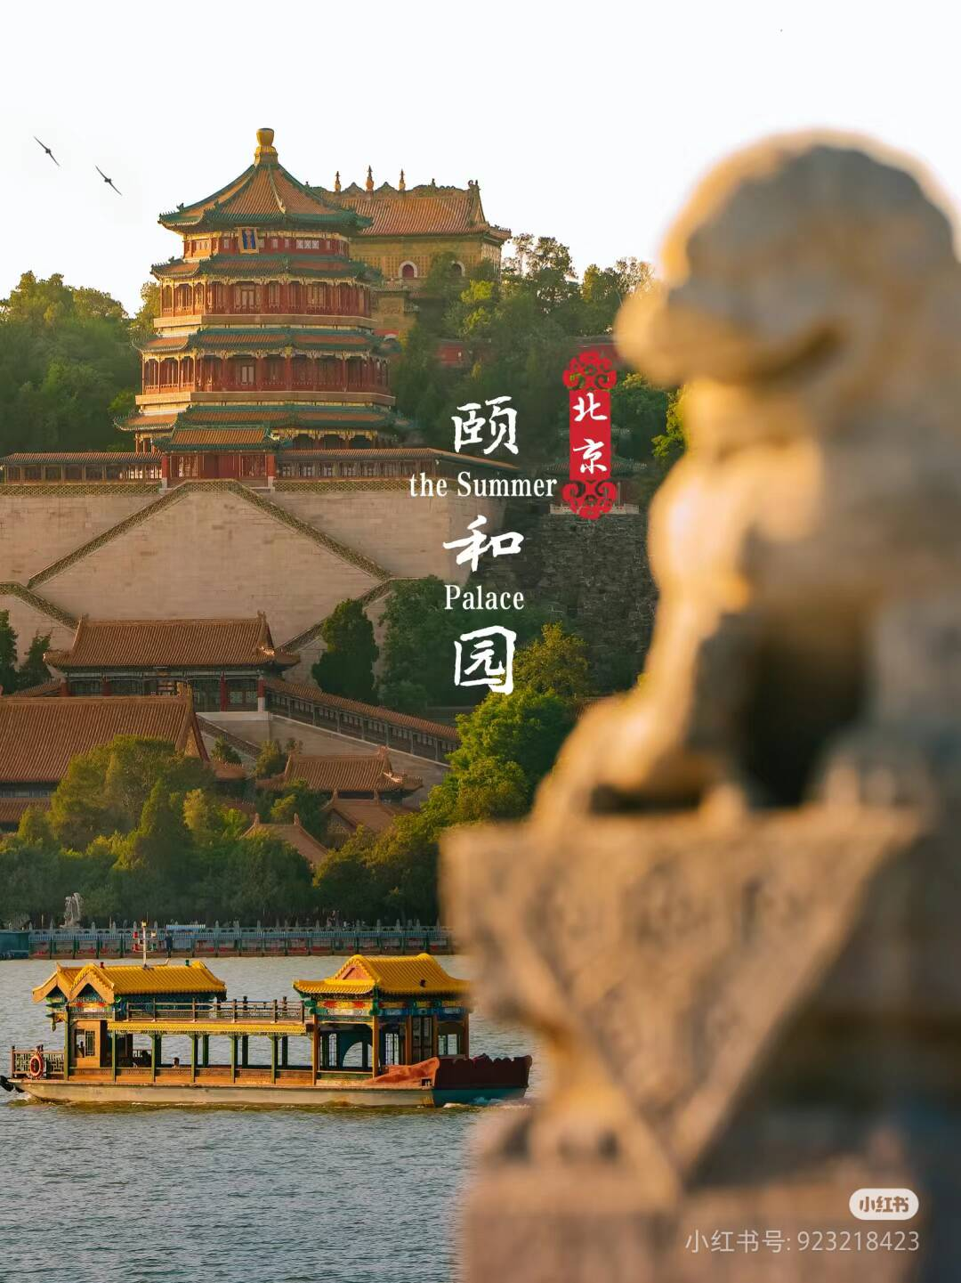
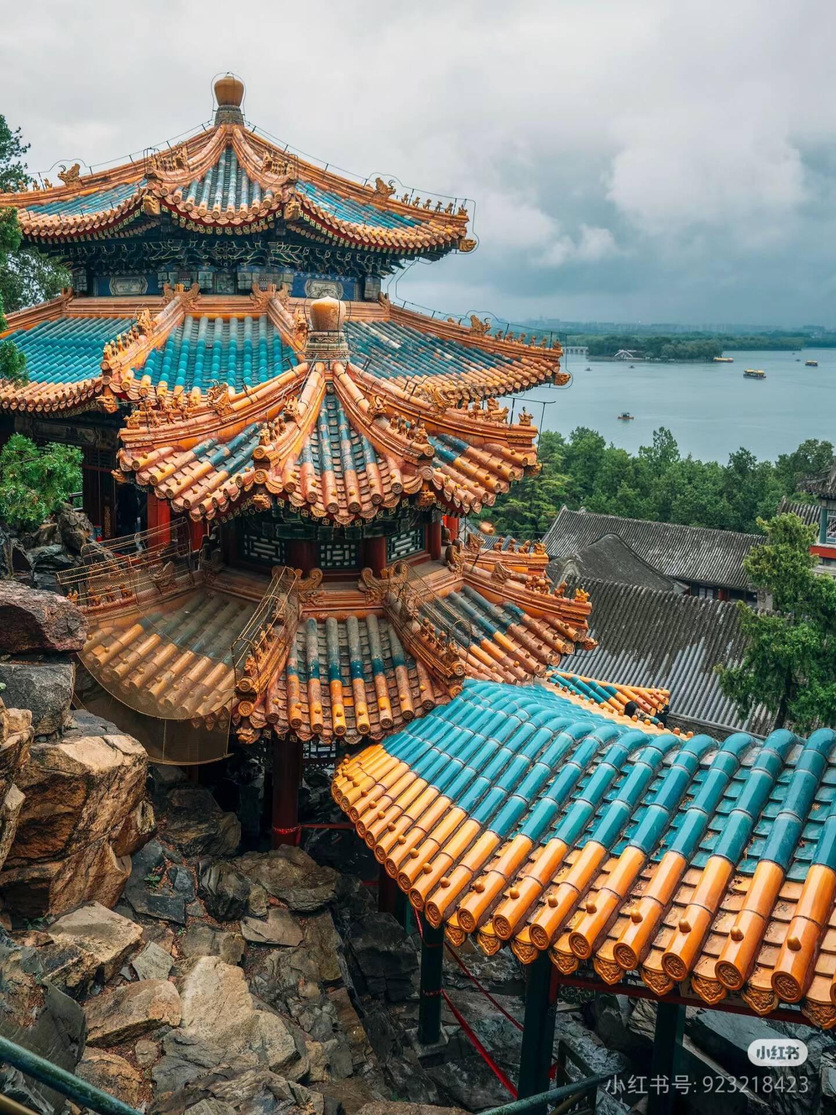
The Foxiang Pavilion on Wanshou Mountain is located on the central axis, forming the opposite view with the Nanhu Island and Seventeen hole bridge in Kunming Lake. This combination of axis and view not only reflects the majesty and symmetrical beauty of the royal garden, but also strengthens the depth and breadth of the space
The Xiequ Garden, Yang Renfeng and Huazhongyou in the Summer Palace are all typical gardens within the big one. They create small but beautiful spaces in the large garden, so that visitors can experience more delicate garden art in the grand garden.

