Slide 1



Language Styles
Group members: Bian Wangqian,
Wang Siqi,
Li Ying,
Tuo Shumei
大雪江南见未曾
今年方始是严凝

Slide 2

Introduction to Language Styles
Official Language in China
CONTENTS
Written and Spoken Chinese
壹
Slang
贰
Dialects
v
叁
肆
伍

Slide 3
Introduction to Language Styles
Part one

Slide 4
1.Background
1
Language style，also called functional style
About 1920s-1930s,Soviet linguistics studied language style，they believed that language styles can be various according to the differences in the communicative environment.
2
Word origination
stylus(Latin)
style/Yuti
originated from
stylos(Greek)
3
The meanings of style
the way of writing or expressing ideas
The style of a writer's work in a certain era
the way of writing
the style of a literary work

Slide 5
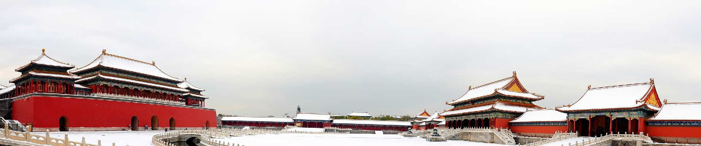
2.Genre, Type of Writing and Style
1.Chinese scholarship
2.Ding Jinguo (2008)
type of writing
文体
First, it refers to the style of a writer and an essay.
Second, it refers to the genre of an essay, and later specifically to the genre of an essay.
type of writing is the genre of an article, focusing on written expression.
characteristics：normative/of public agreement/mandatory

Slide 6
Genre(语体)
1
Definition
Genre is a specific, personal discourse or discourse text that has been repeatedly used to form an agreed-upon paradigm for all members of a particular linguistic community, and is the result of a typology of the selective relationship between language use and context.

Slide 7
Style(风格)
1
Definition
It links the subject of creation, the object of discourse and the subject of appreciation, allowing individuals to give full play to their subjective initiative in the use of language and to create individual styles.

Slide 8
the difference of type of writing ,genre and style
type of writing(文体) | genre（语体） | style（风格）
distinctly national | interlingual commonalities
 | The basis for the existence of style is genre
 | social | individual and subjective
Actually, Mr. Ding Jingguo named them separately in order to distinguish them, and for the sake of unification, we use “style” to illustrate Yuti in pinyin in this presentation.

Slide 9
Definition of Language Styles
1
It is as an alias for “vernacular” as opposed to “the classical Chinese”, referring to the system of language and writing
The appearance of "style" in rhetorical works began in 1932 with the first edition of Chen Wangdao's Rhetoric, which Chen called the style of language, or rhetorical style or rhetorical category.
2
In general, the study of language styles in the perspective of linguistics in China started late, and it is generally believed that the study started in the mid-1950s after the founding of New China.
3
Zhang Gong defines style in this way: “The speaker or the writer, according to the content of expression, the purpose of communication, the characteristics of the audience or readers, the occasion of communication and other factors, choose to use the national language materials (words and phrases), which naturally carry some characteristics. So the style is formed by the combination of such characteristics.
4
1.literary style
2.scientific style
oral language+ written language
3.politicl style
4.official style

Slide 10
Official Language in China
Part two

Slide 11

Official Language(官方语)
An official language is a language with a legal role that is determined by the actual needs of life in a country, including the national language and the general language.

Slide 12
National Language（国语）
1
Definition
The national language is the official language that symbolizes the dignity of the nation and is used to sing the national anthem.The national language is naturally the official language, but not necessarily the general language.

Slide 13
General Language（通用语）
1
Definition
The general language is the most popular official language, and plays the most important role in the actual linguistic life of a country, especially in the fields of administration, education and media.

Slide 14
How to Address the Official Language of China
kou-yu
Putonghua
Chinese
1.In 1955, Putonghua replaced “Kou-yu” ;
2.Putonghua, is the modern standard Chinese language with the Peking pronunciation and the northern dialect.
3.Putonghua is also one of the six working language of the United Nation and an important means of communication between China and foreign countries.
The term “Kou-yu” came into being after the founding of the Republic of China, and the "Provisional Education Conference" held in Beijing in July 1912 affirmed the name "Kou-yu" and decided to implement it nationwide
Chinese. It is generally considered to be the language of the Han people, the main language of China.

Slide 15
Written and Spoken Chinese
Part three

Slide 16
Spoken Chinese
1.There has not been a widespread spoken language in history.
2.since the Spring and Autumn Period, China has had a relatively unified "general language", known in ancient times as Yayan or Xiayan, the common language of the Hua and Xia tribes.
3.Starting from Yuan, the capital dialect began to become a new Yayan.
4.By the Ming Dynasty, the general spoken language, Cuon Hoa(官话), which was dominated by the Beijing dialects, appeared and also became quite widespread.
5."Beijing Mandarin" even gained massive popularity and gradually became the general standard spoken language in modern China, as well as the prototype of Putonghua in modern China.

Slide 17
Characteristics of Modern Spoken Chinese
1.Spoken language has a number of phonetic expressions.
The last syllable of commonly used words in spoken Chinese is often read lightly,such as: 豆腐、衣服
Spoken intonation can express subtle feelings, and can also be used as a means to distinguish the tone of statements, questions.
2.In terms of vocabulary, colloquial language has its own words, mainly common words with colloquial color.
an ending with “儿(er)”,such as: 今儿（today）、花儿（flower）
a large number of overlapping words and familiar words in mosaic format, such as: 亮晶晶(gleaming), 冷冰冰(icy), 坑坑洼洼(of roads surface being bumpy and rough).

Slide 18
Characteristics of Modern Spoken Chinese
3.The flexibility of the use of words in spoken Chinese
the use of words, that is, nouns are often used as verbs or adjectives, such as:把孩子奶大(to raise a child up)
Secondly, multi-syllable words are split up to use, such as: 努一把力(make efforts)
To summarize, the main characteristics of Chinese spoken language are: focus on the role of speech in communication,use a wide range of words, especially common colloquial vocabulary,short sentences, sometimes incomplete, less use of compound sentences; relatively simple structure of the discourse, allowing the topic to change from time to time, and not valuing the coherence of the whole text and so on.

Slide 19

Classification of Written Chinese
壹
Literary style（(novels,plays,poems,songs)）
It is characterized by the integrity and vividness of linguistic images, the richness of language, and a high degree of aesthetic sensibility.
贰
Scientific style（textbooks and dictionaries）
It distinguishes itself by the accuracy of concepts, the rigor of judgments and the thoroughness and precision of reasoning.
叁
Political style（editorials, commentaries ，political speeches）
The language of political discourse is strongly combative, and readers can see the writer’s passionate stance clearly. It is characterized by the use of both scientific and literary language.

Slide 20
Classification of Written Chinese
肆
Official style（official letters, bulletins)
It is characterized by the simplicity, accuracy and rigor of matters. The language entails a high degree of factual accuracy and certainty of the specialized words used properly.

Slide 21



Conclusion
Although language styles have their respective independent characteristics, but they are interrelated and influenced by each other. The popular scientific discourse has both literary and artistic components, and generally uses figurative techniques. Political discourse has the characteristics of what both scientific and literary discourse has. The official discourse then reflects the logical laws of the world and the way it works and is considered scientific. Therefore, we can see that there is no insurmountable boundary between the various language styles and there is always a connection between them, more or less.

Slide 22
Part four：Slang
4.1.1 Definition:
A type of language consisting of words and phrases that are considered to be very informal, more common in speech than in writing.
Restricted to a particular context or group of people
A nonstandard variety of speech characterized by newly coined and rapidly changing words and phrases.

Slide 23
4.1.2: Origin and creation
Slang emanates from conflicts in values (superficial or fundamental)
Slang may be created When an individual applies language in a new way to express his emotion (hostility, ridicule, or contempt, often with sharp wit)
Slang is produced largely by social forces rather than by an individual
This is one reason why it is difficult to determine the origin of slang terms.

Slide 24
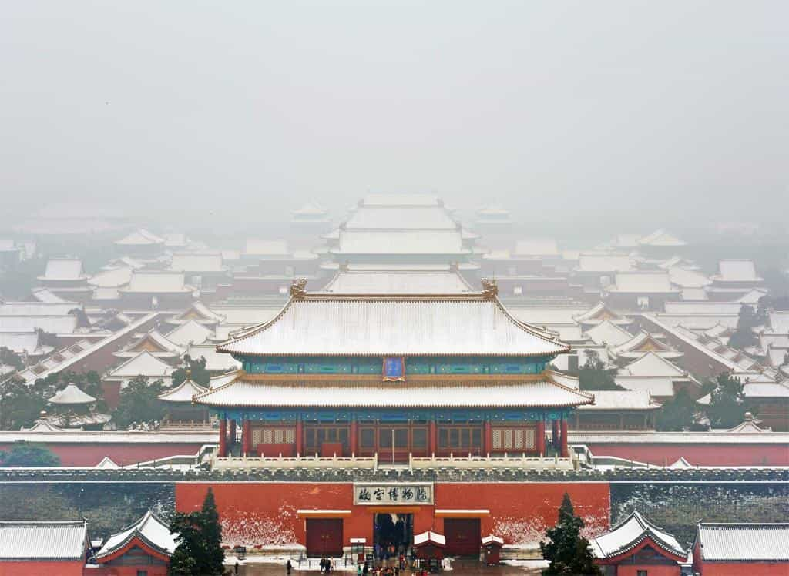
4.2 Characteristics
1. Marker of in-group solidarity
2. Correlate of human groups with shared experiences, (children at a certain school or of a certain age, a member of a certain socially definable group)
3. A high birth and death rate.
4. Excessive use tends to dull the lustre of even the most colourful and descriptive words and phrases.
Rate of turnover in slang words is encouraged by the mass media

Slide 25
4.3 Internet Slang
4.3.1Change of ways in popularize slang
In the past: much of Chinese slang was developed through ancient stories that were passed down through generations.
At present: with the rise of the Internet and texting, a new development of language is forming---- internet slang.
Internet Slang represents a main type of Chinese modern slangs
The uniformity in Chinese slang is the use of Chinese slang on the internet.

Slide 26
4.3.2 Different types of internet slang
1.Chinese Slang About Society
Singles Day 光棍节 (guānggùn jié)
Singles day is on the 11th of November every year because the date looks like four single people standing beside each other (11.11).
2.Chinese Slang Using Numbers
Many Chinese numbers sound very similar to how another character may sound, therefore mimicking the meaning.
666
the colloquialism 666 (liùliùliù) comes from 牛牛牛 (niuniuniu) meaning awesome, excellent.

Slide 27
3.Chinese Slang Using Letters
YYDS
YYDS is like the equivalent of GOAT (the greatest of all time ）in English.
It’s an abbreviation of the Chinese 永远的神 (yǒnɡyuǎn de shén) which literally means “forever the God”.

Slide 28
4.4 The Significance:
Understand what’s going on in reality with the locals.
Improve your day-to-day communication in China.
Better appreciate and adapt to Chinese culture.

Slide 29
Part five：Dialects
4.1. Definition: a variety of a language that is distinguished from other varieties of the same language by features of phonology, grammar, and vocabulary, and by its use by a group of speakers who are set off from others geographically or socially.
one thing in common: they all share the same writing system based on Chinese characters.

Slide 30
5.2 Varieties of Dialects
5.2.1 Geographic dialects (or regionalects)
It can be roughly classified into seven large groups:
Putonghua (Mandarin), mainly based off of the Beijing dialect.
Gan, (Hunan, Hubei, Anhui, and Fujian.) Kejia (Hakka) Southern China and Taiwan East Asia,
Min, ( Fujian) Wu (Shanghai, Zhejiang Province,)
Xiang,(Hunan province ) Yue (Cantonese).
Each language group contains a large number of dialects.

Slide 31
5.3 The Status Quo of Regionalects
Shrinking or even dying out
Alien to young people.
Assimilated by mandarin.
Gradually lost their soil and the young people are gradually alienated from the regional culture embedded in the dialects

Slide 32
5.4 Four reasons that can better explain this situation.
Development and convenience of transportation
The promotion of Mandarin
Television and Internet media that require and promote Mandarin.
Many young people took pride in speaking Mandarin and felt that the regionalect are too old-fashioned.

Slide 33
5.5 Approaches to Protecting and Promoting Regionalects
Issue a policy to protect the regionalects
Mass media has to play its own role in promoting the vernacular language
It can also be used in television programmes where appropriate.

Slide 34
5.6 Social dialects
Definition: A variety of speech associated with a particular social class or occupational group within a society.
It includes professional terminology, jargon, cant, etc.
Social factors that influence sociolects include socio-economic status, age, occupation, and gender and so on.

Slide 35
感谢
古
世间无限丹青手 一片伤心画不成
典
建
筑
大雪江南见未曾
今年方始是严凝

