Slide 1

Cultural output of Chinese Mobile Games
汇报人： 刘沛楠

Slide 2

01
Overview of Chinese Mobile Game Industry

Slide 3

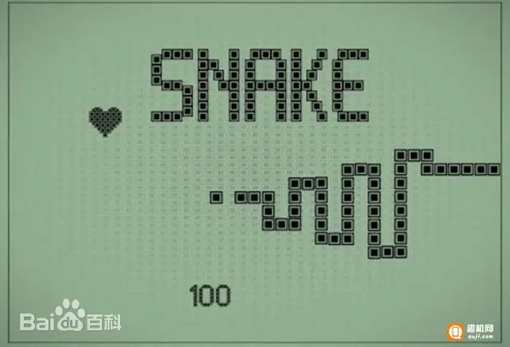
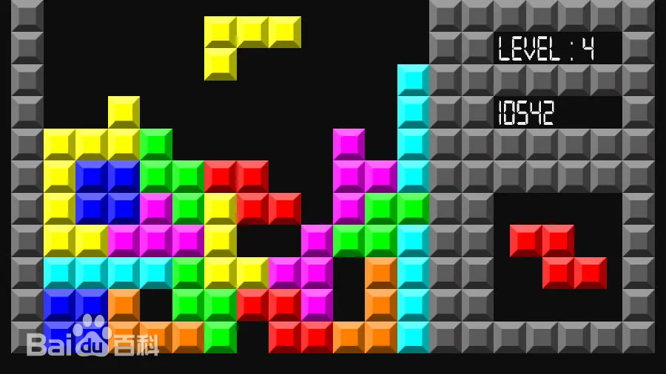
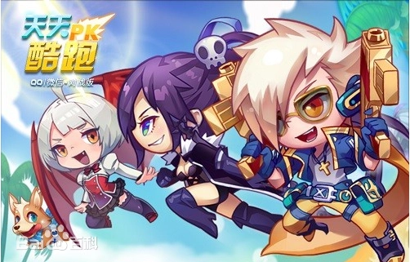

01
Initial Development Stage (Early 2000s to Late 2000s)
Initial Development Stage (Early 2000s to Early 2010s)
Origins and Emergence: The nascent stage of Chinese mobile games can be traced back to the early 2000s, when the proliferation of smartphones and the development of mobile internet gradually brought mobile games into the public eye.
However, in the early days, mobile games were primarily simple single-player games, such as Snake and Tetris.
Rapid Growth Stage(Early-2010s to Mid- 2010s)
02
Explosive Growth: In the mid-2010s, the Chinese mobile game market experienced explosive growth. On one hand, the performance of smartphones continued to improve, providing better hardware support for mobile games.
Emergence of Classic Games: During this stage, several classic mobile games emerged, such as Tencent's "Tian Tian Ai Xiao Chu" (Candy Crush-like game) and "Cool running" (an endless runner game).

Slide 4
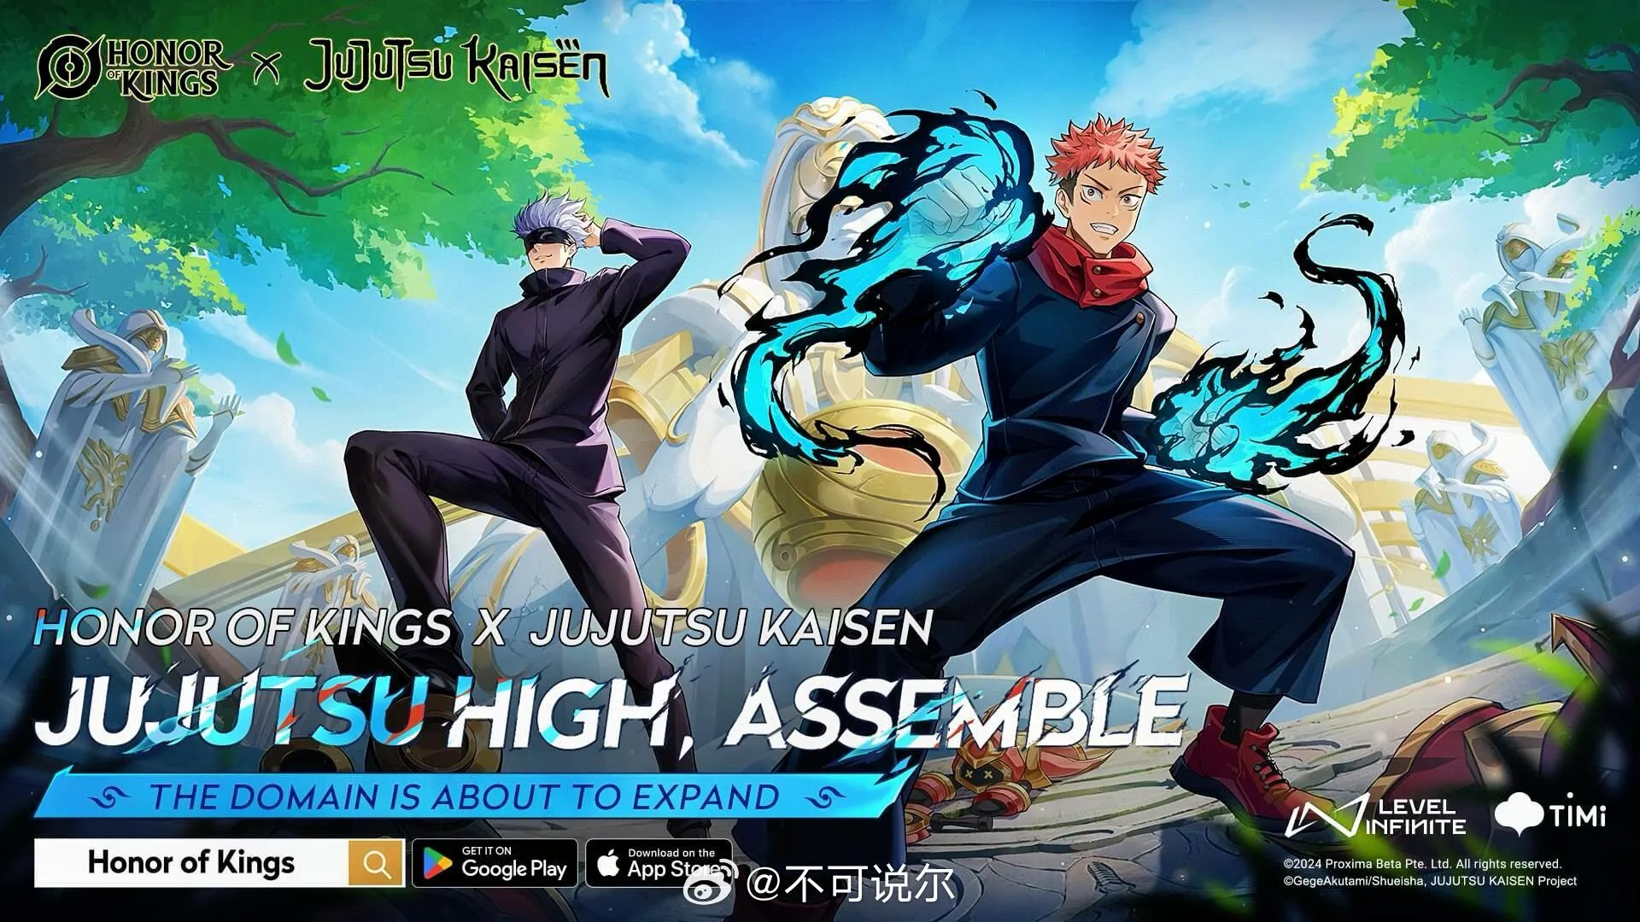

Market Size and Growth Rate
03
Diversified Development Stage (Mid 2010s to Present)
Diversification Trend: Entering the 2020s, the Chinese mobile game market has shown a trend of diversification. On one hand, game types have become more diverse, covering almost all types of games; on the other hand, gameplay has also continuously innovated, with new play styles such as MOBA (Multiplayer Online Battle Arena) and "chicken dinner" (battle royale) games gradually gaining popularity.
Emergence of High-Quality Games: In this stage, several high-quality mobile games have emerged, such as Tencent's "Honor of Kings" (王者荣耀) and “PUBG Mobile" (和平精英). These games have won the favor of a wide range of players with their exquisite graphics, rich gameplay content, and excellent gaming experience.
Pronounced IP Trend: In recent years, IP has become a key element in the game market. Many mobile games are based on popular novels, anime, movies, and other IPs for adaptation or derivation, such as “Jujutsu Kaisen” (咒术回战).

Slide 5

Market Size and Growth Rate
01
Large market size
China's mobile game market is one of the largest in the world, with millions of active players and a high level of engagement.
02
Rapid growth rate
The market has experienced significant growth in recent years, driven by factors such as the proliferation of smartphones and tablets, as well as improvements in internet connectivity.
03
Strong revenue generation
Mobile games generate substantial revenue through in-game purchases, advertising, and other monetization strategies.

Slide 6
Trends and Developments
Esports: Esports has become increasingly popular in China, with many mobile games hosting professional tournaments and leagues.
Cloud gaming: Cloud gaming is a growing trend in China, allowing players to stream games directly to their devices without the need for downloads or high-end hardware.
Social features: Mobile games in China often incorporate social features such as chat, friend systems, and multiplayer gameplay to enhance player engagement and retention.
Increased competition: The mobile game market in China is highly competitive, with new games and developers constantly entering the market.

Slide 7
Three Giants
Q: do you know the three giants of Chinese game industries?
A: Netease, Tencent and miHoYo.

Slide 8
02
Netease: A Leading Player in Chinese Mobile Games

Slide 9
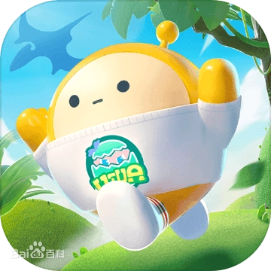

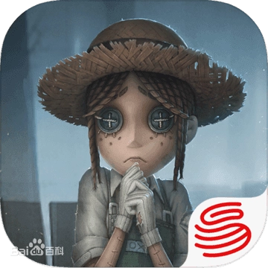
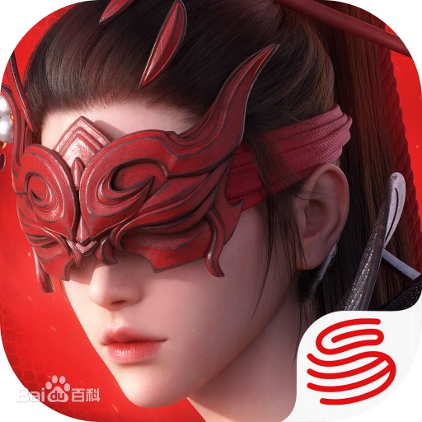
Popular Games Developed by Netease
Eggy Party
Onmyoji
01
02
A casual competitive mobile game. players navigate through a series of obstacle courses and mini-games with the goal of striving to be the first to reach the finish line.
A mobile game based on Japanese mythology and folklore, featuring a unique turn-based battle system and stunning graphics.
Identity V
Naraka
03
04
An Asymmetrical Battle Arena (非对称对抗竞技) game. Centered around a 1V4 asymmetrical competitive gameplay, the game offers players a thrilling experience with its absurd gothic art style and suspenseful, mind-bending storyline.
A martial arts-themed action-adventure battle royale game. Players take on the role of a hero, collecting various resources across the map to compete against other players and survive until the end.

Slide 10
03
Tencent: Dominating the Chinese Mobile Game Market

Slide 11
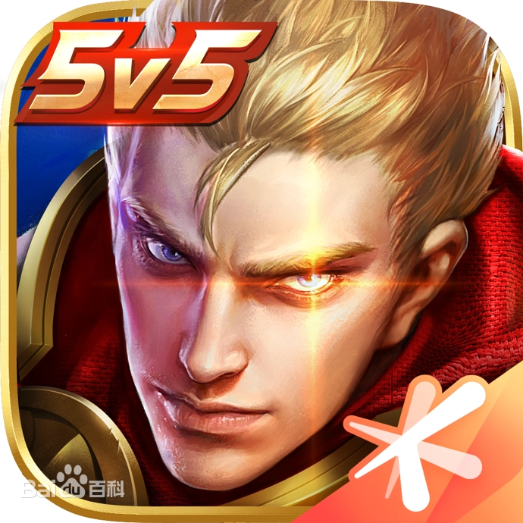



Popular Games Developed by Tencent
Honor of Kings
Teamfight Tactics
01
02
a Multiplayer Online Battle Arena (MOBA) game. The game features two teams competing against each other on a predefined map, with the ultimate objective of destroying the opposing team’s base.
an auto-battler mobile game authorized by "League of Legends" and specifically designed for the mobile platform.
PUBG Mobile
League of Legends: Wild Rift
03
04
A free-to-play battle royale game. Players take on the role of a soldier, collecting various resources across the map to compete against other players and survive until the end.
A Multiplayer Online Battle Arena (MOBA) game. The game features two teams competing against each other on a predefined map, with the ultimate objective of destroying the opposing team’s base.

Slide 12
04
miHoYo: Rising Star in the Chinese Mobile Game Industry

Slide 13



Successful Games from miHoYo: Genshin Impact, etc
Genshin Impact
Honkai Impact 3rd
Honkai: Star Rail
A popular open-world RPG game featuring a vast world to explore, unique characters, and an engaging storyline. The game has received critical acclaim and commercial success, becoming one of the most popular mobile games in the world.
A popular action RPG game with a strong female protagonist, featuring fast-paced combat, stunning graphics, and an immersive storyline.
This is a new galaxy adventure strategy game developed by miHoYo. Players will board the Star Rail and visit the myriad worlds residing in the universe.

Slide 14
05
Cultural Output through Chinese Games

Slide 15

Incorporation of Traditional Chinese Culture in Games
Traditional Chinese elements
Many mobile games incorporate traditional Chinese elements such as martial arts, mythology, and historical figures.
Cultural heritage
These games serve as a means of preserving and promoting China's rich cultural heritage to a wider audience.
Artistic style
The use of traditional Chinese art styles, such as ink painting and paper-cutting, adds a unique visual appeal to these games.

Slide 16
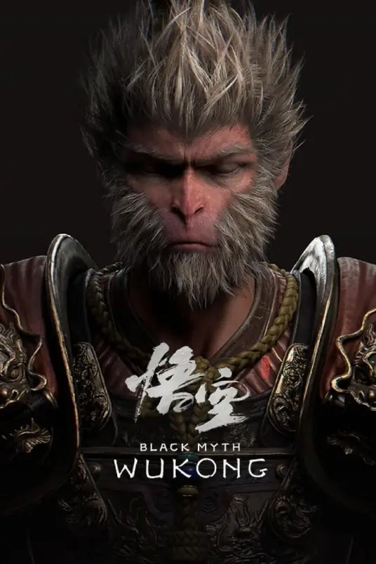
Cultural Output of “Black Myth: Wukong”
Spreading Chinese Classic Culture:
Based on the Chinese literary classic "Journey to the West.“
Presenting Rich Cultural Elements:
In terms of scenes, they are drawn from real-life locations and highly restored ancient architecture, natural landscapes.
Stimulating Overseas Interest in Chinese Culture:
The game has performed exceptionally well in overseas markets, topping sales charts in multiple countries upon release and attracting a large number of international players, sparking their interest in Chinese culture.

Slide 17

THANKS
感谢您的观看

