Slide 1


Premodern Literature
Tang-Song
Zhao Ke 赵轲

Slide 2

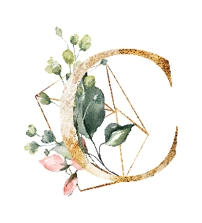

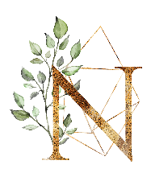
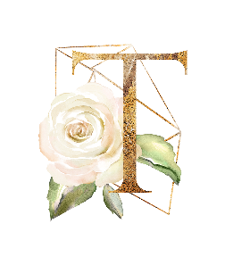
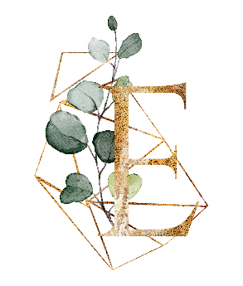

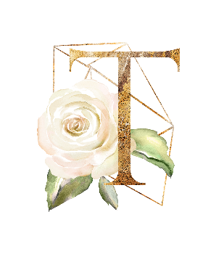
The Eight Tang-Song Prose Masters
Classical Prose Movement of late Tang Dynasty and Song Dynasty
Translations

Slide 3

The Eight Tang-Song Prose Masters

Slide 4
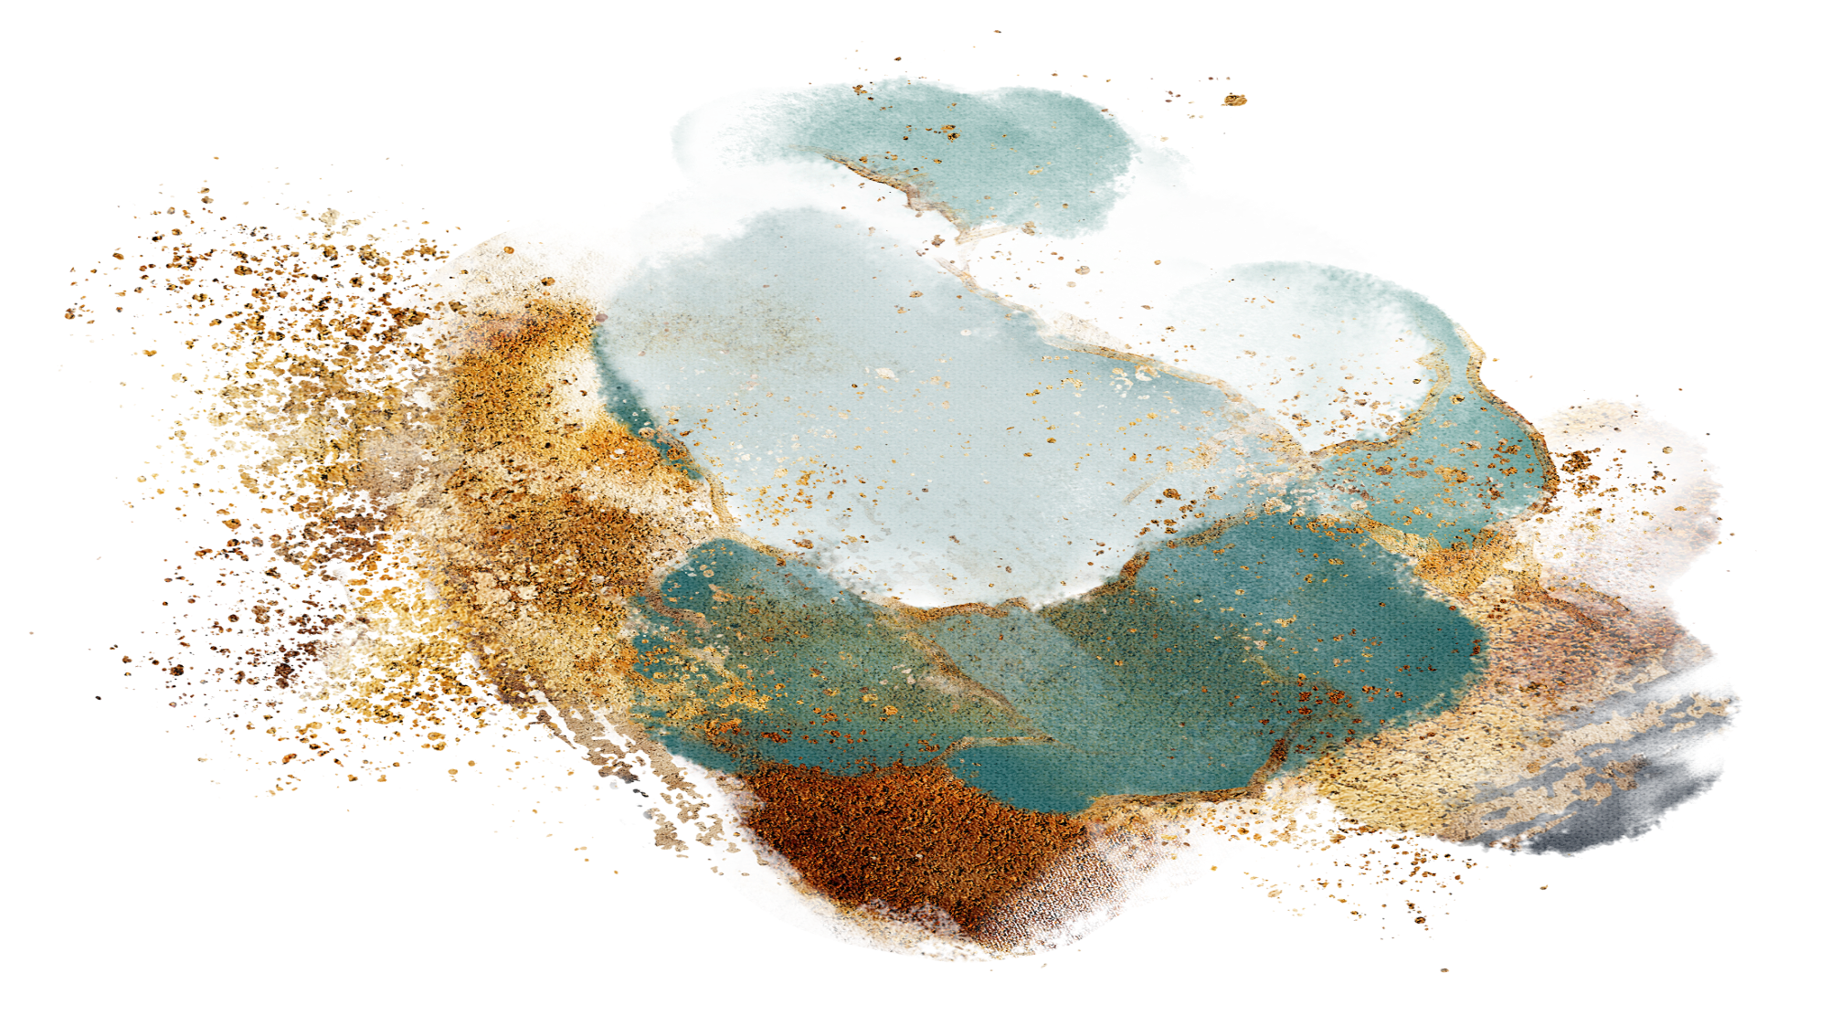
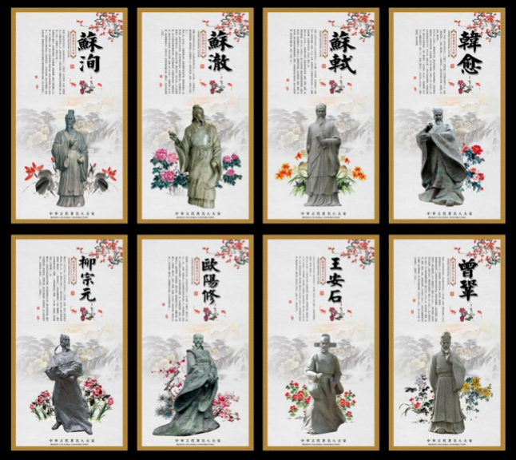
A Brief Introduction
Han Yu and Liu Zong yuan
in Tang Dynasty
Ouyang Xiu, Su Xun, Su Shi, Su Zhe, Wang Anshi and Zeng Gong in Song Dynasty
Feature
They all advocated prose (散文) and opposed parallel prose (骈文).

Slide 5
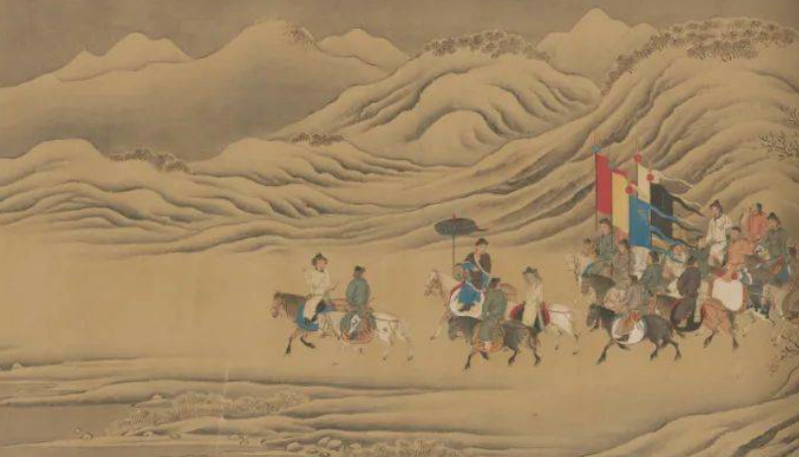
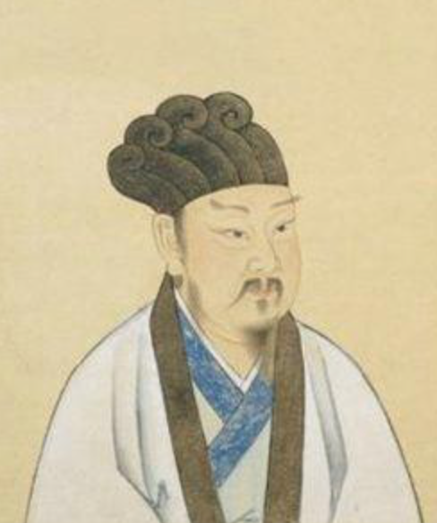
Productions: Han Yu
Name: Han Yu
Identity: Litterateur, Philosopher, Thinker
Hometown: Heyan\Jiaozuo (now)
Productions:
Han Changli Collection (韩昌黎集)
Title:
The Decline of Eight Generations（文起八代之衰）
The Article Giant（文学巨匠）
Admired Literate of One Hundred Generations（百代文宗）

Slide 6

Relationship of The Eight
Su Zhe
Father
Su Xun
Father
Representative figures of Linchuan Literature
Brother
Su Shi
Teacher
Zeng Gong
Core figures of the Ancient Prose Movement in the Song Dynasty
Ouyang Xiu
Classmates
Wang Anshi
Han Yu
Liu Zongyuan
Leaders of the Ancient Prose Movement in the Tang Dynasty

Slide 7
The Classical Prose Movement
The Classical Prose Movement of the late Tang Dynasty and the Song Dynasty in China, also known as the Classical Prose Movement, is a movement with the style reform as its surface and Confucianism Renaissance as its depth.
First Stage: Han Yu and Liu Zongyuan started it.They teached young people so that the movement could achieve further development.
Second Stage: After the Death of Han and Liu.Their students wrote with such ancient characters as to hinder understanding or neglected the importance of writing good essays.
Third Stage：Ouyang Xiu restarted it.As many people were dissatisfied with the florid parallel prose style, the Classical Prose Movement reached another peak during that period.

Slide 8

Translations
Metal and Stone's Article Left
×
Articles writen on steles and metalwares
Collection of Inscriptions
《金石遗文》
Inscriptions
External Collection
《外集》
External
额外
Out
×
外面
×

Slide 9
Translations
My Conclusion
1
We do not translate literally or word by word. Instead we do translation according to the meaning of words.

Slide 10
Translations
Willow First-Clan
Collection of Inscriptions
《金石遗文》
Liu Zongyuan
柳宗元
韩愈
Han Cure
External Collection
《外集》
Shang Zhongyong
《伤仲永》
Grieve for Middle Permanency

Slide 11
Translations
My Conclusion
For Chinese first names, they are easier to be translated because most of they have certain meaning while for last names, it would be harder due to their meaninglessness. Rather than translating halfly like Han Cure, in the text book writers use Han Yue and something like that.
1
2
We do not translate literally or word by word. Instead we do translation according to the meaning of words.

Slide 12
Translations
Talking about teachers
Han Yu
On Teachers
《师说》
The Teacher's Theory
Collection of Inscriptions
《金石遗文》
Liu Zongyuan
柳宗元
External Collection
《外集》
Shang Zhongyong
《伤仲永》

Slide 13


