Slide 1
Oil-paper Umbrella

Slide 2
CONTENTS
History
Production Process
Connotations and Implications
1
2
Production Areas
3
4
Notes:
模板来自于：第一PPT https://www.1ppt.com/

Slide 3

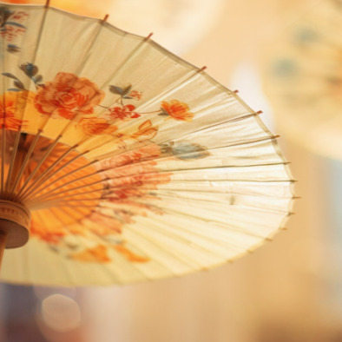
History

Slide 4


Invented by Lu Ban's wife Yun
At the end of the Spring and Autumn Period, Lu Ban, a famous carpenter in ancient China, often worked in the field, so Yun made the earliest umbrellas to prevent him from getting wet.

Slide 5
Production Process

Slide 6
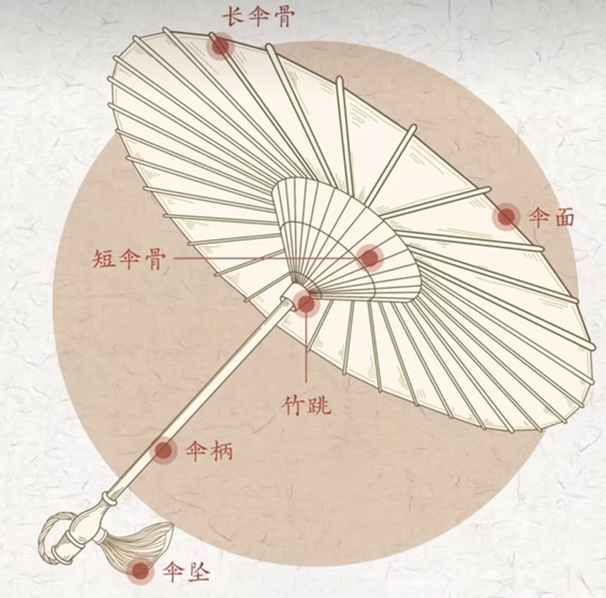
Bamboo selection and preparation
①
Umbrella ribs assembly
②
Canopy application and oiling
③
Pattern painting
④

Slide 7
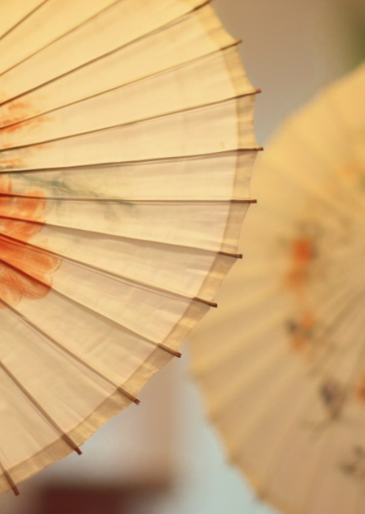
Bamboo is selected, crafted, soaked in water, and then dried in the sun.
The bamboo is drilled, threaded, and assembled into the umbrella ribs.
Rice paper(皮纸) is cut, glued onto the ribs, trimmed, oiled(桐油),and then exposed to sunlight.
Finally, patterns are painted onto the umbrella.

Slide 8
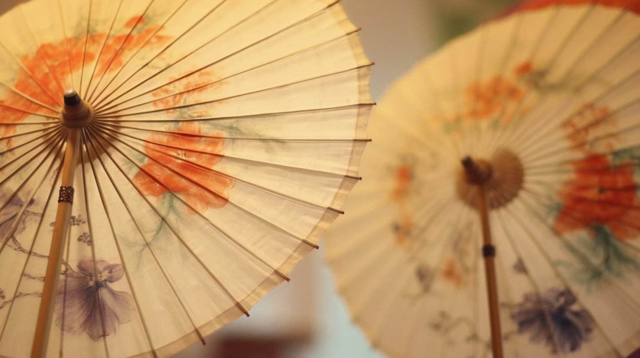
What types of paper and oil are used for the canopy of an oil-paper umbrella?

Slide 9
Connotations and Implications

Slide 10
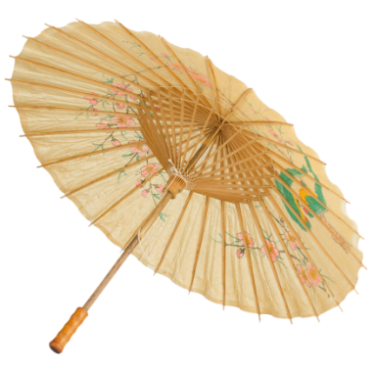
Symbol of Prosperity and Good Fortune
多子多福
The pronunciation of "oil paper" (油纸) is similar to "have children" (有子) in Chinese. The umbrella frame resembles the character "人" (person) and is made up of many such shapes, while the traditional character for "umbrella" (傘) has four "人" characters beneath one, symbolizing "five sons bringing honor to the family" in ancient times.

Slide 11
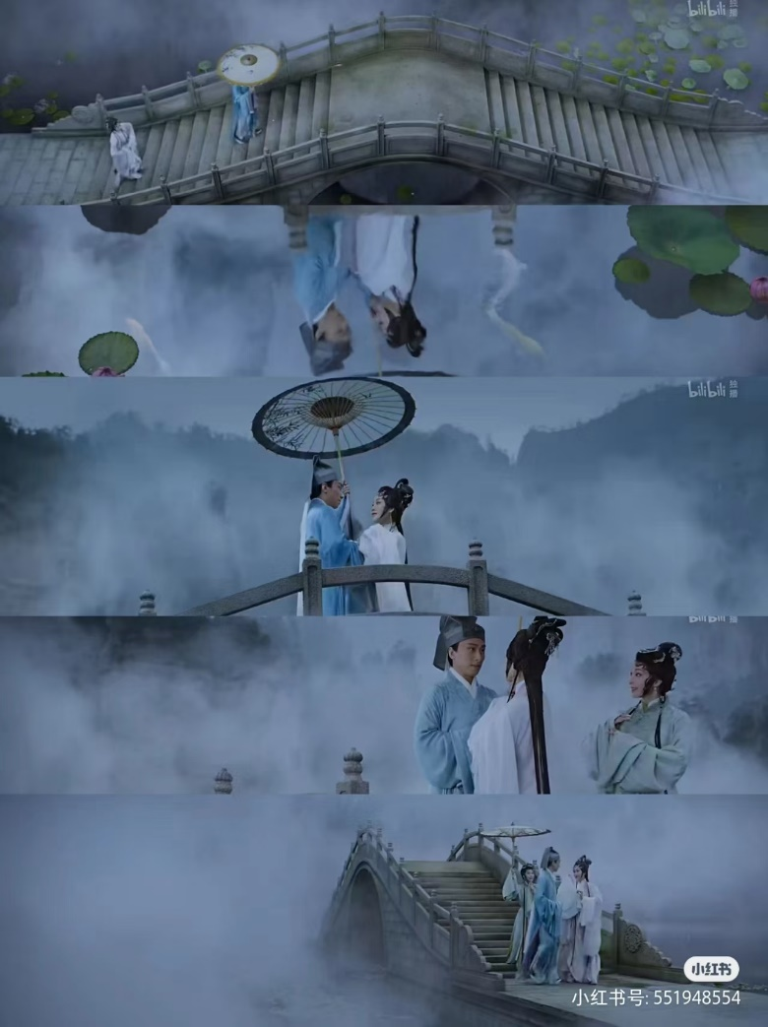
Representation of Lifelong Love
恩爱百年
The oil-paper umbrella has long been a part of classic love stories. In The Legend of the White Snake, Xu Xian and Bai Suzhen met on the Broken Bridge of West Lake under an oil-paper umbrella, creating an eternal love story.

Slide 12
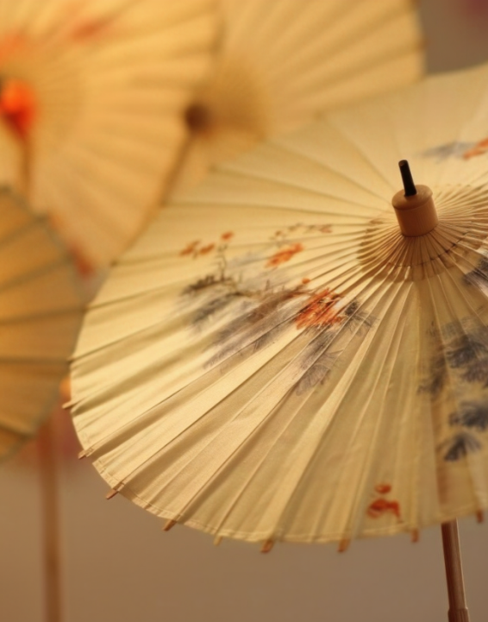
Symbol of Rising Success
The umbrella ribs are made of bamboo, which in Chinese culture symbolizes peace and steady growth, conveying wishes for continual advancement.
Symbol of Fulfillment, Reunion, and Peace
The round shape of the umbrella represents completeness, unity, and peace.

Slide 13
For Dispelling Evil and Ensuring Peace and Luck
According to Chinese folklore, tung oil, used in making oil-paper umbrellas, is believed to ward off disasters, repel evil, and drive away ghosts.
For Ancestral Worship
This tradition dates back to ancient China, where emperors carried yellow canopies as symbols of authority. It represents respect in the afterlife, freedom from suffering, and hope for reincarnation.

Slide 14
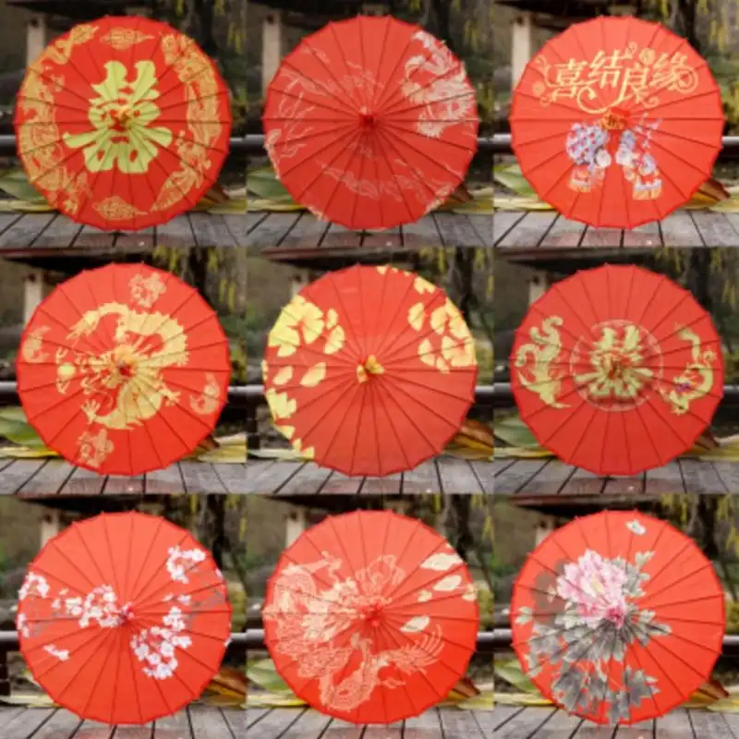
For academic success and celebration
In China, red oil-paper umbrellas symbolize academic success and celebration. Historically, scholars carried them to exams, representing safety and success. Today, they are gifted by friends and family before major exams and on occasions like birthdays and weddings to wish for prosperity and happiness.

Slide 15
What are the connotations of oil-paper umbrellas?

Slide 16
Production Areas

Slide 17
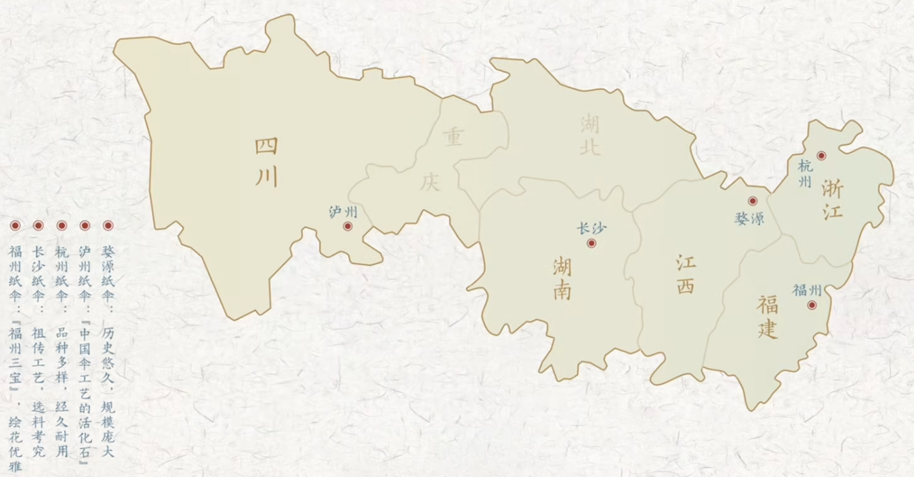
The five main production areas of oil-paper umbrellas

Slide 18
Thanks!

