Slide 1
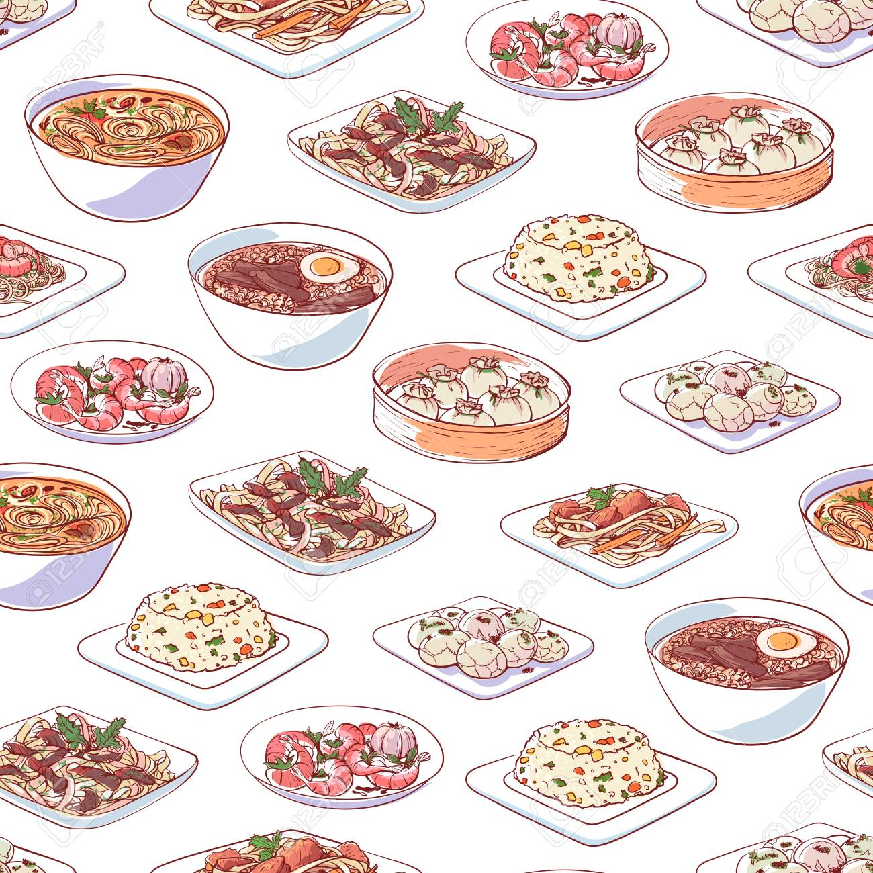
Traditional Cuisine
__The Art of Chinese Cooking__
SAFFANA ALSIED
HA THI THU HANG

Slide 2
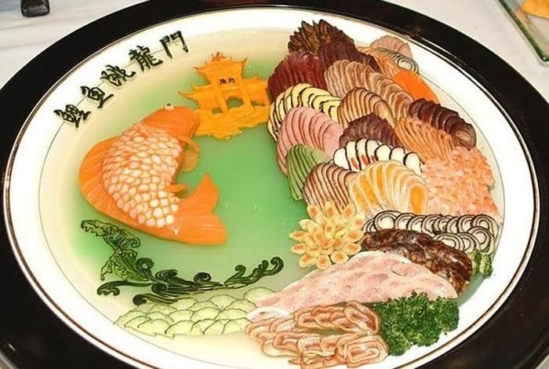
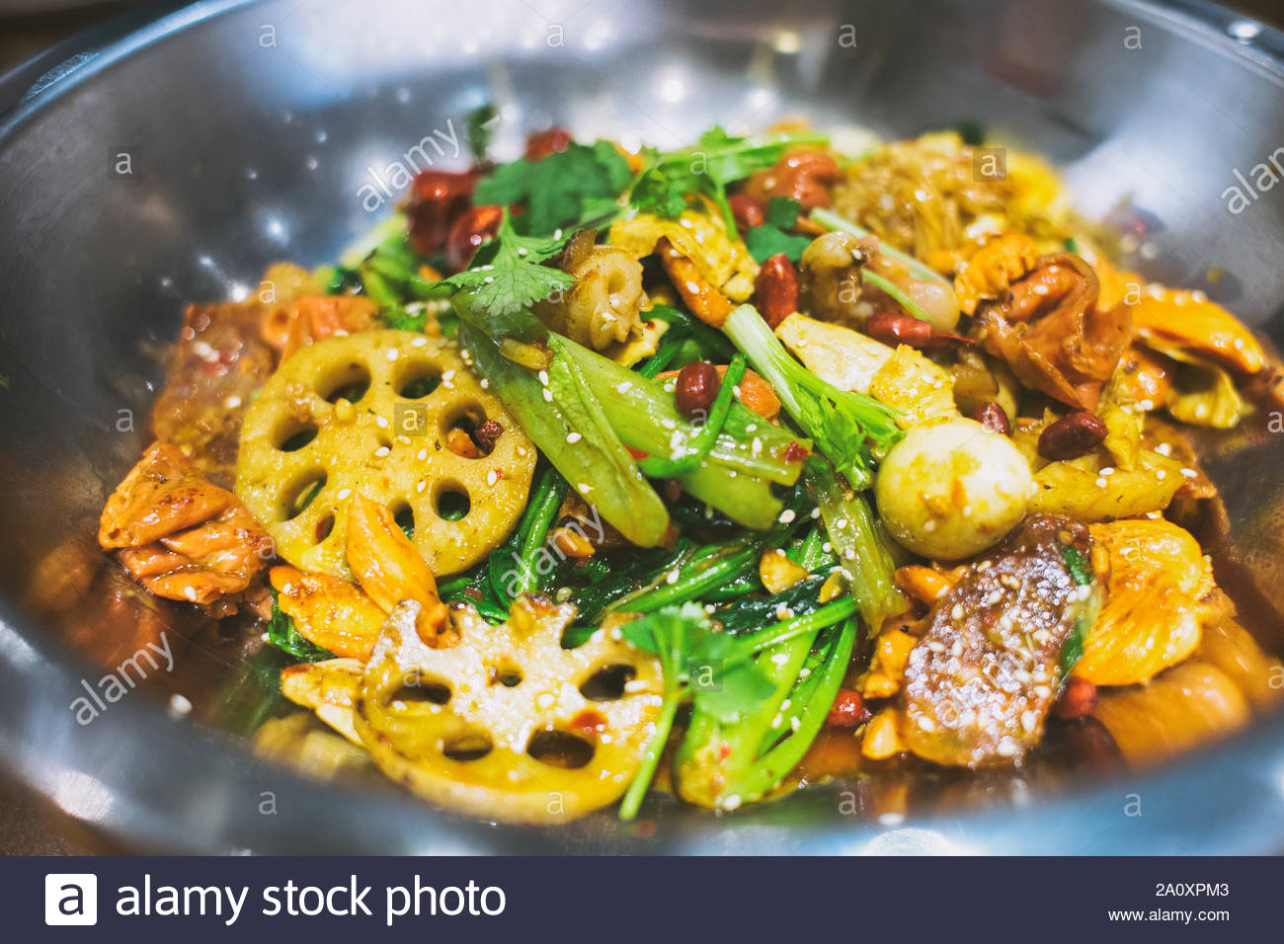
Brief Introduction of The Art of Chinese Cooking

Slide 3
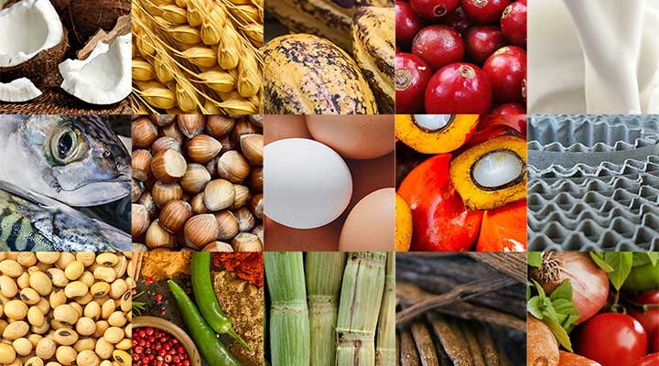
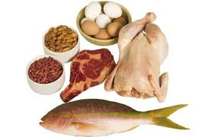
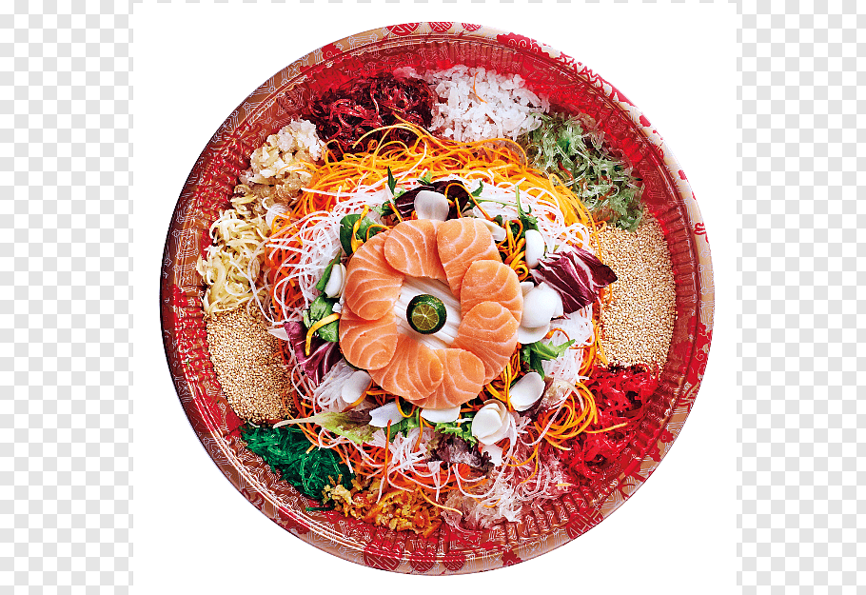
Ingredients
Chinese cuisine uses a variety of raw materials
It is important to create dishes that are also focused by Chinese chefs that the ingredients must be preparation and choose fresh and high quality
The chefs also pay attention to the combination of main ingredients and auxiliary materials

Slide 4
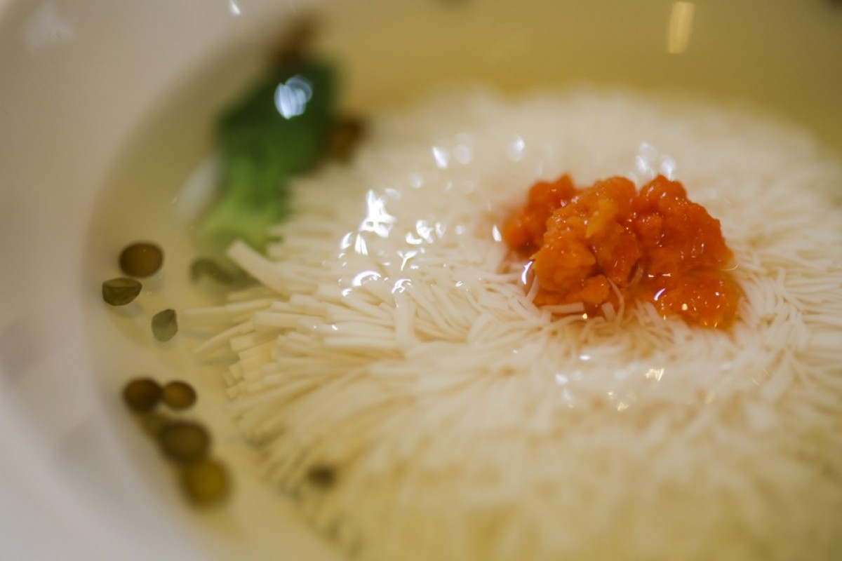
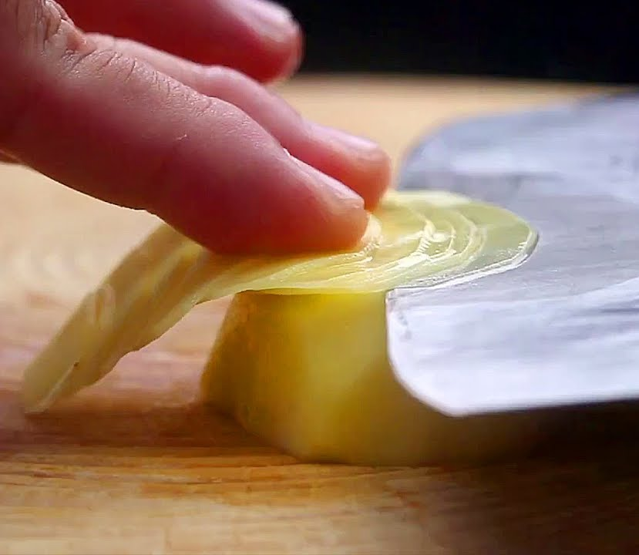
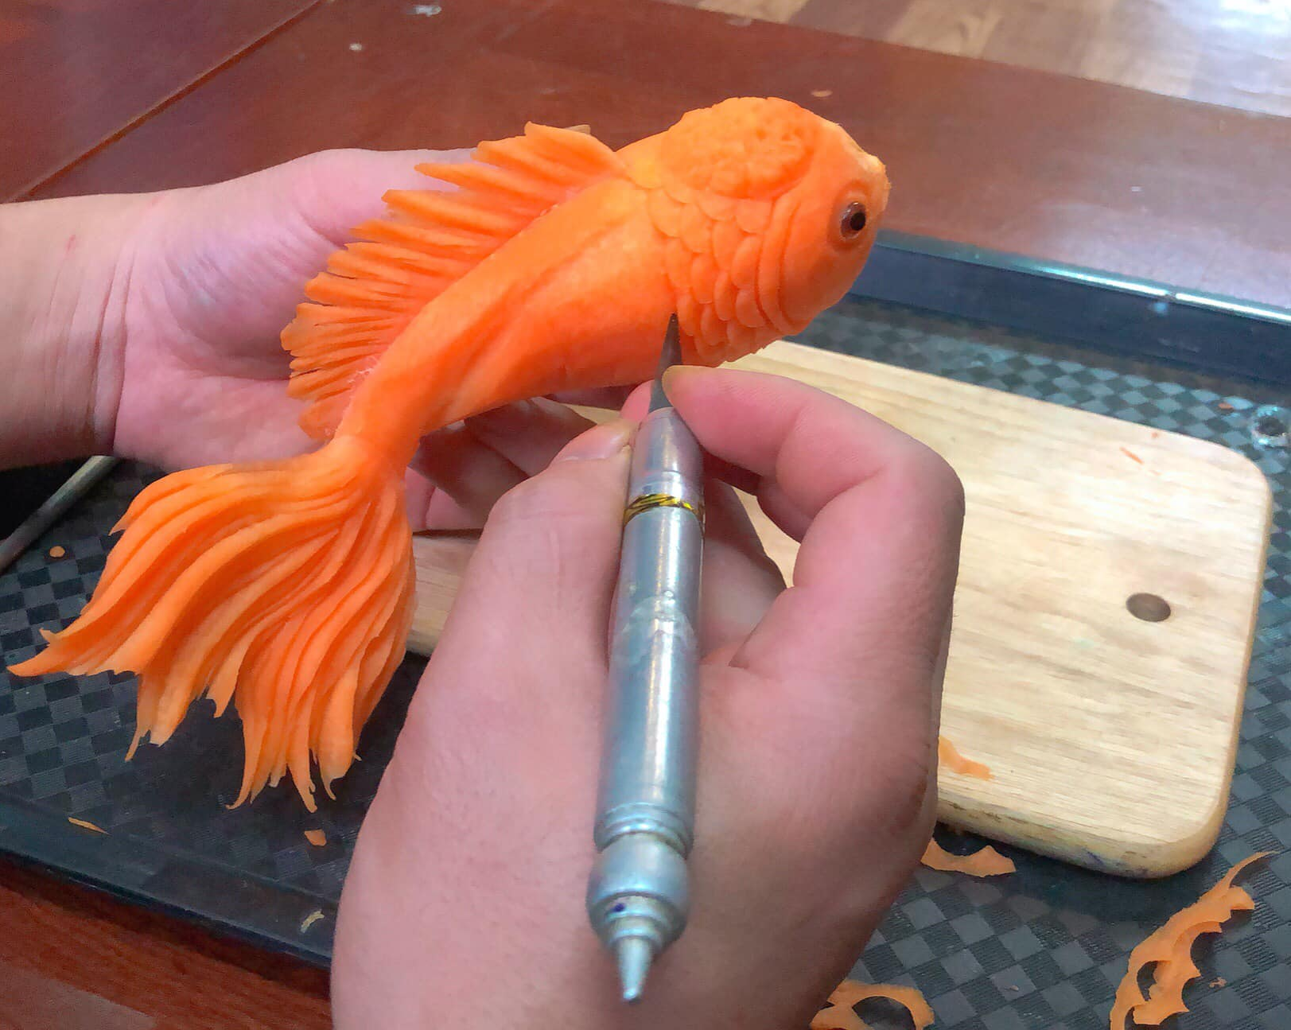
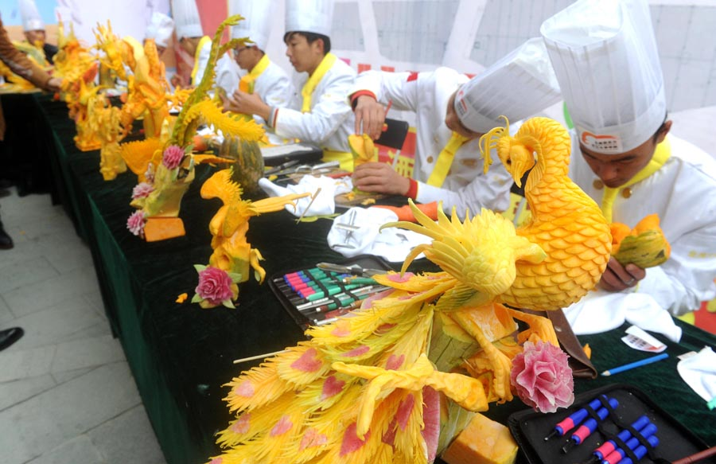
Cutting
China is a nation of gourmets and art lovers food. With the people’s love for food, the chefs have mastered the art of culinary knife skills. In particular, unlike western chefs, Chinese chefs own only one knife. These knives are traditionally crafted making it durable to wear and tear.
In Chinese cooking, the way the knives are used greatly affects the character and taste of each dish. There are four techniques: vertical, horizontal, slanted, and carving. All these cuts are essential to achieve perfection for certain types of dishes.
Tofu knife skill

Slide 5
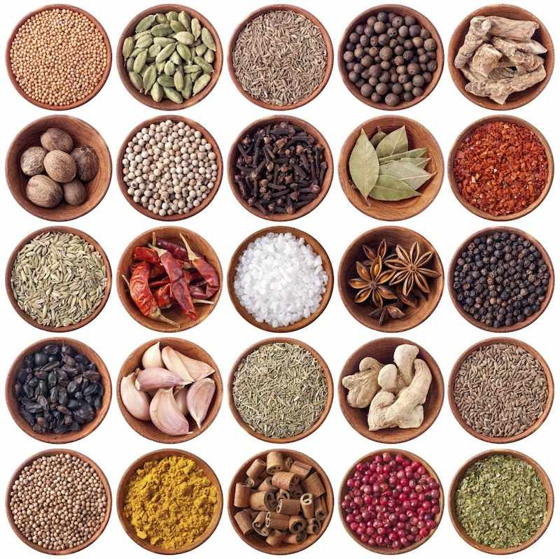
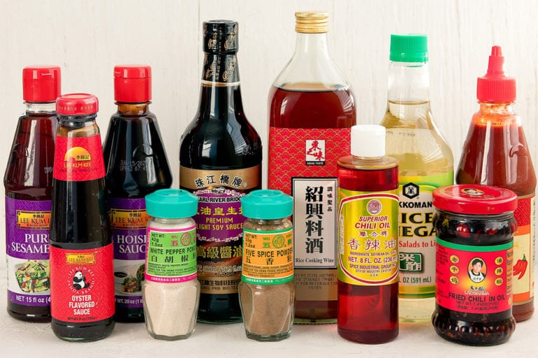
Seasoning
Salt; Vinegar; Soy Sauce; White Sugar; Monosodium Glutamate; Cooking Wine; Cinnamon (gui pi); Chicken Essence, Broad Bean Paste; Dry Chili Sections, Pepper Powder; Starch; Cardamom (cao guo); etc.
They’re important in cooking various dishes, create special dish flavors when used either singly or blended. The number of spices and herbs used is estimated at more than one hundred. Chinese chefs needs seasonings to cook any dish especially delicious dish with distinctive flavor and attractive color, have helped to shape the different styles of Chinese cooking, and all kinds of salty, sweet, sour, and pungent flavors can be found in those cuisines. With many people even delicious ingredients can taste bland and uninteresting without appropriate seasonings. Chinese chefs see to it that seasonings are added at the right time to ensure a better flavor.

Slide 6
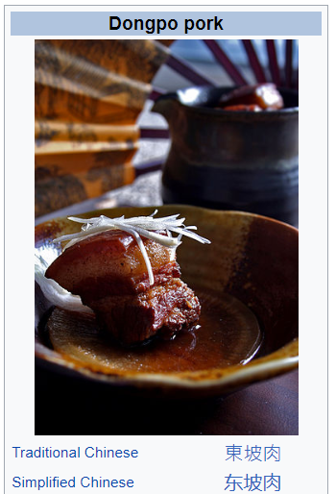
Time and temperature
The food is cooked very slowly over a low flame. Meat is usually browned first, then large quantities of soy sauce, sugar, wine or sherry, ginger, five-spice powder, chili powder, cilantro, and other seasonings are added, together with water or broth.
It may take up to several hours before the meat is done to the desired tenderness. The finished product can be served hot or cold. The sauce is rich and dark brown; hence the descriptive name “red stewing”.

Slide 7
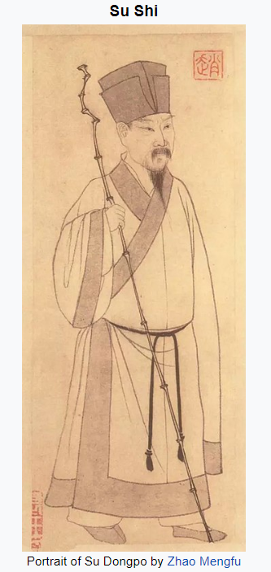
Dongpo rou (东坡肉 Dongpo Braised Pork) is said to have been invented (or at least inspired) by Su Tungpo. Legend has it that during Su Tungpo's life of poverty during his banishment to Hangzhou, he improved on the traditional process, he first braised the pork, added huangjiu (yellow wine) to make red-braised pork, then slowly stewed it on low heat.
Su Shi (or Su Tungpo) was born in Meishan, near Mount Emei today Sichuan province (1037-1101).
He was a Chinese calligrapher, gastronome, pharmacologist, poet, and writer of the 11th-century Song dynasty, and one of the four classical Chinese gastronomes. Beginning in 1060 and throughout the following twenty years, Su held a variety of government positions throughout China.
Su was an important figure in Song Dynasty politics, aligning himself with Sima Guang and others, against the New Policy party led by Wang Anshi.

Slide 8
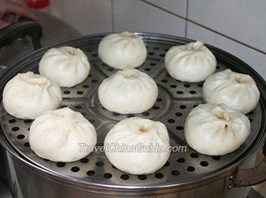
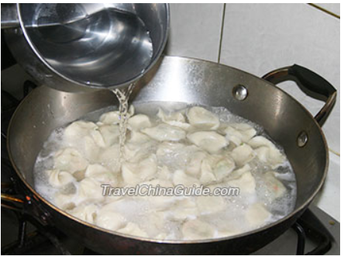
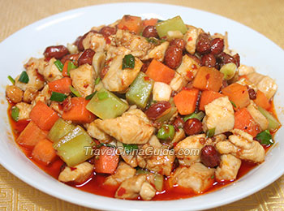
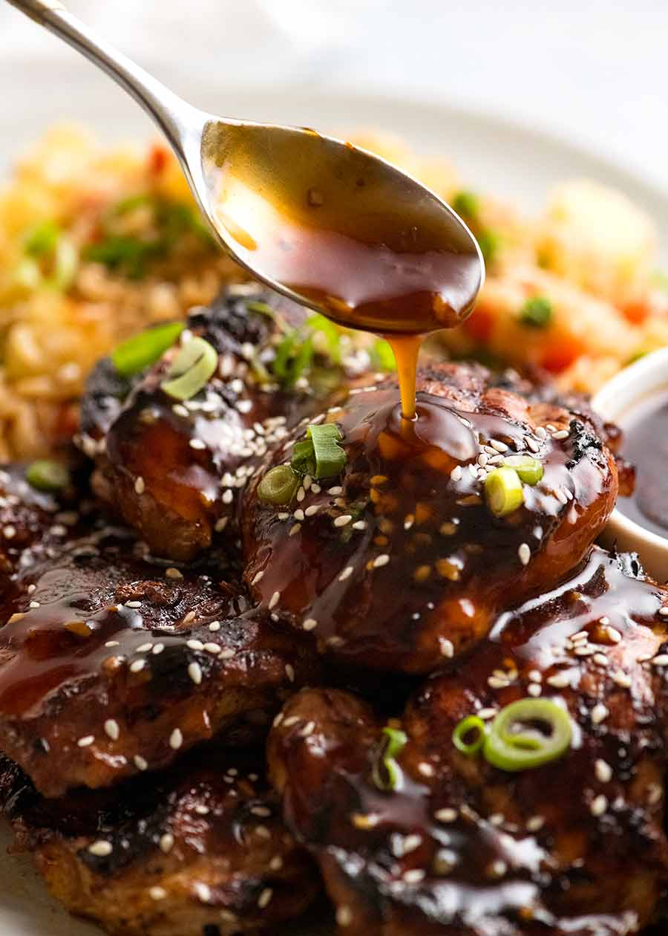
Steamed Stuffed Buns
There are more than thirty techniques in Chinese cuisine Different materials require different flavourings
Pickling 腌
Boil Dumplings
Dressing 凉拌
Kung Pao Chicken
Boiling 煮
Baking in Salt 盐焗
Honey Soy chicken marinade
Bake Stewing 煨
Instant Boiling 涮
Quick Boiling 汆
Simmering 炖
Scalding 焯
Flash-Frying 油爆
Stewing in soy sauce and syrup
Quick-Frying 熘
Steam Stewing 焖
Deep-Frying 炸
Smoking 熏
Pan-Frying 煎
Roasting 烤
Stir-Frying 炒
Braising 烧
Crisp Frying with Syrup 拔丝

Slide 9
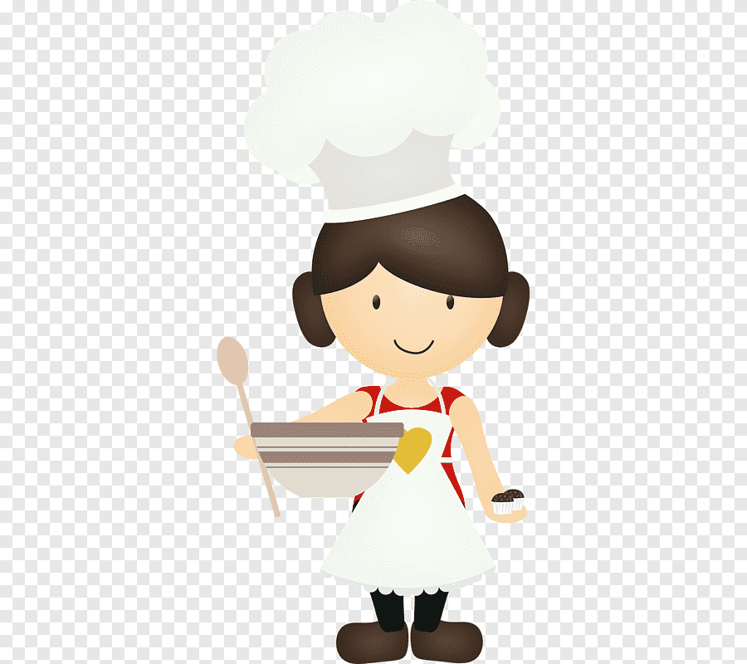
Thank you!

