Slide 1

The Contrast of Japanese-English Translation
Taking "Snow Country" as an Example
By彭永亮(Peng Yongliang)&谢子熠(Xie Ziyi)
2020.12.21

Slide 2

Catalog
I. About Snow country
II. The author and translator
III. Comparison of original text and translation
IV. Summary

Slide 3
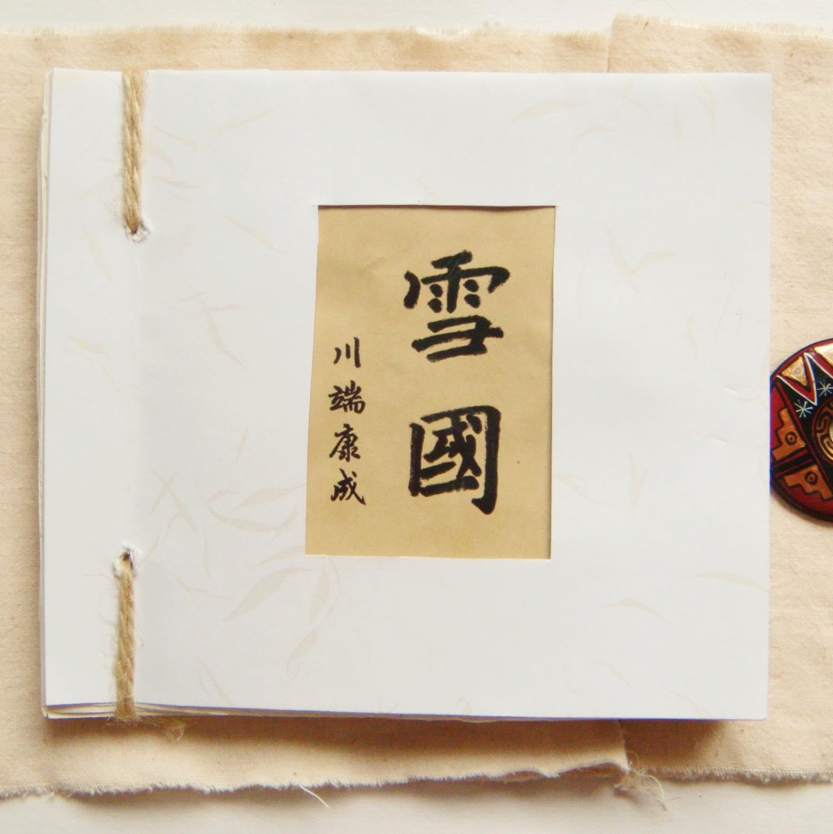
“Snow Country”
Part I.
Snow Country (雪国, Yukiguni) is a novel by the Japanese author Yasunari Kawabata. The novel is considered a classic work of Japanese literature and was among the three novels the Nobel Committee cited in 1968, when Kawabata was awarded the Nobel Prize in Literature.
定めない人間のいのちの各瞬間の純粋持続にのみ賭けられたやうなこの小説に、もし主題があるとすれば、この一句の中にある。（中略）それは女の「内生命の変形」の微妙な記録であり、焔がすつと穂を伸ばすやうなその「移り目」の瞬間のデッサンの集成である。駒子も葉子も、ほとんど一貫した人物ですらない。一性格ですらない。彼女たちは潔癖に、生命の諸相、そのゆらめき、そのときめき、その変容のきはどい瞬間を通してしか、描かれないのである。作中に何度かあらはれる「徒労」といふ言葉は、かうして無目的に浪費される生のすがたの、危険な美しさに対する反語である。
— 三島由紀夫「解説 雪国」（『日本の文学38 川端康成集』）
雪国 (新潮文庫)2006

Slide 4
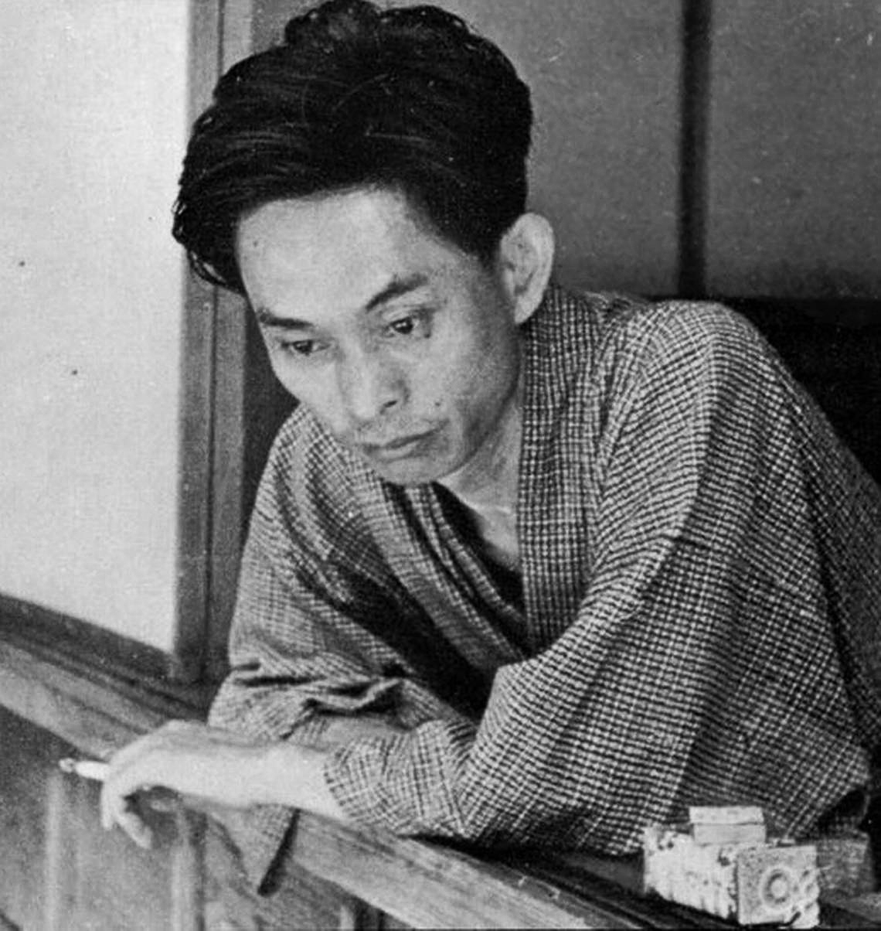
川端 康成(Kawabata Yasunari) A Japanese novelist and short story writer whose spare, lyrical, subtly-shaded prose works won him the Nobel Prize for Literature in 1968, the first Japanese author to receive the award. His works have enjoyed broad international appeal and are still widely read.
Part II.I The author

Slide 5
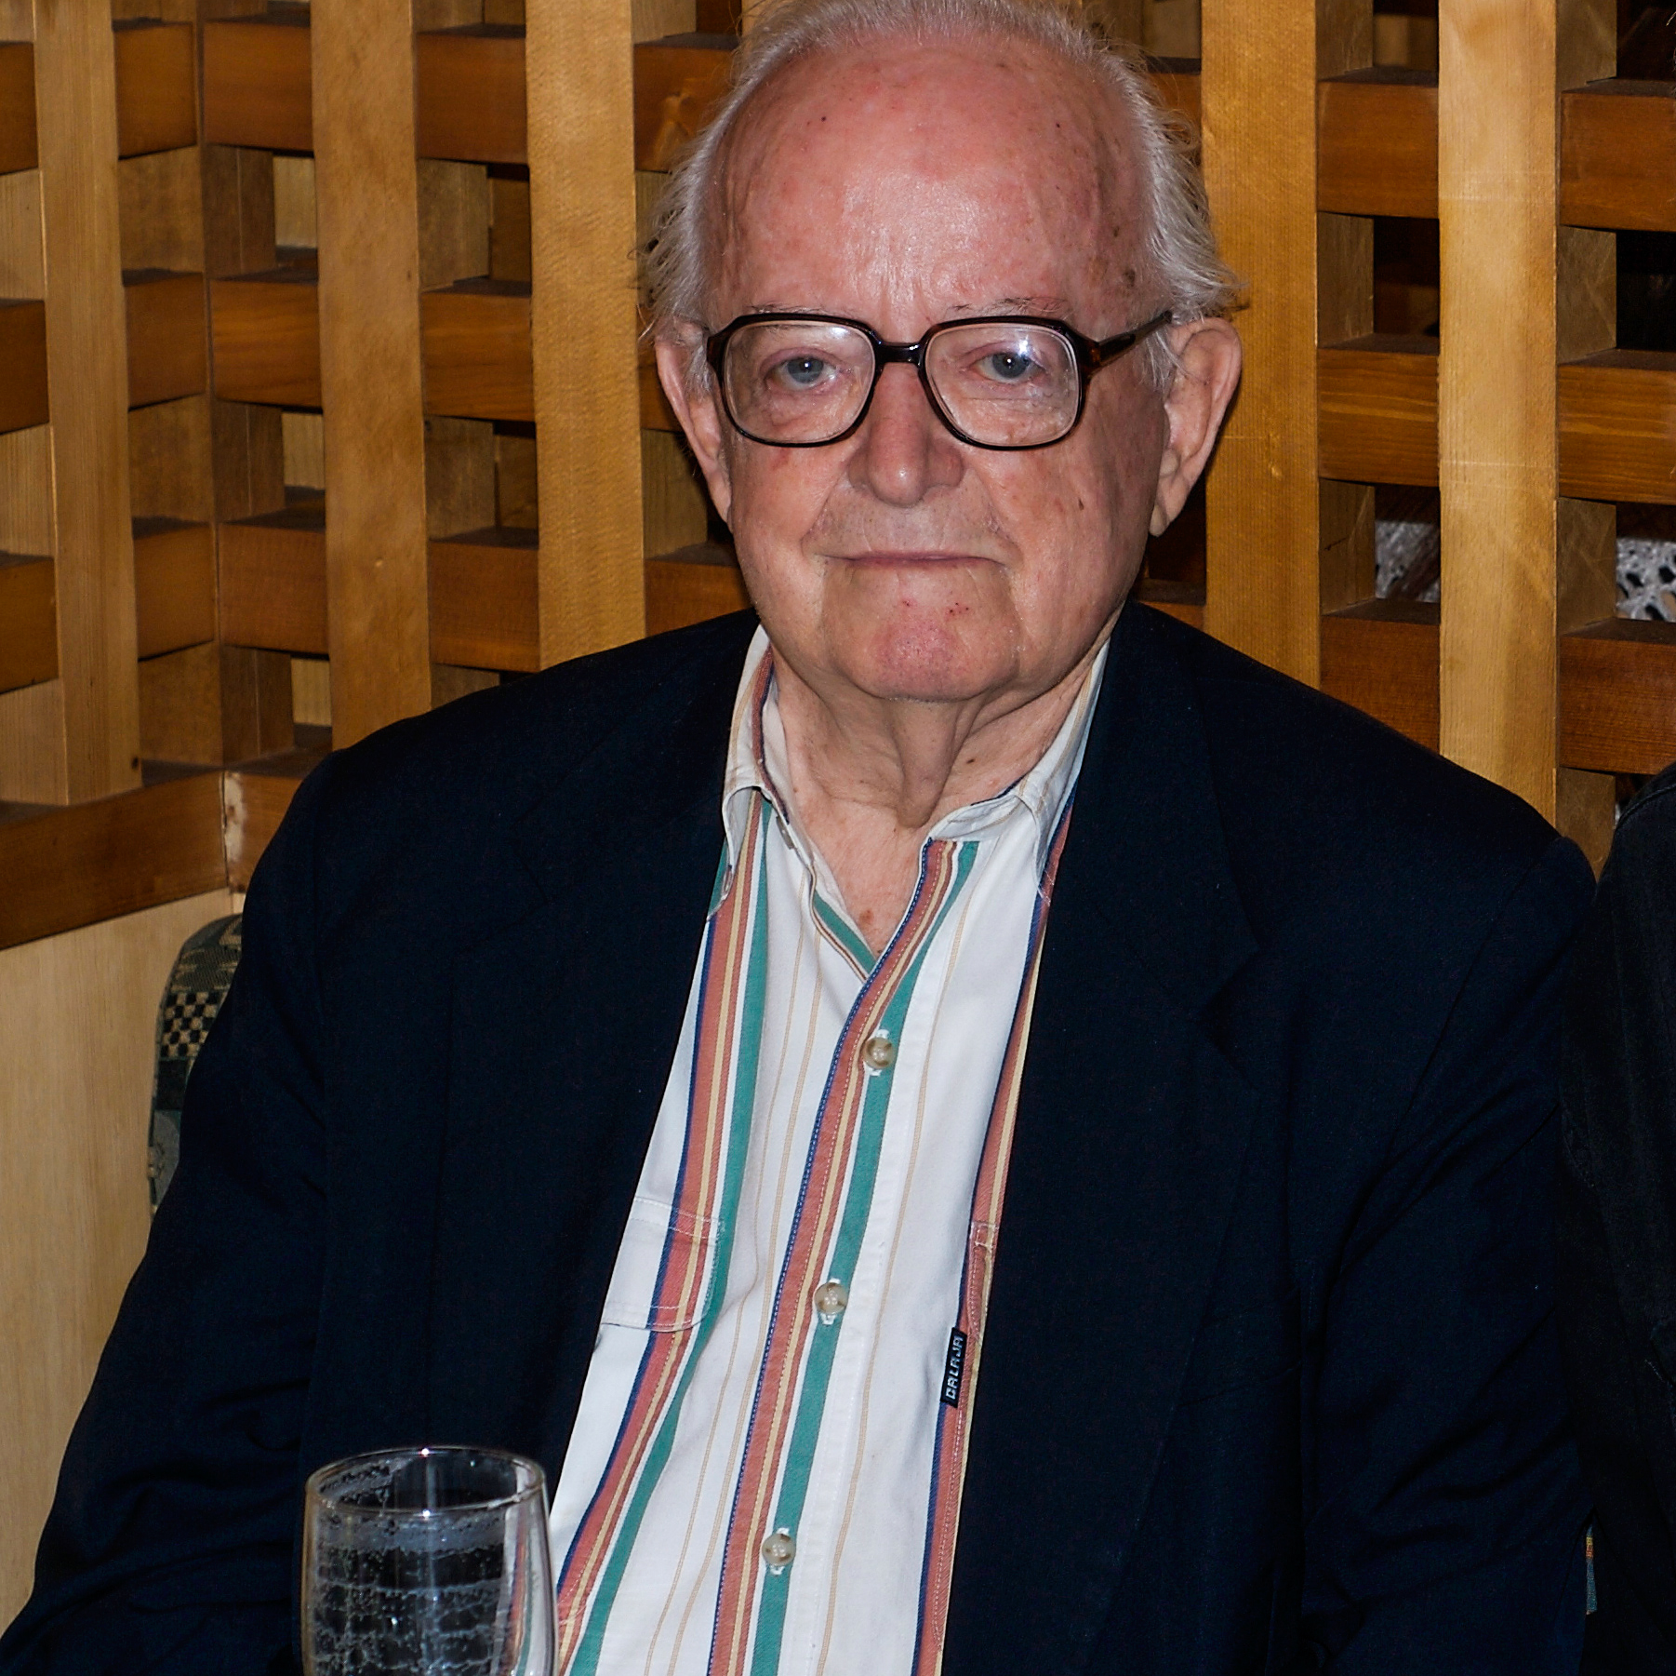
E.Seidensticker Edward George Seidensticker was a noted post-World War II scholar, historian, and preeminent translator of classical and contemporary Japanese literature. His English translation of the epic The Tale of Genji, published in 1976, was especially well received critically and is counted among the preferred modern translations. Seidensticker is closely associated with the work of three major Japanese writers of the 20th century: Yasunari Kawabata, Jun'ichirō Tanizaki, and Yukio Mishima. His landmark translations of novels by Kawabata, in particular Snow Country (1956) and Thousand Cranes (1958), led, in part, to Kawabata being awarded the Nobel Prize in Literature in 1968.
Part II.II The translator

Slide 6
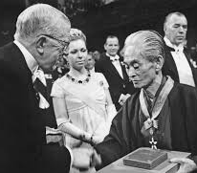
「ノーベル賞の半分は、サイデンステッカー教授のものだ。」 ——川端康成（1969）『美しい日本の私―その序説』 “Half of the Nobel Prize belongs to Professor Seidensticker.” ——Kawabata, Yasunari (1969) Japan, the Beautiful, and Myself
Japan, the Beautiful, and Myself is a critique of Kawabata Yasunari, the first Japanese person to be awarded the Nobel Prize in Literature on December 10, 1968, which was delivered at the Swedish Academy in Stockholm on December 12, 1968.
It is a monumental work that declares that this tradition has been handed down from generation to generation in the heart of Kawabata himself, a contemporary Japanese writer.
The full text of his speech was published in the Asahi Shimbun and other newspapers on December 17 of the same year, and the following year. The book has also been translated by Edward G. Seidensticker.
在此处插入徽标

Slide 7

Comparison of the original text and translation
Part III.
人の目？神の目？

Slide 8
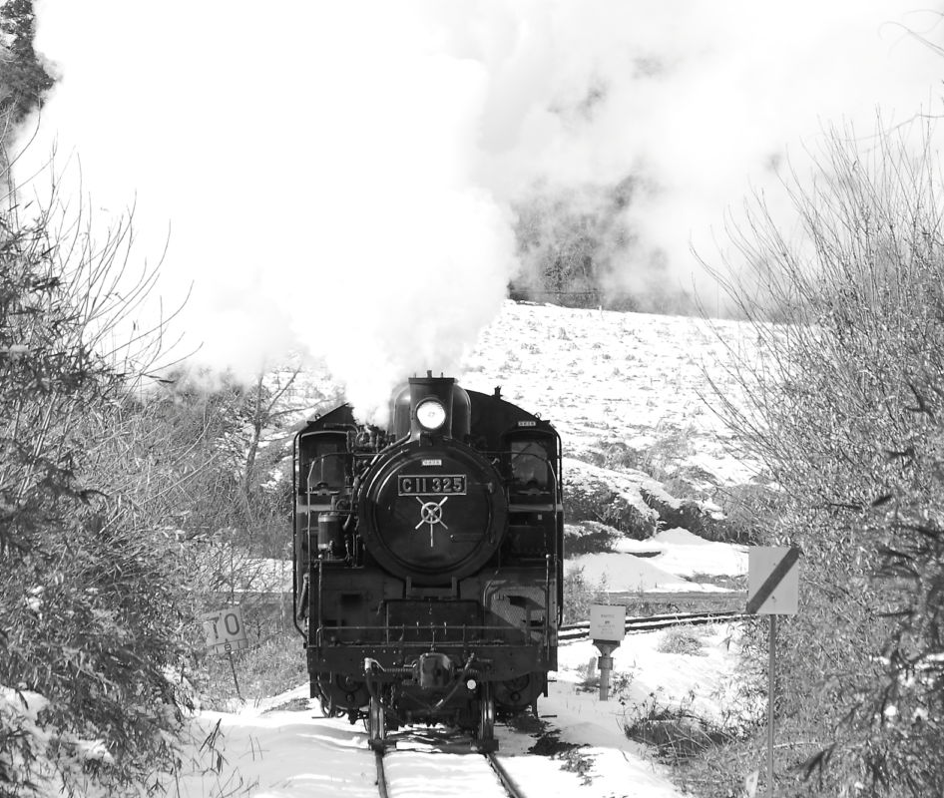
Original text: Prologue of Snow Country
国境の長いトンネルを抜けると雪国であった。夜の底が白くなった。信号所に汽車が止まった。向側の座席から娘が立って来て、島村の前のガラス窓を落とした。雪の冷気が流れこんだ。 娘は窓いっぱいに乗り出して、遠くへ叫ぶように、「駅長さあん、駅長さあん。」明かりをさげてゆっくり雪を踏んで来た男は、襟巻で鼻の上まで包み、耳に帽子の毛皮を垂れていた。
川端康成作品「雪国」の舞台の一つ・新潟県

Slide 9
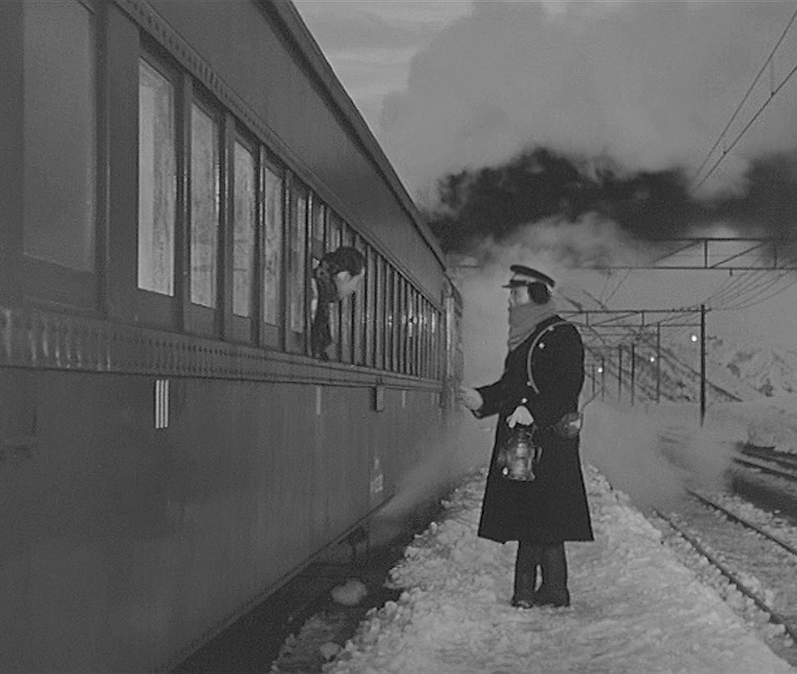
English translation By E.Seidensticker
The train came out of the long tunnel into the snow country. The earth lay white under the night sky. The train pulled up at a signal stop. A girl who had been sitting on the other side of the car came over and opened the window in front of Shimamura. The snowy cold poured in. Leaning far out the window, the girl called to the station master as though he were a great distance away. The station master walked slowly over the snow, a lantern in his hand. His face was buried to the nose in a muffler, and the flaps of his cap were turned down over his face.
東宝映画「雪国」（1957年）の鉄道シーン

Slide 10

Comparison I.I:
国境の長いトンネルを抜けると、雪国であった。
The train came out of the long tunnel into the snow country.
The original text, "国境の長いトンネルを抜けると、雪国であった。" is a sentence that makes translators cry. This kind of Japanese sentence is extremely difficult to be translated into English. Is this sentence a compound sentence or a multiple sentence? What is it that went through the tunnel? Was it a person, a car, or a train? What was it that was in the snow country? Subject is essential in English writing, but in this Japanese sentence, there is no subject or subject equivalent. Since we can't identify the subject, we can't begin the work of translating it into English. The verb "抜ける" or "であった" is important, but the subject (noun) is simply omitted.
在此处插入徽标

Slide 11
Comparison I.II:
国境の長いトンネルを抜けると、雪国であった。
The train came out of the long tunnel into the snow country.
He omitted the word "国境" and added the word "the train" as the subject. It is a natural English sentence that is easy to understand. When we close our eyes, we can see the scene vividly." The preposition “out of ” in "out of the long tunnel" functions as if it were a verb. In the original sentence, "雪国であった" the train was in a state of stillness, but in the English sentence, "The train came into the snow country.”
Let's compare the expressions in the original text and the translation again. The difference in ideas between Japanese and English is obvious.
在此处插入徽标

Slide 12
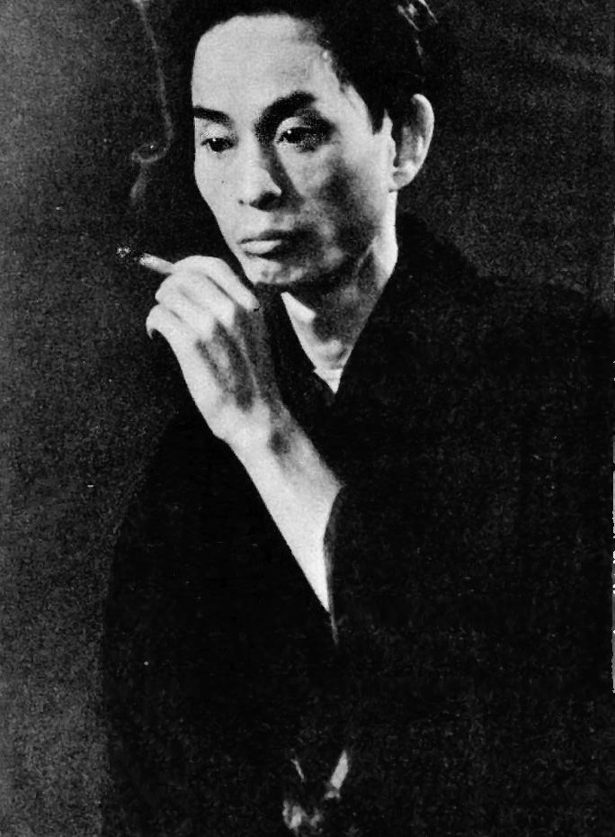
Comparison II.I
夜の底が白くなった。
The earth lay white under the night sky.
What does it mean to say, "夜の底が白くなった”? The word "夜" usually means when the sun has set and it is dark (time). However, time flows but has no form, so naturally there is no "bottom. In other words, "夜" here is not "night" in the usual sense. So what kind of situation is it expressing? I think this "夜" may be a literary expression of the "darkness" seen from Shimamura's car window. More specifically, before entering the tunnel, there was no snow on the Gunma side of the road, and the night view from the car window was nothing but "darkness"; however, as soon as they passed through the long tunnel and entered the snow country (i.e. Yuzawa Town in Niigata), the "darkness" changed completely. In fact, the snow had been on the ground there for a long time and had not changed, but to Shimamura (Kawabata Yasunari), it must have seemed as if the lower part of the "darkness" (the ground) had suddenly turned white.
Kawabata c. 1932

Slide 13
Comparison II.II
夜の底が白くなった。
The earth lay white under the night sky.
Compared with the abstract Japanese expression "夜の底" the English phrase "the earth under the night sky" is "concrete" and "descriptive" and easy to understand. The earth" and "night sky" are clearly linked by the preposition "under. In other words, while Japanese prefers abstract expressions, English prefers concrete expressions, and the "relationship between things" is really clear.
"The earth lay white under the night sky" is freely translated into "the ground was covered with snow. If literally translated, the result is "The bottom of the night became white." I have no idea what it means, and I'm sure it would not have been enough to win the Nobel Prize in Literature.
Kawabata c. 1932

Slide 14

Contrastive Analysis and Linguistic Typology
Characteristics of Linguistic Typology | English | Japanese
Language Family | Indo-European languages | Japanese-Ryukyuan languages
Morphological Typology | Fusional Language | Agglutinative Language
Representation | Nominative-accusative | Nominative-accusative
Word Order | SVO | SOV
Writing System | Phonogram | Ideogram
Sound | Ends with a consonant (sound of breath) | Ends with a vowel (sound of voice)
Semantic Fields | Hardly used
IV. Summary

Slide 15
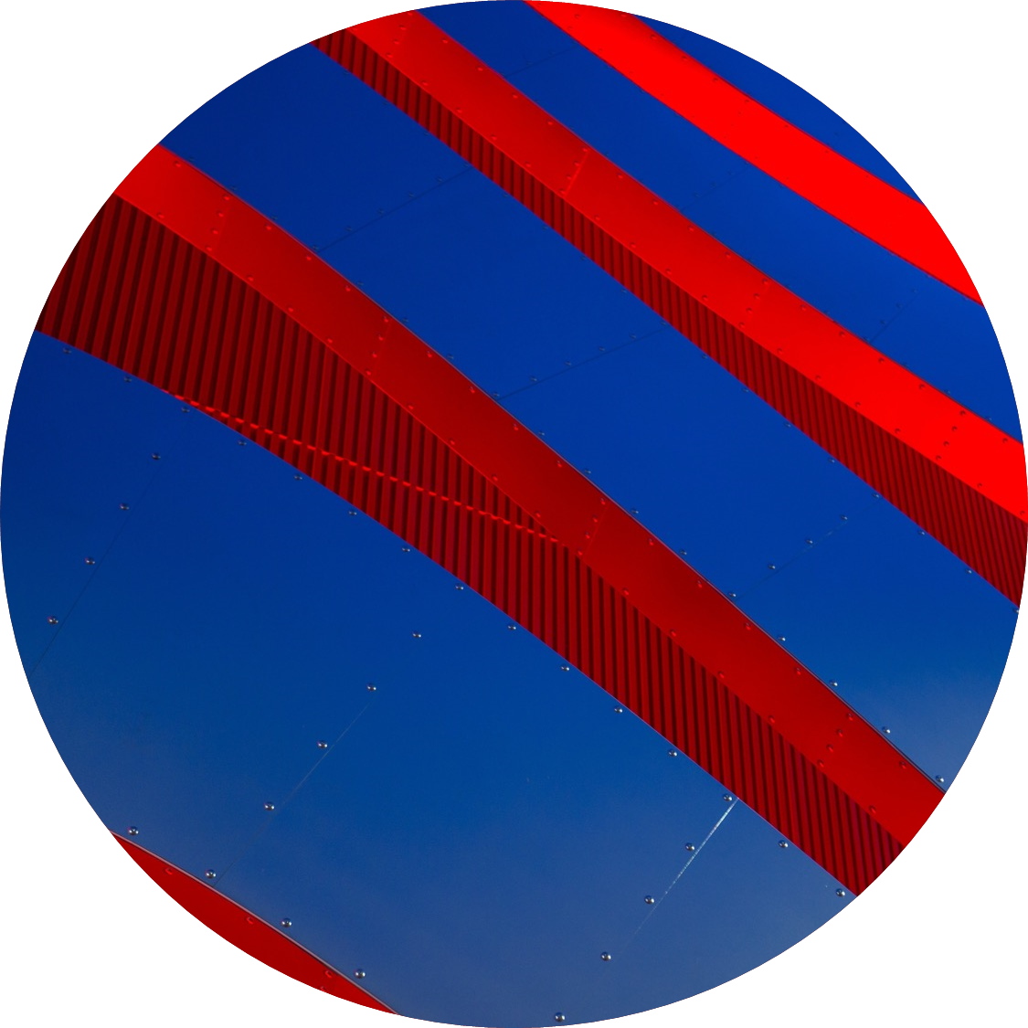
Thanks for listening
Stay warm and healthy, and good luck in the coming new year.
Happy winter solstice.
By Peng Yongliang & Xie ziyi
2020.12.21

