Slide 1
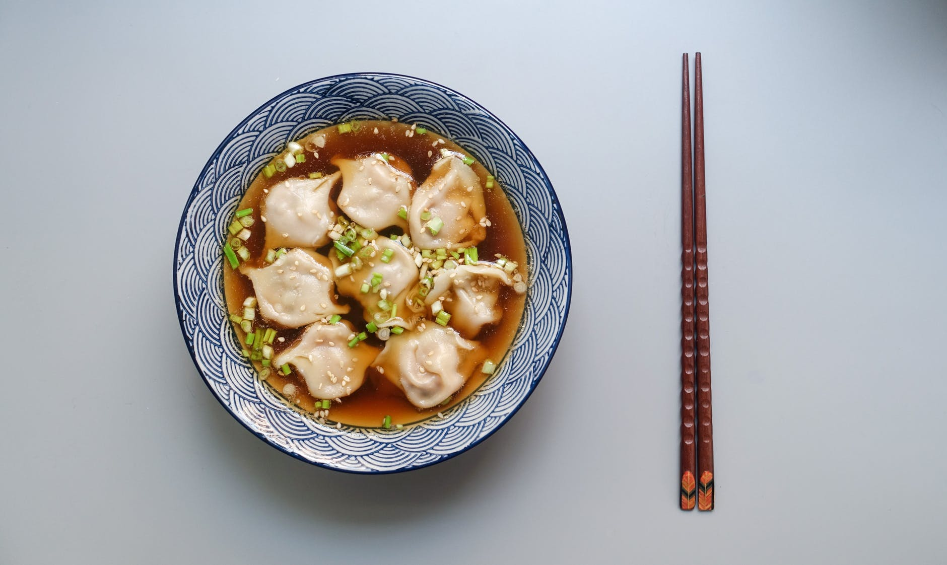
Traditional Cuisine:
饺子Jiaozi
中/国/传/统/美/食/推/介
presenter: 吴松芸

Slide 2
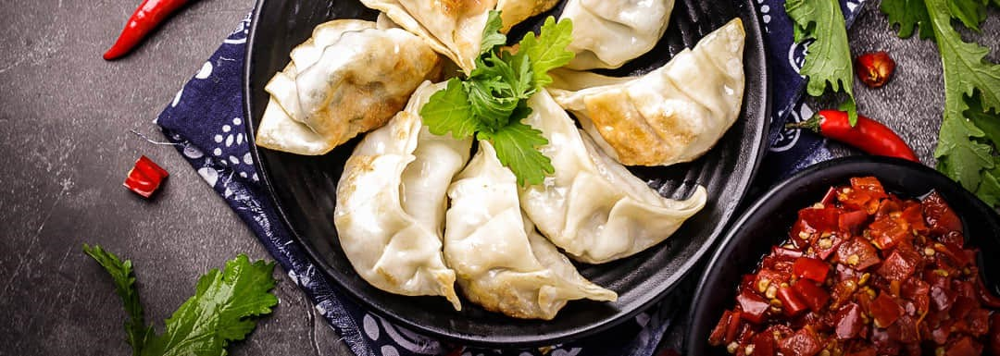
目录 Contents
Part 1 / Origin and History
Part 2 / Types and Variations
Part 3 / Folding Technique
Part 4 / Culture and Tradition

Slide 3
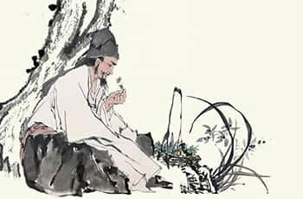
Origin and History
Time: during the era of the Eastern Han (AD 25–220)
Character: Zhang Zhongjing
practitioner of traditional Chinese medicine
Event: the febrile disease was turning into an epidemic
Solution: He treated these poor people by stewing lamb, black pepper, and some warming
medicines in a pot, chopped them, and used them to fill small dough wrappers.
He boiled these dumplings and gave them with the broth to his patients.
Conclusion: In order to celebrate the New Year as well as recovering from frostbitten ears,
people imitated Zhang's recipe to make Jiao'er.

Slide 4
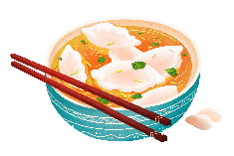
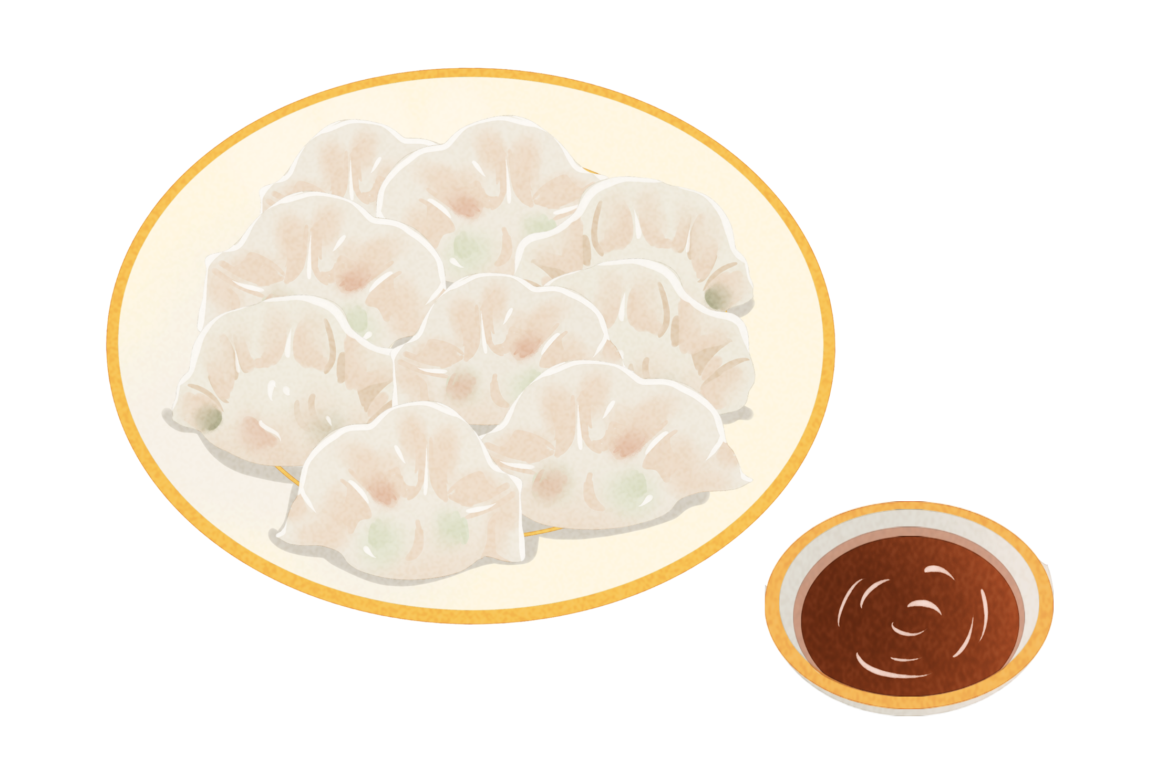
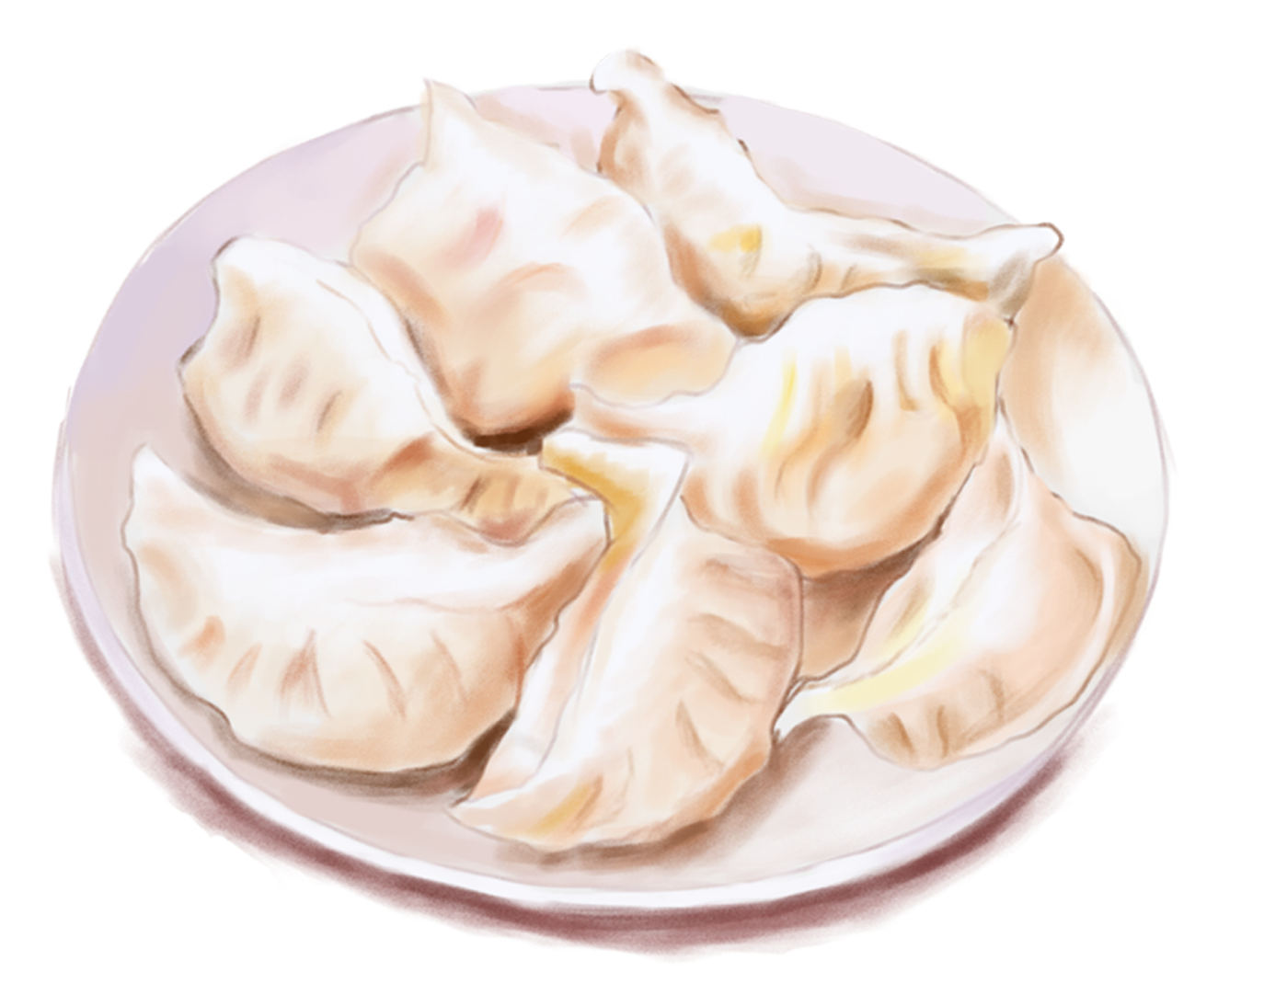
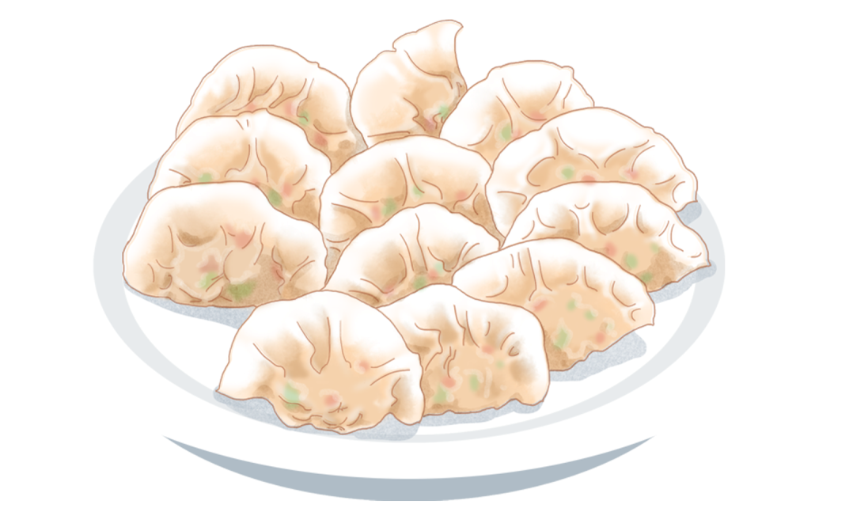
Other theories suggest that jiaozi may have derived from dumplings in Western Asia.
the Western Han dynasty
jiaozi (饺子) were called jiaozi (角子)
the Three Kingdoms period
the book Guangya《广雅》 by Zhang Yi 张揖mentions jiaozi.
the Northern Qi
dynasty
Yan Zhitui颜之推 wrote: "Today the jiaozi, shaped like a crescent moon, is a common food in the world."
Six dynasties
Turfan tombs contained dumplings.
the Tang dynasty
jiaozi become more popular, called Bian Shi (扁食).
Chinese archaeologists have found a bowl of jiaozi in the Tang dynasty tombs in Turpan.[6] 7th or 8th century dumplings and wontons were found in Turfan.

Slide 5
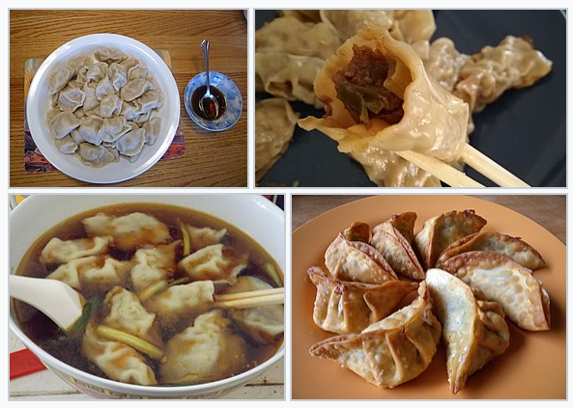
Types and Variations
Steamed dumplings
蒸饺
Boiled dumplings
水饺
Pan-fried dumplings
煎饺
Soup dumplings
汤饺
Deep fried dumplings 炸饺

Slide 6
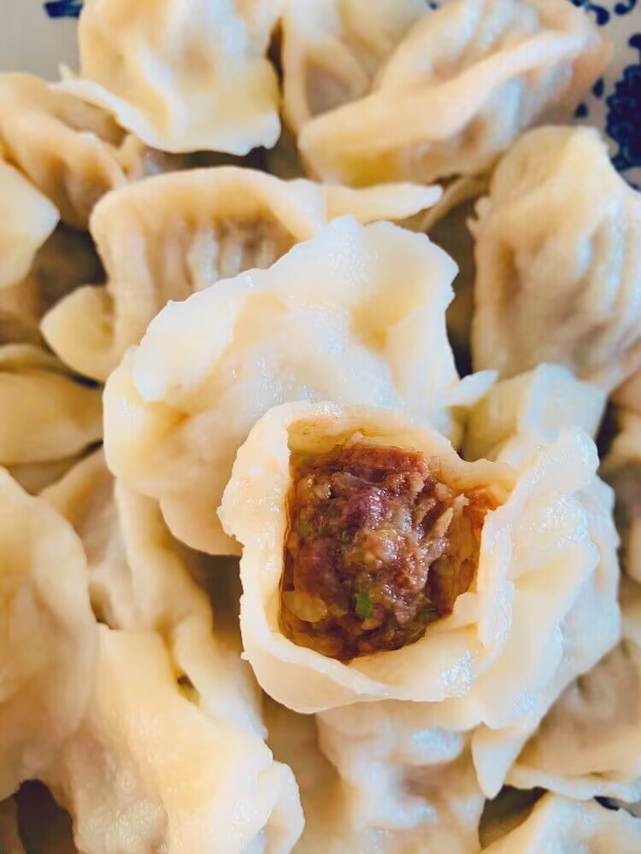
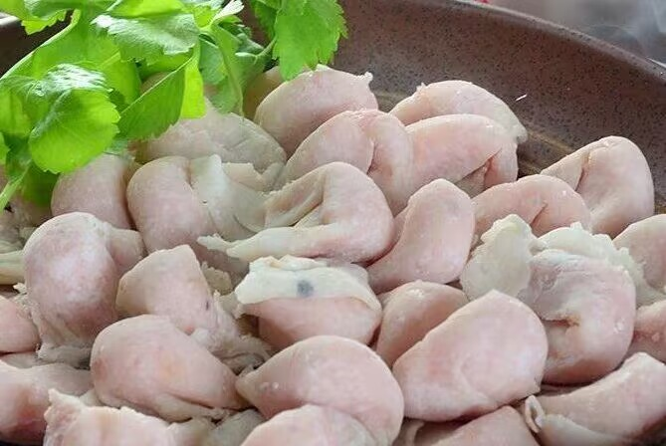
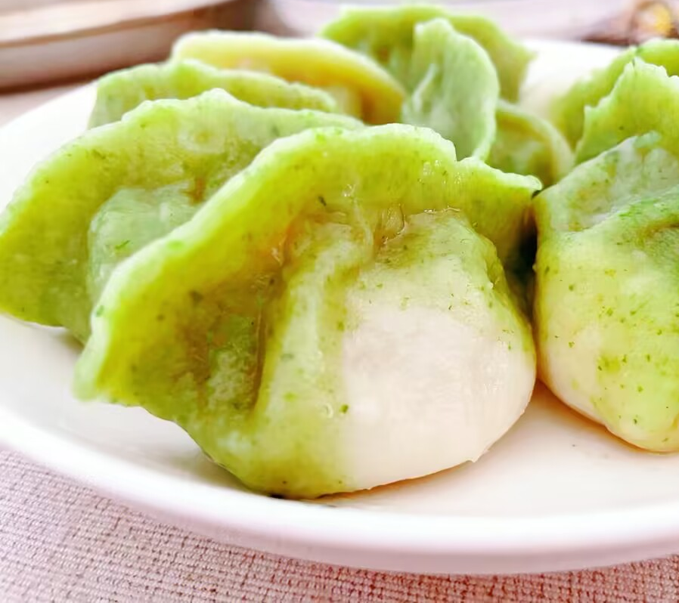
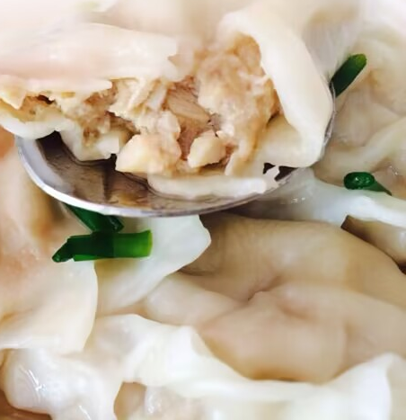
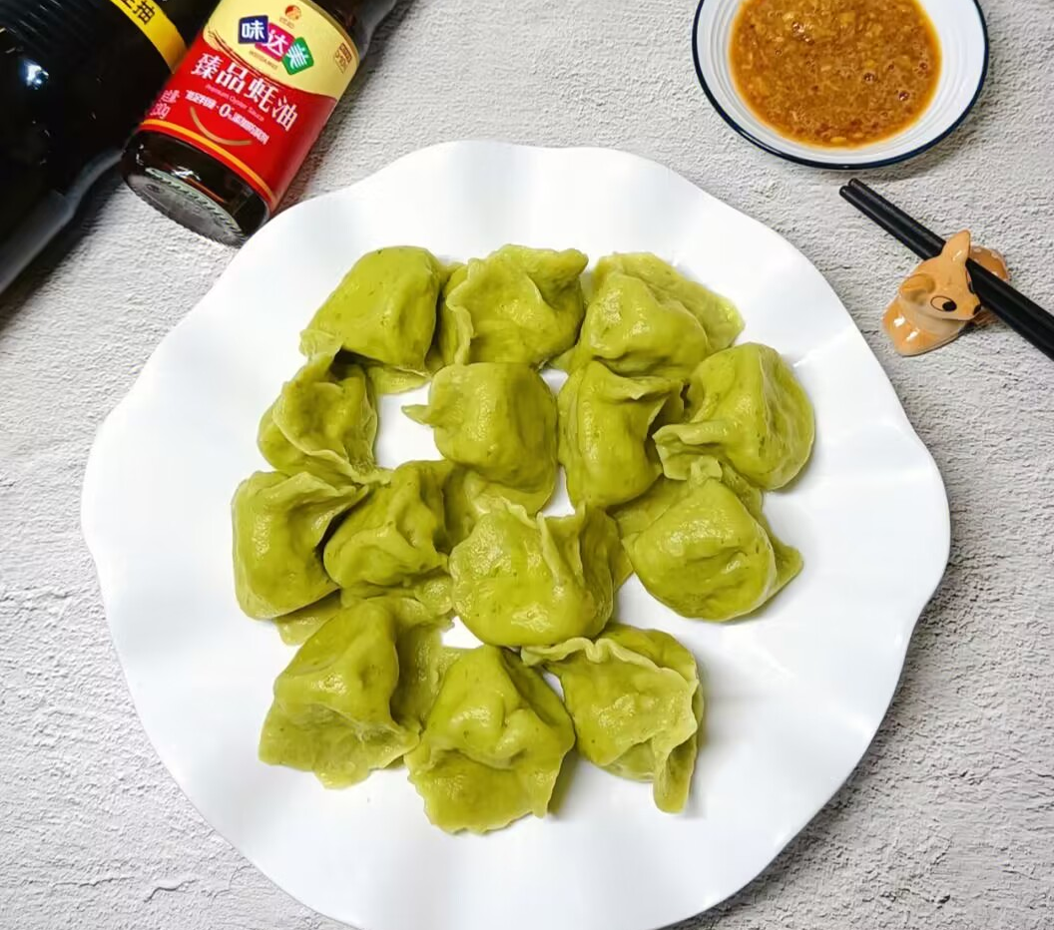
Fillings
Common dumpling meat fillings include chicken, pork, beef, shrimp, and fish which are usually mixed with chopped vegetables. Popular vegetable fillings include napa cabbage, scallion (spring onions葱), celery（芹菜）, leek（韭菜）, spinach（菠菜）, mushroom, carrot, garlic chives, and edible black fungus（黑木耳）.

Slide 7
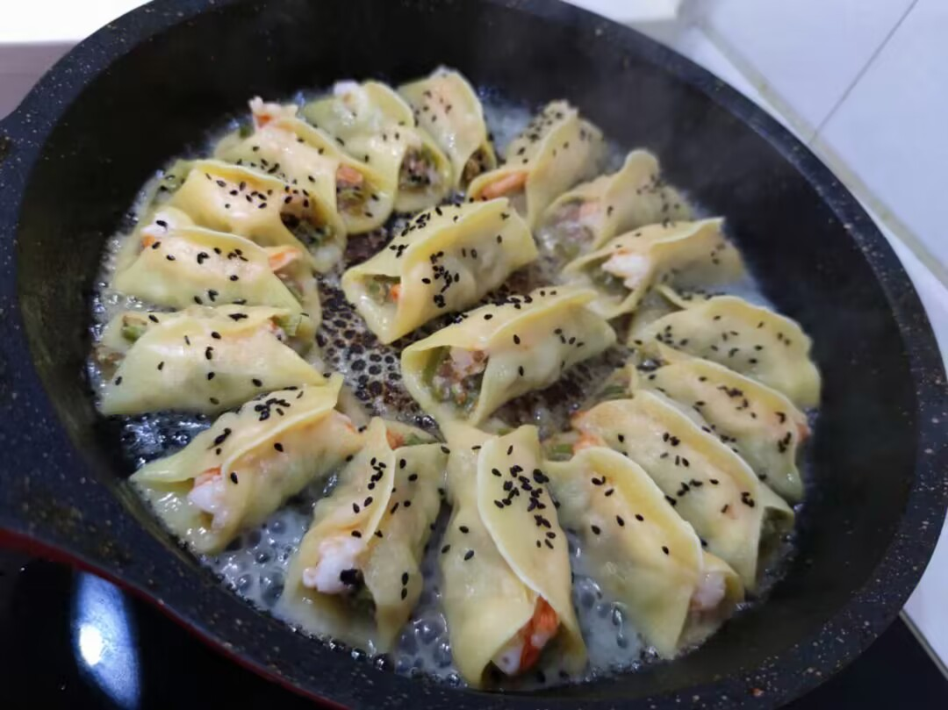
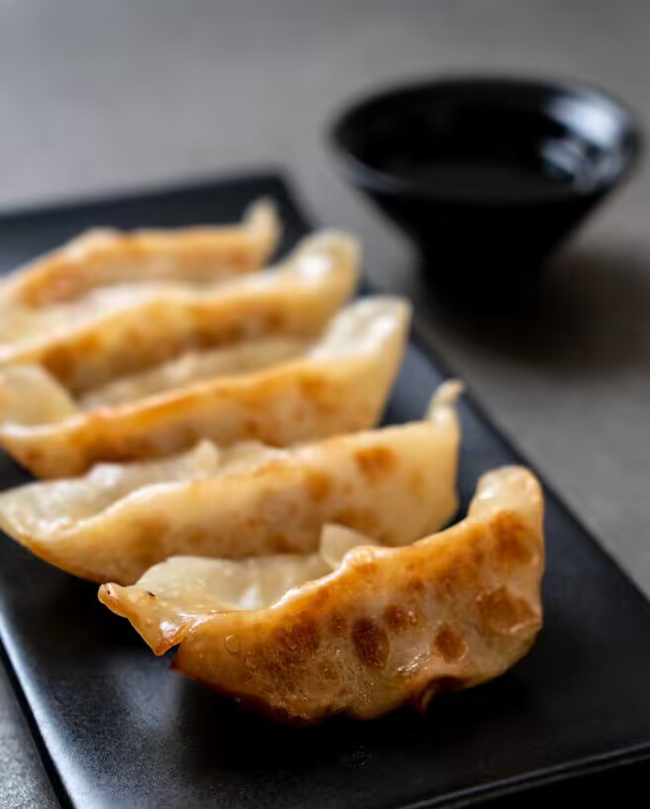
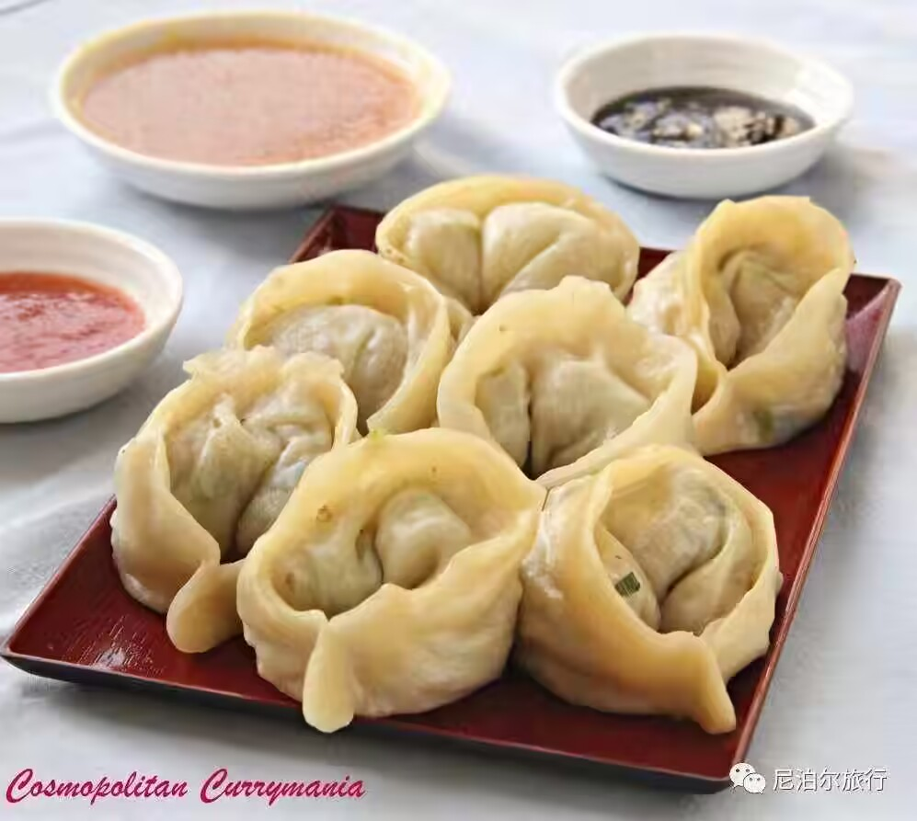
Variations of jiaozi:
Guotie
Gyoza
Momo

Slide 8
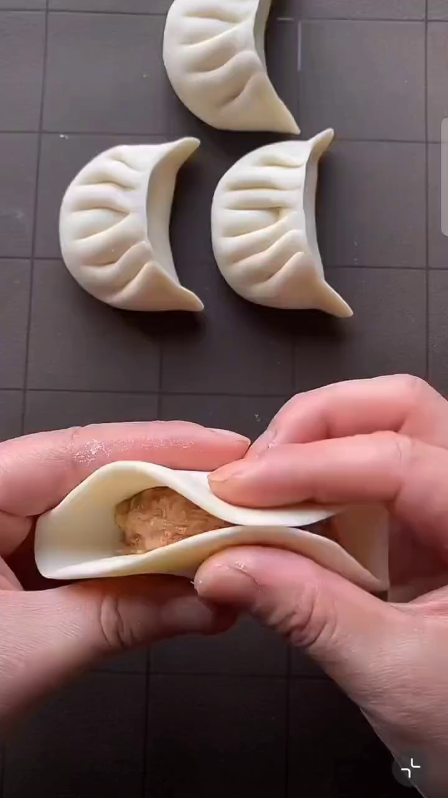
Folding Technique
pleat 褶子
The most famous and common technique is the pinched-edge fold.
Take a wrapper and put one tablespoon of filling into the center of the wrapper.
Fold a half of edge to the other half.

Slide 9
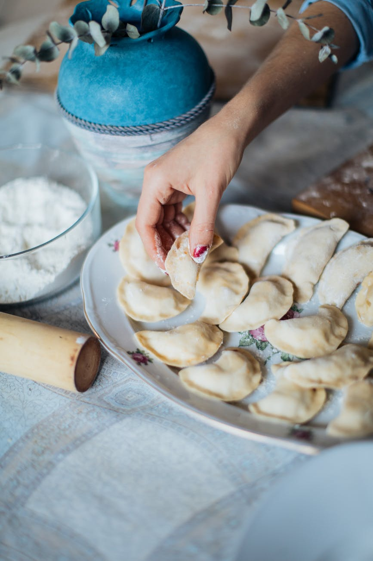
Culture and Tradition
Jiaozi look like yuan bao silver or gold ingots used as currency during the Ming dynasty, and as the name sounds like the word for the earliest paper money, serving them is believed to bring prosperity.
01
02
Many families eat these at midnight on Chinese New Year's Eve. Some cooks will even hide a clean coin inside a jiaozi for the lucky to find.
Different filling symbolizes different wishes and prospects.
•beef-financial growth •cabbage-good luck and wealth
•celery-diligence. •fish-wealth for the diner.
•mushroom-fortune and wealth
03

Slide 10
Thank You!
谢谢大家！

