Slide 1

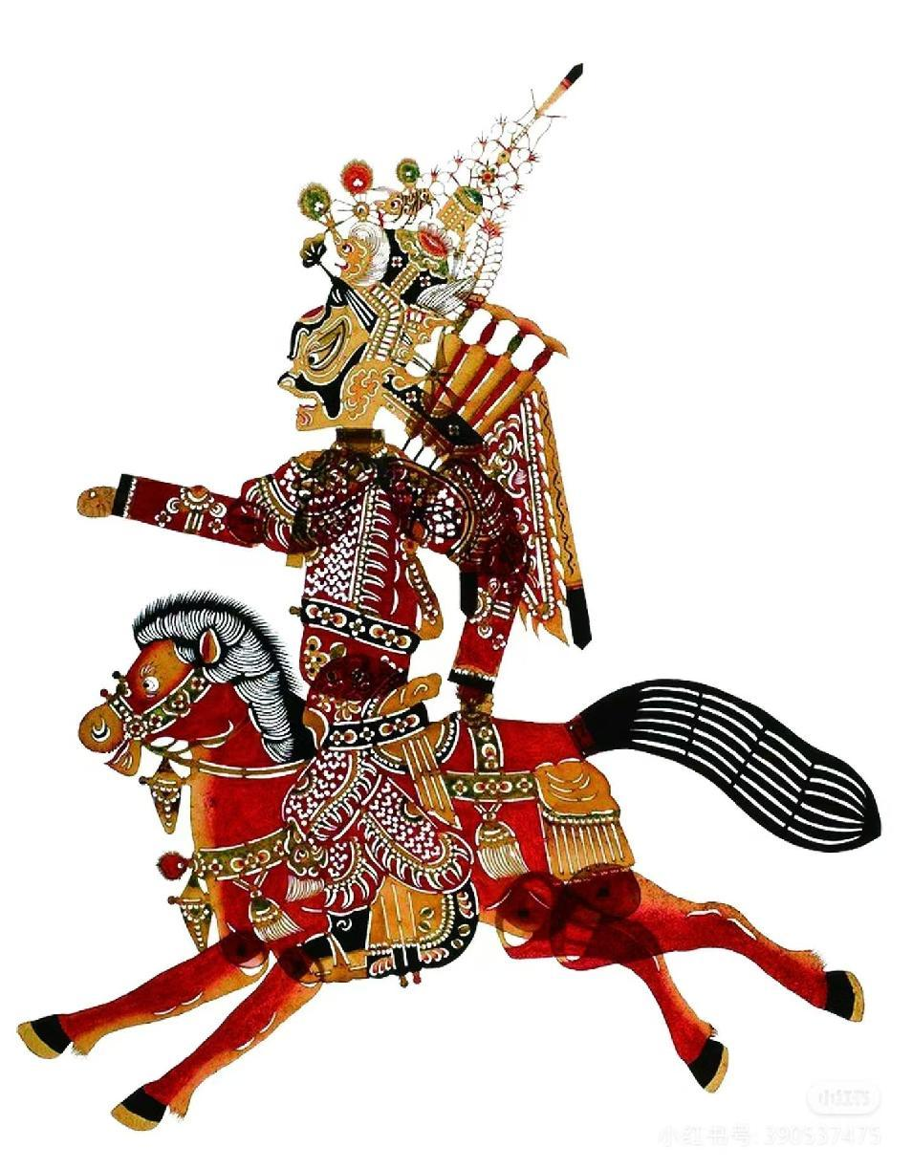

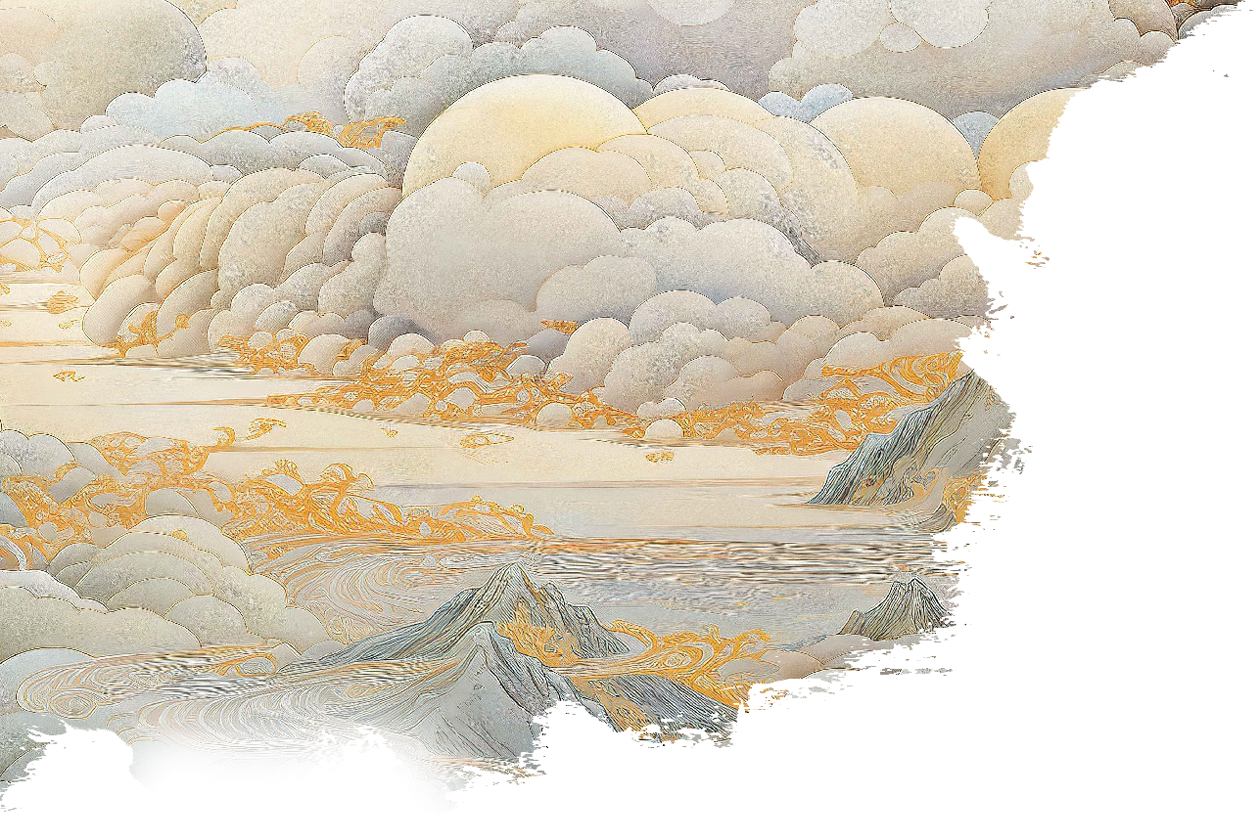
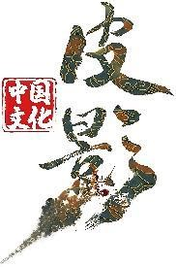
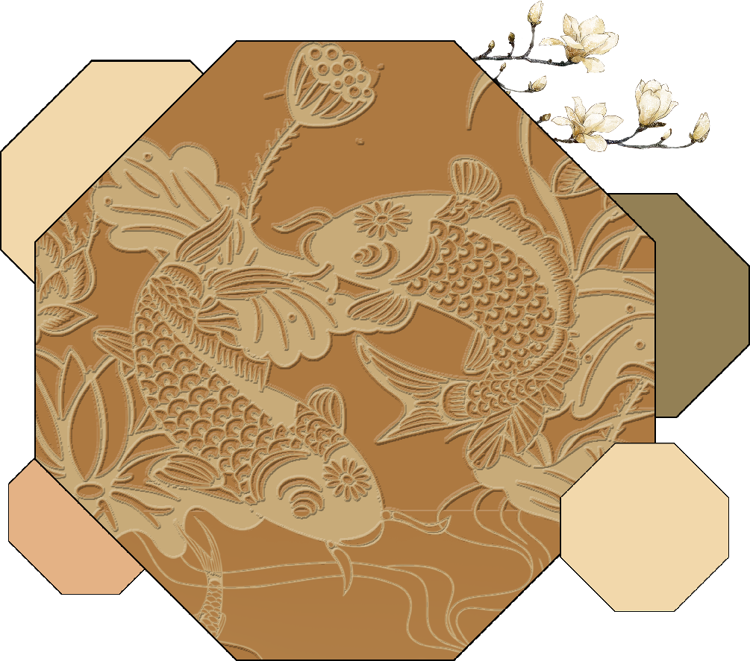

Chinese Shadow Puppetry
intangible
cultural
heritage
202330092205
彭佩欣
（Peng Peixin）

Slide 2
Contents
01
Introduction to Shadow Puppetry
02
Characteristics of Shadow Puppetry
03
Translation Perspectives on Shadow Puppetry

Slide 3

01
Introduction to Shadow Puppetry

Slide 4
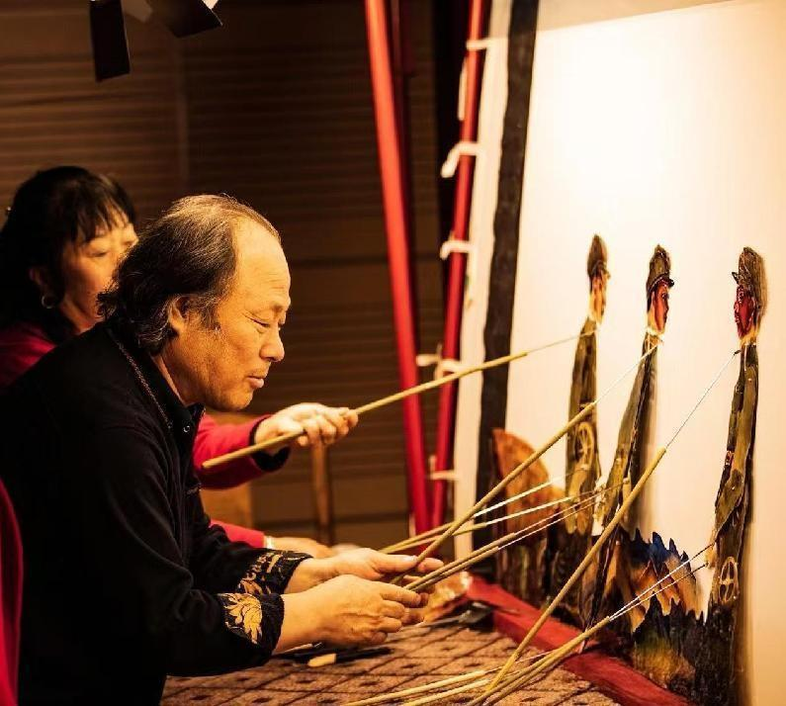
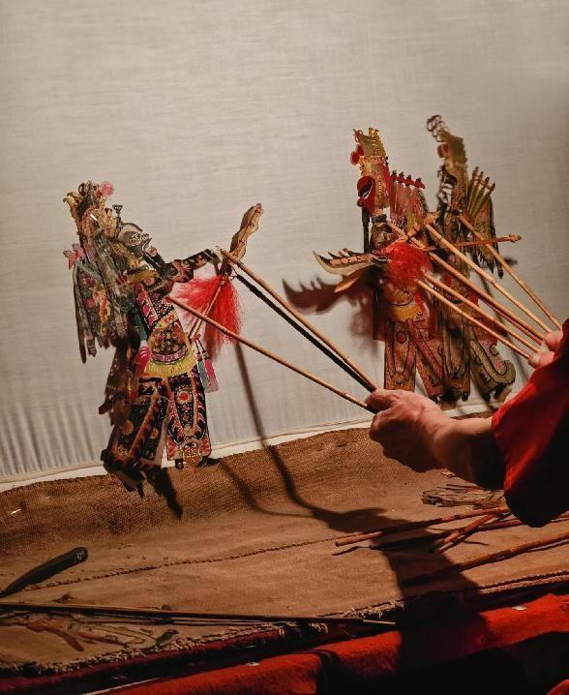
Core Definition
Shadow puppetry (皮影戏 píyǐngxì), alternatively termed "Silhouette Theater" or "Lamp Shadow Play," is a traditional folk drama utilizing articulated figures crafted from animal hides or cardboard. Performers manipulate these figures behind an illuminated white screen, synchronizing regional musical dialects with percussive rhythms and stringed accompaniments to evoke rustic charm.

Slide 5
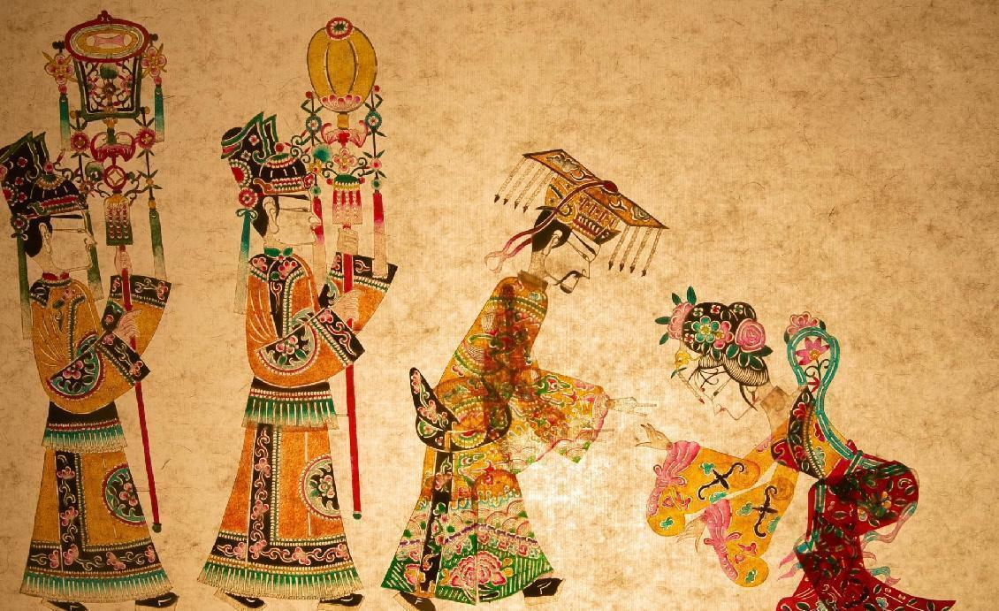
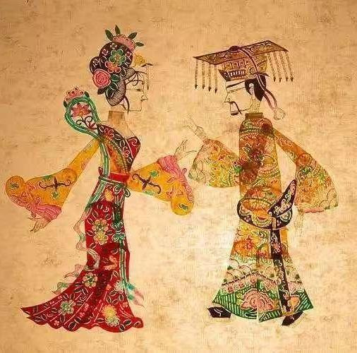
“Have you heard the historical stories of shadow puppetry?”

Slide 6
02
Characteristics of Shadow Puppetry

Slide 7
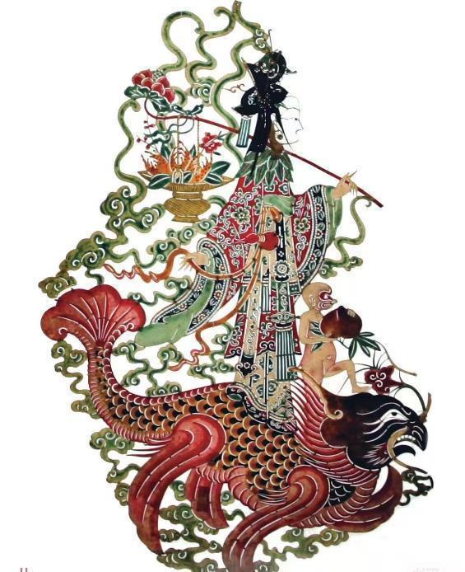
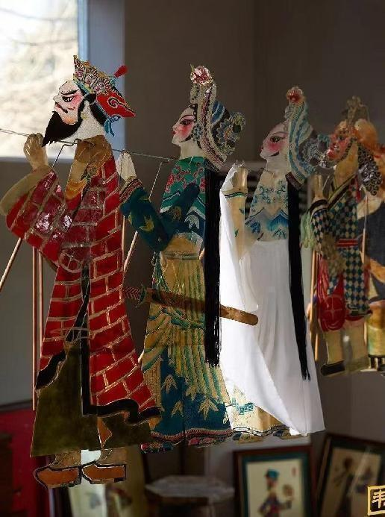
Thematic Characteristics of Chinese Shadow Puppetry
●Historical Epics: Romance of the Three Kingdoms(《三国演义》), Water Margin(《水浒传》), Journey to the West(《西游记》)●Folk Legends: White Emperor City Entrustment(《白帝城托孤》), Farewell My Concubine ( 《霸王别姬》), Legend of the White Snake(《白蛇传》)●Mythological Fantasies: Eight Immortals Crossing the Sea(《八仙过海》), NeZha Conquers the Dragon King(《哪吒闹海》), Cowherd the Weaver Girl(《牛郎织女》)

Slide 8
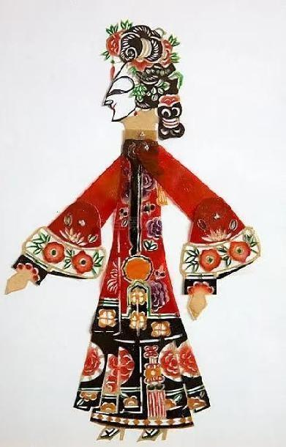
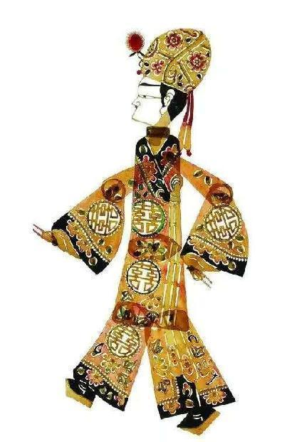
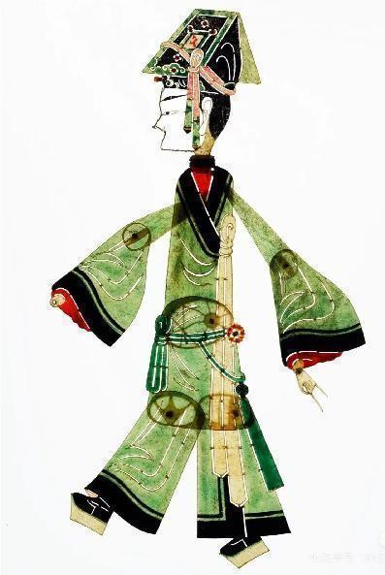
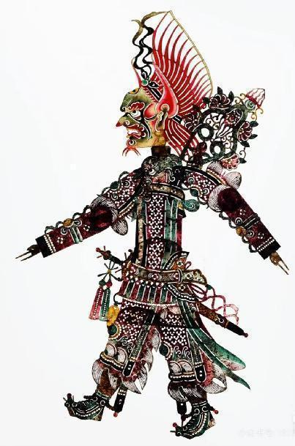
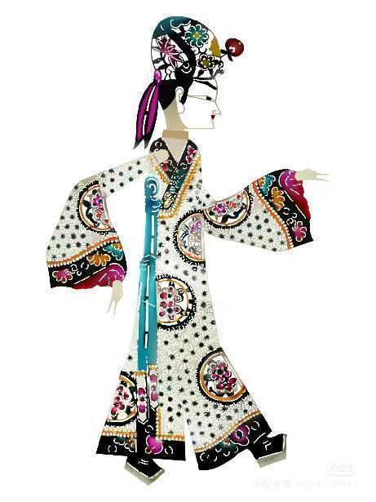
Chromesthetic Features of Chinese Shadow Puppetry
‌ The color characteristics of shadow puppetry are primarily reflected in the richness and contrast of hues. Following the traditional "Five Elements and Five Colors" principle, the five primary colors of red, yellow, green, black, and white are interwoven and juxtaposed, creating a vibrant and colorful display. These highly transparent pigments are seldom blended, producing opulent and visually striking color combinations. The intentional separation of these pure, saturated colors enhances dramatic contrasts, resulting in a dazzling aesthetic that embodies both traditional cultural symbolism and folk artistic charm.
Red
Yellow
Green
Black
White

Slide 9
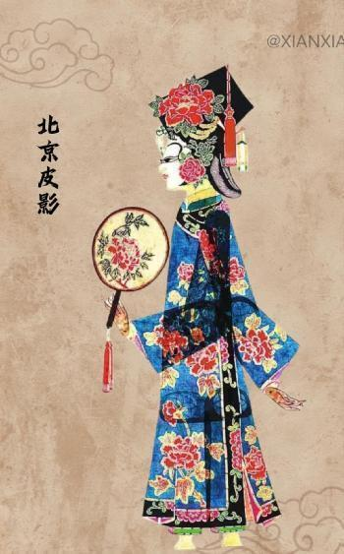
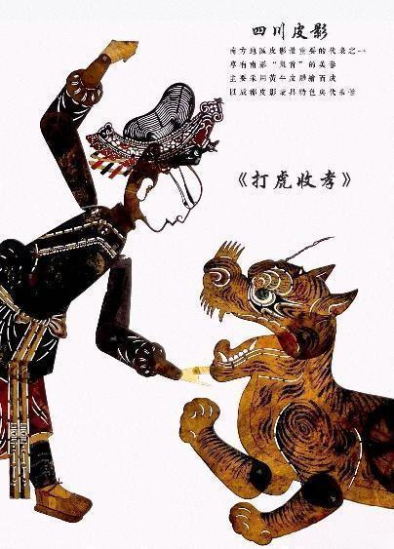
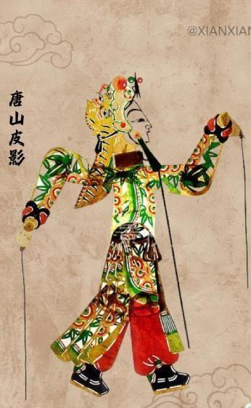
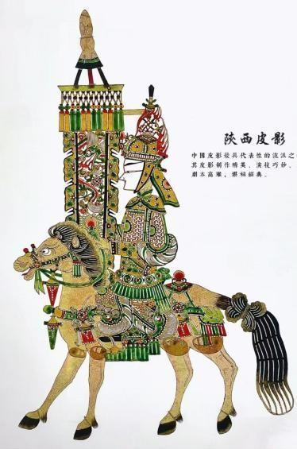
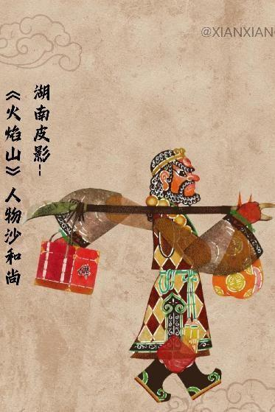
"What are the schools/styles of shadow puppetry?"
Beijing
Shadow Puppetry
Sichuan
Shadow Puppetry
Tangshan
Shadow Puppetry
Shaanxi
Shadow Puppetry
Hunan
Shadow Puppetry
Delicate carvings, royal themes, opera-inspired music, refined color symbolism.
Semi-transparent leather, humorous folk tales, exaggerated motions, Sichuan opera rhythms.
Intricate knife techniques, donkey hide material, complex patterns, northern folk tunes.
Bold lines, historical sagas, rustic aesthetics, Qin腔 (Qinqiang) musical influences.
Colorful dyes, Hunan opera fusion, mythological themes, dynamic shadow transitions.

Slide 10
03
Translation Perspectives on Shadow Puppetry

Slide 11


Slide 12
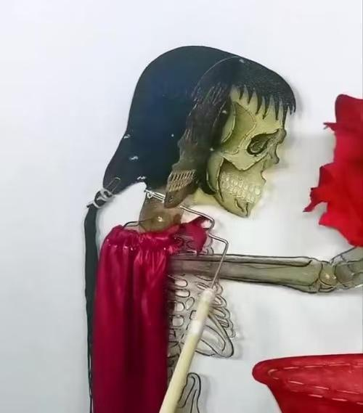
A. White Bone Demon?
B. Calcified Femme Fatale?
C. Bone Spirit?
D. Lady White Bone?

Slide 13
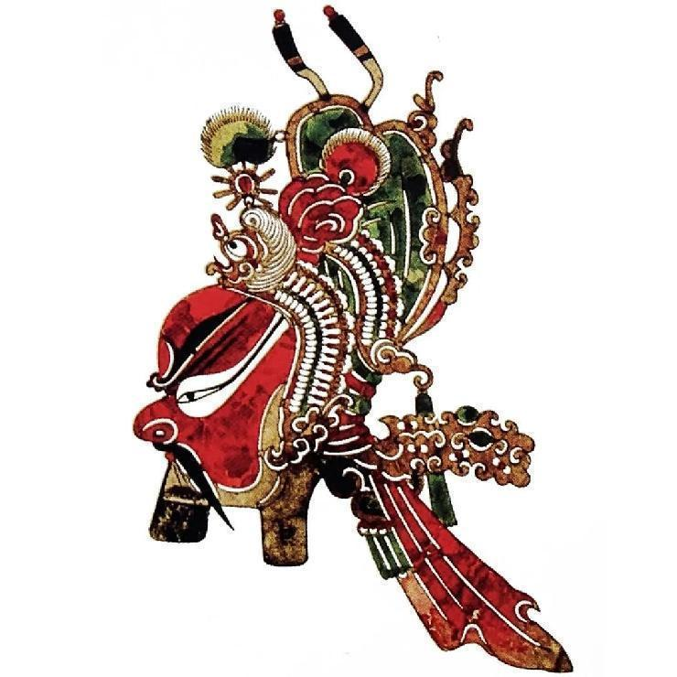
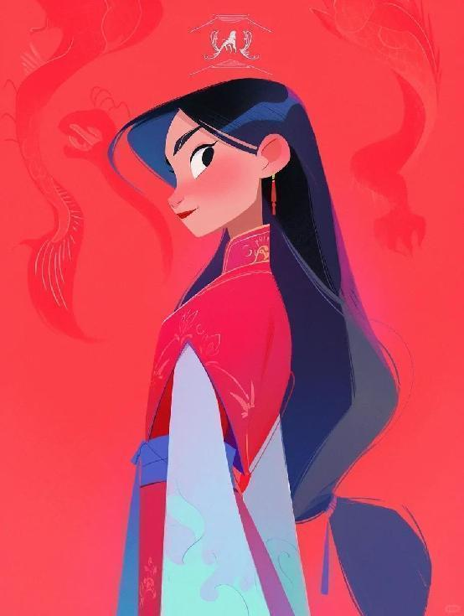
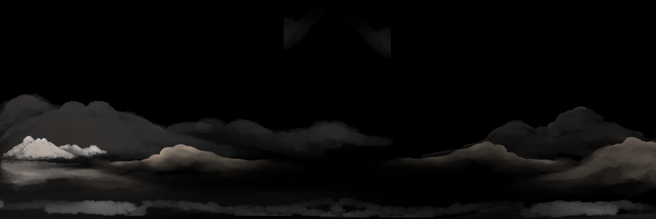
VS
the Western heroic expression of 'the warrior in red' from Disney's Mulan
'red-faced Guan Yu' from Shaanxi shadow puppetry
When the 'red-faced Guan Yu' from Shaanxi shadow puppetry—a symbol of Chinese loyalty and bravery—encounters the Western heroic expression of 'the warrior in red' from Disney's Mulan, which translation strategy would you choose as a translator: literal rendering of the color code (red=heroism) or annotating cultural origins (red=Chinese historical loyalty)?

Slide 14
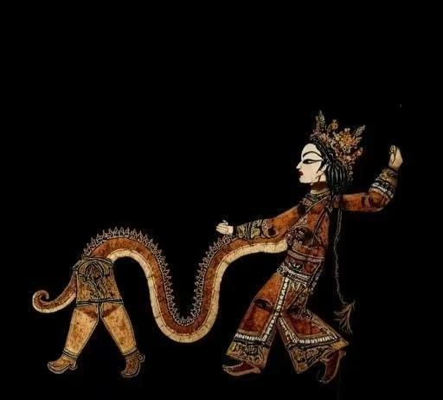
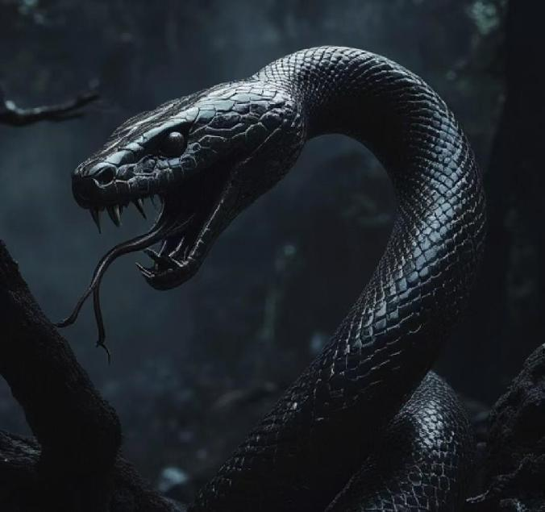
Legend of the White Snake
Chinese Sperpent Theology
(中国灵蛇观)
Ophidiophobic Ontology
(西方蛇魔论)
Wisdom
Longevity
Spiritual Creature
Evil
Temptation
Incarnation of the Devil

Slide 15
Thanks

