Slide 1
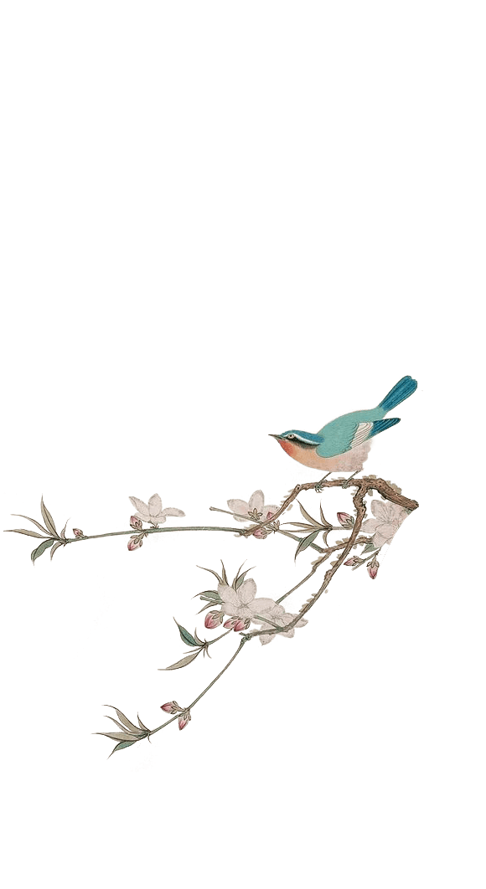
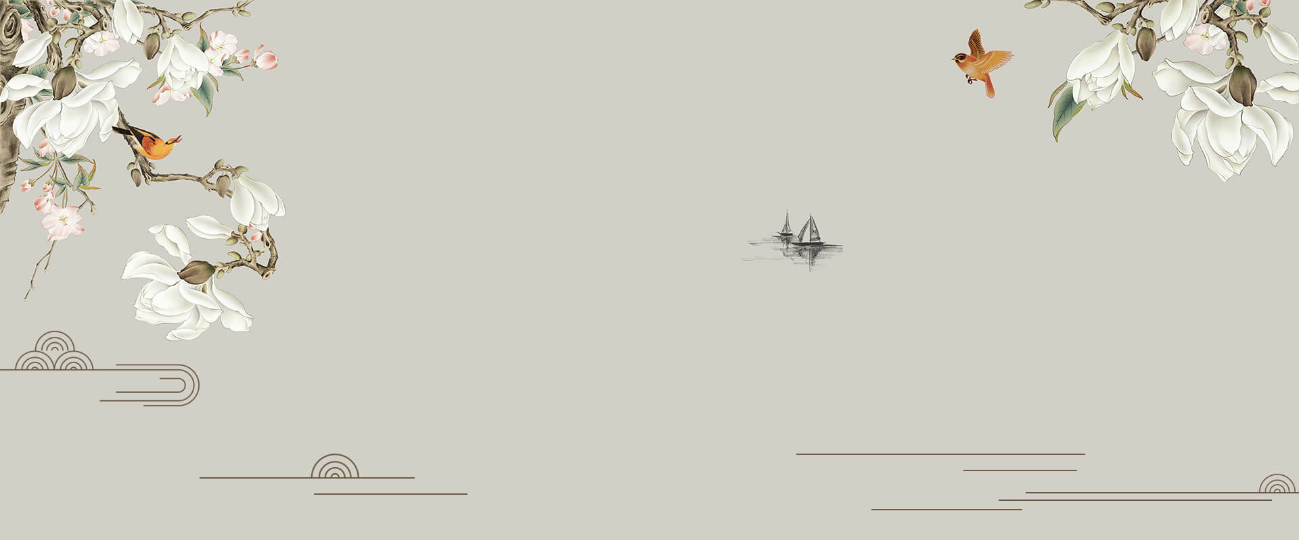
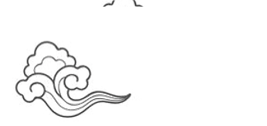
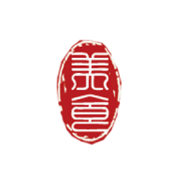
Chinese Clothing
Holly

Slide 2
Contents
Introduction
Chinese Traditional Clothing
Chinese Traditional Clothing Elements
Chinese Traditional Clothing Design
Chinese Traditional Clothing Colors
Conclusion

Slide 3
Ⅰ. Introduction
Chinese Clothing has a long history while Han people dominate most periods in history. For thousands of years, generations of clothing designers have devoted themselves to building the Kingdom of Clothes, making the garments(服装） that cover the human body into an important component of Chinese culture.The progress can be seen through its changes in clothing styles.

Slide 4
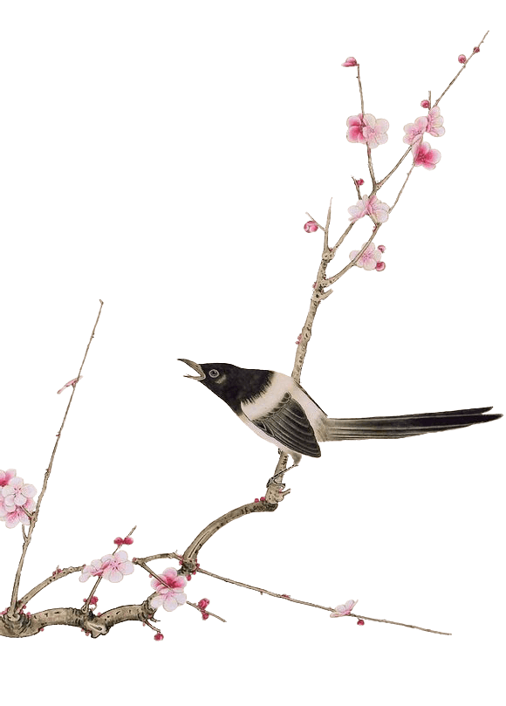
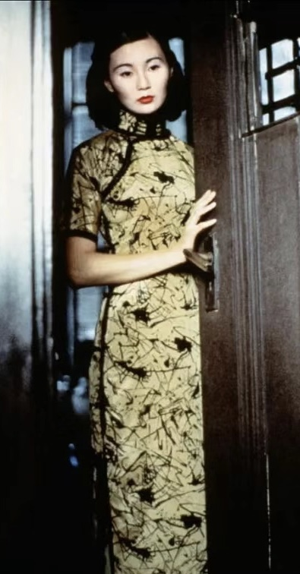
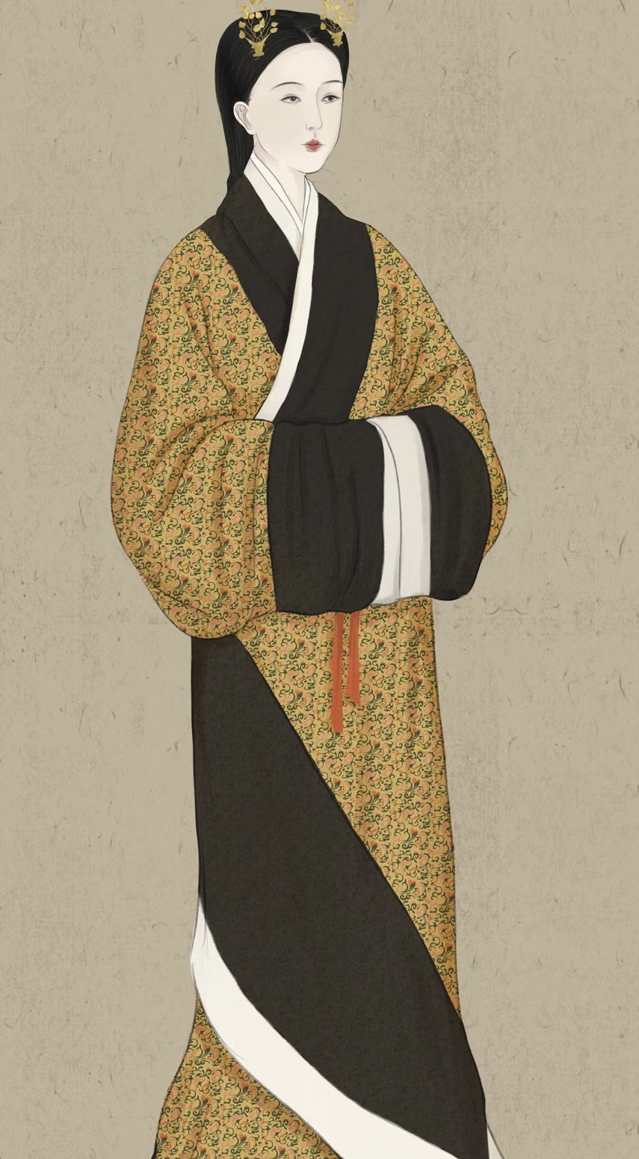
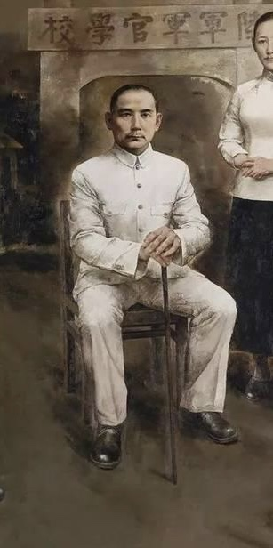
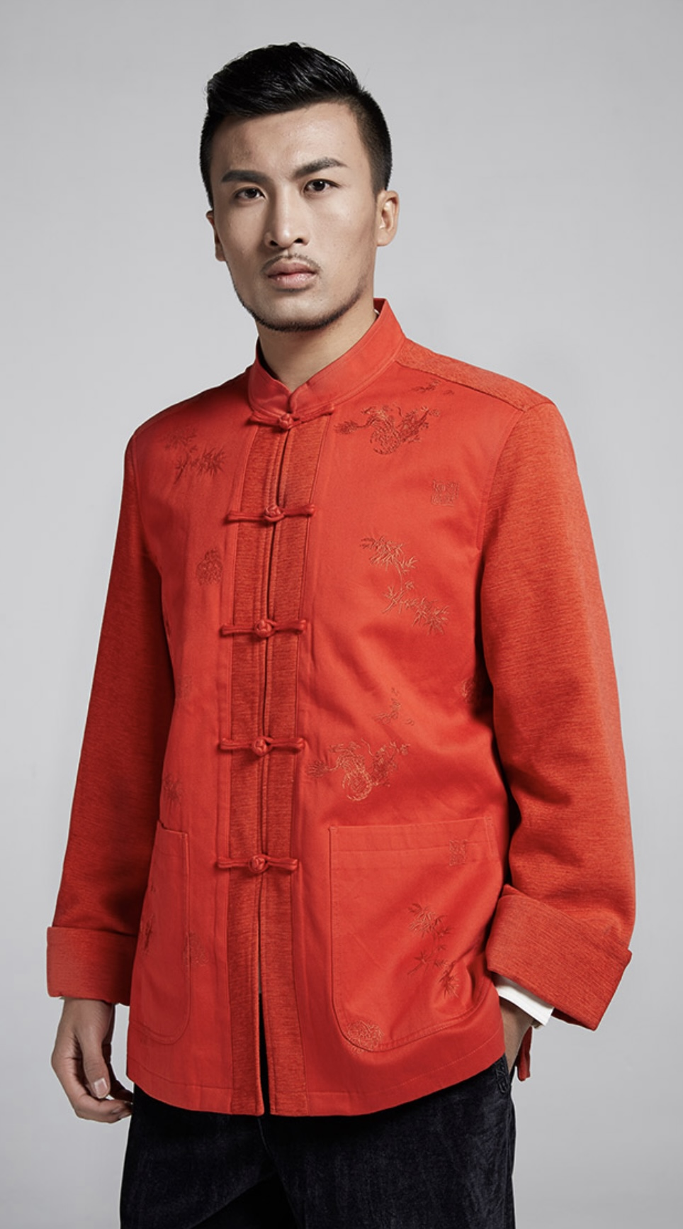
Ⅱ.Chinese Traditional Clothing
3
1
4
叁
2
Cheongsam
Han Fu
Chinese Suit
Chinese Tunic Suit

Slide 5
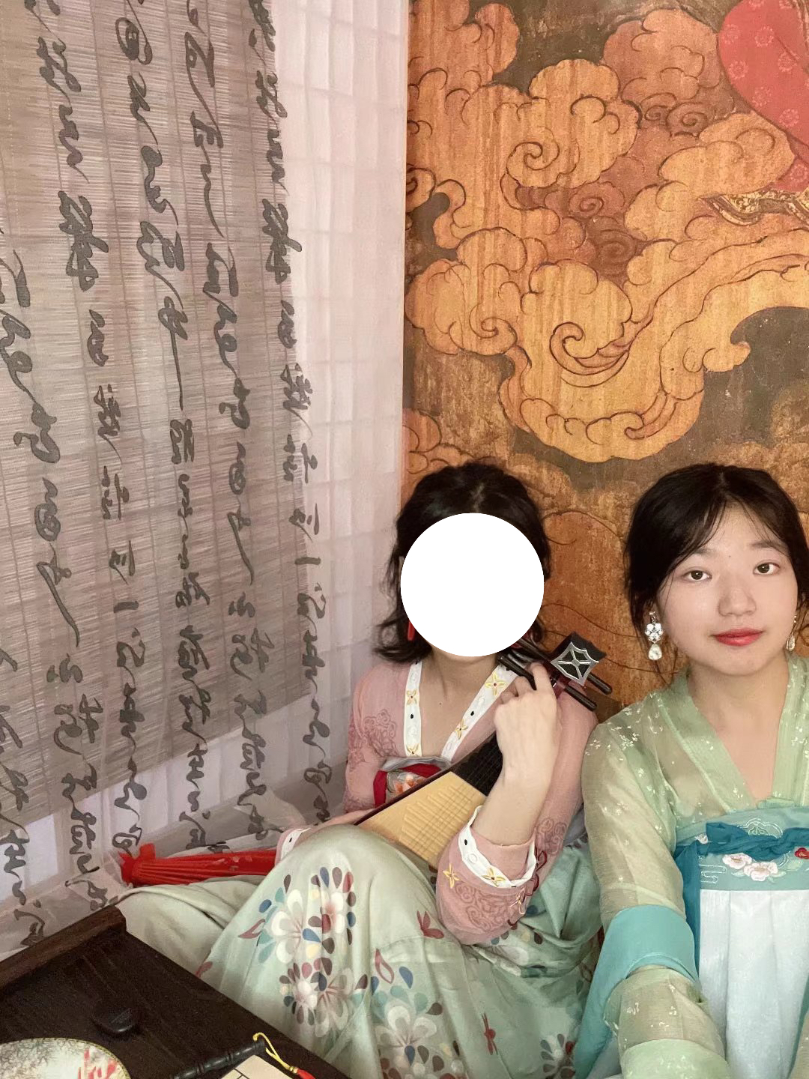
1. Traditional Han Chinese Clothing (Han Fu)
It refers to the attire worn by the Han people from the enthronement of the Yellow Emperor(about 2698BC) till the late Ming Dynasty (1368-1644AD). It became known as the Han Fu(fu means 'clothes" in Chinese)because the fashion was improved and popularized during the Han Dynasty. It is usually in the from of long gown, cross collar, wrapping the right lapel over the left, loose wide sleeves and no
buttons but a sash. Although simple in design, it gives different feelings to different wearers.

Slide 6
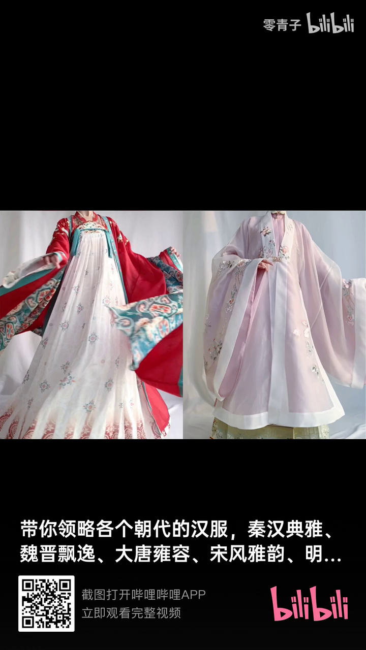

Slide 7
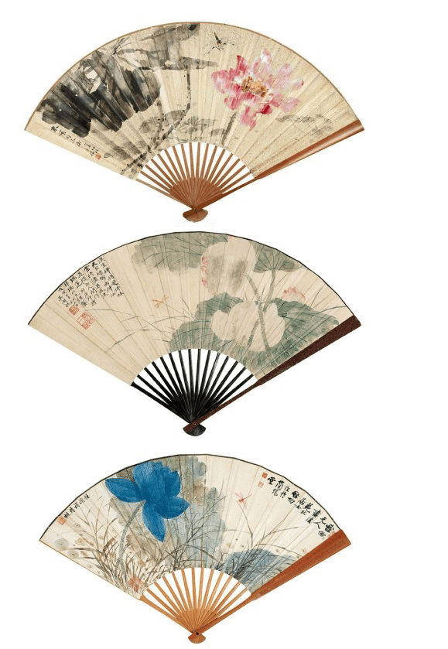
2. Chinese Suit(Tang Zhuang)
It is a combination of the Manchu male jacket of the Qing Dynasty and
the western style suit. It is usually straight collared, with coiled buttons
down the front. Its color and design are in traditional Chinese style but
tailoring is western. (www. topchinatravel. com, 2019, Aug-2. )
It is a combination of the Manchu(满族） male jacket of the Qing Dynasty and the western style suit. It is usually straight collared, with coiled buttons down the front. Its color and design are in traditional Chinese style but tailoring is western.

Slide 8
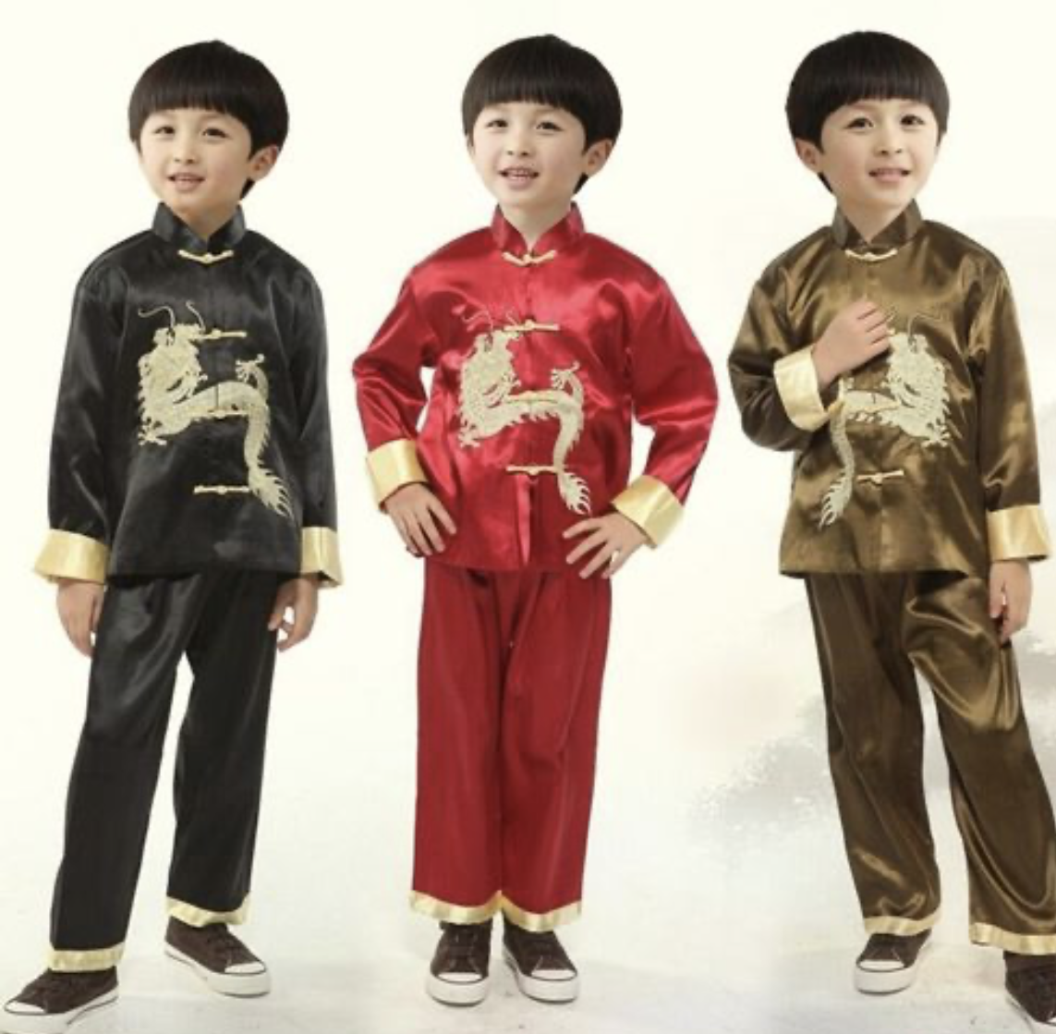

Slide 9
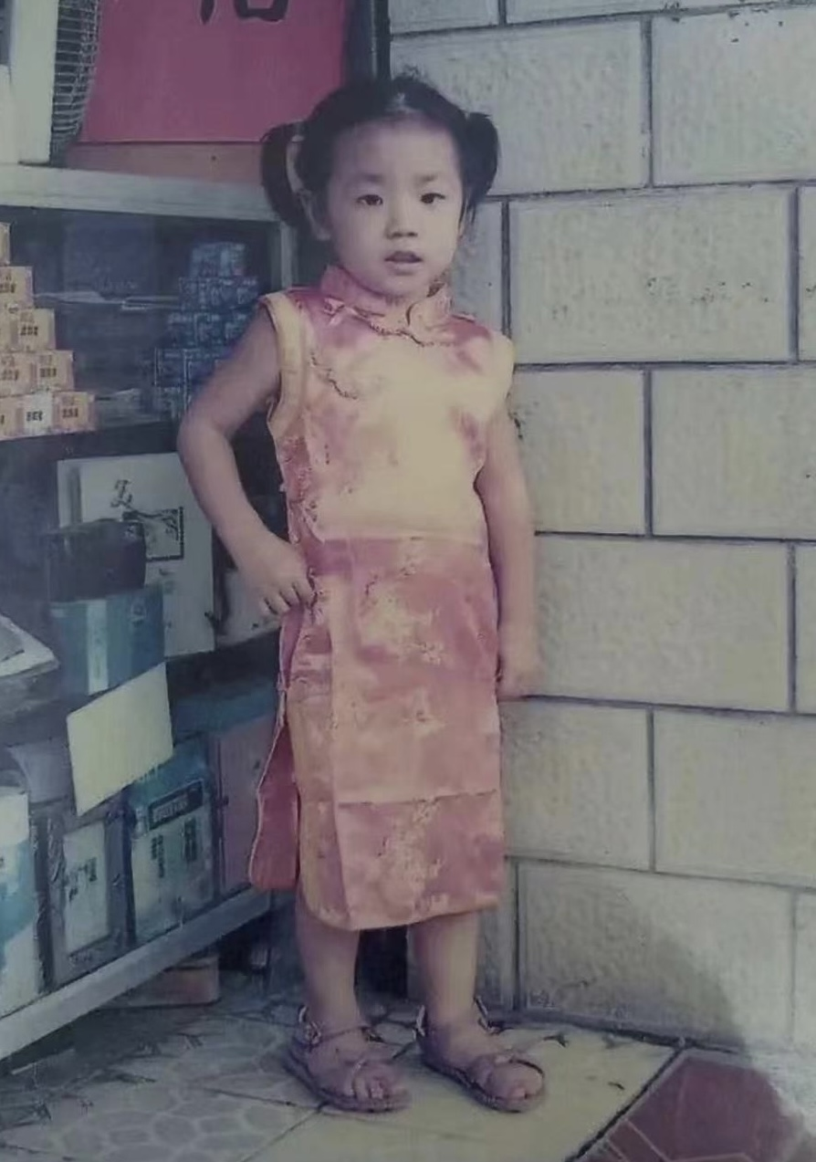
3. Cheongsam(Qi Pao)
Originated from the Manchu female clothes, it evolved by merging with western patterns that show off the beauty of a female body. Its features are straight collar, strain on the waist, coiled buttons and slits on both sides ofvthe dress. Materials used are usually silk, cotton and linen. Cheongsam is the most popular Chinese attire in the world today.

