Slide 1
Do you know how many actresses have played the role of Wu Zetian in movies and TV dramas?
Who is the one that left the deepest impression on you?

Slide 2

Wu Zetian
Presented by: Zhou Ranran Jerry

Slide 3
MENU
Brief Introduction to Wu Zetian's Life
Wu Zetian's Political Tactics and Achievements
Culture and Art during Wu Zetian's Era
Wu Zetian's Impact and Evaluation by Posterity

Slide 4
01
Brief Introduction to Wu Zetian's Life
Chapter

Slide 5
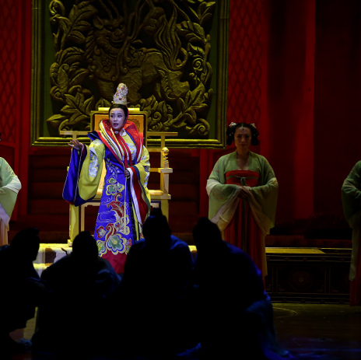
Early Years and Entry into the Palace
Early Life
Wu Zetian was born in Binzhou Wenhui (now Wenhui County, Shanxi Province), the second daughter of Wu Shiyue (武士彟), a founding hero of the Tang Dynasty. From a young age, she was intelligent and showed extraordinary talent and courage.
Becoming a Talented Lady
In 637 AD, at the age of 14, Wu Zetian was summoned to the palace for her exceptional beauty, becoming a talented lady to Emperor Taizong of Tang, Li Shimin, and was bestowed the title "Wu Mei". In the palace, she not only stood out for her beauty but also won the emperor's praise with her wisdom and courage.
Taming the Horse Incident
Wu Zetian once recalled an incident of taming a horse for Emperor Taizong in the palace, demonstrating her extraordinary courage and wisdom. Although she did not gain the emperor's favor because of this, it laid the foundation for her future political career.

Slide 6
Becoming Empress and Participating in Politics
01
02
03
04
Getting Acquainted with Li Zhi
Entering the Monastery as a Nun
Returning to the Palace
Participating in Politics
After becoming the empress, Wu Zetian began to actively participate in court politics, and she and Emperor Gaozong Li Zhi were known as the "Two Saints". She not only assisted Gaozong in handling military and state affairs but also gradually took control of the actual political power.
During Emperor Taizong's illness, Wu Zetian got acquainted with the crown prince Li Zhi and developed a romantic affection for him. This provided an important opportunity for her later political rise.
After Taizong's death, Wu Zetian followed the convention and entered the Gan Ye Temple in Chang'an as a nun. However, she did not give up her political ambitions and waited for the right moment to make a comeback.
In 651 AD, after Li Zhi's mourning period ended, Wu Zetian was recalled to the palace. She gradually consolidated her position with wisdom and tactics and became the empress in 655 AD.

Slide 7
Establishing the Zhou Dynasty and Becoming Emperor
Deposing the Empress Wang and Establishing Wu:
Wu Zetian used a series of political maneuvers to successfully depose Empress Wang and Consort Xiao, consolidating her position as empress and paving the way for her future reign.
Alone in Control of the Court:
As Gaozong's health deteriorated, Wu Zetian gradually took control of the court's power. She implemented a series of measures to strengthen centralization, crack down on political opponents, and dissenters.
Political Reforms: During her reign, Wu Zetian carried out a series of political reforms and system innovations, such as creating the imperial examination system and the military examination system to select talents; focusing on agricultural production and economic development; strengthening centralization and maintaining social stability. These reform measures laid the foundation for the prosperity and development of the Tang Dynasty.
Declaring Herself Emperor and Changing the Dynastic Title: In 690 AD, Wu Zetian officially declared herself emperor and established the Zhou Dynasty, with Luoyang as the capital. She proclaimed herself the "Empress of the Holy and Divine", becoming the only female emperor in Chinese history.

Slide 8
Later Years and Death
Later Life
Although Wu Zetian maintained control over the court in her later years, her health gradually deteriorated. She gradually delegated power to her trusted ministers and began to enjoy her later years.
Shenlong Coup
In 705 AD, the chancellor Zhang Jianzhi and others launched the Shenlong Coup, forcing Wu Zetian to abdicate in favor of the crown prince Li Xian. After the coup, Wu Zetian moved to the Shangyang Palace and spent the last days of her life there.
Death and Last Wishes
On December 16, 705 AD, Wu Zetian died in the Shangyang Palace at the age of eighty-two. She left instructions to be buried with Gaozong in the Qianling Mausoleum and left a stele without inscriptions for posterity to judge her merits and demerits.

Slide 9
02
Wu Zetian's Political Tactics and Achievements
Chapter

Slide 10
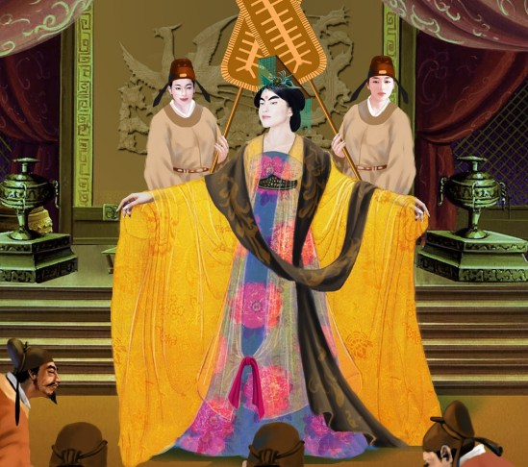
Reorganizing the Administration and Harsh Official Policy
Reorganizing the Administration
01
Selecting officials strictly, establishing the Nine-rank system, strengthening the assessment and supervision of officials, and improving the quality of officials.
A system of spies
02
Employing secret police, cracking down on the opposition and corrupt officials, and severely suppressing political dissent and rebellion to maintain stability.
Revising Laws
03
Revising the "Tang Code Commentary", strengthening the construction of the legal system, and making national management more standardized and institutionalized.

Slide 11
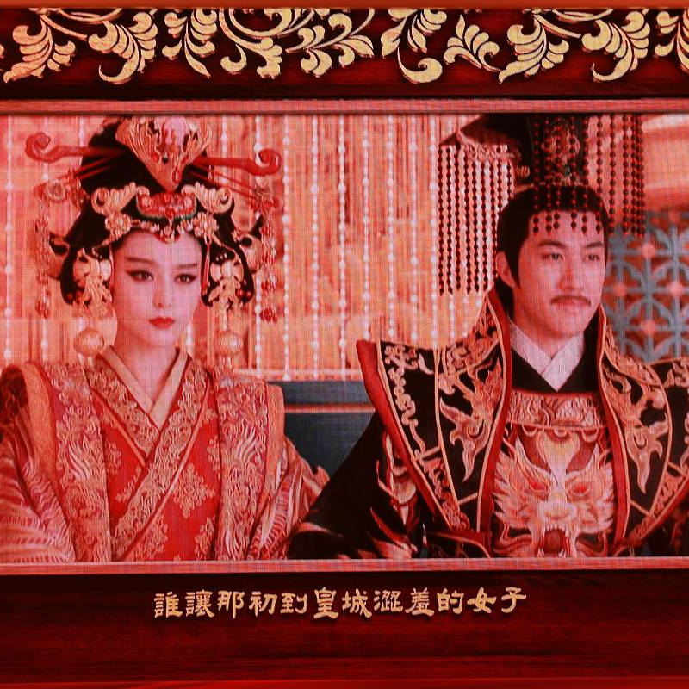
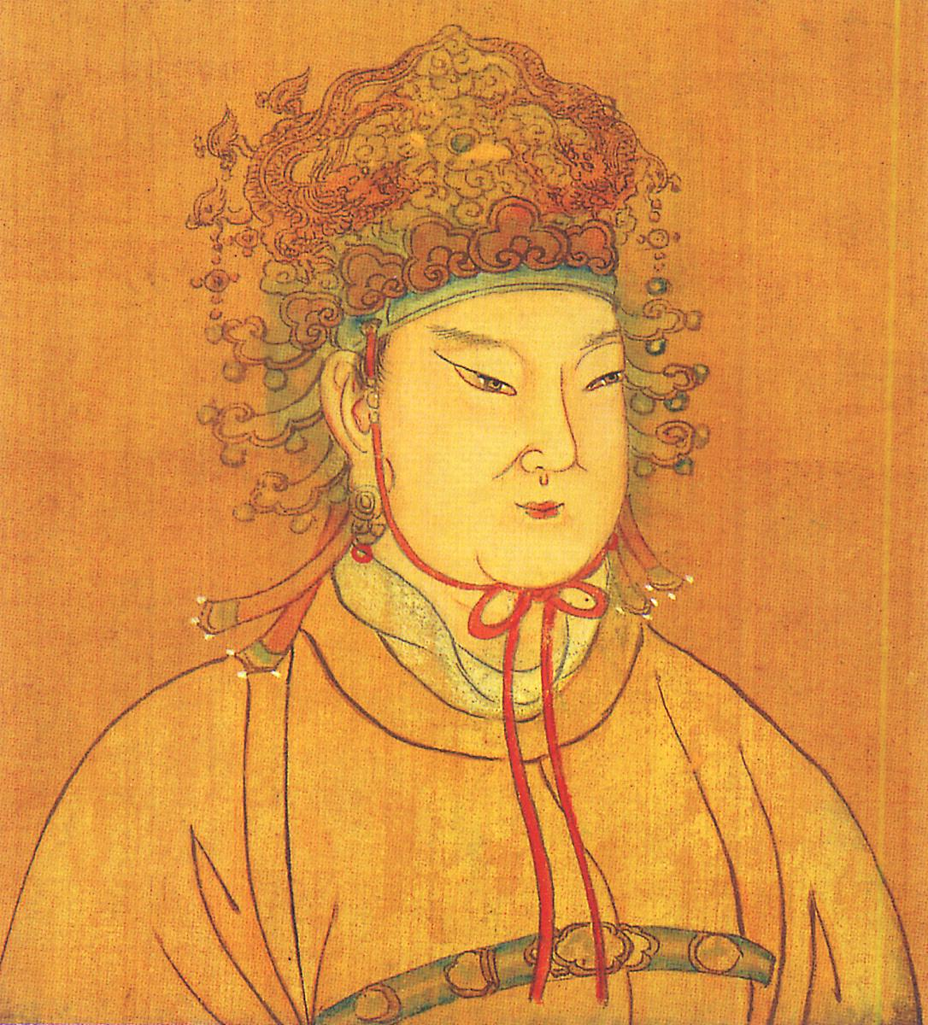
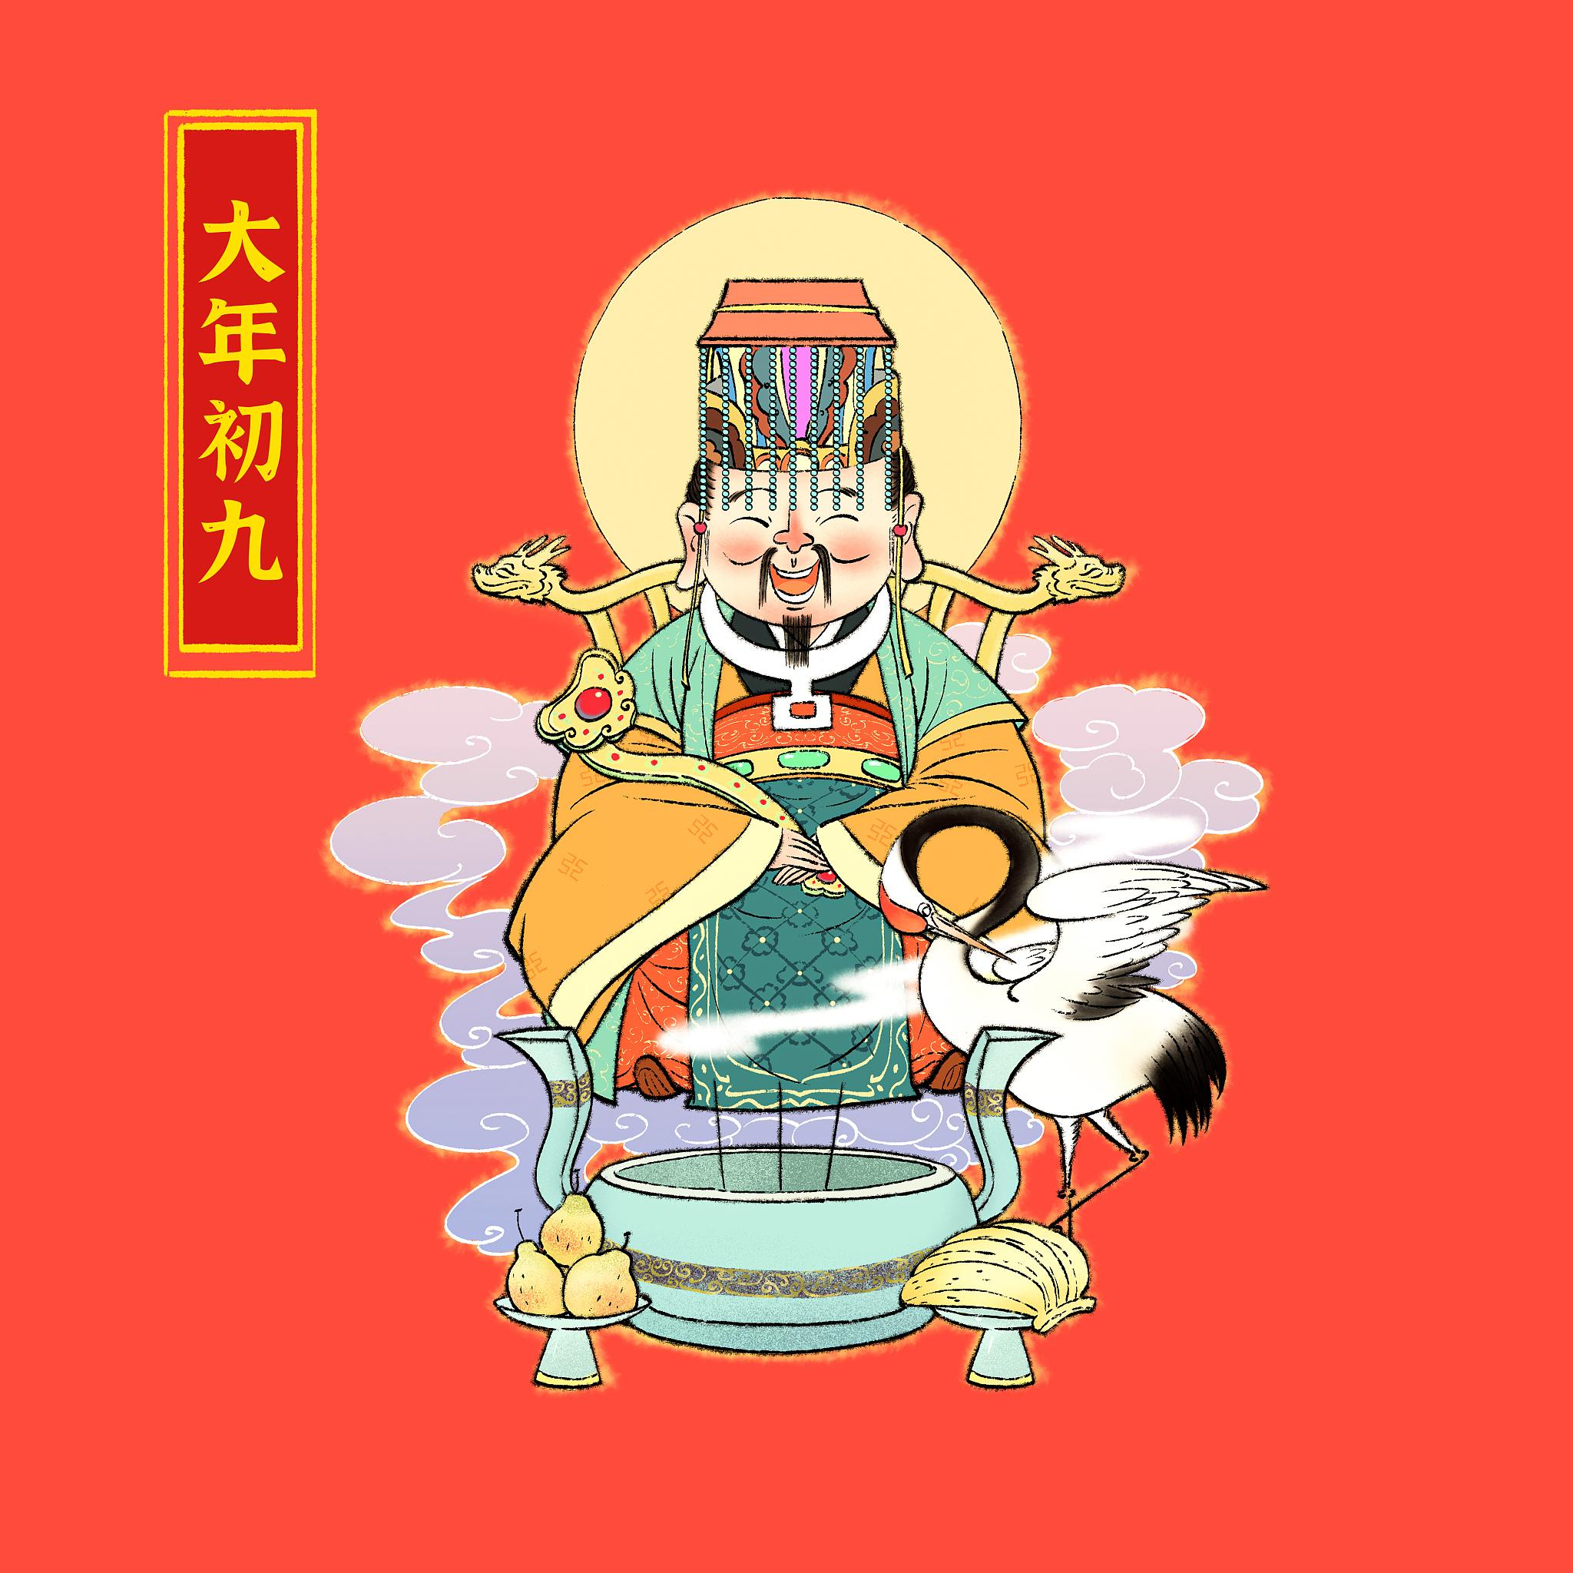
Developing the Imperial Examination and Selecting Talents
Creating the Imperial Examination System
Developing the Imperial Examination
Promoting Literature
Conducting personal interviews with the tribute students, selecting outstanding talents, and expanding the ruling base.
Increasing the subjects of the imperial examination, focusing on practical abilities, allowing more talented individuals to enter the officialdom.
Valuing literature and cultural education, establishing literary institutions such as "North Gate Scholars", and promoting cultural prosperity.

Slide 12
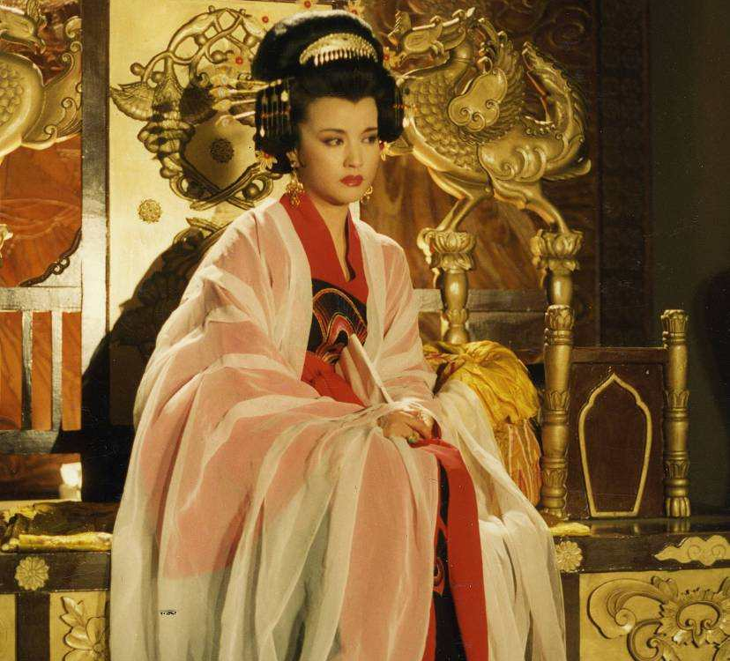
Consolidating Central Power and Weakening Aristocratic Families
Weakening Aristocratic Families
Crack down on the power of aristocratic families, elevate the status of common landlords, and strengthen centralization.
Reforming the Official System
Reforming the system of the Three Departments and Six Ministries, strengthening imperial power over central and local governments, making the bureaucratic system more complete.
Inspecting Localities
Sending envoys to inspect localities, strengthening the supervision and management of local officials, and maintaining central power.

Slide 13
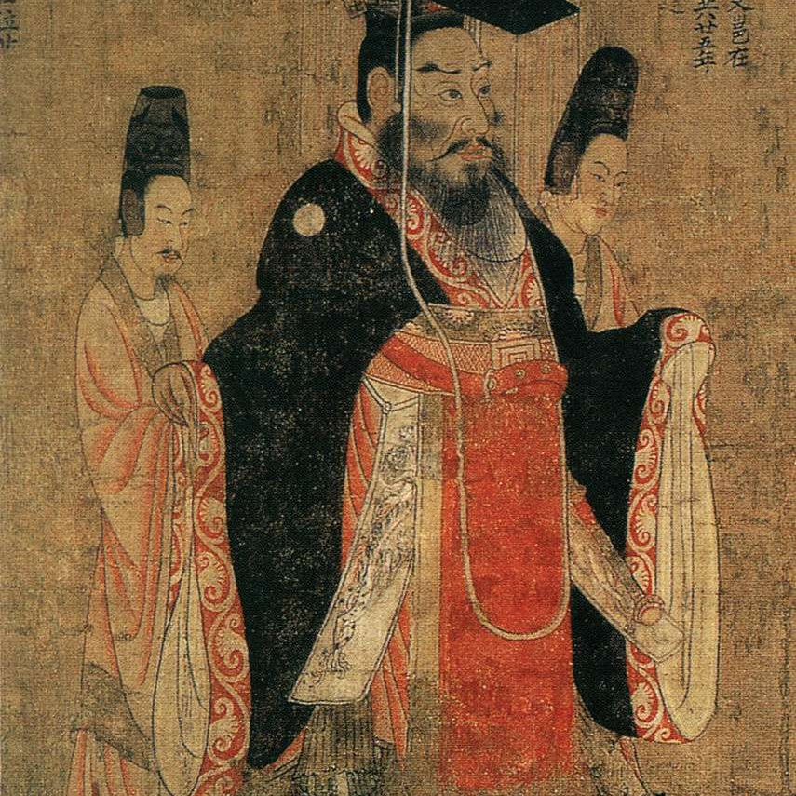
Military Expansion and Border Management
Border Management
Establishing institutions such as the Four Garrisons of the Western Regions and the Beiting Protectorate to strengthen the management and defense of border areas, and maintaining national unity.
Military Expansion
Waging wars to expand the territory of the Tang Dynasty, making it one of the dynasties with the widest territory in history.
System of Land Equalization
Implementing the System of Land Equalization in border areas to promote agricultural production and provide food and supplies for the army.

Slide 14
03
Culture and Art during Wu Zetian's Era
Chapter

Slide 15
Promoting Buddhism and the Development of Taoism
Buddhism Flourishes
Taoism is Also Emphasized
During Wu Zetian's era, Buddhism experienced unprecedented prosperity. She not only practiced Buddhism herself but also promoted its development by building numerous Buddhist temples, translating Buddhist scriptures, and appointing eminent monks to official positions. During this period, the status of Buddhism in society significantly increased, and Buddhist culture was widely disseminated, having a profound impact on future generations.
While promoting Buddhism, Wu Zetian did not neglect the development of Taoism. She built the Taiqing Palace, made Taoism a state religion, and granted titles and rewards to Taoist priests, raising the status of Taoism in the court. This policy of giving equal importance to both Buddhism and Taoism reflects Wu Zetian's openness and tolerance in religion.

Slide 16
Poetry Creation and Literary Prosperity
Poetry Creation
Wu Zetian herself was a talented poet, and her poems, totaling 46, were included in the "Collected Tang Poems". She was adept at using the rhetoric of the graceful and restrained school, depicting personal emotions and natural scenery in her poems, showing a unique artistic style.
Literary Prosperity
During Wu Zetian's era, literature flourished greatly. She actively protected talented literati and encouraged them to create literary works. At the same time, by holding poetry gatherings and soliciting poetry manuscripts, she stimulated the creative enthusiasm of literati and promoted the prosperity of Tang Dynasty literature. During this period, many outstanding literary figures and works emerged, leaving behind a rich cultural heritage for future generations.

Slide 17
Development and Contribution of Science and Technology
Improvement of papermaking process
Development of Printing Technology
Progress in Agriculture and Textile Industry
During Wu Zetian's period, improvements were made to the papermaking process, beginning the use of hemp or bamboo fibers for paper production, which enhanced the quality of the paper. At the same time, the craftsmanship for making paper became more refined, with the addition of a paper polishing process, making the paper smoother and more suitable for writing.
During Wu Zetian's era, the printing technique also saw certain improvements. Although the traditional movable type printing allowed for mass printing, the quality of the print was relatively low. In this period, the woodblock printing method was introduced, which used wooden boards to create printing plates, making the characters more uniform and the printing improved.
In agriculture, the use of iron agricultural tools was widespread during Wu Zetian's era, and the shape and structure of plows were improved to increase farming efficiency. At the same time, the development of water conservancy projects and the improvement of irrigation facilities increased the utilization efficiency of farmland.

Slide 18
04
Wu Zetian's Impact and Evaluation
Chapter

Slide 19
Positive Evaluation and Affirmation of Historical Status
The Only Female Emperor
Bridge between Past and Future
As the only female emperor in Chinese history, Wu Zetian achieved significant accomplishments in politics, economy, and culture during her reign, setting an example for women's rule in later generations.
Wu Zetian connected the "Zhenguan Era" and the "Kaiyuan Era" of the Tang Dynasty, playing a bridging role and making important contributions to the prosperity and stability of the Tang Dynasty.
Outstanding Political Skills
Promoting Social Progress
Wu Zetian performed exceptionally in politics, implementing a series of reform measures, such as strengthening centralization, improving the bureaucratic system, and developing the imperial examination system, showing her extraordinary political wisdom and talent.
Wu Zetian advocated for equality and valued women's rights, promoting the progress and development of Tang Dynasty society and laying the foundation for the improvement of women's status in later generations.

Slide 20
Negative Evaluation and Controversial Issues
Harsh Rule
Luxury and Corruption
01
02
During her reign, Wu Zetian employed cruel officials and initiated a large number of wrongful cases, leading to social unrest and sparking some controversy and criticism.
In her later years, Wu Zetian gradually became luxurious and corrupt, building numerous temples and increasing the burden on the people, which is also one of the reasons she received negative evaluations.
Family Politics
Gender Bias
03
04
In the later period of her rule, Wu Zetian heavily relied on members of the Wu family, leading to corruption in the court and serious bribery among officials, causing adverse effects on the political ecology of the Tang Dynasty.
As a female ruler, Wu Zetian has always been troubled by gender bias in history. Some feudal historians and male rulers have a negative attitude towards her, believing that women are not suitable to rule the country.

Slide 21
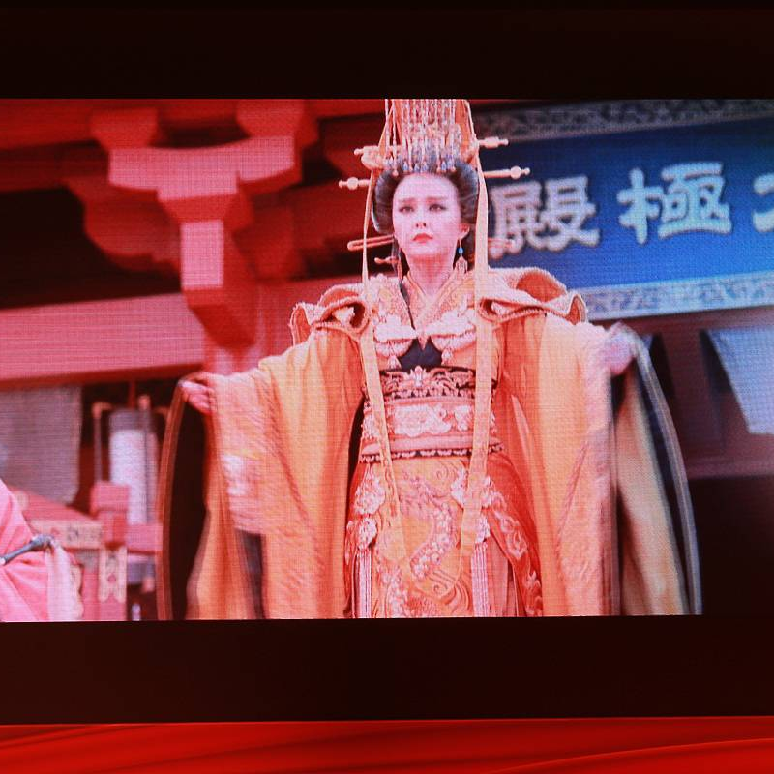
Enhancing the Status of Women in History
Breaking Gender Taboos
Wu Zetian's rise broke traditional gender taboos, proving that women can also play excellent leadership roles in the political arena.
Inspiring Women to Pursue Equality
Wu Zetian set an example for future generations of women, inspiring them to pursue equal rights and social status.
Promoting the Development of Women's Education
Wu Zetian valued women's education, promoting the development of women's education in the Tang Dynasty, providing more opportunities for women in later generations.

Slide 22
Impact on Future Political Systems and Cultural Influence
Wu Zetian implemented a series of political system reforms and innovations during her reign, such as the military examination system and the imperial examination system, which had a profound impact on the political systems of later generations.
Wu Zetian's ideas of advocating equality and valuing women's rights had a positive impact on the social ethos of later generations, promoting the transformation and progress of social ethos.
Cultural and Artistic Prosperity
Historical Status Established
Political System
Innovation
Transformation of Social Ethos
As the only female emperor and outstanding female ruler in Chinese history, Wu Zetian's historical status has been widely recognized and established in later generations.
Wu Zetian herself was also a talented literary figure, valuing poetry creation and the development of culture and arts during her reign, promoting the prosperity of Tang Dynasty culture and arts.

Slide 23

THANKS

