Slide 1
Eat Drink Man Woman
Use of food in film by director Ang Lee.

Slide 2
Ang Lee
Born in 1954
Graduated from the National Taiwan College of Arts in 1975
Later received a BFA in Theatre/Direction from University of Illinois, and a Masters in Film production at NY University.
Makes drama and action films.
Is known for being progressive for his time.
Uses detail and settings to help tell the story.

Slide 3
The opening sequence took over a week to film
http://www.youtube.com/watch?v=8uYVYhox2Rw
Set in Taiwan
Allows for more progressive view to be shown in the film.
Nominated for an Oscar and Golden globe for best foreign film.
Won three awards in various film festivals.
http://www.youtube.com/watch?v=l7pKpO8NErU
http://www.youtube.com/watch?v=0Um_rXMBXAs

Slide 4
Food
“Food balanced with energy, flavor and nature.”
Like Ying and Yang
Cooking is associated with memories.
Smell is the sense that is the closest related to memories.
Family communicates by eating.
Chu- No taste buds= no feelings.
His happiness had a correlation with his ability to appreciate food.
End= able to taste Jia Chen’s food.

Slide 5
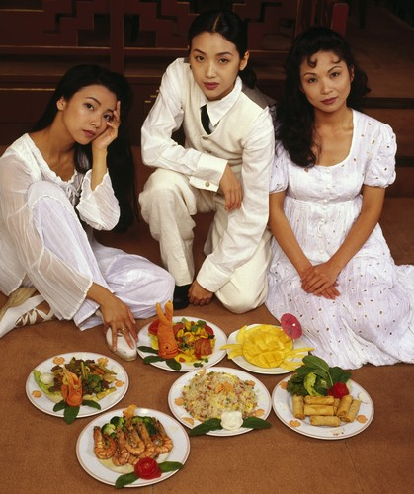
Two responsibilities:
Daughters – Required to care for father
Father – Required to care for daughters
Both sides feel responsibility is a burden.
Stereotypical roles of women:
Youngest is carefree
Oldest is reserved and laden with responsibility
2nd is resentful of her father.
Madame Liang
How does their dress affect your view of them?

Slide 6
Sources
http://www.imdb.com/title/tt0111797/?ref_=sr_1
http://www.imdb.com/name/nm0000487/bio
http://content.epixhd.com/webassets/static/movies/images/websized/132/Eat_Drink_Man_Woman_stills_7153.jpg

