Slide 1


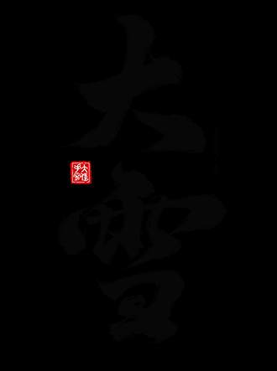
What “The Story of Minglan” Reveals About Chinese Culture
汇报人： 胡馨尹

Slide 2


Introduction
The Drama
and Cultural Lens

Slide 3

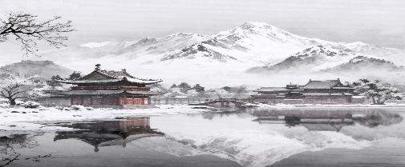

The Story of Minglan Overview
Engaging plot and nuanced characters as cultural text
Popular Chinese historical drama set in the Northern Song period
壹
人物性格立体，情节层层递进，承载着儒家伦理、家族制度等深层文化信息。
以北宋时期为背景，通过细腻的叙事展现历史风貌，使观众在娱乐中感知古代中国社会的运行逻辑与文化脉络。
Illuminates enduring cultural logics in China
贰
通过家庭互动、礼仪规范等，揭示中华文化重视等级秩序、道德修养与集体和谐的核心逻辑。

Slide 4
PART 01
Family Hierarchy
and Confucian Values

Slide 5
Family Hierarchy and Confucian Values
壹
贰
Sheng family roles
Filial Piety and Self-Cultivation
盛家家长与正妻居于顶端，妾室与子女依母系地位排序，不仅体现权力分配，更明确了各自的义务与责任，是家族治理的基础。
孝道是维系家族和谐的关键，子女对父母的尊敬与服从，是社会秩序在家庭层面的体现，确保代际传承的稳定。
叁
肆
Gendered Spheres as Complementary Governance
Hierarchy as responsibility, not just control
在剧中，长辈负责仲裁纠纷、主持仪式，层级关系通过责任分工来维护家族和谐，体现了儒家“各安其分”的思想。
家庭内部事务由女性主导， 男性负责外部公共事务, 反映了传统社会对公私领域的明确划分。

Slide 6
PART 02
Aesthetics:
The Beauty of Order and Restraint

Slide 7
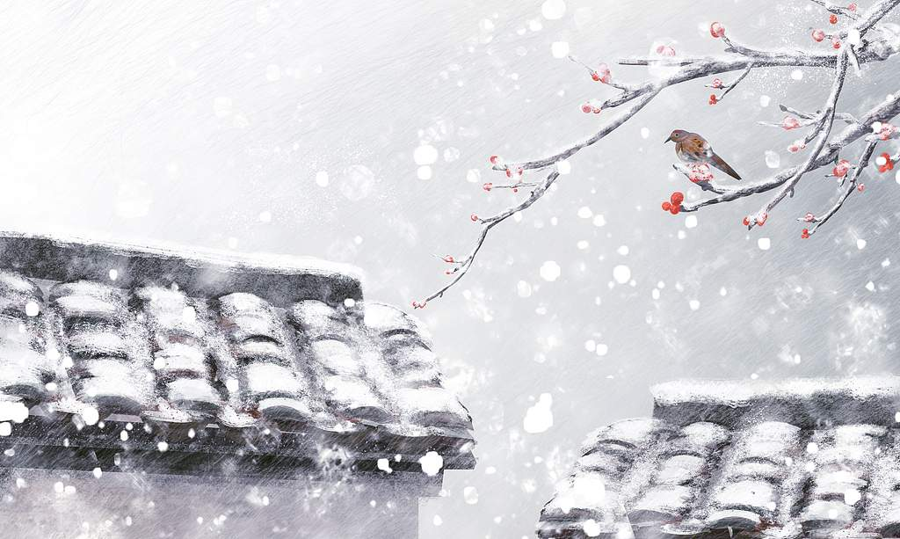
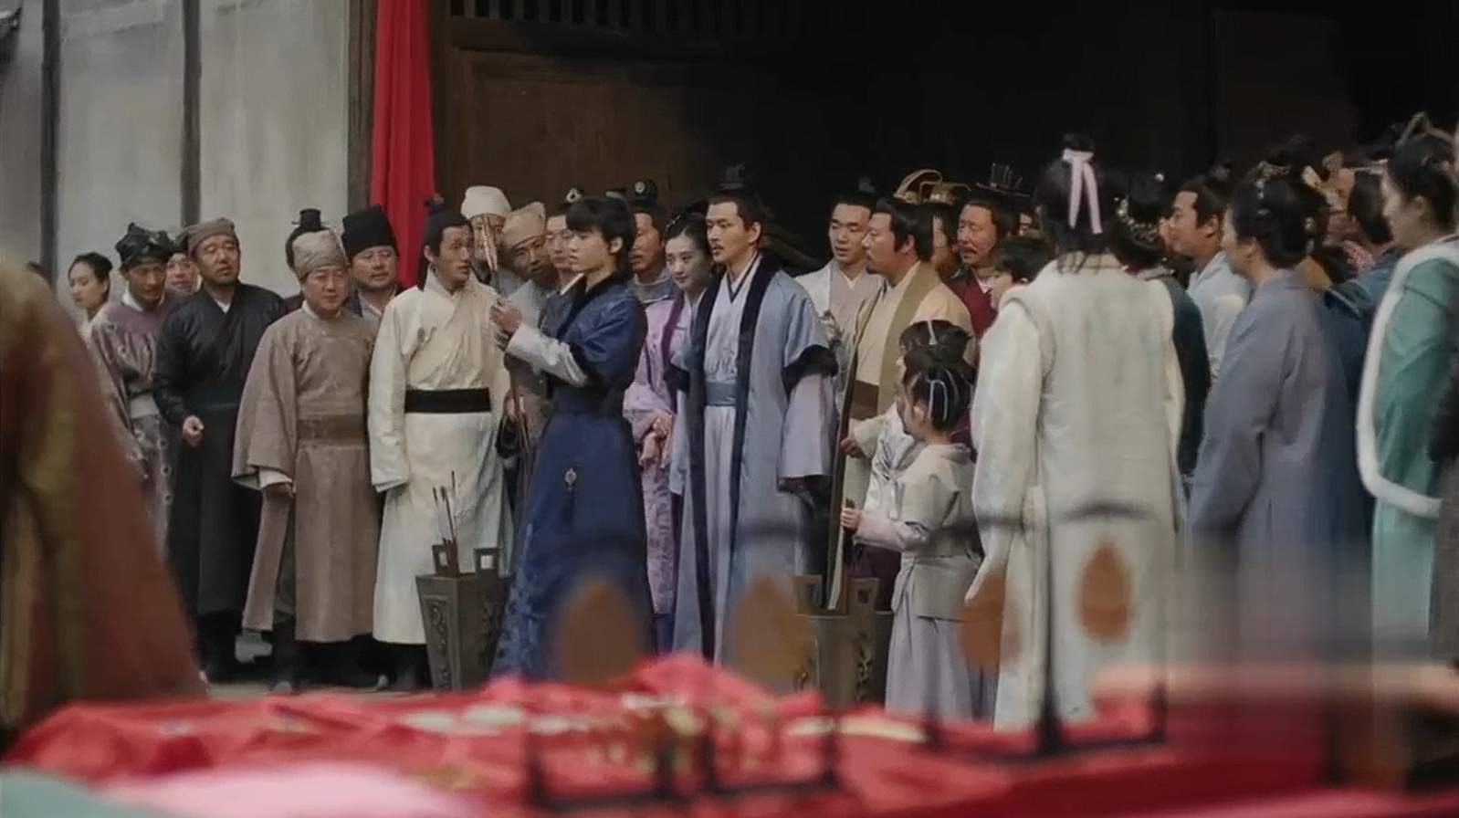
Restraint as Elegance and Ethics
Song dynasty aesthetics: muted colors, simple lines
Restraint signals moral poise and seriousness
Clothes and colors index rank and occasion

Slide 8


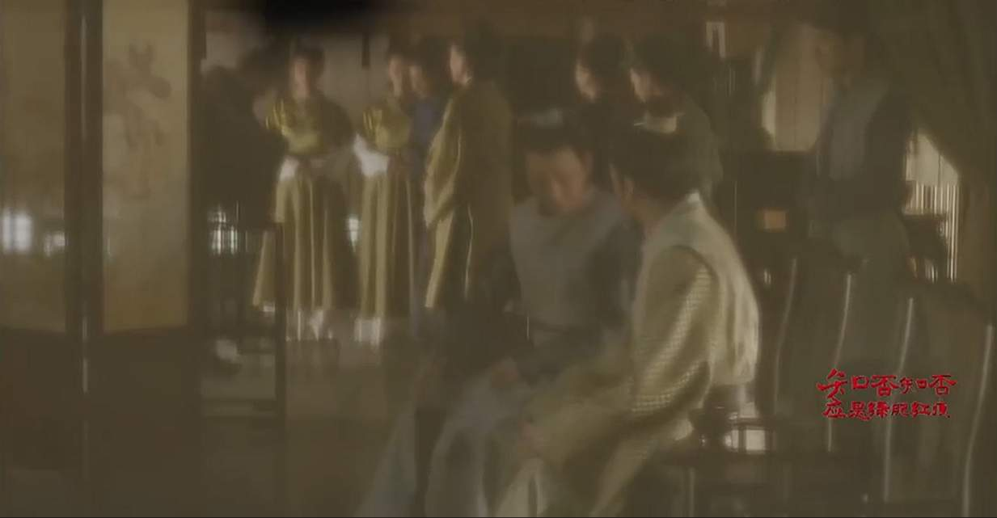
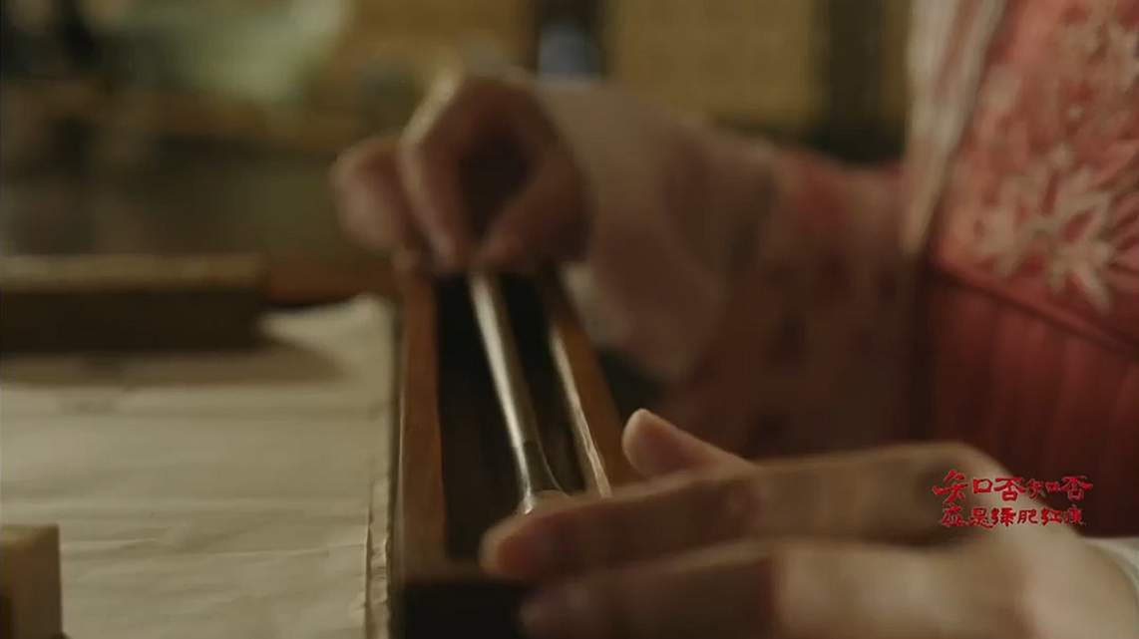

Space Organizes Virtue
Courtyards choreograph status
Seat height, proximity to ancestral tablets signal importance
Scholar's studios embody literati ideals

Slide 9
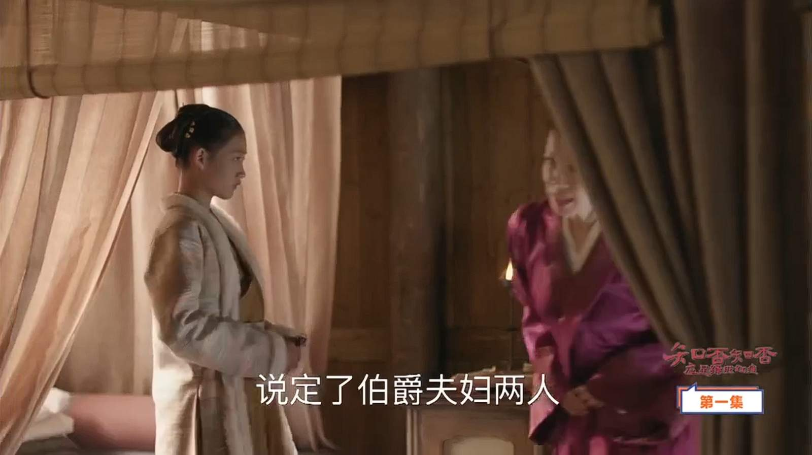
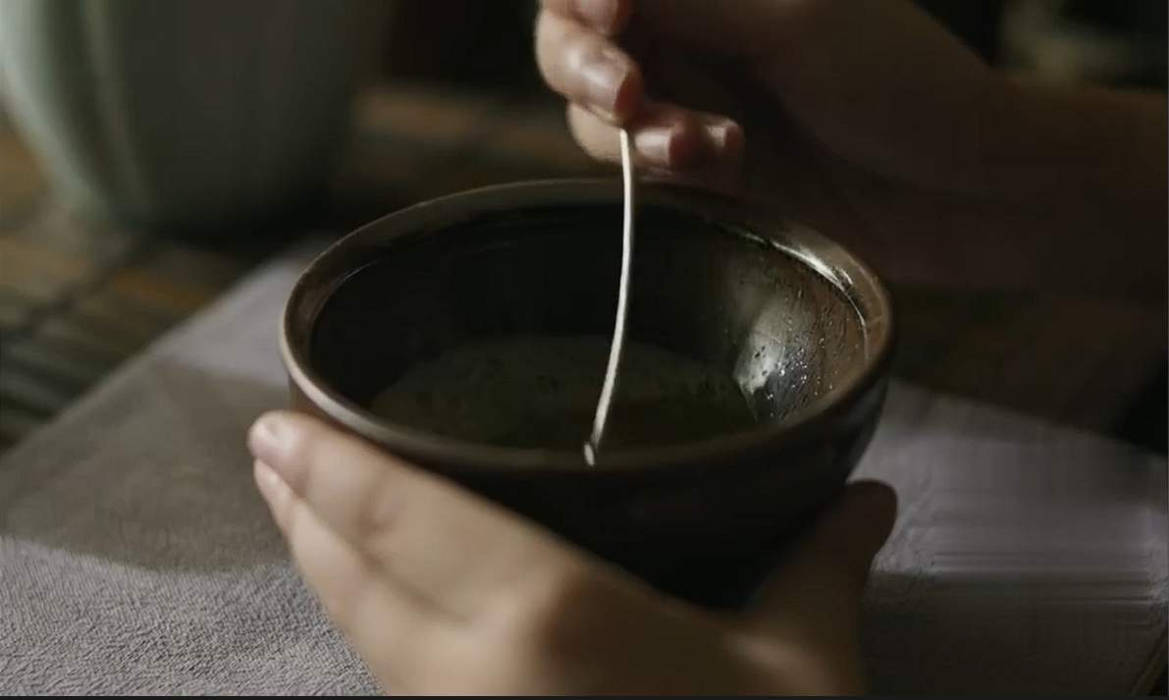
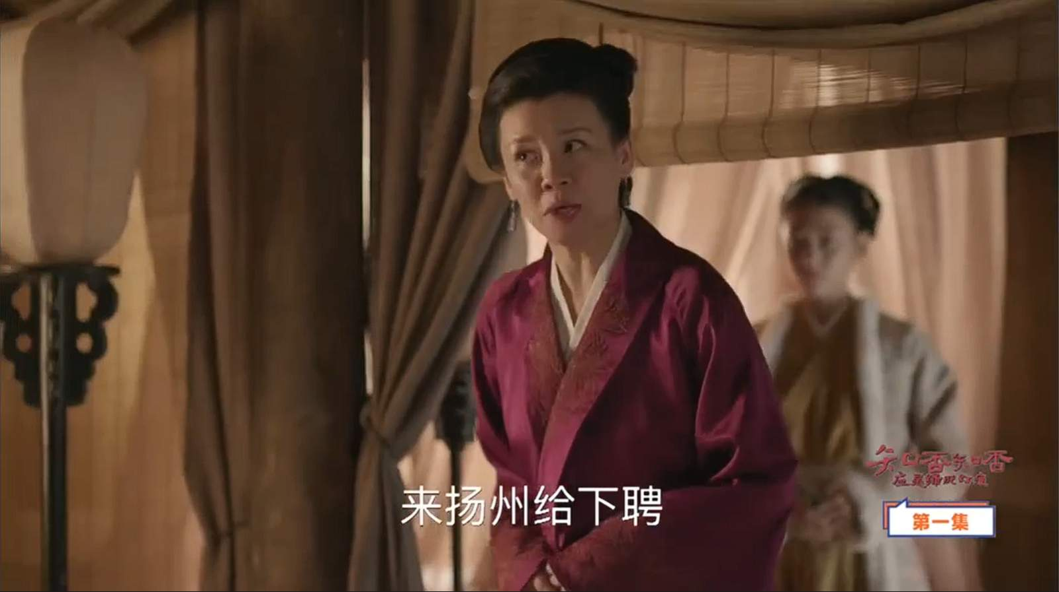
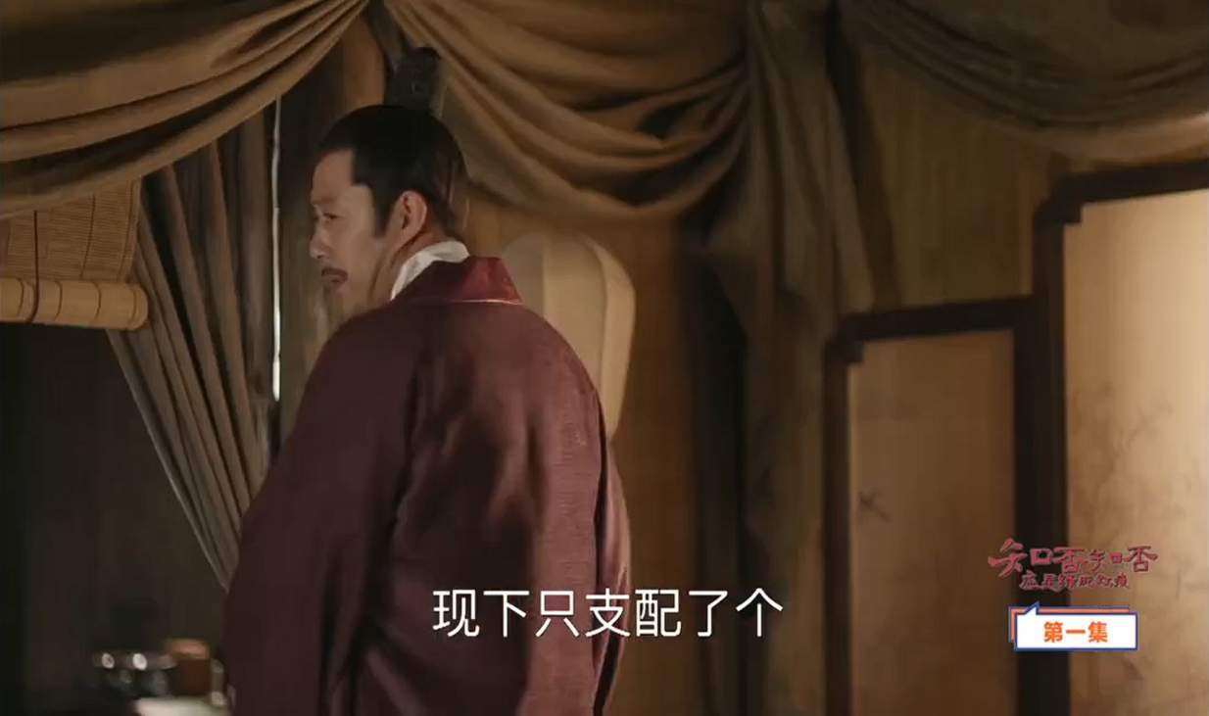
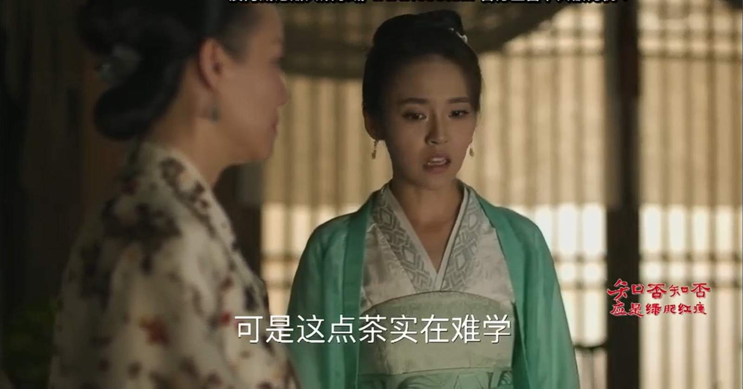

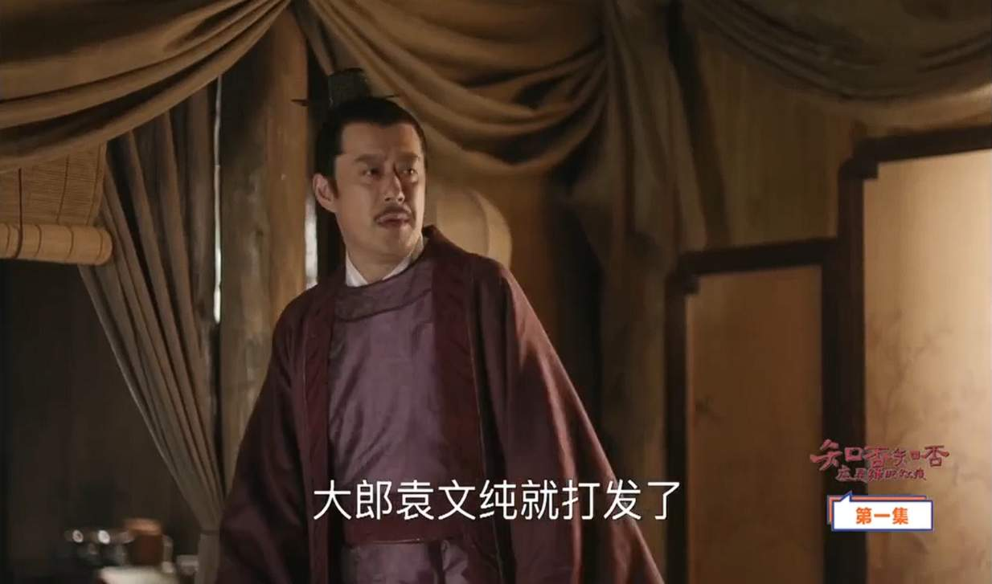
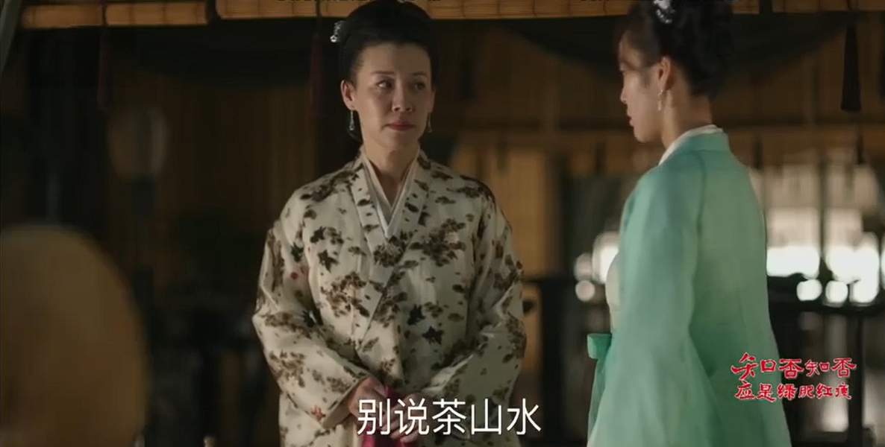
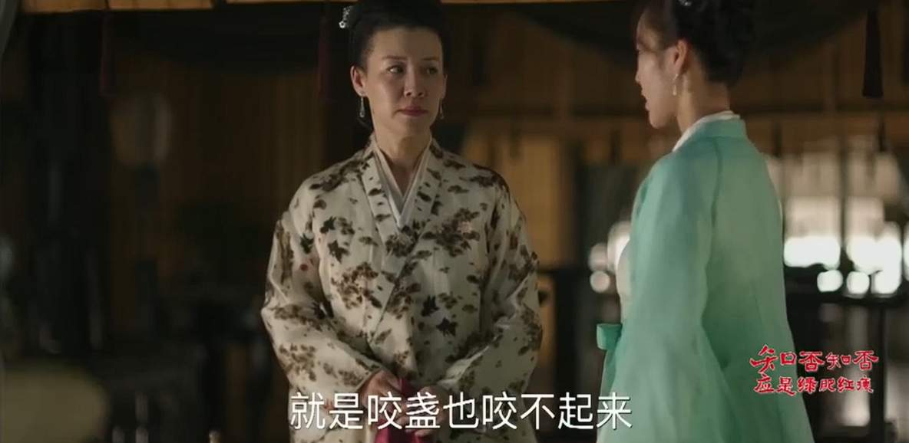
Ritual as Performed Beauty
Weddings, seasonal rites, and tea ceremonies are artfully staged

Slide 10

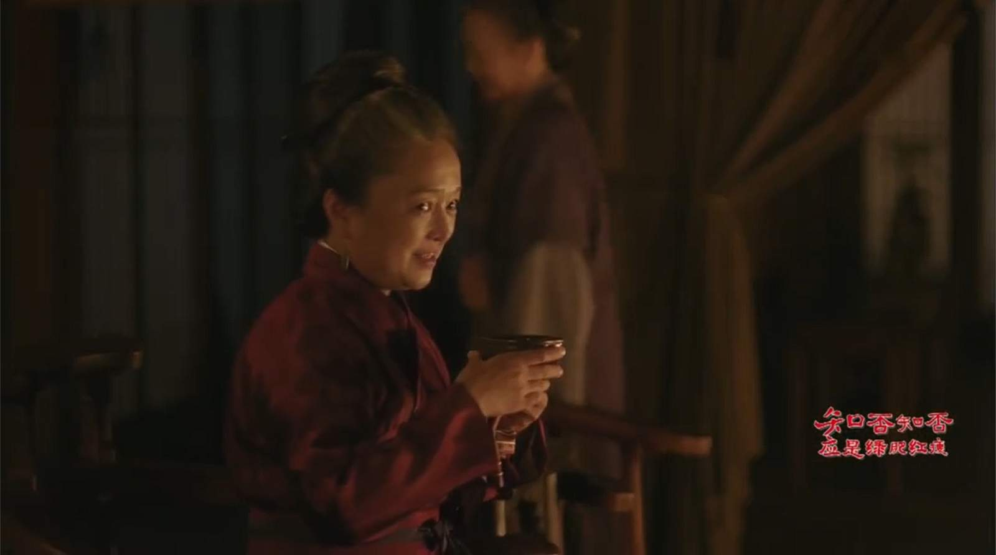
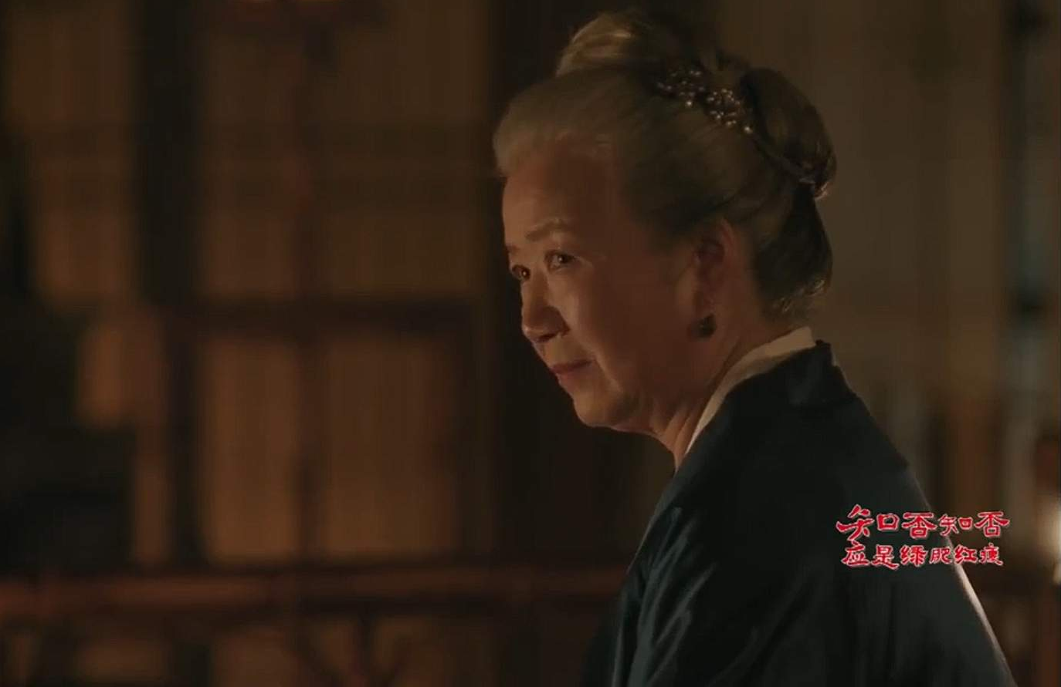
Emotional Poise as an Aesthetic
Subtle acting: glances, pauses, layered speech

Slide 11
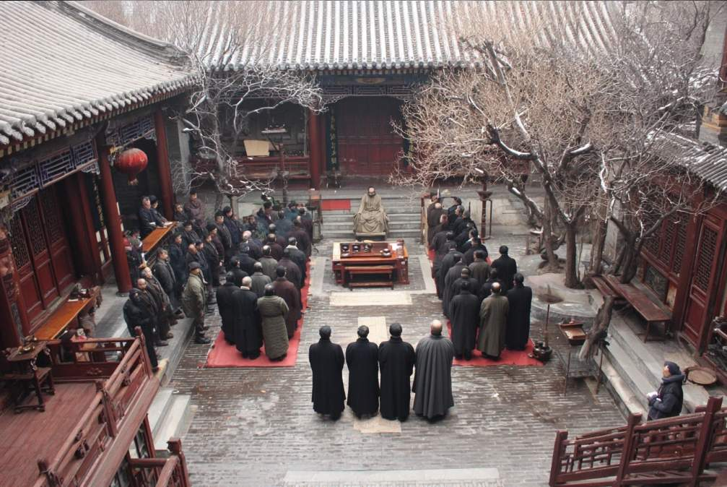

Slide 12
PART 03
Imperial Examination System and Governance

Slide 13
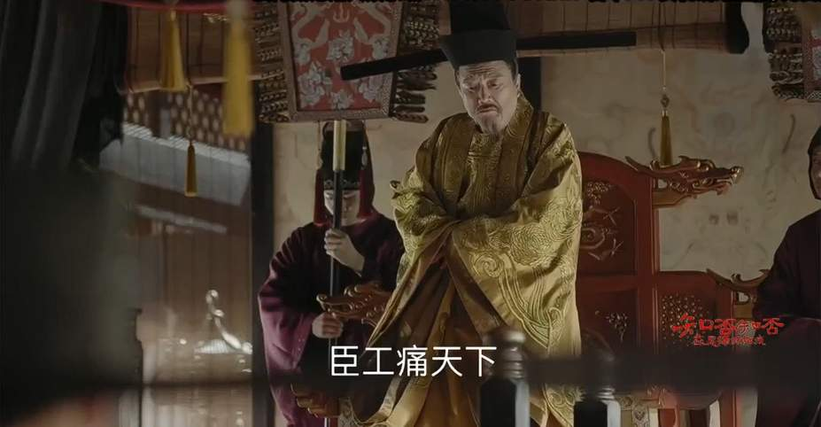
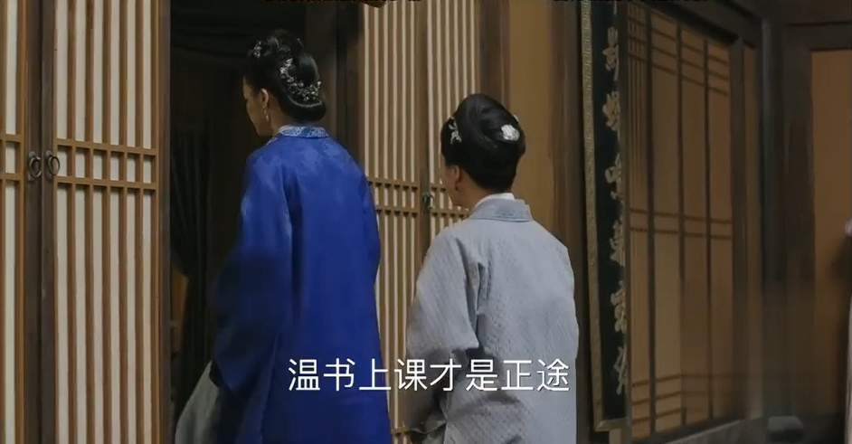
Meritocracy with Limits
Families invest in education
家族长期投入教育资源，希望子弟通过科举提升地位，一定程度上反映了考试制度对社会流动的作用。
Ideal officials care for people, maintain granaries, and judge fairly
好官不仅精通政务，更关心民生，如保障粮食储备、公正断案，这些行为被视为道德实践，而非单纯职责。

Slide 14
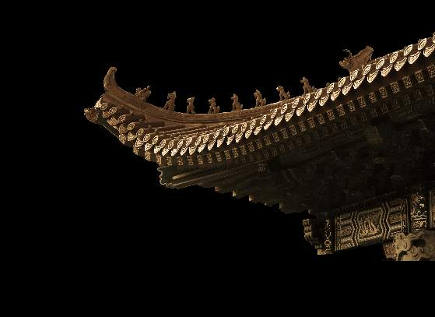




Family and State as One: Force and Flexibility
Characters navigate the military and court politics tension
剧中人物在军旅与朝堂间周旋，展现文武平衡的复杂性，反映传统治理中刚柔并济的智慧。
关键词
Aim to restore relationships and enforce rules
Family management mirrors bureaucratic governance
地方纠纷处理常结合法律条文与乡土习俗寻求双方接受的方案，更注重关系修复而非单纯惩罚。
家族内部的纪律管理与官僚体系运作相似，体现“家国同构”的理念。

Slide 15


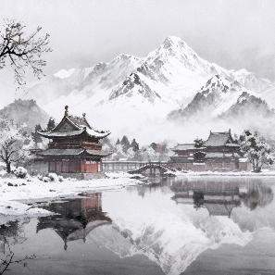

Debate on Learning as a Fair Ladder
Statement: "A test-based system creates a fair society."
Pro side: standardized exams reward effort and expand opportunity
Con side: resources, networks, and exclusions limit fairness

Slide 16
Conclusion
Culture as Lived Order

Slide 17


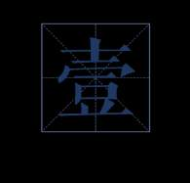
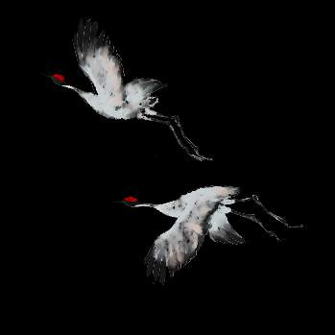
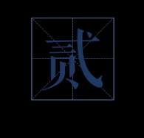
Enduring Appeal and Moral Realism
Three Intertwined Ideas Staged in the Drama
Culture as craft practiced through people, rooms, clothes, words, procedures

Slide 18

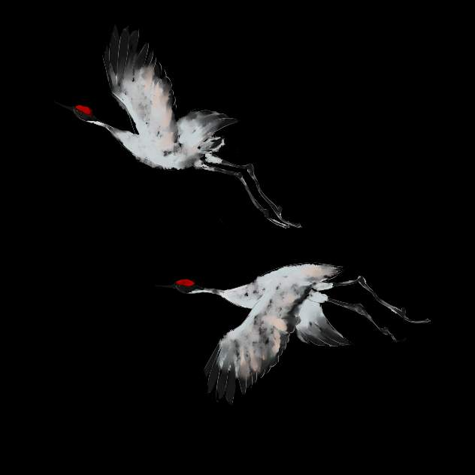
Thanks
for
Listening

