Slide 1
3. The totem（图腾） worship in the primitive society
According to some researches on the origin of Chinese zodiac, there were only twelve earliest surnames in ancient China, which were derived from the names of the twelve animals in the Chinese zodiac scheme. Here the twelve animals refer to the totems at ancient times and different surname tribes use different animals as their totems. Therefore, the twelve animals of Chinese zodiac was developed from the totems of ancient tribes

Slide 2
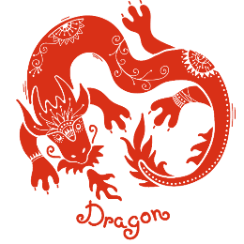
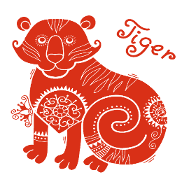
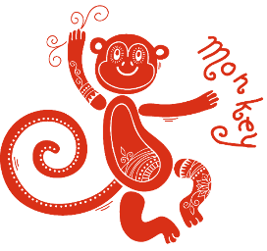
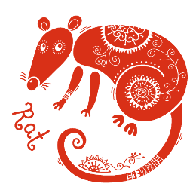
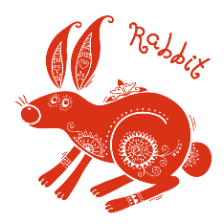
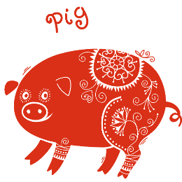
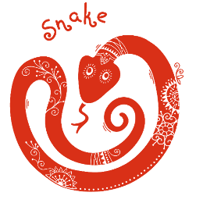
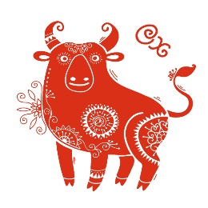
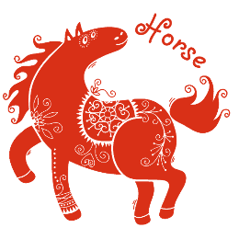
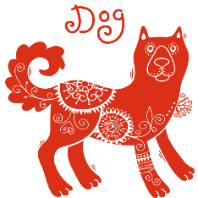
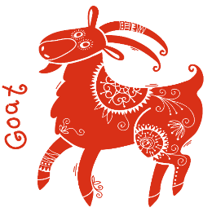
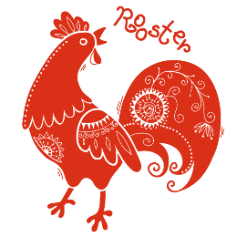
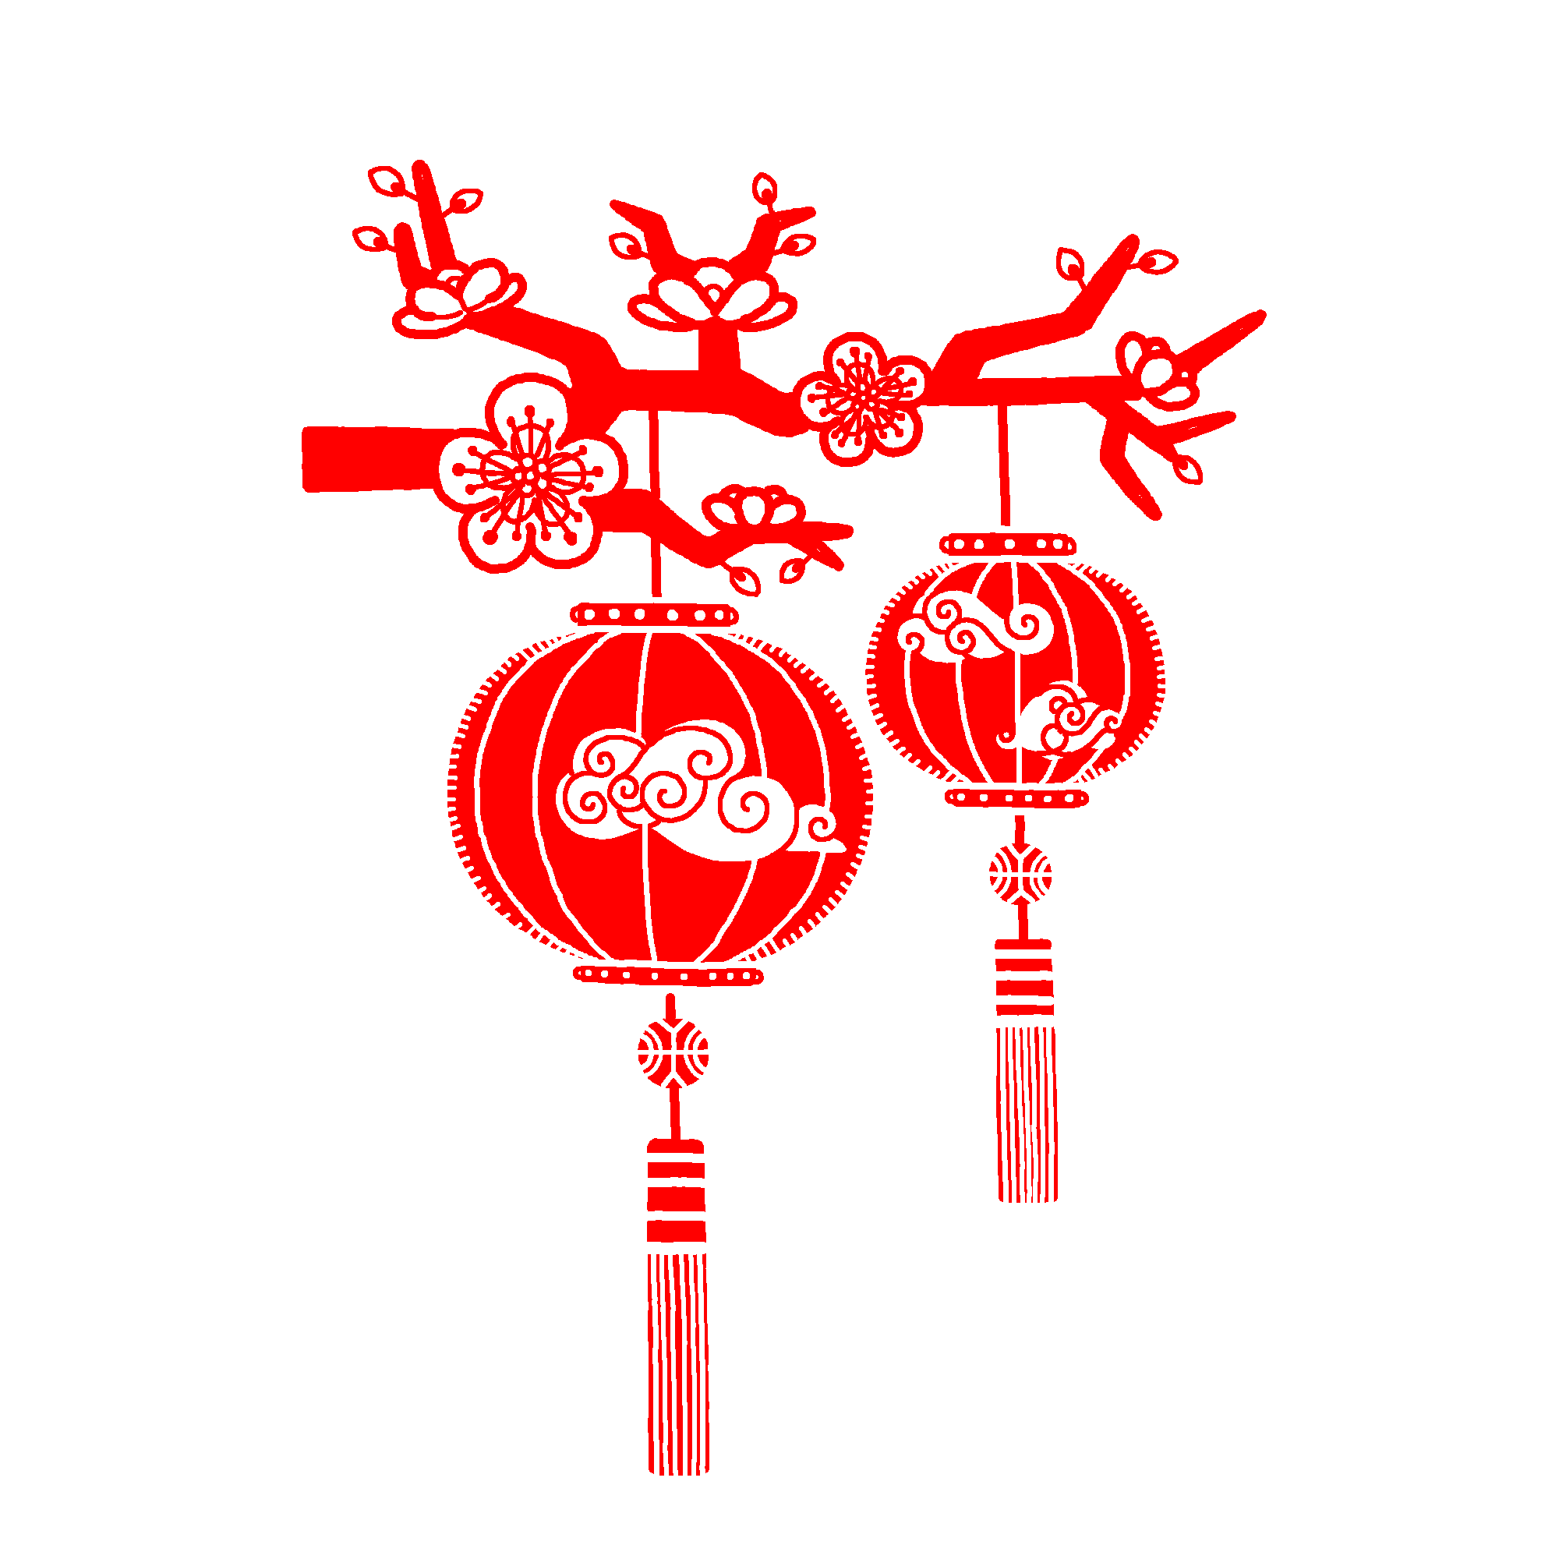





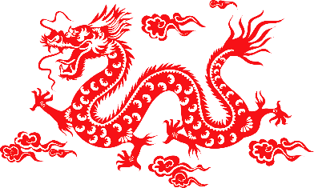

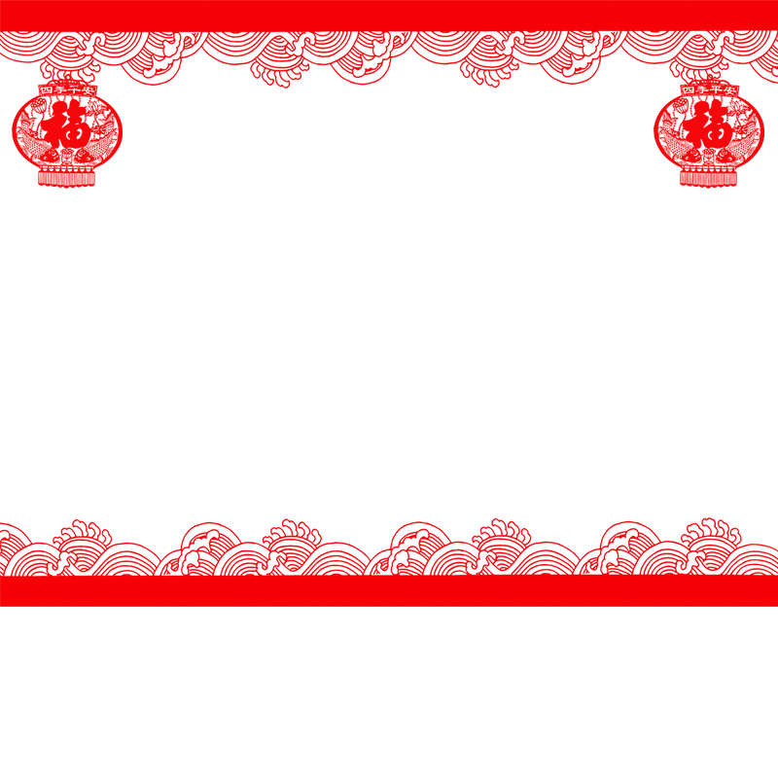

Ⅱ
Folk Culture and Belief

Slide 3
The zodiac sign can not only reveal one’s age, but also represent his or her personality, career prospects and way of life according to Chinese superstition.
According to superstitious belief in China, Zodiac animals are combined with the Five Elements that consist of Metal, Wood, Water, Fire and Earth, to tell one's destiny.

Slide 4
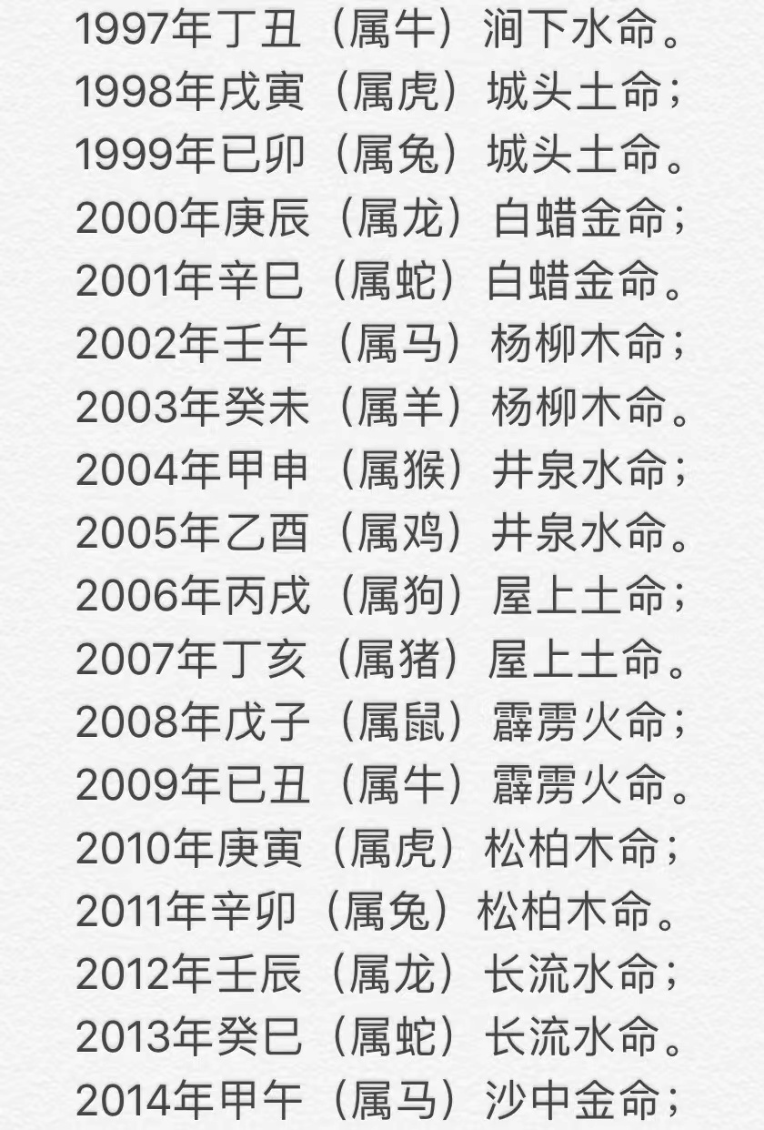
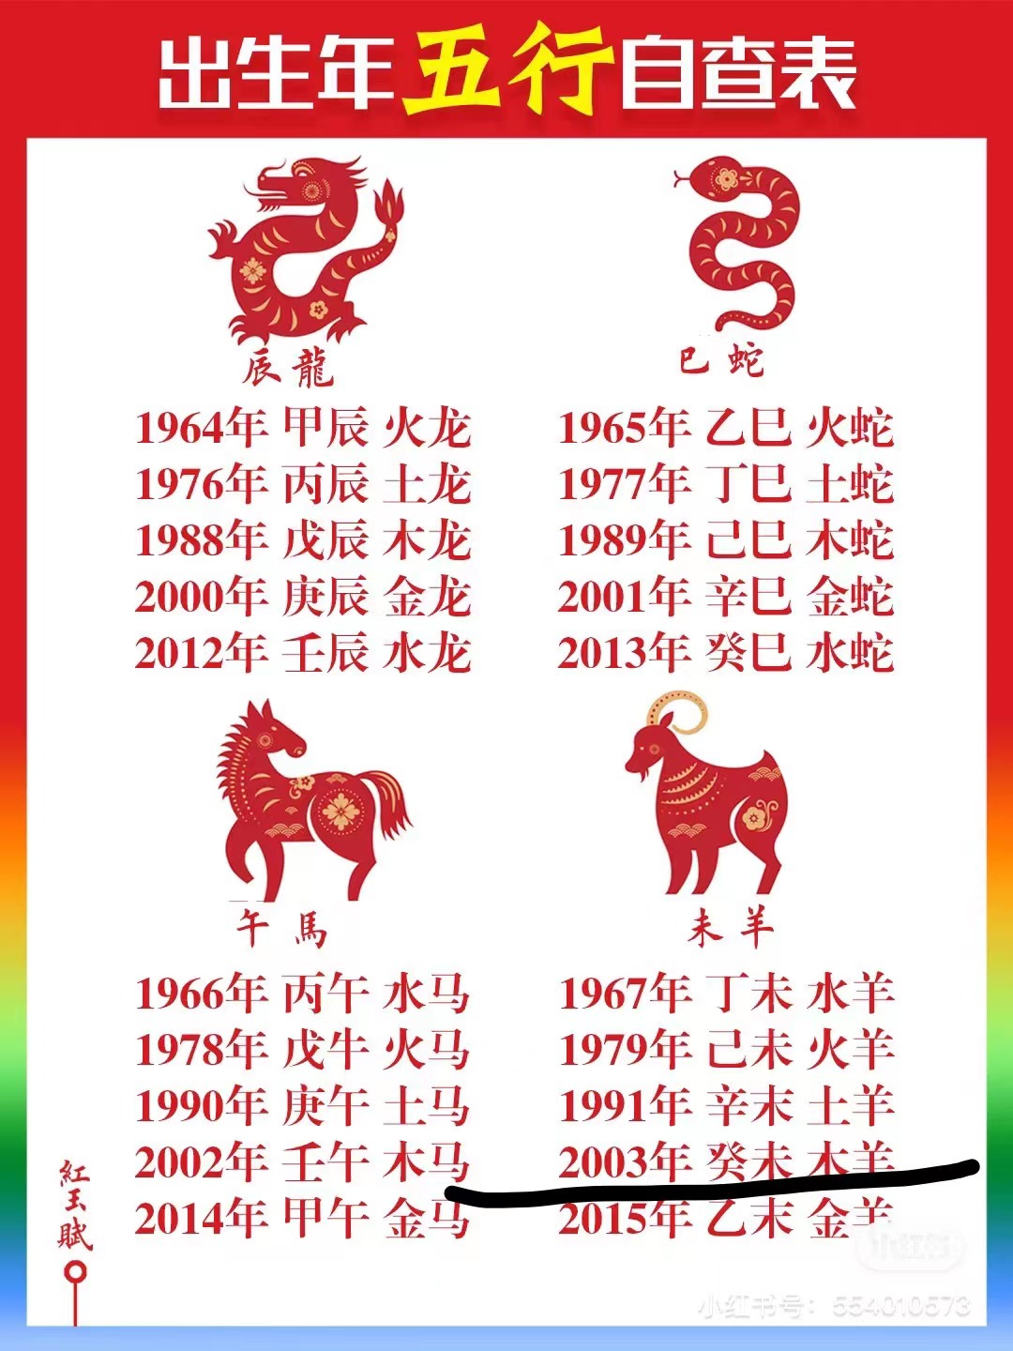
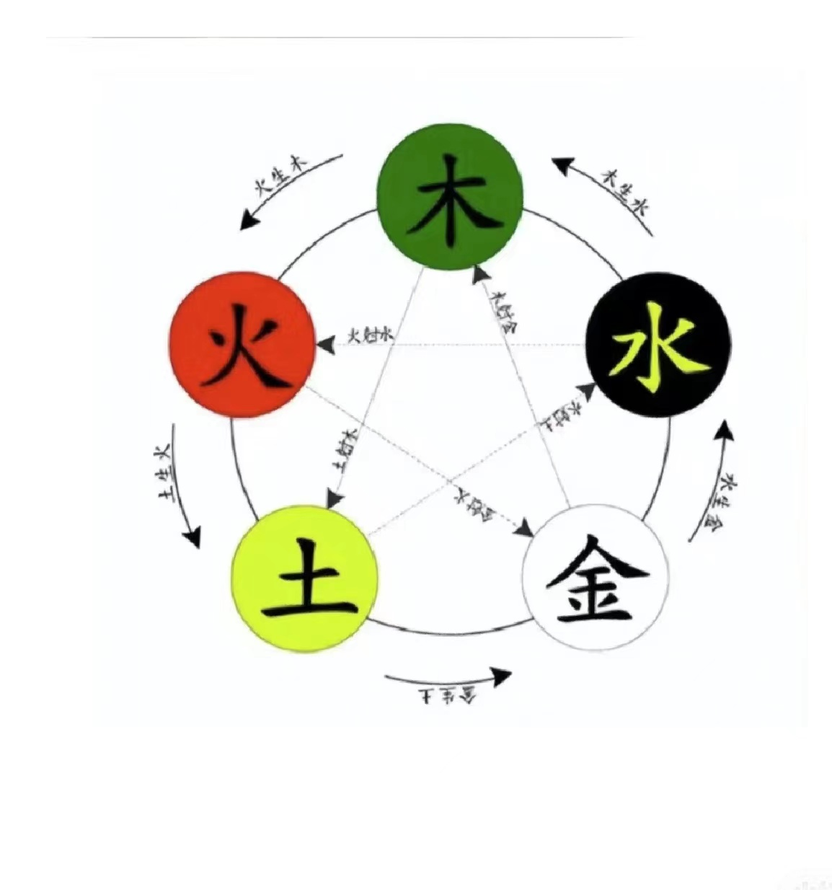

Slide 5
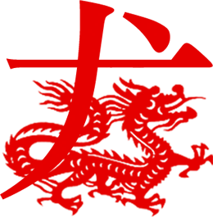
Besides, since the zodiac is determined by the year of birth, there are many implications of one’s birth year. For example, some zodiacal preferences prevail in Chinese population.

Slide 6
Moreover, Chinese people believe certain animals get on better than the others, so the zodiac has had a great impact on marriage as well.
And this is the reason why men and women would like to evaluate their Bazi（生辰八字）, the Eight Characters, before they get married.

Slide 7
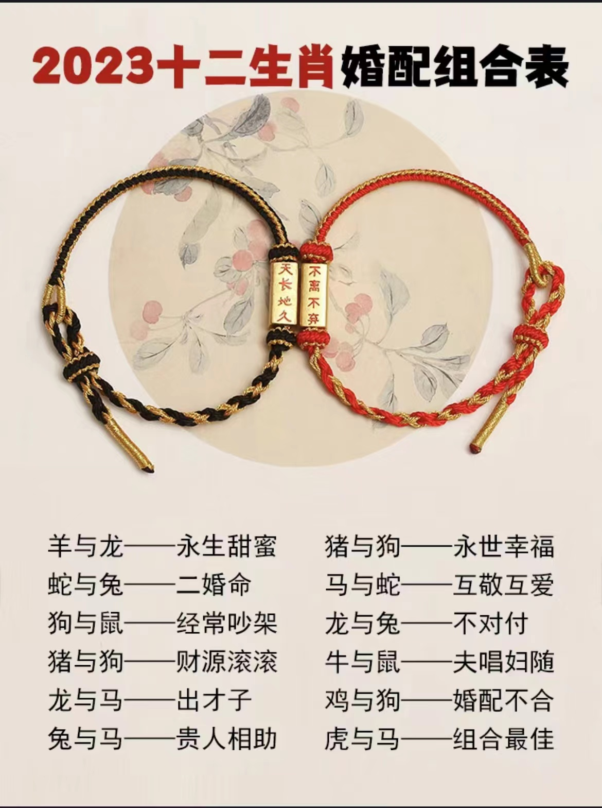
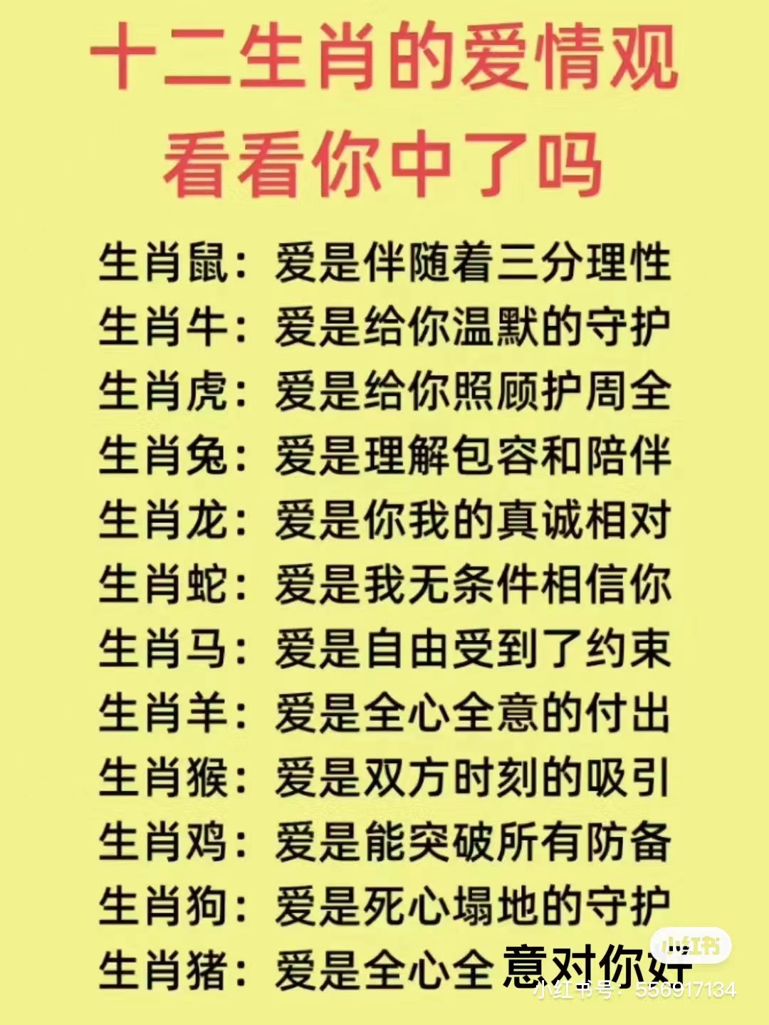

Slide 8
Ⅲ
Conclusion

Slide 9
The traditional Chinese astrology
The five elements theory
Yin and Yang system
Heavenly Stems and Earthly Branches system
But people have to consider zodiac in a rational and scientific way. Perhaps the zodiac may help us to understand what we’re given, but it cannot determine our destiny. We should treat it as the precious cultural heritage and explore the profound culture and historical traces embodied in it

Slide 10

Thanks for your listening

