Slide 1
The Jin Ping Mei
China's First Novel

Slide 2
What is the Jin Ping Mei?
The Jin Ping Mei, or The Plum in the Golden Vase or The Golden Lotus is China's first true independent novel.
Has many controversies surrounding it:
  Is it a classic or erotica?
  A satire and commentary on the political and social state of China at the time?
  Who is its author?

Slide 3
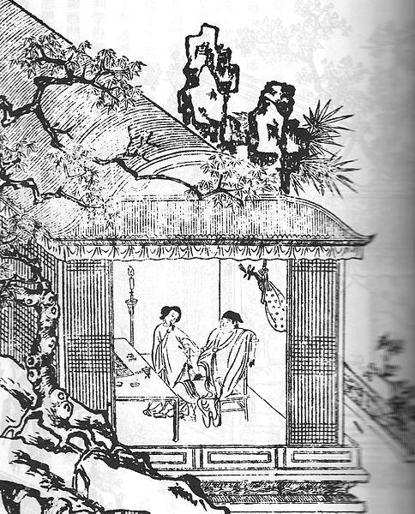
In a name
The Jin Ping Mei takes its name from the three central female characters :
Pan Jinlian (潘金蓮, whose given name means "Golden Lotus")
Li Ping'er (李瓶兒, given name literally means, "Little Vase"), a concubine of Ximen Qing
Pang Chunmei (龐春梅, "Spring plum blossoms"), a young maid who rose to power within the family
Because of how this title is built, there is no direct translation.
Ximen and Golden Lotus Illustration Ca. 17th century.

Slide 4
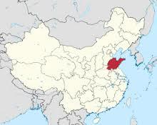
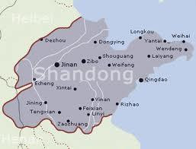
The Author
Unknown author
Calls himself Lanling Xiaoxiao Sheng (蘭陵笑笑生), the "Scoffing Scholar of Lanling"
Came from what is now called the Shandong Province if he was really from Lanling(Whaley 1947)

Slide 5
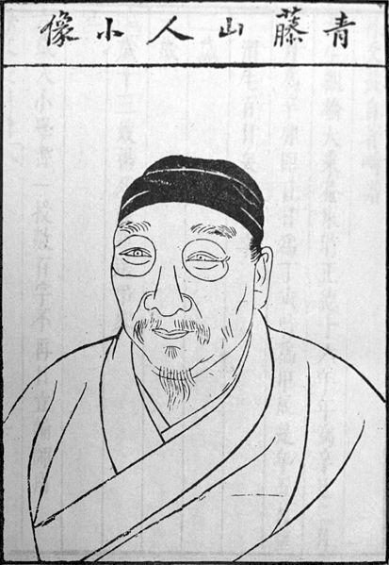
Theories of Authorship
Main theory is that he was Xu Wei(pictured left), claiming that their poetry styles match(Whaley 1947).
Others state he was an unknown author
Could have been one of many authors who wrote and passed their works to one another

Slide 6
The Plot
Simply put, this is the story of Ximen Qing's family and how it falls apart in one hundred chapters.
The Jin Ping Mei describes in "naturalistic detail the life of the family of a well-to-do businessman, Ximen Qing, who has acquired his wealth largely through dishonest means and who devotes himself to the pursuit of carnal pleasure and heavy drinking." To these ends he acquires six wives and numerous maidservants and concubines. Not even satisfied with these women, he spends most of his time seeking the pleasures of entertainment areas.
For much of the book, the "action" in the family centers on the rivalry of his wives Pan Jinlian and Li Ping'er . They are both competing for the affection of their husband who, on the other hand, is out on the town with his friends almost every day. He should be more concerned with his family and having more kids, but, he is only interested in having a good time.

Slide 7
The Plot
Ximen and his fifth wife, Pan Jinlian, whom he has acquired by poisoning her first husband, nearly succeed in corrupting the entire household and eventually lead to its entire downfall.
Ximen ends up poisoning himself by using too many drugs at the age of thirty-three.
The first wife, however, remains virtuous and in the end bears a son who becomes a Buddhist monk to atone for his father’s sins. She gives up her son to a monastery and adopts one of the other characters as Ximen's "son". She lives to be 69 years old.
Little Vase slowly bleeds to death after her son dies.
Golden Lotus meets up with her first husband's brother. He is out to avenge his brother's death and does so by proposing to marry her and then kills her.
(Britannica)

Slide 8
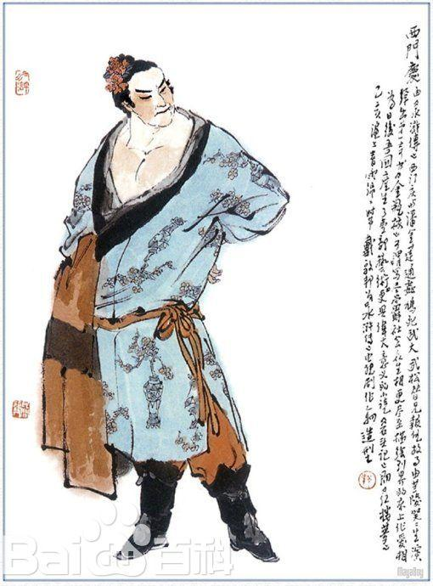
Characters
Ximen Qing (西門慶 ) He is a rich, ex military official turned merchant. He owns a pharmaceutical warehouse that seems to be very lucrative that was inherited from his father. At first, he holds a minor political post and later he is promoted. If he had a personal motto in life, it would probably be "Wine Women and Song". He and his good friends are constantly out visiting the town's "entertainment" areas. He chose women who would bring him money, such as the third and fourth wives who were very rich widows. There have been many portrayals of his doings in film, art, and literature.

Slide 9
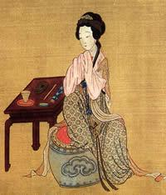
Characters
Wu Yueh Niang “Moon Lady”. She is Ximen's first wife and she is not a very "strong" person. As long as there is peace in the house, she is happy.
Pan Jinlian (潘金蓮)“Golden Lotus”. For most of the story she is Ximen's fifth wife. She is constantly fighting with the sixth wife. She is the "Jin" of the title.
Li Ping'er (李瓶兒) "Little Vase". She is Ximen Qing's sixth wife, and she is his favorite. She is also the mother of his only son. She is the "Ping" (or "Vase") of the title. This name may be in relation to her beautiful body shape.
Pang Chunmei (龐春梅,) "Spring plum blossoms”. She is the servant, and partner in crime, of Pan Jinlian. She is the "Mei" (or "plum")of the title. Her name alludes to the idea of carnal sexuality.
Over 70 pages worth of minor characters that the author keeps in line

Slide 10
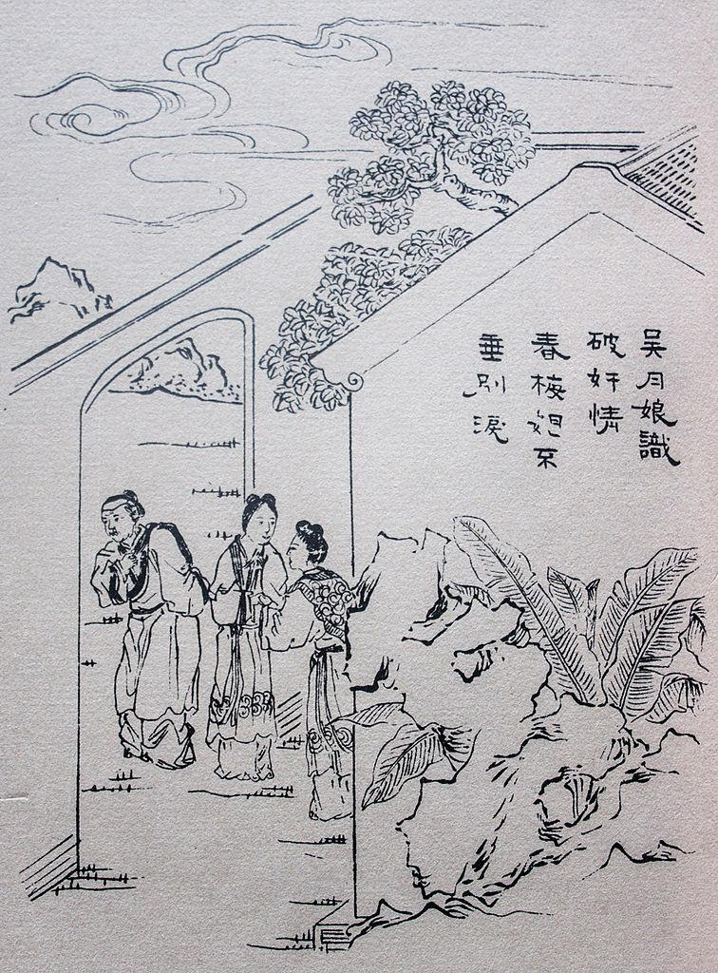
Historical Background
The Novel
This novel was probably written during the middle of Wangli's reign, between 1573 and 1620 AD.
This book, or parts of it at least,is first mentioned, in the 1590's.
The first mention of the entire book comes somewhere around 1606.
The Golden Lotus was first released in 1610 as a wood block stamped form.
Earlier versions where handwritten.

Slide 11
Historical Background
Ming Dynasty
The Mid Ming Dynasty was full of social and moral issues.
Ming Dynasty lasted from 1368-1644
The officials and merchants were all too often corrupt and power hungry.
Founded by Zhu Yuanzhang, a man of humble origins who later assumed the name Emperor Hongwu.
Possibly 62 million people in China
Saw an expansion of western trade, including firearms and Jesuit Missionaries
The Ming became known as not only one of the most stable dynasties, but also one of the most autocratic(Britannica: Ming Dynasty).

Slide 12
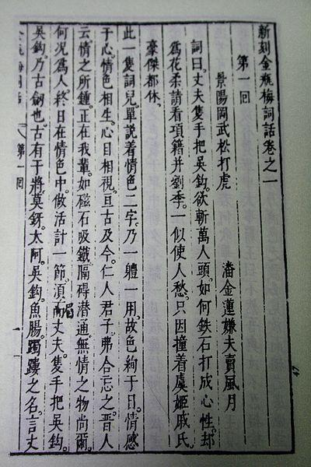
Writing Style: Vernacular
Written in the Vernacular, meaning The Jin Ping Mei was written in the common spoken language of the people instead of the formal
This made it available to many more people
First work to be published as such

Slide 13
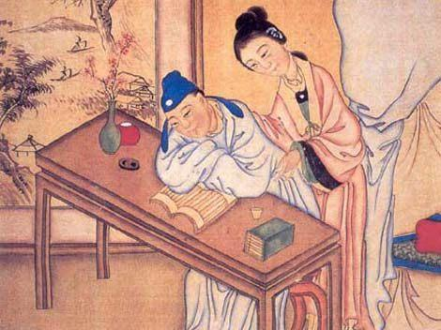
Writing Style:Poetry
Written as a combination of dialogue, prose, and poetry.
The poetry was used to beautify descriptions of situations and things.
Classical Chinese poetry forms were used, such as Shi

Slide 14
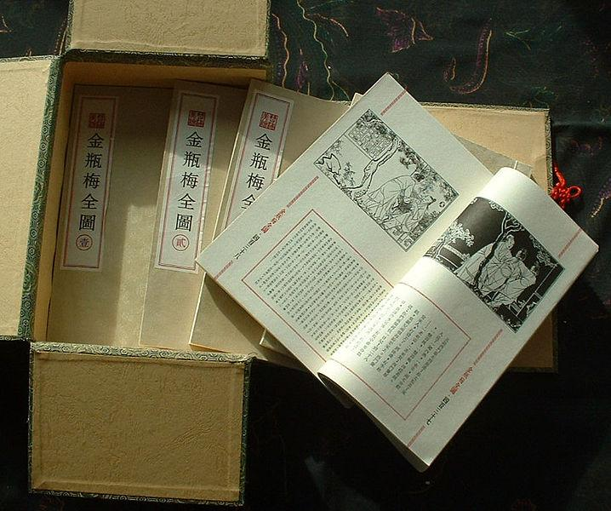
Example of the Poetry
Troubled in her sorrowing heart,
she murmurs to herself,
"This good affinity has turned out
to be a bad affinity."¹
In retrospect she rails against
that "willow" in the quarter;²
Though shamefaced to confront
the "lotus" of the Jade Well.
Only because his spring dalliance
has been carelessly revealed,
Have the phoenix mates been forced
to go their separate ways.
Who is able to dip up the waters
of the River of Heaven,
That they may wash their former sins
completely away?
Standing screens and brocaded windbreaks like Shih
Ch'ung's were set up;
Warming drapes of oiled paper sprigged with plum
blossoms were suspended.
Braziers were filled with animal-shaped briquettes;
All the appurtenances of a feast were duly arrayed.

Slide 15
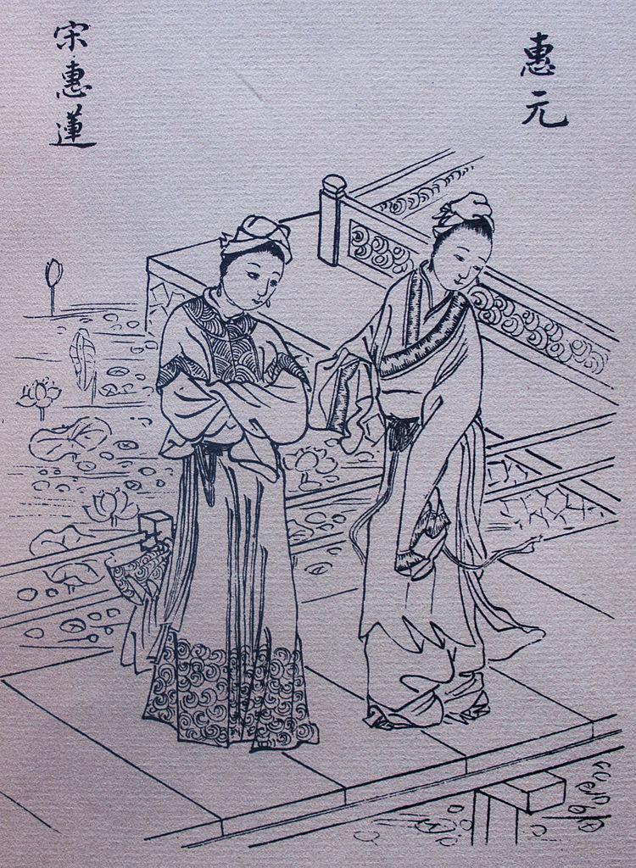
Examples of the Poetry
Hsi-men Ch'ing ordered a servant to see him to the door and the front gate was closed for the night. Wife and concubines then went their separate ways, but Hsi-men Ch'ing spent another night with Yüeh-niang in the master suite. There is a poem that testifies to this:
A marriage affinity bound with red cord
is not to be doubted;
Having had to burn their door-bars for fuel,
they are of one mind.
Like fish and water, perfectly suited,
from this time forth;
Their mutual feelings will surely sustain
a lifetime of bliss.
Many one or two line poems to describe feelings:
Amid clustering blossoms and clinging brocade,
Laughing and joking at each other's expense.

Slide 16
Controversies: Allegory?
Some have said that Ximen represents the emperor and his wives are the squabbling ministers. It is more likely that it offers commentary of lifestyles and social issues as a whole that the author was not proud of.
It also provides insight into how women of the day were viewed and treated. The women characters have various aspects. Some are strong and willful, while others are weak and submissive. Eventually all of them submit to the will of the man.
No matter how one reads this work, it can be seen that the author intended for social satire to help the audience gain an appreciation for the problems of the day.
An example of this satire is found in the wives gift giving. While this giving was a social norm, the copious amounts in which the wives give is a commentary on the socially elite of the day and their wasteful ways.
The author is also showing how social manipulation was common, as such gifts where used to control one another in the government(Vučinić-Nešković).

Slide 17
Controversies: A Classic or Pornographic?
The prose is full of classic poetry, beautifully crafted satire, and allegory,
According to this novel, in this society, explicit sex seems to be a perfectly acceptable topic of everyday conversations.
Author Li Yu called it one of the Four Marvelous Masterpieces (四大奇書), along with along with Romance of the Three Kingdoms, Water Margin, and Journey to the West.
Acclaimed Qing critic Zhang Zhupo described it as "the most incredible book existing under the heavens" (第一奇書)(as quoted in He 2007),
In the 20th century, influential author Lu Xun also held it in great esteem(He 2007).
Ximen himself has six wives and concubines.
The work has seventy-one explicit encounters often portrayed through poetry.
The sexual encounters are described with the same attention to detail that every other scene is. (The first English translator, felt so uncomfortable with all the very explicit sex scenes that he translated those parts into Latin. )

Slide 18
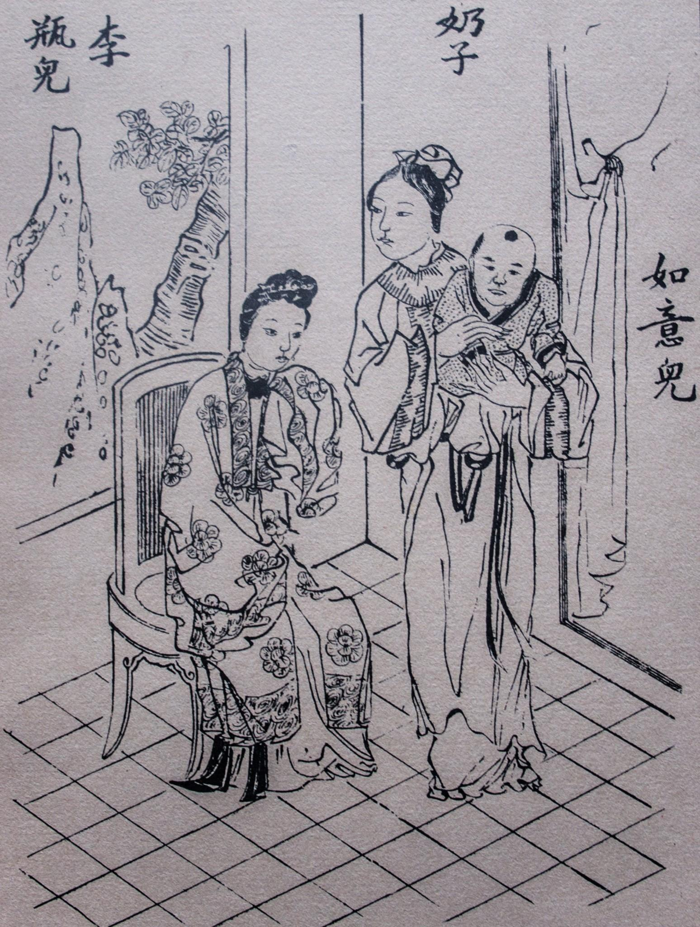
Conclusion
The Jin Ping Mei is China's first novel
Tragic plot teaching that people are rewarded as they deserve
Written in poetry and the vernacular language of the time
Unknown authorship
Possible social allegory
A classic work

Slide 19
References
Chang, Kang-I & Owen, Stephen. "The Cambridge History of Chinese Literature Volume Two From 1375". New York, Cambridge University Press, 2010.
Ping Chen. Modern Chinese: history and sociolinguistics (illustrated ed.). Cambridge University Press. 1999
Norman, Jerry. Chinese. Cambridge: Cambridge University Press. 1988.
Ramsey, S. Robert. The Languages of China. Princeton, NJ: Princeton University Press. 1987.
Luo, Jing. Over a Cup of Tea: An Introduction to Chinese Life and Culture. University Press of America. 2004.
Roy, David Tod.Translator. The Plum in the Golden Vase or, Chin P'ing Mei: Volume Two: The Rivals. Princeton University Press. 2001.
Encyclopædia Britannica. "Jinpingmei." www.britannica.com. Web. 9 April 2013
Encyclopædia Britannica. "Ming Dynasty." www.britannica.com. Web. 9 April 2013
Cultural China. "Jin Ping Mei: The Fifth Great Classic or Just A Twisted Story?" history.cultural-china.com. Web. 8 April 2013
Jianjun He. "Burning Incense at Night: A Reading of Wu Yueniang in 'Jin Ping Mei'".Chinese Literature: Essays, Articles, Reviews (CLEAR) , Vol. 29, (Dec., 2007).
Vesna Vučinić-Nešković. "Social Exchange and Power Relations in Jin Ping Mei: An Analysis of a Classic Chinese Novel." Antropologija 12. 2012.
Images from Wiki Commons

