Slide 1
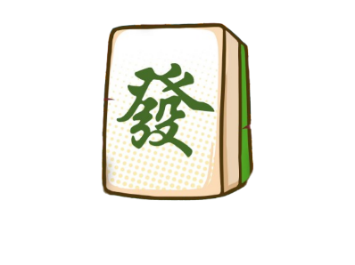
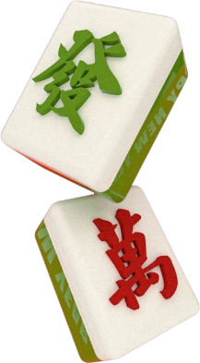

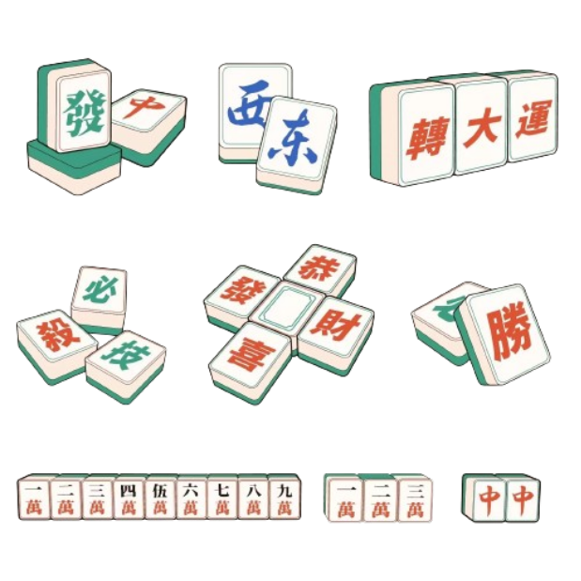
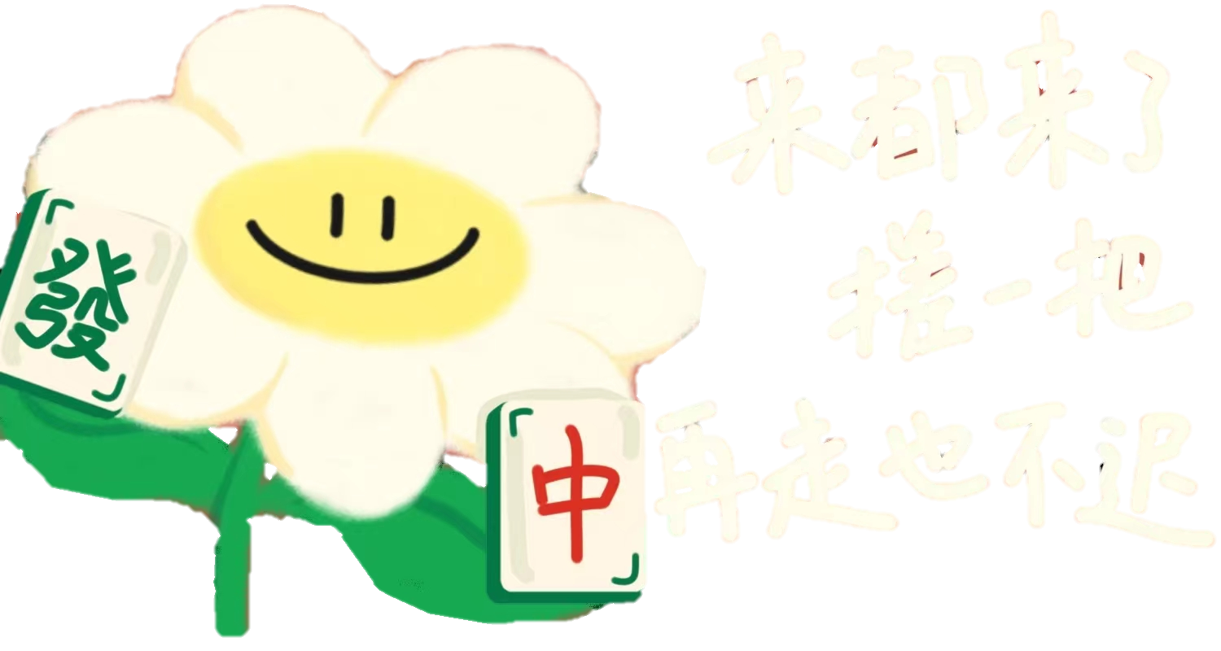

Mahjong Culture
Director: Zhou Yuzhen

Slide 2

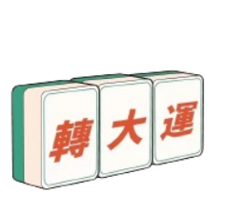

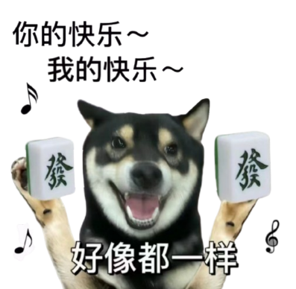


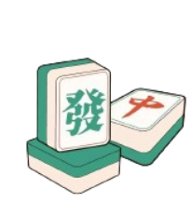
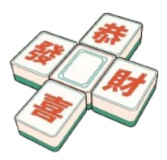

CONTENTS
02
Rules
01
Origin
04
Influence
03
Wisdom in Mahjong

Slide 3


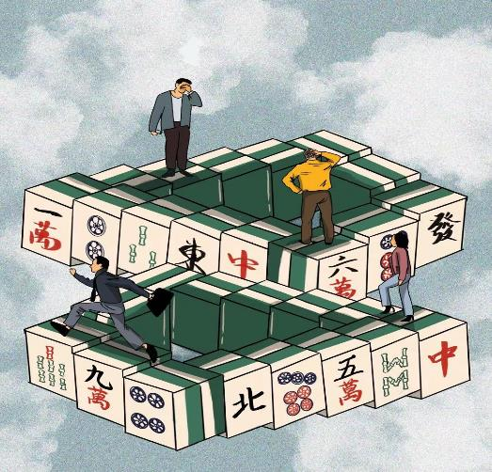

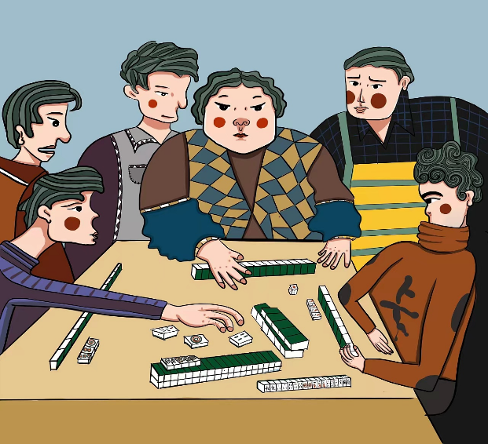

Gang 杠 gàng
杠上开花
Hu 胡 hú
01
Origin
Chi 吃
Hu 胡 hú
Chi 吃 chī
自摸
Peng 碰pèng
Gang

Slide 4
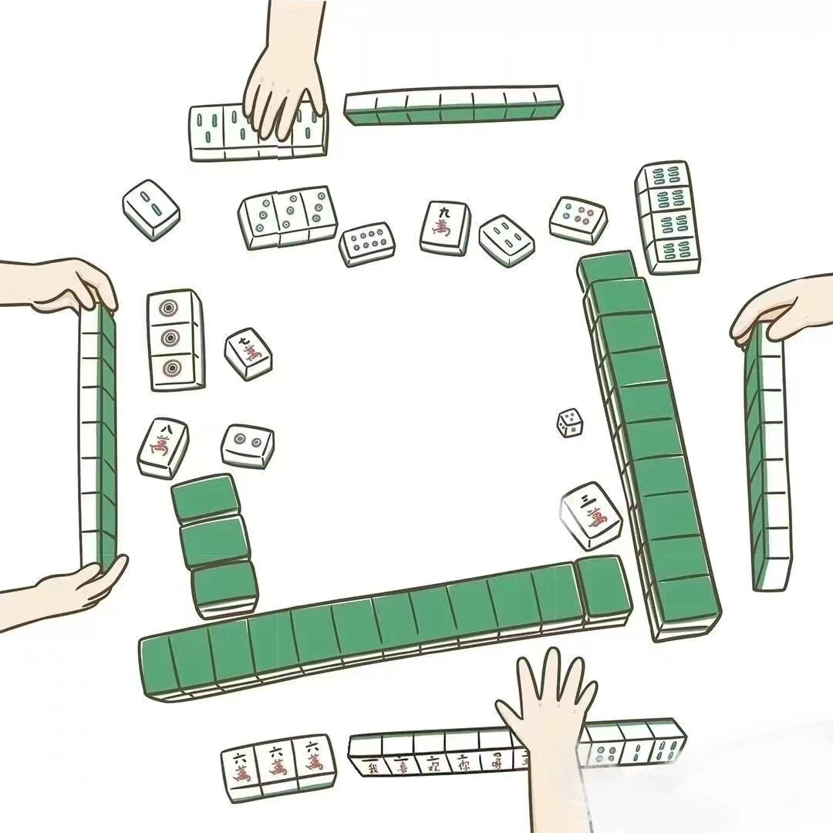
Origin
In China, the game was originally called “Ma Que”（麻雀）, meaning sparrow—which is still used in some languages in southern China. It is said that the clacking of tiles during shuffling resembles the chattering of sparrows.

Slide 5
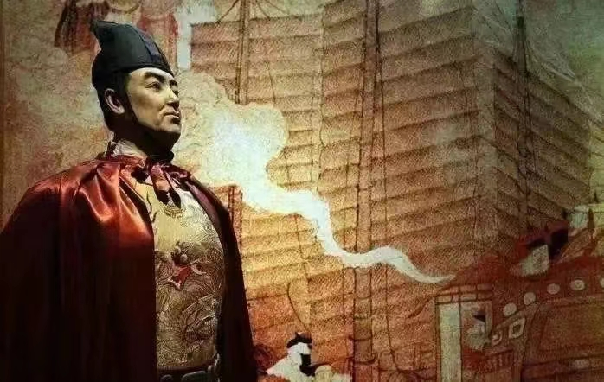
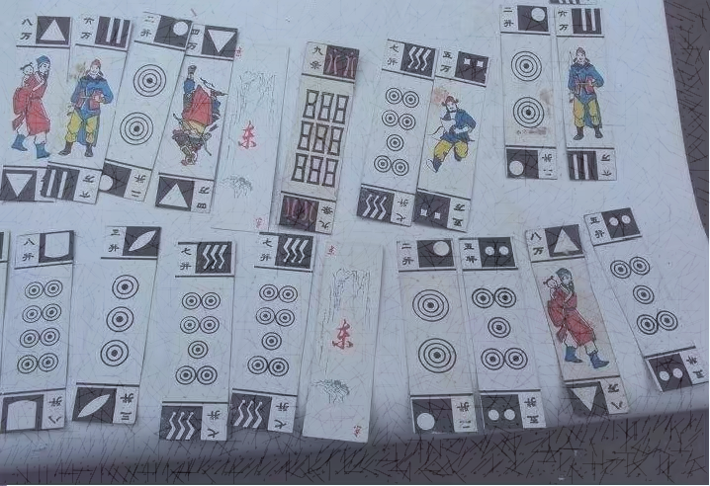
Origin
Zheng He's Voyage Theory
When Zheng He went to the West, the entire fleet lacked entertainment equipment, while the voyage was long and boring. In order to stabilize the army's mind, and avoid quarrels, Zheng He invented a bamboo card for entertainment.
Food-Protection Cards Theory
There was a royal granary in Taicang where rice was stored. Because of the constant problem of birds, the granary director in order to encourage the officers and soldiers to catch birds, they made a bamboo chip to calculate the number of sparrows hit by officers and soldiers, and later slowly evolved into an entertainment tool.

Slide 6



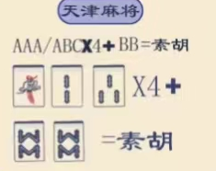
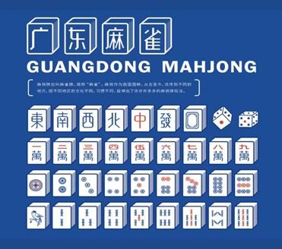
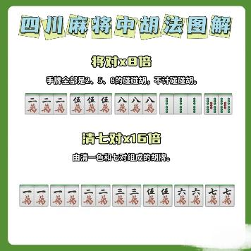
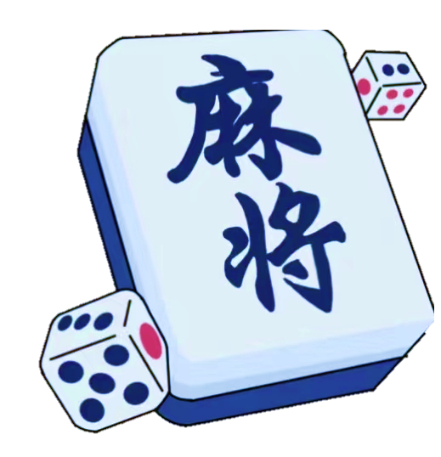
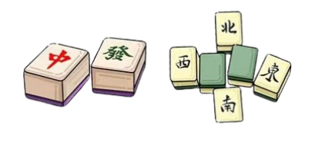

Mahjong of various places
Tianjin mahjong
Guangdong mahjong
Sichuan mahjong

Slide 7
Gang 杠 gàng
杠上开花
Hu 胡 hú
02
Rules
Chi 吃
Hu 胡 hú
Chi 吃 chī
自摸
Peng 碰pèng
Gang

Slide 8

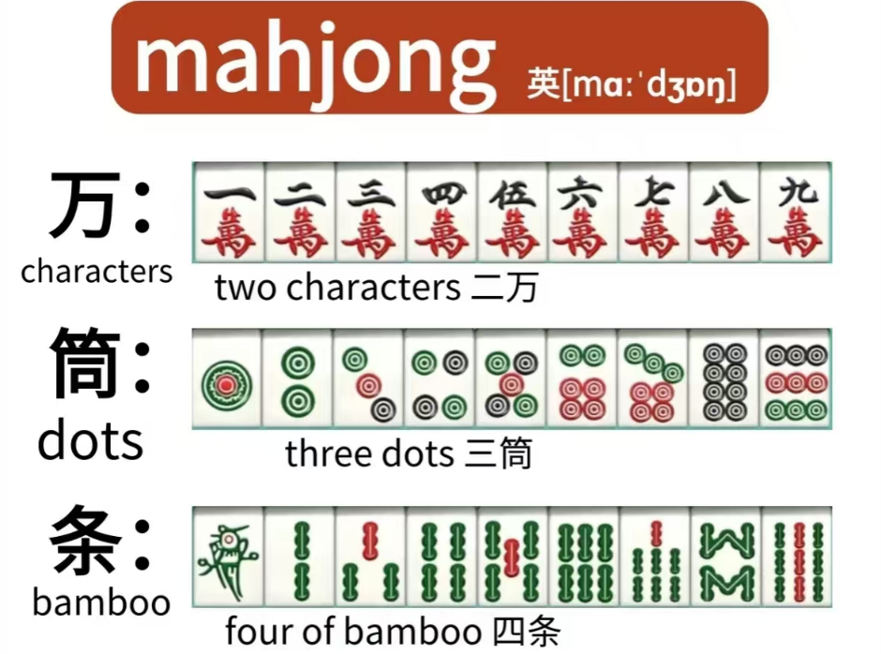
Mahjong Tiles
3 numbered groups are known as “Suits”. Each suit is numbered from 1 to 9.

Slide 9
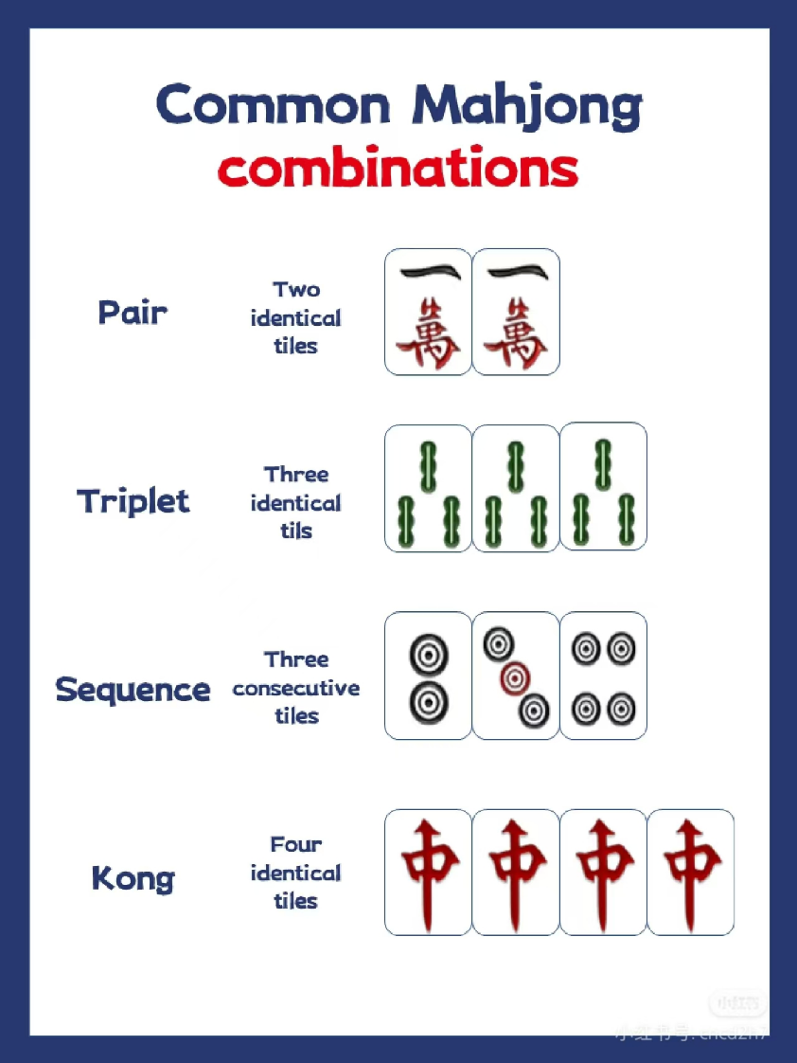
Types of Sets
对子
刻子
顺子
杠

Slide 10
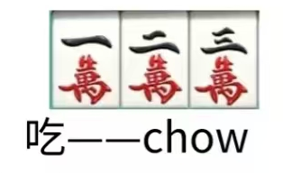
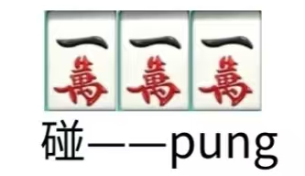
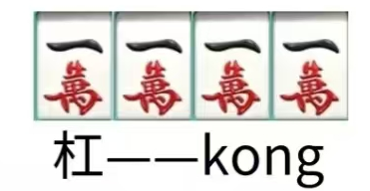
Types of Sets

Slide 11
The basic winning hand 平胡
The pair (orange) has to be made of identical tiles (AA).
The groups (grey) can be either made of identical tiles (AAA), or ordered ones (ABC).

Slide 12
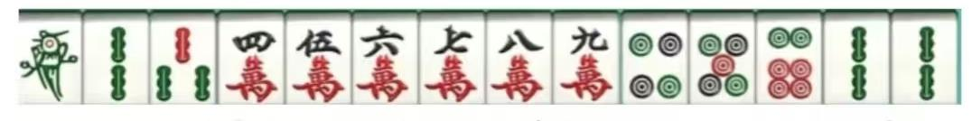


You can Hu with other’s discarded tile, or the tile you draw that completes your hand.
MahJong!
胡啦！

Slide 13
Changsha Mahjong
The basic winning hand 平胡
The pair (orange) has to be made of a pair of 2s, 5s, or 8s.
The groups (grey) can be either made of identical tiles (AAA), or ordered ones (ABC).

Slide 14
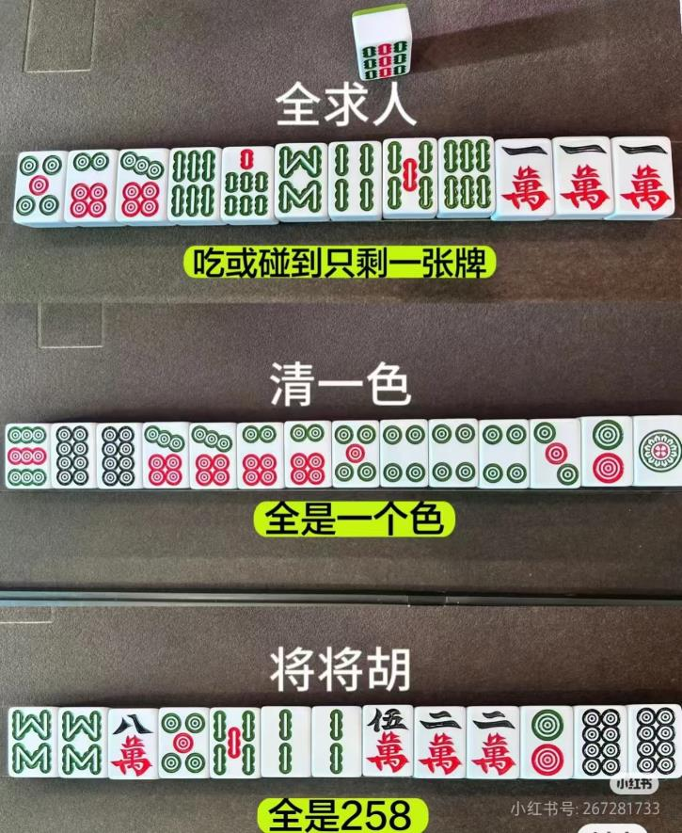
Special Winning Hands
The player has melded sets through Chow or Pung and is waiting for the last tile to win.
The hand consists of tiles from only one suit (dots, bamboos, or characters).
All tiles in the hand are 2s,5s,or 8s.

Slide 15
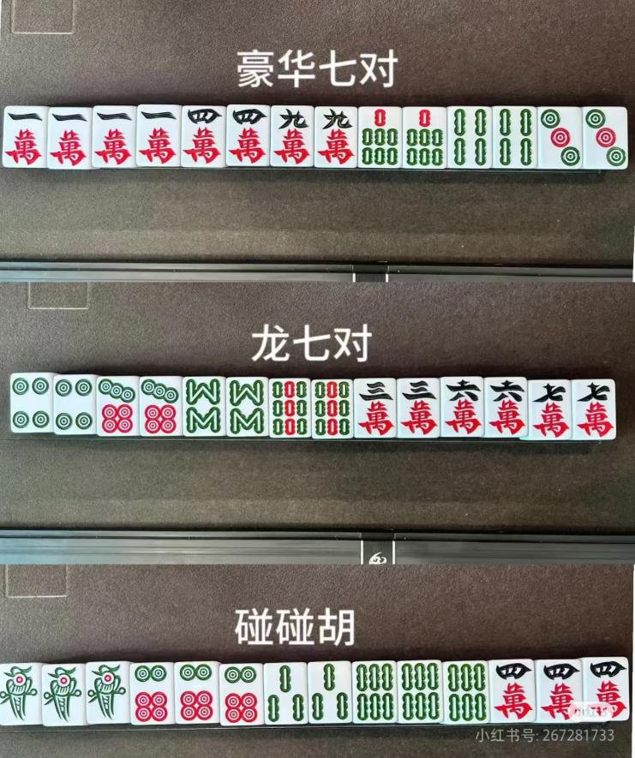
Special Winning Hands
The hand contains any five pairs of tiles and one set of four identical tiles.
The hand is composed of seven pairs.
This hand consists entirely of Pungs and a pair. There are no Chows (sequences) in this hand.
These are all Big Win multiplied by 2.

Slide 16
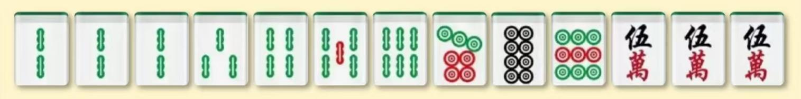
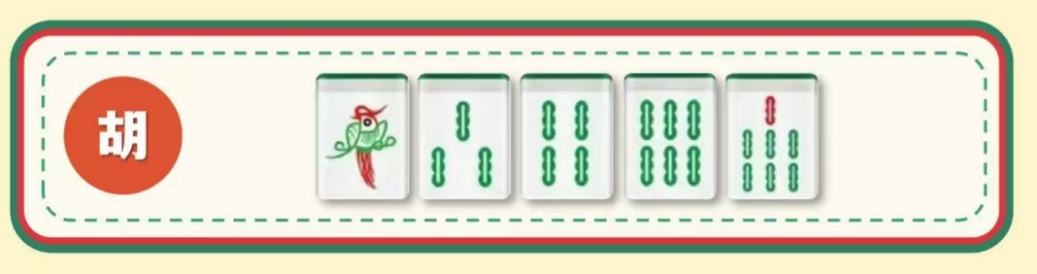
Game Time
Which tiles can help complete the winning hand?

Slide 17
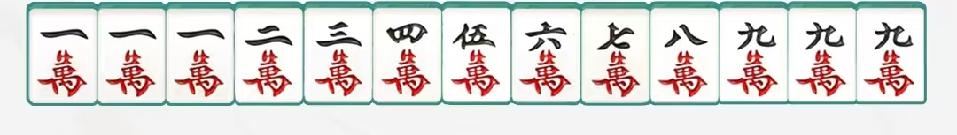
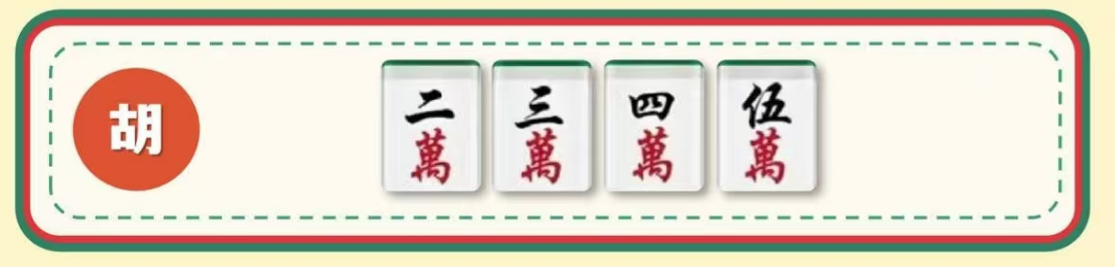
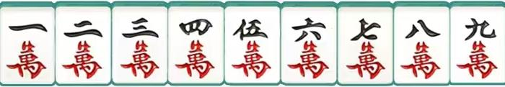
Game Time
Which tiles can help complete the winning hand?
Nine Gates 九莲宝灯

Slide 18

Gang 杠 gàng
杠上开花
Hu 胡 hú
03
Wisdom in Mahjong
Chi 吃
Hu 胡 hú
Chi 吃 chī
自摸
Peng 碰pèng
Gang

Slide 19
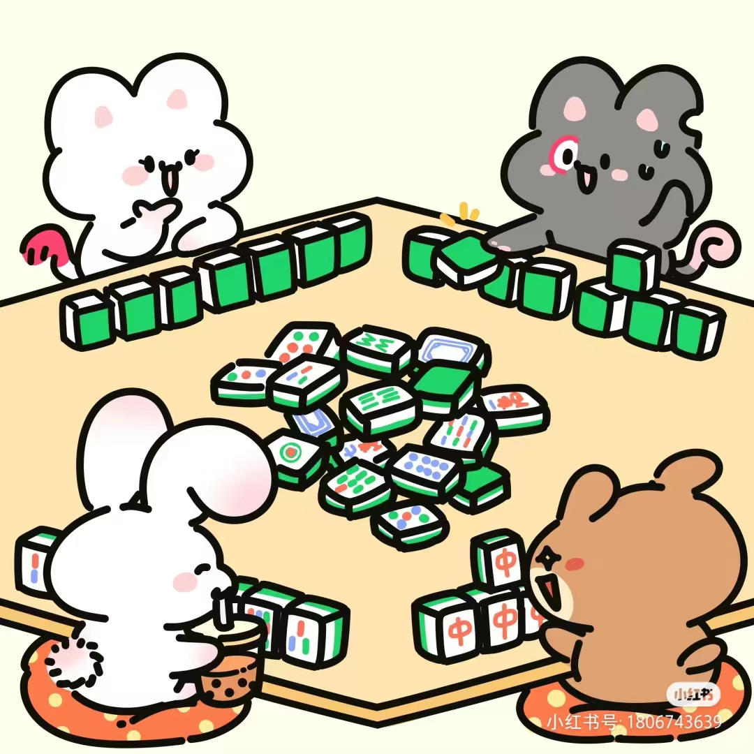
Chairman Mao once said: “China has three contributions towards the world: traditional Chinese medicine, A Dream in Red Mansions written by Cao Xueqin, and mahjong”

Slide 20
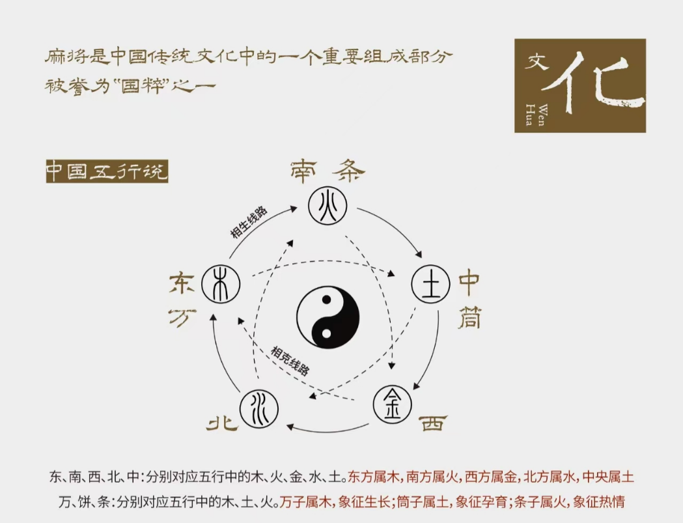
Five Elements Theory
Ancient Chinese philosophers believe that the world is made up of metal, wood, water, fire, and earth, five of the most basic materials.

Slide 21
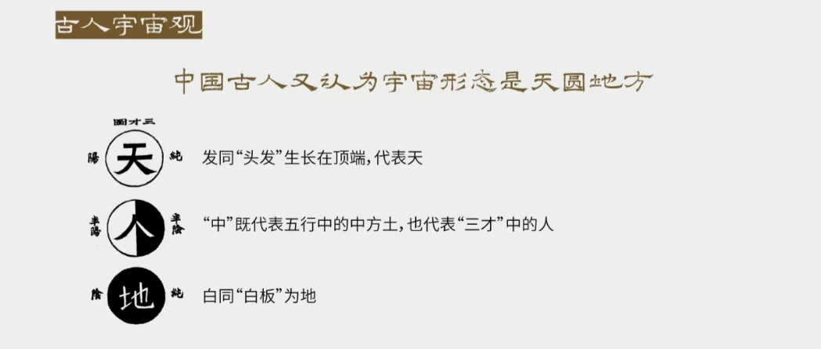
Cosmology View
“Zhong” represents not only the earth in the Five Elements, but also the Man in the “Three Talents”.
（三才：Heaven “ 天 ”, Earth “地” and Man “人”）
The ancient Chinese had the thought that the sky is round and the ground is square.

Slide 22
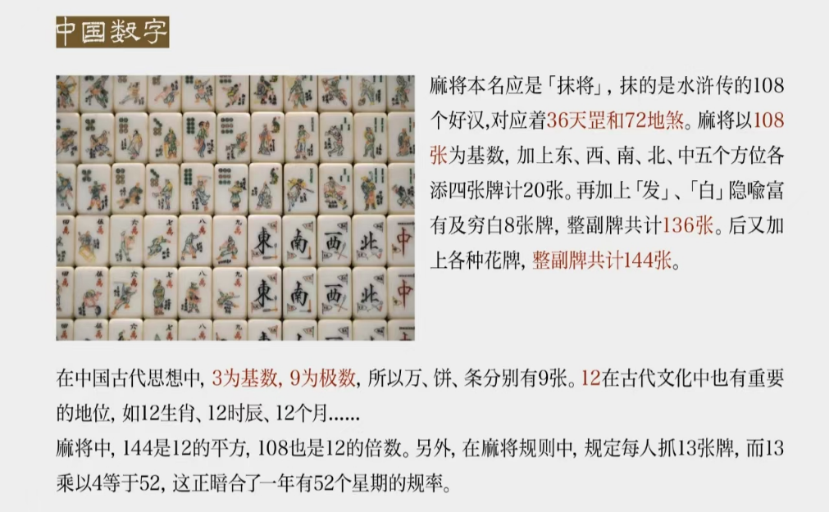
Chinese Numbers
The 36 dots in the mahjong tiles represent the 36 tiangang（36天罡）, while the 72 bamboo and the characters together symbolize the 72 earth devil（72地煞）. With a total of 108 main tiles, they correspond to cultural elements such as the 108 Generals（108将） of Water Margin and the 108 Buddhist prayer beads（佛珠）, reflecting the ancients’ reverence for the universe and their exploration of natural laws.

Slide 23
Chinese Numbers
In ancient Chinese thought, 3 is the cardinal number（基数） and 9 is the polar number（极数）, so there are 9 pieces of 3 suits, “wan”, “tong” and “tiao” respectively.
In the mahjong rules, it is stipulated that each person catches 13 cards, and 13 multiplies 4 is 52, which is the same as the rule of 52 weeks a year.

Slide 24
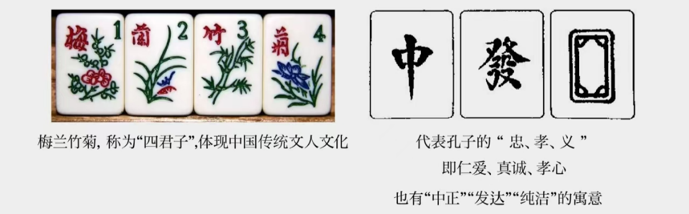
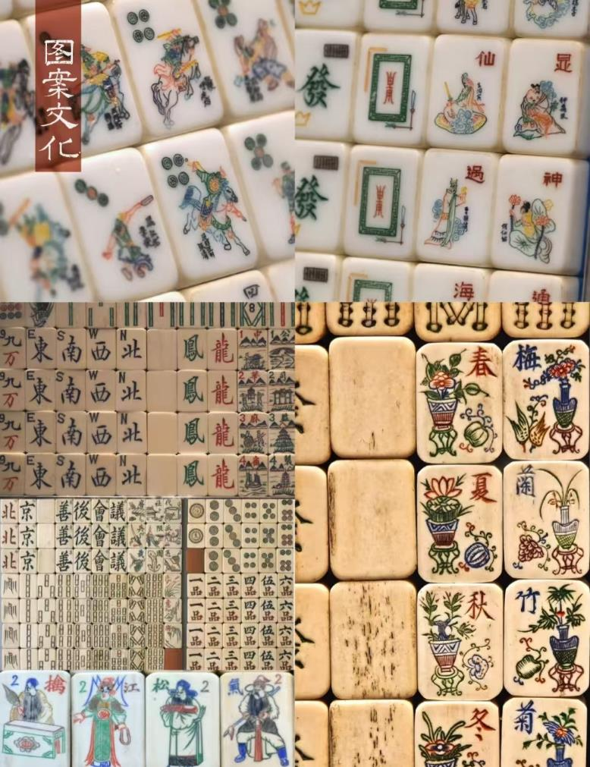
Aesthetics
梅“Plum” stands for nobility
兰“orchid” for elegance
竹“bamboo” for modesty
菊“chrysanthemum” for purity
“Middle”, “hair”, and “white” 3 cards are on the moral meaning of “fair”, “development” and “purity”.

Slide 25
Gang 杠 gàng
杠上开花
Hu 胡 hú
04
Influence
Chi 吃
Hu 胡 hú
Chi 吃 chī
自摸
Peng 碰pèng
Gang

Slide 26
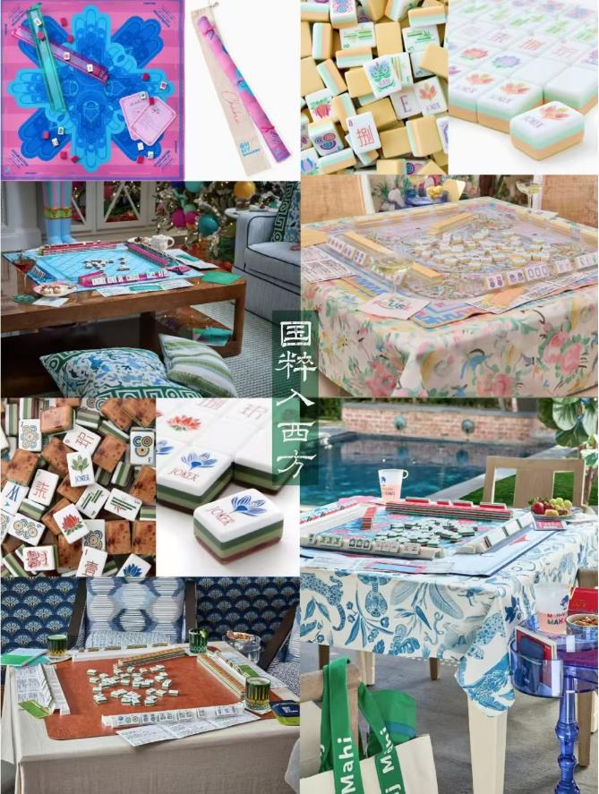
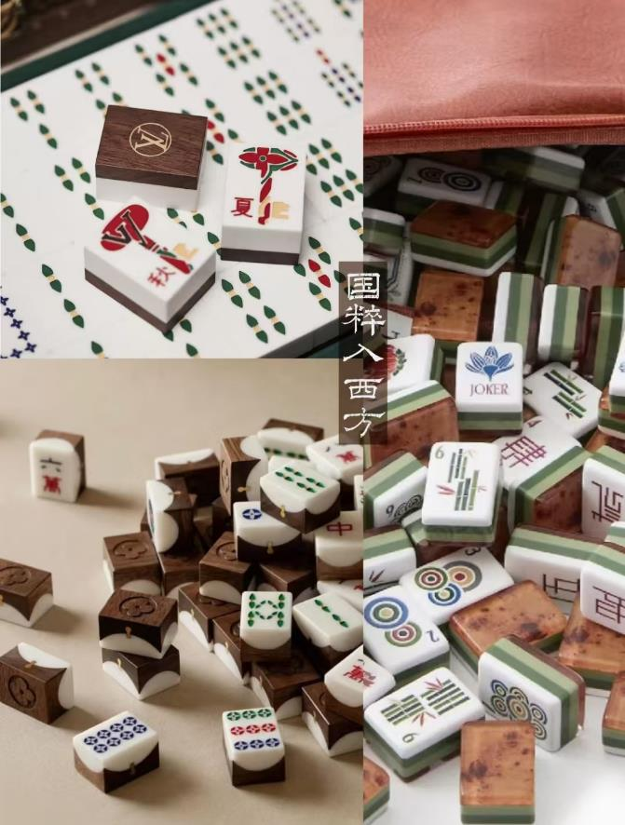
Influence
Since it was introduced into other countries from China, mahjong has developed rapidly. Now mahjong has become one of the most popular entertainment items for people all over the world.

Slide 27


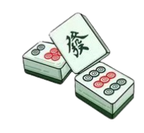
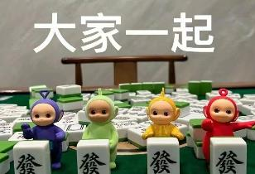
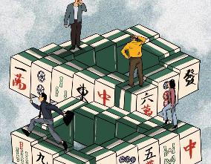
Influence
In 1937, The National Mahjong Federation, the largest mahjong association in the United States, was founded in New York. 全国麻将联合会
In 1998, the Japan Mahjong Tournament Organizing Committee was established to hold mahjong tournaments in Japan and around the world. 日本麻将比赛组委会
It was not until June 18, 1998 that the State General Administration of Sport officially approved mahjong as a sports competition. This is a key step towards mahjong becoming an official sports competition project, which has a milestone significance. 正式批准麻将为体育竞赛项目
In October 2005, the World Mahjong Organization was established in Peking, China, under the joint initiative of mahjong organizations from China, Japan, the United States, Germany, France, Denmark, the Netherlands, Hungary and other countries. The World Mahjong Games is known as the Olympic Games in the field of mahjong.
世界麻将组织
China is considering the idea of putting forward a formal application to the International Olympic Committee to consider the traditional Chinese game of Mahjong as an Olympic event.
...

Slide 28
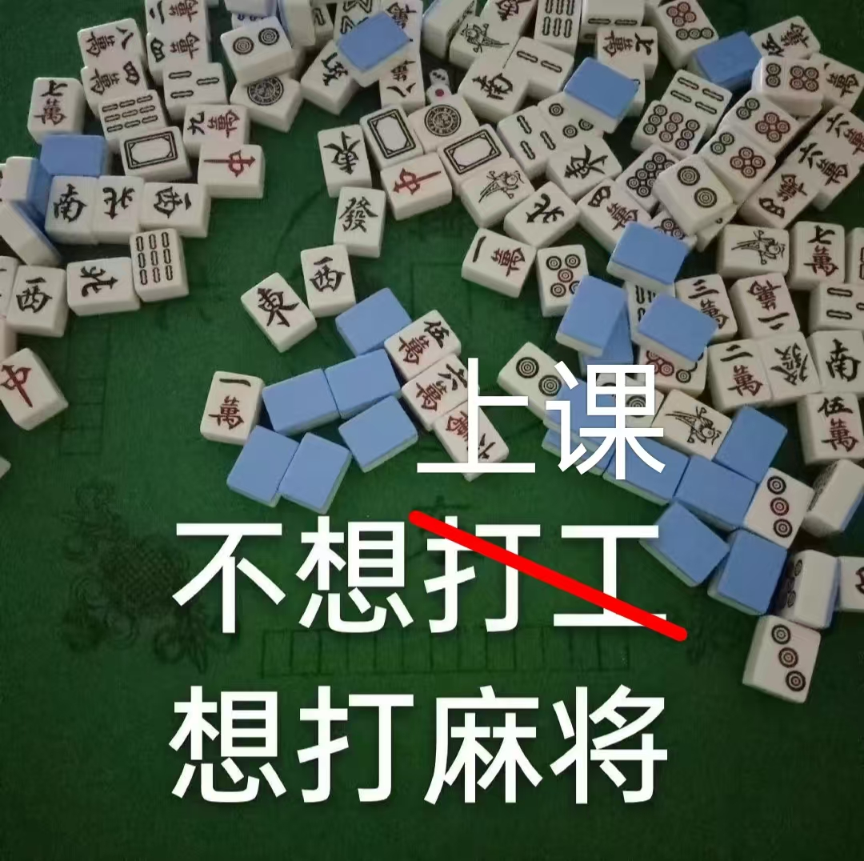

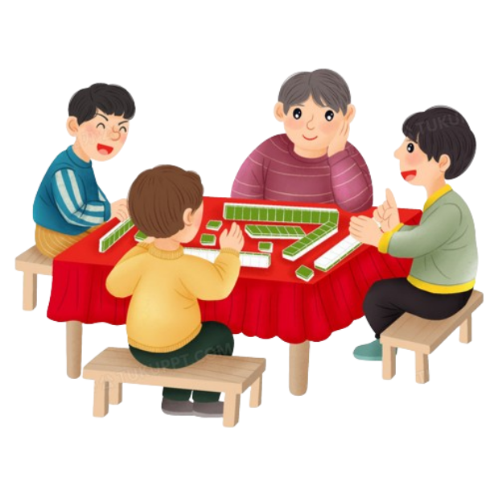
Thank you!

