Slide 1
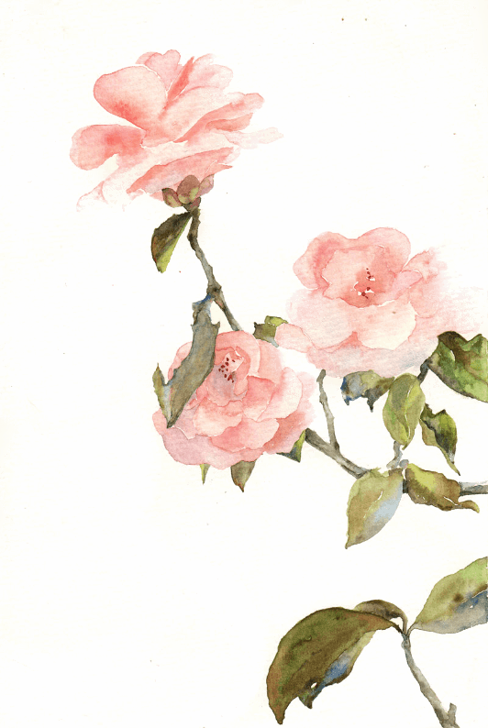

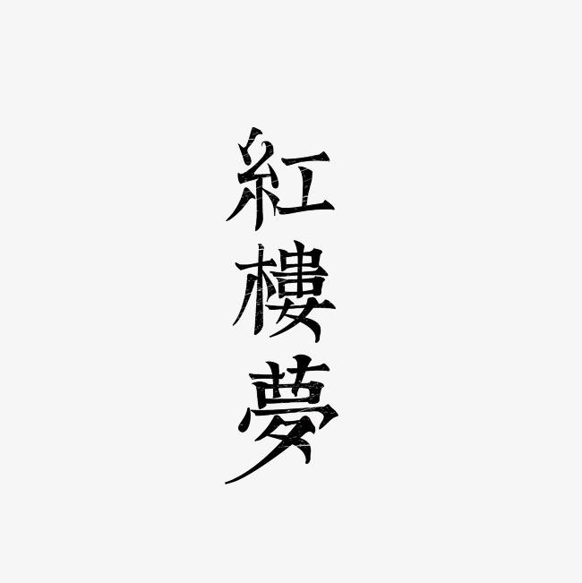


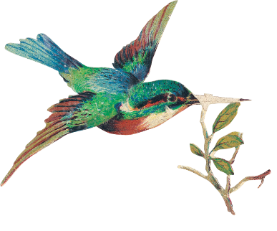
The Translation of
The Red Chamber Dreams
—Zou Xinyu & Cao Runxin

Slide 2

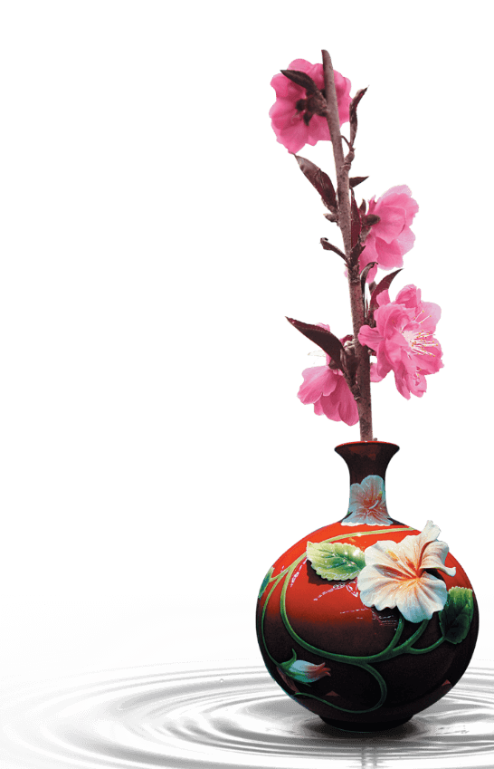
Content
Section 1 Translation History
Section 2 Translation Difficulties
Section 3 Translation Theory

Slide 3
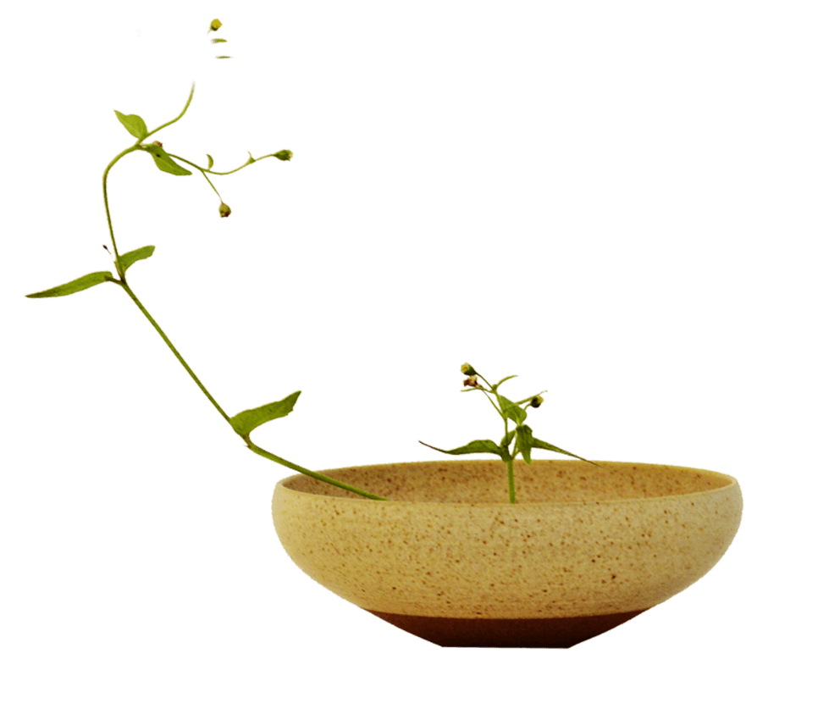

Section 1
The Translation History
of
The Red Chamber Dreams

Slide 4
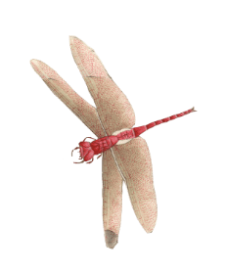
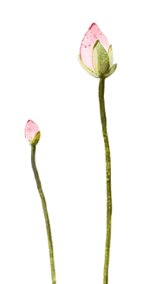

Year | Translation | Translator
1819 | The Red Chamber Dreams | John Barrow
1829 | Dreams of the Red Chamber | John Francis Davis
1830 | Dreams of the Red Chamber | John Francis Davis
1842 | Dream in the Red Chamber | Friedrich August Gützlaff
1846 | Dream of the Red Chamber | Robert Thom
1868-1869 | Dream of the Red Chamber | Edward Charles Bowra
1884 | Dream of the Red Chamber | Herbert A. Giles
1892-1893 | The Dream of the Red Chamber | H. Bencraft Joly
1927 | Dream of Red Chamber | Wang Liang-chih
1929/1958 | Dream of the Red Chamber | Wang Chi-chen
1930 | The Dream of the Red Chamber | Harry Clemons
1950s | Red Chamber Dream | Bramwell Seaton Bonsall
1958 | The Dream of the Red Chamber | Frorence Mchugh & Isabel Mchugh
1973-1986 | The Story of the Stone also known as The Dream of the Red Chamber | David Hawkes & John Minford
1978-1980 | A Dream of Red Mansions | Yang Hsien-yi & Glad-ysYang
Translation History
1830-1900

Slide 5




Robert Thom’s translation:
EXTACT
FROM THE
HUNG-LOW-MUNG, CHAPTER VI
‘An Yung-foo yï-tsïh-chung,
Now as regards the interior of the Town-mansion of the Yung family,
hô-soan-ke-laï Jin-Kow suy püh
on summing them up, altho’the inmates may not be accounted many,
to,tsung sháng che heá,yäy yew san pïh
still with one and another they amounted to some three hundred and odd
yü k’ow; szé suy püh to, yï-téen mouths(to feed;)and the business (transacted) altho’not much, yet every
yäy yew yee ürh-she keen
day they had always some ten or twenty cases(to attend).
红楼梦 第六回
按荣府一宅中合算起来人口虽不多从上至下也有三百余口事岁不多也有一二十件

Slide 6
H. Bencraft Joly’s translation:
As regards the household of the Jung Mansion, the inmates may, on adding up the total number, not have been found many; yet, counting the high as well as the low, there three hundreds persons and more. Their affairs may not have been very numerous, still there were, every day, ten and twenty matters to settle.
红楼梦 第六回
按荣府一宅中合算起来人口虽不多从上至下也有三百余口事岁不多也有一二十件
Wang Chi-chen’s translation of 1929:
Although the Yungkuofu was not unduly large, there were over three hundred months from master to servant, and mistress to maid. Although the household duties were not unduly burdensome, there occurred daily at least a score of tasks and cares to be attended to.
Wang Chi-chen’s translation of 1958:
Although the Yungkuofu was not unduly large, there were over three hundred months from master to servant, and mistress to maid. Although the household duties were not unduly burdensome, there occurred daily at least a score of things to be attended to.

Slide 7
Truth becomes fiction when the fiction's true, Real becomes not-real when the unreal's real. —David Hawkes
When false is taken for true, true becomes false; If non-being turns into being, being becomes non-being. —Yang Hsien-yi
假作真时真亦假，
无为有处有还无。
Happy Red Court —David Hawkes
Green Delights —Yang Hsien-yi
怡红院
The Naiad’s House —David Hawkes
Bamboo Lodge —Yang Hsien-yi
潇湘馆
Yesterday her lord’s bones laid in clay; On silken bridal bed shall lie today. —David Hawkes
Yesterday, yellow clay received white bones; Today, red lanterns light the love-birds’ nest. —Yang Hsien-yi
昨日黄土陇头送白骨，
今宵红灯帐底卧鸳鸯。

Slide 8
Section 2
The Translation Difficulties
of
The Red Chamber Dreams

Slide 9
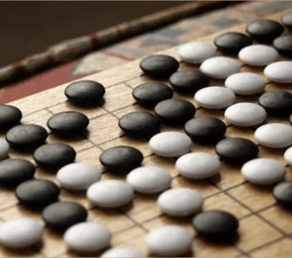
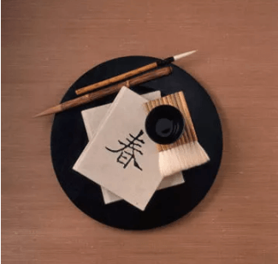
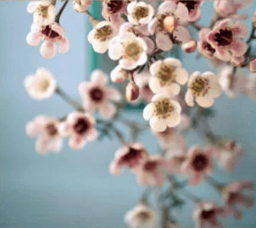
01
02
03
Content
Language
Culture

Slide 10
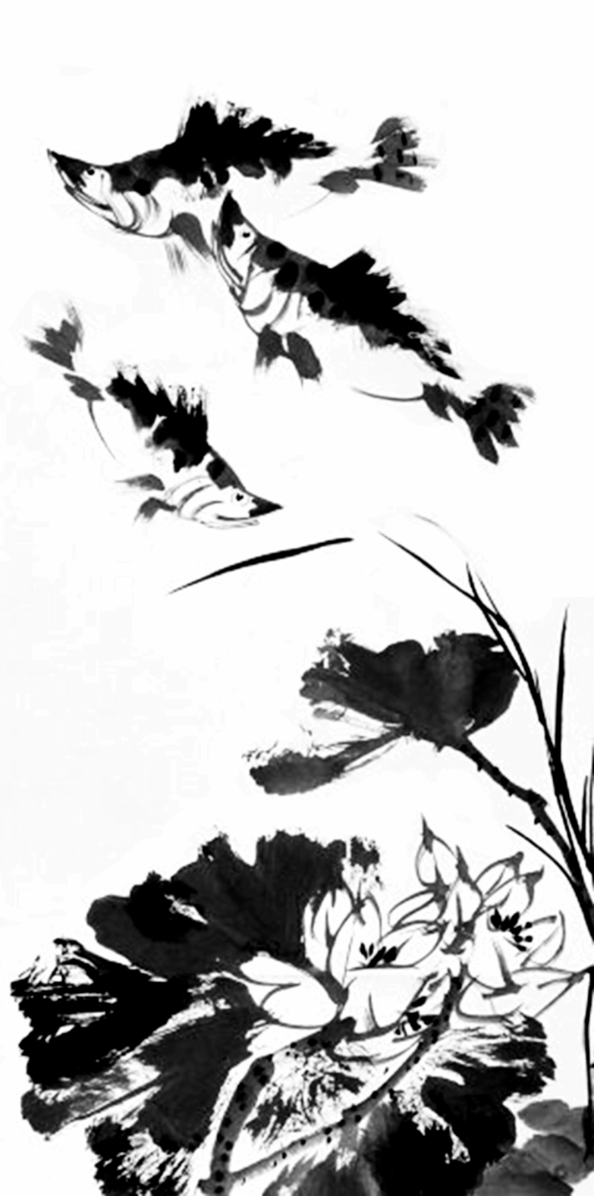
Language | Characteristic
style | fresh, interesting, implicit, vivid, succinct, etc.
Language of characters | The personality of each character is perfectly revealed by his or her words.
Linguistic form | Classical Chinese, colloquialism, dialect
Rhetoric | Homophonic, argot, pun, duality, etc.
words | Overlapping verbs, erhuaci, reduplicatives, onomatopoeia, etc.

Slide 11
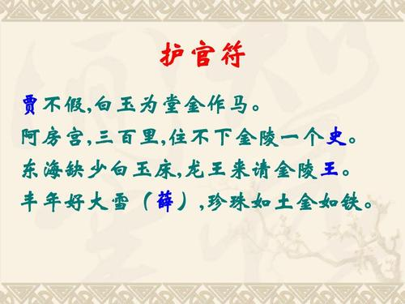
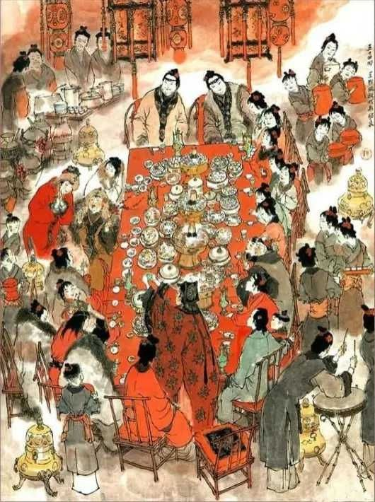
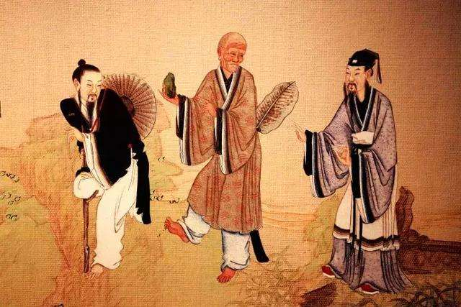
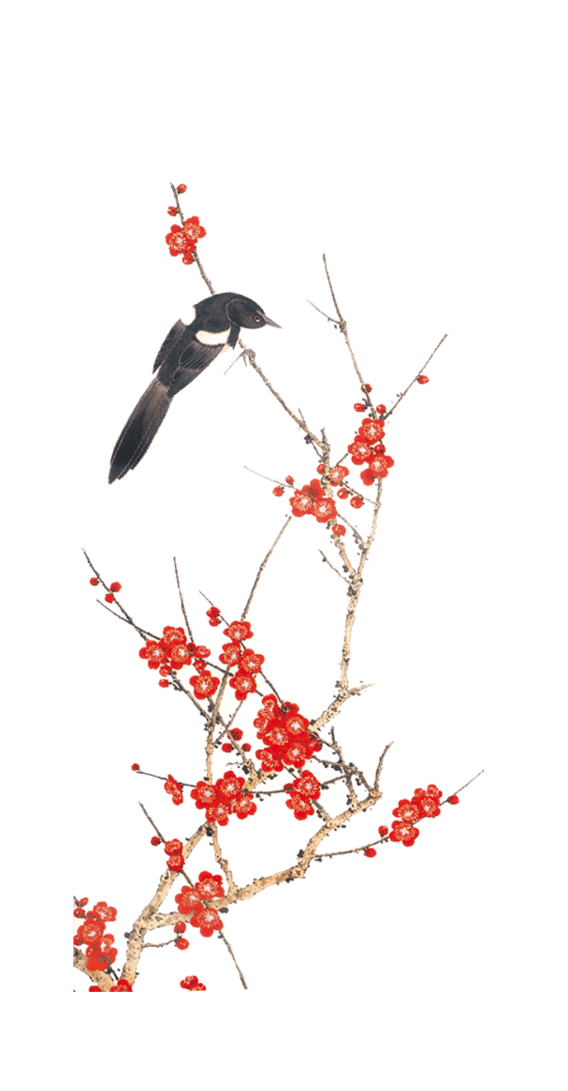
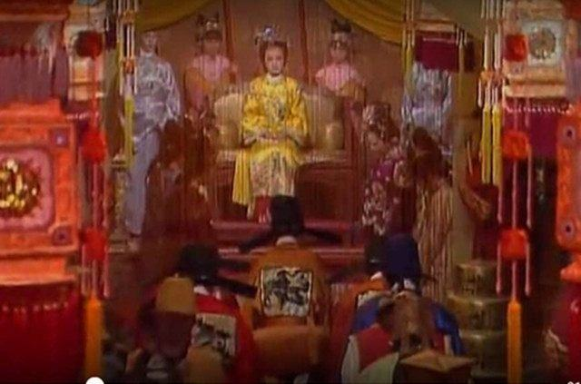
Family Culture
Cultural Life
(Tea Culture,
Wine Culture)
Culture
Religion Culture
Court Culture

Slide 12
1.The title of the book
8.Food (160)
2.Characters’ name (female:480 male:495)
Content
9.Religious theory (>370)
10.Traditional opera (>260)
3.Idiom (>900)
11.Official title（>140）
4.Poem (>260)
12.Etiquette and custom (156)
5.Buildings (102)
13.Personal appellation (129)
6.Medicine (179)
14.System of decrees and regulations
(113)
7.Clothes and accessories (208)
15.Gardens, Solar terms, Songs, Art, etc. (max≈100,min≈40)

Slide 13
Section 3
The Translation Theory
Of
The Red Chamber Dreams

Slide 14
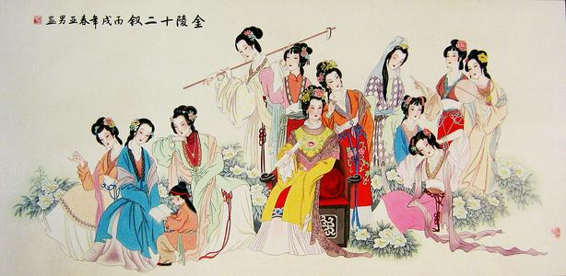
Question:
What kind of theoretical viewpoint should the translation of The Red Chamber Dreams be based on?

Slide 15

Chinese translation theory:
Buddhist Scripture translation
Faithfulness, expressiveness and elegance
Literal translation, Free translation……
Sublimation……
Linguistics Culture
Manifestation
Connotation
Surface connotation
Connotation
(Cultural connection)
Deep connotation

Slide 16
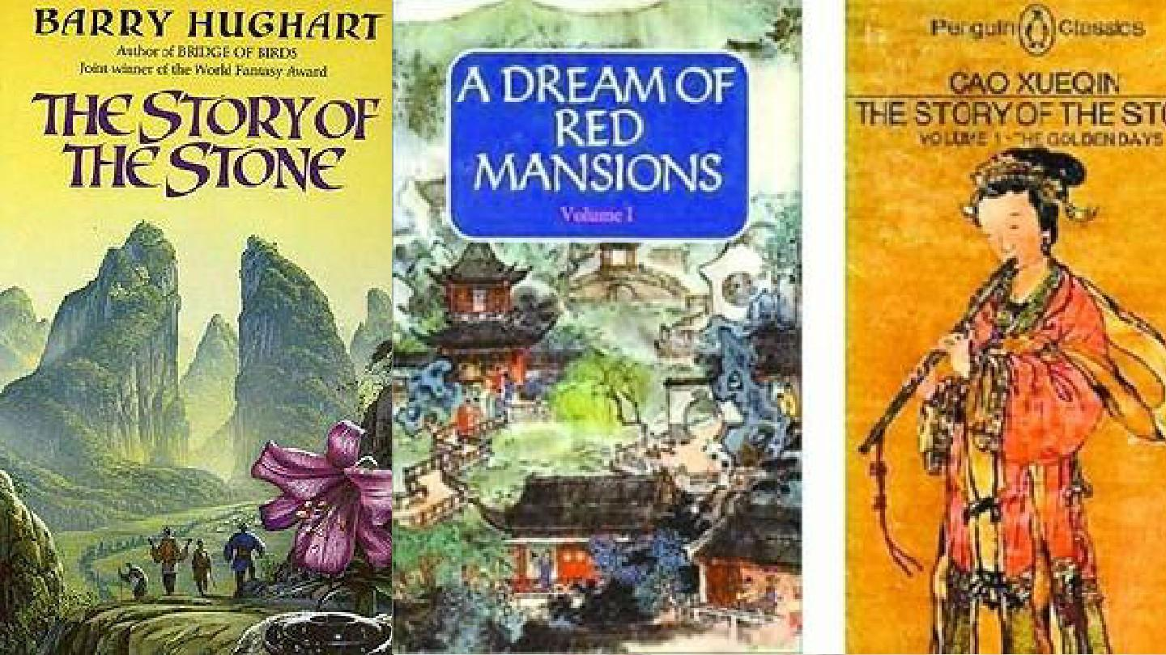

The best way to analyze the translation theory of The Red Chamber Dreams :
Comparative Translation Studies

Slide 17


Thank you!

