Slide 1

Contemporary Culture
汇报人：英语笔译 李婷Li Ting

Slide 2
Contents
Part 1
Part 2
Introduction
The Development Course

Slide 3

Introduction

Slide 4
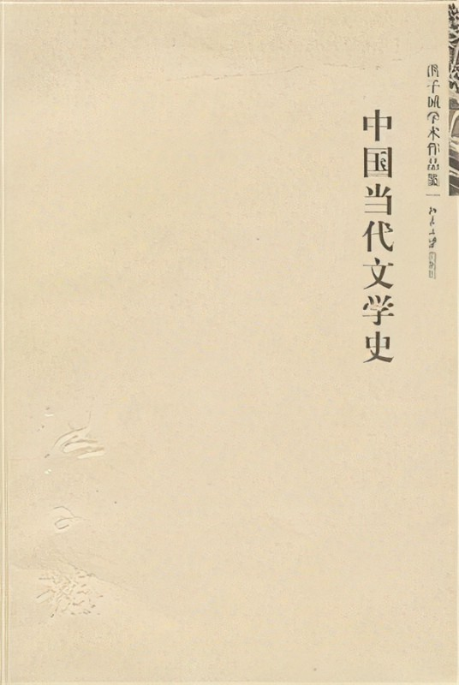
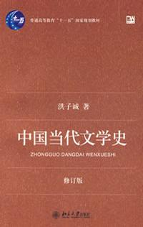
Part 1:Introduction
Definition: Contemporary culture refers to the literature from the founding of New China in 1949 to the present day.(1949-至今）
Chinese contemporary literature is the continuation of Chinese modern literature.
The First National Conference of the Representatives of Literary and Art Workers(第一次中华全国文学艺术工作者代表大会，1949 ）

Slide 5



The Development Course
Contemporary Culture
Minimalist PowerPoint Template

Slide 6
The Development Course
A
B
C
D
Seventeen Years Literature (1949-1966)
The Great Cultural Revolution Literature
(1966-1976)
Literature of the New Period (1976-1989)
Literature in the Market Economy (1990s-present day)

Slide 7
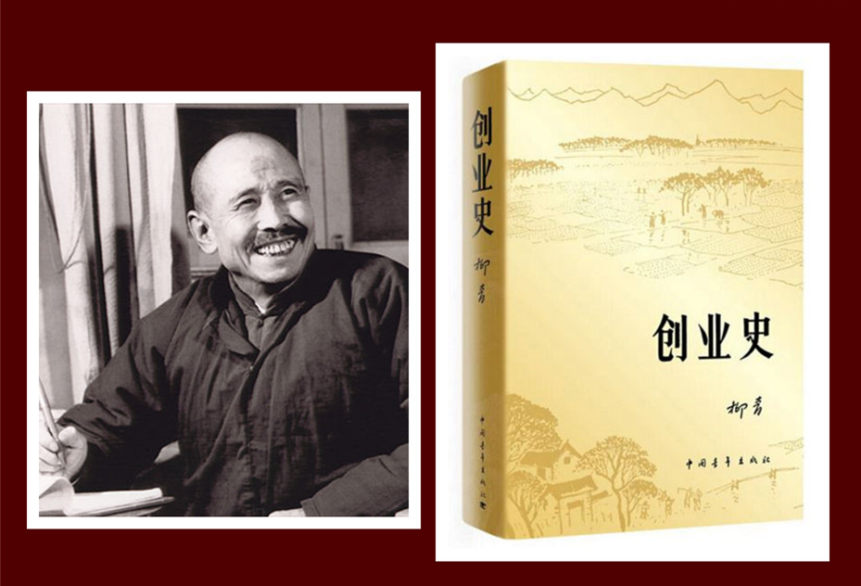
Part 2: The Development Course
1.Seventeen Years Literature (1949-1966)
https://www.ypppt.com/
“letting a hundred flowers blossom and hundred schools of thoughts contend”(双百方针）
① Novels: Builders of a New Life 《创业史》——Liu Qing(柳青)
Keep the Red Flag Flying 《红旗谱》——Liang Bin(梁斌)
Tracks in the Snow Forest 《林海雪原》——Qu Bo(曲波)
② Plays: Teahouse 《茶馆》——Lao She(老舍)
Guan Hanqin 《关汉卿》——Tian Han(田汉)
③ Operas:The Red Guards of Honghu 《洪湖赤卫队》
④ The song and dance epics: The East is Red《东方红》
⑤ Popular poems by Ai Qing(艾青), Guo Xiaochuan(郭小川) and He Jingzhi(贺敬之), etc.

Slide 8
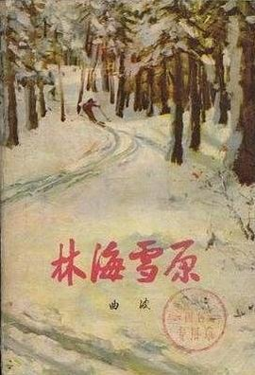
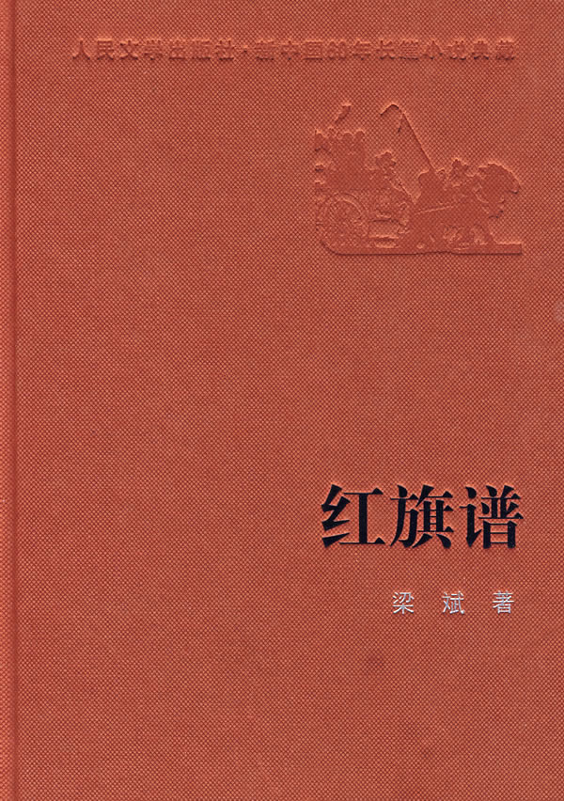
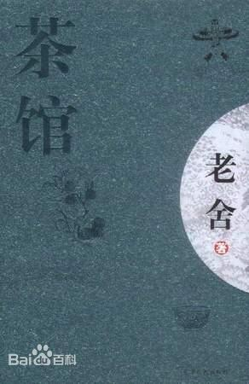
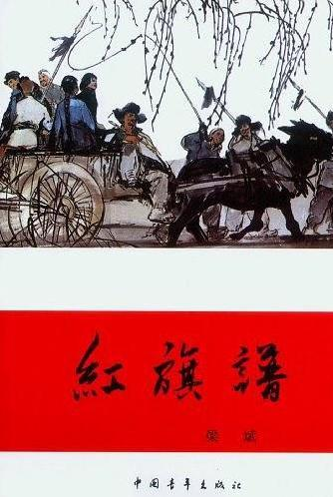

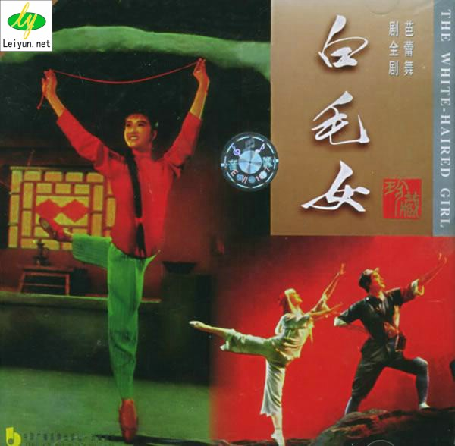
Part 2: The Development Course
reflects the features of the age and people’s aspiration for a new life.
greatly influenced inspiring people’s enthusiasm about and participation in the socialist construction.

Slide 9
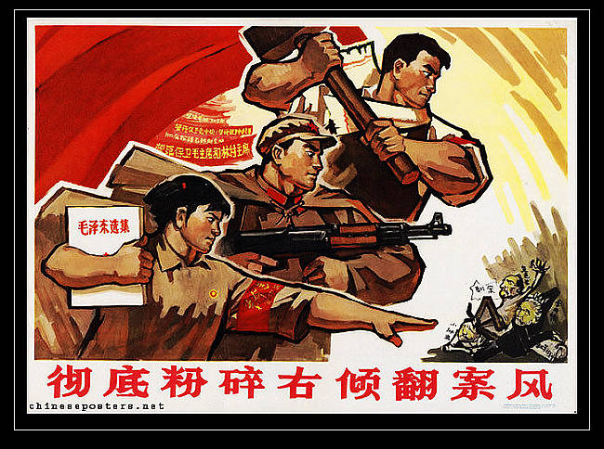
Part 2: The Development Course
2.The Great Cultural Revolution Literature
(1966-1976)
Revolutionary model dramas(革命样板戏）：The Red Lantern《红灯记》, Taking Tiger Mountain by Strategy《智取威虎山》, etc.
Highlight positive and heroic characters.
During this period, literature withered. But the great victory in smashing the Gang of Four and 1976 ushered in new period.

Slide 10
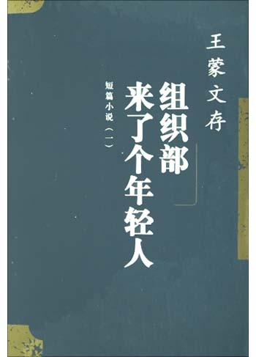
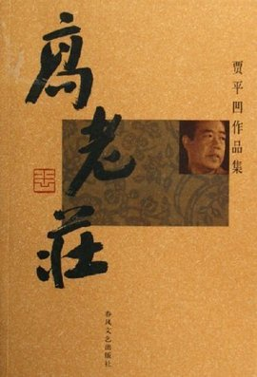
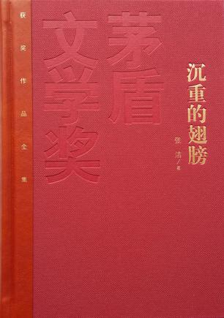
Part 2: The Development Course
3.Literature of the New Period (1976-1989)
Enormous progress was also made in reportage literalture, poetry, essays, children's literature, science fiction and minority literature. Meanwhile a large number of middle-aged and young writers emerged, such as Wang Meng(王蒙), Jiang Zilong(蒋子龙), Gao Xiaosheng(高晓声), Jia Pingwa(贾平凹), etc.

Slide 11
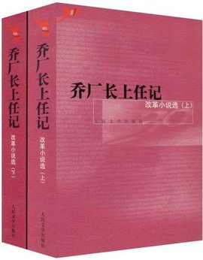
Part 2: The Development Course
Features
1. Reflects various aspects of life of the changing society, like Wound Literature, which exposes the persecution of people under the tyranny of the Gang of Four.
2. About the reforms carried out in all fields, like Reform Literature with Manager Qiao Assumes Office《乔厂长上任记》 as its representative.
3. Multi-expressionism. Many many middle-aged and young writers have been borrowing Wester modernlist techniques, such as stream-of-consciousness, symbolism and black humor.

Slide 12
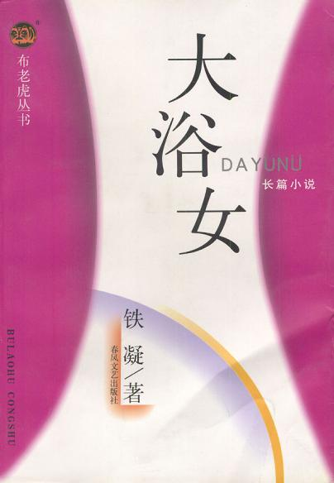
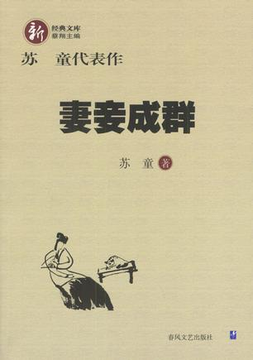
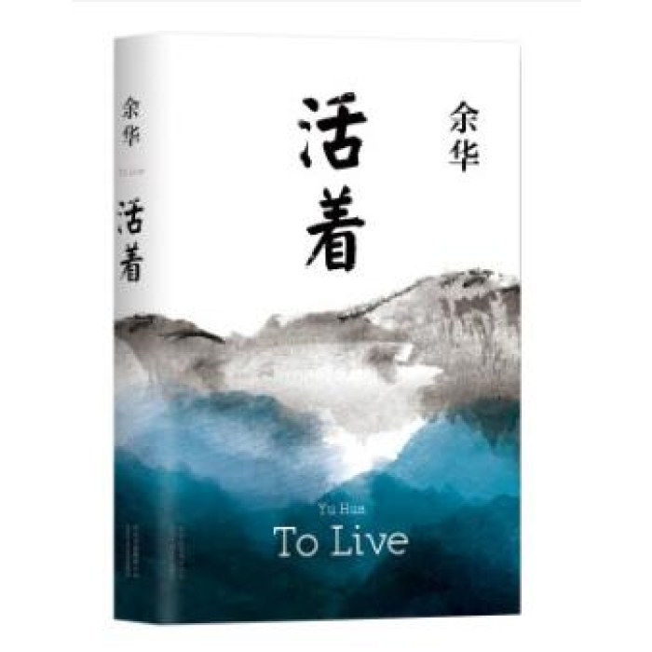
4. Literature in the Market Economy (1990s-present day)
After the 1990s, "rebuilding the lost humanistic spirit" became the main idea in the field of literature, and many writers began to reflect on it deeply. The whole field of literary creation entered a stage of in-depth development dominated by "pursuing humanistic spirit, caring for real life and raising individual sensibility.
For instance, Raise The Red Lantern 《妻妾成群》——Su Tong(苏童)
To Live《活着》——Yu Hua(余华)
The Bathing Women《大浴女》——Tie Ning(铁凝)
Part 2: The Development Course

Slide 13
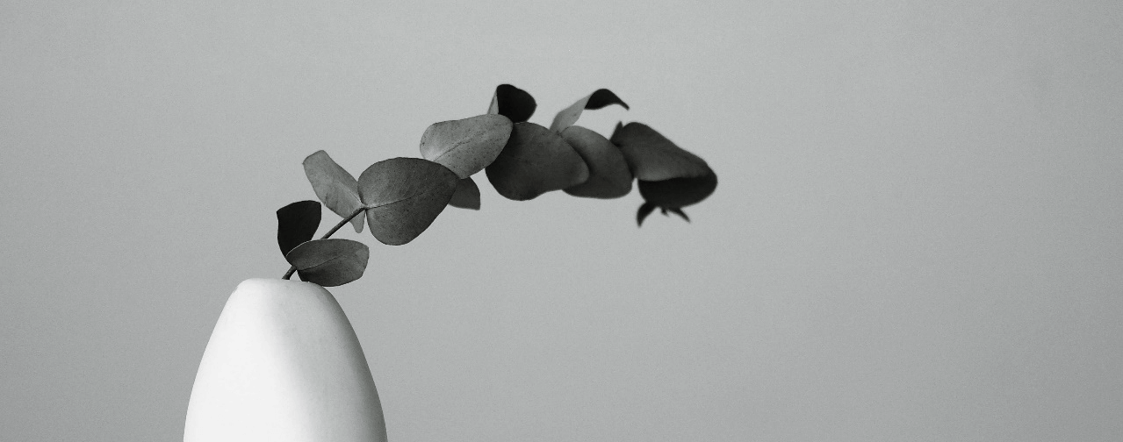


Thank You!

