Slide 1

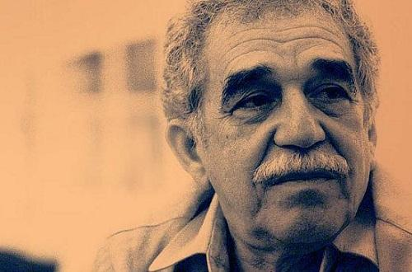
Mo Yan
&
García Márquez
莫言与马尔克斯
Prestented by Chen Siyu

Slide 2
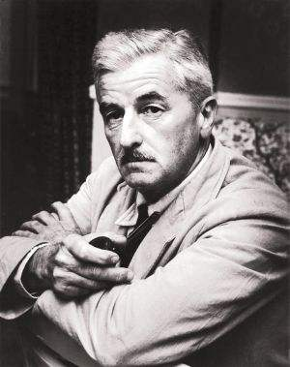
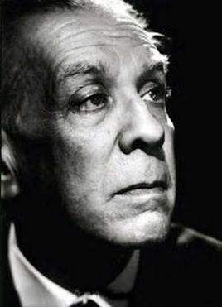
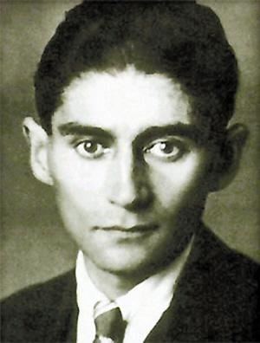
William Faulkner
威廉·福克纳
Jorge Luis Borges路易斯·博尔赫斯
Franz Kafka
弗兰兹·卡夫卡

Slide 3
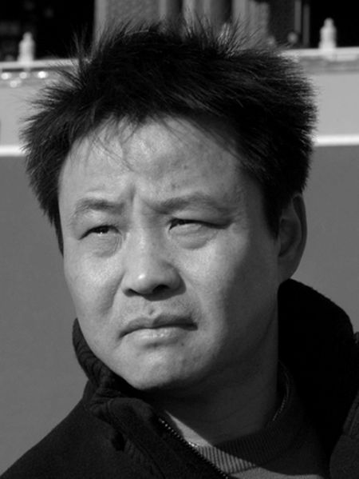
“All of a sudden, I was faced with the vast sea of literature. I have to face foreign literature, classical Chinese literature and modern Chinese literature… I chose foreign literature at last. The choice can be seen as an author’s choice, or in other words a choice for writing’s sake, rather than a choice out of attitude towards life or the way to feel in life. As a Chinese writer, I was fortunate to be raised by foreign literature.

Slide 4
“In 1986, I read Kafka, Kafka surprised me by
his arbitrariness on the form of narration……
from Kafka, I found that free narration enabled
us to express thoughts and emotions more
fully.

Slide 5
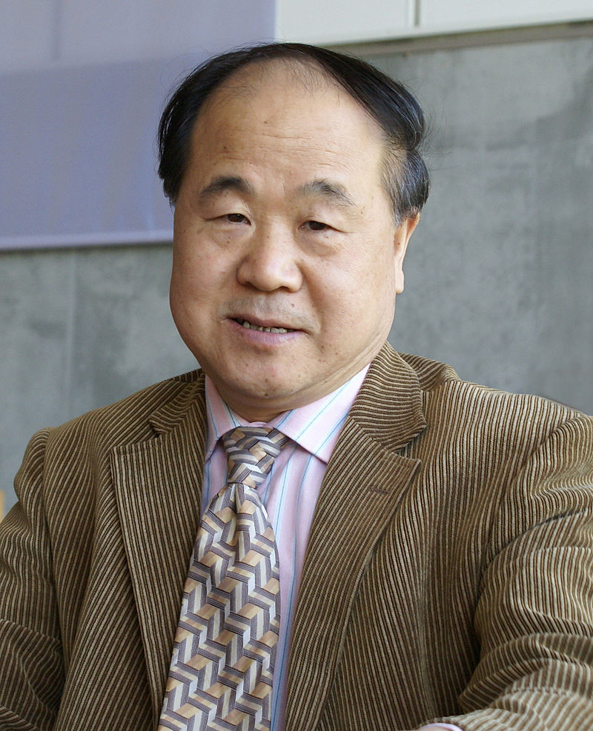
A Chinese novelist and short story writer. Donald Morrison of U.S. news magazine TIME referred to him as "one of the most famous, oft-banned and widely pirated of all Chinese writers", and Jim Leach called him the Chinese answer to Franz Kafka or Joseph Heller. Leading figure of root-seeking literature.

Slide 6
“who with hallucinatory realism merges folk tales, history and the contemporary”
Mo Yan is a poet who tears down stereotypical propaganda posters, elevating the individual from an anonymous human mass. Using ridicule and sarcasm Mo Yan attacks history and its falsifications as well as deprivation and political hypocrisy. Playfully and with ill-disguised delight, he reveals the murkiest aspects of human existence, almost inadvertently finding images of strong symbolic weight.
North-eastern Gaomi county embodies China’s folk tales and history. Few real journeys can surpass these to a realm where the clamour of donkeys and pigs drowns out the voices of the people’s commissars and where both love and evil assume supernatural proportions.

Slide 7
With his stories，García Márquez has created a world of his own which is a microcosmos. In its tumultuous, bewildering yet graphically convincing authenticity it reflects a continent and its human riches and poverty.
Perhaps more than that: a cosmos in which the human heart and the combined forces of history time and again burst the bounds of chaos-killing and procreation.

Slide 8
context
一方面有降落着的“影响的种子”，即20世纪后期以来以马尔克斯为代表的拉美魔幻现实主义在欧美乃至世界范围内的“爆炸性” 影响；
另一方面，也许是更重要的方面，则是有“条件具备的土地”，即作为接受主体的中国文学与马尔克斯的文学有着极为相似的历史文化语境和现实文化境遇。

Slide 9
context
两者历史文化语境的相似性，集中体现在中国、拉美这两块地域辽阔且有着悠久文化传统的大陆共同拥有神奇、丰富的自然遗产和文化遗产。为马尔克斯魔幻现实主义文学提供丰厚精神资源的拉丁美洲神奇的自然景观、神秘的神话传说和悠久的文化传统，同样存在于中国大地。
其次，从《离骚》、魏晋志怪、唐传奇到《西游记》、《红楼梦》，中国传统文学中从来就不乏“神秘性”的因子。这种神秘文学传统使20世纪后期的许多中国作家在接触马尔克斯的魔幻现实主义文学时，似曾相识之感油然而生，并自信也能创造出中国式的魔幻现实主义文学。

Slide 10
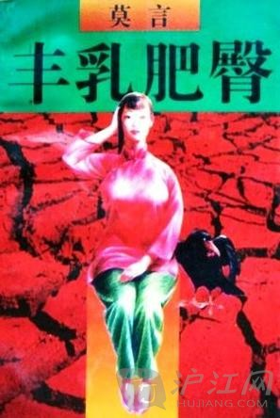
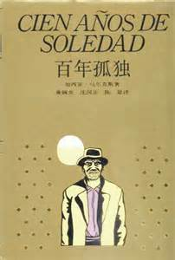
Big Breasts& Wide Hips
One Hundred Years of Solitude

Slide 11
Similarities(general)
·A muti-generational story of a family.
·Metaphor of the country and the nation.
·The theme of life, death, sex, reproduction etc.

Slide 12
Similarities(my thoughts)
Way of observation: through direct senses (a war scene)
Obsession for animals
Irrationality, chaos, primitivism.

Slide 13
“河堤上，三个买卖人互相打量着，交换着迷惘的目光，他们好像要说点什么，但终究什么也没有说，彼此点点头，便连连打着呵欠，走回家去睡觉。他们都已过中年，对某些事情十分敏感而机警，但对某些事情的反应却迟钝起来，花茉莉把一个小瞎汉领回家去寄宿，在他们看来虽然有点不可思议但又毕竟是顺理成章，因为他们的家中虽然完全可以安排下一个小瞎子，但比起花茉莉家来就窄巴得多了。花茉莉一人独住了六间宽敞明亮的瓦房，安排三五个小瞎子都绰绰有余。因此，当小瞎子蹒跚着跟在花茉莉身后走下大堤时，三个人竟不约而同地舒出了一口如释重负的长气。”
民间音乐
（1983）

Slide 14
跑到她们栖身的胡麻地前，那里有一个蓄着脏水的大坑，坑里茂盛地生长着一些杂草和几棵像树一样粗壮的水荇，通红的茎秆，肥大的叶片是鲜嫩的鹅黄色，梢头高挑着一束束柔软的粉红色花序。那浑身着火的人一头扎到水坑里，砸得坑中水花四溅，一群半大的、尾巴刚刚褪掉的小青蛙从坑边的水草中扑扑楞楞地跳出来，几只洁白的、正在水荇叶背产卵的粉蝶轻飘飘地飞起来，消逝在阳光里，好像被灼热的光线熔化了。那人身上的火熄了，全身乌黑，头上脸上沾着一层厚厚的烂泥，腮上弯曲着一条细小的蚯蚓。分不清哪是他的鼻子哪是他的眼，只能看到他的嘴。他痛苦地哭叫着：“娘啊，亲娘，痛死我啦……”一条金黄的泥鳅从他嘴里钻出来。他在泥塘里蠕动着，把水底沉淀多年的腐臭气味搅动起来。
丰乳肥臀
（1996）

Slide 15
“家里的人都在谈情说爱。奥雷连诺用无头无尾的诗句倾诉爱情。他把诗句写在梅尔加德斯给他的粗糙的羊皮纸上、浴室墙壁上、自个儿手上，这些诗里都有改了观的雷麦黛丝：晌午闷热空气中的雷麦黛丝；玫瑰清香中的雷麦黛丝；早餐面包腾腾热气中的雷麦黛丝——随时随地都有雷麦黛丝。每天下午四点，雷贝卡一面坐在窗前绣花，一面等候自己的情书。她清楚地知道，运送邮件的骡子前来马孔多每月只有两次，可她时时刻刻都在等它，以为它可能弄错时间，任何一天都会到达。情形恰恰相反：有一次，骡子在规定的日子却没有来。雷贝卡苦恼得发疯，半夜起来，急匆匆地到了花园里，自杀一样贪婪地吞食一撮撮泥土，一面痛苦和愤怒地哭泣， 一面嚼着软搭搭的蚯蚓，牙床都给蜗牛壳碎片割伤了。到天亮时，她呕吐了。她陷入了某种狂热、沮丧的状态，失去了知觉，在呓语中无耻地泄露了心中的秘密。”
百年孤独

Slide 16
《民间音乐》：slower，more simple，gentle，
《丰乳肥臀》：faster，intense，more senses，complicated rhetorical device，strong colors，rich imagination

Slide 17
The works I wrote in 1985, were undoubtedly influenced by foreign literature both in thoughts and in form, mainly from One hundred years of Solitude by García Márquez… It first shocked me with those extremely exaggerated artistic techniques through which time and space were turned upside down, the world of lives were crossed.

Slide 18
Differences
Mo Yan : a storyteller.
《丰乳肥臀》：duality, contrast.
《百年孤独》: Existential, transcendent.
《丰乳肥臀》：social, morally ethical.

Slide 19
References 参考文献
[1]莫言，丰乳肥臀[M].杭州：浙江文艺出版社，2017.
[2]加西亚·马尔克斯，百年孤独[M].海口：南海出版公司，2011.
[3]哈罗德·布鲁姆，徐文博译，影响的焦虑——一种诗歌理论（增订版） [M].南京：江苏教育出版社，2006.
[4]莫言，民间音乐[M]. 沈阳: 春风文艺出版社，2004.
[5]余华，川端康成和卡夫卡的遗产[J].外国文学评论，1990（2）:109-110.
[6]莫言，两座灼热的高炉[J].世界文学，1986（3）：298-299.
[7]腾讯网，腾讯文化，莫言谈马尔克斯：我用20年，离开他又靠近他，2014-04-21，http://cul.qq.com/a/20140421/009955.html.
[8]崔玲，从我国三十年代长篇小说的繁荣看西方文学对中国作家、作品的影响[N].齐齐哈尔师范学院学报，1992（1），67-72.
[9]王恒升，莫言早期小说创作论[J].东岳论丛，2007（1），117-120.

