Slide 1

QIGONG 气功
by Ngo Thi Minh Huong (吴氏明红）
Rajabov Anushervon（阿努克）

Slide 2
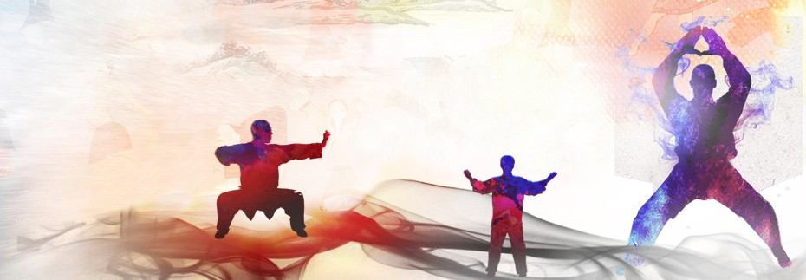
Introduction about Qigong 气功
Qigong气功 (/ˈtʃiːˈɡɒŋ/) is a millennia-old system of coordinated body-posture and movement, breathing, and meditation used for the purposes of health, spirituality, and martial-arts training.

Slide 3
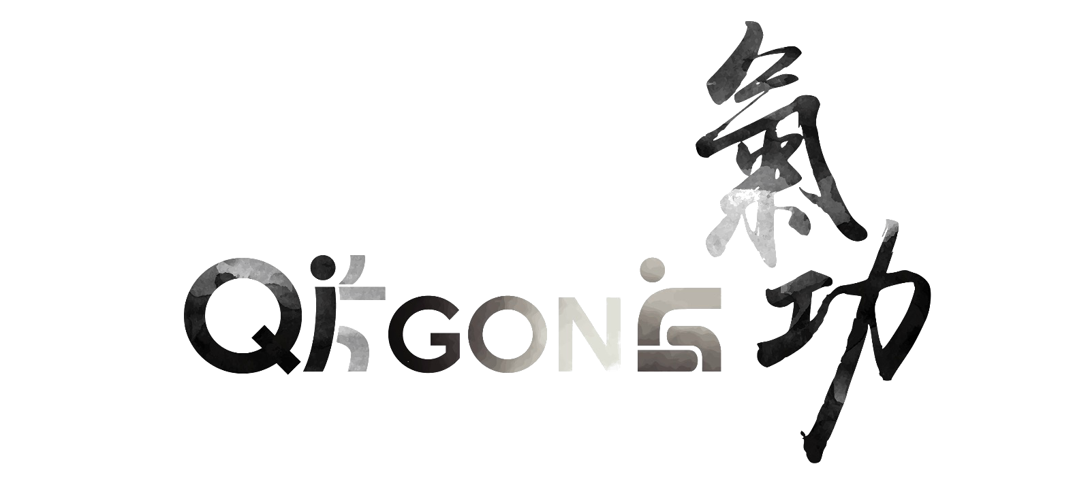
II. Definition
Qigong (气功) can be described as a mind-body-spirit practice that improves one's mental and physical health by integrating posture, movement, breathing technique, self-massage, sound, and focused intent.

Slide 4

Qi (气／氣) primarily means air, gas or breath, referring to a supposed energy circulating through the body.
Gong (功) is cultivation or work, include practice, skill, mastery, merit, achievement, service, result, or accomplishment.
The two words are combined to describe systems to cultivate and balance life energy, especially for health and wellbeing.

Slide 5
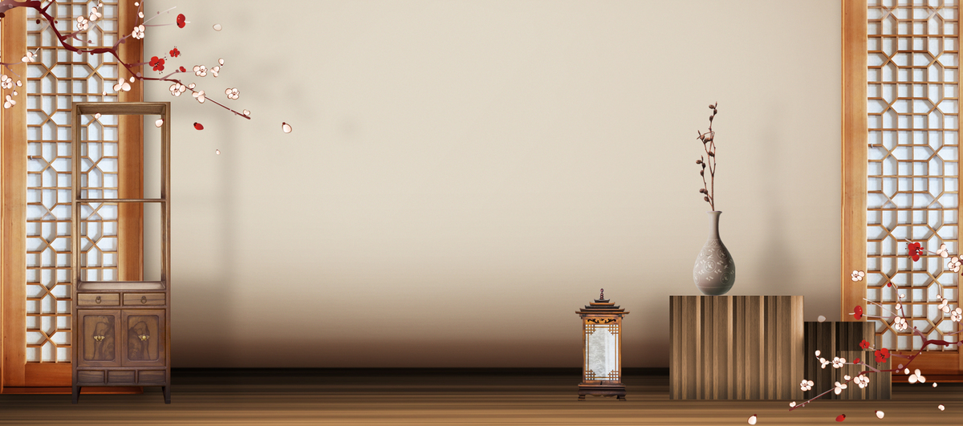
III. History and origins
With roots in ancient Chinese culture dating back more than 4,000 years, a wide variety of qigong forms have developed within different segments of Chinese society:
in traditional Chinese medicine
in Confucianism
in Daoism and Buddhism
in Chinese martial arts

Slide 6

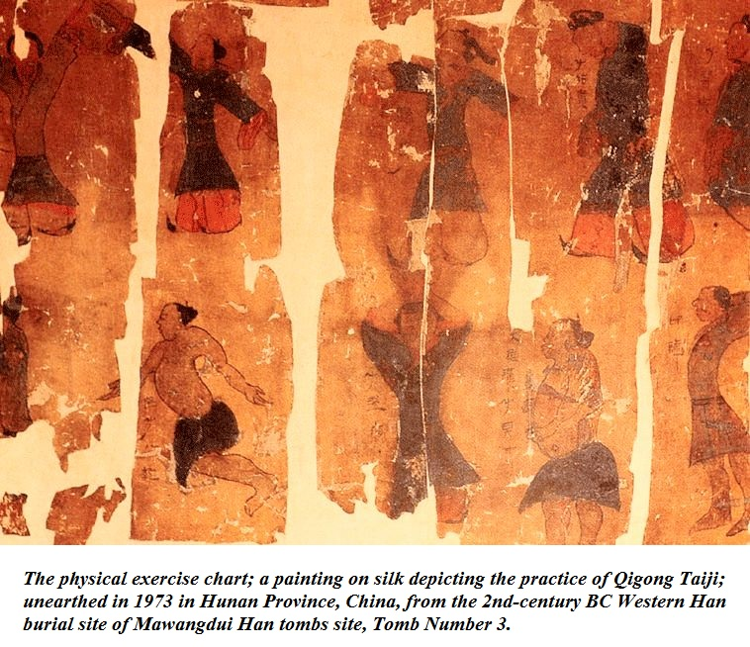
Through the globalization, the practice of qigong spread from the Chinese community to the world.
Today, millions of people around the world practice qigong and believe in its benefits.

Slide 7

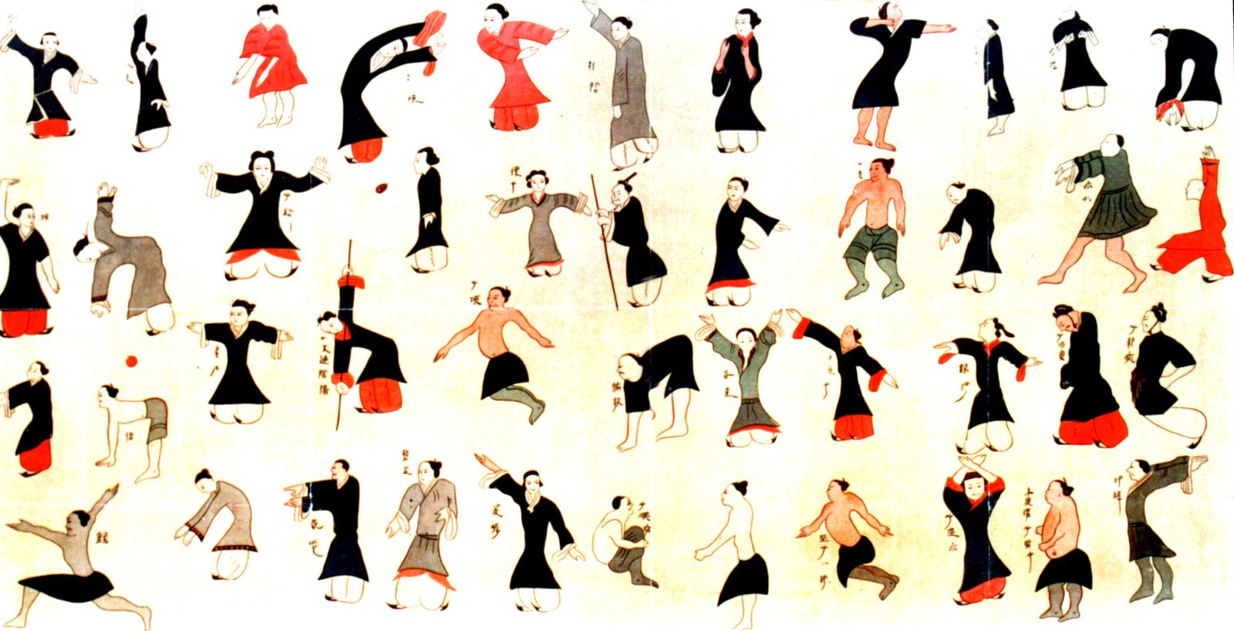
IV. TYPES OF QIGONG

Slide 8

There are over 3,000 types of Qigong in the world, but they all fit into 1 of 5 main categories:
Medical Qigong to heal self and others
Martial Qigong for physical prowess
Spiritual Qigong for enlightenment
Intellectual Qigong for boosting intelligence and memory
Vitality Qigong for longevity

Slide 9

Medical Qigong (also called Health Qigong)
This is the most popular of the five categories. It is the oldest of the four branches of Traditional Chinese Medicine.
There are two types of medical Qigong:
Self-Healing Qigong.
External Qigong or Qi Emission.

Slide 10
2. Martial Qigong (also called Warrior Qigong)
This type of Qigong focuses on physical prowess.
3. Spiritual Qigong
This type of qigong uses mantras, mudras, sitting meditations, and prayers to pursue enlightenment.

Slide 11
4. Intellectual Qigong (also called Scholarly Qigong)
This category covers a lot of ground: boosting intelligence and memory, helping with decision-making, improving your luck.
5. Vitality Qigong (also called Longevity Qigong)
These techniques cultivate strength, flexibility, suppleness, and fitness, all of which contribute to overall vitality and thus longevity.

Slide 12
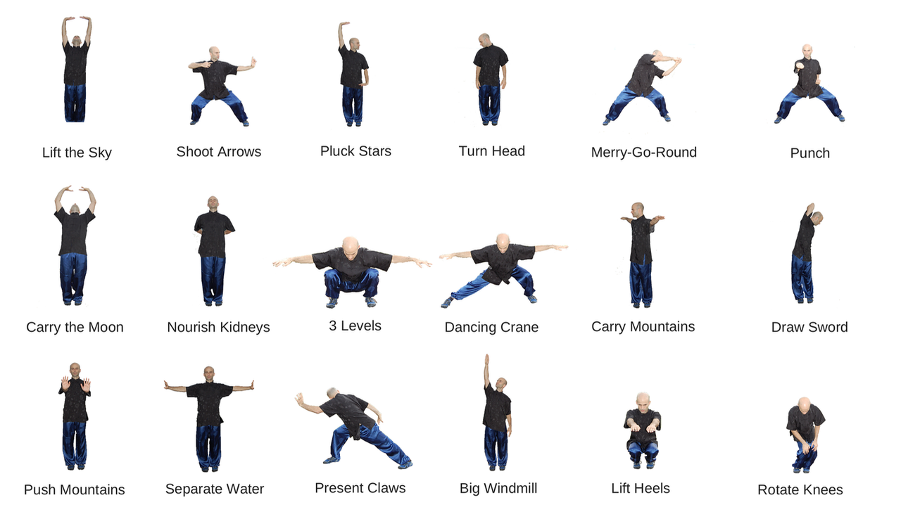
V. Qigong techniques

Slide 13
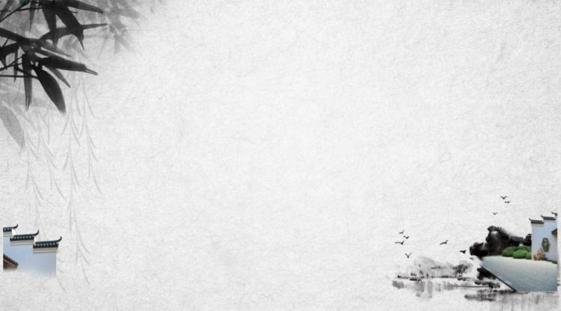
There are two types of Qigong practice
Wai Dan (External Elixir) involves physical movement and concentration
Nei Dan (Internal Elixir) involves sitting meditation and guided imagery or visualization

Slide 14
Main principles in practicing qigong
Intentional movement: careful, flowing balanced style
Rhythmic breathing: slow, deep, fluid movement
Awareness: calm, focused meditative state
Visualization: of qi flow, philosophical tenets, aesthetics
Chanting/Sound: use of sound as a focal point

Slide 15
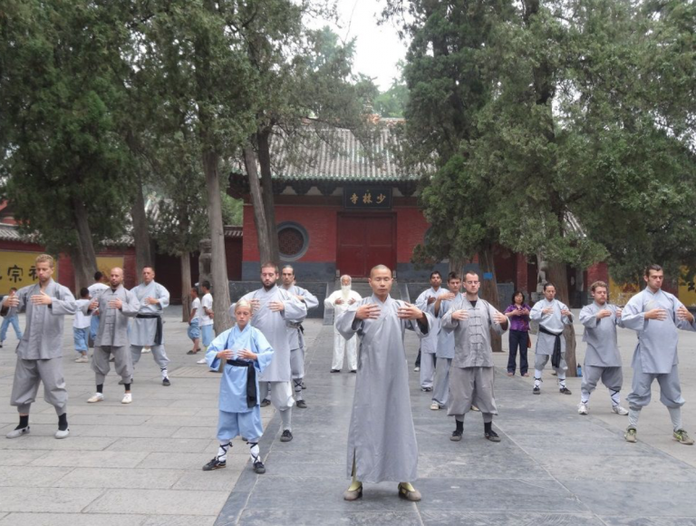
VI. Contemporary qigong

Slide 16

Contemporary qigong blends:
"internal alchemy" (Neidan 內丹術)
"circulating qi" (Xing qi 行氣) and "standing meditation" (Zhan zhuang 站桩)
"guiding and pulling" (Dao yin 導引)
In contemporary China as well as in all over the world, Qigong is now practiced by millions people, primarily for its health benefits.

Slide 17
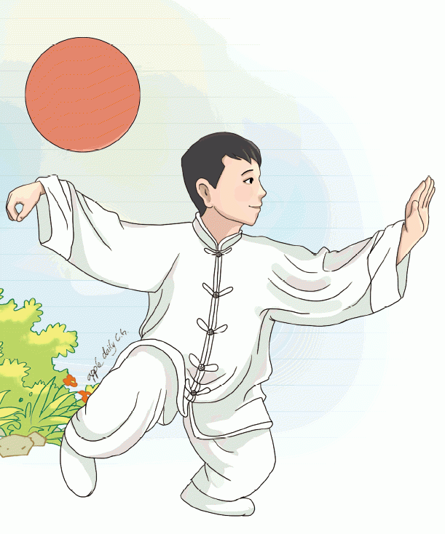
VII. Benefits of Qigong - Qigong opens the flow of energy in meridians. - Qigong enhances our ability to feel the Life Force underlying the physical world and to deepen our communication with it.

Slide 18
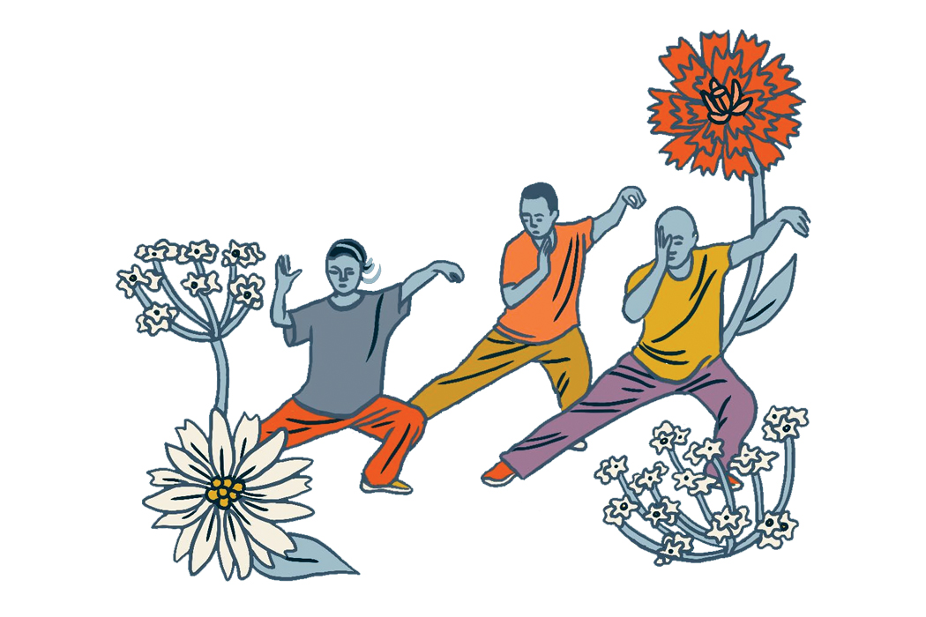
THANKS FOR LISTENING!

