Slide 1
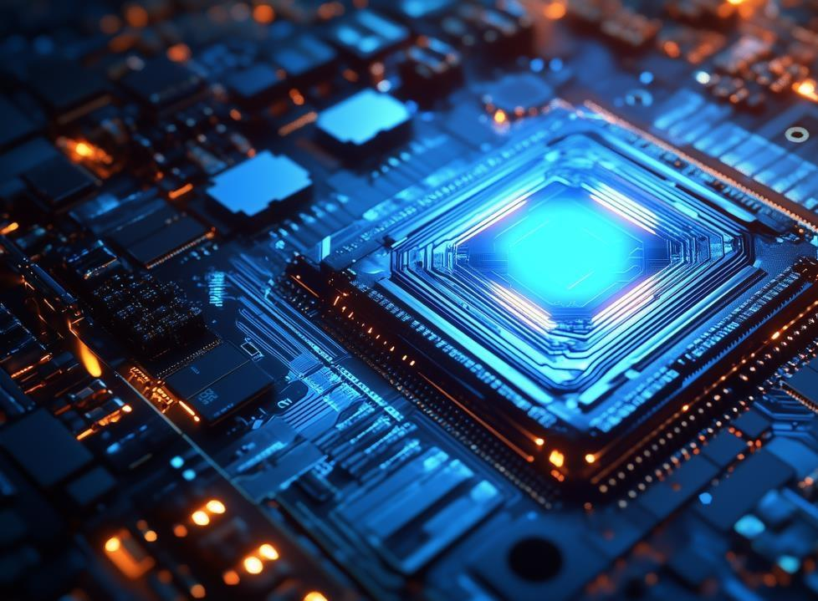
Chinese Electric Vehicle
主讲人：24日语笔译耿红玫

Slide 2
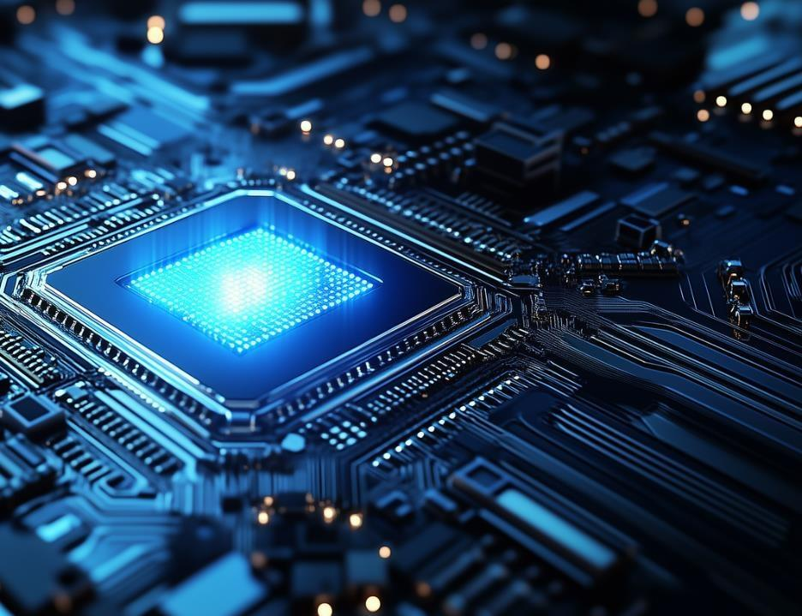
01
PART
Introduction
PowerPoint design

Slide 3
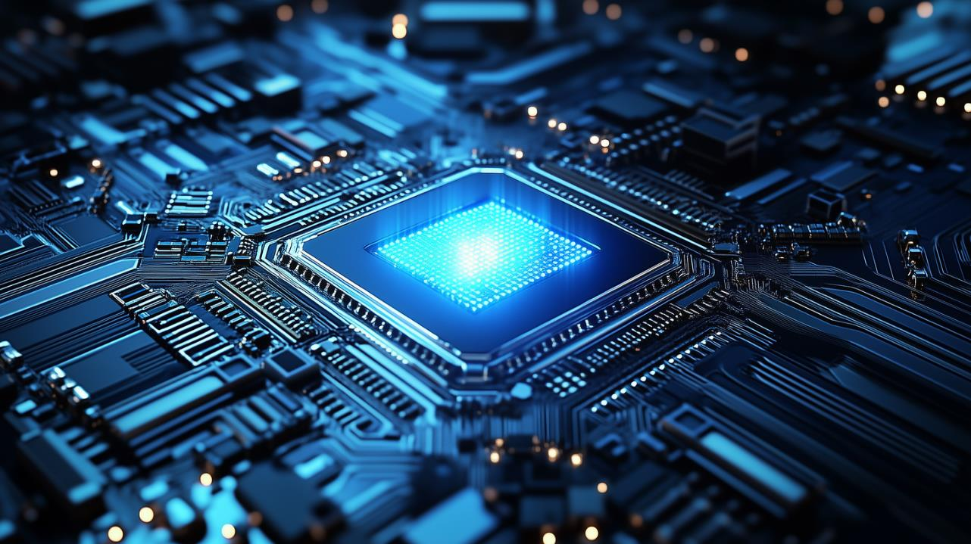
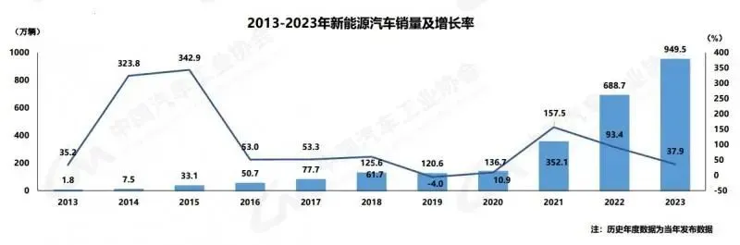
the current state of the EV market in China
In 2023, more than 9 million electric vehicles were sold in China, which was more than the combined sales of Europe and the United States.

Slide 4
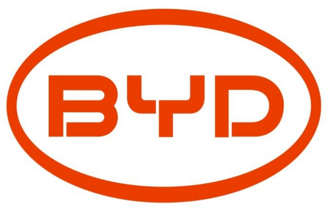


the current state of the EV market in China
Domestic Chinese brands dominate the market, accounting for 94% of EV sales in the country. Brands like BYD, NIO, and XPeng are leading the industry.

Slide 5
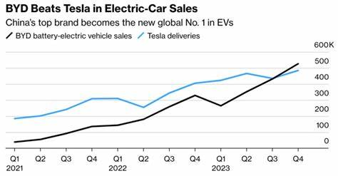
the current state of the EV market in China
In the fourth quarter of 2023, BYD even surpassed Tesla in global EV sales.

Slide 6
02
PART
Characteristics
PowerPoint design

Slide 7
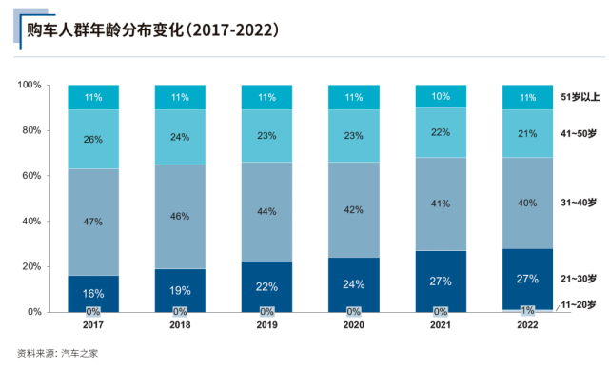
the characteristics of Chinese EV consumers
Chinese EV buyers are mostly young.
More than 50% of EV buyers in China are under the age of 40.

Slide 8
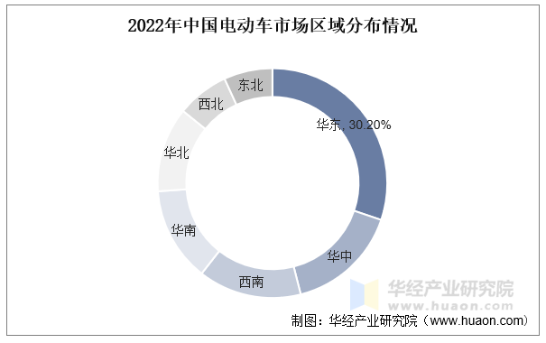
regional differences
In southern China, where the weather is warm, EVs perform well, and sales are high. In the north, cold temperatures can reduce battery
efficiency, so traditional fuel cars are still more popular.

Slide 9
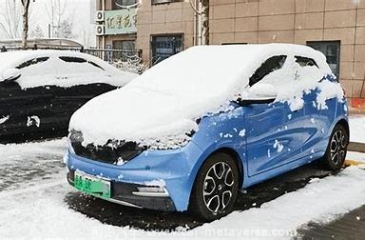
regional differences
In southern China, where the weather is warm, EVs perform well, and sales are high. In the north, cold temperatures can reduce battery
efficiency, so traditional fuel cars are still more popular.

Slide 10
03
PART
As a translator
PowerPoint design

Slide 11
my perspective
. The demand for translating technical documents, user manuals, and marketing materials has increased significantly. Many international companies want to enter the Chinese EV market, and they must adjust their messaging to local consumers. For example, in China, people prefer the term “智能汽车” (smart car), which focuses on AI-driven features, while in Western markets, the focus is more on sustainability and emissions reduction.

Slide 12
04
PART
Role
PowerPoint design

Slide 13
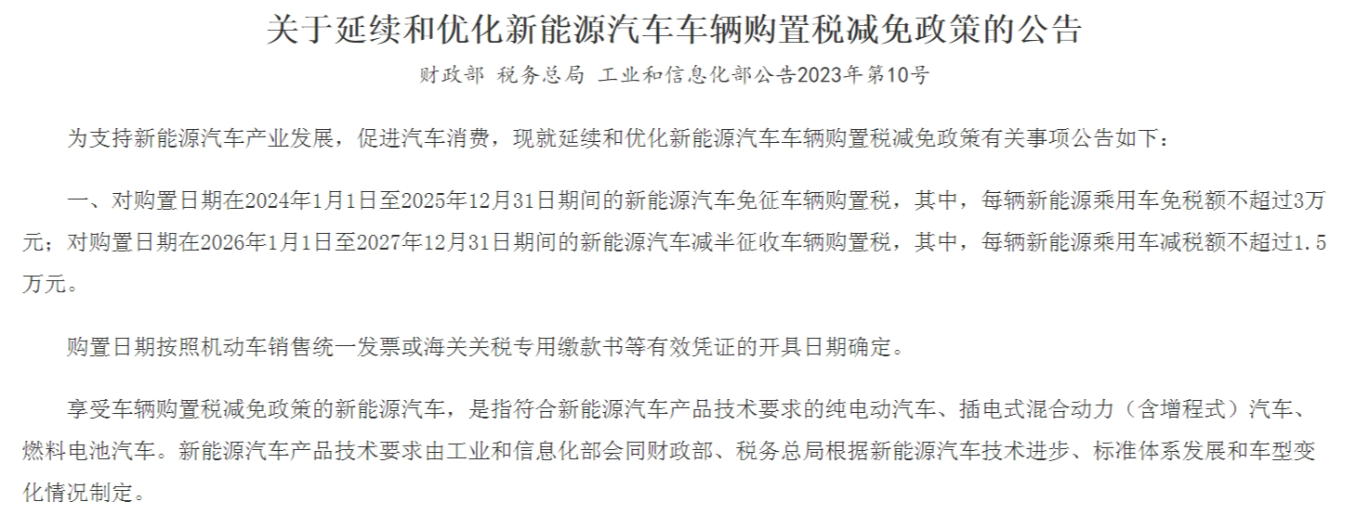
the role of government policies
One reason China has been so successful in EV development is its strong government policies.

Slide 14

the role of government policies
the Chinese government has provided subsidies, tax breaks, and other financial incentives to both consumers and manufacturers.

Slide 15
Thank you！

